Slide 1

NSF
In a Nutshell

Slide 2


NSF is an independent federal agency created by congress in 1950. It’s the only agency whose mission includes support for all fields of fundamental science and engineering, except medical sciences.
Funds about 24% of all federally-supported basic research conducted by US colleges/universities
Funds about 11k awards/year
1 in 2.3 success rate
Does not fund health science research
Strategic Plan for 2018-2022 – Expand knowledge in science, engineering and learning, Advance the capability of the Nation to meet current and future challenges, Enhance NSF’s performance of its mission.
What is NSF?
Notes:
What sets NSF apart from DHHS, DOD and other agencies that start with “department of” is that they are an independent agency instead of an executive branch agency. Executive branch agencies, as the name implies, are given national priorities from the executive branch.
Independent agencies like NSF, NASA, and NEH have Missions that do not have to align with priorities of the federal govermentt. They have their own constant mission regardless of national priorities and presidential administrations.
NSF will fund just about anything except medical sciences

Slide 3
Directorates
Each directorate has an assistant director and is further subdivided into divisions
Biological Sciences (BIO)
Computer and Information Science & Engineering (CISE)
Engineering (ENG)
Geosciences (GEO)
Mathematical and Physical Sciences (MPS)
Social, Behavioral and Economic Sciences (SBE)
Education and Human Resources (EHR)
Notes:
NSF is divided into these seven directorates which specialize in the particular research area that their name implies

Slide 4
Program Solicitations are available under Divisions, such as the Division of Environmental Biology (DEB), which is under the Directorate for Biological Sciences (BIO).
The acronym for the Division is included on the proposal cover sheet, along with the relevant program.
Organization list: https://www.nsf.gov/staff/orglist.jsp
Notes:
They are further subdivided into divisions. The program solicitations are sometimes specific to the divisions, so for example the Division of Environmental Biology is under the Directorate for Biological Sciences. The acronym for the Division may be included on the proposal cover sheet, along with the relevant program. There are also solicitations that span across multiple divisions.
Program Divisions are responsible for the scientific, technical and programmatic review and evaluation of proposals and for recommending that proposals be declined or awarded. The scientific, engineering and/or educational aspects of an award will be monitored by the NSF Program Officer identified in the award notice.
A link to the full NSF organization list is provided here if you’re interested. It lists all of the directorates and the divisions that are under them.

Slide 5
Types of Proposals
Standard: response to FO. Max $ amount and duration. Standard merit review.
REU Supplements and Sites: Research Experiences for Undergraduates, NSF 19-582.
DDRIG: Doctoral Dissertation Research Improvement Grants. Designed to improve the quality of dissertation research. DDRIG awards provide funds for items not normally available through the student's university such as enabling doctoral students to undertake significant data-gathering projects and to conduct field research in settings away from their campus. DDRIGs do not provide cost-of-living or other stipends or tuition.
RAPID: Used when there is a severe urgency with regard to availability of, or access to, data, facilities or special equipment, or for quick-response research on natural or anthropogenic (pollution) disasters or similar unanticipated events. Up to $200k and 1 year.
EAGER: Early-concept Grants for Exploratory Research. Used to support exploratory work in its early stages on untested, but potentially transformative, research ideas or approaches. May be high risk – high payoff. Up to $300k and 2 years.
Notes:
Something that comes up occasionally is Research Experiences for Undergraduates, or REU. The goal of the REU program is to expand student participation in all kinds of research, and to attract a diverse pool of students into careers in science and engineering.
Investigators with an active NSF research award may request an REU Supplement through the Supplemental Funding Request module in FastLane; or investigators preparing a research proposal may include an REU Supplement request as a component of the proposal in the supplementary docs section. Supplements provide support for a few undergrads on the project.
REU Sites are based on independent proposals, are funded by research divisions throughout NSF and have an annual deadline. An REU Site consists of a group of undergraduates who work in the research programs of the host institution, and each of them are associated with a specific project.
All REU students are paid stipends through the participant support cost section of the budget.

Slide 6
RAISE: Research Advanced by Interdisciplinary Science and Engineering. Used to support interdisciplinary projects that require substantial funding from more than one program or discipline, promise transformative advances, and have the potential for discoveries that may not be recognized through traditional review. Up to $1M and 5 years.
GOALI: Grant Opportunities for Academic Liaison with Industry. Collaboration between academic research institutions and industry. Research should further scientific and engineering foundations to enable future breakthrough technologies with the potential to address critical industry needs. Funds can be used for university research/education activities. Must be submitted to an active funding opportunity or as a supplemental funding request to existing NSF award.
Ideas Lab: Supports the development and implementation of innovative project ideas that have the potential to transform research paradigms and/or solve intricate problems. NSF issues “call for participants” solicitation that describes the specific focus of the Lab. Submitted as preliminary proposal.

Slide 7
FASED: Facilitation Awards for Scientists and Engineers with Disabilities. Reduce barriers to participation in research by providing special equipment and assistance to people with disabilities so they can pursue careers in science and engineering. Funding requests made in conjunction with regular competitive proposals, and as supplement request.
Conference: Brings experts in special areas of science and engineering together. Should be submitted at least one year prior to conference.
Equipment: for specialized equipment for individual investigators, departments, or internal or external collaborators. Competes with research and education proposals. Includes MRI grants.
Center: Centers focus on integrative learning, the frontiers of knowledge, and investing in a diverse set of partner organizations and individuals. For centers and their programs that contribute to NSF’s strategic plans. Up to 10 years in duration.
Research Infrastructure: For construction and operation of major research equipment and facilities. Contact program to discuss appropriate funding mechanism before proposal submission.

Slide 8
Review & Award Cycle
Phase I: proposal preparation and submission
  There are 90 days between when the opportunity is announced and when the proposal is submitted/received.
  Plan the start date to be at least 6 months from the submission date.
Funding opportunities:
  program descriptions
  Program announcements
  program solicitations
  Dear Colleague letters
  Researchers can also send in unsolicited proposals
Notes:
Phase I is the proposal preparation which is guided by the NSF document Proposal and award policies and procedures guide or the PAPPG
Proposals may be submitted in response to the various funding opportunities that are announced on the NSF website.
These funding opportunities fall into four categories -- program descriptions, program announcements, program solicitations, Dear Colleague letters and Unsolicited Proposals
The term "program description" includes broad, general descriptions of programs and activities in NSF Directorates and Divisions. Program descriptions are posted on Directorate/Division websites to encourage the submission of proposals in specific program areas of interest to NSF. Program descriptions utilize the generic eligibility and proposal preparation instructions specified in Part I of the PAPPG, as well as the National Science Board approved merit review criteria.
The term "program announcement" refers to formal NSF publications that announce NSF programs. Program announcements also utilize the generic eligibility and proposal preparation guidelines specified in Part I of the PAPPG.
The term "program solicitation" refers to formal NSF publications that encourage the submission of proposals in specific program areas of interest to NSF. These are what I see most frequently. They generally are more focused than program announcements, and normally are for a limited period of time. Competition among proposals is more precisely defined than with program announcements, and proposals received compete directly with each other for NSF funding.
Program solicitations are issued when the funding opportunity has one or more of the following features:
provides supplemental proposal preparation guidance or deviates from the guidelines established in Part I of the PAPPG;
contains additional review criteria relevant to the program;
requires submission of a letter of intent (see Chapter I.D.1) or preliminary proposal (see Chapter I.D.2);
deviates from (or restricts) the standard categories of proposers specified in Section E. below;
limits the number of proposals that may be submitted by an organization and/or Principal Investigator (PI) or co-Principal Investigator (co-PI);4
requires cost sharing;
requires a limitation in indirect (Facilities & Administrative (F&A)) costs;
specifies additional award conditions and/or reporting requirements;
anticipates use of a cooperative agreement.
4. Dear Colleague Letters (DCLs) DCLs are intended to provide general information to the community, clarify or amend an existing policy or document, or inform the NSF proposer community about upcoming opportunities or special competitions for supplements to existing awards. They also may be used to announce NSF’s interest in receiving proposals in specified topical areas for Rapid Response Research (RAPID); Early-concept Grants for Exploratory Research (EAGER); Research Advanced by Interdisciplinary Science and Engineering (RAISE); and Conference.
Unlike NIH Not all NSF proposals have a deadline, in which case the Program Solicitation will state “Proposals Accepted Anytime” in the deadline section

Slide 9
Letters of Intent
  Required by some solicitations
  Not a binding document
  Submitted by Sponsored Programs
  Includes synopsis, project personnel and participating organizations.
Notes:
Some NSF program solicitations require or request submission of an LOI in advance of submission of a full proposal. This requirement will be identified in the program solicitation, and such letters are submitted electronically to NSF.
An LOI is not a binding document. The predominant reason for its use is to help NSF program staff gauge the size and range of the competition, enabling earlier selection and better management of reviewers and panelists. In addition, the information contained in an LOI is used to help avoid potential conflicts of interest in the review process. It is not externally evaluated or used to decide on funding.
Proposers that plan to submit a collaborative proposal from multiple organizations should submit a single LOI for the entire project, because NSF considers a collaborative proposal to be a unified research project.
It is always important to check the solicitation for LOI requirements because failure to submit a required LOI will result in a full proposal not being accepted or returned without review
An LOI normally contains
the Principal Investigator’s (PI’s) and co-PI's names,
a proposed title,
a list of possible participating organizations (if applicable),
and a synopsis that describes the work in sufficient detail to permit an appropriate selection of reviewers.
.

Slide 10

Preliminary Proposal
Required by some solicitations
PI initiates a regular proposal but checks off “preliminary proposal” on the cover sheet.
Submitted by Sponsored Programs
NSF will send an email with a decision
Notes:
Some NSF program solicitations require or request submission of a preliminary proposal in advance of submission of a full proposal. The three predominant reasons for requiring submission of a preliminary proposal are to:
to reduce the proposers' unnecessary effort in proposal preparation when the chance of success is very small. This is particularly true of exploratory initiatives when the community senses that a major new direction is being identified, or competitions that will result in a small number of awards;
to increase the overall quality of the full submission; and
And the third reason is to assist NSF program staff in managing the review process and in the selection of reviewers.
The NSF program solicitation will specify content and submission requirements when preliminary proposals are to be used. Preliminary proposals are prepared by the PI. Once complete the PI will forward to Sponsored Programs for AOR submission.
Two decisions will be received from NSF after submission of a preliminary proposal. The program solicitation will specify the type of decision to be rendered for a particular program.
Invite/Not Invite Decisions This type of mechanism is used when the NSF decision made on the preliminary proposal is final, affecting the organization’s eligibility to submit a full proposal. Only submitters of favorably reviewed preliminary proposals are invited and eligible to submit full proposals. The PI and the organization's Sponsored Projects Office (SPO) (or equivalent) will be electronically notified of NSF's decision to either invite submission of a full proposal or decline NSF support.
Encourage/Discourage Decisions This type of mechanism is used when the NSF decision made on the preliminary proposal is advisory only. This means that submitters of both favorably and unfavorably reviewed preliminary proposals are eligible to submit full proposals. The PI and the organization's SPO will be notified of NSF's decision to either encourage or discourage submission of a full proposal.

Slide 11
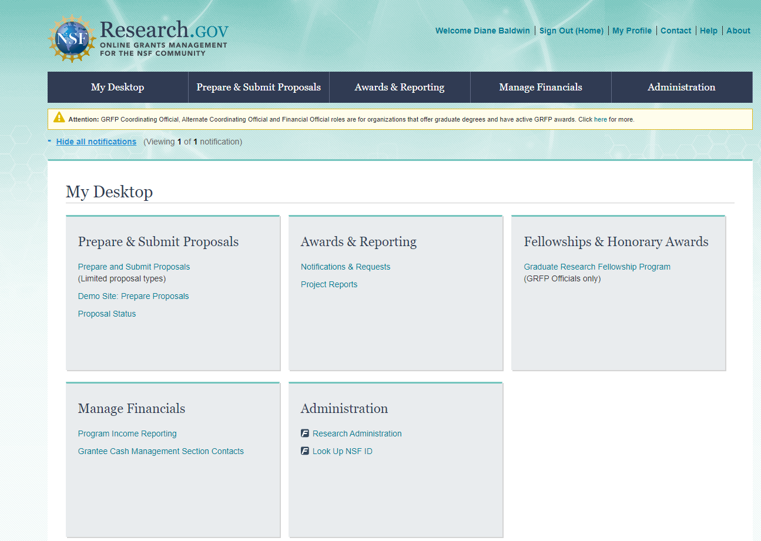
Research.gov
FastLane
Research.Gov
Notes:
FastLane is the current system we use for managing NSF proposals and awards is being phased out. Research.gov will be the new system used and in some instances is already being required. The NSF funding opportunities will clearly specify whether submission via Research.gov is available or required.
This is a screenshot of the main page in Research.gov, Administration is where you want to go to get to proposals and awards that you have access to in FastLane, Prepare and submit is how you would access proposals in research.gov

Slide 12
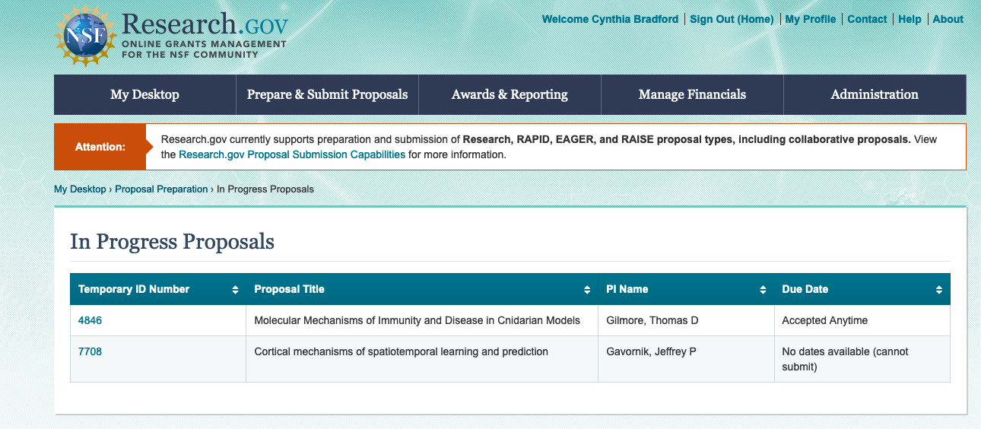
Research.gov
Notes:
Once you’ve selected the Administration tab you’ll see this screen, the temporary ID number is what you would select to enter into the proposal.

Slide 13
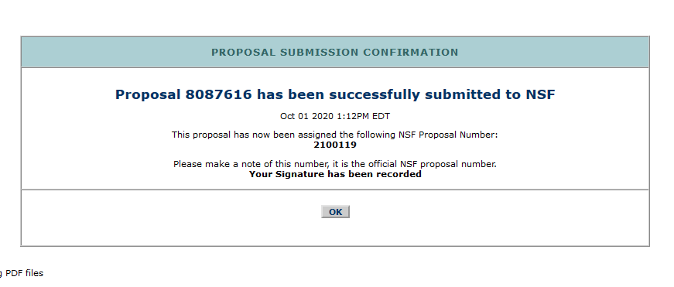
Notes:
After submitting a proposal, FastLane confirms submission via an updated screen that notes the NSF proposal number
NSF sends a confirmation email to the PI only

Slide 14
Proposal & Award Policies & Procedures Guide (PAPPG)
Part I sets forth NSF's proposal preparation and submission guidelines. The coverage provides guidance for the preparation and submission of proposals to NSF.
Part II of the NSF PAPPG sets forth NSF policies and procedures regarding the award, administration, and monitoring of grants and cooperative agreements. Coverage includes the NSF award process, from issuance and administration of an NSF award through closeout.
Notes:
The PAPPG is documents relating to the NSF’s proposal and award process. It serves as the Foundation's implementation of Uniform Guidance – which is a government-wide framework for grants management. If the PAPPG and NSF Grant Conditions are silent on a specific area covered by uniform guidance, the requirements specified in uniform guidance must be followed.
The order of precedence is
RFP/PA (it may cite some additional requirements that are not listed in the general guidelines)
PAPPG – updated annually
UG
The PAPPG is made up of 2 parts, the first part is the submission guidelines, and the second part is the policies and procedures for awards.
Similar to NIH, the NSF program solicitation may modify the guidance of the PAPPG, in which case the solicitation instructions must be followed. You might also see that an award includes a reference to the solicitation number and states that the award is subject to the provisions of that solicitation.
A few things you should know related to the policies in the guide:
when Grant General Conditions or an award notice reference a particular section of the PAPPG, then that section becomes part of the award requirements through incorporation by reference.
Awards may also contain a hyperlink to special conditions for conference or group travel awards that are not included in the PAPPG.
The PAPPG also contains the guidelines for changes in project direction or management, prior approval requests, and reporting.

Slide 15

Format of the Proposal
Proposal Pagination Instructions
Each section of the proposal that is uploaded as a file must be individually paginated prior to being uploaded to the electronic system.
Proposal Font, Spacing and Margin Requirements
Use one of the following fonts identified below:
Arial (not Arial Narrow), Courier New, or Palatino Linotype at a font size of 10 points or larger;
Times New Roman at a font size of 11 points or larger; or
Computer Modern family of fonts at a font size of 11 points or larger
Notes:
Fastlane doesn’t automatically paginate the proposal for us so each section has to include the page numbers for just that file. Research.gov automatically paginates the application.
If you’re not used to NSF and see a lot of NIH, the fonts might strike you as incorrect. Arial can be 10 points, and NSF still allows the use of times new roman in 11pt.

Slide 16
Format of the Proposal (cont’d)
No more than six lines of text within a vertical space of one inch
Margins, in all directions, must be at least an inch. No proposer-supplied information may appear in the margins.
Paper size must be no larger than standard letter paper size (8 ½ by 11”).
Notes:
Unlike NIH margins have to be an inch on all sides.
In FastLane uploads do not need to be in PDF beforehand because Fastlane can convert documents into PDFs online, but the fonts can look odd when you use this method.
In research.gov the uploads generally have to be pdfs.
In research.gov, if the font is less than Arial 10pt or Times New Roman 11pt an error will generate that says, “For line spacing, there should be no more than six lines per inch on the document. Please refer to the Proposal Preparation Document Upload FAQs. NSF may return a proposal without review if it does not meet line spacing requirements.”
What they mean by line spacing is actually the font size. If you see this error, there’s a good chance that the appropriate font size that was used in the word doc shrank when it was converted to pdf

Slide 17
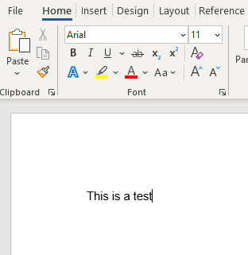
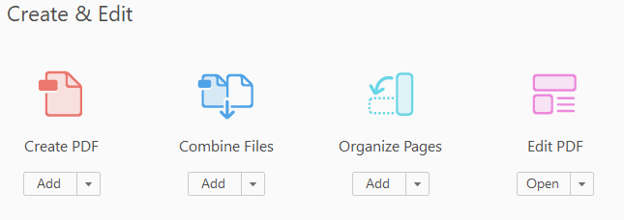
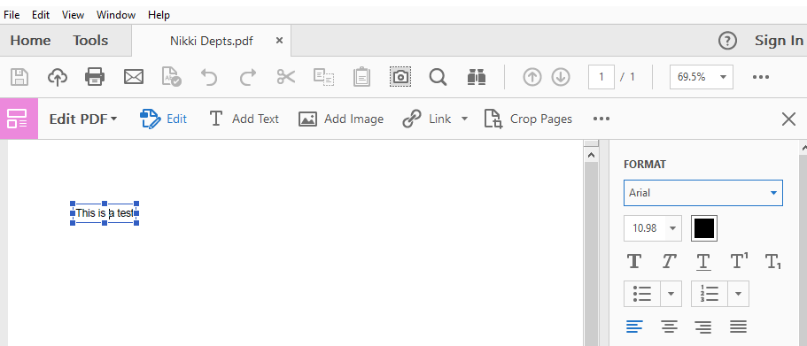
Word doc to pdf conversion
Notes:
Adobe’s response to the conversion problem is "The issue of the resultant text size in PDF files being a small fraction different from that specified in the application is due to how these Windows applications output either via print or the internal pathway used for creation of PDF with either Microsoft or Adobe tools. The text you specify in your Office document as 11 point type may appear as 10.98 point or 11.04 point in the resultant PDF file.
The same symptoms occur regardless of how you produce PDF – “using the Adobe PDFMaker "save as Adobe PDF" function, Microsoft's native "save as PDF," or via print drivers including the Adobe PDF PostScript printer driver instance as well as third party print drivers that create PDF. The PostScript generated by the PostScript printer driver, shows that these applications are actually requesting these oddball point sizes and that is what you get for printed output. Unfortunately, there is nothing that Adobe can do about this.”
There’s not much we can do about it either. As you can see in the slide, a word doc was created in Arial 11pt, but when it printed to pdf, the font shrank to 10.98pt. You can check this by going to the tools tab and selecting “edit pdf.” The side bar on the right will appear. When you click into the text, you will be able to see the font size of the pdf.
If you are able to select “actual size,” select that instead of “fit” when printing.

Slide 18
Sections of the Proposal
Single Copy Documents
  Authorization to Deviate from NSF Proposal Preparation Requirements (if applicable)
  List of Suggested Reviewers or Reviewers Not to Include (optional)
  Proprietary or Privileged Information (if applicable)
  Proposal Certifications
  Submission of Proposals by Former NSF Staff
Cover Sheet
Project Summary (beware of nonsensical punctuation)
Table of Contents
Project Description
  Must contain a separate section labeled “Broader Impacts”
  has been revised to remove the requirement for the Project Description to contain, as a separate section within the narrative, a section labeled "Intellectual Merit"
References Cited
  Use of Et al. not allowed
Notes:
The Single copy documents section isn’t used frequently. It’s used for information that is for NSF use only, and not provided to reviewers. The proposal certifications, like COI and responsible conduct of research, are listed in FastLane and research.gov on the submission confirmation screen, and agreed to when SP submits the proposal as the AOR. They are listed on page 2 of the proposal cover sheet.
The list of suggested reviewers is always the first page of the proposal, instead of the cover sheet.
The table of contents generates automatically and can’t be edited.

Slide 19
Sections of the Proposal (cont’d)
Biographical Sketch(es)
Budget and Budget Justification
Current and Pending Support
Facilities, Equipment and Other Resources
Collaborators & Other Affiliations Information (COA)
Special Information and Supplementary Documentation
    Data Management Plan https://www.nsf.gov/bfa/dias/policy/dmp.jsp
    Postdoctoral Mentoring Plan (if applicable)
    Project Management Plan, or deviation letter as required
Notes:
Facilities is the only section listed here that won’t be discussed elsewhere. It’s the same as with NIH, it’s used to assess the adequacy of the resources available to perform the proposed effort, and it should only include resources that are directly applicable. The PAPPG specifically says that the description should be narrative in nature and must not include any quantifiable financial information.
This section is also used to describe the role of key personnel not requesting salary in the budget. Effort is as needed, like with NIH other significant contributors, except they’re not mentioned in the budget justification at all.

Slide 20
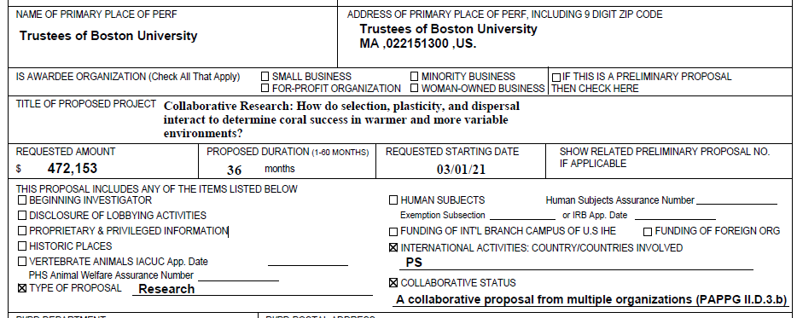
Notes:
This is an example of the printed cover sheet. If applicable the title of the project must include the acronym of the program or whether the project is Collaborative Research, or both. The acronyms will be provided in the solicitation guidelines.
On the left there are options for beginning investigator, historic places, and so on. These are used as applicable. These are all self explanatory, except a beginning investigator is someone who has not been a PI or co-PI on a Federally funded award, with the exception of a doctoral dissertation, postdoc fellowship, or research planning grants.
If there are vertebrates or human subjects, the assurance number and, if available, approval date are entered. There are no additional documents specifically related to vertebrates or human subjects.
If international countries are involved the 2 letter country identifier also needs to be included here. Up to 5 countries can be listed.
As you can see on this example a foreign county will be involved. In FastLane there’s a dropdown to select a country by its full name so you don’t have to know the code. If the country is unknown, you can use “worldwide” as the country.
The Type of proposal and collaborative status are always required.

Slide 21
Project Summary:
Overview (activity, objectives, methods), intellectual merit, broader impacts
Project Description:
15 pages unless otherwise noted. Even if allowed, you will get a warning if it exceeds 15 pages. Statement of work, outline of work plan, relationship of work to present state of knowledge in the field and to PI’s work in progress. Must have broader impacts and results from prior NSF support.
References Cited must include the names of all authors.
Notes:
The Project Summary consists of an overview, a statement on the intellectual merit, and a statement on the broader impacts of the proposed activity. These 3 headings have to be included, and in FastLane the sections should be pasted into text fields under each heading. In research.gov, it has to be a pdf upload, and the system will scan the document to make sure the headings are present and on their own lines.
Sometimes in FastLane pasted text will convert into a strange punctuation combination in the next word, and apostrophes will convert into a question mark, so scan the document to make sure nothing looks abnormal . A pdf is only allowed for the summary in FastLane if there are special characters, like Greek letters, that the text fields can’t recognize.
The Project description is usually 15 pages unless the proposal type is something like RAPID or EAGER in which case there will be a different page limit. Sometimes 20 pages are allowed, which will generate a warning in FastLane and research.gov even though the proposal is referencing the solicitation number that allowed for the higher page count.
The things to check the description for are broader impacts and results from prior NSF support.
Prior results are used by reviewers to assess the quality of prior work funded by NSF. NSF has reached out to us in the past when the prior support was not fully described as required in the guidelines. If any PI or co-PI on the proposal has received prior NSF support including an award that ended in the past five years or any current funding, including NCEs, the information on that award has to be included whether it’s related to the proposal or not.
But if more than one NSF award was received, they only have to report on the one award that is most closely related to the proposal.
In summary, you only have to show one NSF award and it should be the one most related to the proposal if applicable, but if the PI has the space to mention more than one award they can do so.
Support means salary support and any other funding awarded by NSF, like an equipment grant.
The PI has to provide the NSF award number, amount, project period, title, summary of results described by Intellectual Merit and Broader Impacts, a listing of the resulting publications or if none, say “No publications were produced under this award.”
Also, they have to provide evidence of research products and their availability, and for expired awards, a description of the relation of the completed work to the proposed work.
The PAPPG doesn’t say what to do if they’ve never had NSF support before, but it’s safer to include a statement that there hasn’t been any prior support.
References cited must include the names of all authors, so “et al” can’t be used.

Slide 22
Budget and Justification
Foreign travel: provide exact locations and why the travel is needed
2 month salary rule: Salary compensation for senior personnel is limited to 2 months of regular salary in any one year across all NSF-funded awards. If anticipated, any compensation for such personnel in excess of two months must be disclosed in the proposal budget, justified in the budget justification, and must be specifically approved by NSF in the award notice budget. Normal re-budgeting authority allows change in effort after award even if over 2 months/year.
People without budgeted effort need to be listed in the facilities section, with no quantified effort.
In most cases NSF does not allow cost share
Notes:
budget justification limit is five pages per institution. A few things to look out for are:
Foreign travel which has to be justified with exact locations.
Also, NSF has a 2 month salary rule where senior personnel can’t have more than 2 months of effort across all of their NSF awards. If the person’s effort on NSF awards will be more than 2 months if the proposal is awarded, we have to justify the additional time. The PAPPG says NSF will specifically approve exceeding the rule in the NOA budget but they don’t call it out so much as approve the requested amount for salary.
People without budgeted effort need to be listed in the facilities section, with no quantified effort.
In most cases NSF does not allow cost share, but Major Research Instrumentation grants are an exception, in which case, cost sharing requirements will be clearly identified in the solicitation

Slide 23
Participant Support Costs
“This budget category refers to direct costs for items such as stipends or subsistence allowances, travel allowances, and registration fees paid to or on behalf of participants or trainees (but not employees) in connection with NSF-sponsored conferences or training projects. Any additional categories of participant support costs other than those described in 2 CFR § 200.75 must be justified in the budget justification, and such costs will be closely scrutinized by NSF. Speakers and trainers generally are not considered participants and should not be included in this section of the budget. However, if the primary purpose of the individual’s attendance at the conference is learning and receiving training as a participant, then the costs may be included under participant support. If the primary purpose is to speak or assist with management of the conference, then such costs should be budgeted in appropriate categories other than participant support.”
Notes:
One thing that’s special about NSF budgets is the option to include participant support costs. They are not included in MTDC, and they have to have their own IO account so that they can’t easily be rebudgeted to another line item. Rebudgeting these costs requires prior approval.
Participants are not BU employees, speakers, or trainers, but people outside BU aren’t always technically “participants.” If you see participant support costs requested on a research proposal budget, dig deeper to make sure they’re appropriate.
Students supported by REU supplements or sites are always budgeted under participant support.
Please note, participants support costs are not included on the federal budget template on the SP website. You will need to create an excel budget that includes lines for participant support costs that are excluded from MTDC.

Slide 24
Appointments section must include any titled academic, professional, or institutional position whether payment is received or not
Senior personnel must identify all current domestic or foreign “professional appointments” outside of the individual’s academic, professional, or institutional appointments at the proposing organization
Biographical Sketch
NSF-approved format of the biographical sketch is now required
Notes:
Who qualifies as a Senior/Key Person?
Unless otherwise specified in a FOA, senior/key personnel are defined as all individuals who contribute in a substantive, meaningful way to the scientific development or execution of the project, whether or not salaries are requested. Consultants should be included in this "Senior/Key Person Profile (Expanded)" Form if they meet this definition.
List individuals that meet the definition of senior/key regardless of what organization they work for.
The purpose of the Biosketch is to provides the ability to assess if the individual or team has necessary qualifications to carryout the project as proposed

Slide 25

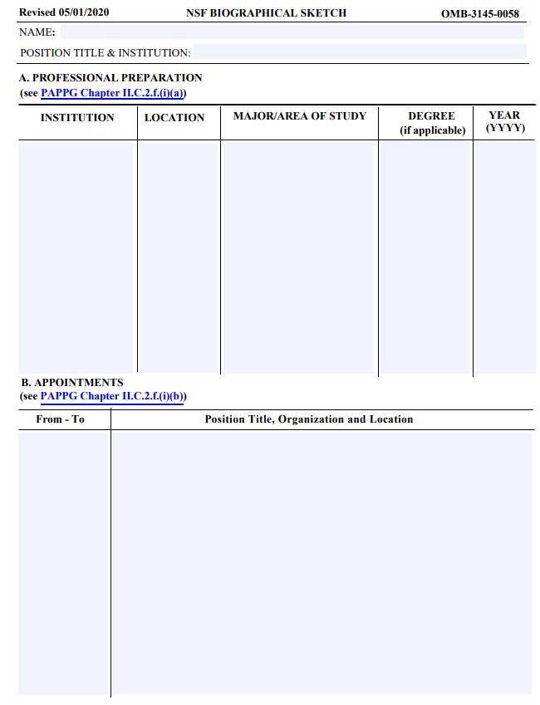
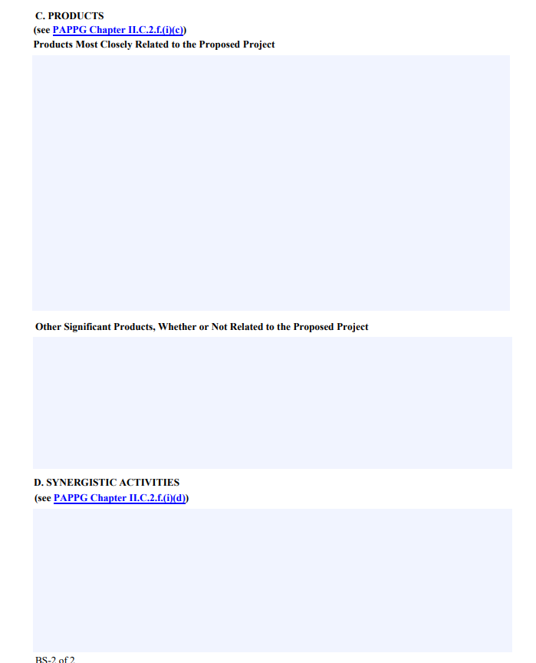
Notes:
NSF now requires the use of either their fillable PDF or SciENcv to submit Biosketches, no other format is allowable. In this slide we are showing the PDF fillable form, on the next slide we’ll look at SciENcv
One thing to note that is different from NIH, the appointments should be in reverse chronological order
For Biosketch NSF has a 2 page limit for Biosketches – on this form you can’t adjust boxes to fit more information
NSF also allows et. Al on the Biosketch, but remember it is NOT allowed in the references
-----------------------------------------------------------------------------------------------------------------------
A list of the individual’s undergraduate and graduate education and postdoctoral training (including location) as indicated below:
Undergraduate Institution(s) Location Major Degree & Year
Graduate Institution(s) Location Major Degree & Year
Postdoctoral Institution(s) Location Area Inclusive Dates (years)
Appointments
A list, in reverse chronological order, of all the individual’s academic/professional appointments beginning with the current appointment.
Products
A list of: (i) up to five products most closely related to the proposed project; and (ii) up to five other significant products, whether related to the proposed project or not.
ScienCV form looks different from the fillable template but both are correct.

Slide 26
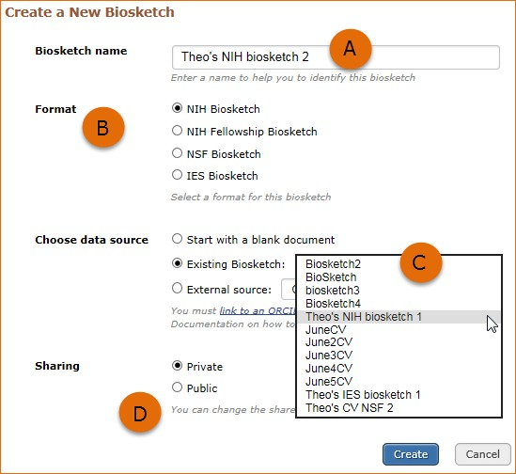
Changes to the Biographical Sketch
Formats
  Permit use of “et al.” for publication citations in the Products section in the event that listing multiple authors makes it difficult to fit the information into the allotted space (NSF fillable format and SciENcv format)
  Increased space for the Products section by removing instructional text. Links added to relevant PAPPG sections (NSF fillable format)
  Clarifying language - Appointments Section
Notes:
SciENcv is an electronic system that helps researchers assemble the professional information needed for federal submissions. SciENcv gathers and compiles all the relevant information including employment, education and professional accomplishments. PIs can use SciENcv to create and maintain biosketches used for submissions and annual reports. Researchers can add delegates who can also work on Biosketches within SciENcv
On the left is a screenshot of what it looks like when creating a Biosketch in SciENcv – You can select the different formats, create a new one or edit an existing Biosketch and make it public which makes it shareable or mark it private
It’s important to note You do need to regenerate each version if edits are made or research.gov will say there is an error
We’ve discovered SciENcv is a better way to create a Biosketch
You’re not limited on how much text is entered
You can save and edit the Biosketch for each proposal
Overall the output looks better which you’ll see on the next slide

Slide 27
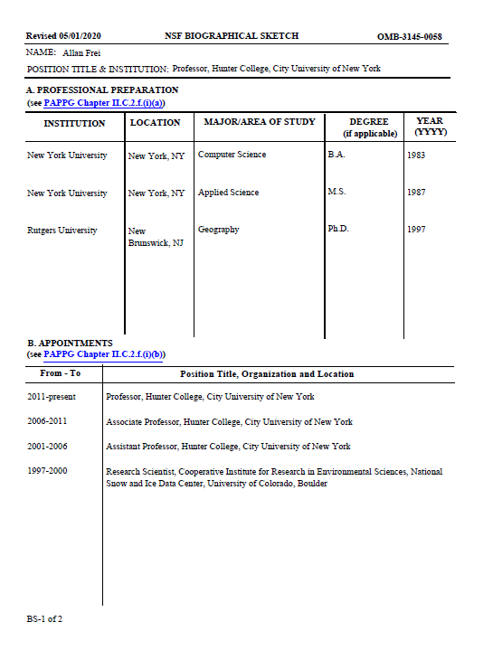
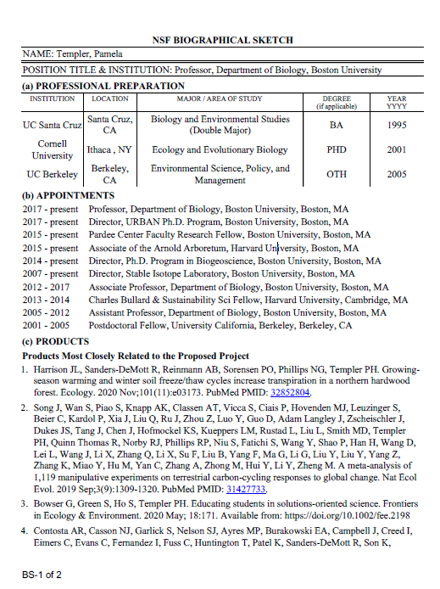
pdf form
SciENcv

Slide 28
Synergistic Activities
Synergistic Activities must be specific and may not include multiple examples to describe a single activity.
Examples:
    Teaching and training innovations
    Contributions to the science of learning
    Development of research tools, computation methodologies and algorithms for problem-solving
    Development of databases to support research and education
    Broadening the participation of groups underrepresented in STEM
    Service to the professional community outside your institution
    https://www.uml.edu/research/research-support-services/research-ready-videos.aspx
Notes:
Synergistic Activities are where the reviewers determine how qualified the individual, team or institution are to conduct the work
Synergistic Activities must be specific and may not include multiple examples to describe a single activity.
So PIs should list Five distinct examples.
NSF advises researchers to use this section to show the reviewers the researcher’s understanding of, and commitment to demonstrating the broader impacts of their work. Synergistic activities section should align with, and supports broader activities listed in the proposal
Synergistic Activities – should highlight the broader impact of the individual’s professional and scholarly activities that focus on the integration and transfer of knowledge as well as it’s creation. A PI should list distinct examples that demonstrate the broader impact of individual professional and scholarly activity – distinct means don’t list whole categories of activities rather specific instances
An example of a synergistic activity is – community outreach – then cite the ONE activity, do not follow that with a list of sub-activities
I am seeking clarification on what is allowable regarding the synergistic activities section of the biographical sketch. Are multiple components allowed?
NSF policy (PAPPG Chapter II.C.2.f(i)(d)) allows for up to five distinct examples of synergistic activities. Each item must be one activity and must not be followed by a listing of additional sub-activities. As an example, the PI may summarize that he/she served on ten review panels, however, the PI must not list the specific panels for that distinct example

Slide 29
Synergistic Activities – Incorrect
Chaired Conferences
Research Administration Basics Irvine, CA 2019
Researcher Administrators United, Boston, MA 2018
Understanding Research Administration San Juan, Puerto Rico 2020
Developed Courses
2021 NSF in a Nutshell
2020 Fundamentals of NSF
2019 Understanding NSF
Correct
Developed the 2021 NSF in a Nutshell course for Boston University
Chaired the 2019 Research Administration Basics Conference in Irvine, CA
Notes:
the PI may summarize that he/she served on ten review panels, however, the PI must not list the specific panels for that distinct example

Slide 30
Current and Pending Support
NSF-approved format of the C&P is now required
Current and pending support information must be provided for this project, for ongoing projects, and for any proposals currently under consideration from whatever source, irrespective of whether such support is provided through the proposing organization or is provided directly to the individual.
The total award amount for the entire award period covered (including indirect costs) must be provided, as well as the number of person-months (or partial person-months) per year to be devoted to the project by the individual.
Notes:
Like the Biosketch, the PDF fillable for or SciENcv are the only allowable formats for C&P.
This slide notes some of the specific guidelines when creating the C&P. NSF uses the information to assess the capacity of the individual to carry out the research as proposed as well as to help assess any potential overlap/duplication.
key points:
This is the format that should always be used for C&P including prior approval requests
Current and pending support information must be separately provided for each individual designated as senior personnel on the proposal.
Current and pending support includes all resources made available to an individual in support of and/or related to all of his/her research efforts, regardless of whether or not the resources have monetary value.
Current and pending support also includes in-kind contributions (such as office/laboratory space, equipment, supplies, employees, students). In-kind contributions not intended for use on the project/proposal being proposed also must be reported. this would speak more to what the institution has to provide to the proposal – the institution and all collaborators combined w/budget you have a sense of what resources are necessary to carryout project
Current and pending support information must be provided for the proposed project, for ongoing projects, and for any proposals currently under consideration from whatever source, regardless of whether the support is provided through the proposing organization or is provided directly to the individual.
*NSF wants to understand all of the resources available to the researcher*

Slide 31
Current and Pending Support (cont’d)
Mentoring activities that take place as part of an individual’s regular appointment at the proposing organization need not be reported. If an individual, however, receives in-kind support either directly or through their organization from an external source to support mentoring of undergraduate or graduate students, that in-kind support, including the time associated with such mentoring, should be identified in the individual’s current and pending support submission.
“Research endeavors” refers to the endeavors of the particular individual. The current and pending support information that must be provided is all planned, pending, and current support that is either provided directly to the individual, or to the individual through their organization in support of that individual’s research endeavors.

Slide 32
Current and Pending Support (cont’d)
Consulting or professional service arrangements as defined in 2 CFR 200.459 are not identified as an example of a source of support in PAPPG Chapter II.C.2.h. that must be reported, as the type of work conducted is not typically considered to be at the same level of a proposal/project or in-kind contribution. However, if the individual will be conducting research as part of the consulting agreement, then the consulting arrangement should be specified in the individual’s current and pending support submission

Slide 33

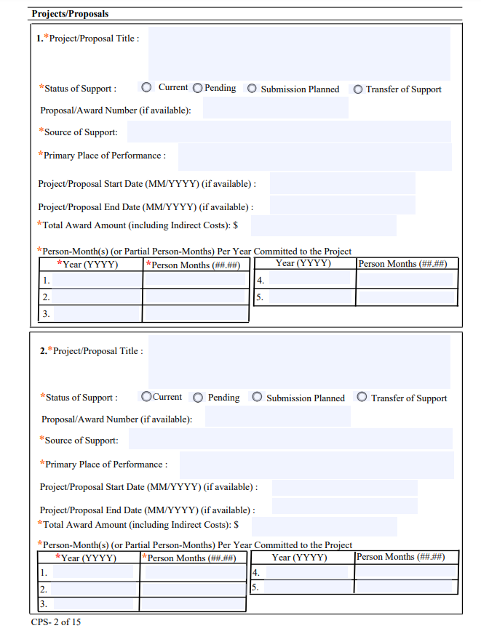
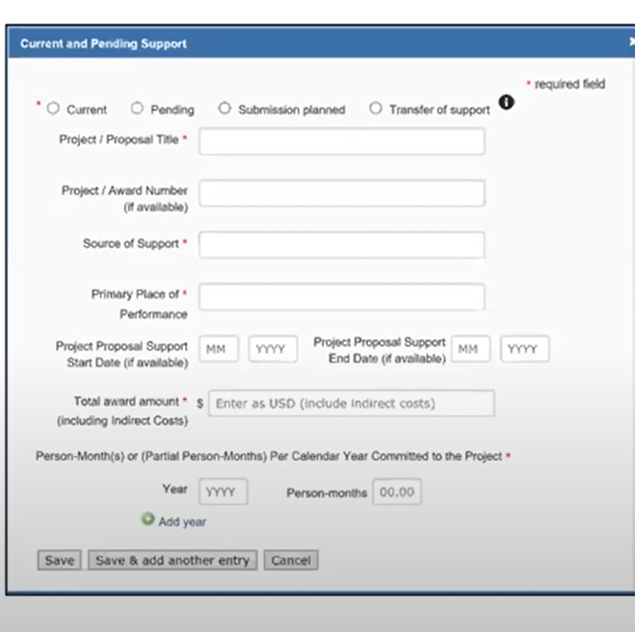

Notes:
This is a visual of the fillable C&P and entering it in SciENcv
on the left is one page of the FIFTEEN page NSF fillable form and the right is SciENcv – which is only as long as the entries you have
Each can document up to 5 years of support
The fillable PDF can also be glitch with the radio buttons dissapearing
NSF FAQs say “If you are reporting person-months that span two calendar years, you should enter the latter year. For example, if your entry covers your organization’s fiscal year of June 2019 through May 2020, you would enter “2020” for the year and include the corresponding person-months as defined and used by your organization in proposals submitted to NSF.”

Slide 34
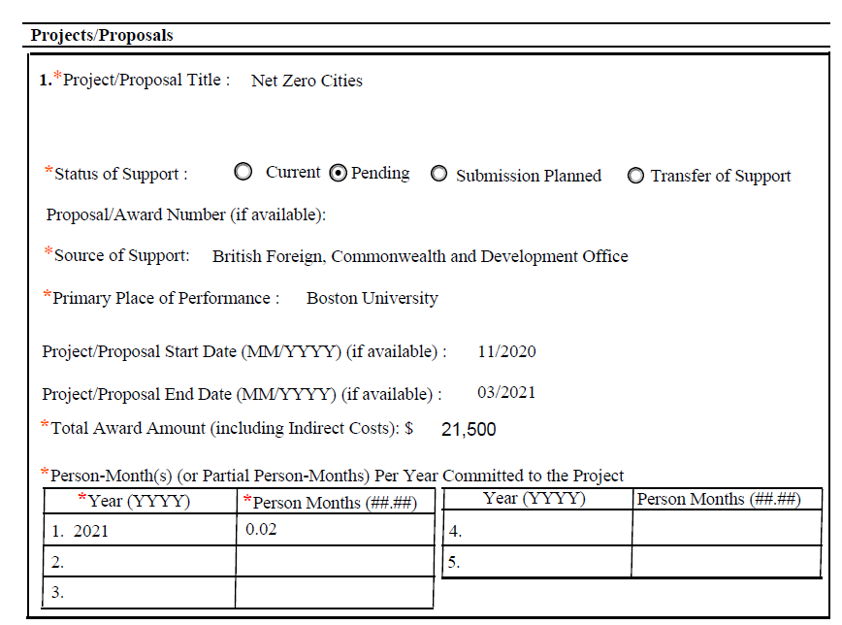
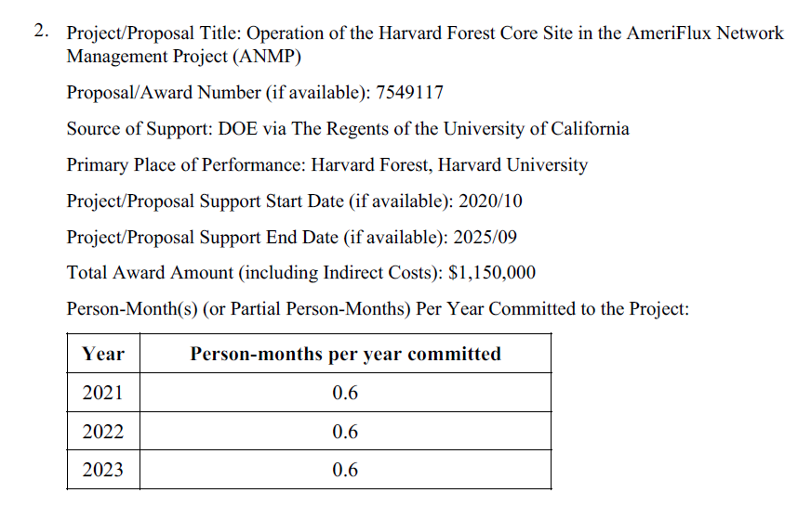
pdf form
SciENcv
Notes:
This is a visual of what the printed versions look like in each system

Slide 35
Other Uploads
Collaborators and other affiliations (COA): Must be separately provided for each individual identified as senior project personnel via an NSF template that is uploaded as an excel document.
Data management plan: 2 pages. PI should review requirements specific to directorate, division and program.
If there is a postdoc you must have a one page Postdoctoral Mentoring Plan.
Letters of collaboration, uploaded as other supplementary docs, should be modeled after the NSF-provided template:
"If the proposal submitted by Dr. [insert the full name of the Principal Investigator] entitled [insert the proposal title] is selected for funding by NSF, it is my intent to collaborate and/or commit resources as detailed in the Project Description or the Facilities, Equipment and Other Resources section of the proposal.”
Letters of support are not allowed
Notes:
Collaborators and other affiliations is a uniquely NSF requirement. It is used to manage reviewer selection.
The COA information must be provided through the COA template which is uploaded as an excel sheet that converts to pdf for viewing purposes.
There are five categories of information that correspond to tables in the template:
the key person’s name and organizational affiliations in the last 12 months,
the names of people they have a relationship with, whether personal or business related that would otherwise preclude their service as a reviewer,
the names of the individual’s Ph.D. advisors; and all of their Ph.D. thesis advisees,
the names of co-authors and collaborators from the past 4 years, and
the names of editorial board, editor-in chief and co-editors with whom they interact.
This section comes before the cover sheet of the application when the entire proposal is printed from FastLane and research.gov.
The Data management plan can be 2 pages max and should describe how the proposal will conform to NSF policy on the dissemination and sharing of research results.
Each proposal that requests funding to support postdoctoral researchers must include a Mentoring Plan. In no more than one page, the plan must describe the mentoring that will be provided to all postdocs supported by the project, regardless of whether they reside at the lead, non-lead, or sub organization.
NSF doesn’t allow letters of support, or any language that conveys an opinion. Instead, collaborators fill out and sign a text template provided by NSF, which is on this slide. These are uploaded under “other supplementary docs” which is where most documents that don’t have their own section in the proposal are placed.
The solicitation will specify if any additional or supplemental documents are needed so make sure to read the solicitation carefully for requirements.

Slide 36
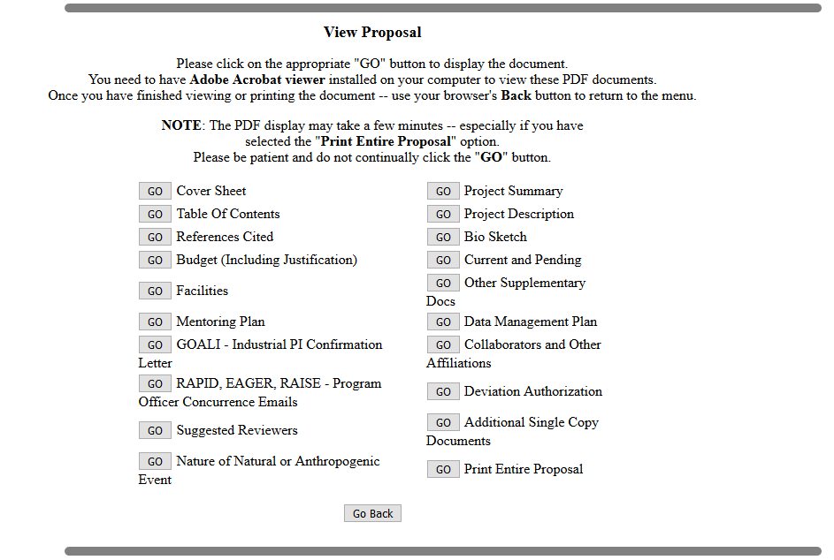
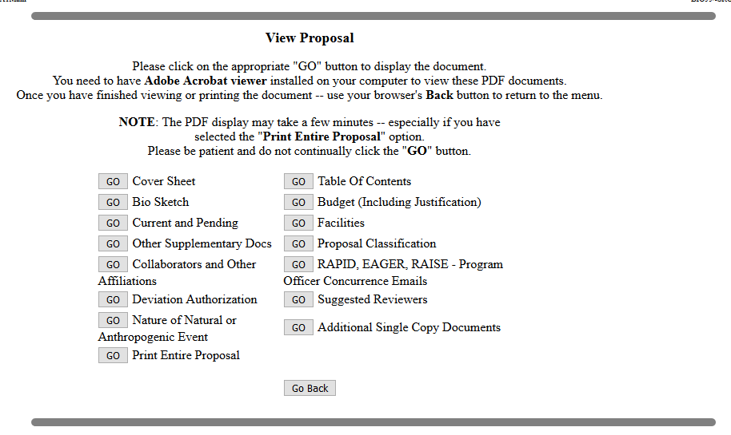
Collaborative proposals can either be 1. submitted by one institution with subawards - if a subaward is included, the subaward entity has to have their own budget in FastLane,
or 2. as a lead, non-lead submission. When we are the non-lead institution we don’t have the ability to upload the science docs. Institutions have to link their proposals in FastLane.
Notes:
Collaborative proposals can be submitted as
1. a single proposal, in which a single award is being requested (with subawards administered by the lead organization); or
2. by simultaneous submission of proposals from different organizations, with each organization requesting a separate award. For these proposals, the project title must begin with the words "Collaborative Research:” Sometimes NSF specifies that this method can’t be used.
In either case, the lead organization’s proposal must contain all of the requisite sections for submission.
For a single proposal, the subaward budget is entered in the website and the justification is uploaded in the budget section of the proposal, so when you click on “go” for the budget in FastLane you’ll see our budget followed by the sub budgets. If awarded, this is the only type of collaborative submission that will involve the subaward team.
For simultaneous submissions, when we’re not the lead organization, the ability to submit the science is taken away from us, as you can see on the right hand side of the slide. When we are the lead organization, we have to make sure we include the collaborator’s information for every field that was taken away from them, like the postdoc mentoring plan and data management plan. Whether we’re the lead or not, we can only see what the linked proposals look like in FastLane when we click on “go” for “print entire proposal,” which creates one pdf for all the institutions, organized by section rather than by institution.
In Fastlane when we submit simultaneously the BU proposal seems to be all set as far as BU is concerned because we can’t see what the collaborators’ status is. In research.gov, you can see the proposal sit in a waiting area until all of the other collaborators submit, which is a more accurate representation of how the process works. The proposal won’t truly be submitted to NSF until all of the linked proposals are submitted.
So how do the PIs decide whether to submit a single proposal or a simultaneous submission? According to NSF, the single proposal method allows investigators from two or more organizations who have developed an integrated research and education project to submit a single, focused proposal. A single investigator bears primary responsibility for the administration of the grant and discussions with NSF, and investigators from any of the participating organizations may be designated as co-PIs. In some instances, simultaneous submission of proposals from multiple organizations that contain the same project description from each organization might be appropriate. The decision of which collaborative proposal method to use must be made internally by the proposing organization.
Sometimes the solicitation will prohibit the simultaneous submission method.

Slide 37
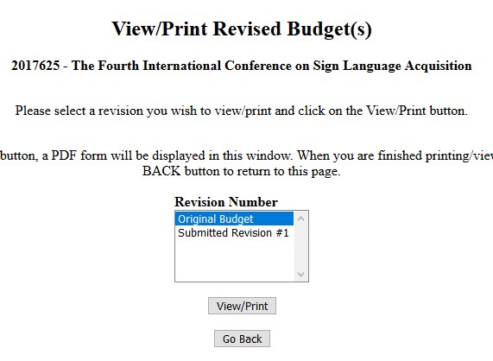
Forwarded/Submitted Revised Budgets
Used prior to award if NSF requests budget revisions. The original budget and revised budget are available to view and compare.
Notes:
After submission, we may be asked to submit a revised budget and/or justification. The program director emails the PI to request the changes before they recommend the award. They may ask that we remove particular line items from the budget, move costs from the main budget to participant support, change the amount of effort, and so on. We may also need to revise the justification if there was not enough detail in the original to determine what some funds will be used for and how they are essential for the project.
Only the original submitted budget and justification, and the uploaded revised versions are visible from this screen.

Slide 38
Phase II: Proposal Review and Processing
Reviewers selected > peer review > program officer review and recommendation > division director review. Takes about 6 months from proposal submission date.
Merit review process: proposals reviewed in a manner that is fair, competitive, transparent, in-depth. Criteria:
Intellectual merit: Does the proposed activity suggest and explore creative, original or potentially transformative concepts to advance knowledge? (project summary)
Broader impacts: potential to benefit society and contribute to specific societal desired outcomes (project summary)
Notes:
Proposals are evaluated by a minimum of three independent reviewers consisting of scientists, engineers and educators who do not work at NSF or the applicant organizations. NSF selects the reviewers from among the national pool of experts in each field.
The proposals are subject to NSF's merit review process which considers the intellectual merit and broader impacts as defined on this slide.

Slide 39
External reviewers evaluate proposals against criteria and consider what the proposer wants to do, why they want to do it, how they plan to do it, how they will know if they succeed, and what benefits could accrue upon success.
Programs officers who are subject matter experts in both technical and programmatic areas conduct merit review and make recommendations to fund or decline a proposal based on reviewers’ evaluations and their own expertise. They consider ratings and comments given by the external reviewers as well as factors that may not have been considered.
Notes:
Then the NSF program officer reviews the proposal and analyzes the input from the external reviewers. The PO makes an "award" or "decline" recommendation to the division director. Final programmatic approval for a proposal is generally completed at NSF's division level. A PI whose proposal has been declined will receive an explanation of the reasons for declination, and copies of the reviews considered in making the decision.

Slide 40
30 days from Business review to finalized award
Types of awards
Grants: Minimal NSF involvement.
Cooperative agreements: Substantial ongoing involvement by NSF. NSF advises, reviews, approves and participates in project activities to the extent specified in the agreement. NSF can unilaterally suspend the project, terminate agreement for cause, or when in the best interest of NSF or the government.
Contracts: Procurement of scientific studies or educational research, as well as audit services, facilities maintenance, IT support, and logistics. PAPPG does not apply, use Guide to NSF Contracting Process.
Phase III: Award Processing
Notes:
If the PO makes an award recommendation and the division director concurs, the recommendation is submitted to NSF's Division of Grants and Agreements (DGA) for award processing. A DGA officer reviews the recommendation from the program division/office for business, financial and policy implications, and the processing and issuance of a grant or cooperative agreement. DGA generally makes awards to academic institutions within 30 days after the program division makes its recommendation.
Grants have Minimal NSF involvement while Cooperative agreements have Substantial NSF involvement. Contracts are subject to the Guide to NSF Contracting Process, rather than the PAPPG. We can also get IPAs from NSF which don’t follow the usual proposal and award process at all.

Slide 41
Award Management
Acceptance
Drawdown of NSF funds constitutes acceptance. Sometimes require formal acceptance. Notify the PO if we choose not to accept.
Period of Performance
Start date cannot be changed. The grantee can authorize a 1st NCE to complete the SOW
Prior Approval
submitted in research.gov under Awards & Reporting, Notifications & Requests. Items needing action are either works in progress or requests that have been forwarded to the AOR
Notes:
Drawing down funds on the award is a signal that we accept the award. If we don’t want to accept we need to notify the PO.
NSF either awards standard grants, which provide the entire project period and entire amount in one NOA, or continuing grants which provide a specific level of support for an initial specified period of time, with a statement of intent to provide additional support for additional periods, provided funds are available and the results achieved warrant further support. Solicitations may say the Anticipated Type of Award is Standard Grant OR Continuing Grant. There is no indication or why one is chosen over the other.
As with NIH, we can initiate a Grantee-Approved No-Cost Extension. Unlike NIH, NSF requires a justification for the 1st NCE. The request can either be created by the PI or the AOR in research.gov under the awards and reporting tab, notifications and requests section. The request should be submitted at least 10 calendar days before the project end date, but NCE requests have been made and approved after the end date, with an explanation for the late request. If there’s a zero balance on the award then research.gov won’t let us submit the request. NSF emails a copy of the request to us, which says “Please note all requests require NSF approval prior to taking action” but we won’t receive a NOA modification for a 1st NCE so the notification email will be used for award setup.

Slide 42
Prior Approvals
Budget activities: change in person months devoted to the project, pre-award costs in excess of 90 days, reallocation of funds provided for participant support costs
No-cost extensions: 1st or 2nd (NSF will send approval email for 2nd NCE)
Changes in objectives, scope, or methodology and other significant changes: significant changes in methods/procedures, significant changes/delays or events of unusual interest, changes in objectives or scope
Changes in PI/PD and co-PI/co-PD or Person-Months Devoted to the Project at the Initiation of the Grantee Organization: Long term disengagement, withdrawal, transfer from one organization to another, substitute (change) PI/PD or co-PI/co-PD
Other: conflicts of interest, subawarding out part of an NSF award
Notes:
When NSF issues an award, that constitutes their approval of the budget items. But remember the costs must always be allowable, allocable, and reasonable in accordance with the cost principles contained in UG.
We are authorized to transfer funds from one budget category to another for allowable expenditures. The only exclusion to this is if there are specific limitations in the grant language.
The PAPPG does not mention prior approval for re-budgeting. Two instances in which we would need prior approval are
if an IPAR is received is requesting a new subaward or
moving funds budgeted for participant support costs to the main account.
The request for either of these would be made in research.gov, and NSF approval will come in the form of an award modification.
When a change does require NSF approval, the request must be submitted via NSF’s systems not an email to the PO. The request should clearly state which budget items, if any, are to be changed and by what amounts, and should explain the reasons for any changes.
There is a prior approval matrix, linked in the reference slide. Unless otherwise specified in the grant notice or the applicable grant general terms and conditions, no additional prior approvals beyond those specified in matrix are required.

Slide 43
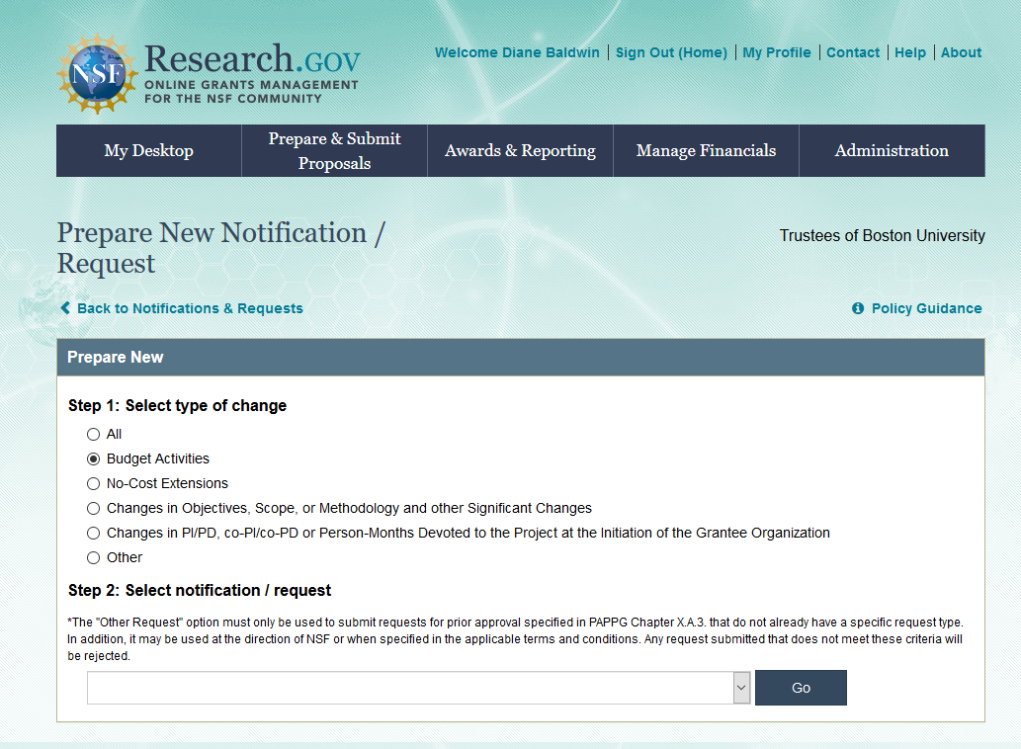
Notes:
The next few slides are screenshots for reference of what the prior approval process looks like in research.gov

Slide 44
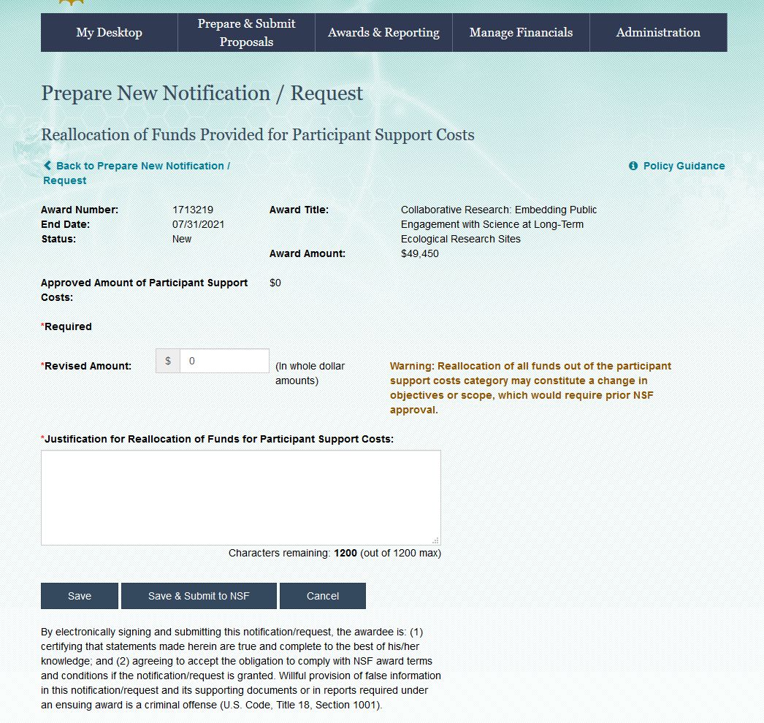
Notes:
This shows what it looks like to request reallocation of the participant support costs – you need to enter the revised amount and a justification
On all the information to be entered into text box there is a 1200 character limit

Slide 45
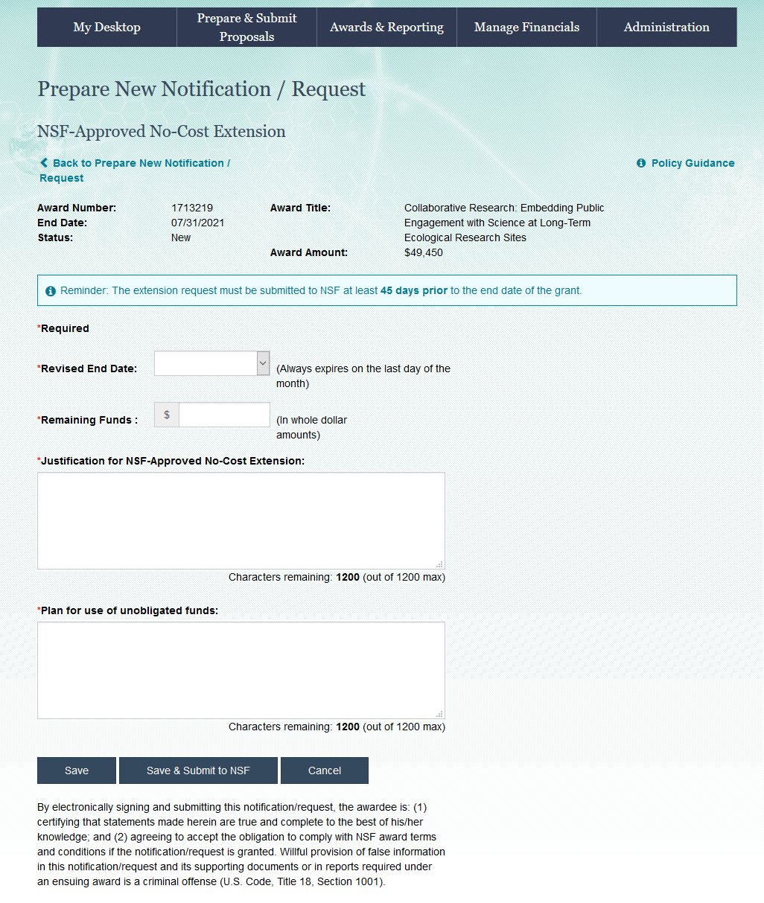
Notes:
NCE request - you enter the revised end date, remaining funds, a justification for the NCE and a justification for the use of the funds

Slide 46
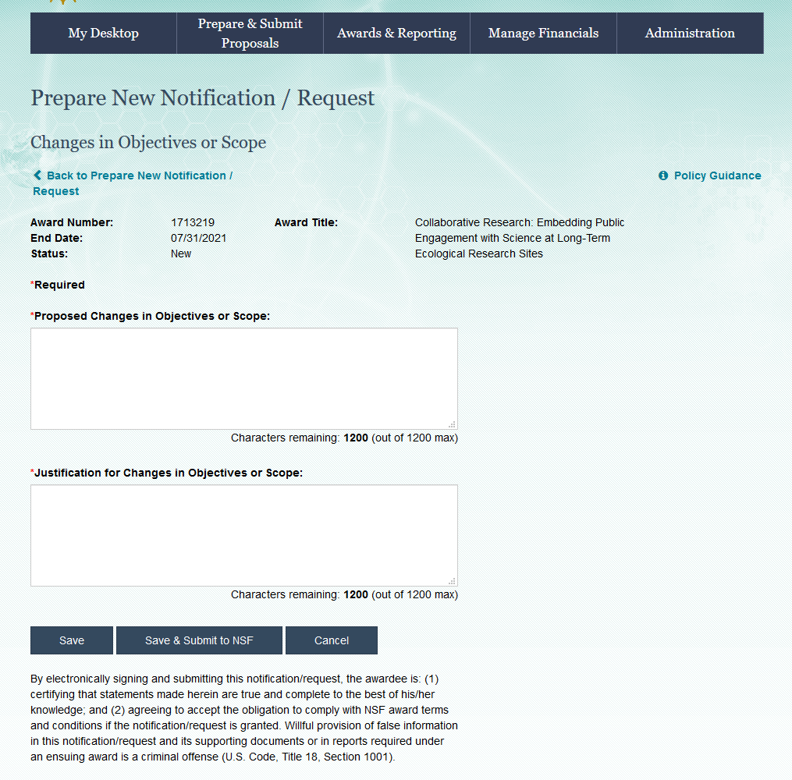
Notes:
prior approval request for a change in scope where you enter the proposed change and then the justification for the changes

Slide 47
If a PI or co-PI has overdue reports on one NSF grant NSF will not release any incremental funding, new awards, or changes to awards for any of the other NSF grants they are associated with.
PIs submit Annual, Final, and Project Outcomes reports without SP involvement.
Report approval is emailed to ospera@bu.edu
Annual & Final Reports
Notes:
Unlike NIH, only the PI or co Pis can create, edit and submit the reports In addition to annual and final reports NSF also requires a project outcomes report, but unlike NIH an invention statement is not required. The front desk does receive reminder emails about these reports that they will forward to the RAs so we are aware.
In FastLane under Awards & Reporting is Project Reports, you can use “report search” to look up specific awards to see if reports are overdue – do any of you use that feature?
Unlike NIH we don’t require RSF because we don’t review and submit

Slide 48
NSF Page Limits
Page Limits
The standard page limits for NSF proposals are as follows. Please note that individual funding opportunities may contain different guidelines that modify or supersede the standard rules.
Section | Page Limit
Project Summary | 1
Project Description | 15
References Cited | none
Biographical Sketches | 2
Budget Justifications | 5
Facilities, Equipment, and Other Resources | none
Data Management Plan | 2
Postdoctoral Mentoring Plan | 1

Slide 49
Boston University Resources
Institutional Prior Approval Request (IPAR)
http://www.bu.edu/researchsupport/files/2017/05/Internal-Prior-Approval-Request-IPAR.pdf
Budget Templates
https://www.bu.edu/researchsupport/2020/09/09/updated-federal-and-non-federal-budget-templates/
Institutional Numbers and Rates
http://www.bu.edu/researchsupport/tools-services/institutional-numbers-and-rates/
Prepare a Proposal (Budget Development, Policies, Form, Contacts)
http://www.bu.edu/researchsupport/project-lifecycle/preparing-a-proposal/
Proposal Summary Form
http://www.bu.edu/researchsupport/files/2019/10/PSF_10.01.19v2.pdf
Sponsor System Registration
http://www.bu.edu/researchsupport/training-how-to/sponsor-system-registration/

Slide 50
External Resources
RPPRs
https://www.nsf.gov/bfa/dias/policy/cps.jsp
SciENcv
https://www.ncbi.nlm.nih.gov/sciencv/
https://www.research.gov/common/attachment/Desktop/SciENcv-FAQs.pdf
Prior Approval Matrix
https://www.nsf.gov/bfa/dias/policy/fedrtc/appendix_a.pdf
Significant Changes
https://www.nsf.gov/pubs/policydocs/pappg20_1/sigchanges.jsp
Proposal & Award Policies & Procedures Guide (PAPPG), June 2020
https://www.nsf.gov/pubs/policydocs/pappg20_1/nsf20_1.pdf
Biographical Sketch and Current and Pending Support Websites
https://www.nsf.gov/bfa/dias/policy/biosketch.jsp
https://www.nsf.gov/bfa/dias/policy/cps.jsp
https://www.research.gov/common/attachment/Desktop/NSFPDF-FAQs.pdf
https://nsfpolicyoutreach.com/resources/2-20-pappg-webinar/
https://nsfpolicyoutreach.com/resources/april-2020-nsf-approved-formats-for-proposals/
https://www.nsf.gov/bfa/dias/policy/nsfapprovedformats/biosketch.pdf

