Slide 1
Guided BUying Requisitioner Invoice Approval and Exception Training
Invoice-to-Pay Training Guide

Slide 2

Introduction to Invoice-to-Pay
Introduction to Ariba Supplier Lifecycle & Performance
Upon completion of this lesson, you will be able to:
  Understand Requisitioner Role and Responsibilities regarding Invoices
Know Invoice-to-Pay Process
Know Key Benefits of Ariba Guided BUying
Invoice Email Notification Process and Required Actions
Understand Ariba Guided BUying Invoice Approval and Exception Process
Understand Key Terms for the Invoicing Process

Slide 3

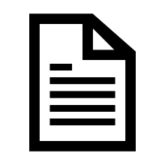

Guided BUying: Overview & Key Terms
Procure-to-Pay Process in Guided BUying
Guided BUying allows Requisitioners at Boston University to purchase products and services from a variety of suppliers. The procure-to-pay process includes the following steps: Purchase Requisition, Approval, Purchase Order, Invoicing, and Fulfillment.
Purchase Requisition (PR) created and submitted for approval.
Approvers review the PR and approve or deny*.
Purchase Orders (POs) are automatically generated after PR is fully approved.
Supplier receives, acknowledge, and fulfills the PO and invoices Boston University
Requisitioner reviews and approves invoice.** Suppliers are paid based on their payment terms.
*PRs will go through a series of approvals based on the dollar amount and commodity code.
**Invoices <$5,000: Requisitioners are notified as a watcher and invoices can be viewed under Your Approvals -> To watch. Payment will release within three days. Invoices ≥$5,000 will be routed to Requisitioners’ Your Approvals->To approve for review and approval.
Notes:
The procure-to-pay process starts with submitting a Purchase Requisition. Once the Purchase Requisition is submitted it will go through a series of approvals before a PO is generated and sent to the supplier. Once the supplier receives the PO, they can provide the products or services and send an invoice digitally through the Ariba Network. Requisitioners will review and approve invoices*

Slide 4

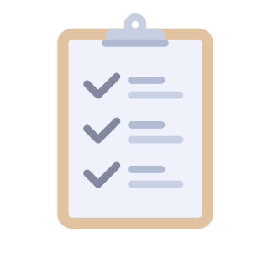


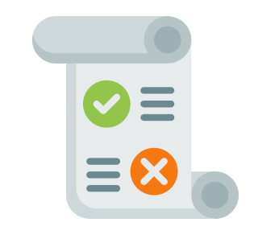
Introduction to Invoice-to-Pay
What is I2P in Guided BUying?
Invoice-to-Pay (I2P) is the process by which shoppers at BU pay for goods and services procured. The I2P process includes the following key activities: Invoice Entry, Ariba Network (AN) Rules, Invoice Reconciliation, Approval, and Payment.
Invoice Entry
The standard process for invoices to be entered into the Ariba Network is through a Supplier submission via EDI, CXML, PO Flip, PDF Email, Paper
AN Rules
An automated quality check occurs; rejecting invoices containing errors before reaching Boston University systems.
Invoice Approval/ Exceptions
The invoice is routed for approval to the requisitioner. Invoice Exceptions generated will also be sent to the requisitioner to resolve.
Invoice Reconciliation
The system auto-validates the invoice for exceptions; analyzing data in the header and line levels.
Payment
Payment is processed once the invoice is fully approved and reconciled. Payment is released on invoice due date (based on negotiated payment terms).

Slide 5




Introduction to Invoice-to-Pay
Benefits of Ariba in the Invoice-to-Pay Process
Fast Approval
Accelerates the invoice approval routing process.
Exception Handling
Prevents invoice failure by offering situation-based exception handling measures.
Automatic Capture
Captures and processes electronic invoices from multiple sources automatically.
Reduced Costs
Reduces invoice processing costs.

Slide 6
Invoice Approval

Slide 7
Invoice Approval
Introduction to Ariba Supplier Lifecycle & Performance
Overview of Key Topics Covered in Invoice Approval:
  Invoice Watcher Email Notification
  Invoice Approver Email Notification
  Invoice Approver Navigation to Invoices
  Invoice Approval Process
    Approve/Deny Invoice
    Manage/Split Accounting
    Add Approvers/Watchers
    Review/Add Attachments to an Invoice

Slide 8
Approval Process
The automated approval process in Guided BUying maximizes efficiency, standardizes processes, and ensures transparency.
The approval flow for each invoice is automatically determined by Ariba based on multiple factors such as the invoice value, PO category, etc. The requisitioner will be able to add approvers where needed.
Three Main Approval Roles
Requisitioner
Requisitioners are responsible for validating, approving and resolving exceptions for an Invoice. Required approvers are added automatically to a request when submitted. However, requisitioners may add watchers and additional approvers as necessary.
Approver
An Approver is someone who is required to approve a document before it can move forward. Approvers receive notifications by email when a Invoice requires their review. Each approver is notified only after the approvers to the left on the approval flow have approved the document.
Watcher
A Watcher is someone who is notified of the submission and status of an invoice, but does not have require approval. For example, when a Requisitioner creates a PR on behalf of a user, that user becomes a watcher for the invoice as well.

Slide 9
Approval Process
Approval Flow Overview
Each approver involved in the approval flow of a Invoice will appear in the approval workflow. Each approver is notified only when the approvers to the left of the approval flow have approved the document. This approval flow can be viewed in the Invoice in Ariba.
Invoice
Approver 1
Approver 2
Approved
A status of Active, means that the Approver has received notification of the request for approval but has not acted on the request.
Notes:
Mohit: Can you add a screenshot from Guided Buying of the approval workflow?

Slide 10



Approval Process
Adding and Removing Approvers
System Generated Approvers
Adding Approvers
Removing Approvers
Ariba assigns approvers automatically based on the requisitioner’s profile. The system generated approvers cannot be removed.
Requisitioners may add additional approvers as necessary. However, this may lengthen the request timelines.
Requisitioners may remove manually added approvers from the approval flow only
Notes:
Change requestor to requisitioner

Slide 11
Approval Process
Approval Timelines
Ariba automates notifications and escalations in the approval process to reduce approval lead-time and support business continuity.
Notification | The approver is notified after the Invoice is ready for review or after the preceding approver has approved the Invoice.
Reminder | Three days after the notification, the approver will be sent a follow-up reminder notification to approve the Invoice.
First notification
Three days after notification – reminder
Notes:
Double check info

Slide 12


Approval Process: Approval Platforms
Approval Platforms
Approvers have the option of approving or denying an invoice via email or within the Ariba tool for standard purchase orders.
Email
Ariba
Approvers can Approve / Deny a Requisition or Invoice through Email for standard purchase orders. Approvers need to click on the Approve / Deny button on the email notification.
Access from your laptop or desktop to the Guided BUying section named “Your Approvals” will contain all items awaiting approval.

Slide 13
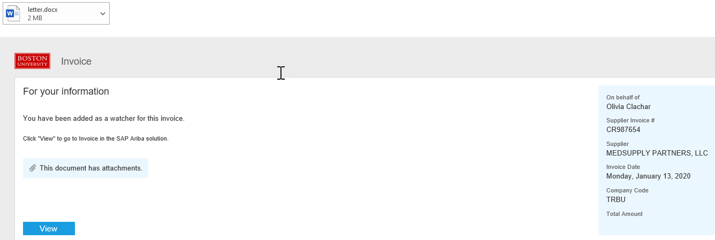
Invoice Watcher: Email Notification
All invoices require validation from the Requisitioner. Requisitioners are added as a Watcher to review all invoices for purchase orders submitted to a supplier.
1
Clicking View will redirect you to Guided BUying
to validate the invoice.
1
Note: Watcher email notifications are sent to Requisitioners for invoice validation for all invoices under $5000 in value.

Slide 14
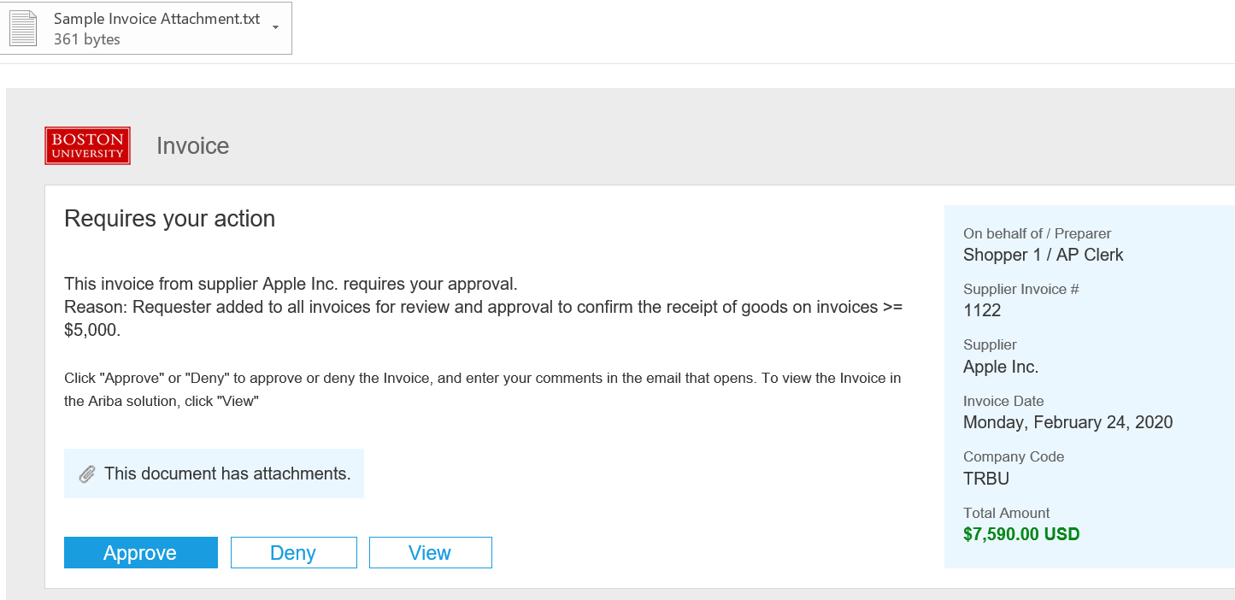
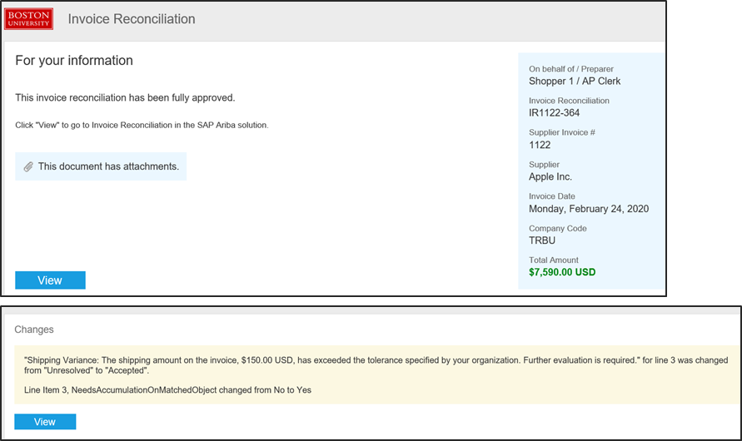
Invoice Approval: Email Notification (1 of 4)
Invoice approval email notifications alerts the requisitioner when an invoice is ready to be approved.
Note: Invoice approval is forwarded to the Requisitioner for all Invoices exceeding $5000 in value.

Slide 15
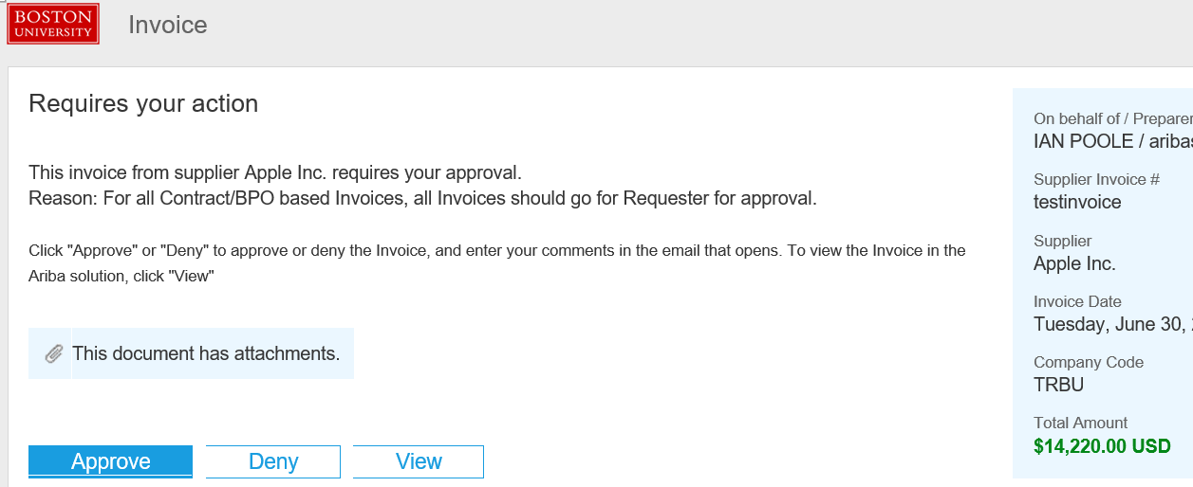
Invoice Approval: Email Notification (2 of 4)
Invoice approval email notifications for a Contract Non-Release that requires accounting information, select View to navigate to Guided BUying to add the appropriate cost center.
1
Click on View for Contract Non-Release invoices.
1
Note: Invoice approval is forwarded to the Requisitioner for all Invoices exceeding $5000 in value.

Slide 16
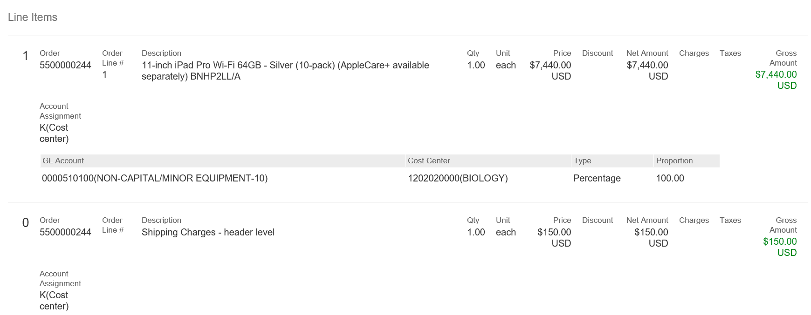
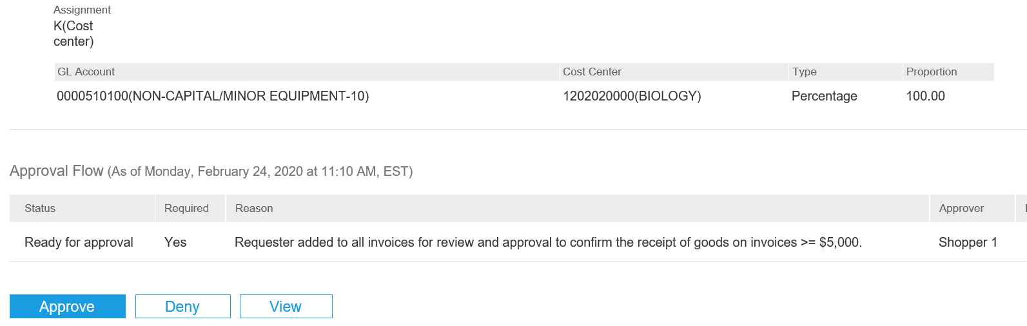
Invoice Approval: Email Notification (3 of 4)
Invoice approval email notification
2
Scroll down in the email body to view line item details.
Once you have reviewed the information, click Approve or Deny as applicable.
Note: This does not apply to Contracts Non-Release. Click on View for Contracts.
2
3
4
If information available in the email is not sufficient, you can click View to review each section of the requisition in Guided BUying.
3
4

Slide 17
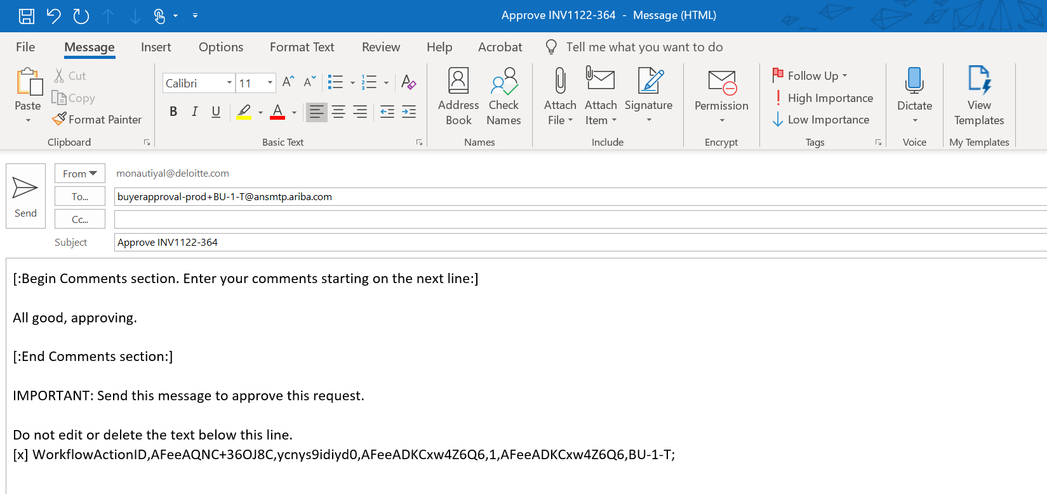
Invoice Approval: Email Notification (4 of 4)
Invoice approval email notification
5
A new email window will open. Enter any comments below the Begin Comments section in the body of the email. This is an optional step. However, it is recommended to include comments when denying a request.
Click Send.
6
5
6

Slide 18
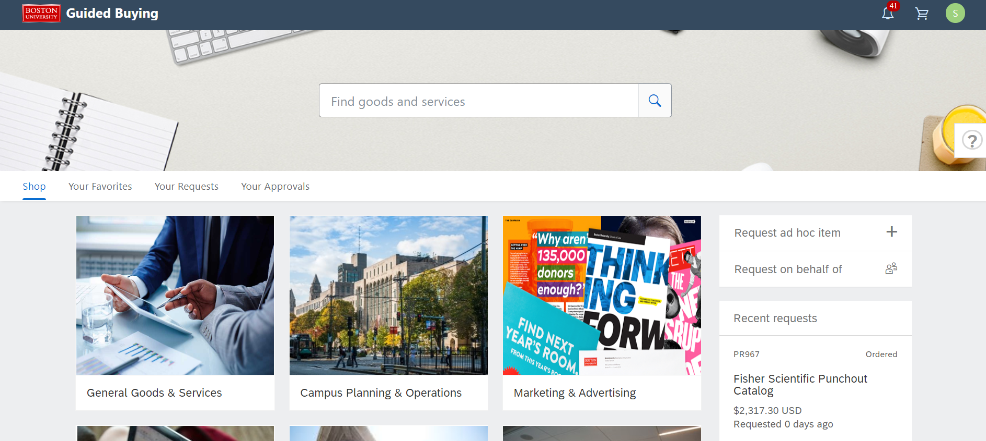
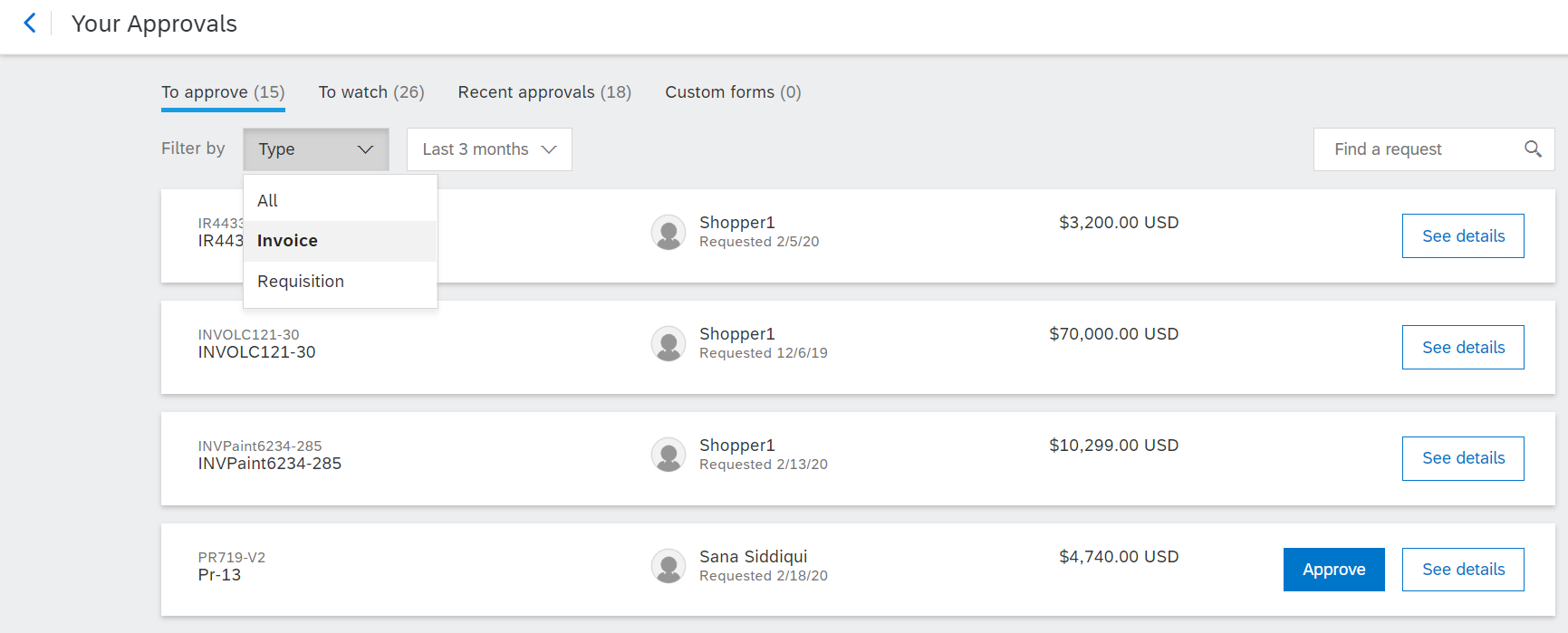
Invoice Approval Page
Search for the Invoice.
1
Click on Your Approvals
1
2
Make sure that To Approve tab is highlighted.
3
From the Filter by drop down, click Invoice.
2
3

Slide 19
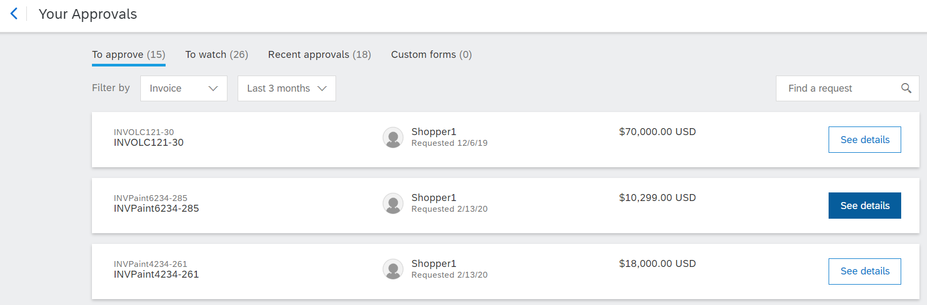
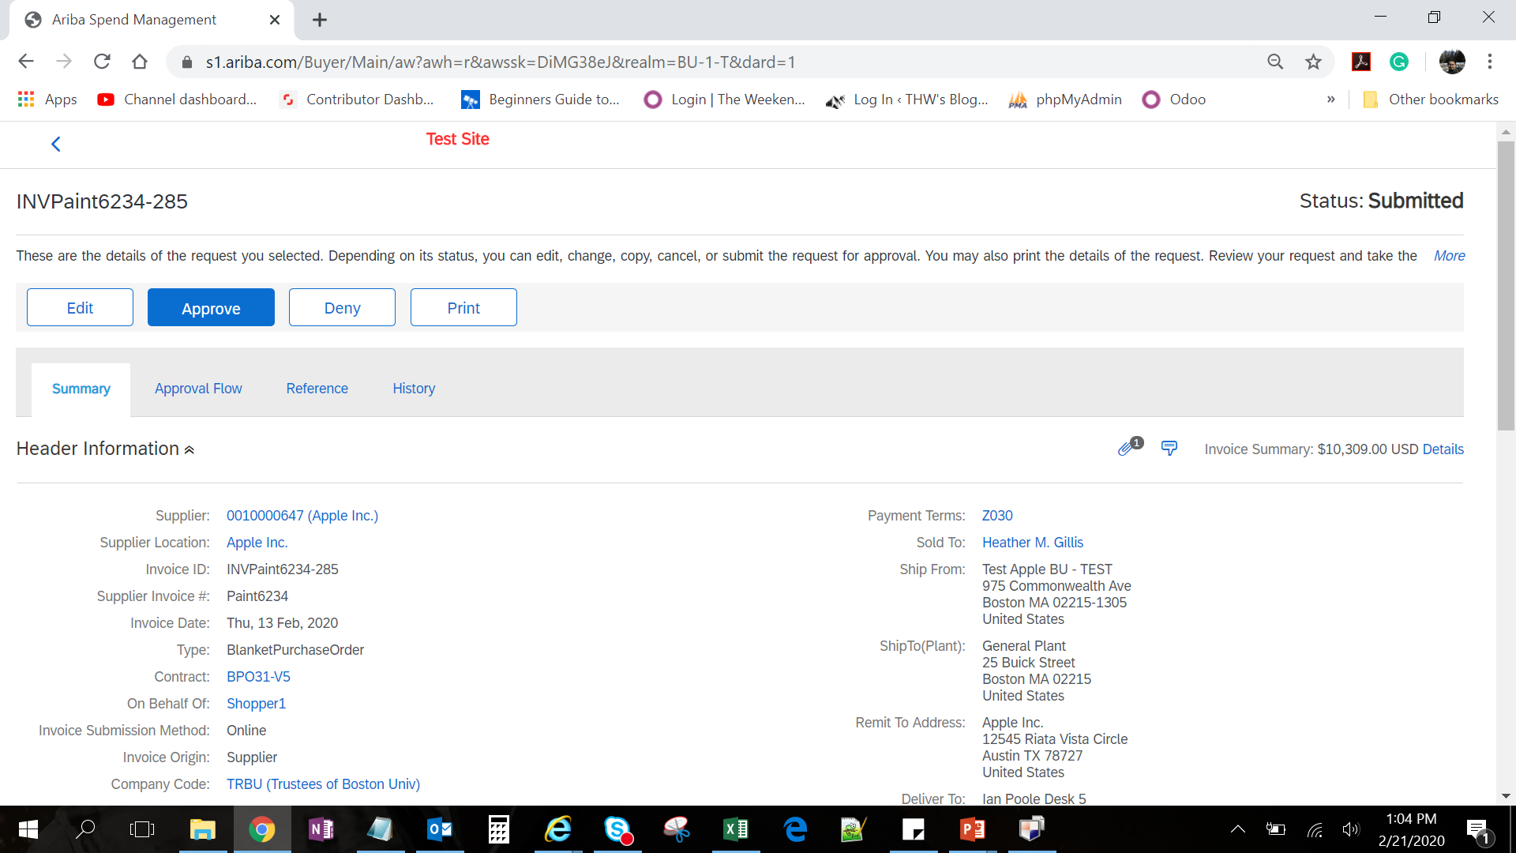
Invoice Approval
Summary Tab - The initial step of the approval process is to review the Summary of the Invoice.
4
Click See details on the Invoice that you want to approve. The invoice number is prefixed with INV and located to the right of the details button.
4
The Summary tab of the selected Invoice will display.
Note: All blue hyperlinks allow you to drill-down to additional information.

Slide 20
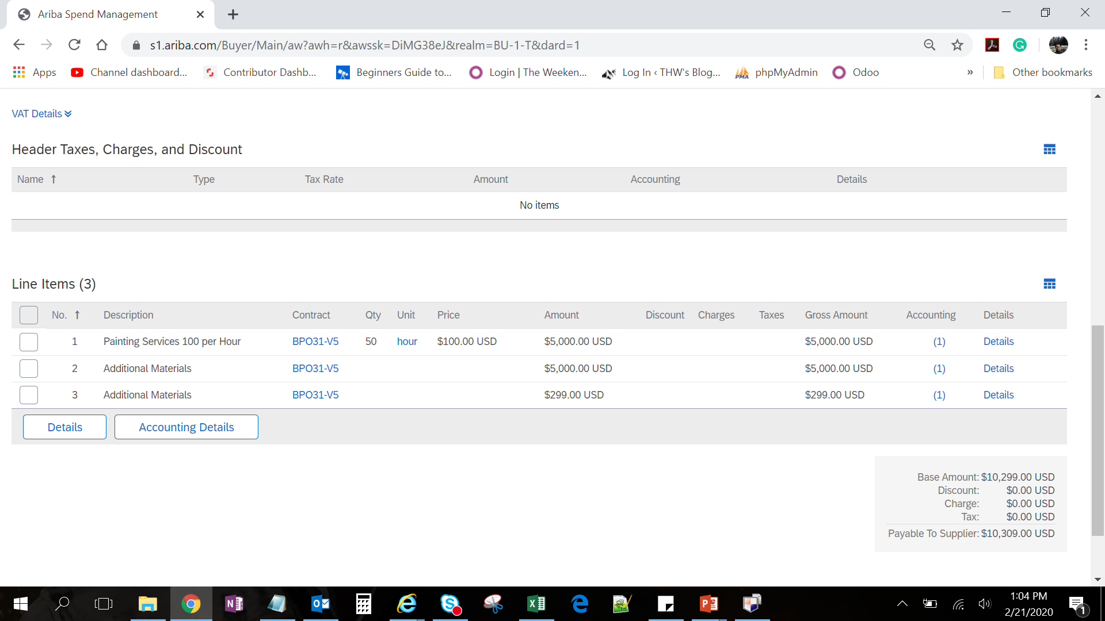
Invoice Approval
Invoice Line Items - The next step in the approval process is to review the invoice line item details and attachments where applicable.
5
Scroll down to see the line item details and their corresponding amount.
5
6
Click on the Attachment icon to view existing attachment or add new attachment.
6

Slide 21
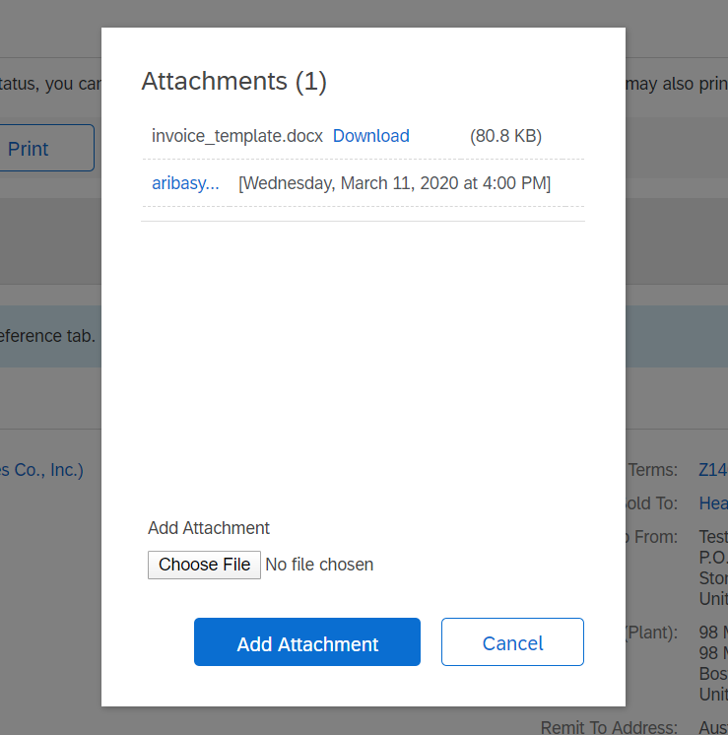
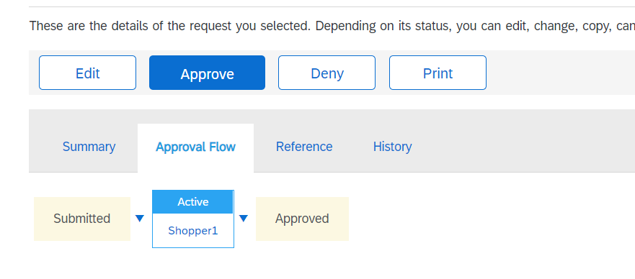
Invoice Approval
Review or Add Attachment and Review of Approval Flow tab on the Invoice.
7
Click Download to view the existing attachments.
7
8
Add Attachment if applicable. Click Choose File to add a new attachment.
8
9
Scroll back to the top and click Approval Flow to view approvers and approval status.
9

Slide 22

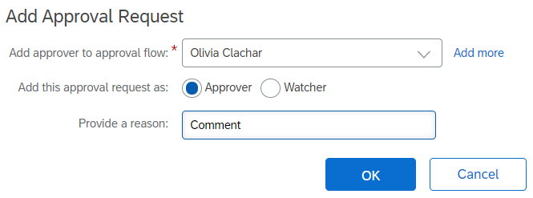
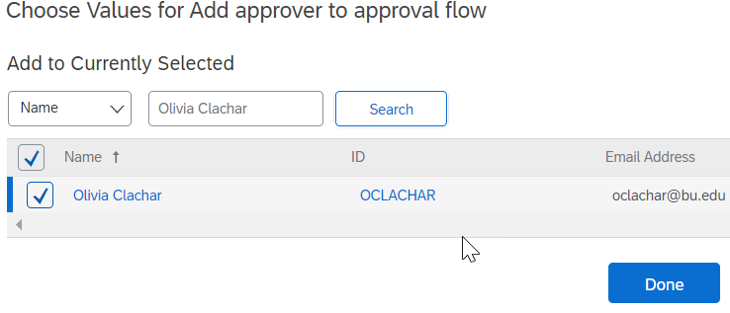
Invoice Approval
Manually Adding Approvers or Watcher to an Invoice
Click on Approval Flow to view approvers or to Add Approvers to the invoice.
10
10
Add Approvers by clicking on the triangle and select Add Serial Approver.
11
11
Enter Approver Name and provide a reason to the approver. Select either Approver or Watcher. Click on OK.
Note: Click on down arrow and select Search More to find employee name.
12
12

Slide 23
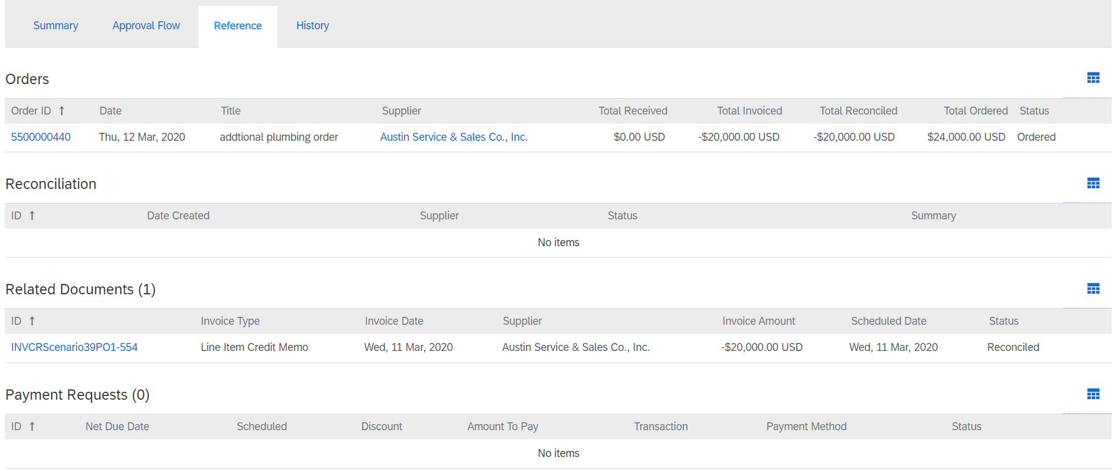
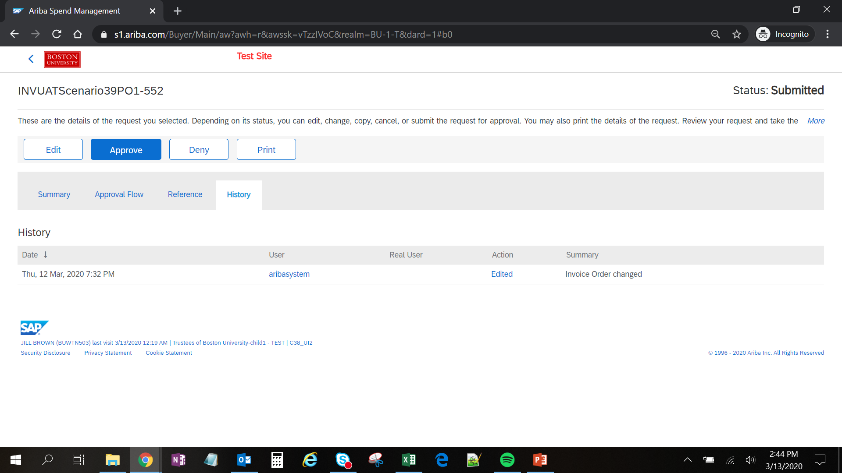
Invoice Approval
Review Reference tab to obtain more information on the Invoice and Invoice Payment. History tab documents date and time certain actions were taken on an invoice.
13
Click Reference tab to view all related documents such as purchase orders, Invoice reconciliation and payment documents.
13
14
Click History tab to view changes date and time certain modifications were made to the invoice.
14
15
Click Edit to update an Invoice during approval.

Slide 24
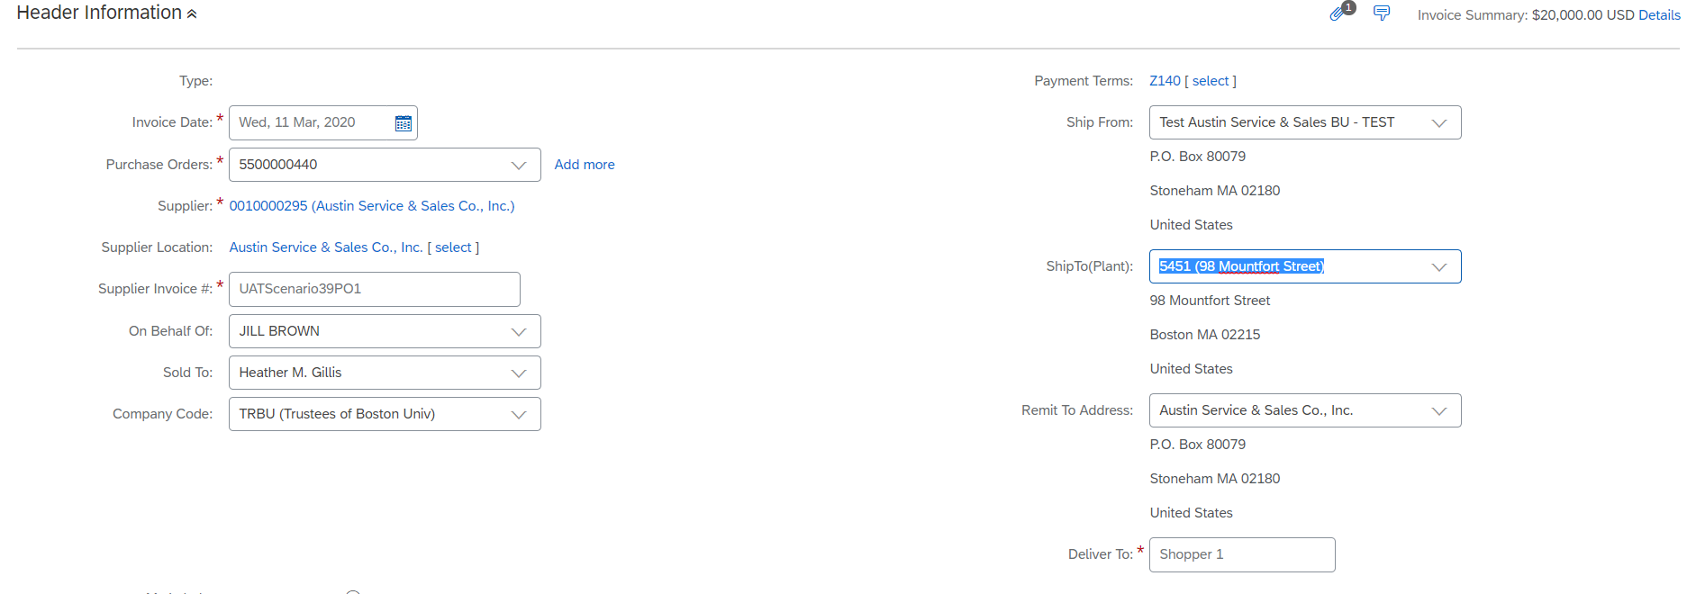
Invoice Approval
Edit Invoice Summary – Change Ship to Address or Remit Address, etc
15
Click Edit to update an Invoice during approval.
15
16
Update any header level information such as Remit Address, Ship-To, etc.
16

Slide 25

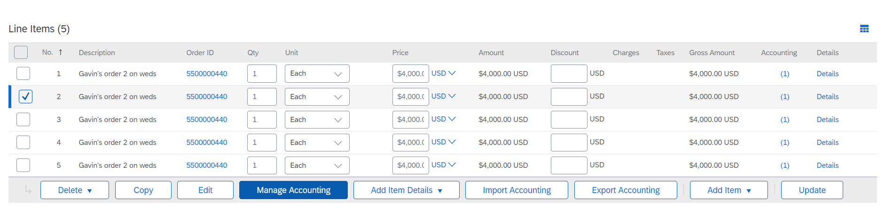
Invoice Approval
Manage Accounting (1 of 2)
At the invoice line item level, modify Cost Object, GL Account Number, and Account Assignment where applicable.
17
Click on Edit and then check off the box next to each line item that require accounting modifications.
17
Click Manage Accounting to update line level accounting details such as cost object or GL account.
Note: Multiple lines can be selected at the same time to make a single modification for all lines.
18
17
18

Slide 26
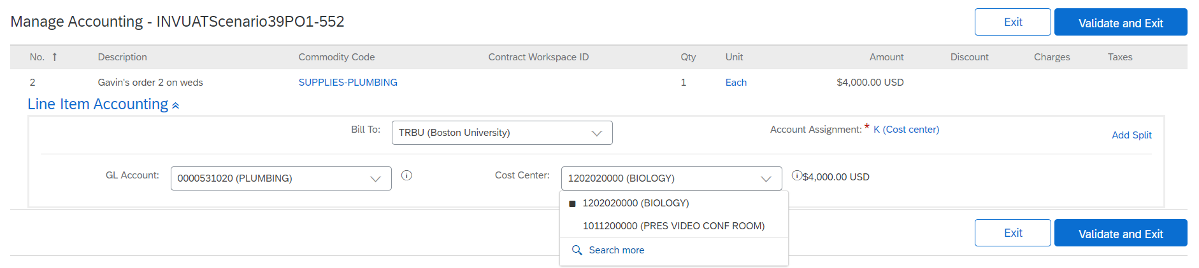
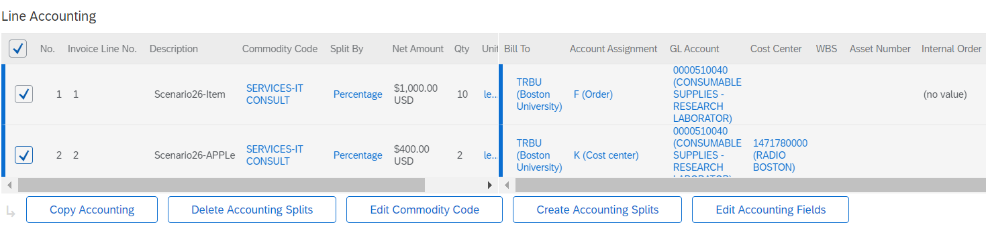
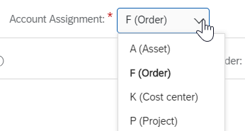
Invoice Approval
Manage Accounting (2 of 2)
Modify an invoice on a single line or multiple lines simultaneously. Contracts require Cost Object and GL Account modification. Purchase Orders also can have the accounting modified prior to invoice submission when needed.
Update the required Cost Center and GL Account by entering the number. To Search, click on drop down arrow and click on Search More. Once accounting is complete, click on Validate and Exit then Submit.
19
19
20
Multiple lines can be modified simultaneously by selecting the line items and clicking managing accounting then click on Edit Accounting Fields. Update the cost accounting fields as noted in step 19. Once complete, scroll to the top and click on Submit.
20
Note: Account Assignment change for an invoice can occur for contracts only. If an invoice for a standard purchase order requires account assignment, then the purchase order will need to be modified.

Slide 27
Invoice Approval
Split Accounting on an Invoice (1 of 2)
21
Create split accounting on a single line by clicking on Add Split.
21
22
Multiple lines can be modified simultaneously by selecting the line items and clicking on Create Accounting Splits.
22

Slide 28
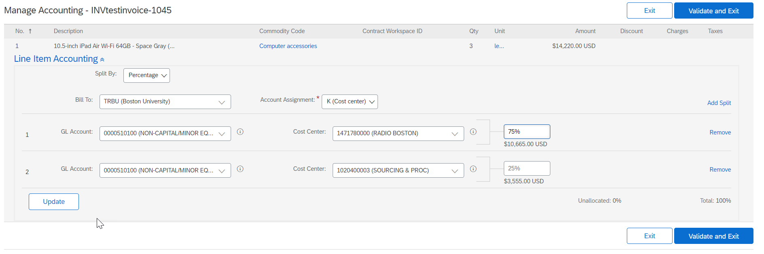
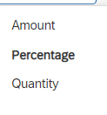
Invoice Approval
Split Accounting on an Invoice (2 of 2)
Create split accounting based on percentage, amount, or quantity in the drop down menu of the Split By field. Enter the corresponding amount.
23
23
24
24
Clicking on Validate and Exit then click on Submit.

Slide 29
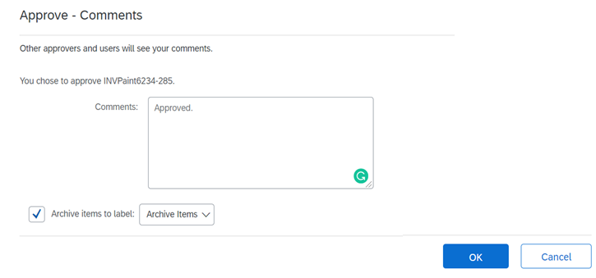
Invoice Approval
Final step after complete review of the invoice is to approve or deny the Invoice.
25
Click on Invoice and click on Approve or Deny.
Note: Click Deny if you want to reject the invoice.
25
26
Enter comments in the comments box (Comments are optional).
26
27
Click OK.
27

Slide 30
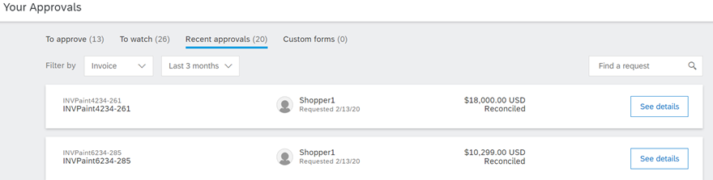
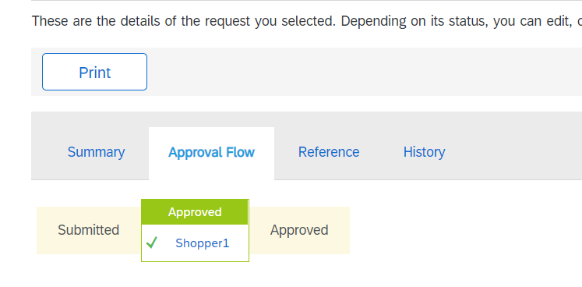
Invoice Approval
Reviewing Approval Status - You can review the status of the invoice approval.
28
28
Once you are redirected to Your Approvals screen, click on Recent Approvals.
29
29
Click See Details.
30
Click on Approval flow tab. The status has been updated to approved.
30

Slide 31
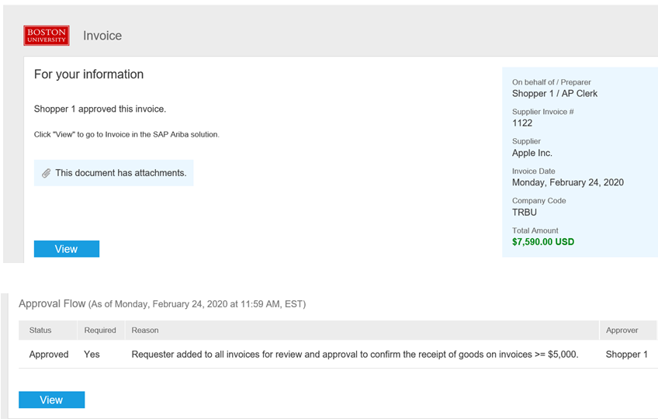
Invoice Approval
Once invoice is approved, an email notification will be sent to you.
31
Upon completion of invoice approval, an email notification is sent to the requisitioner, approvers and watchers. The approver information is displayed in the email.
17
Scroll down to bottom of the email to view current status of the invoice.
18
31

Slide 32
Invoice Exceptions

Slide 33
Invoice Exceptions
Introduction to Ariba Supplier Lifecycle & Performance
Upon completion of this lesson, you will be able to:
  Understand Invoice Reconciliation (2 Way Match) Concept
  Know Invoice Exception Concepts and Navigation
  Understand Invoice Exception Notifications and Automatic Routing
  Invoice Exception Resolution Process
  Common Invoice Exceptions

Slide 34
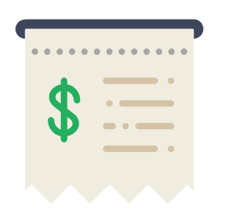

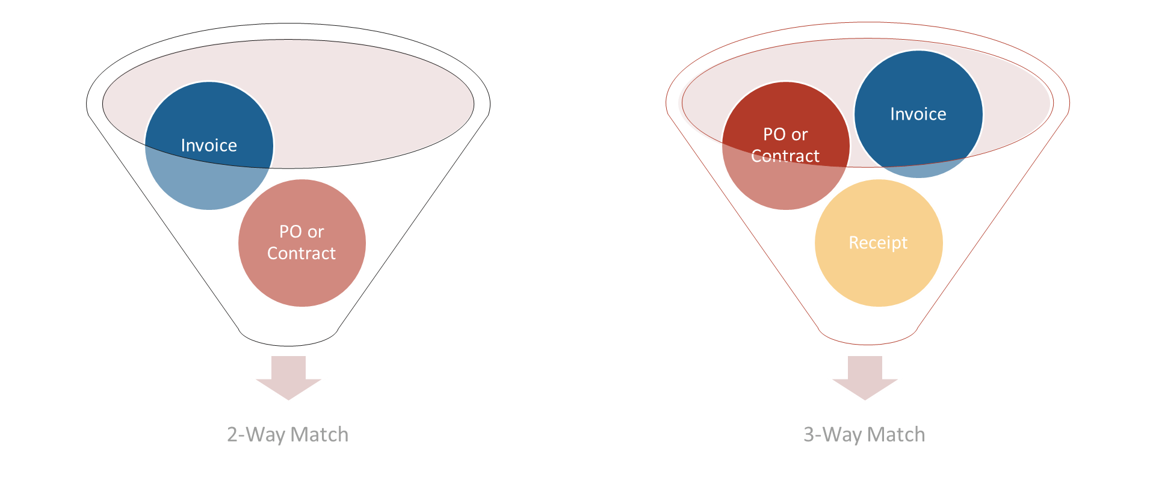
Invoice Exceptions vs Reconciliation
Invoice Concepts
Invoice Reconciliation
If you find discrepancies on an invoice that do not meet the University’s invoicing policies these exceptions must be reviewed. You can use the Invoice Reconciliation (IR) document to manage and track the exceptions.
Invoice Exception
An invoice exception is a discrepancy between the invoice and its associated order. Invoice Exceptions are used to detect invoice errors and exceptions (e.g. Price Variance), allowing only validated invoices to be routed for approval.
2 Way Match to Auto Reconciliation
Ariba matches invoices to other documents such as purchase orders and contracts; then exceptions are automatically generated
2 Way Match

Slide 35
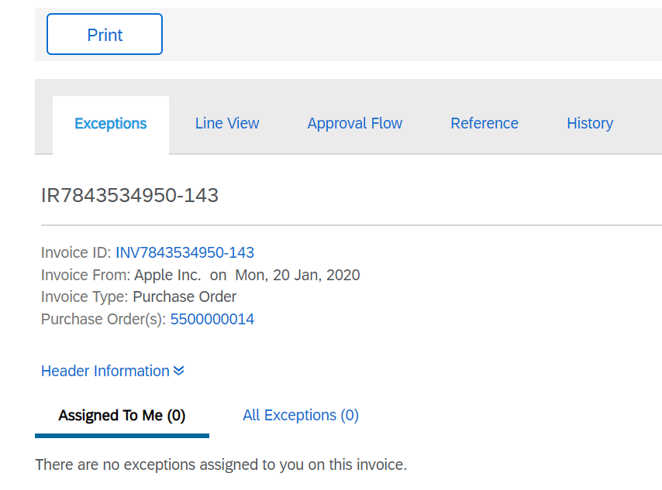
Invoice Exceptions
Invoice Reconciliation Document
View the exception raised (if any) for the invoice.
View the approval matrix for the exception.
View significant actions that have occurred.
An Invoice Reconciliation (IR) document is created when the invoice is matched to its associated Purchase Order. If any discrepancies are found, they are listed in the IR document.
After all the exceptions are reconciled and approved, the IR document is submitted and the payment process is initiated.

Slide 36

Invoice Exceptions
Invoice Exception Handling
Quantity Variance
Notify Requester (E-Mail)
Requisitioner updates PO
Invoice
Price Variance
Requester Resolves Exception
Rejected Invoice sent back to Supplier
Purchase order and Payment Terms Exception
AP Team Resolves Exception
No
Yes
Exceptions Cleared ?
Invoice Reconciliation
Exceptions Exist ?
Shipping & Handling Exceptions
Requester Resolves Exception
Yes
Post Ok-To-Pay document to SAP
No
Tax Exceptions
AP Team Resolves Exception
Invoice Exceptions occur when an invoice falls out of tolerance or does not meet basic system requirements. An approval flow is triggered on the Invoice Reconciliation (IR) document when an Invoice Exception occurs. The invoice is then routed to the most appropriate group to clear the exception or reject the invoice. Exception approvers can be systematically added or the exception can be routed to a single group, who then manually adds the most appropriate point of contact for review and action.

Slide 37
Invoice Exceptions
Roles and Responsibilities Involved in Exception Handling
Accounts Payable
Accounts Payable is responsible for conducting invoice processing / matching, exception routing, invoice approval workflows, invoice payments, etc.
Approver
  An Approver needs to take an action on the document i.e. either approve it or reject it. Approver can be added automatically in the system or added manually by Requisitioner or another Approver.
Requisitioner
  A Requisitioner is responsible for handling exceptions raised and assigned to them. For example, Price Variance, Received Quantity Variance, PO Amount Variance, etc.
Watcher
A Watcher is a person in the approval flow who is notified of the submission and status of an invoice. The watcher is responsible for reviewing and validating all invoices for orders submitted. The Requisitioner will be added as a watcher for all invoices less than $5000.

Slide 38

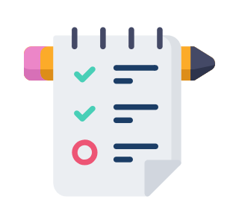


Invoice Exceptions
Invoice Tolerances
What are Invoice Tolerances?
Invoice Tolerances are set in two places – Ariba Network and Ariba Buying & Invoicing.
Some exception types auto-clear when a specific action is taken (e.g. Received Quantity Variances auto-clear as additional quantities are received).
There are three primary actions a user can take when handling an exception: accept, defer or reject.
Tolerances errors can result in an automatic invoice reject back to the Supplier.

Slide 39
Common Invoice Exceptions reviewed by Requisitioner
Name | Description | Absolute Tolerance | Percentage Tolerance | Approver | Auto Reject | Allow Req?
PO Price Variance | The price on the invoice line item, is different from the price on the purchase order line item, and the difference is more than the tolerance set in your configuration. | $100 | 50% | Requisitioner | No | No
PO Catalog Price Variance | The catalog item price on the invoice line item, is different from the price on the purchase order line item, and the difference is more than the tolerance set in your configuration. | $100 | 50% | Requisitioner | No | No
PO Quantity Variance | The quantity on the invoice line item, is different from the quantity on the purchase order line item, and the difference is more than the tolerance set in your configuration. |  | 0% | Requisitioner | No | No
PO Line Amount Variance | Mostly applicable for amount based invoicing commodity codes mostly. When user enters the amount more than the available amount on the invoice line item. | $100 | 50% | Requisitioner | No | No
Special Handling Variance | The handling amount on the invoice, has exceeded the tolerance specified by your organization. Further evaluation is required. | $100 |  | Requisitioner | No | Yes
Shipping Variance | The shipping amount on the invoice, has exceeded the tolerance specified by your organization. Further evaluation is required. | $100 |  | Requisitioner | No | Yes

Slide 40
Auto Rejected Invoice Exceptions (1 of 3)
Auto rejections will be sent back to supplier for resubmission.
Name | Description |  | Auto Reject
Invalid Invoice Date | The date on the invoice is before the ordered date. |  | Yes
Item Unmatched | Ariba Invoice is unable to find a line item on the purchase order that matches the invoice line item of . |  | Yes
Invoice currency mismatch | The currency on the invoice does not match the currency on the purchase order. |  | Yes
Invoice ID Maximum Character Length Exceeded | The maximum characters for a supplier invoice number (16) has been exceeded and the Invoice will be auto-rejected. |  | Yes
Canceled Order | Ariba Invoice of amount is matched to a purchase order that has been canceled. |  | Yes

Slide 41
Auto Rejected Invoice Exceptions (2 of 3)
Auto rejections will be sent back to supplier for resubmission.
Name | Description | Auto Reject
PO Closed for Invoicing | The purchase order has been closed for invoicing. | Yes
PO Line Closed for Invoicing | The purchase order line has been closed for invoicing. | Yes
PO Rejected for Invoicing | The purchase order has been rejected by Ariba Network supplier while confirming the order. | Yes
PO Line Rejected for Invoicing | The purchase order line item has been rejected by Ariba Network supplier while confirming the order. | Yes
Invoice has mixed currency | Different line items has different currency in invoice | Yes
Invoice has mixed amounts | The line items on the invoice contain positive and negative amounts | Yes
Invoice has mathematical errors | Amounts of invoice lines don't match to the invoice total. Applicable for cXML or EDI invoices if supplier's EDI configuration has issues. | Yes

Slide 42
Auto Rejected Invoice Exceptions (3 of 3)
Following are the tolerance limits required to configure invoice exceptions on the Ariba Network
# | Exception | Description | Percentage | Absolute
1 | Allow suppliers to change the unit price | Due to variations in pricing or availability, suppliers might need to increase the unit price for an item. If you do not allow unit price changes, you can still set a price tolerance percentage that suppliers cannot exceed | 75%
2 | Allow suppliers to increase item quantities | Suppliers might need to increase item quantity for best pricing or shipment, particularly for non-catalog items | 10%
3 | Allow suppliers to increase line item subtotals | Suppliers might need to increase line item subtotals due to variations in pricing or availability | 75% | $200

Slide 43
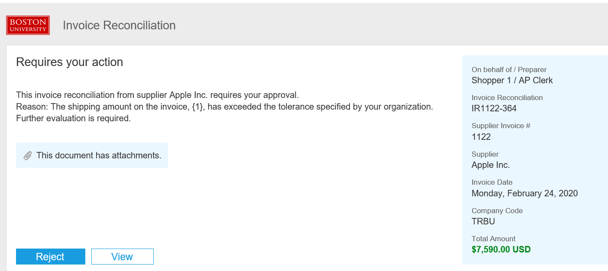
Invoice Exceptions
Invoice Exceptions Notification (1 of 2)
If an invoice exception is generated, the requester will be notified through email stating exception reason.
1
Open the email notification and click view.
You will be redirected to the invoice exception page in Ariba Guided Buying.
1
1

Slide 44
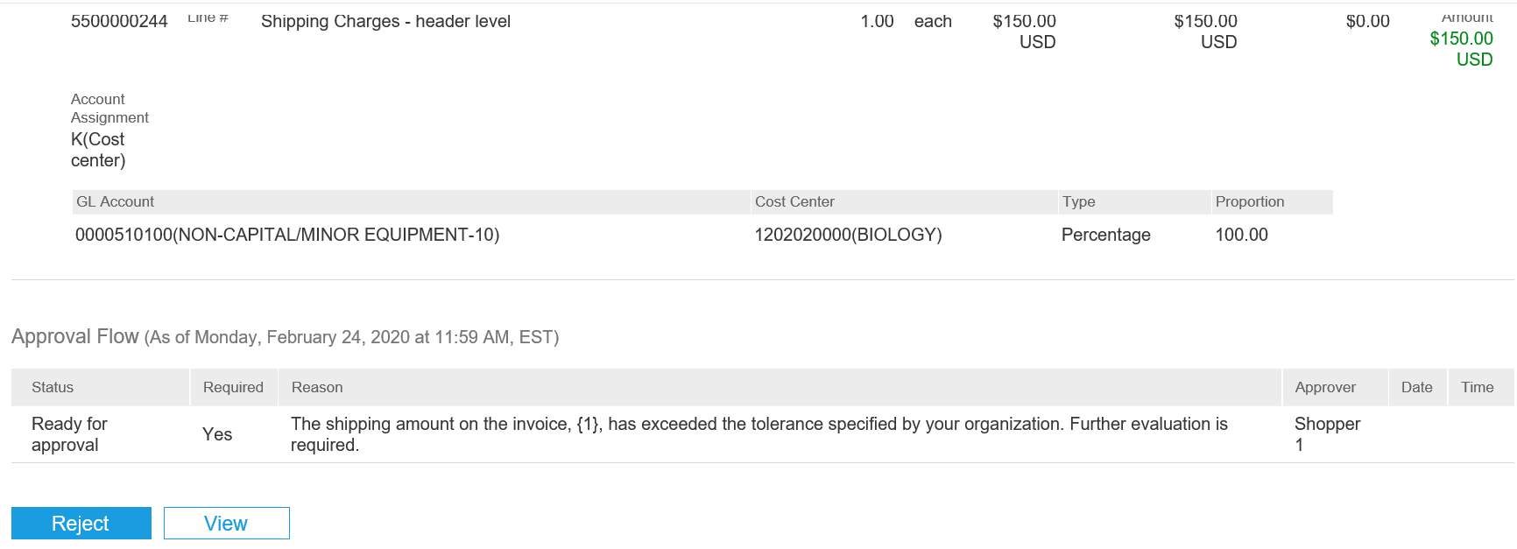
Invoice Exceptions
Invoice Exceptions Notification (2 of 2)
The notification also contains invoice status, line item detail and invoice attachment.
2
Alternately, scroll down to view the current status, line item detail and reason for rejection.
3
Click View.
2
3

Slide 45
Invoice Exception Navigation
An alternative option to view an invoice exception is to search for the Invoice within Guide Buying
1
1
Click on Your Approvals
2
Make sure that To Approve tab is highlighted.
3
From the Filter by drop down, click Invoice.
2
Click the See details button next to the invoice for which you need to handle exceptions.
4
4
3

Slide 46
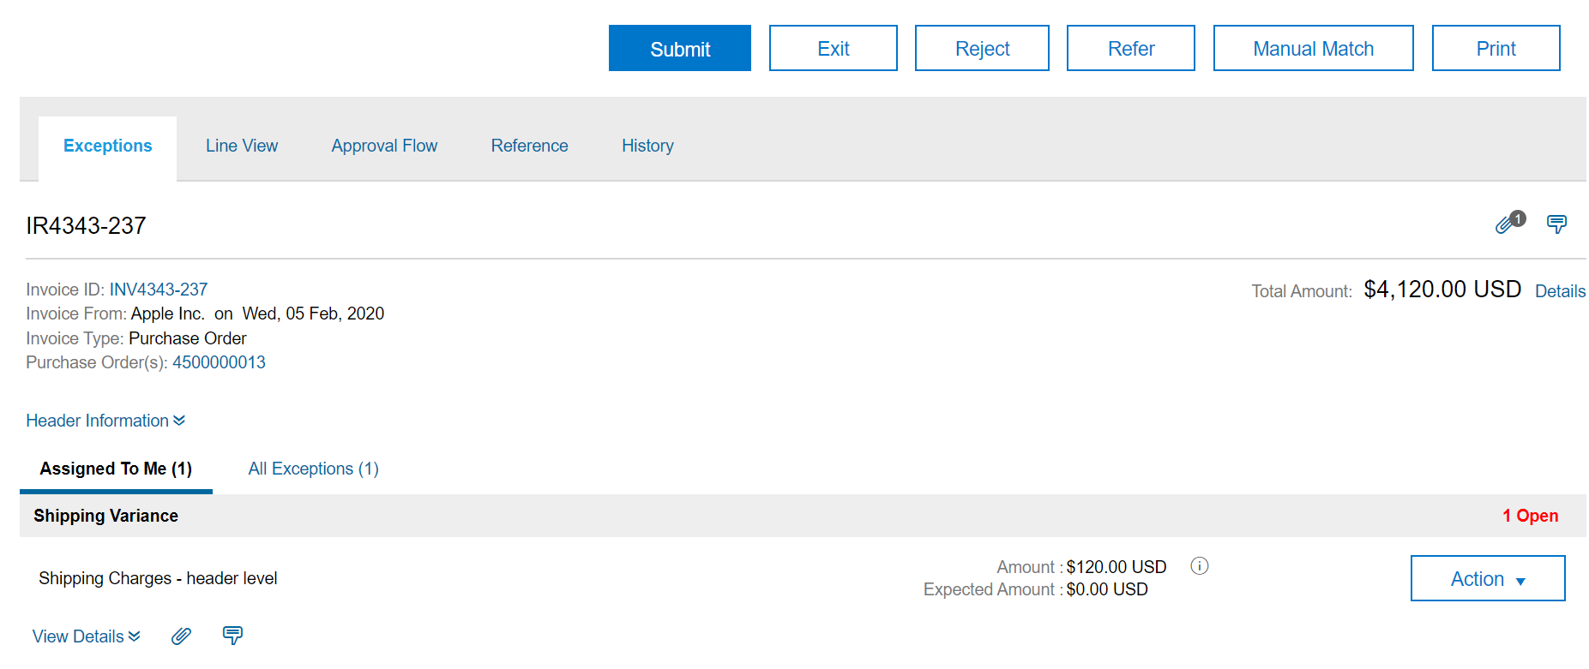
Invoice Exceptions
Handle Invoice Exceptions
In this example, we will look at the steps to handle a Shipping Variance.
5
Click the Exceptions tab to view the exceptions raised for the particular invoice.
5
6
Click the Assigned To Me tab to view the exceptions assigned to you for this invoice.
6

Slide 47
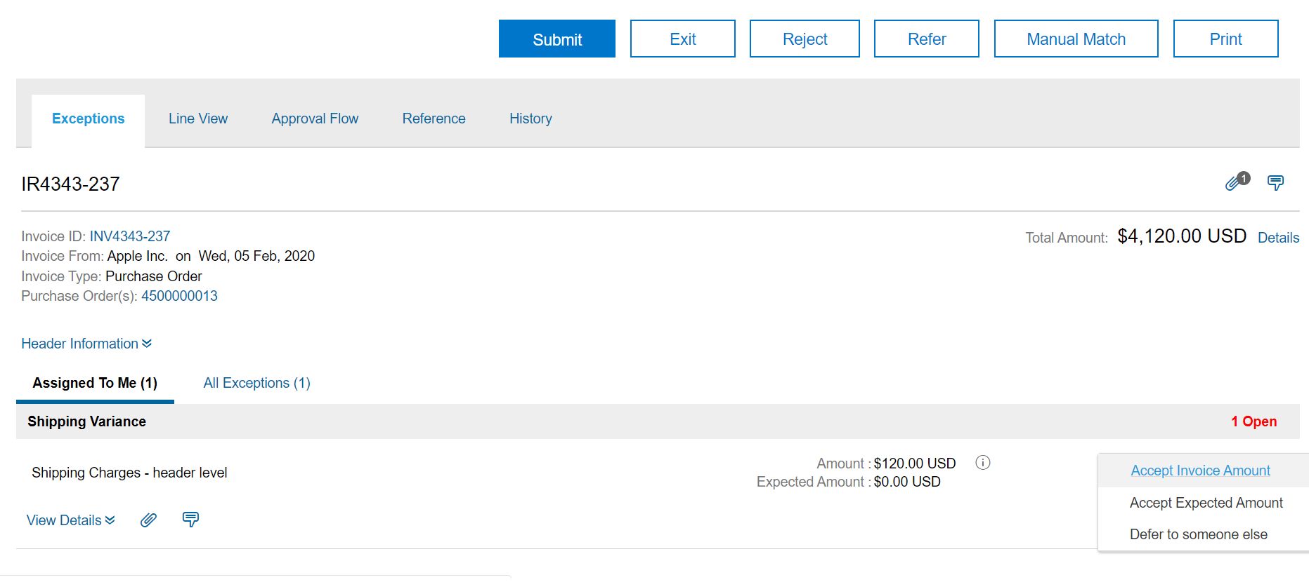
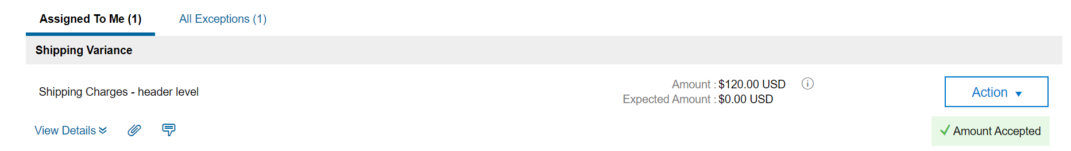
Invoice Exceptions
Handle Invoice Exceptions
Accept Invoice Amount
7
Click the Action drop-down button next to the exception. Select the required option from the drop-down menu.
7
8
You will receive a confirmation from the system after you handle the exception.
8
Note: Select Accept Invoice Amount if you want to choose the invoice amount or select Accept Expected Amount if you want to choose the PO amount.

Slide 48
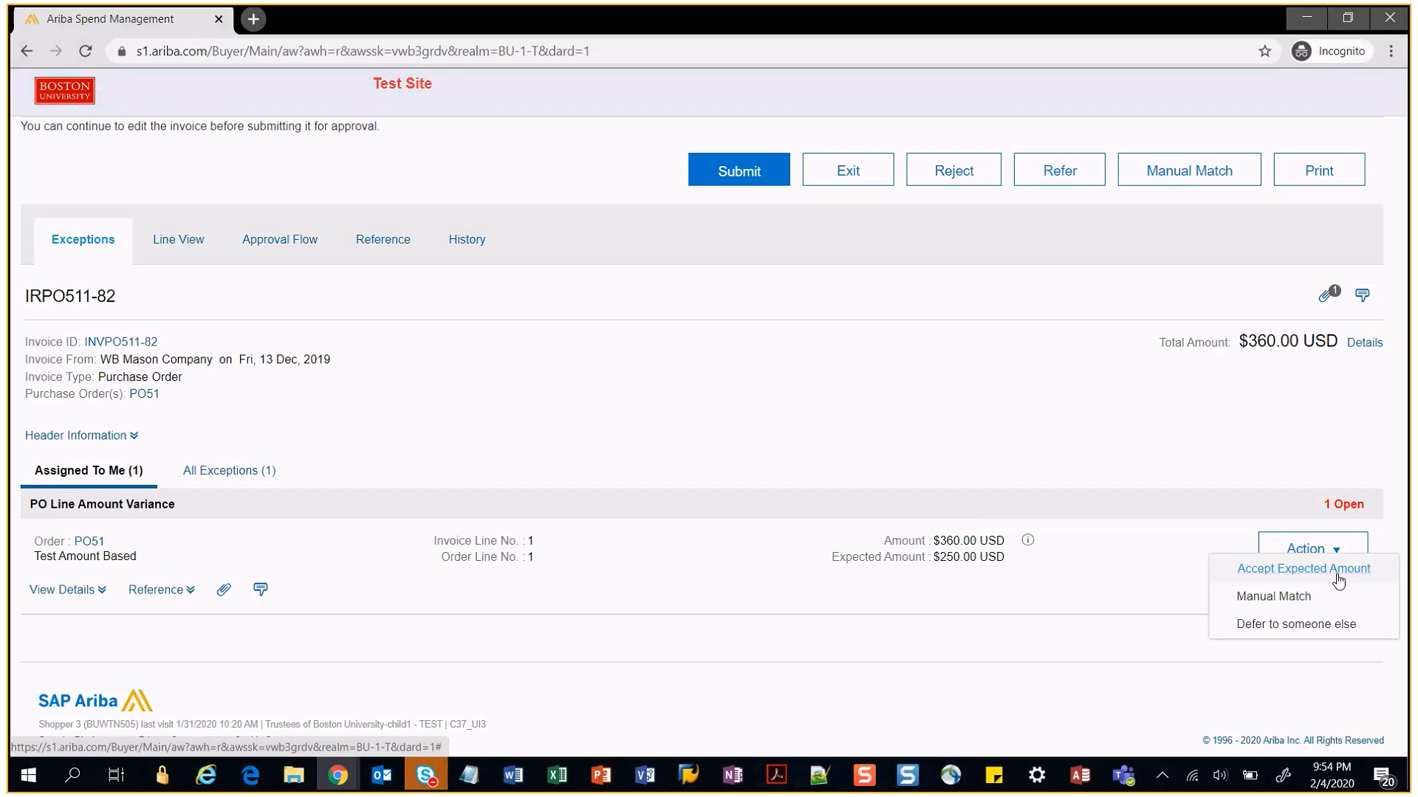
Invoice Exceptions
Handle Invoice Exceptions - Change Purchase Order (PO) details
For any amount or quantity variance between PO and Invoice, you need to update the PO details. You can also reject the invoice back to supplier.
1
If you want to accept the invoice amount, then you have to login to GB and update the PO details to match those in the invoice. Clicking on Action button doesn’t allow you to accept the Invoice amount.
2
1
2
If you don’t want to approve the expected amount, then you can reject the invoice by clicking Reject button.

Slide 49
Invoice Exceptions Confirmation Notification
A confirmation email is received once exception has been cleared stating the modifications to the invoice.
1
The invoice reconciliation status can be seen in the notification.
1
2
The details of the exception are available at the bottom of the email.
2

Slide 50
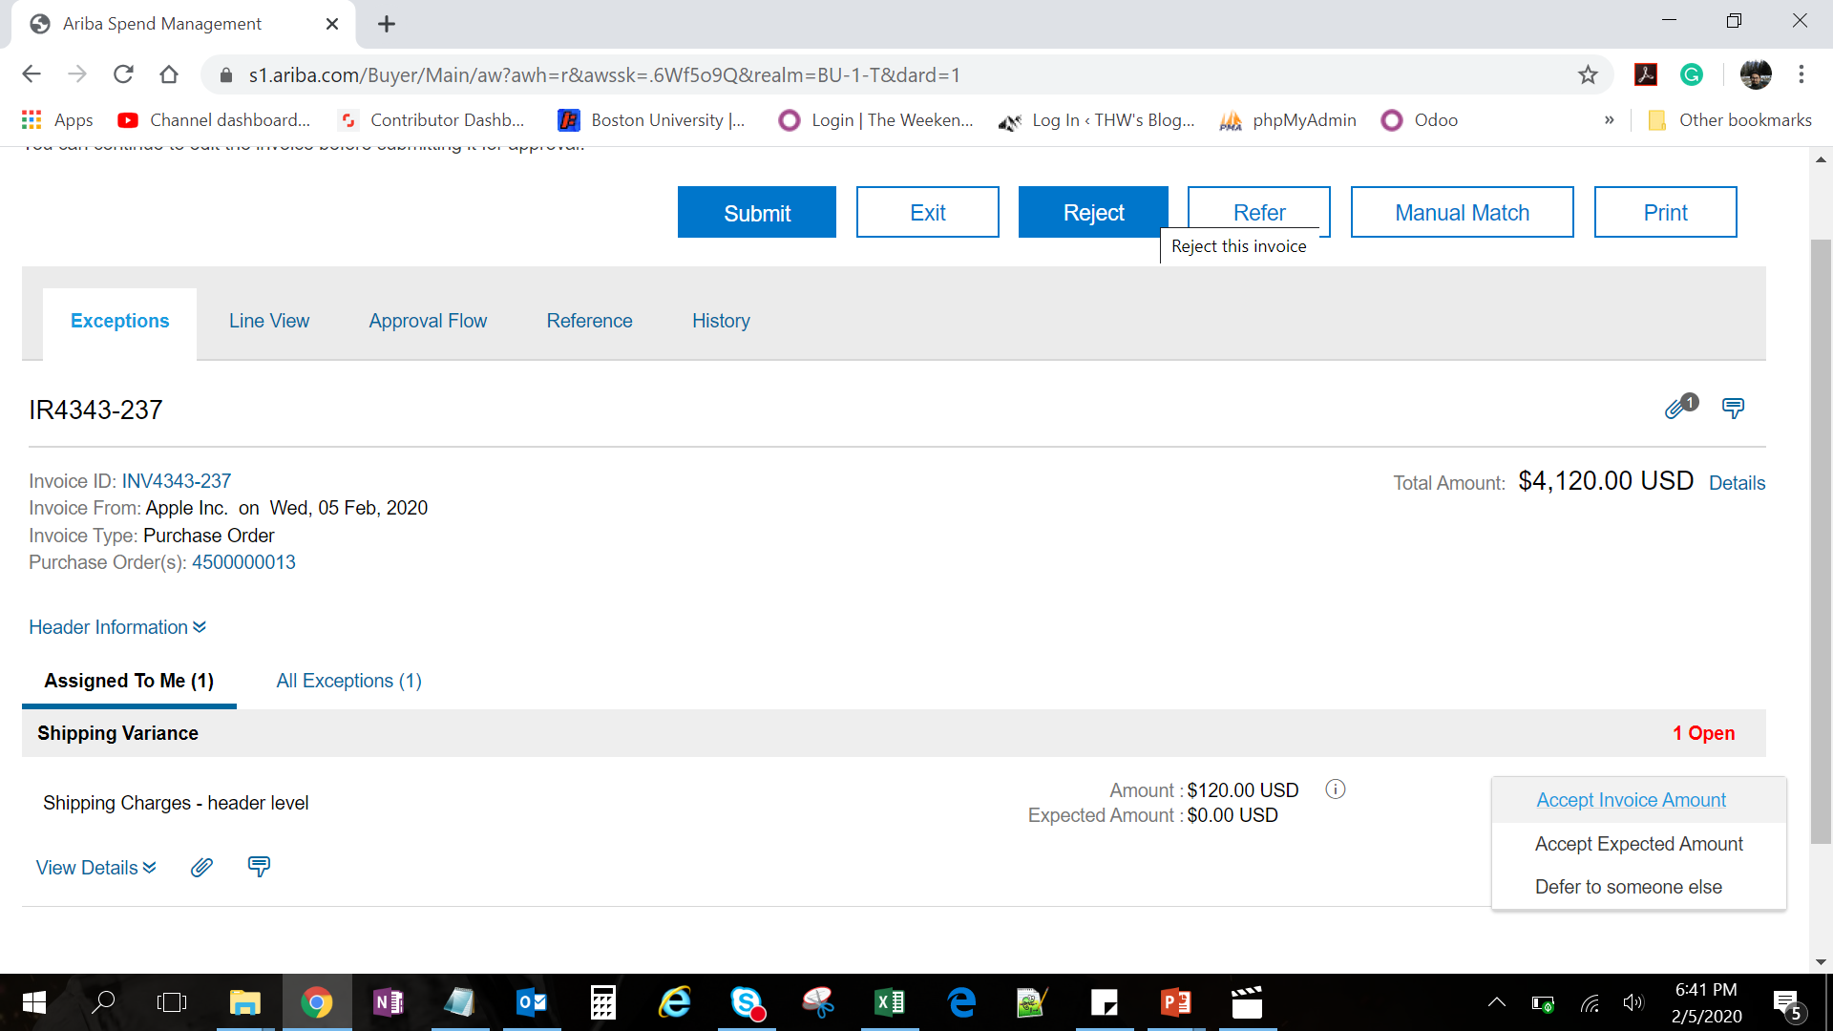
Invoice Exceptions
Handle Invoice Exceptions (Reject – 1 of 2)
You can also reject the invoice if amount is higher than allowed tolerance or the invoice contains incorrect information and requires resubmission from the supplier.
1
Click on the Reject button at the top.
1

Slide 51
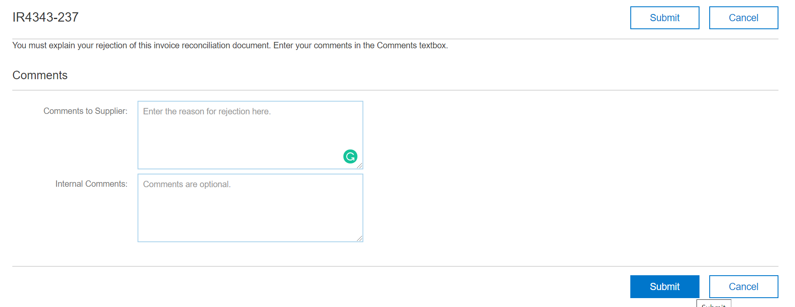
Invoice Exceptions
Handle Invoice Exceptions (Reject – 2 of 2)
There are two comments sections that allow you to send a message to the supplier regarding the invoice rejection. You also can create a separate message for internal recipients only.
2
Enter reason for rejection.
2
3
Click Submit.
3

Slide 52
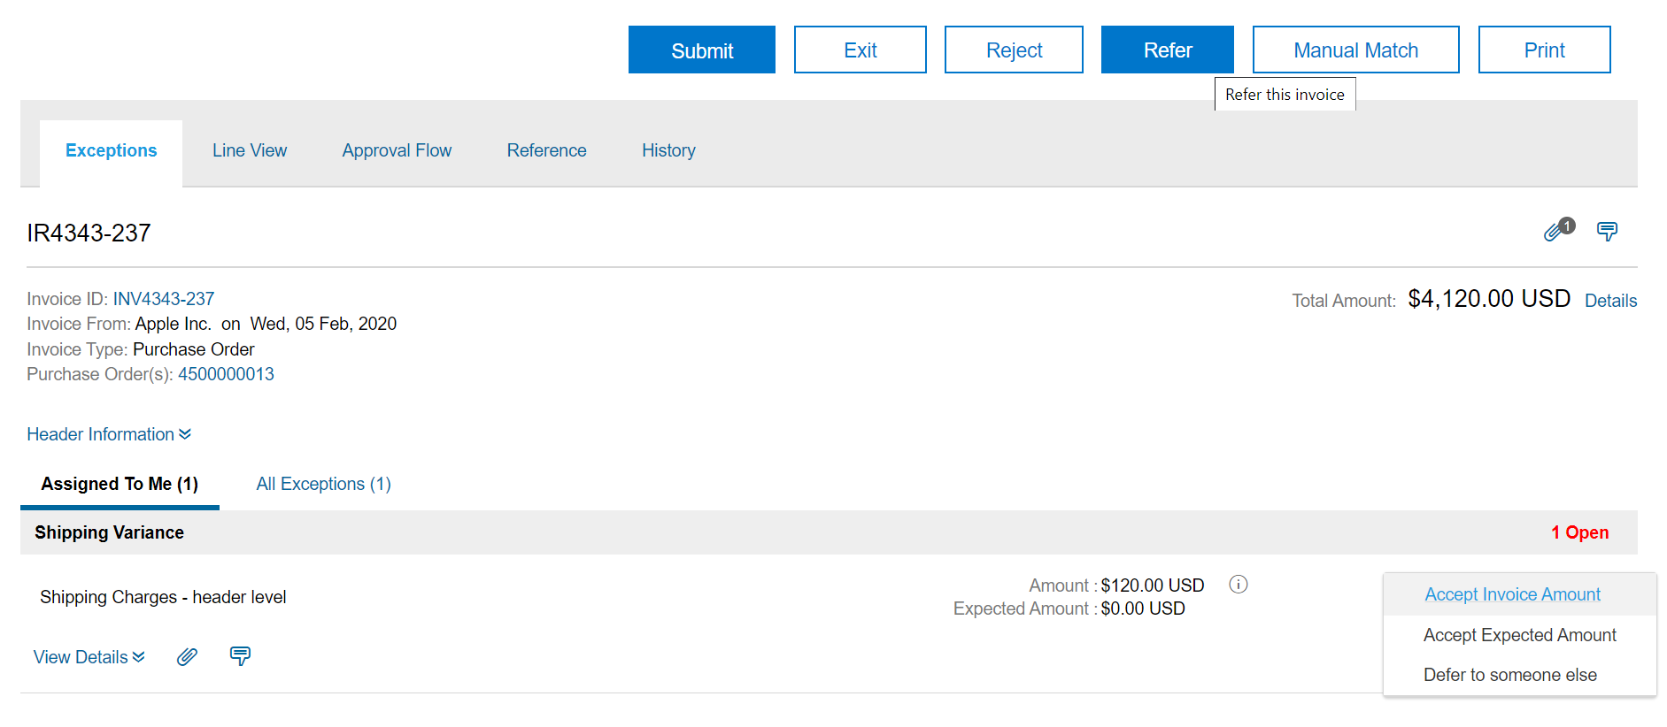
Invoice Exceptions
Handle Invoice Exceptions (Defer to Someone – 1 of 3)
You can also defer the invoice to someone by following the steps below:
1
Click the Action drop-down button next to the exception. Select the Defer to someone else option from the drop-down menu.
Alternatively, you can click on the Refer button at the top.
1
Note: Ariba uses both terms, Refer and Defer. Clicking on any of the button results in the same action. To avoid ambiguity, Defer has been used in this guide.

Slide 53
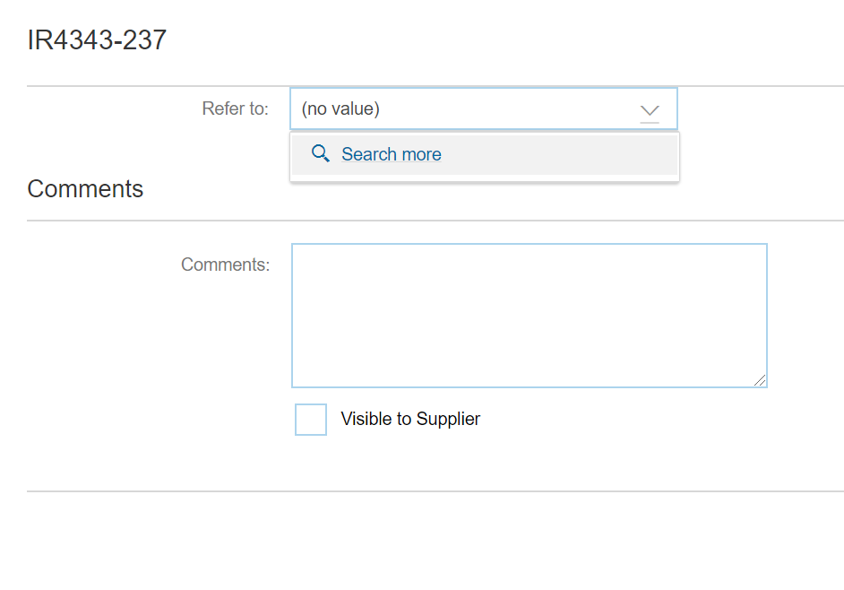
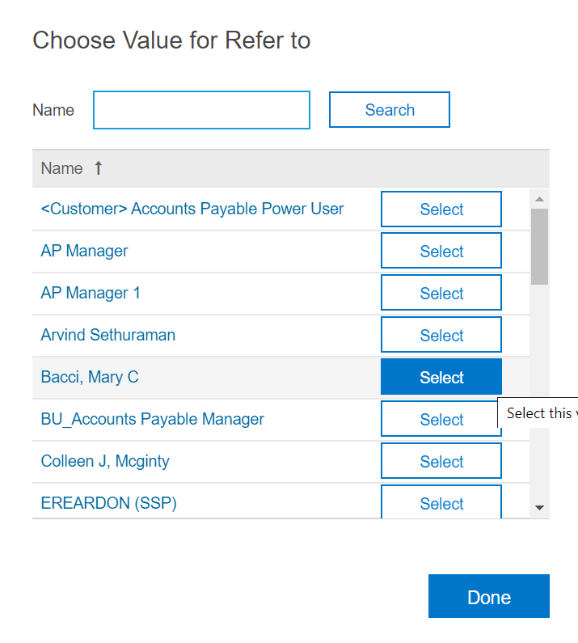
Invoice Exceptions
Handle Invoice Exceptions (Defer to Someone – 2 of 3)
Select the person to defer to by clicking on the drop down arrow and select the individual to defer the invoice.
2
Click Search more. A new window opens.
2
3
3
Enter the name of the person/role you want to refer to and click Search.
4
From the available results, click on Select button against the name of person/role you want to refer to.
4

Slide 54
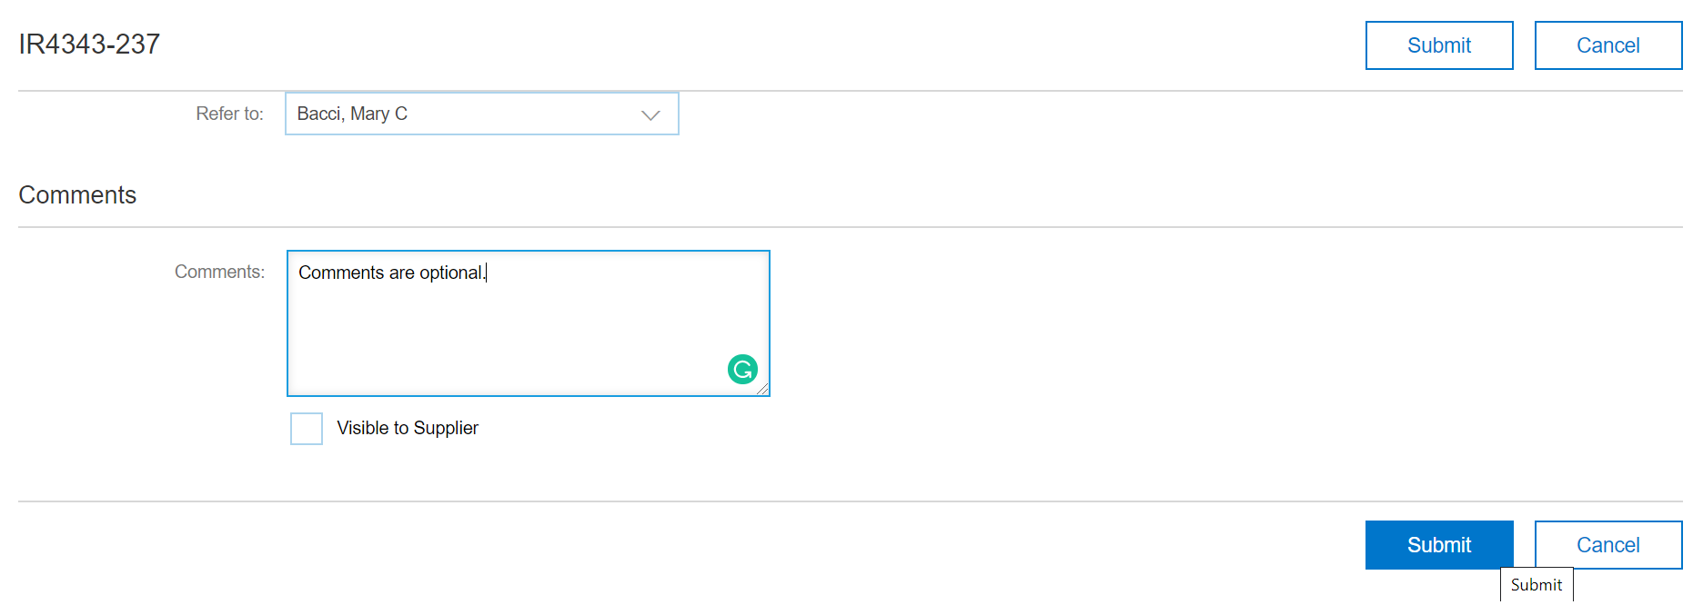
Invoice Exceptions
Handle Invoice Exceptions (Defer to Someone – 3 of 3)
You can enter a detail comment to the person that will receive the invoice to handle the invoice exception.
5
Click Submit.
5

Slide 55
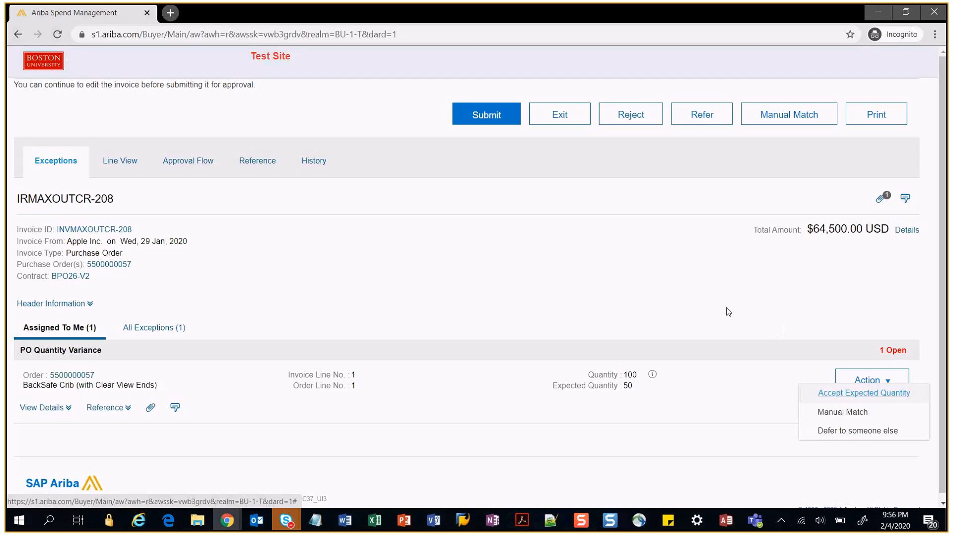
Invoice Exceptions
Handle Invoice Exceptions (Manual Match – 1 of 6)
Supplier submits Invoice against some other PO.
In such a case, you need to Manually match the correct PO number against the invoice by following the below procedure:
1
Click the Action drop-down button next to the exception.
2
Select the Manual Match option from the drop-down menu.
1
2

Slide 56
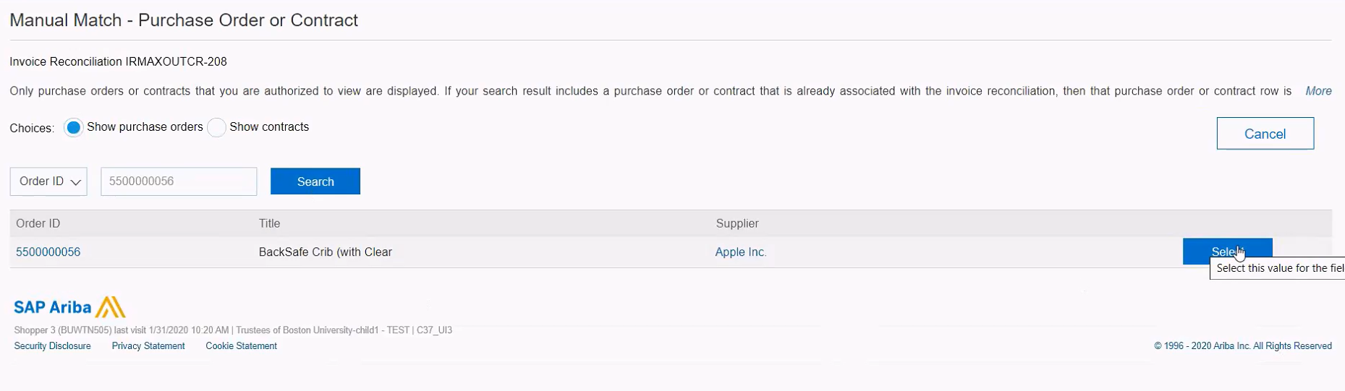
Invoice Exceptions
Handle Invoice Exceptions (Manual Match – 2 of 6)
Select Line Items
You can manually match the invoice line item with the PO line item.
3
Click the radio button next to Show PO.
3
4
Enter the correct PO number and click search
4
5
Click Select.
5

Slide 57

Invoice Exceptions
Handle Invoice Exceptions (Manual Match – 3 of 6)
Submit Invoice
After you handle the exception for the invoice, you can submit it as displayed:
7
6
The exception status has updated to cleared.
7
Click the Submit button.
6

Slide 58

Invoice Exceptions
Handle Invoice Exceptions (Manual Match – 4 of 6) – Unmatched Item Exception
In case a Supplier submits Invoice with an additional item which is not present/available on the original PO (e.g. service charge, freight charge)
In such a case, an Unmatched Item Exception will be raised on the Invoice and will be sent to the Shopper
If you want to accept the additional item on the Invoice, you need to change the PO and add the exact same line item to the PO.
After adding the item to the PO, manually match the invoice item with the correct PO item number by following the below procedure:
1
Click the Action drop-down button next to the exception.
2
Select the Manual Match option from the drop-down menu.
1
2

Slide 59


Invoice Exceptions
Handle Invoice Exceptions (Manual Match – 5 of 6) – Unmatched Item Exception
Select Line Items
You can manually match the invoice line item with the PO line item.
3
Select the check box against the Invoice item that is not matched.
3
4
Select the newly added item on the PO that now matches the invoice item
4
5
5
Click Match.
6
Success message will be shown after the match is complete
6
7
7
Click on Save and Exit button.

Slide 60

Invoice Exceptions
Handle Invoice Exceptions (Manual Match – 6 of 6) – Unmatched Item Exception
Submit Invoice
After you handle the exception for the invoice, you can submit it as displayed:
9
8
The exception status has updated to cleared.
9
Click the Submit button.
8

Slide 61
Managing Notification Preferences

Slide 62
Managing Notification Preferences
Introduction to Ariba Supplier Lifecycle & Performance
Upon completion of this lesson, you will be able to:
  Manage which notifications show up in email
  Manage the event types which trigger email notification

Slide 63


Managing Notification Preferences
1
1
Login to the B&I dashboard and click on user profile (AP Clerk in this illustration) on top right corner.
2
2
Click on Change email notification preferences
3
Email notification preferences window will open.
3

Slide 64

Managing Notification Preferences
4
Click on the drop down against Edit preferences for.
4
5
Select Invoice Reconciliation from the options available in the drop down list, (or any other option for which you want to change email notification preferences).
5

Slide 65


Managing Notification Preferences
6
Under Notification method, select the required option (individual or consolidated).
6
7
Under Notification frequency, select the required option from the drop down list.
7

Slide 66


Managing Notification Preferences
8
Click Save.
9
Click Yes to confirm the changes.
8
9

Slide 67
Training Sessions & Guides
Training Sessions
Training sessions will be held on a monthly basis. Stay up-to-date on training information by subscribing to the Sourcing & Procurement Newsletter.
Guides & FAQs
How to Place Orders
  Step-by-Step Guides
  Video Tutorials
FAQs
Invoice Guides and FAQ
Contact Us
Ordering Information: Submit a ticket to Sourcing & Procurement via the Financial Affairs Customer Service Portal.
Invoice & Payment Information: Submit a ticket to Accounts Payable via the Financial Affairs Customer Service Portal.
67

Slide 68
Guided BUying Requisitioner Invoice Approval and Exception Training
Invoice-to-Pay Training Session
Questions?

