Slide 1
Guided BUying QRG
Quick Reference Guide
Invoice Exception Defer Process

Slide 2
Invoice Exception Defer Process

Slide 3
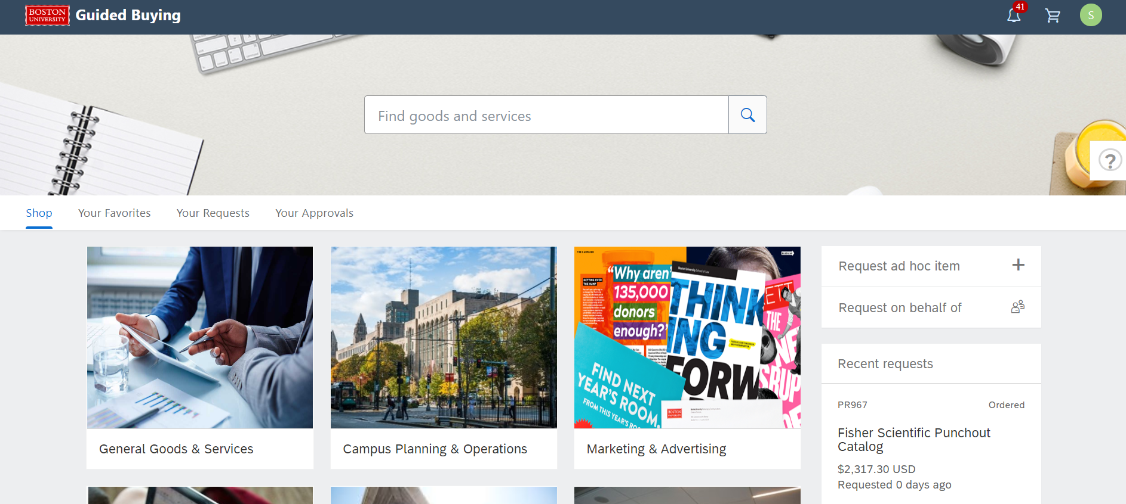
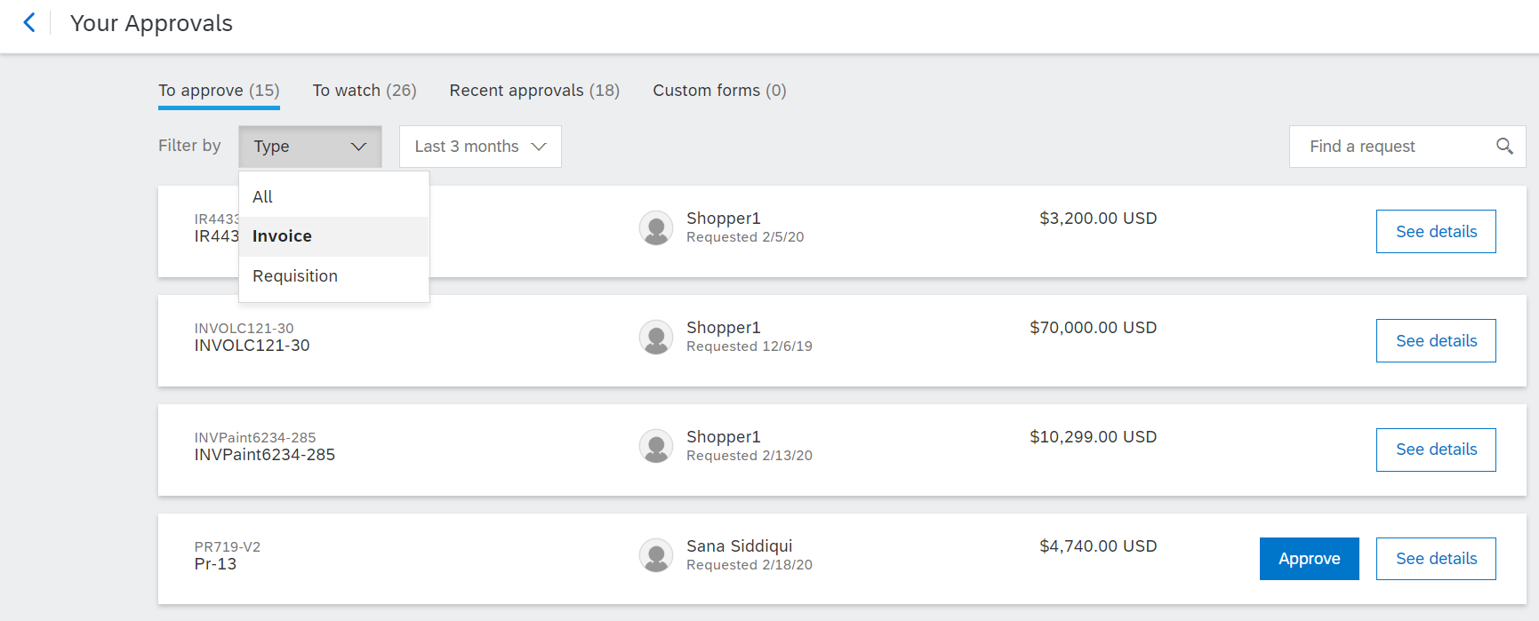
Invoice Exception Navigation
To view an invoice exception, navigate to the Invoice Reconciliation Document (IR) within Guide Buying.
1
1
Click on Your Approvals
2
Make sure that To Approve tab is highlighted.
3
From the Filter by drop down, click Invoice.
2
Click the See details button next to the (IR) invoice reconciliation for which you need to handle exceptions.
4
4
3

Slide 4
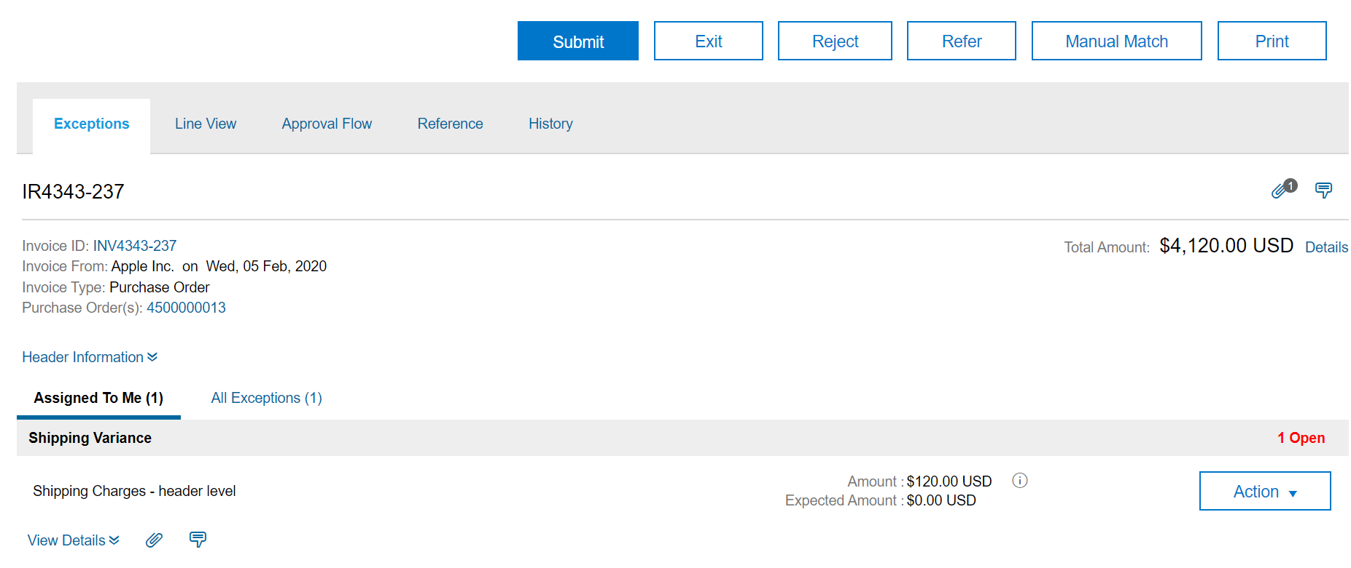
Invoice Exceptions
Handle Invoice Exceptions
In this example, we will look at the steps to defer a Shipping Variance.
5
Click the Exceptions tab to view the exceptions raised for the particular invoice.
5
6
Click the Assigned To Me tab to view the exceptions assigned to you for this invoice.
6

Slide 5
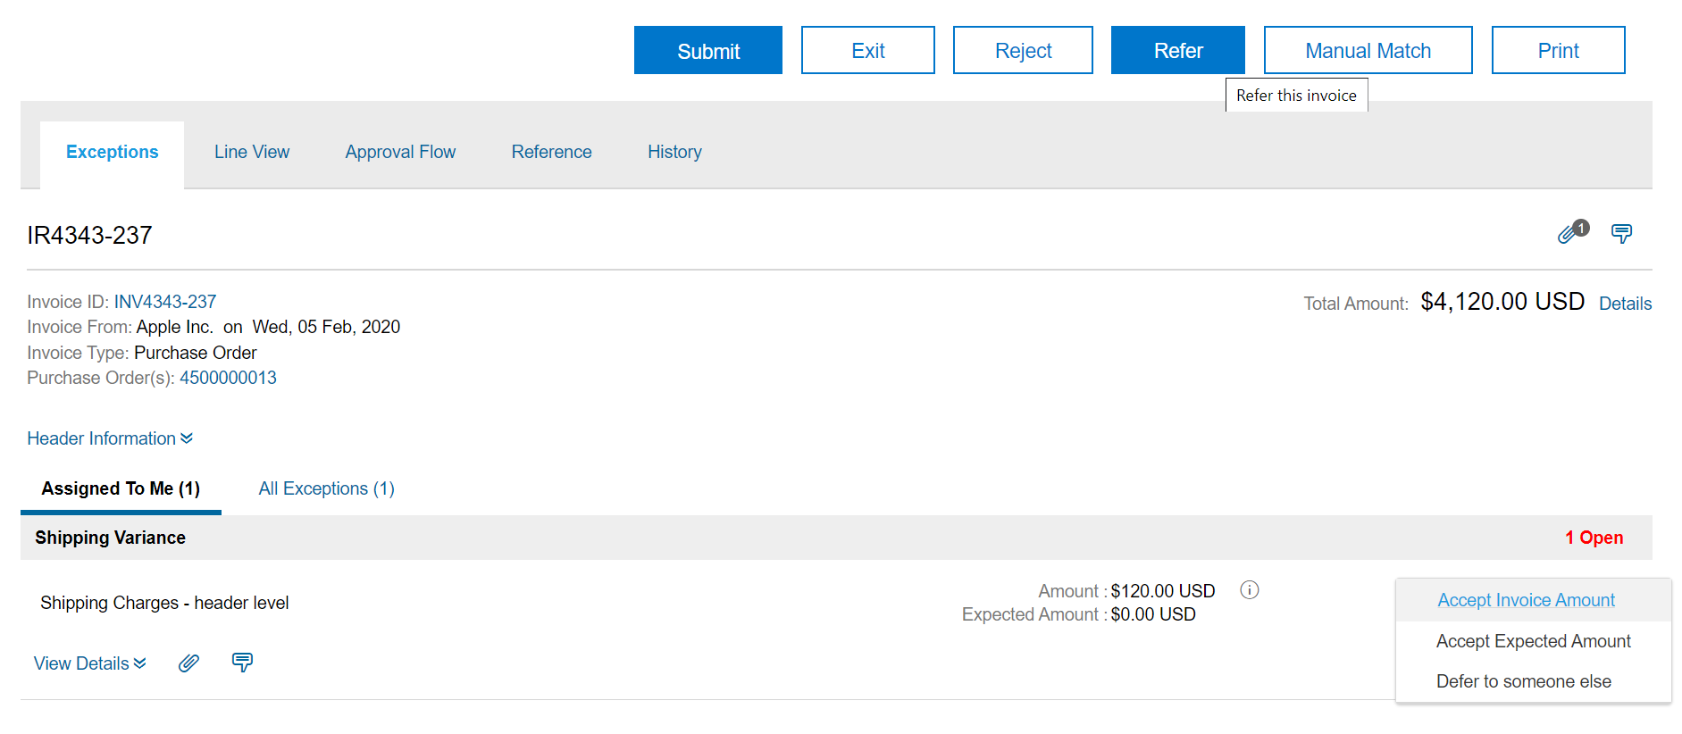
Invoice Exceptions
Handle Invoice Exceptions (Defer to Someone – 1 of 3)
Defer the invoice to someone by following the steps below:
7
Click the Action drop-down button next to the exception. Select the Defer to someone else option from the drop-down menu.
Alternatively, you can click on the Refer button at the top.
7
Note: Ariba uses both terms, Refer and Defer. Clicking on any of the button results in the same action. To avoid ambiguity, Defer has been used in this guide.

Slide 6
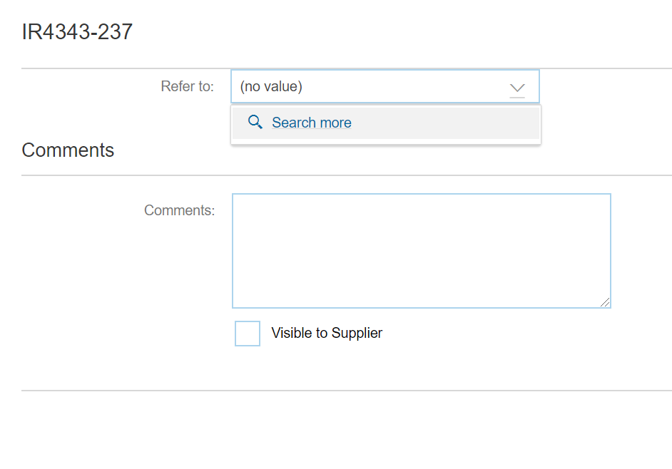
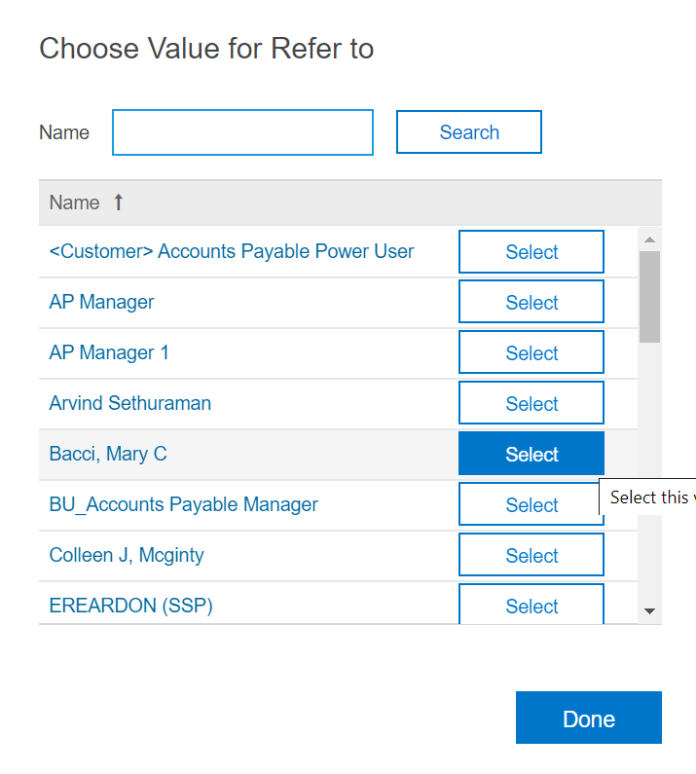
Invoice Exceptions
Handle Invoice Exceptions (Defer to Someone – 2 of 3)
Select the person to defer to by clicking on the drop down arrow and select the individual to defer the invoice.
8
Click Search more. A new window opens.
8
9
9
Enter the name of the person/role you want to refer to and click Search.
10
From the available results, click on Select button against the name of person/role you want to refer to.
10

Slide 7
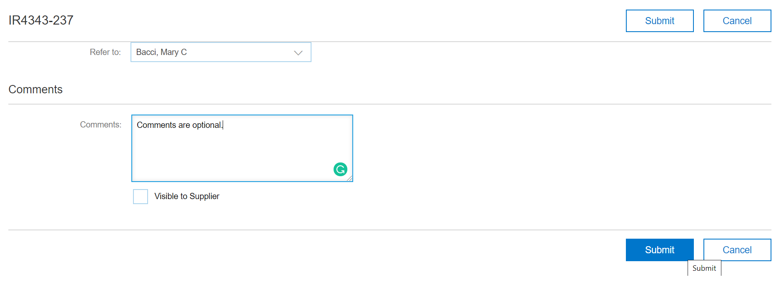
Invoice Exceptions
Handle Invoice Exceptions (Defer to Someone – 3 of 3)
You can enter a detail comment to the person that will receive the invoice to handle the invoice exception.
11
Click Submit.
11

Slide 8
Additional Resources: Guides, FAQ, and Assistance
Guides & FAQs
How to Place Orders
FAQs
Invoice Guides and FAQ
Contact Us
Ordering Information: Submit a ticket to Sourcing & Procurement via the Financial Affairs Customer Service Portal.
Invoice & Payment Information: Submit a ticket to Accounts Payable via the Financial Affairs Customer Service Portal.
8

