Slide 1

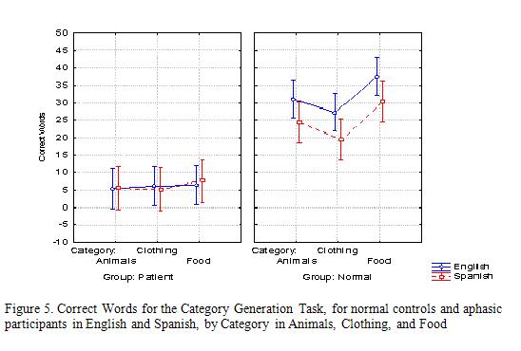
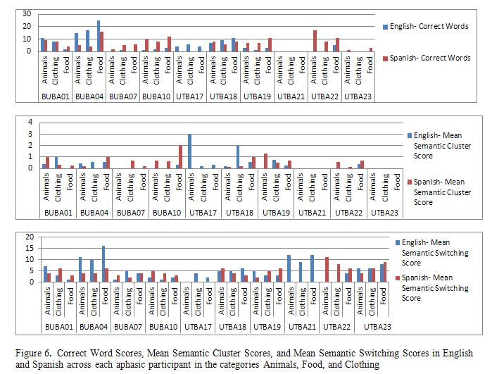
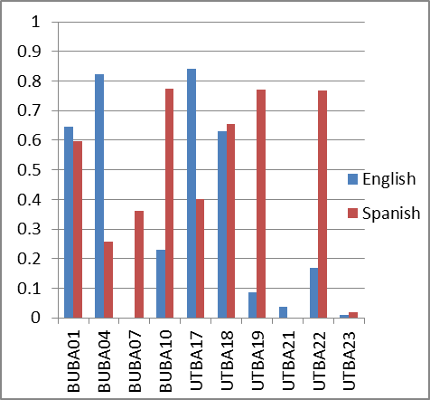
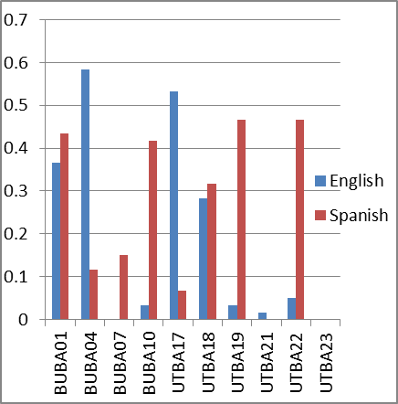
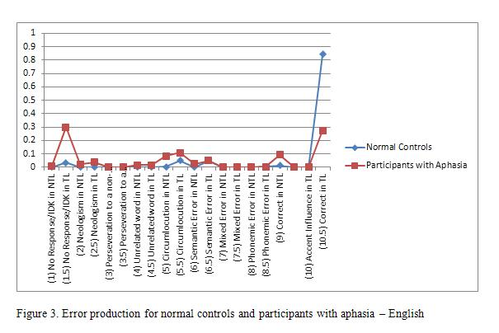
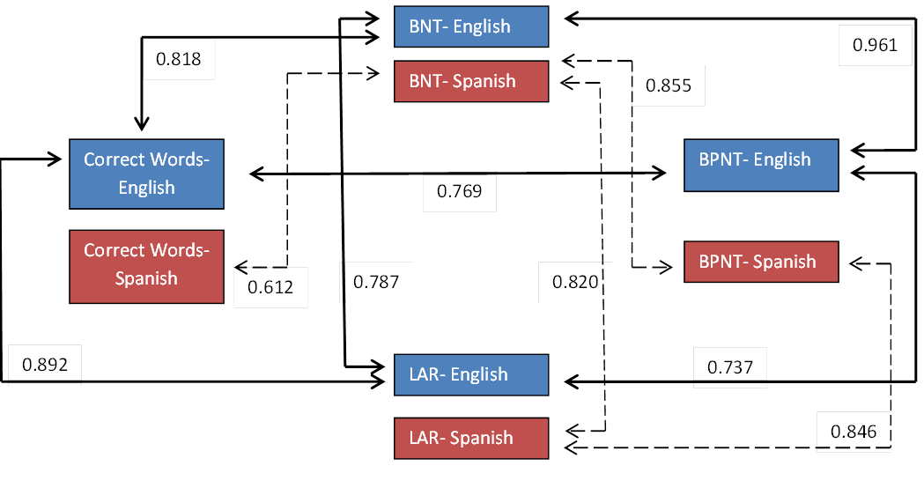
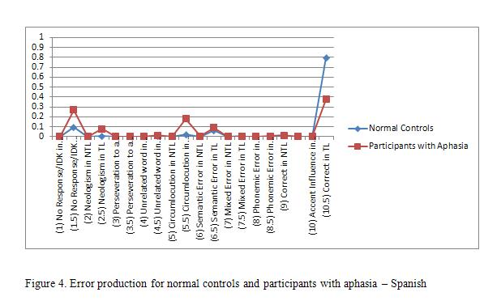
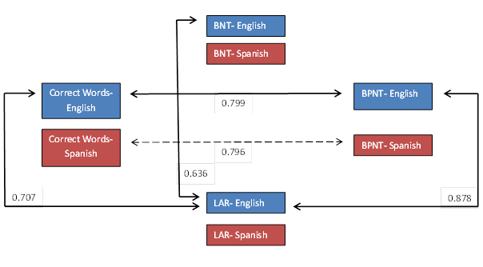
The Nature of Lexical-Semantic Access in Bilingual Aphasia
Swathi Kiran, Isabel Balachandran, and Jason Lucas
Department of Speech and Hearing Sciences, Boston University
Background Information
Results: BNT & BNPT
Results: Category Generation
Discussion
The nature of lexical semantic access has not been systematically examined in individuals with bilingual aphasia. Most studies thus far have been case study or small sample analyses of picture naming or description in individuals with Spanish-English bilingual aphasia (Roberts & DesLauriers, 1999; Munoz & Marquardt, 2003).
Aims: Three goals of the study
To examine the nature of lexical-semantic access in individuals with bilingual aphasia and their normal controls.
To examine the nature of differential language proficiency and its influence on three lexical retrieval tasks.
To examine the effect of post-stroke impairment above and beyond the influence on pre-stroke proficiency on lexical retrieval in individuals with bilingual aphasia.
CONTROLS:
For the BNT, there was a significant effect of language even after controlling for LAR (F (1,21) = 16.68, p < 0.001). Post hoc tests indicated that naming accuracy on the BNT was higher in English than Spanish (p < 0.005). For the BPNT, there was also a significant effect of language after controlling for LAR (F (1,21) = 8.87, p < 0.05).
Differences in performance between languages
For normal controls, naming on the BNT, BNPT and both correct words and mean semantic cluster scores on the category generation task differed between the languages even after controlling for the language proficiency. Overall, the data revealed that the normal controls were more proficient in English than Spanish and this difference drove their results on the tasks.
In contrast, for aphasic participants, there was no significant effect across languages or within the language across the three tasks.
PATIENTS:
For patients, the group analysis was not significant for either the BNT or BPNT when language ability was taken into account.
Individual patient analysis
Individual patient analysis
Differences in performance between participant groups
Normal controls were significantly better at naming on the BNT and BNPT than patients with aphasia.
The number of correct words, and mean semantic cluster was also significantly higher for controls than patients.
Participants
BNPT
BNT
Twelve Spanish-English bilingual non-brain damaged individuals between the ages of 18 and 70 (mean age = 34.92 years, SD = 18.89).
Ten Spanish/English bilingual speakers with aphasia participated in the study (mean age = 59 years, SD = 18.3).
All participants with aphasia experienced a single, unilateral cerebral vascular event (CVA, or stroke)
Participants with apraxia were excluded from the study because the motor complexity can impact oral naming; which was the main task in the study.
Error and Clustering Strategies
At first glance this difference between the groups may suggest that aphasic participants and normal controls perform radically differently on the lexical access tasks.
However, analysis of errors show that both groups produce similar errors in both languages, with the difference being the rate of each error type between the groups.
Analysis of errors
Individual Patient Performance
Participants BUBA04 and UTBA17 produced more correct responses in English than Spanish across the three tasks.
However, participants BUBA07, BUBA10, UTBA19, UTBA22, and UTBA23 produced more correct responses in Spanish than English in all three tasks.
Two patients, BUBA01 and UTBA18 received scores that were remarkably similar in both languages, while participant UTBA21 produced either no correct responses or performed with very low accuracy in both languages, for all tasks.
In the CG task, the broad variety of responses and scores were independent of category, however it was clear that the categories Animals and Food were easier to access than Clothing for the patients
Assessment of language proficiency levels:
All participants received extensive background language assessments and a comprehensive LUQ (Kiran, Pena, Bedore, & Sheng, 2010). This questionnaire obtained information about the period of age of language acquisition (AoA).
Participants were required to self-rate their proficiency (pre-stroke for participants with aphasia) in each language in terms of their ability to speak and understand the language in formal and informal situations and read and write in each language.
The measures scored were Language Ability Rating (LAR), Educational History, Family Proficiency, Confidence, Lifetime Exposure, and Current Exposure.
English targets
Results: Correlation across tasks
Error production of BPNT for normal controls and participants with aphasia – English
Error response types were similar in the BPNT for both normal controls and aphasic participants for English targets. The greatest errors made being No response/ IDK in TL (1.5), Circumlocution in TL (5.5), Correct response in NTL (9), and Correct response in TL (10.5).
Materials and Methods
References
Picture Naming Scoring: For both naming tests, Boston Naming Test (BNT) and Bilingual Picture Naming Test (BNPT), all participants were shown the target stimuli and given up to thirty seconds to generate a response.
Responses were counted as correct if they matched the target response. All other responses were coded on a 20-point error scale.
Correlations for controls
Costa, A., La Heij, W., & Navarrete, E. (2006). The dynamics of bilingual lexical access. Bilingualism: Learning and Cognition, 9(2), 137-151.
Kiran, S., Pena, E., Bedore, L., & Sheng, L. (2010). Evaluating the relationship between category generation and language use and proficiency. Paper presented at the Donostia Workshop on Neurobilingualism, San Sebastian Spain.
Muñoz, M., & Marquardt, T. (2003). Picture naming and identification in bilingual speakers of Spanish and English with and without aphasia. Aphasiology, 17(12), 1115-1132.
Roberts, P.M., & Deslauriers, L. (1999). Picture naming of cognate and non-cognate nouns in bilingual aphasia. Journal of Communication Disorders, 32(1), 1-23.
Troyer, A.K., Moscovitch, M., & Winocur, G. (1997). Clustering and switching as two components of verbal fluency: Evidence from younger and older healthy adults. Neuropsychology, 11(1), 138-146.
Spanish targets
Participant | BAT Comp % |  | BAT Sem % |  | BNT % |  | Bilingual Picture Naming Task %
 | English | Spanish | English | Spanish | English | Spanish | English | Spanish
BA01 | 70.00 | 80.00 | 53.33 | 55.00 | 58.33 | 11.67 | 64.45 | 59.75
BA04 | 70.00 | 61.67 | 60.00 | 48.33 | 0.00 | 15.00 | 82.40 | 25.90
BA07 | 6.67 | 66.67 | 23.33 | 38.33 | 3.33 | 41.67 | 0.00 | 36.10
BA10 | 40.00 | 73.33 | 30.00 | 50.00 | 0.00 | 0.00 | 23.15 | 77.53
BA17 | 81.67 | 93.33 | 51.67 | 58.33 | 51.66 | 8.33 | 84.1 | 40.00
BA18 | 66.67 | 83.33 | 61.67 | 76.67 | 28.33 | 31.67 | 63.20 | 65.50
BA19 | 16.67 | 75.00 |  | 31.67 | 3.33 | 46.67 | 8.6 | 77.00
BA21 | 16.67 | 20.00 |  |  | 1.67 | 0.00 | 3.8 | 0.00
BA22 |  |  |  |  | 5.00 | 46.67 | 16.67 | 76.85
BA23 | 63.33 | 70.00 | 40.00 | 55.00 | 36.67 | 43.37 | 0.95 | 1.90
BC01 | N/A | N/A | N/A | N/A | 73.33 | 53.33 | 88.81 | 69.00
BC02 | N/A | N/A | N/A | N/A | 88.33 | 56.67 | 97.23 | 90.48
BC03 | N/A | N/A | N/A | N/A | 95.00 | 58.33 | 90.74 | 75.93
BC05 | N/A | N/A | N/A | N/A | 80.00 | 76.67 | 93.52 | 88.90
BC06 | N/A | N/A | N/A | N/A | 83.33 | 61.67 | 95.37 | 80.40
BC07 | N/A | N/A | N/A | N/A | 76.67 | 81.67 | 83.33 | 87.96
BC08 | N/A | N/A | N/A | N/A | 70.00 | 65.00 | 80.96 | 83.74
BC09 | N/A | N/A | N/A | N/A | 86.67 | 60.00 | 94.44 | 84.26
BC10 | N/A | N/A | N/A | N/A | 13.33 | 63.33 | 26.85 | 91.67
BC11 | N/A | N/A | N/A | N/A | 90.00 | 26.67 | 99.06 | 49.08
BC12 | N/A | N/A | N/A | N/A | 83.33 | 85.00 | 94.45 | 92.60
BC14 | N/A | N/A | N/A | N/A | 60.00 | 53.33 | 81.47 | 74.77
Category Generation (CG) Scoring: For the CG task, the responses of all participants were transcribed and tabulated separately for each category and each language.
Four measures were obtained from this data; (a) the total number words produced, (b) total correct words produced, (c) mean semantic cluster size, and (d) mean semantic switching in each subcategory for each language, Spanish and English (Troyer et al., 1997; Troyer et al., 2000).
Acknowledgments
Error production of BPNT for normal controls and participants with aphasia – Spanish
Error response types were similar in the BPNT for both normal controls and aphasic participants for Spanish targets. The greatest errors made being No response/ IDK in TL (1.5), Circumlocution in TL (5.5), Correct response in NTL (9), and Correct response in TL (10.5).
Correlations for Patients
A portion of this was supported by NIDCD # R21DC009446 and a Clinical Research Grant from American Speech Language Hearing Foundation to the first author.

