Slide 1
Boston University Financial Affairs Training Series
After-the-Fact Review Guidelines
Presented by:
Matt Abrams, Associate Comptroller, Accounts Payable & Payroll
Gretchen Hartigan, Assistant Vice President, Post Award Financial Operations
Jennifer Rogers, Training Manager, Post Award Financial Operations
Shelly Stewardson, Director, Research Accounting, Post Award Financial Operations
Notes:
Gretchen

Slide 2
Agenda
Introductions
Take Aways
After-the-Fact Review Policy Guidelines
What to check during a review
Helpful Tools
Report Templates
Notes:
Gretchen
Introductions: Myself, Matt, Jen, Shelly
Housekeeping:
Sign up sheet going around, please make sure you sign it
We’ll email a feedback survey around after the session which will only take a few minutes and we would value your responses
Background:
Comptroller Led – Derived because our Comptroller said if she’s not looking at her accounts then was concerned that others weren’t... This is something I do as well for my accounts.... Not monthly but regularly... quarterly
Focus group consisted of 27 people from across the University covering both Med and CRC and central and department administrators.
Also includes input from our colleagues from: Budget Office, Disbursements, General Accounting, Student Accounts, and PAFO

Slide 3

Warm Up Activity
Name
Title
Years at BU
Notes:
Jen

Slide 4
Things to take away from the training
Reviewing accounts is very important
Templates and guidelines are available
  The guidelines are not meant to replace existing additional requirements set by each School, College, and Department
  The templates are not mandatory. If you have a process that works well and meets the basic principles that we discuss, continue to use it
Retain evidence of your reviews
  Documentation should you need to change
  Good business practice
Set up a regular review schedule for yourself, and stick to it
Notes:
Gretchen

Slide 5

Why we need After-the-Fact Review
Ensure accuracy and completeness of transactions
Spot unusual or inappropriate transactions
Inform management of variances from total budget, or significant changes in actuals from one year to the next
Check that Sponsored Research account spending aligns with the awarded budget
Check that Gift and Spendable Endowment Accounts are not overspent and are spent in accordance with Donor wishes
Notes:
Shelly
Ensure that transactions posted to the general ledger are accurate, complete, and recorded in the appropriate account.
Identify and resolve questions about unusual or inappropriate transactions.
Inform management of variances from total budget, or significant changes in actuals from one year to the next.
It is important to note that timing should be considered before variances to budget are escalated to management. Specifically, if an unplanned budget increase has been approved, it takes time to route through the system for update.
Ensure that Sponsored Research account spending aligns with the awarded budget. Questions will be raised where actuals to the awarded sponsored program budget is accelerated, lagging, or inconsistent.

Slide 6
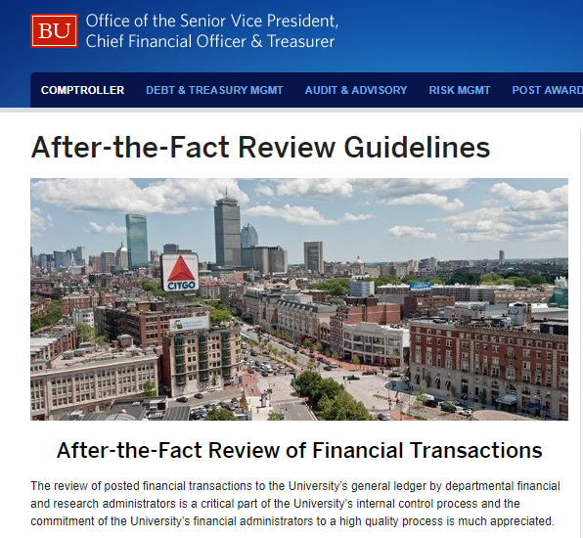
After-the-Fact Review of Financial Transactions Guidelines
Guidelines are posted here:
http://www.bu.edu/cfo/after-the-fact-review/
Notes:
Shelly
Guidelines are posted here...

Slide 7
Terminology and definitions
Financial Transactions
All financial activity is covered within the guidelines.
Commitments
Commitments are amounts we are obligated to spend in the future.
Actuals
Actuals represent activity that has already been paid (expense) or earned (revenue).
Notes:
Shelly
Commitments don’t include fringe, F&A, salary

Slide 8
Terminology and definitions
Unrestricted accounts
Unrestricted accounts in most instances represent the department budget.
Designated accounts
Designated accounts are created when institutional funding is set aside for a purpose that extends over multiple fiscal years.
Restricted accounts
Restricted accounts include: gift accounts, endowment spendable, and sponsored research.
Material
A material transaction is a financial transaction that has a significant impact to a department’s bottom line. (Note: Potentially unallowable costs on sponsored research should be evaluated regardless of the amount.)
Notes:
Shelly
Check understanding here, any questions?
Give examples where helpful.

Slide 9
Guideline Standards

Slide 10

Frequency
An effective review and reconciliation process should generally happen every month, as close to after the end of the month as possible.
Please note that several University jobs that post financial activity run after the calendar month has ended. Consequently, on a typical month it is best to review your accounts after the 6th business day of the month to ensure completeness. The fiscal year end closing schedule differs from the typical month end closing schedule. Refer to the Fiscal Year Closing Memo for key due dates to ensure a smooth, fast, and accurate close.
Notes:
Matt – speaks briefly to payments posting, and approval process

Slide 11

Risk and Materiality
In all departments, more time and attention should be spent on higher risk, higher dollar transactions; and those where the risk of error or compliance issues is greater; and each department has to determine a materiality level for their reviews, and this will vary. (Remember: Potentially unallowable costs on sponsored research should be evaluated regardless of the amount.)
We’ll discuss examples of risk and materiality on the next slides.
Notes:
Matt

Slide 12


High Risk Transactions
What do you look out for?
Notes:
Matt
When you review your accounts, what are the transactions that you look out for? What seems high risk to you?
If you see, For example several shopping carts with multiple small amount transactions for WB Mason all under $499 – this could be someone trying to circumvent the workflow approval process?
What about if you see a terminated employee still being paid?
Incorrect amounts or missing activity.
Unidentifiable charges.
Transactions that were not initiated or approved by your department.
Personal expenses.
Employee has incorrect work-schedule (e.g.: part time faculty used to work in fall semester, but now works in spring semester).
Fraudulent charges.
High volume of low dollar transactions. May indicate that someone is trying to circumvent the workflow and approval process.
Purchase Orders under $5,000
P-card under $1,000
Shopping cart under $500 (For example several shopping carts with multiple small amount transactions for WB Mason all under $499)
Current employee not moved to correct funding source timely.
Former employee not terminated in SAP timely resulting in an overpayment.

Slide 13
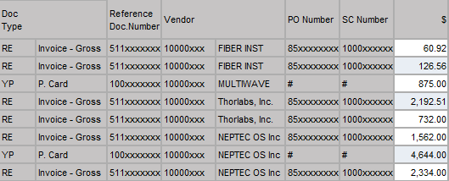
Risk and Materiality
Materiality is also an important consideration; a small dollar transaction may need only a review for reasonableness, whereas an unexpected P.card transaction for a large dollar amount requires more follow-up.
Unrestricted Account Example
Notes:
Matt
In this example, there is a cost for $60.92 that you don’t immediately recognize. It’s such a small amount that it’s not necessarily worth pulling the supporting documentation so you might just want to check for reasonableness, let’s say you see that it was used to purchase lab supplies and so that’s ok.
You also see a larger amount, $4,644. This is enough money that you want to make sure it was charged accurately and that it belongs on this account, so you pull the documentation to check.

Slide 14

Formalizing the Process
The review process itself should be documented in writing. This can be either in paper or electronic form.
Name
Date
Reconciled By | Date
Jane Doe | 01/06/2019
Notes:
Matt
We’ll go over available templates and the tracker shortly. But the important thing to note here is that even if you don’t print any other records or reports, you need to record that you did the review.

Slide 15
Spending Restricted Dollars
How to Manage Purpose Restrictions
For details on the restriction on a gift or endowment, contact General Accounting and Financial Reporting.
When purpose restrictions are difficult to meet:
Contact General Accounting and Financial Reporting – we may be able to help.
There may be flexibility in the original gift agreement.
A preference is not a restriction.
Sometimes related costs may be charged (depending on the gift agreement).
For restrictions that are impossible to meet, modifications to the restriction can sometimes be sought in court or may be available as a matter of law with respect to older, smaller funds (under a legal doctrine, “Cy Pres”, for “as close as possible”) – contact Financial Affairs to explore.
Generally, restricted dollars should be spent first (as long as the spending meets the donor’s restriction):
  Is responsive to the wishes of the donor;
  Preserves greatest flexibility for the Department, the School, and the University; and
  Has a positive impact on the University’s operating results (restricted funds not spent must be taken out of operations).
  Sometimes funds are small, and meaningful expenditures can’t be made until several years’ earnings have been accumulated.
Notes:
Donna

Slide 16


The Campaign for Boston University
Restricted Accounts: Gifts vs Grants
Gift - Typically from an individual, foundation, or corporation. Not from the government – at the federal, local, or state level
Grant – Grants or sponsored activities undertaken by the University with the support of an external entity which expects in return specific outcomes that either directly benefit the provider or the public.
Notes:
Donna

Slide 17


The Campaign for Boston University
Gift vs Grant Questions
Is the funding provided by the US Government, at the federal, state, or local level?
If YES, this is likely a GRANT
Is the funding provided by an individual (not an organization)?
If YES, this is likely a GIFT
If you aren’t sure, complete the following Checklist of 6 questions…
Notes:
Donna

Slide 18
The Campaign for Boston University
Gift vs Grant Checklist
Is this funding to accomplish a specific Statement of Work?
Is there a detailed line item budget for salary?
Does the funding agreement require return of any unexpended funds at the end of a designated period?
Does the funding agreement require detailed financial reporting beyond a summary report of expenditures?
Does the funding agreement include terms and conditions for the disposition of tangible property?
Does the funding agreement include terms and conditions for the disposition of intangible property?
If answer to most questions are YES, you most likely have a GRANT.
If you aren’t sure, contact General Accounting & Financial Reporting for assistance.
Notes:
Donna
Gift vs Grant Checklist
A commitment to a specific project plan, as opposed to a general field of study or research area; the commitment describes a specific line of scholarly inquiry such as testing of a hypothesis, experiments, a model project or a defined set of deliverables
e.g., commitment of percentage of effort
i.e. “Start” and “Stop” dates
i.e. line item detail, percentages of effort
i.e. equipment, records, technical reports, theses, dissertations, or other deliverables
i.e. intellectual property, rights in data, copyrights

Slide 19
Philanthropic Fund Types
FUND TYPES VIA SAP INTERNAL ORDER ACCOUNT NUMBERS
920-Funds: Principal balance of endowment funds
925-Funds: Spendable account (payout account) related to endowments
928-Funds: Annuity funds
930-Funds: Current restricted gift funds
932-Funds: Building and construction funds
934-Funds: Undesignated gift funds
940/943-Funds: Loan funds
950/955-Funds: Grant funds
Building Funds: Contributions by donors for purposes of renovating existing building or creating new ones.
Current-Use or Gift Funds – Accounts established for gifts that are given for current year or near term expenditure. They may have restricted or unrestricted terms and conditions.
Endowment – Funds for which a donor has stipulated that the principal is to be kept intact in perpetuity for general or restricted purposes.
Funds Functioning as Endowments (FFE) – Funds created with University monies or the donor has stipulated that both principal and income of an endowment could be used for general or restricted purposes. These are often called quasi-endowments.
Spendable Accounts – Each endowed fund has a linked spendable account where the income distributed is recorded each month and is available for spending based on the related fund restrictions.
Note: there are other types of funds at the institution, but this training focuses specifically
on funds related to gifts to the University and their accompanying gift restrictions.
Notes:
Donna

Slide 20
The Campaign for Boston University
Fiscal Year End Considerations (Gifts)
Over-Expended 930- & 925- funds at fiscal year-end (June 30th)
  Reviewed by General Accounting
  Notices sent in May & June to Departments to be corrected by 6/30
  General Guidelines:
    Preferred if expenses moved to the correct cost object rather than processed using transfers
    Transfers – 579999 (always a debit) & 479999 (always a credit)
      MUST offset
      Require approval by Central Offices – through SAP workflow
Allowed
Not Allowed
Transfers out of a spendable endowment (925’s) or a restricted gift (930’s) but should be viewed as an exception
Transfer from unrestricted accounts to a spendable endowment (925’s) or a restricted gift (930’s)
Bottom Line -> ONLY GIFTS can be added to gift and endowment funds. -> Funds from unrestricted budgets should not be transferred to gift and endowment funds
Notes:
Donna
Allowed
Subject to Budget Office approval
Attach supporting documentation to the journal entry. This will expedite processing especially when the limitation of the description field does not provide sufficient info as to the purpose of the transfer
These entries are reviewed/approved by General Accounting. Same comment on supporting documentation
Not Allowed
If a funding transfer is required between cost centers
Transfer of budgets (budget adjustment)
Internal charge and recovery using expense GL accounts
If one of the funds are over-expended, best practice is to move expenses to an appropriate cost object with sufficient funding

Slide 21
The SIX things to check during your review and reconciliation process
Notes:
Gretchen

Slide 22
1. Appropriate and allowable
Are these transactions…
Transactions must be appropriate and allowable, representing revenues and expenses for activities for the department and are recorded using the correct accounts (e.g. cost center, internal order, and general ledger account) and in the correct time frame.
In general, revenue is recorded once it has been earned and expenses are recorded once they have been incurred (e.g. goods and services have been received.)
2. Recognizable and approved
3. Supported with documentation
4. Reasonable
5. Closed out, if applicable
6. Resolved, if applicable
Notes:
Gretchen
Salary should be charged once Effort is committed, not as soon as the account is set up just because

Slide 23
1. Appropriate and allowable
Are these transactions…
Transactions must be recognizable and represent items that were authorized and approved by a departmental approver. (In many cases this is the manager or supervisor.)
On the other hand, is any activity missing that you would expect to see?
2. Recognizable and approved
3. Supported with documentation
4. Reasonable
5. Closed out, if applicable
6. Resolved, if applicable
Notes:
Gretchen

Slide 24
1. Appropriate and allowable
Are these transactions…
Transactions must be supported by adequate documentation.
  If processed in SAP with workflow, all appropriate documentation is contained within the system, (e.g.: HCM forms, shopping carts, journal entries).
  Other significant or material items without electronic workflow that you do not recognize must be compared to supporting documentation to confirm transactions were authorized (e.g.: ISR or disbursement requests).
2. Recognizable and approved
3. Supported with documentation
4. Reasonable
5. Closed out, if applicable
6. Resolved, if applicable
Notes:
Gretchen

Slide 25
1. Appropriate and allowable
Are these transactions…
The transaction dollar amounts are reasonable and do not exceed available funding.
2. Recognizable and approved
3. Supported with documentation
4. Reasonable
5. Closed out, if applicable
6. Resolved, if applicable
Notes:
Gretchen

Slide 26
1. Appropriate and allowable
Are these transactions…
Open commitments that represent goods and services received and invoiced/ expensed must be closed.
2. Recognizable and approved
3. Supported with documentation
4. Reasonable
5. Closed out, if applicable
6. Resolved, if applicable
Notes:
Gretchen

Slide 27
1. Appropriate and allowable
Are these transactions…
Discrepancies must be followed up and resolved within a timely manner, with the resolution documented
2. Recognizable and approved
3. Supported with documentation
4. Reasonable
5. Closed out, if applicable
6. Resolved, if applicable
Notes:
Gretchen

Slide 28
Identifying & resolving errors
Understanding Errors
Resolving Errors
It is important to understand the nature and frequency of errors. Errors may help in detecting if there are specific transactions that are confusing, requiring additional training or system updates; or if a process needs to be adjusted to prevent future errors.
When an error is identified it must be resolved in a timely manner. It is good business practice to resolve errors within the month of being identified. This will help to ensure that the financial data used in reporting and invoicing are accurate.
Notes:
Shelly
In addition to identifying errors, it is important to understand the nature and frequency of errors. Errors may help in detecting if there are specific transactions that are confusing, requiring additional training or system updates; or if a process needs to be adjusted to prevent future errors.
When an error is identified it must be resolved in a timely manner. It is a good business practice to resolve errors within the month of being identified. This will help to ensure that the financial data used in reporting and invoicing are accurate.

Slide 29
Helpful Tools
Notes:
Shelly
Now we are going to go through the resources to help you complete these tasks.
You were given a packet of handouts; we will go through an overview of them now and then in more detail later on.

Slide 30

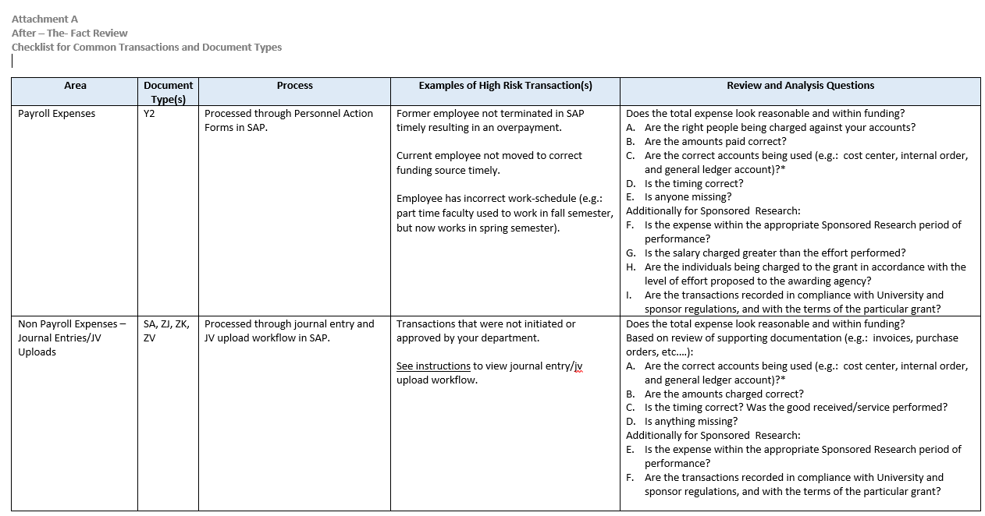
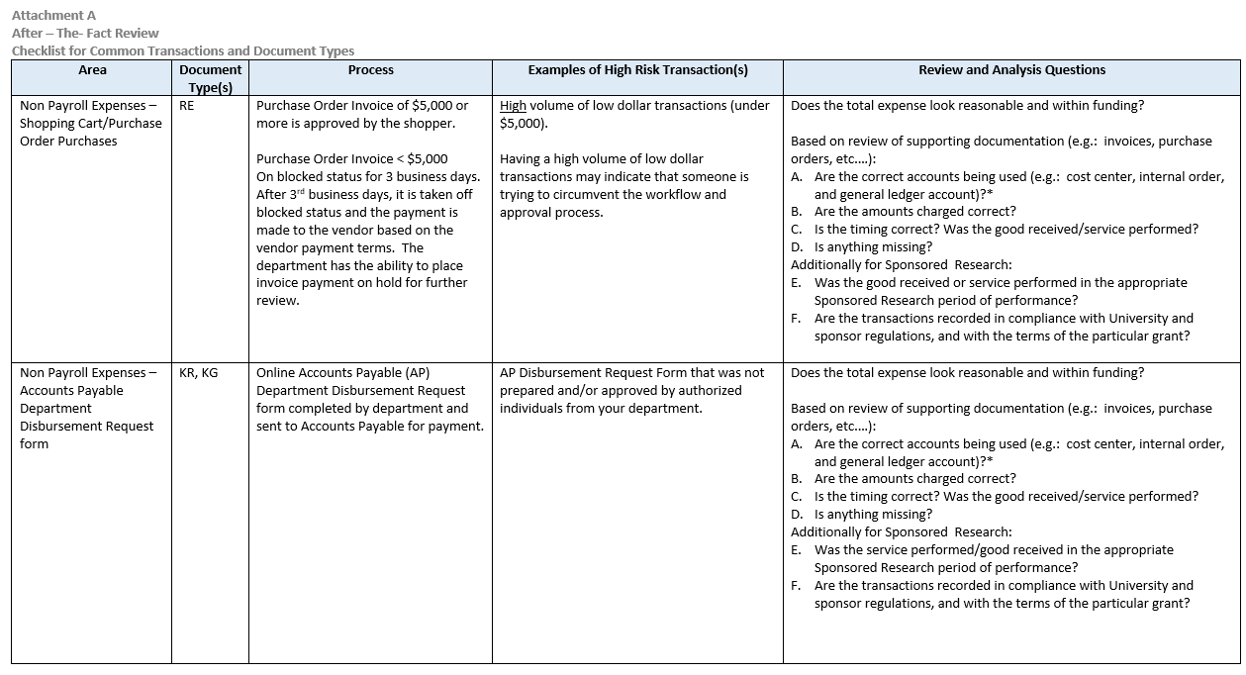
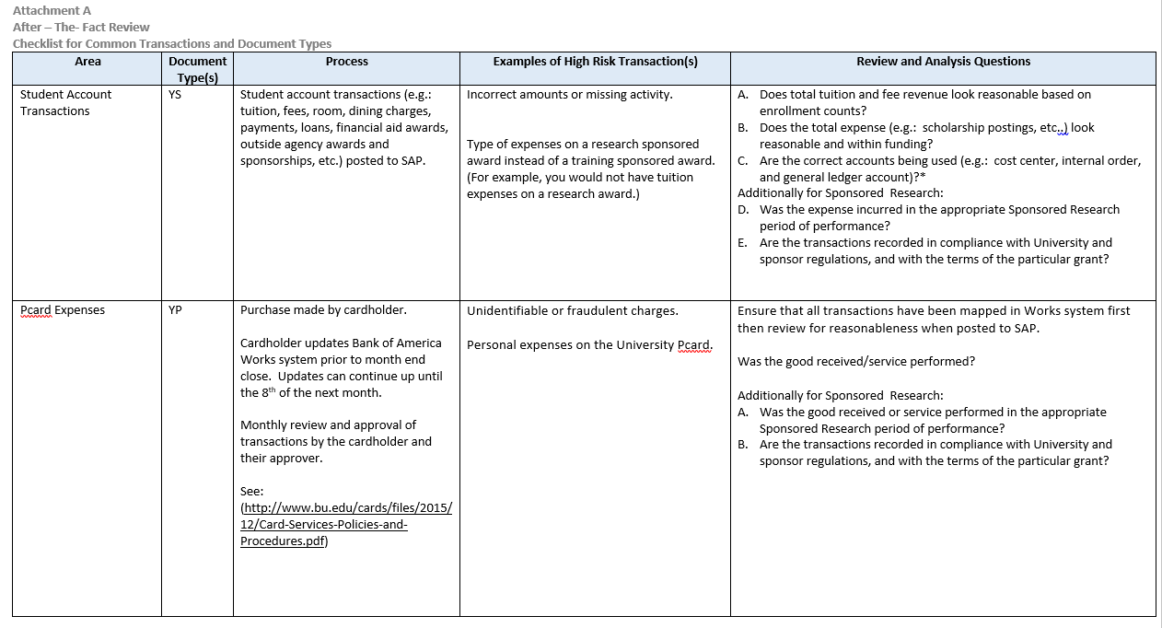
Checklist for Common Transactions and Document Types (Attachment A)
Notes:
Shelly
Attachment A is a “Checklist for Common Transactions and Document Types”.
This is a nice guidance document to reference for when you are reviewing your reports and do not realize what one of the codes mean. We’ve also given you some examples of high risk transactions along with questions you should ask yourself when reviewing particular expenditures.
For example, on page one, the first box, you will see the document Y2 which is for payroll expenses that are processed through Personnel Action Forms in SAP. Examples of high risk transactions include former employees continuing to be paid and not terminated in the system or a current employee charged to a wrong account. Questions to ask yourself: Are the right people being charged against the right accounts? Are the amounts paid correct? In most cases, effort should follow salary so if John Brown is charged 100% to Grant A, is that reasonable in that he is not doing any other work? i.e. Administrative, teaching, clinic, writing proposals? Is the timing correct? i.e. Grant A ended 9/30/2017 and yet charges continue to occur in October and November 2017?
There are numerous Document Types along with Examples of High Risk Transactions along with Questions you should be asking yourself. Please be sure to read through and review them after this meeting.

Slide 31

Tracking Sheet
Best practice is to document your review in case you are asked by internal or external auditors.
Accounts* = cost center, internal order, general ledger account, etc…
Accounts* | Name / Title | Reconciled By: | Period Reviewed | Date | Open Issues
1234567890 1245678901 1256789012 | Any Department 1 Any Department 2 Any Department 3 | Roger Smith | 5/1/2016 – 5/31/2016 | 6/15/16 | No
9091234567 9098901234 | Dr. Jones’ Designated Account Dr. Rogers’ Designated Account | Sandra Johnson | 5/1/2016 – 5/31/2016 | 6/15/16 | No
Notes:
Shelly
Best Practice
Internal / External Auditors
If you found a mistake on a grant in July and don’t move until December, you better have this documented or Shelly is going to say No

Slide 32

Who to contact?
When you are unable to resolve a question related to your After-The-Fact-Review within your department and need assistance from a central university department, please refer to the Central University Contacts listed on Attachment C.
Notes:
Shelly
Please see Attachment C which is a listing of all of the Central University Contacts you need.
Note: The third box up, we talk about Billing, Expense, and Fund Reservation Activity. In regards to Closing a Non-Sponsored Program Fund Reservation (FRN) for Subawards (starts with “40”) These are created by any department administrator; contact the creator to resolve (bring in “Created By” in any Commitment Report within BW)

Slide 33
Report Templates
Notes:
Donna
Now we are going to go through the resources to help you complete these tasks.
You were given a packet of handouts; we will go through an overview of them now and then in more detail later on.

Slide 34
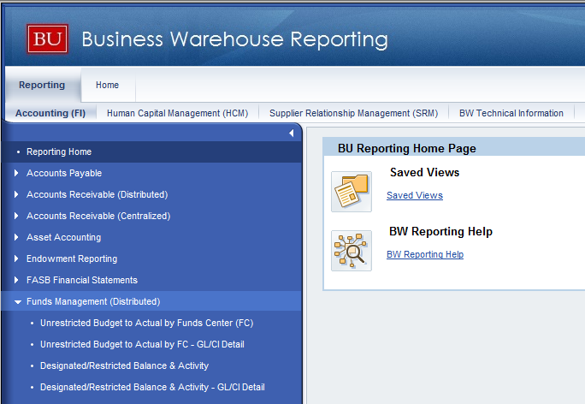
BW Report Resources
Non sponsored research (everything but grants)
Unrestricted Budget to Actual by FC – GL/CI Detail report
Designated/Restricted Balance & Activity – GL/CI Detail report
Transaction Detail report
Transaction Detail w/Payroll Detail report
Notes:
Donna
Note to training group that this may not be the view folks see within BW... this is Gretchen’s view and the attendees may have a different view based on their security.

Slide 35
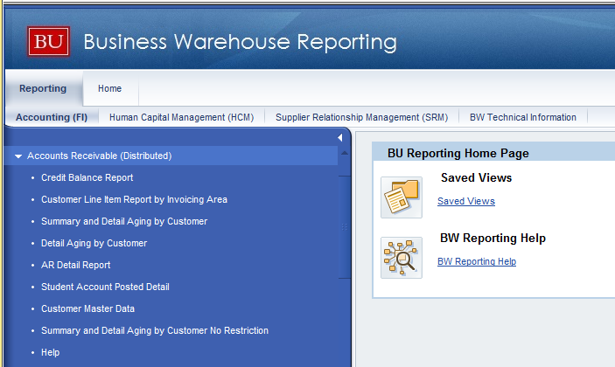
BW Report Resources
Non sponsored research (everything but grants)
Transaction detail for Document Type YS can be viewed on the Student Account Posted Detail report located in the Accounts Receivable – (Distributed) Folder.
Notes:
Donna

Slide 36
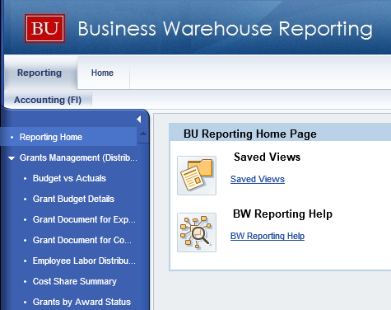
BW Report Resources
Sponsored Research
Budget vs Actuals
Employee Labor Distribution by Grant
Grant Document for Commitments
Grant Document for Expenditures
Notes:
Shelly

Slide 37
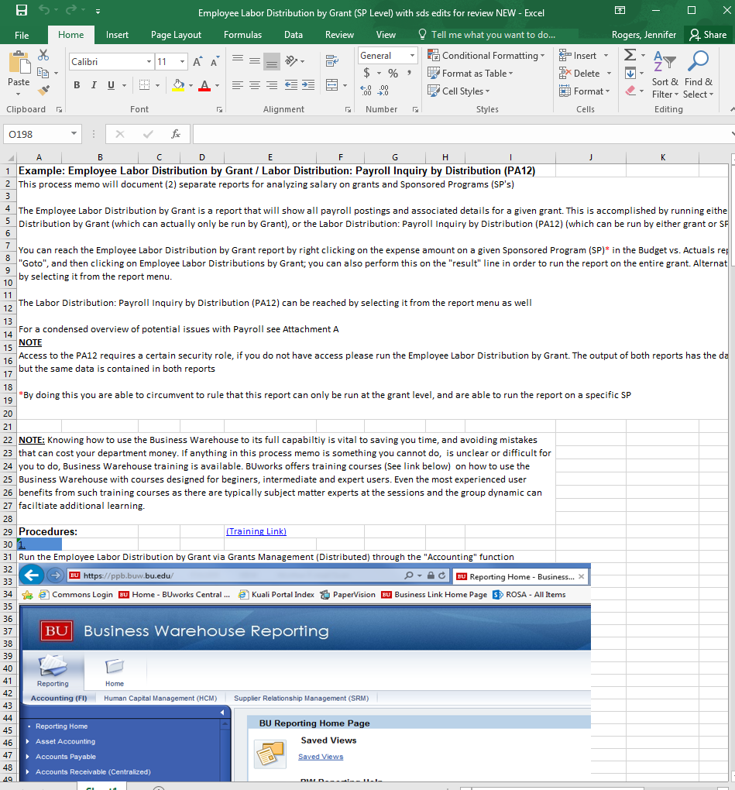
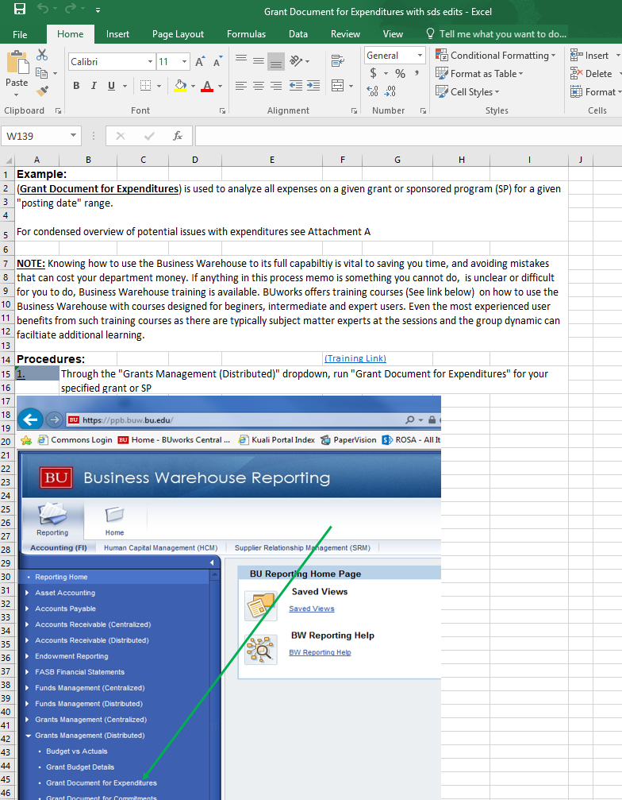
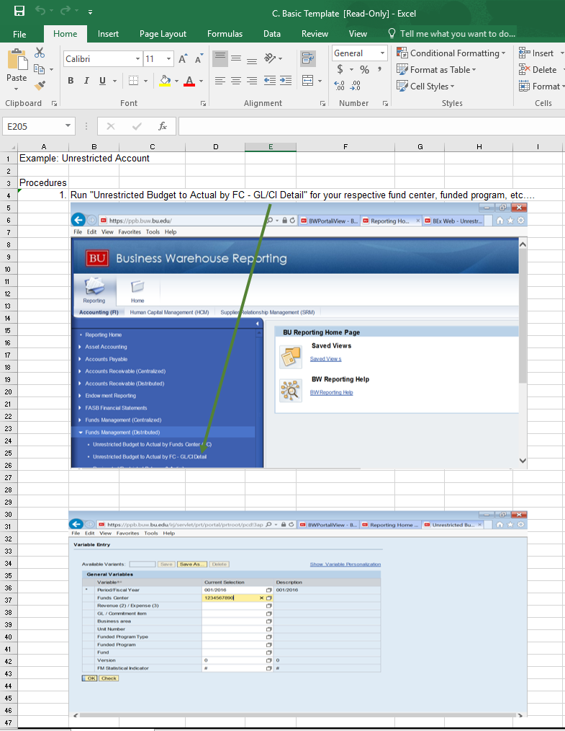
Templates
A series of template examples with instructions have been created to assist with the review process
Departments are not required to use these templates, however, the documented after-the-fact reviews must meet the general guideline standards
  If you have a process that works for you, and it meets the general guideline standards, then continue to use what you have
  As previously stated, the guidelines are not meant to overwrite existing additional requirements set by each School, College, and Department
http://www.bu.edu/cfo/comptroller/resources/after-the-fact-review/
Notes:
Shelly
Read thru the Slide... A series of template examples with instructions have been created to assist with the review process.
We understand that departments may have their own templates such as such, you are not required to use these template examples, however, the documented after-the-fact reviews must meet the general guideline standards. If you have a process that works for you, and it meets the general guideline standards, then continue to use what you have.
The templates we will make available are:
Basic Template
Shared Designated Accounts Template
Grant Budget vs Actual Template
Employee Labor Distribution by Grant (SP Level) Template
Grand Document for Expenditures Template and;
Grant Document for Commitments Template
We did not print all of these templates for you; at the end of this presentation we will be going through in more detail the Grant Budget vs Actual Template and the Grand Document for Expenditures Template.
However, all templates and reference material we are going through today will be available on-line.
Gretchen
Ok, let’s go through the templates that we referenced before.
We are going to specifically go through Template F1 (Budget vs Actuals) and F3 (Grant Document for Expenditures)
Open document in Excel and scroll through, discussing at a high level to point out:
instructions, (note: your BW picture may look different then the one listed based on your security)
link to BW training,
reference to Attachment A: Checklist for Common Transactions and Document Types and
Importance of Budget vs Actual.
I run BvA for EVERYTHING... This is where I always start
Highly recommend you run at Grant level b/c if there are 5 IO’s on one grant, you want to make sure that nothing snuck in on an old IO when it shouldn’t have
The BvA is a great high level report... Gives you a quick snapshot of bottom line and sponsored class to see if anything truly looks off at first glance
Animals charged when you know there are no animals with this research
Burn rate: Award ends in 6 months yet 95% of the award is spent
Is the budget set up correctly?
There are a ton of free characteristics and even more property characteristics (attributes) that you can bring in as needed
For sponsored research the BvA is great because you can quickly tell if your expenditures are exceeding budget
For non-sponsored research, one would use one of the FM Budget to Actual reports... For non-sponsored, you will want to review for instance that Period 1 actuals are the same year over year for that period... i.e. I didn’t spend 50% of my PAFO Cost Center in period 1 when last year in FY2016, I only spent 10% of it.
Importance of Grant Document for Expenditures
Nice thing about BW is you can continue to drill down... You can either start at BvA and if you see something funky, you can drill down into the detail, or you can start with a report like the Grant Document for Expenditures which will give you the detail in full
This will give you the expenditures in detail and then from there you can drill into FB03 for more detail if it were a journal entry or follow up with AP if it’s for a vendor you know nothing about.
Based on the account, this file may be HUGE... For sponsored research I will tell you that materiality is zero in that, even a $5 mistake needs to be moved. Take the file in steps... Look at payroll, does everything look appropriate? Move on to expenditures... Is their a vendor that you are surprised to see? Children’s Hospital invoices when you were not aware that Children’s was a sub on this award? Patient Care charges when there is no human research involved?
Make sure timing is good... Any expenditures that occurred after the award ended? Large ticket items that were purchased in the last 30 days before the grant ended?

Slide 38
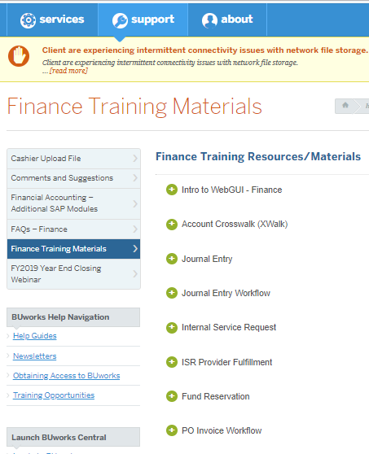
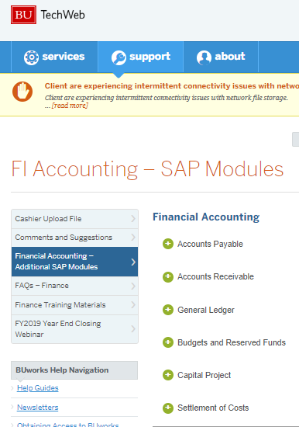
Additional Finance Training Resources (BUWorks)
http://www.bu.edu/tech/support/buworks/help/finance/finance-training-resources/
Notes:
Matt
Journal Entry training, PO invoice workflow, Accounts Payable, Accounts Receivable

Slide 39
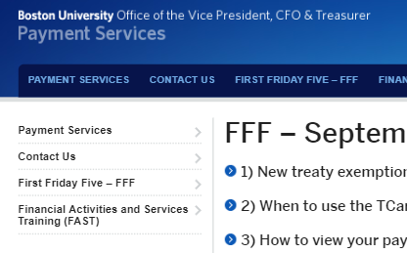
Additional Finance Training Resources (FFF)
“What happens to a Disbursement Request after it has been submitted online?”
Automatically entered into the OnBase system
Confirmation email sent to submitter
Form is reviewed by Accounts Payable analysts for accuracy
If a new vendor, SAP vendor profile will need to be created
AP will enter details into SAP, generating unique 10 digit FI doc number
Payment generated according to vendor’s payment terms
http://www.bu.edu/paymentservices/fff-september-7-2018/
Notes:
Matt
Since the 2017 changeover from paper to online disbursement submissions, the processing method has also undergone some changes. The following is a guide to the new procedure, along with examples of common errors to be avoided, as they can delay payment processing:
1) When completed Disbursement Requests are submitted via the webform, they are automatically entered into the OnBase system used by Accounts Payable. At this time, a confirmation email is sent to the submitter which includes payee details and a unique 8-digit Source Document (SD) number.
Common error: the submitter’s email address was incorrectly entered, so the confirmation email cannot be received
2) The disbursement form is reviewed by Accounts Payable analysts for accuracy, ensuring that there is a valid invoice attached and that the data on the form (including invoice date, payee name/address, and remittance amount) match the invoice.
Common errors: the attached document is not a valid invoice; the documentation is incomplete or insufficient to process payment (particularly with foreign vendors); data on the invoice and the disbursement form do not match
3) If the vendor has not previously been paid by BU, the vendor relations group in Accounts Payable will need to create an SAP vendor profile. In these cases, a W9 (US vendor) or W8BEN (foreign vendor) should be attached to the disbursement form at the time of submission.
Common error: failure to attach a properly completed (including signature/date) W9 or W8BEN
4) Once all information is verified and the vendor profile is available, Accounts Payable will enter the disbursement details into SAP. This will generate a unique, 10-digit FI Document number, which will be visible in BUWorks/SAP Reporting to those with access to the account being charged. Payment is then generated according to the vendor’s payment terms, an explanation of which can be found her

Slide 40
Additional Training
Gift and Endowment Training
February 27th
9am -11am
Kilachand Center for Integrated Life Sciences, room 101
Topics covered include: Overview and definition of philanthropic fund types, endowments and how they work, fund establishment overview and process, fund restrictions and how to access them, and many other topics.
Sign up link: Sign up here

Slide 41
Things to take away from the training
Reviewing accounts is very important
Templates and guidelines are available
  See the CFO website for attachments
Retain evidence of your reviews
  Documentation should you need to change
  Good business practice
Set up a regular review schedule for yourself, and stick to it
After-the-fact Review Webinar Recording (4-29-20)
Let us know any comments, questions, concerns!
Feedback Survey
Additional BW Training available with Bill Stewart
Notes:
Matt

