Slide 1
You Must Remember This
Some reminiscences of the Boston Center
John Stachel
Center for Einstein Studies
October 22, 2010

Slide 2



Slide 3
Shakespeare Sonnet 30
When to the sessions of sweet silent thought
I summon up remembrance of things past,
I sigh the lack of many a thing I sought,
And with old woes new wail my dear time's waste:
Then can I drown an eye, unused to flow,
For precious friends hid in death's dateless night,
And weep afresh love's long since cancell'd woe,

Slide 4
Shakespeare Sonnet 30
And moan the expense of many a vanish'd sight:
Then can I grieve at grievances foregone,
And heavily from woe to woe tell o'er
The sad account of fore-bemoaned moan,
Which I new pay as if not paid before.
But if the while I think on thee, dear friend[s],
All losses are restor'd and sorrows end.

Slide 5
Goethe Faust I-- Zueignung
Ihr naht euch wieder, schwankende Gestalten!
Die früh sich einst dem trüben Blick gezeigt.
Versuch’ ich wohl euch diesmal fest zu halten?
Fühl’ ich mein Herz noch jenem Wahn geneigt?

Slide 6
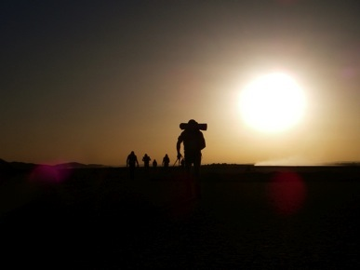

Slide 7
Goethe Faust I-- Dedication
Ihr drängt euch zu! nun gut, so mögt ihr walten,
Wie ihr aus Dunst und Nebel um mich steigt;
Mein Busen fühlt sich jugendlich erschüttert
Vom Zauberhauch der euren Zug umwittert.

Slide 8
A.S. Kline translation (2003)
Again you show yourselves, you wavering forms,
Revealed, as you once were, to clouded vision.
Shall I attempt to hold you fast once more?
Heart’s willing still to suffer that illusion?
You crowd so near! Well then, you shall endure,
And rouse me, from your mist and cloud’s confusion:
My spirit feels so young again: it’s shaken
By magic breezes that your breathings waken.

Slide 9
David Luke translation (1987)
Uncertain shapes, visitors from the past
At whom I darkly gazed so long ago,
My heart's mad fleeting visions—now at last
Shall I embrace you, must I let you go?
Again you haunt me: come then, hold me fast!
Out of the mist and murk you rise, who so
Besiege me, and with magic breath restore,
Stirring my soul, lost youth to me once more.

Slide 10
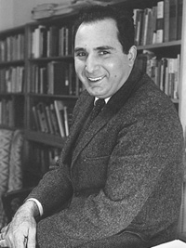
Marx Wartofsky (1965)

Slide 11
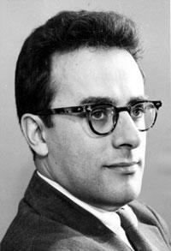
Young Bob Cohen

Slide 12
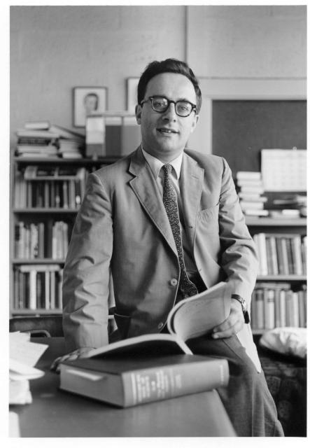
Bob Cohen in 1964

Slide 13
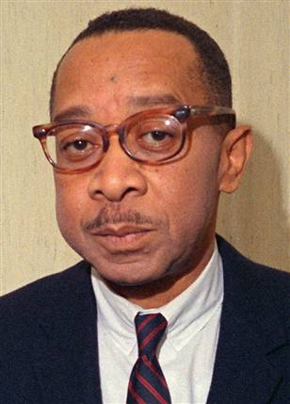
Kenneth B. Clark (1969)

Slide 14
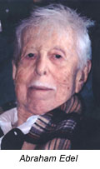
Abraham Edel (1967)

Slide 15
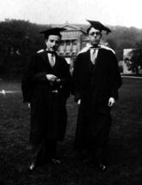
Leon and Abraham Edel (1927)

Slide 16
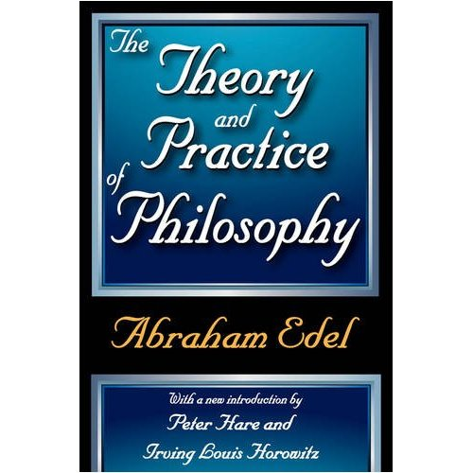

Slide 17
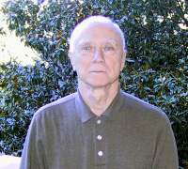
David Finkelstein

Slide 18
Huseyn Yilmaz (1969)

Slide 19
Ralph Schiller (1962)

Slide 20
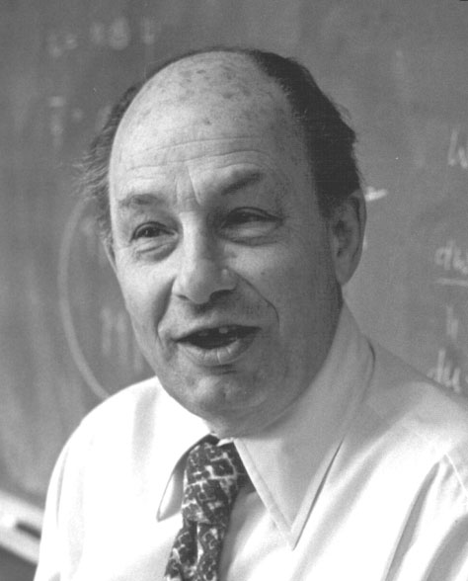
Peter G. Bergmann (1966)

Slide 21
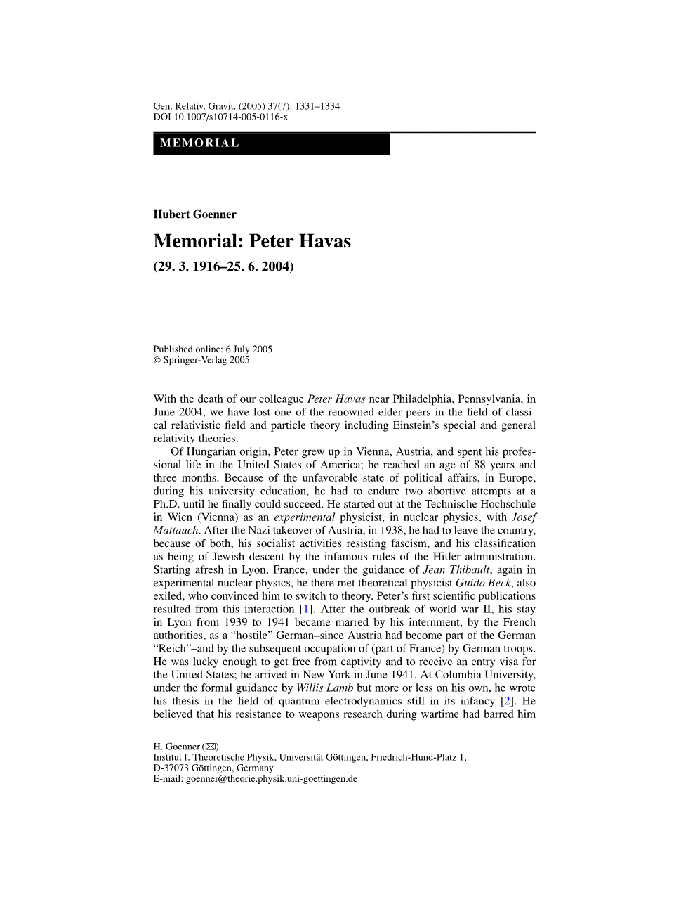
Peter Havas (1965)

Slide 22
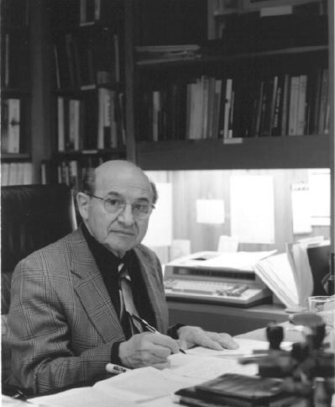
Adolf Grünbaum (1962)

Slide 23
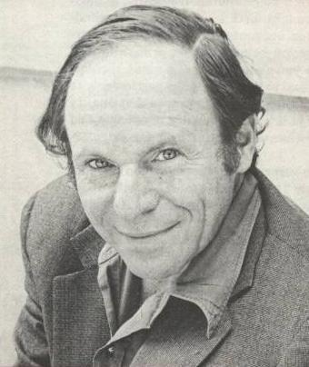
Philip Morrison (1969)

Slide 24
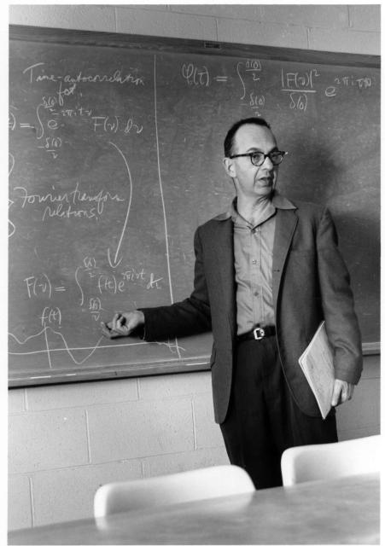
Armand Siegel (1968)
Physics Department Gallery / Historical Photos / Armand Siegel 1962.jpg
Armand Siegel 1962.jpg
« previous
59 of 78
next »
Download photo (1382x1960)

Slide 25
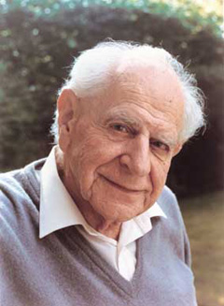
Sir Karl Popper (1969)

Slide 26
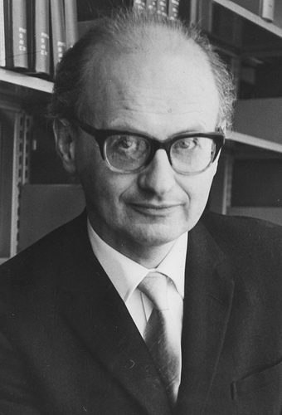
Imre Lakatos (1967)

Slide 27
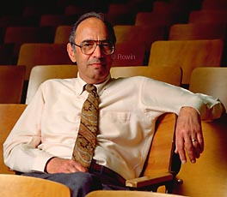
Tom Kuhn (1970)

Slide 28
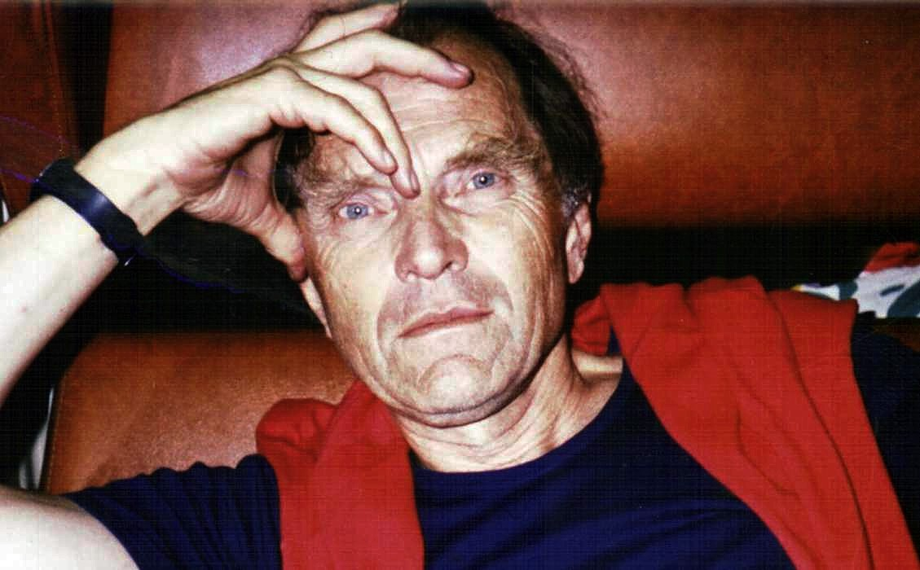
Paul Feyrabend (1966)

Slide 29
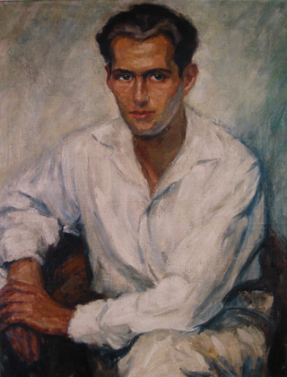
Hans Ekstein (1974)

Slide 30
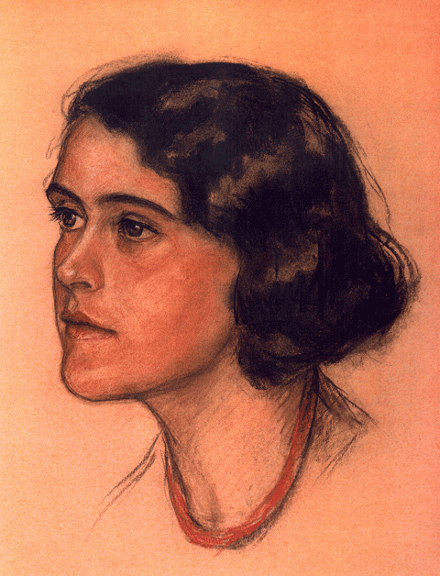
Eva Ekstein, geb. Rosenthal

Slide 31
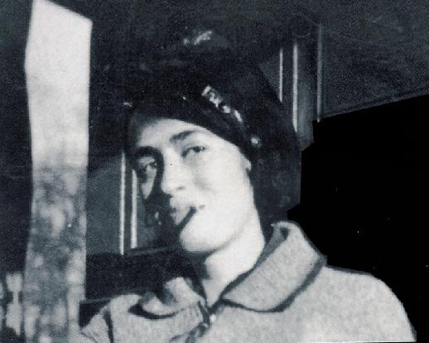
Lisa Fittko, geb. Ekstein

Slide 32
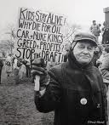
Milič Čapek (1964)

Slide 33
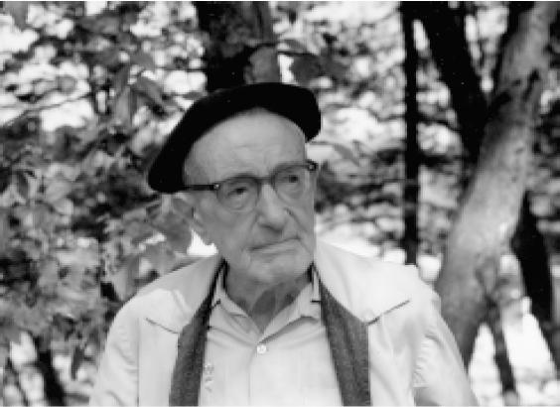
Dirk Struik (1971)

Slide 34
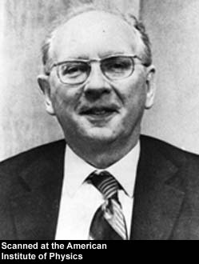
Leon Rosenfeld (1974)

Slide 35
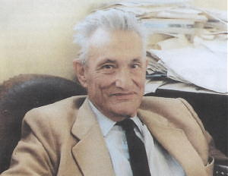
Jean Pierre Vigier (1974)

Slide 36
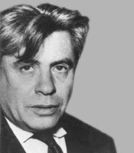
Lucien Goldmann

Slide 37
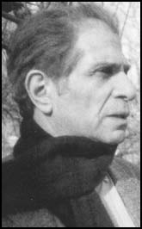
Ralph Miliband (1978)

Slide 38
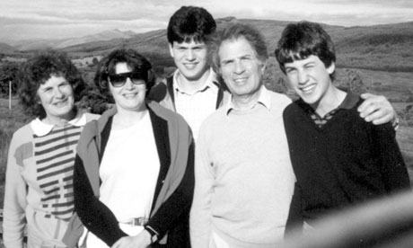
Marion, her sister, Hadassa, David, Ralph and Ed Miliband on holiday in Scotland, 1987

Slide 39
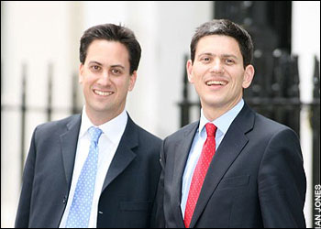
The Miliband Brothers, Edward and David

Slide 40
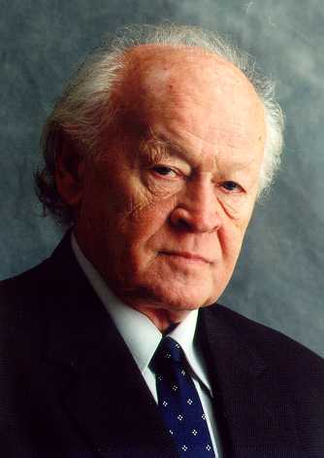
Mihailo Markovic (1978)

Slide 41
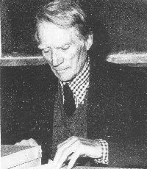
Jean van Heijenoort (1966)

Slide 42
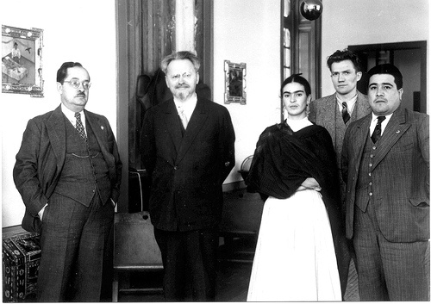
With Trotsky in Exile: From Prinkipo to Coyoacâan

Slide 43
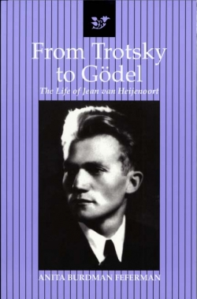
Anita Burdman Feferman :Politics, Logic and Love:The Life of Jean van Heijenoort

Slide 44
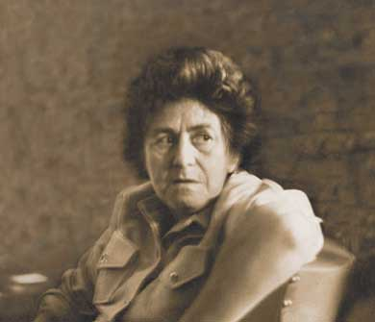
Raya Dunayevskaya

Slide 45
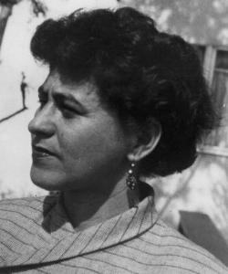
Raya Dunayevskaya

Slide 46
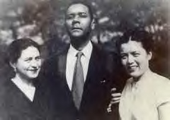
R.D., C.L. R. James, Grace Lee

Slide 47
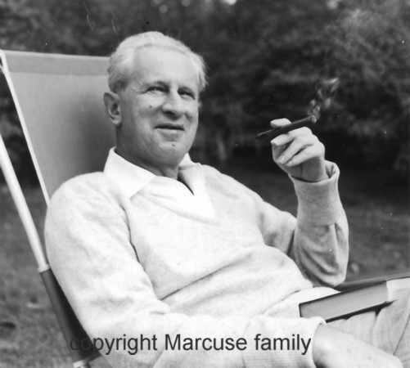
Herbert Marcuse (1964)

Slide 48
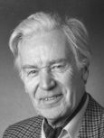
Paul Lorenzen (1971)

Slide 49
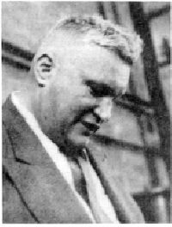
Lew Kowarski (1971)

Slide 50
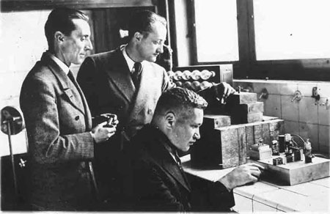
De gauche à droite, Frédéric Joliot, Hans Halban et Lew Kowarski lors de leur expérimentations sur la réaction en chaîne.
© Fonds Curie et Joliot-Curie/ACJC

Slide 51
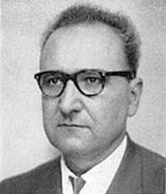
Roger Garaudy

Slide 52
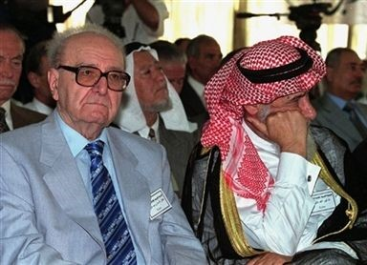
Ragaa since 1982

Slide 53
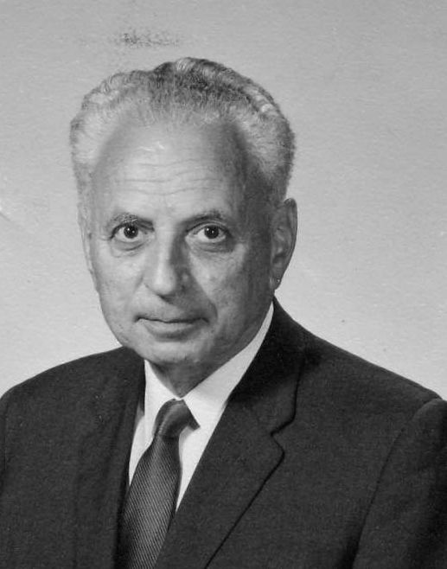
László Tisza (1961)

Slide 54
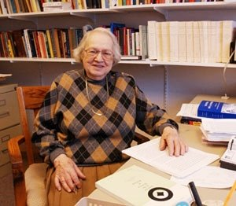
Marjorie Grene (1971)

Slide 55
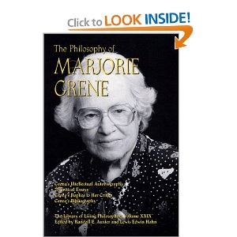
NY Times Obit-uary, 28/3/09
Her sense of humor sparkled when she was asked about being the first woman to have an edition of the Library of Living Philosophers devoted to her — Volume 29 in 2002.. “I thought they must be looking desperately for a woman,” Dr. Grene said.

Slide 56
The Institute of Relativity Studies
Obvious joke: I have my own IRS
Not-so-obvious joke-- Remember the film:
2001: A Space Odyssey

Slide 57
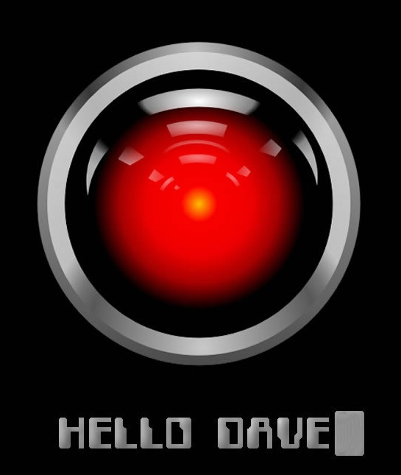
The Computer HAL

Slide 58

Move up one letter: HAL→

Slide 59
Take IRS—
Move up one letter IRS→ JST
John Stachel–
but also, alas!
Joseph Stalin

Slide 60
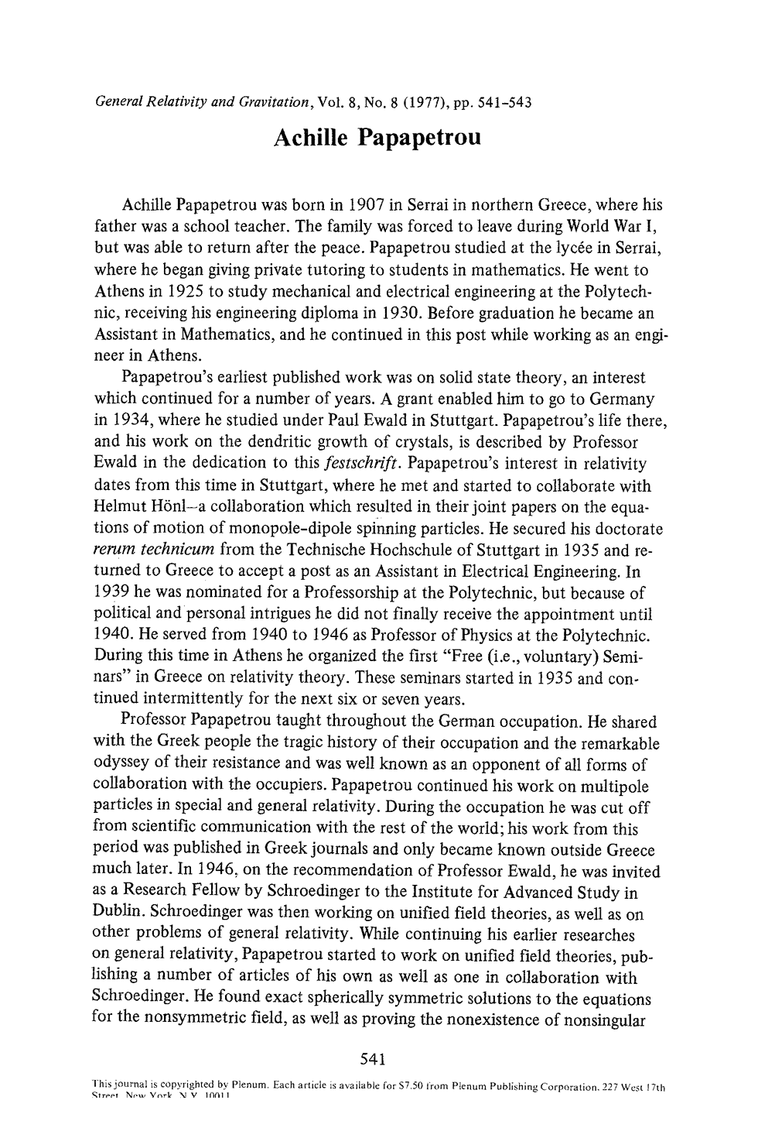
Achille Papapetrou (1972)

Slide 61
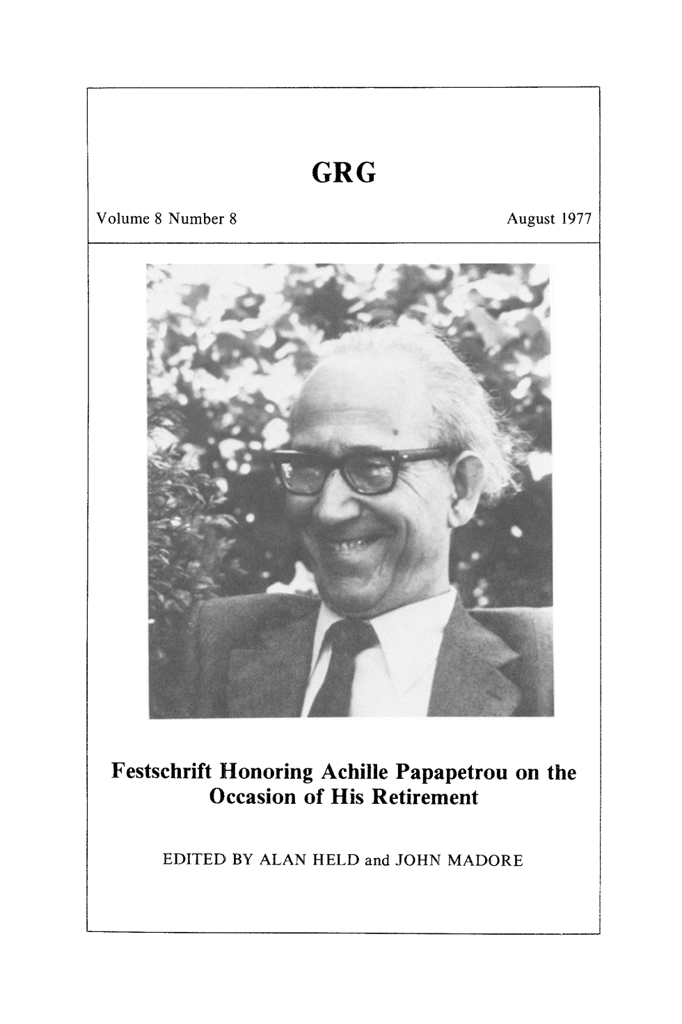

Slide 62
The Institute of Relativity Studies
One of the Earliest Conferences on Quantum Gravity:
"Gravitation and Quantization," Osgood Hill Conference, October 31-November 3, 1972
[Chris Isham: "Gravitation: Quantization Pursued,“ Nature 240, 382-383 (15 December 1972)]

Slide 63
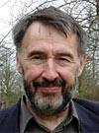
Chris Isham (1972)

Slide 64
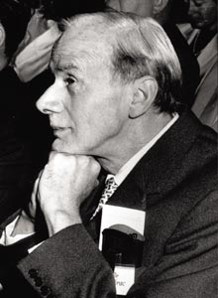
Paul Dirac (1972)

Slide 65

John Archibald Wheeler (1972)

Slide 66

Bryce Seligman DeWitt (1972)

Slide 67
The Institute of Relativity Studies
Conference honoring second edition of Adolf Grünbaum’s book
"Absolute and Relational Theories of Space and Space-Time," Osgood Hill Conference, 3- 5 June 1974
Proceedings published in Minnesota Studies in the Philosophy of Science, vol. 8, Foundations of Space-Time Theories (Minneapolis: University of Minnesota Press 1977)

Slide 68
Adolf Grünbaum (1962)

Slide 69
8thTexas Symposium on Relativistic Astrophysics
PREFACE:
`Michael D. Papagiannis
Department of Astronomy, Boston University
The Eighth Texas Symposium on Relativistic Astrophysics was held in Boston, Massachusetts, December 13 through 17, 1976. …These Symposia bring together physicists and astronomers with a common interest in high-energy and relativistic cosmic phenomena.

Slide 70
8thTexas Symposium on Relativistic Astrophysics
The Local Organizing Committee, consisting of Professors R. Giacconi and H. Gursky of Harvard University, B. Burke and I. Shapiro of MIT, M. Papagiannis and J. Stachel of Boston University, S. Deser of Brandeis University, and R. Gajewski of AS&E, Inc., labored hard under the chairman-ship of Professor Stachel for almost a year to prepare the scientific program and organize all the technical details for the Symposium, … which was held with great success at the Copley Plaza Hotel, in historic Copley Square of Boston.

Slide 71
8thTexas Symposium on Relativistic Astrophysics
I should like to express our appreciation to Donna Onash, who handled most efficiently all the organisational aspects of the Symposium; to Barbara Rahke, who helped with secretarial responsibilities; and to several physics graduate students of Boston University, in particular Steve Wolfson, Ben Rosen, and Patricio Letelier, who were of great help with the many technical details.
This Was My Parting Act Before

Slide 72
My Move to Princeton in December 1977:
Like all acts of emigration, it involved a push and a pull:
The pull was:

Slide 73

Albert Einstein

Slide 74
December 1977: My Move to Princeton
Like all acts of emigration, it involved a push and a pull:
The push was:

Slide 75

John Silber

Slide 76
But That’s Another Story!
Thank You !

