Slide 1
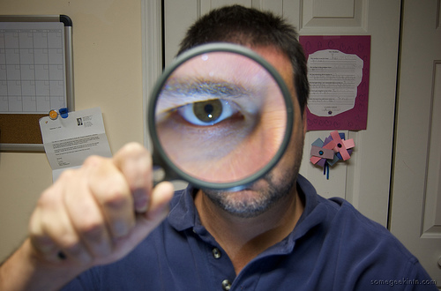

Reexaming the biological race debate
Quayshawn Spencer

Slide 2
Outline
Thesis
Background
The Onto-Semantic Strategy
Four Problems with the Onto-Semantic Strategy
Observation
Conclusion
Applications to the Public Health Genomics Race Debate

Slide 3
Thesis
The philosophical foundations of biological racial anti-realism are shaky at best.

Slide 4

Background

Slide 5
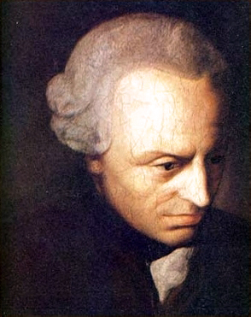
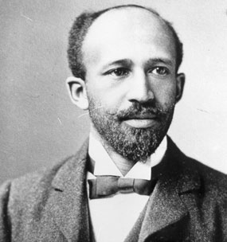

The Race Debate
“What is a race?” (Kant 1775)
Does race exist? If so, how?
  Biological Racial Realism, 1775
  Social Constructivism, 1897
  Racial Anti-Realism, 1992

Slide 6

The Three Major Views

Slide 7

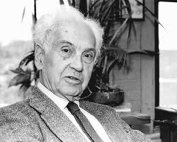

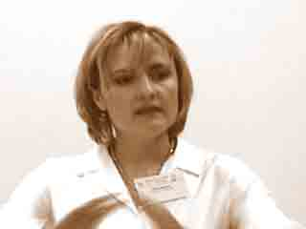
Biological Racial Realism

Slide 8
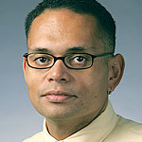


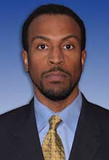
Social Constructivism

Slide 9



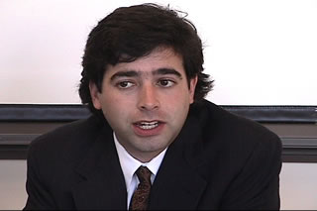
Racial Anti-Realism

Slide 10

The Majority View

Slide 11
Biological Racial Anti-Realism

Slide 12
The Onto-Semantic Strategy

Slide 13
The Onto-Semantic Strategy
The joint metaphysical and semantic strategy of showing that no real biological kind is also a classification of race as ordinarily understood.
It is the most sophisticated defense of BR anti-realism in contemporary philosophy.

Slide 14
Onto-Semantic BR Anti-Realists

Slide 15

The Seven Steps of The Onto-Semantic Strategy

Slide 16
Step 1: Figure Out How to Figure Out the Folk Meaning of ‘Race’
Step 1a: Select the theory of meaning that best models the folk meaning of ‘race’.
  Descriptivism v. Referentialism
  Racial descriptivists. The folk meaning of ‘race’ is its definite description in folk discourse.
  e.g. Races are necessarily groups that differ in “visible physical features of the relevant kind” (Glasgow 2009).
  Racial referentialists. The folk meaning of ‘race’ is its referent in folk discourse.
  e.g. Races are Black, White, Asian, and other groups like that (Haslanger 2008).

Slide 17
Step 1
Step 1b. Select the best method for marshaling evidence for a hypothesis about the folk meaning of ‘race’.
  The armchair approach. Conceptual analysis is the best approach (e.g. thought experiments).
  The abductive strategy. Race is whatever best explains folk racial phenomena (e.g. passing, visibility, etc.).
  The historical strategy. The meaning is best determined by historical work.
  The experimental approach. Controlled experiments are the best way to determine the meaning.

Slide 18
Step 2: Figure Out the Folk Meaning of ‘Race’
Using the theory of meaning from step 1a and the evidential method in step 1b

Slide 19
Step 3: Define ‘Real Biological Kind’
Natural kinds v. Pragmatic kinds
Natural kind. A kind that exists independently of human thought and language.
  e.g. Appiah (1996) & Zack (2002)
Pragmatic kind. A kind that is useful in a certain epistemic context.
  e.g. Haslanger (2008)

Slide 20
Step 4: Compile a List of Candidates
e.g. Glasgow (2009) considers Andreasen’s cladistic subspecies, Kitcher’s lineage subspecies, Risch’s “genetic clusters” of populations, etc.

Slide 21
Step 5: Elucidate Each Candidate
e.g. A cladistic subspecies is a monophyletic group of breeding populations in a biological species (Andreasen 1998).
e.g. Human cladistic subspecies are Caucasians, Amerinds, Pacific Islanders, sub-Saharan Africans, etc., but not Asians or Latinos.

Slide 22
Step 6: Set a “Reasonable Overlap” Standard
Set a reasonable semantic standard for when a scientific kind is not the referent of an ordinary kind term.
e.g. Glasgow’s (2009) non-negotiability standard.

Slide 23
Step 7: Eliminate Each Candidate
Show that no candidate from step 4 is both a real biological kind, according to step 3, and the referent of ‘race’ , according to steps 2, 5, & 6.

Slide 24
Example
Glasgow, A Theory of Race (2009)
Descriptivist armchair approach
Folk race is a human division based on “visible physical features of the relevant kind.”
A real biological kind is a kind that is not “biologically arbitrary” (BA).
A BA kind is a kind such that “the biological facts do not give us sufficient reason to mark off that kind”.

Slide 25
Example (cont.)
Candidates: superficial theory, genetic racial realism, & populationism
Non-negotiability semantic standard
Superficial theory, genetic racial realism, & constrained populationism are not RBKs.
Unconstrained populationism is not a theory of folk race.
Q.E.D.

Slide 26

Four Problems with the Onto-Semantic Strategy

Slide 27
Problem 1
Descriptivism is an inappropriate way to model the folk meaning of ‘race’.
  It’s not clear that the folk concept of race is even coherent.
  It’s not necessary to have certain mental content to be a competent user of ‘race’.

Slide 28
Problem 2
The armchair method is inappropriate in our case.
  It’s bound to be unrepresentative of the folk’s notion because ‘race’ isn’t well-behaved like say ‘human’.

Slide 29
Problem 3
There’s no appropriate account of real biological kindhood.
  Natural kinds rig the debate in favor of BR anti-realism.
    Nobody knows whether such kinds even exist.
    Nobody knows how to identify them even if they do exist.
  Pragmatic kinds are too easy to come by.
    e.g. baramin is a RBK under a pragmatic kind view

Slide 30
Problem 4
The reasonable overlap standards used are unreasonable.

Slide 31
Example
…the hypothesis that there are human folk races is the hypothesis that there are human groups of common ancestry that are (roughly) definable by shared inherited intrinsic properties. It’s a consequence of this stipulation that biological subspecies, at least as many evolutionary biologists have conceived of them, are not likely to be folk races. That’s because membership in a subspecies is not an intrinsic property, but a relational one (Appiah 2006, 366).

Slide 32
Observation
No BR anti-realist has used a non-descriptivist, non-armchair, non-natural kind, non-pragmatic kind, and a truly reasonable semantic overlap standard to defend BR anti-realism.

Slide 33
Conclusion
The philosophical foundations of biological racial anti-realism are shaky at best.

Slide 34

Applications to the Public Health Genomics Race Debate

Slide 35
The Question
To what extent, if any, is folk race a real biological kind in the context of public health genomics (e.g. pharmacogenomics, genetic epidemiology, etc.)?

Slide 36
Four Recommendations
To answer this question we should …
  Be open-minded about the answer because it’s not clear that BR anti-realism is true.
  Focus on folk race, not ethnicity or local population
    e.g. Tang et al. (2005) study “SIRE groups” and Taylor et al. (2004) present results for “African Americans”.
  Use a referentialist semantics & employ reasonable semantic overlap standards
  Employ an appropriate notion of real biological kind, not too strict & not too lenient.

Slide 37
The End

