Slide 1
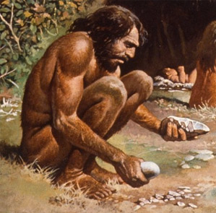
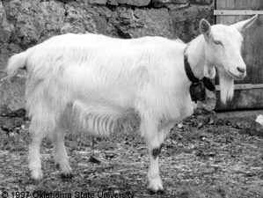
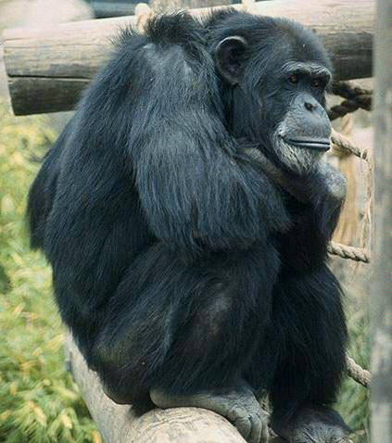
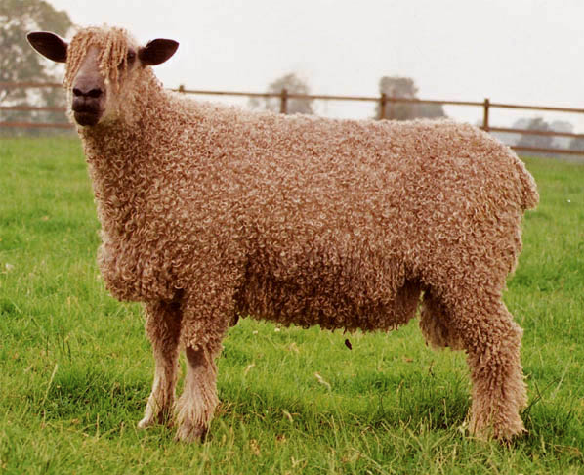

Slide 3
5 digits
2 digits

Slide 4
3-color vision
red-green colorblind
clavicle
no clavicle
5 digits
2 digits
large brain
small brain
simple stomach
complex stomach
no tail
tail

Slide 5
THESE RESEMBLANCES CONTRIBUTE TO
OVERALL PATTERNS OF SIMILARITY, BUT
NONE REPRESENTS A CONVERGENCE.
3-color vision
red-green colorblind
clavicle
no clavicle
5 digits
2 digits
large brain
small brain
simple stomach
complex stomach
no tail
tail

Slide 6
OTHER PATTERNS OF SIMILARITY:
no fur
FUR

Slide 7
WITHIN A GROUP, ONLY NON-PRIMITIVE (derived) TRAITS CAN CARRY A PHYLOGENETIC SIGNAL.
?
HAIR LOSS
(derived)
FUR
(primitive)

Slide 8
CHARACTERS OF SHARED DERIVATION (synapomorphies)
•CUD-CHEWING
•NO CANINE TEETH
•TOE LOSS
•NO CLAVICLE
•COMPLEX MOLARS
•BIG BRAINS
•POOR OLFACTION
•NO TAIL
•SMALL EARS
•BONY EYE SOCKET

Slide 9
CHARACTERS OF SHARED DERIVATION (synapomorphies)
LAST COMMON
ANCESTOR HAD
NONE OF THESE
•CUD-CHEWING
•NO CANINE TEETH
•TOE LOSS
•NO CLAVICLE
•COMPLEX MOLARS
•BIG BRAINS
•POOR OLFACTION
•NO TAIL
•SMALL EARS
•BONY EYE SOCKET

Slide 10
RETAINED PRIMITIVE FEATURES (symplesiomorphies)
•FURRED
•SPEECHLESS
•QUADRUPEDAL
•EAT RAW FOOD

Slide 11
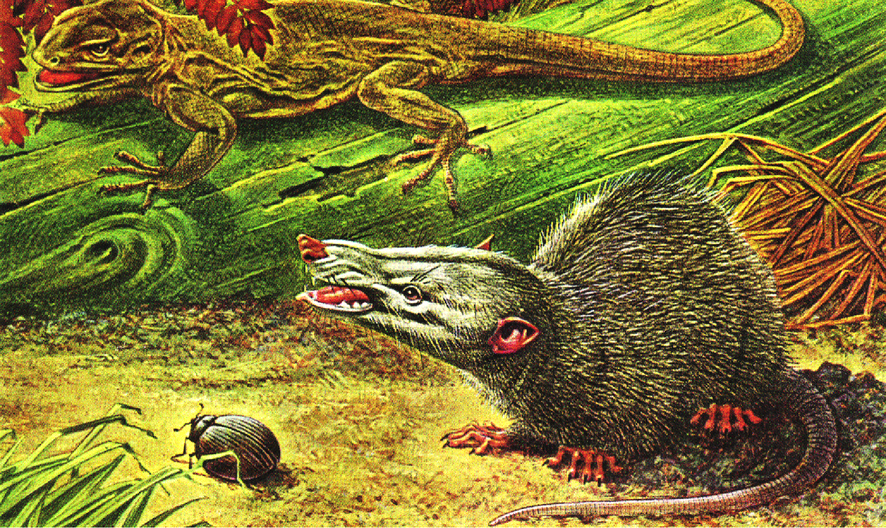
RETAINED PRIMITIVE FEATURES (symplesiomorphies)
LCA: FURRED,
SPEECHLESS,
QUADRUPEDAL,
ATE RAW FOOD,
5 DIGITS, ETC.

Slide 12
CONVERGENCES: shared, non-primitive characters of INDEPENDENT derivation (often reflecting common selection pressures)
BEARDS
BEARDS

Slide 13
beards
no beards

Slide 14
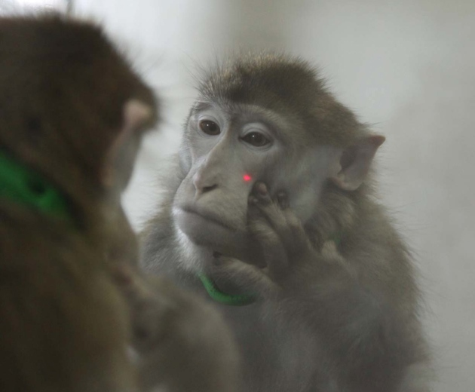
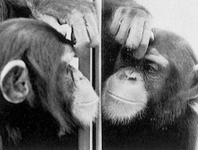

Slide 15
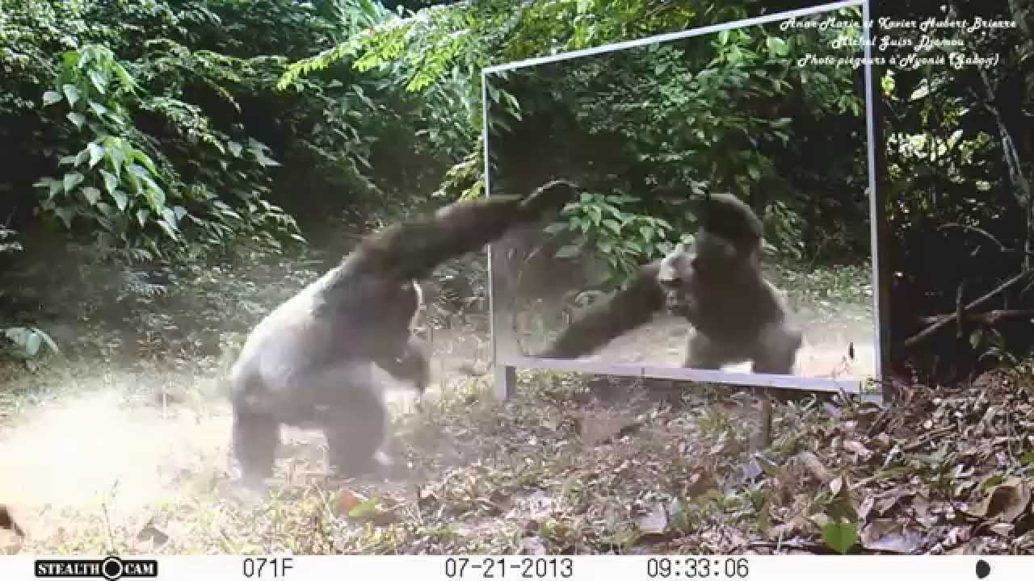

Slide 16
MORGAN’S CANON:
“In no case is an animal activity to be interpreted in terms of higher psychological processes if it can be fairly interpreted in terms of processes which stand lower in the scale of psychological evolution and development.”
—C. Lloyd Morgan (1903)

Slide 17
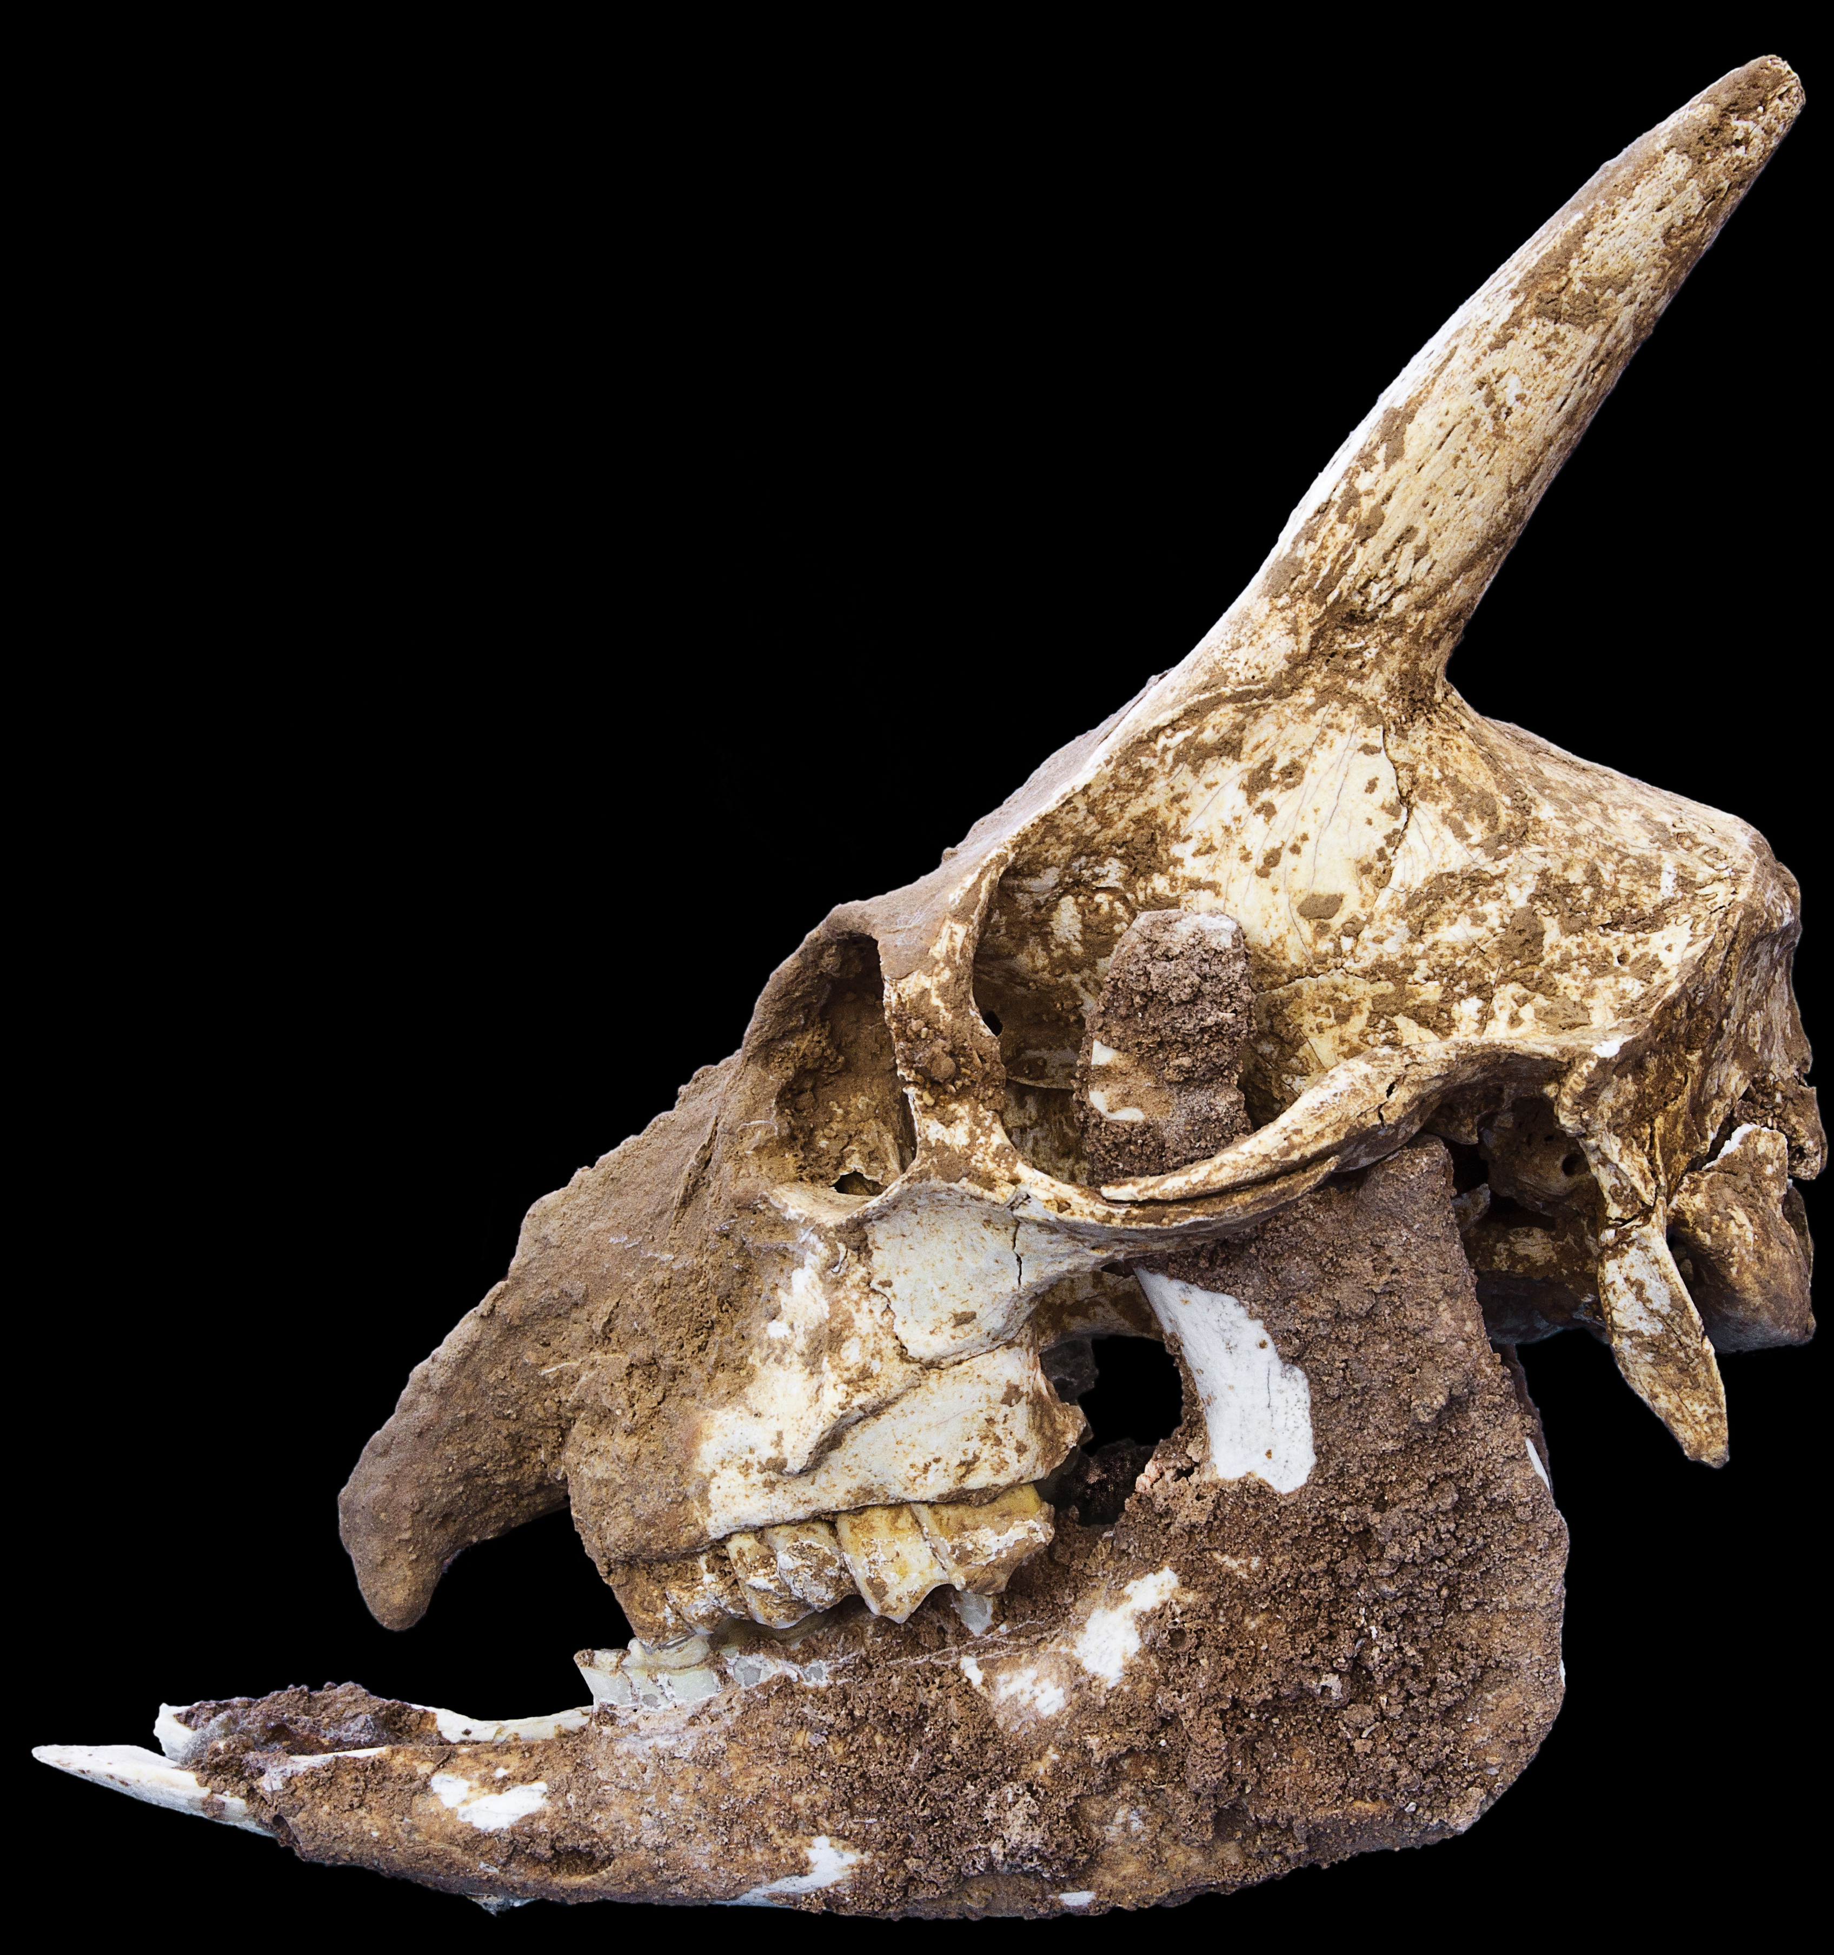
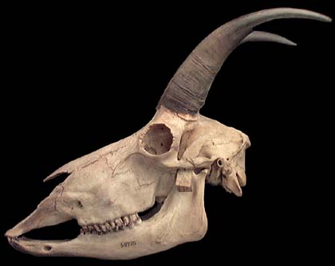
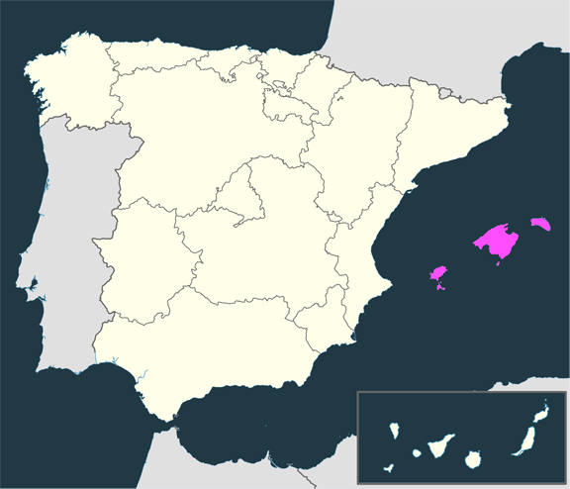
Myotragus
Balearic Island Goat: stubby legs, forward-facing eyes, and—
REDUCED
BRAIN
Oreamnos
Rocky Mountain Goat

Slide 18
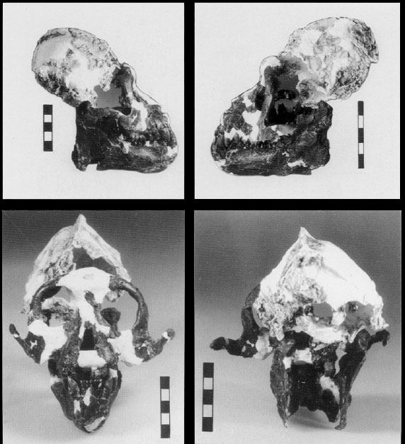
Oreopithecus
Postcranially advanced Miocene ape living on an
isolated Mediterranean
island in what is now Tuscany:
REDUCED BRAIN
Modern chimpanzee

Slide 19
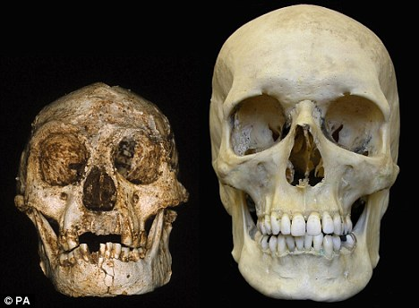
Homo floresiensis
Dwarf human living on an isolated Indonesian island 20,000 years ago:
REDUCED BRAIN— A
CONVERGENCE

Slide 20
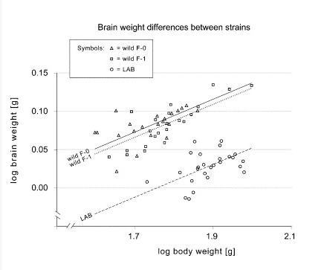
DOMESTICATION RESULTS IN DECREASED BRAIN SIZE
LAB GERBILS
Mongolian gerbils (Meriones unguiculatus)
(Stuermer & Wetzel, 2006)

Slide 21
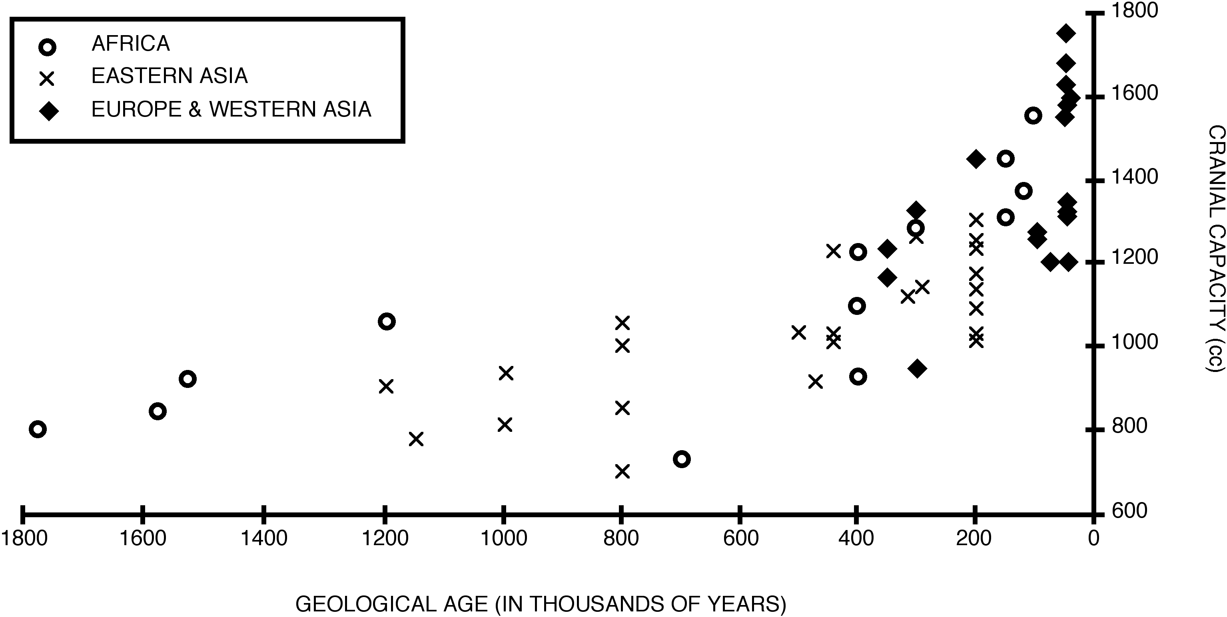
ARE MODERN HUMANS DOMESTICATED CAVEMEN?
MODERN AVERAGE
(Homo data from Cartmill & Smith, 2009; red stars = pooled-time averages from Ruff et al., 1997)

Slide 22
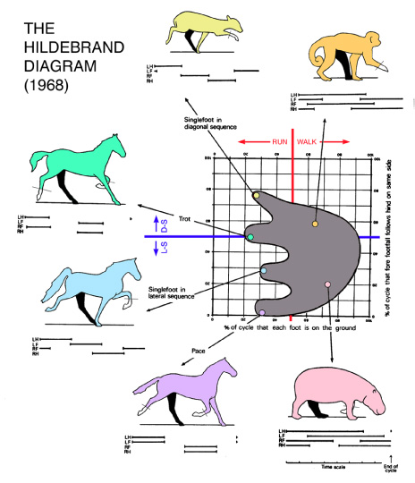

Slide 23
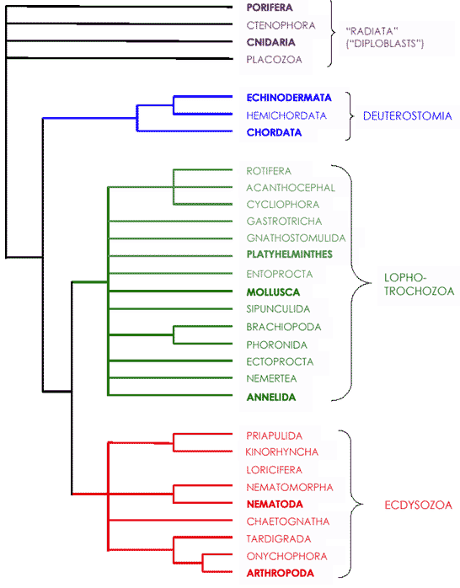
Trestman, 2013: only 3 phyla with “complex, active bodies,” meaning—
•Articulated and differentiated
appendages
•Many degrees of freedom of
controlled motion
•Distal senses (e.g., ‘‘true’’ eyes)
•Anatomical capability for
active, distal-sense-guided
mobility (fins, legs, jet
propulsion, etc.); and
•Anatomical capability for active
object manipulation (e.g.,
chelipeds, hands, tentacles,
mouth-parts with fine-motor
control).
These are the three groups in which our contributors have
discussed the possibility of mental convergence.
()

Slide 24
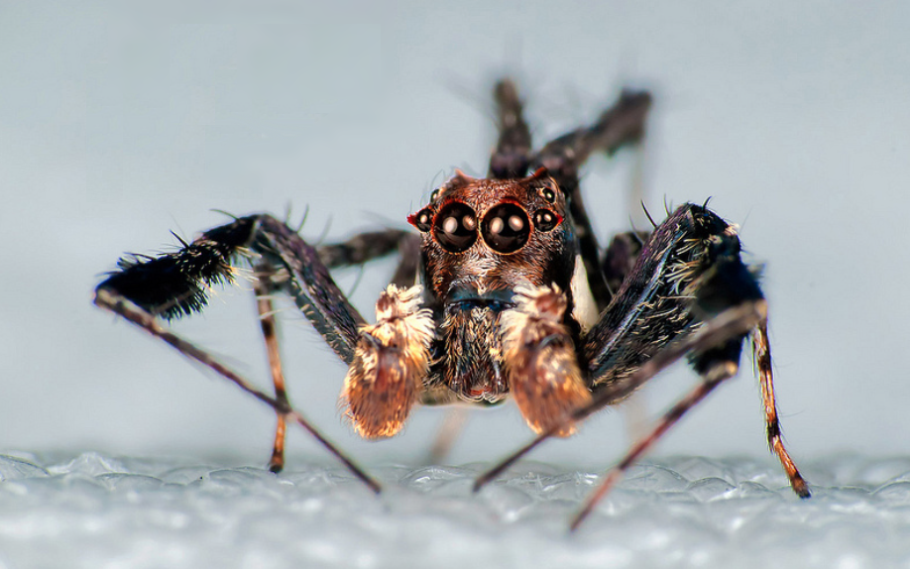

Slide 25
Trestman, 2013: only 3 phyla with “complex, active bodies,” meaning—
•Articulated and differentiated
appendages
•Many degrees of freedom of
controlled motion
•Distal senses (e.g., ‘‘true’’ eyes)
•Anatomical capability for
active, distal-sense-guided
mobility (fins, legs, jet
propulsion, etc.); and
•Anatomical capability for active
object manipulation (e.g.,
chelipeds, hands, tentacles,
mouth-parts with fine-motor
control).
These are the three groups in which our contributors have
discussed the possibility of mental convergence.
()

Slide 26
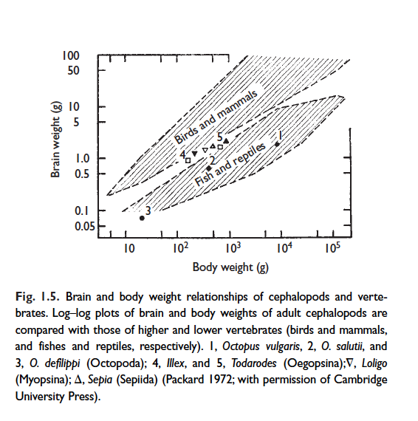

Slide 27
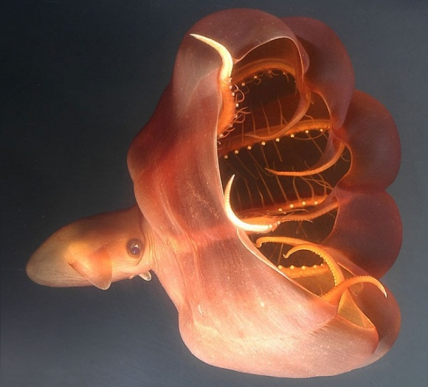
Vampyroteuthis infernalis

Slide 28
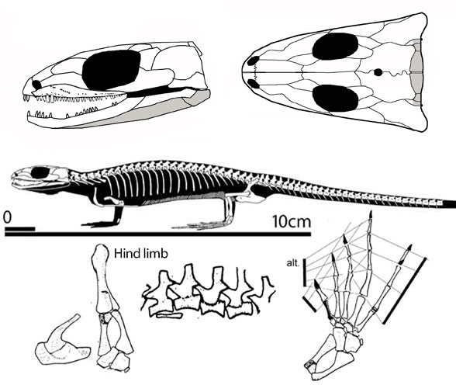
Hylonomus aciedentatus (Late Carboniferous, 312 Mya)

Slide 29
(Cartmill, 1990)

Slide 30
NO MATTER HOW WE DRAW THE (LOG-TRANSFORMED) LINE, THE VERY SMALL AND THE VERY LARGE FALL BELOW IT.
(Cartmill, 1990)

Slide 31
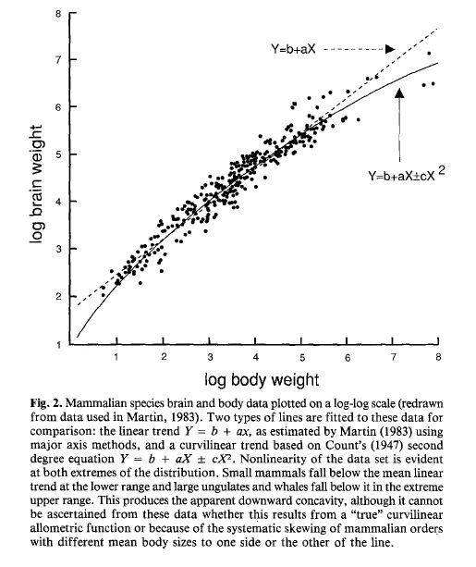
THERE IS NO EMPIRICAL OR THEORETICAL JUSTIFICATION FOR ASSUMING LOG-LINEARITY.
(Deacon, 1989)

Slide 32
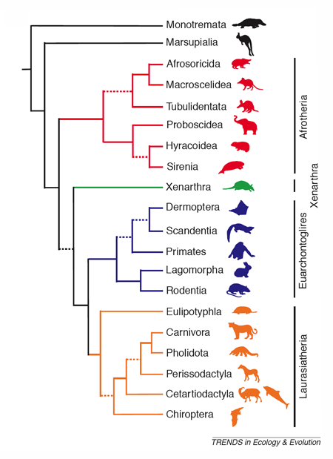

Slide 33
(Cartmill, 1990)

Slide 34
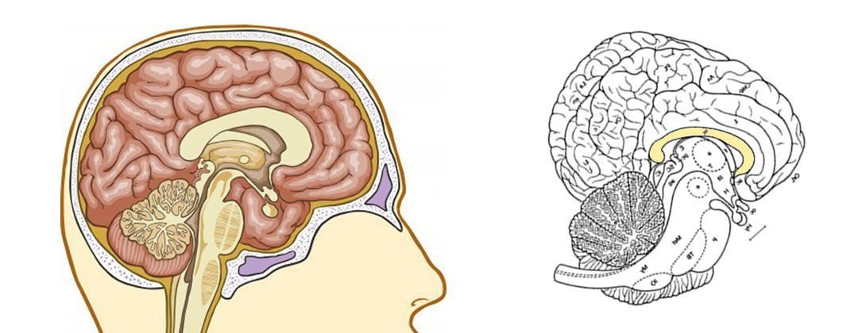

Slide 35
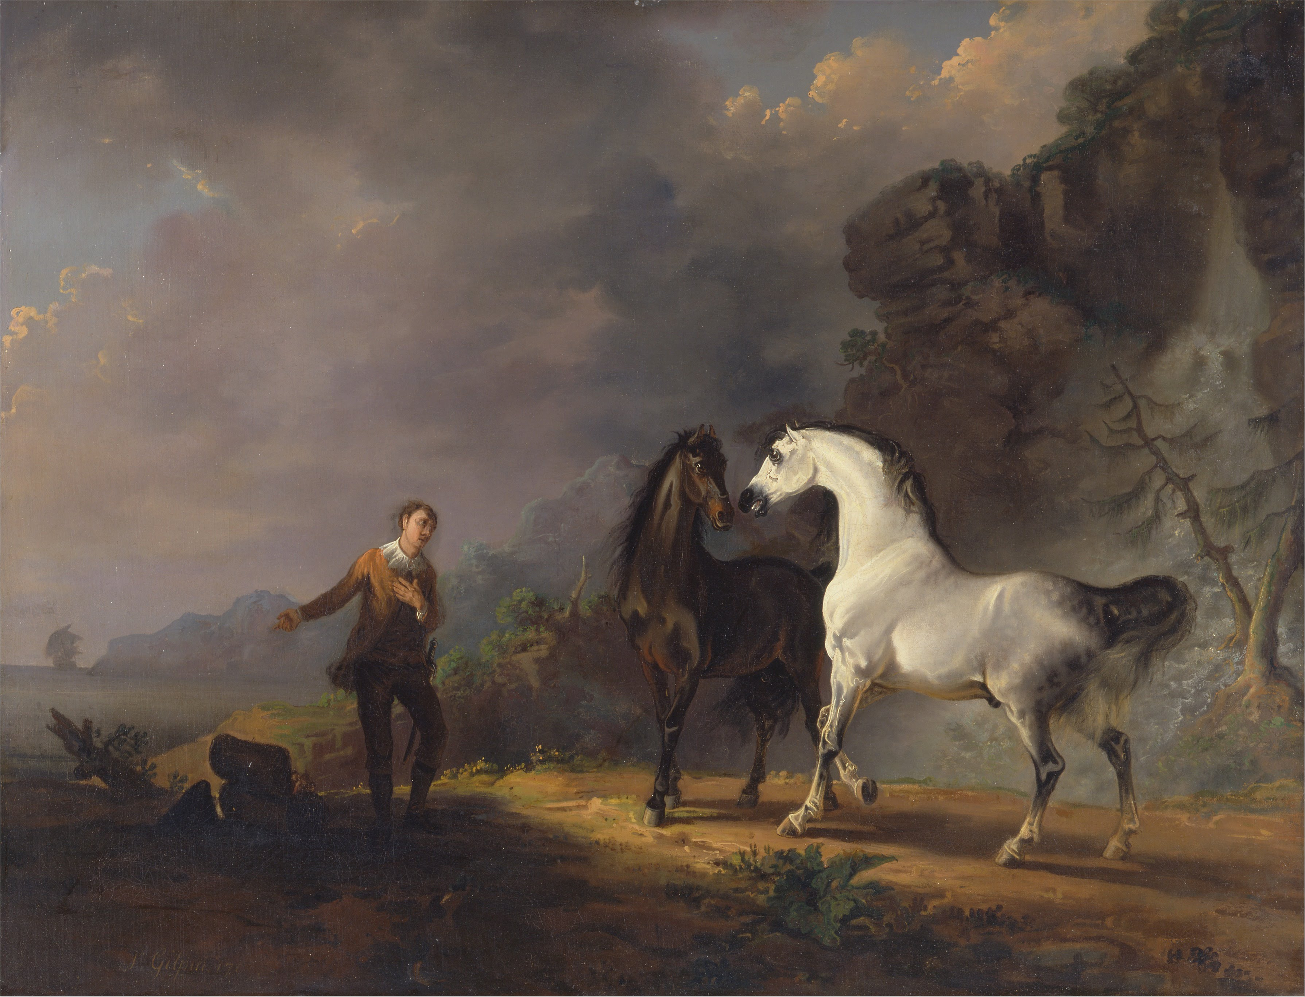
I remember, in frequent discourses with my master … having occasion to talk of lying and false representation... It was with much difficulty that he comprehended what I meant … For he argued thus: “that the use of speech was to make us understand one another, and to receive information of facts; now, if any one said the thing which was not, these ends were defeated, because I cannot properly be said to understand him; and … he leaves me worse than in ignorance, for I am led to believe a thing black when it is white, and short when it is long.” And these were all the notions he had concerning that faculty of lying, so perfectly well understood, and so universally practised, among human creatures.
—Gulliver’s Travels, Bk. 4, Ch. 5 (1726)

