Slide 1
SMART MOVES:
Is Behavioral Flexibility Evidence of Cognitive Complexity?
Irina Mikhalevich, Ph.D., Washington University-St. Louis
Russell Powell, Ph.D., Boston University
Corina Logan, Ph.D., University of Cambridge

Slide 2
The Assumption: Behavioral Flexibility is Evidence of Cognitive Complexity
  “Animal cognition is constituted by the processes used to generate adaptive or flexible behavior in animal species” – Andrews, “Animal Cognition” Stanford Encyclopedia of Philosophy
  “The general characteristic that nearly every test for cognition is meant to elicit is behavioral flexibility…” – Buckner 2015

Slide 3
The Problem
Assumption: Behavioral Flexibility (BF) is evidence of Cognitive Complexity (CC)
BUT:
The assumption is undefended
Defense is important: problem of underdetermination
Notes:
A proper defense would explain why BF is EVIDENCE for CC.
Place cognition and behavior in proper evolutionary context (“adaptive” in what sense?)
Clarify the notion of behavioral flexibility
Clarify the notion of cognition at work
Such a defense:
Offers grounds for broad-based comparisons across experiments in comparative cognition, grounding inferences in theoretical framework
Provides biologically unifying empirically-grounded account of the evolution of complex cognition
Currently, comparative cognition asks disjointed questions and has difficulty adjudicating among competing hypotheses. We think that this is due, in large part, to the absence of a unified theory of cognition and its relationship to evolution, environment, and behavior.
Ex: Association taken to rule out metacognition, so tests seek to rule out associative explanations first. If we can identify behavioral markers of complex cognition, then we can avoid relying on an unprincipled heuristic.
NEEDS A DEFENSE: in addition to offering a unifying account of the relationship between complex cognition and behavior, we also provide a qualified defense of employing the intuition in scientific methodology.
Need some hard-hitting examples here
Head off the objections from Carl:
*Why do we need a single scale and why call that “complexity”? (answer: Aids in methodology by explaining why the predictions are evidential

Slide 4
Underdetermination
Simplicity is no solution
Look beyond the experiment
Notes:
A proper defense would explain why BF is EVIDENCE for CC.
Place cognition and behavior in proper evolutionary context (“adaptive” in what sense?)
Clarify the notion of behavioral flexibility
Clarify the notion of cognition at work
Such a defense:
Offers grounds for broad-based comparisons across experiments in comparative cognition, grounding inferences in theoretical framework
Provides biologically unifying empirically-grounded account of the evolution of complex cognition
Currently, comparative cognition asks disjointed questions and has difficulty adjudicating among competing hypotheses. We think that this is due, in large part, to the absence of a unified theory of cognition and its relationship to evolution, environment, and behavior.
Ex: Association taken to rule out metacognition, so tests seek to rule out associative explanations first. If we can identify behavioral markers of complex cognition, then we can avoid relying on an unprincipled heuristic.
NEEDS A DEFENSE: in addition to offering a unifying account of the relationship between complex cognition and behavior, we also provide a qualified defense of employing the intuition in scientific methodology.
Need some hard-hitting examples here
Head off the objections from Carl:
*Why do we need a single scale and why call that “complexity”? (answer: Aids in methodology by explaining why the predictions are evidential

Slide 5
Talk Outline
Conceptual Decoupling
Simplicity & Underdetermination
Adaptive Triadic Model of Cognitive-Behavioral Evolution
Notes:
A proper defense would explain why BF is EVIDENCE for CC.
Place cognition and behavior in proper evolutionary context (“adaptive” in what sense?)
Clarify the notion of behavioral flexibility
Clarify the notion of cognition at work
Such a defense:
Offers grounds for broad-based comparisons across experiments in comparative cognition, grounding inferences in theoretical framework
Provides biologically unifying empirically-grounded account of the evolution of complex cognition
Currently, comparative cognition asks disjointed questions and has difficulty adjudicating among competing hypotheses. We think that this is due, in large part, to the absence of a unified theory of cognition and its relationship to evolution, environment, and behavior.
Ex: Association taken to rule out metacognition, so tests seek to rule out associative explanations first. If we can identify behavioral markers of complex cognition, then we can avoid relying on an unprincipled heuristic.
NEEDS A DEFENSE: in addition to offering a unifying account of the relationship between complex cognition and behavior, we also provide a qualified defense of employing the intuition in scientific methodology.
Need some hard-hitting examples here
Head off the objections from Carl:
*Why do we need a single scale and why call that “complexity”? (answer: Aids in methodology by explaining why the predictions are evidential

Slide 6
1. Definitions: Conceptual Decoupling

Slide 7
Cognition and Behavior
  “Animal cognition is constituted by the processes used to generate adaptive or flexible behavior in animal species”
  K. Andrews, “Animal Cognition” Stanford Encyclopedia of Philosophy

Slide 8
Special Circularity 1
  Lesson: Avoid building mechanisms into definition of phenomenon absent an evidence base suggesting that the mechanism is the cause of the phenomenon

Slide 9
Special Circularity 1 cont.
  Example:
Explanadum: Natural Design
Potential Explanans: Natural Selection
Biological Function
=_{def}
traits produced by mechanism of natural selection

Slide 10

Special Circularity 2
  Know: Pine is a tree
  Observe: There is a Pine
  Learn: There is a tree.
  Non-ampliative “evidence” is not
  interesting evidence
Notes:
Behavioral flexibility is often defined as that which is possible as a result of complex cognitive feats but this is inadmissible:
NOTE TO SELF:
Special circularity is the practice of defining behavioral flexibility in terms of cognitive complexity and is a mistake when behavioral flexibility is called upon to serve as evidence for cognitive complexity. This move is common in comparative cognition and in philosophical action theory, where behavior is distinguished from mere movements because the former is defined in terms of its motivational drivers. It is also natural because cognitive mechanisms serve as explanations for behaviors. For example, awareness of her own uncertainty explains why a rat correctly chose to decline taking a difficult test (Crystal & Foote 2007). However, this move is only permissible in cases where we already know the causes of behavioral flexibility. If we know the causes in advance – e.g., if we know that jumping spider detouring behavior (a subset of BF) is caused by a cognitive map (a form of CC) – then BF cannot be novel evidence of CC. Our account of evidence requires that the observed behavior serves as a proof.
But why, somebody may wonder, can’t the observation of BF on an account that defines BF in terms of the proximal cognitive mechanism serve as proof of CC? In the abstract, our condition seems peculiar: after all, armed with the knowledge that a pine is a kind of tree, isn’t the presence of a pine evidence of the presence of a tree? Perhaps, but this sense of evidence is uninteresting since it requires the observer of the pine to have prior knowledge of the conceptual relationship between the idea of a pine and that of a tree. As a result, presenting me with a pine when I already know that pines are trees tells me nothing new. However, conventional notions of evidence suggest that empirical evidence ought to add something to what we know. Thus, in order to serve as evidence in the ampliative sense, a defense of the intuition that BF is evidence for CC must avoid the problem of “special circularity” by refusing to build cognitive mechanisms into the account of behavior. Given this difficulty, how might we define behavioral flexibility?
Quote Cittka or non-arbitrariness
For instance, after honeybees were discovered to be capable of learning, the criterion of “learning” as a mark of “intelligence” was discarded (Chittka et al. 2012, 2678). Chittka et al. lament that “there may be good reasons not to equate learning speed with intelligence, but the fact that humans do not top the chart should not be one of them” (ibid). However, this incident is not rare and comparative cognition is notorious for moving the goal posts for what counts as a marker of cognition in response to findings that animals who were not previously expected to be capable of some ability – say, learning in honeybees– were, in fact, capable of it. Definitions of cognition should not be shaped by the intuitions about which entities are likely cognitive or by the changes in the research program that these intuitions drive.

Slide 11
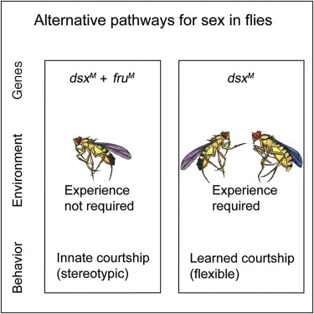
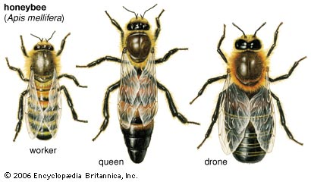
Behavioral Flexibility
Behavioral trait modification (recombination) during the lifetime of the organism.
Significant behavioral trait modifications (recombination) during the lifetime of the organism based on experience.
Phenotypic Plasticity
Behavioral Plasticity
Morphological Plasticity
Behavioral Flexibility
(Rigid Behaviors)
Notes:
We will further distinguish behaviorally rigid repertoires, even if diverse and subject to early ontogenetic modification, from those that are capable of significant modification throughout the lifetime of an organism based on experience.
Another point: bees have about 60 fixed behaviors but many flexible ones; so: same animal but both fixed and flexible behavioral types: ~ 60 rigid behaviors in honeybee workers
-Chittka & Neven 2009

Slide 12
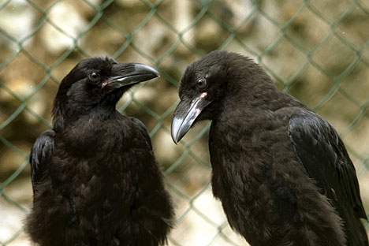
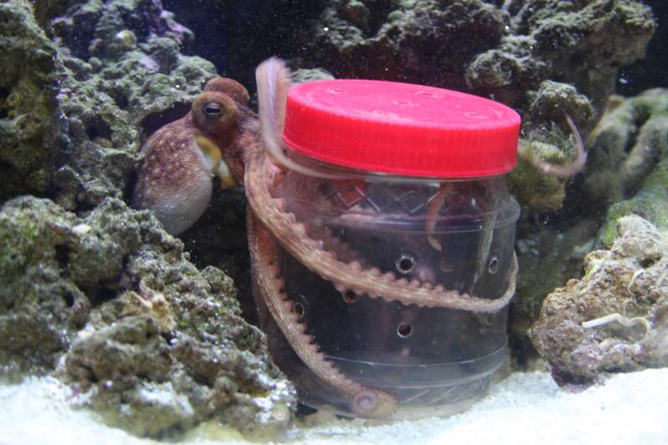
Behavioral Flexibility: Handful of Examples
1. Raven consolation (Photo: Thomas Bugnar); 2. Octopus opening jar

Slide 13
Cognition
Information-processing approach
…least controversial…

Slide 14
Cognition in Comparative Cognition Science
“Cognition refers to the mechanisms by which animals acquire, process, store and act on information from the environment.”
- Shettleworth Cognition, Evolution, and Behavior 2012

Slide 15
“Big Tent” Approach to Cognition
Most phylogenetically inclusive
Fit evolutionary-ecological framework

Slide 16
Cognitive Complexity: Informational Approach
Total quantity of information processed?
No.

Slide 17
Cognitive Complexity: Informational Approach cont.
Complexity of cognition measured by kinds of information animals extract from environment
Concrete features of the environment: percepts (redness); bound representations ([this] poppy)
Abstract features of the environment: concepts (flower; mate), relations (same/difference/ caused-by; lower-than/)

Slide 18
2. Underdetermination

Slide 19
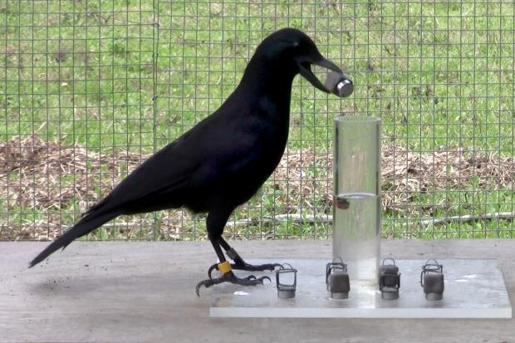
The Problem of Underdetermination in Comparative Cognition
Planning?
…
Associative chaining?

Slide 20
Prefer Simplicity Heuristic
More complex explanation
…
Simpler explanation

Slide 21
3. Adaptive Triadic Model of Cognitive-Behavioral Evolution

Slide 22
Starting Points
Behavioral Flexibility
Cognitive Mechanisms Heterogeneous Sophisticated Brains Environment

Slide 23
Environmental Complexity Thesis (Godfrey-Smith 1996, 2002)
The evolutionary function of cognition is to enable organisms to interact in fitness-enhancing ways with a heterogeneous environment by exploiting ecologically relevant information

Slide 24
Adaptive Triadic Model of Cognitive-Behavioral Evolution
Behavioral Flexibility
Heterogeneous Sophisticated Brains Environment

Slide 25
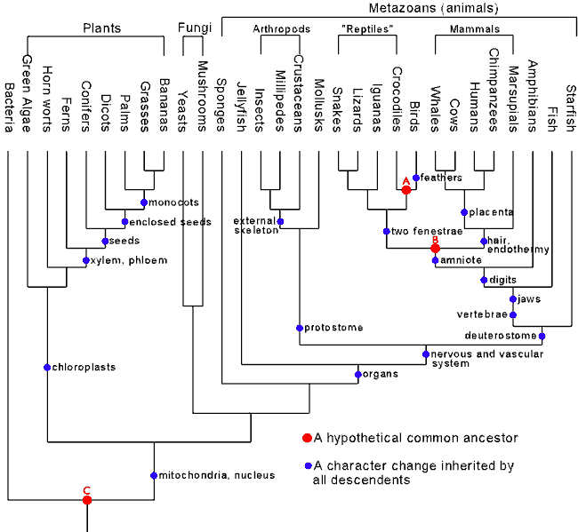
Convergence as Natural Experiment
Similarities in traits across broad array of taxa suggests convergence.
Convergent trait-environment clusters as natural experiments

Slide 26
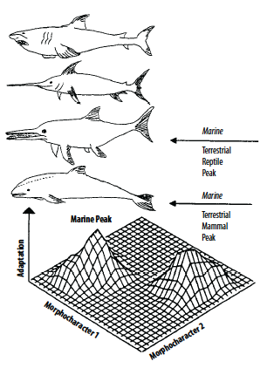
Convergence as Natural Experiment cont.
Some cases of convergence clearly implicate similar evolutionary functions
E.g., the independent evolution of dorsal fins and pectoral fins in aquatic environments in:
ichthyosaurs (Mesozoic reptiles)
marine mammals (dolphins)
Drawing from McGhee (2008)

Slide 27
Convergence as Evidence
Model Lineages Target Lineage X
Lineage 1: Trait A + Trait B + Trait C + Environment R.
Lineage 2: Trait A + Trait B + Trait C + Environment R. GIVEN: Trait A + Trait B +
Environment R
…
Lineage n: Trait A + Trait B + Trait C + Environment R. PROJECT: Trait C
A. Curry

Slide 28
Convergence as Evidence: Justification for projection
Depends on Model/Target Relations:
Homology: Reliable inheritance of developmentally interconnected features
Convergence: Biological regularity whose causes are largely external to the lineage – viz., shared selection regime

Slide 29
Convergence as Evidence for Adaptive Function
Convergent regularities permit us to:
… infer selective environments based on known traits
… infer traits based on known selective environments
… infer traits from other traits in known selective environment

Slide 30
Convergence as Evidence
Model Lineages Target Lineage X
Lineage 1: BF + CC + Neurol. Trait + Het. Env.
Lineage 2: BF + CC + Neurol. Trait + Hetero Env. GIVEN: BF + Het. Env. + Neurological Trait
Environment R
…
Lineage n: BF + CC + Neurol. Trait + Het. Env. PROJECT: CC
A. Curry

Slide 31
Environmental Heterogeneity: Working Definition
  Environment A of evolving lineage X is more heterogeneous than environment B of evolving lineage Y only if A contains more fitness-relevant informational signals in relation to X than B does in relation to Y.

Slide 32
Fitness Relevant Information Signals
  Informational signals about states of affairs that would, if detected and acted upon, have some net statistical effect on organismic fitness.

Slide 33
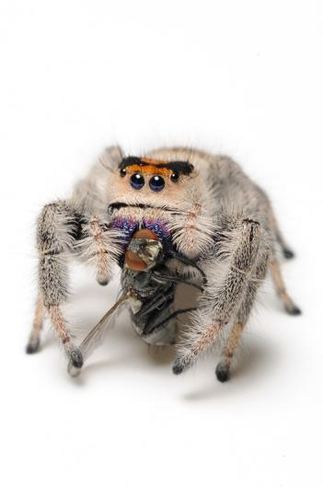
Two Dimensions
  Variability: Number of signal TYPES
  E.g. number of different prey types
  Predictability: REGULARITY of signal pattern
  E.g., not knowing which prey you may encounter

Slide 34
Predictions: when flexible behavior should fail to evolve
few fitness-relevant informational signals;
many fitness-relevant informational signals, but detecting them or responding to them entails a net loss of fitness due to some evolutionary tradeoff
there are many fitness-relevant informational signals but evolvability constraints prevent phenotypic variations as a result of which signal-detection systems never arise.

Slide 35
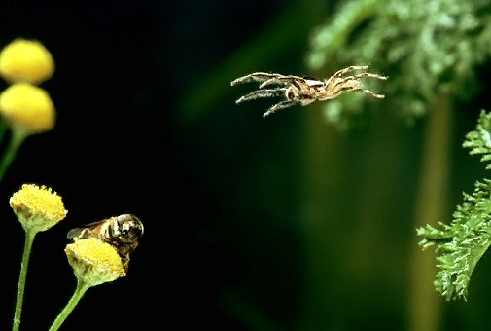
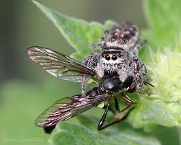
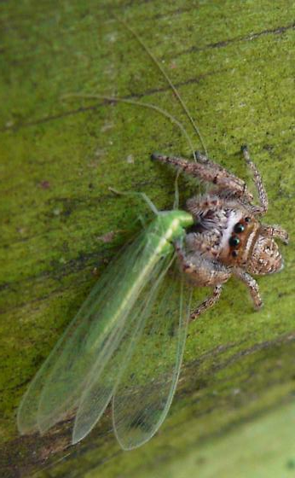
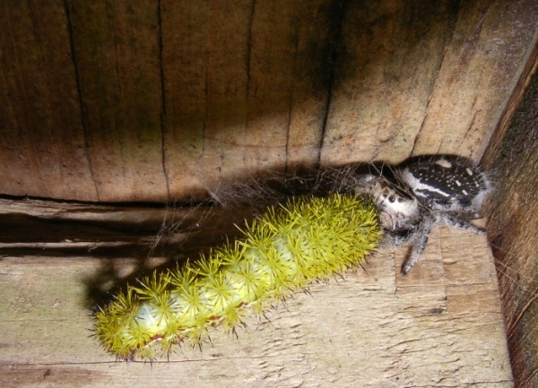
Predictions: Behavioral flexibility is expected to arise …
When animal lifeways strongly incentivize the detection and processing of a range of informational signals whose natures and sources vary substantially over space and time, development and evolutionary tradeoffs permitting.

Slide 36
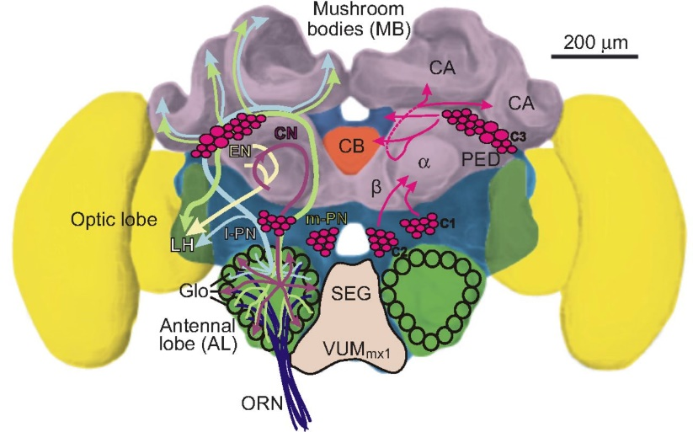
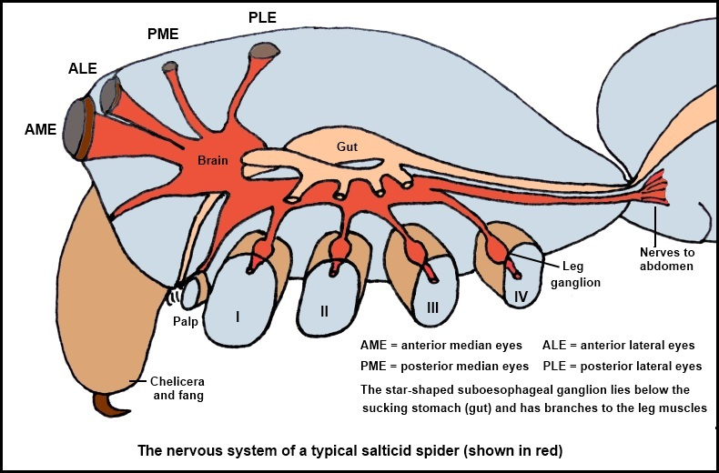
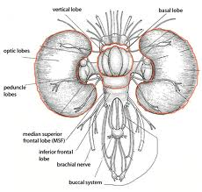
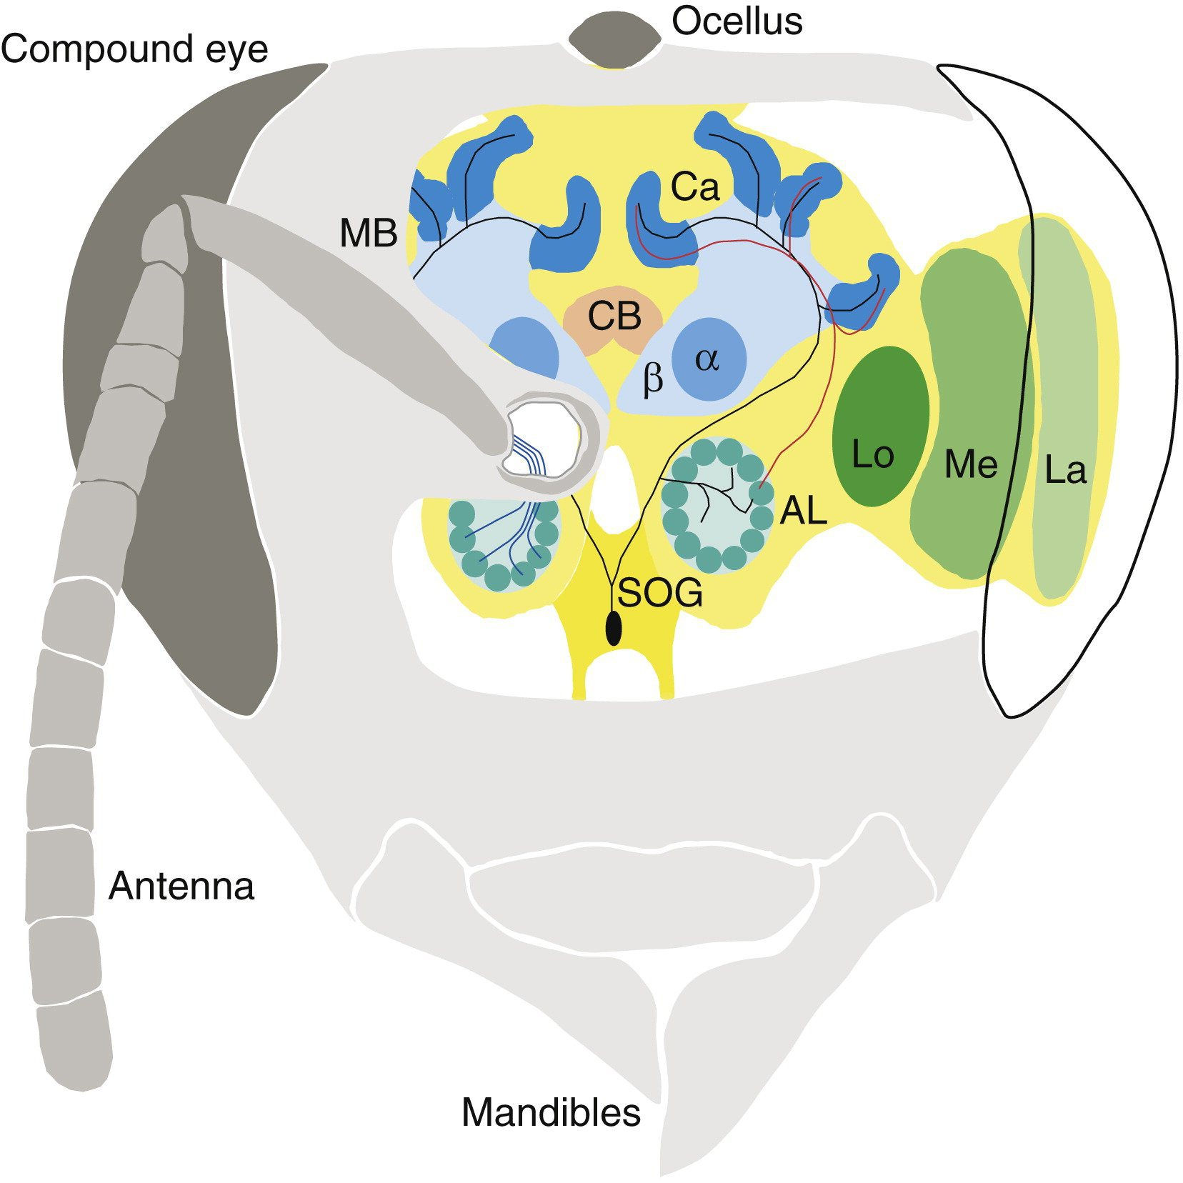
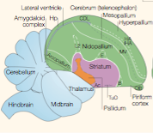
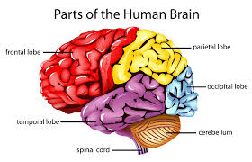
Neuroanatomical Convergence: Sample
1
2
Arthropod Mushroom Bodies
Octopod Vertical Lobe
Avian nidopallium & mesopallium
Human Brain
3
4
3. Avian Brain Nomenclature Consortium 2005
Notes:
Indeed, there is a growing body of evidence linking the encephalization or neuron density of brain regions associated with more abstract informational integration in mammals (the cortex including the neocortex and striatum), birds (the telencephalon including the nidopallium [previously neostriatum] and mesopallium [previously hyperstriatum ventrale]), octopuses (the central lobe), and insects (the mushroom bodies) to problem-solving abilities that evolved in the context of heterogeneous selective environments (e.g., Maguire et al. 2000; Patel et al. 1997, Jarvis et al. 2013, Albertin et al. 2015; Farris 2013; Grasso & Basil 2009, Snell-Rood et al. 2009).

Slide 37
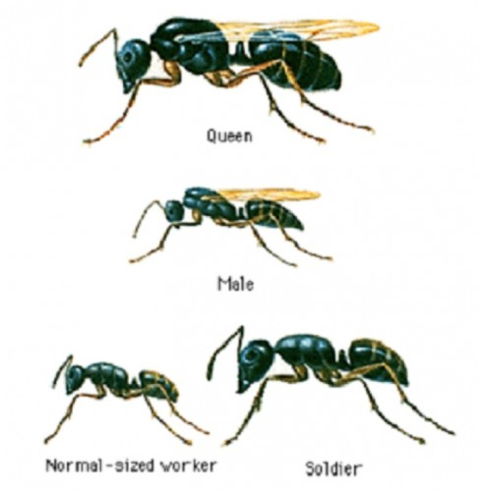
Counterexample 1
  Social Brain Hypothesis = subset of ATM
    Increased sociality → Increased brain size/structure
    BUT: Increased group size among ants → simplification of brains and behavior of individual ants

Slide 38
Counterexample 1 cont.
    Consistent with general principle: Complexification of individual permits specialization of parts, leading to the reduction of functional complexity of parts.*
    EXAMPLE: Single-celled eukaryotes → multicellular organisms
    ALSO TRUE FOR: Eusocial Hymenoptera**
    *McShea 2002
    ** McShea and Anderson 2001

Slide 39
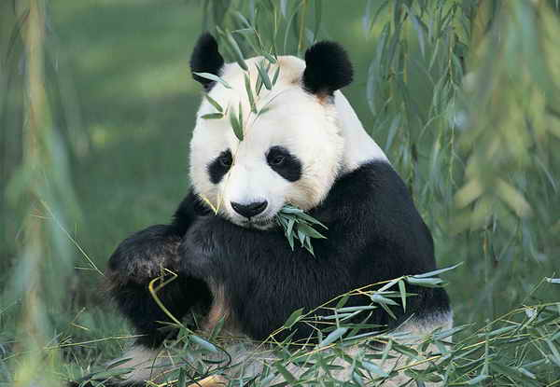
Counterexample Objection 2:
  Monotonous (vegetarian) food source
  BUT: Larger than expected brain to body ratio
  → Likely a holdover from ancestral forms
  Giant Panda

Slide 40
Concluding Thoughts
Answer to underdetermination problem in comparative cognition
Start to the evolutionary story: links for brain-behavior-cognition

Slide 41
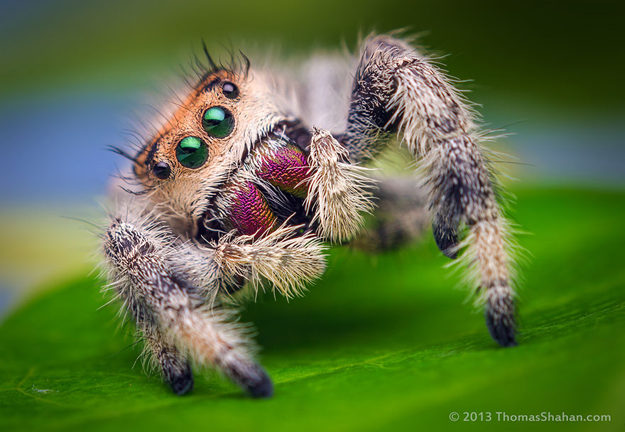
THANK YOU!
Irina Mikhalevich, Ph.D.
McDonnell Postdoctoral Fellow Washington University – St. Louis
irina@wustl.edu

Slide 42
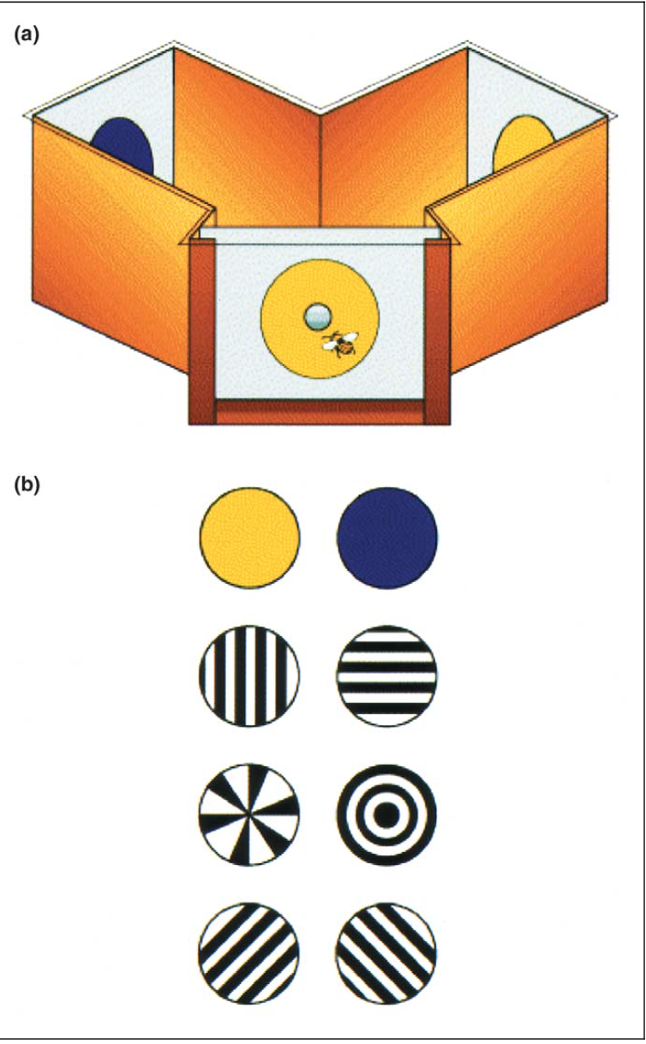
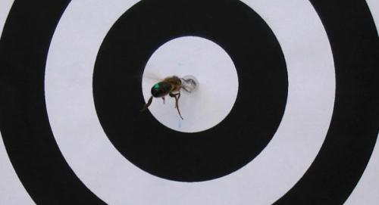
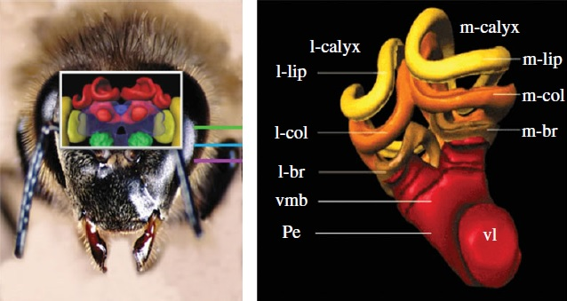
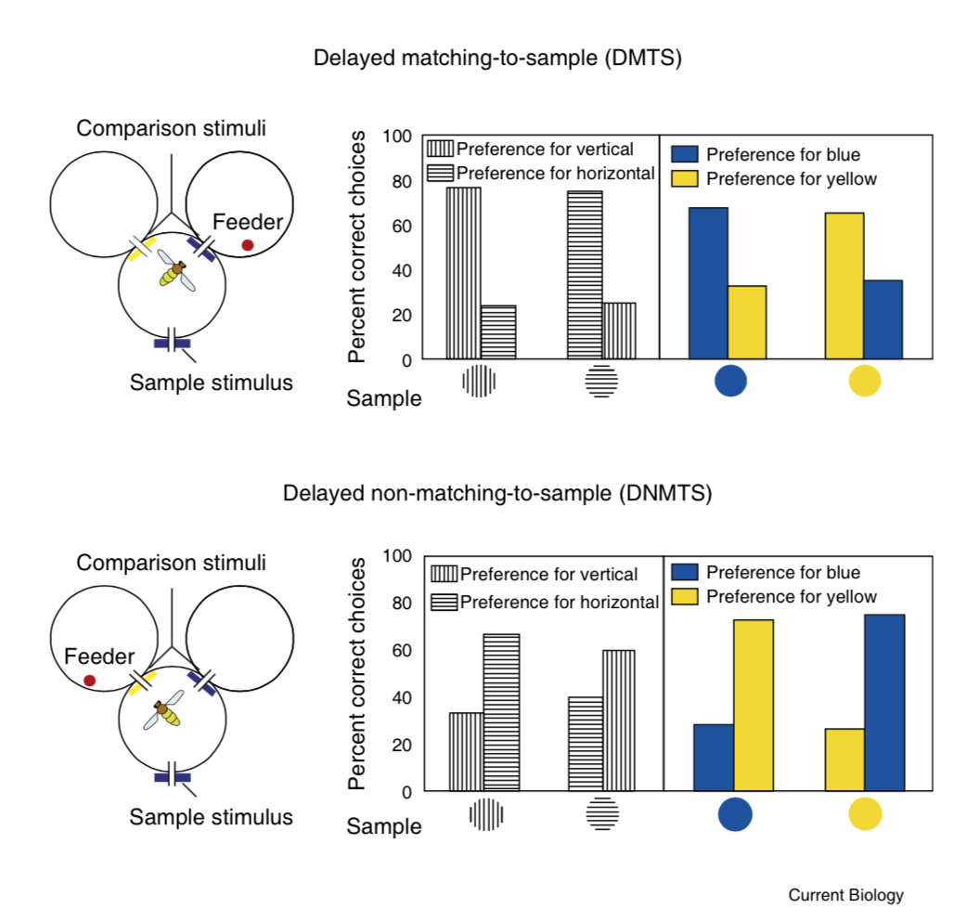
One example: Brain-Behavior-Environment Triad in Honeybees
(c)
(a)
(b)
(d)
Augmented mushroom bodies shown in red, reflecting hypertrophied ‘central processers’
(b)(c)(d): Pattern and concept learning in bees trained to recognize sameness and difference (both within and across sensory modalities). Bees are first presented with a stimulus, then enter a ‘Y’ maze, and are rewarded with sucrose.
and (b): From Avarguès-Weber & Giurfa 2013; (c): From Greenspan & Swinderen 2004; (d): From Chittka & Niven 2009
Notes:
So, what might such a case look like?

Slide 43
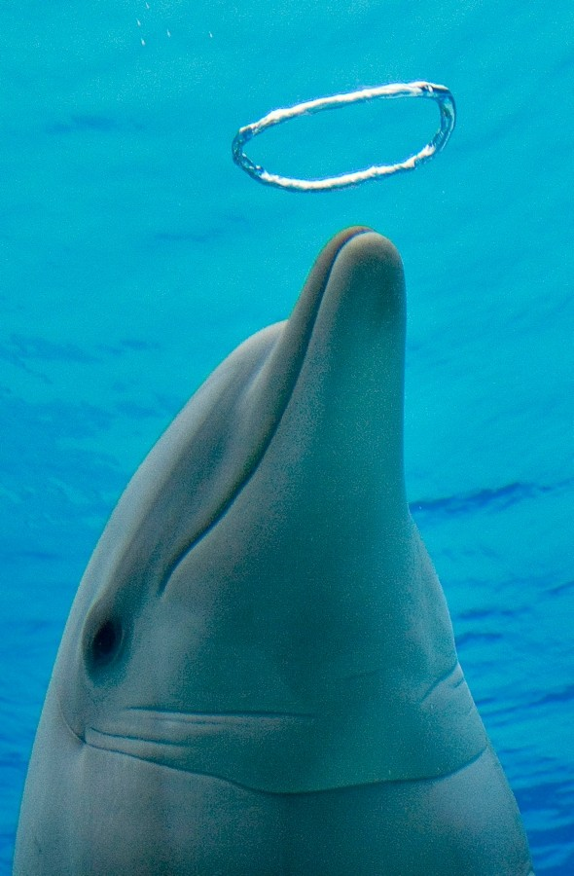
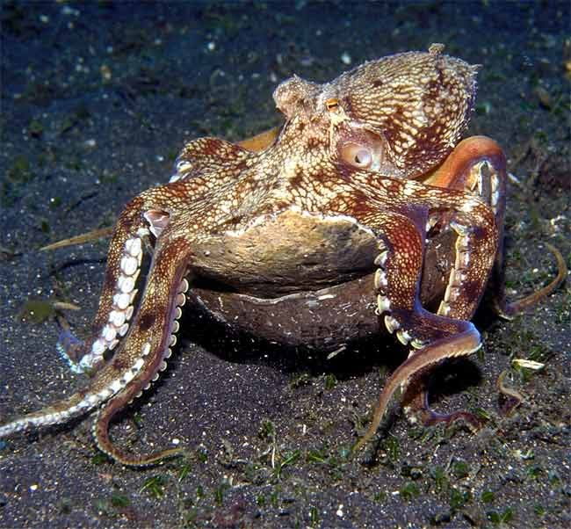

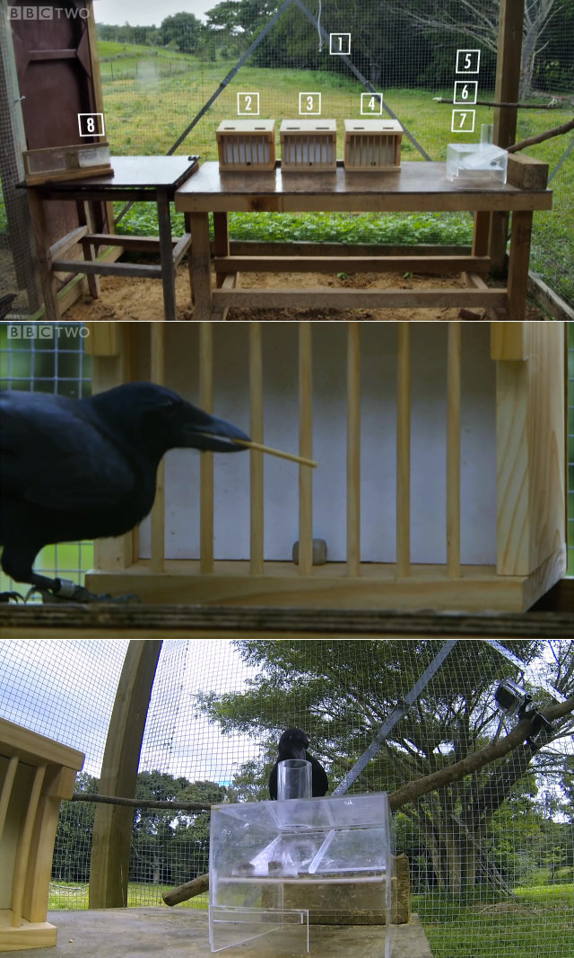
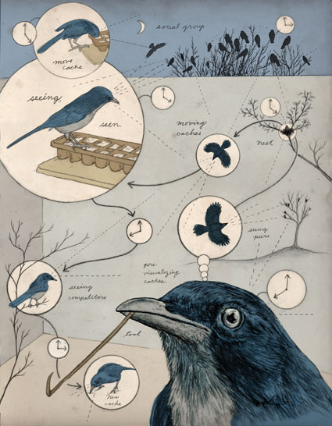
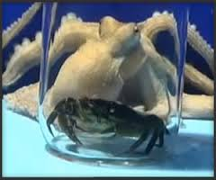
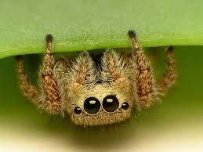
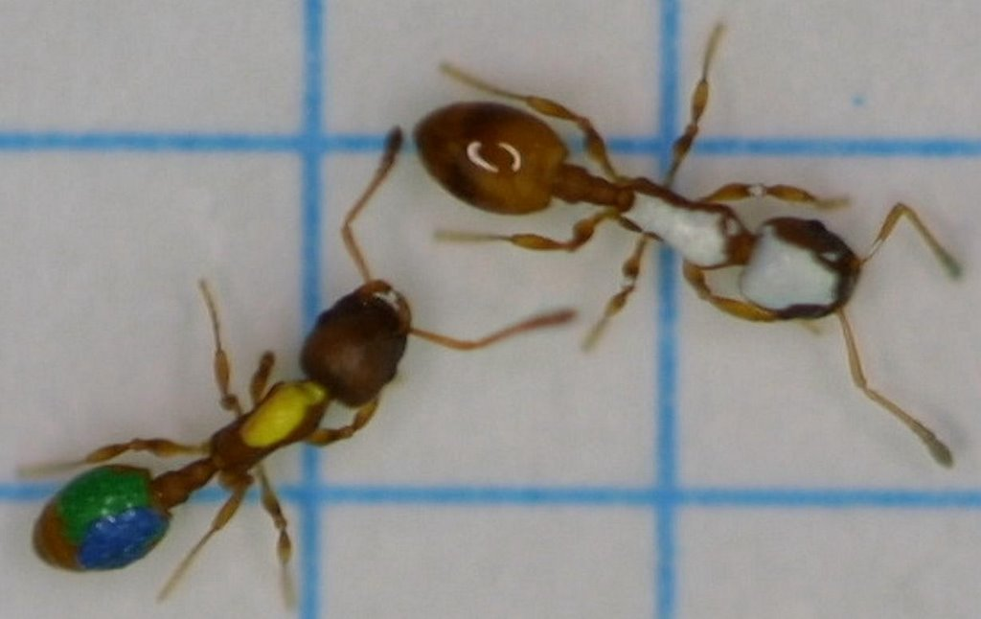

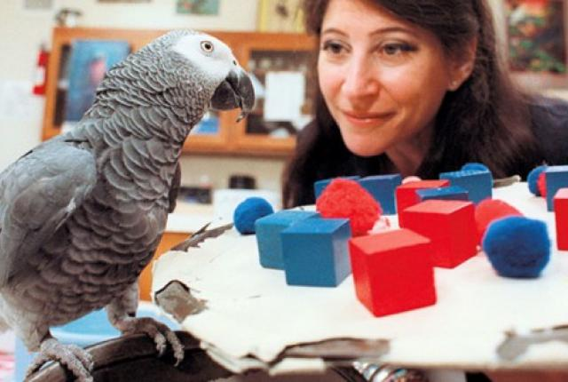
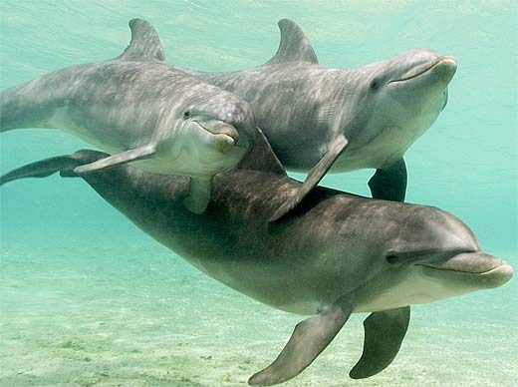
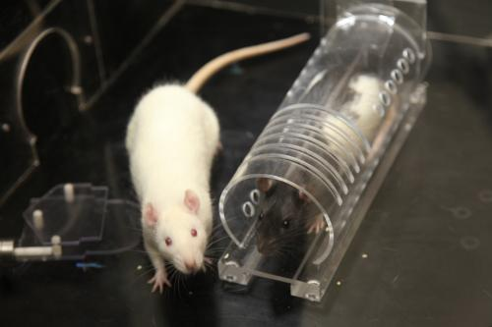
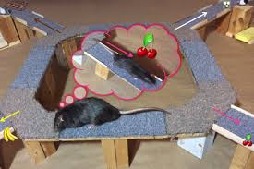
Notes:
I am not the first to note that these days rarely a week goes by without a study coming out about the latest sophisticated ability found in nonhuman animals. Just to name a small fraction:
1. Here is Chaser, the border collie, shows owner and emeritus professor of psychology has taught him over 1000 English words that refer to over 1000 unique objects.
2. Here is Alex the Parrot, who could answer correctly when asked to use multiple conceptual categories in a single task, such as identifying the number of objects based on similarities in shape, or the color of objects of a certain texture. He seemed to be able to count up to 7 and to innovate words and phrases.
3. We know dolphins to be playful, but they are the only species apart from humans that creates their own toys
4. And, living in complex fission-fusion societies where cooperation and competition require delicate social interaction, are candidates for a theory of mind.
5. They are not alone in this, since corvids such as the western scrubjay (poetically pictured here on the cover of Discover Magazine) appears to know when others are watching them store food and to re-cache their food more frequently when watched, especially if they have experience stealing others’ food – suggesting that they may understand the motivations of potential thieves based on their own experience.
6. Rats appear to show something like empathy for compatriots (though not for strangers)
7. And regret, as distinct from disappointment, after having made a poor decision as suggested by this “restaurant row” experiment, suggesting an awareness of their own complicity in the suboptimal outcome
8. Meanwhile, crows such as 007 here, have solved multi-stage puzzles, suggesting the ability to plan and use tools to execute these plans
9. While common octopuses have used discarded coconut shells for hiding, taking the shells for future use
10. And have even opened jars to reach a tasty crab
11. But there is more: Ants teach other ants in what is known as tandem runs;
12. Bees not only communicate using the waggle dance, but may also know the concept of same and different and learn rapidly
13. And tiny jumping spiders have been called the “jack of many trades, and master of them all” by the world expert on jumpers, Robert Jackson
Suppose that the research leading to these findings is mostly sound – what unifies these strands of research and inference? (NEXT)
Standard definition of cognition in comp. cognition trades on the notions of adaptive information processing and behavioral flexibility. This definition structures research programs by relying on the intuition that flexible behaviors are evidence of complex cognition.
We think that this intuition is largely right, but that it stands in need of some theoretical reorientation, which we offer.
For instance, the intuition that BF is evidence of CC is not defended and the definition of cognition in terms of adaptive information processing that leads to flexible behavior is problematic.
We believe that the intuition may be vindicated, but only by reinterpreting and reorganizing each of these components of the definition of cognition: i.e., adaptive, information-processing, flexible behavior.
We thus offer a biologically-grounded defense of the intuition by considering the conditions for the evolution of complex cognition across diverse lineages.
NEEDS A DEFENSE: in addition to offering a unifying account of the relationship between complex cognition and behavior, we also provide a qualified defense of employing the intuition in scientific methodology.
Currently, comparative cognition asks disjointed questions and has difficulty adjudicating among competing hypotheses. We think that this is due, in large part, to the absence of a unified theory of cognition and its relationship to evolution, environment, and behavior.

Slide 44
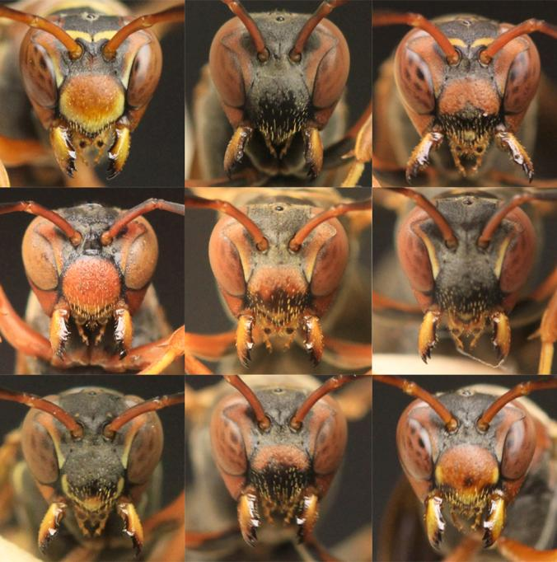
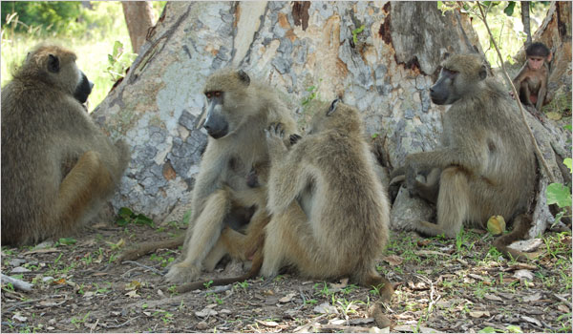

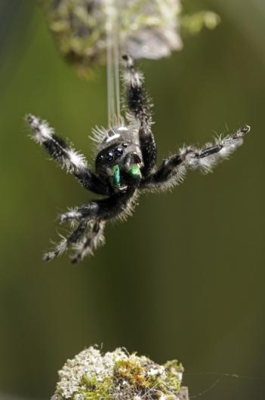
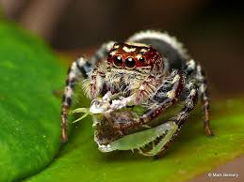
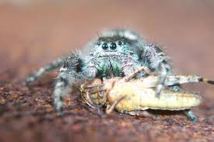
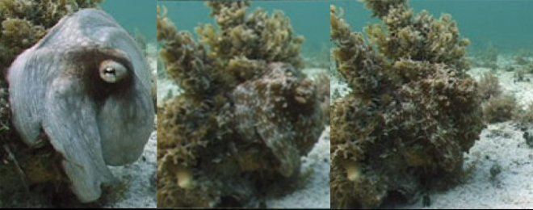
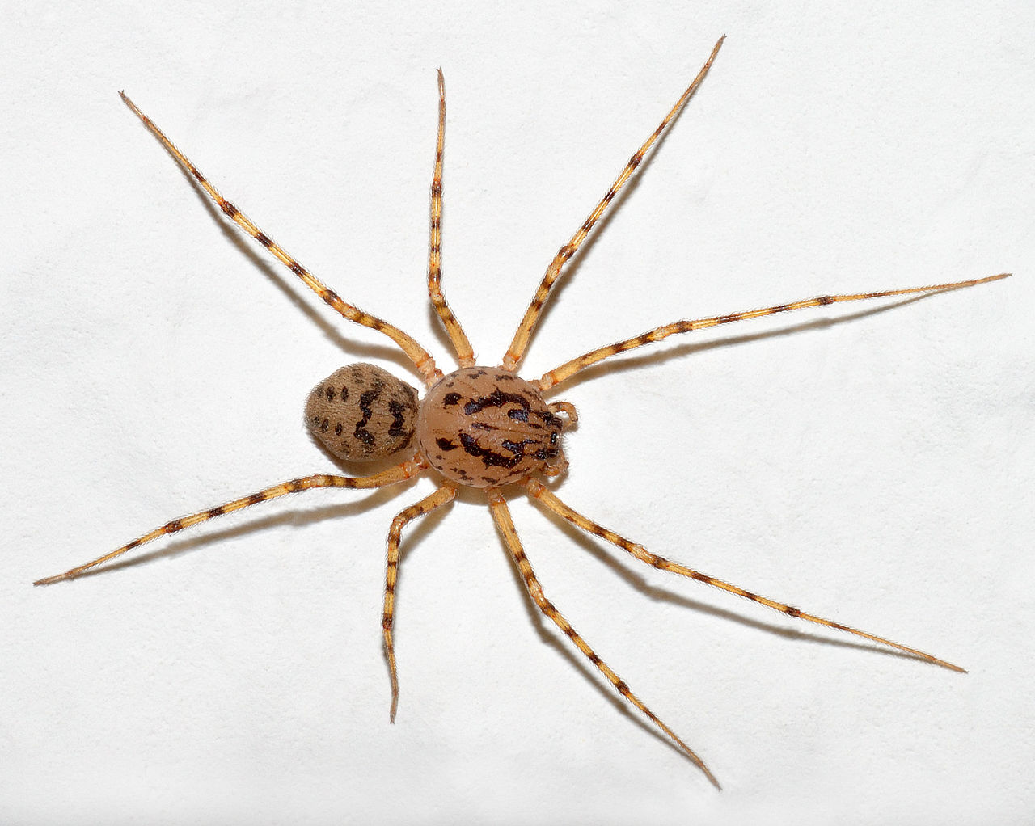
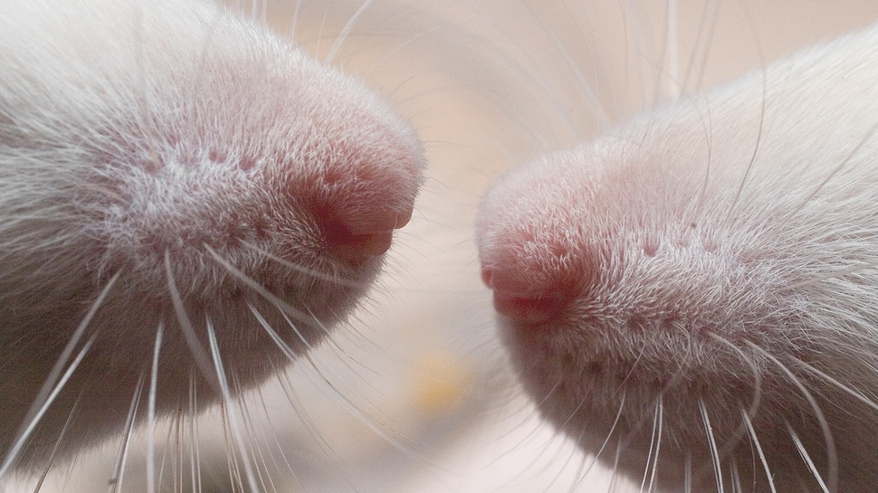
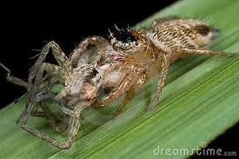
Heterogeneous social & physical environments in animals with neuroanatomical convergence

Slide 45
The Appeal to Simplicity Solution

Slide 46
Metabolic Argument & Simplicity

Slide 47
Against the Metabolic Argument for Simplicity

Slide 48
Defense of Simplicity 2: Association

Slide 49
Informational view + Buckner’s taxonomy + behavioral flexibility
Inhibition
Higher order
& abstract learning
Class formation
Multi-modality
Ex: Episodic-like memory; Metacognition
Expectation generation and monitoring
Context Sensitivity
Cue recognition
More rigid behaviors More flexible behaviors
Notes:
context-sensitivity (the ability to “react differently to the same cue in different contexts”);
speed (of problem solving – often used as an indicator of “insight”);
class formation (“the ability to group objects and situations into classes governed by a firm member/non-member distinction rather than by superficial perceptual similarity”);
“higher order and abstract learning” (e.g., analogical reasoning, same/different conceptual abilities);
multi-modality (“Multi-modality is the capacity to integrate and process cues across different sensory channels” (16));
inhibition (“The ability to inhibit behavioral strategies in the face of changing environmental circumstances” (18));
monotonic integration (the ability to “distinguish elemental conditioning from strategies that organize cues along monotonic dimension”, which order cues by increasing value” such as size (ibid)); and
expectation generation and monitoring.

