Slide 1
Cetaceans and Primates: Convergent Themes in Cognition
Lori Marino
The Kimmela Center for Animal Advocacy
Convergent Minds
The Evolution of Cognitive Complexity
Boston University 2015

Slide 2
Outline
What is convergence?
Background on primate and cetacean evolution
Convergent evolution of large brains
Convergent cognition
Conclusions

Slide 3
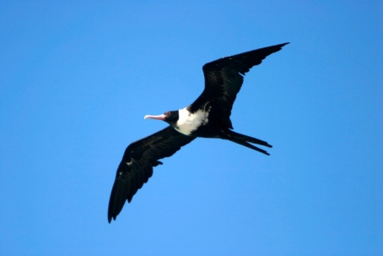
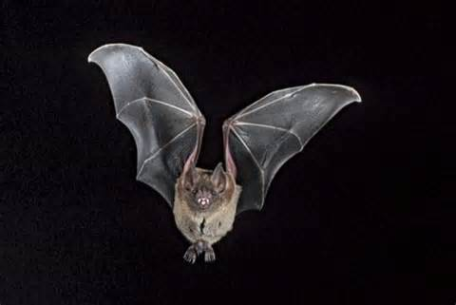

What is convergent evolution?
Convergent evolution is the acquisition of the same or similar biological traits in distantly-related lineages.
A
B
C
C
Analogous traits
Functional convergence is the acquisition of the same or similar biological functions in distantly-related lineages.
Example: flight

Slide 4
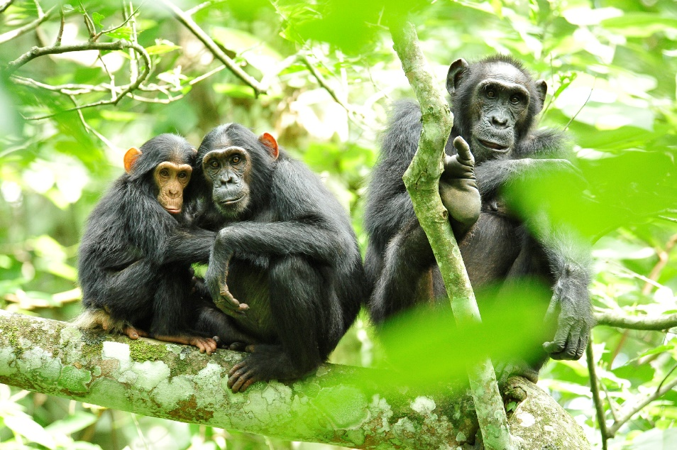
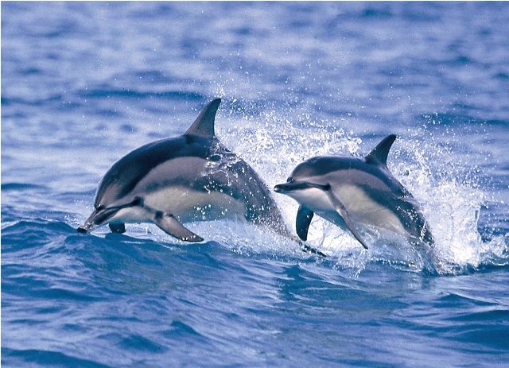

Cognitive Convergence
Convergence in those processes that comprise the way an organism thinks (functional definition).
Primates
Cetaceans
Phylogenetically distantly related (95 mya)
Evolved in very different physical environments
Represent different neuroanatomical paths to complexity

Slide 5
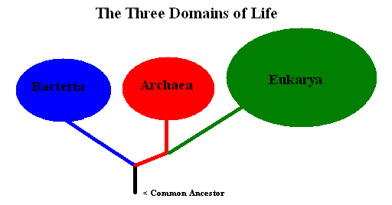
Convergence is relative – not all-or-nothing
(because all life on earth is related by common descent and evolution is conservative)
Homologies in basic mechanisms
of information
processing
How much do bottom levels constrain top levels?
(Phylogenetic inertia, historical burden, etc.)

Slide 6
Convergence depends upon the level of analysis
(because “examples of convergence” only “exist”
within defined contexts)
Functional? Flight - yes
Behavioral? Depends
Anatomical? Depends
Structural? Depends
Chemical? No
Molecular? No

Slide 7
Convergence is a complex concept and this is
Illustrated in comparisons of primate and cetacean
cognition.

Slide 8
Background

Slide 9
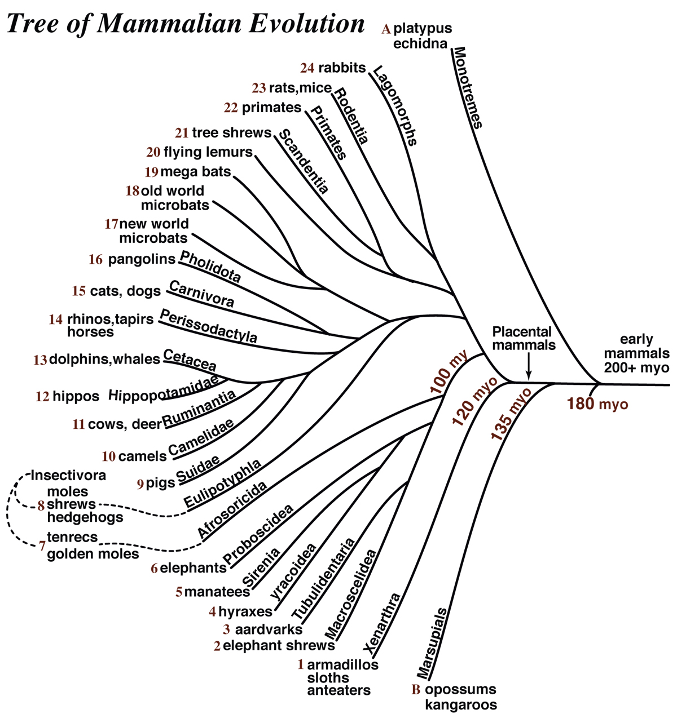
Most recent
ancestral group
that eventually
led to primates
and cetaceans
lived approx.
95 million years ago.
Courtesy of
Jon Kaas
Notes:
This is a tree depicting all of the major modern mammal groups. The main point I want to make with this slide is that cetaceans and primates – as mammals go – are deeply divergent taxa. If we place primates and cetaceans among other mammals in the family tree we have to go back at least 90 million years ago to find a common ancestor between these two orders.

Slide 10
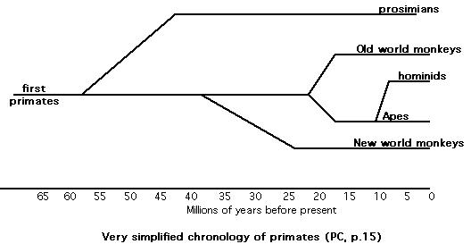



Very simple chronology of primate and
cetacean evolution
Modern
Humans
(200K ya)
Mysticetes
Odontocetes
Modern
odontocetes

Slide 11
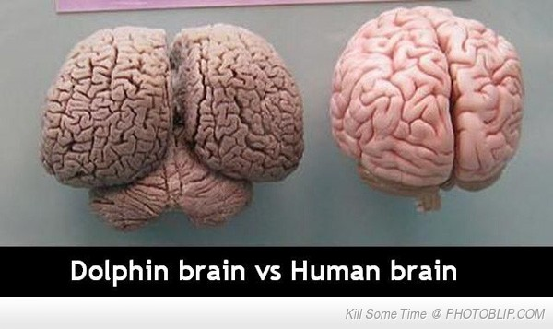
Evolution of Large Brains
In Primates and Cetaceans
The common ancestor of primates and cetaceans did not possess a large brain and, by inference, was not especially cognitively sophisticated. Therefore, any cognitive features shared by modern cetaceans and primates that we can reasonably expect were absent in the common ancestor are contenders as examples of cognitive convergence
1800 g
1300 g

Slide 12
Encephalization Quotient (EQ)
The extent to which a species’ average adult brain size exceeds (or falls below) the size that would be expected compared with other species of the same body size.
EQ = 1 “average”
EQ <1 “below average”
EQ >1 “above average”

Slide 13
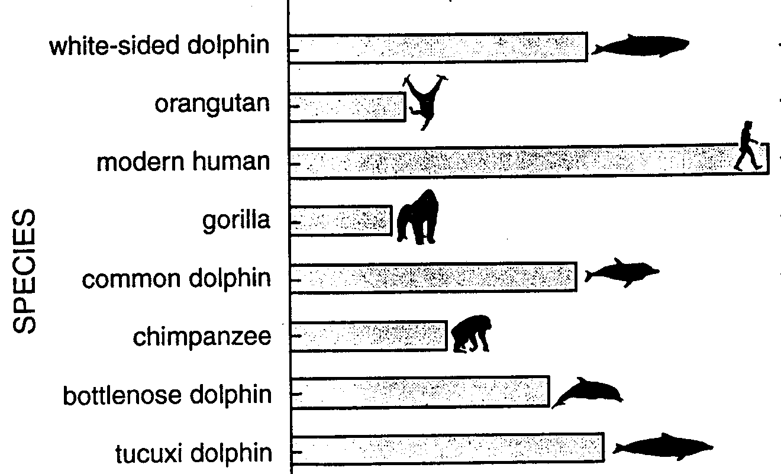


Convergent for Large Brains and High EQ Levels
Modern delphinids have the second highest EQs on the planet next to modern humans (and greater than our ape relatives)
*
*
*
*
rough-toothed dolphin
Orca
* = p < .05
1.0
Average
3.0
5.0
7.0
Marino (1995, 1998, 2002, 2004)
EQ
Notes:
When you compare the EQ of humans, great apes and several odontocete species you find that not only do odontocetes have large brains in absolute sense but are significantly more encephalized than any other animals except modern humans.

Slide 14
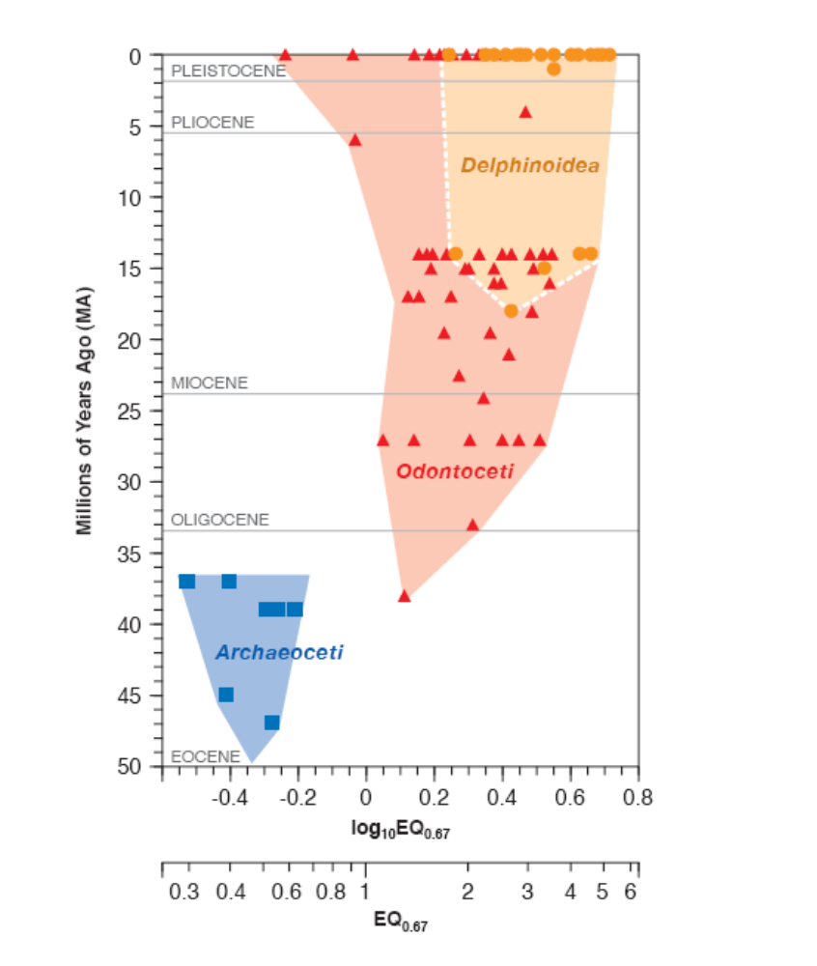
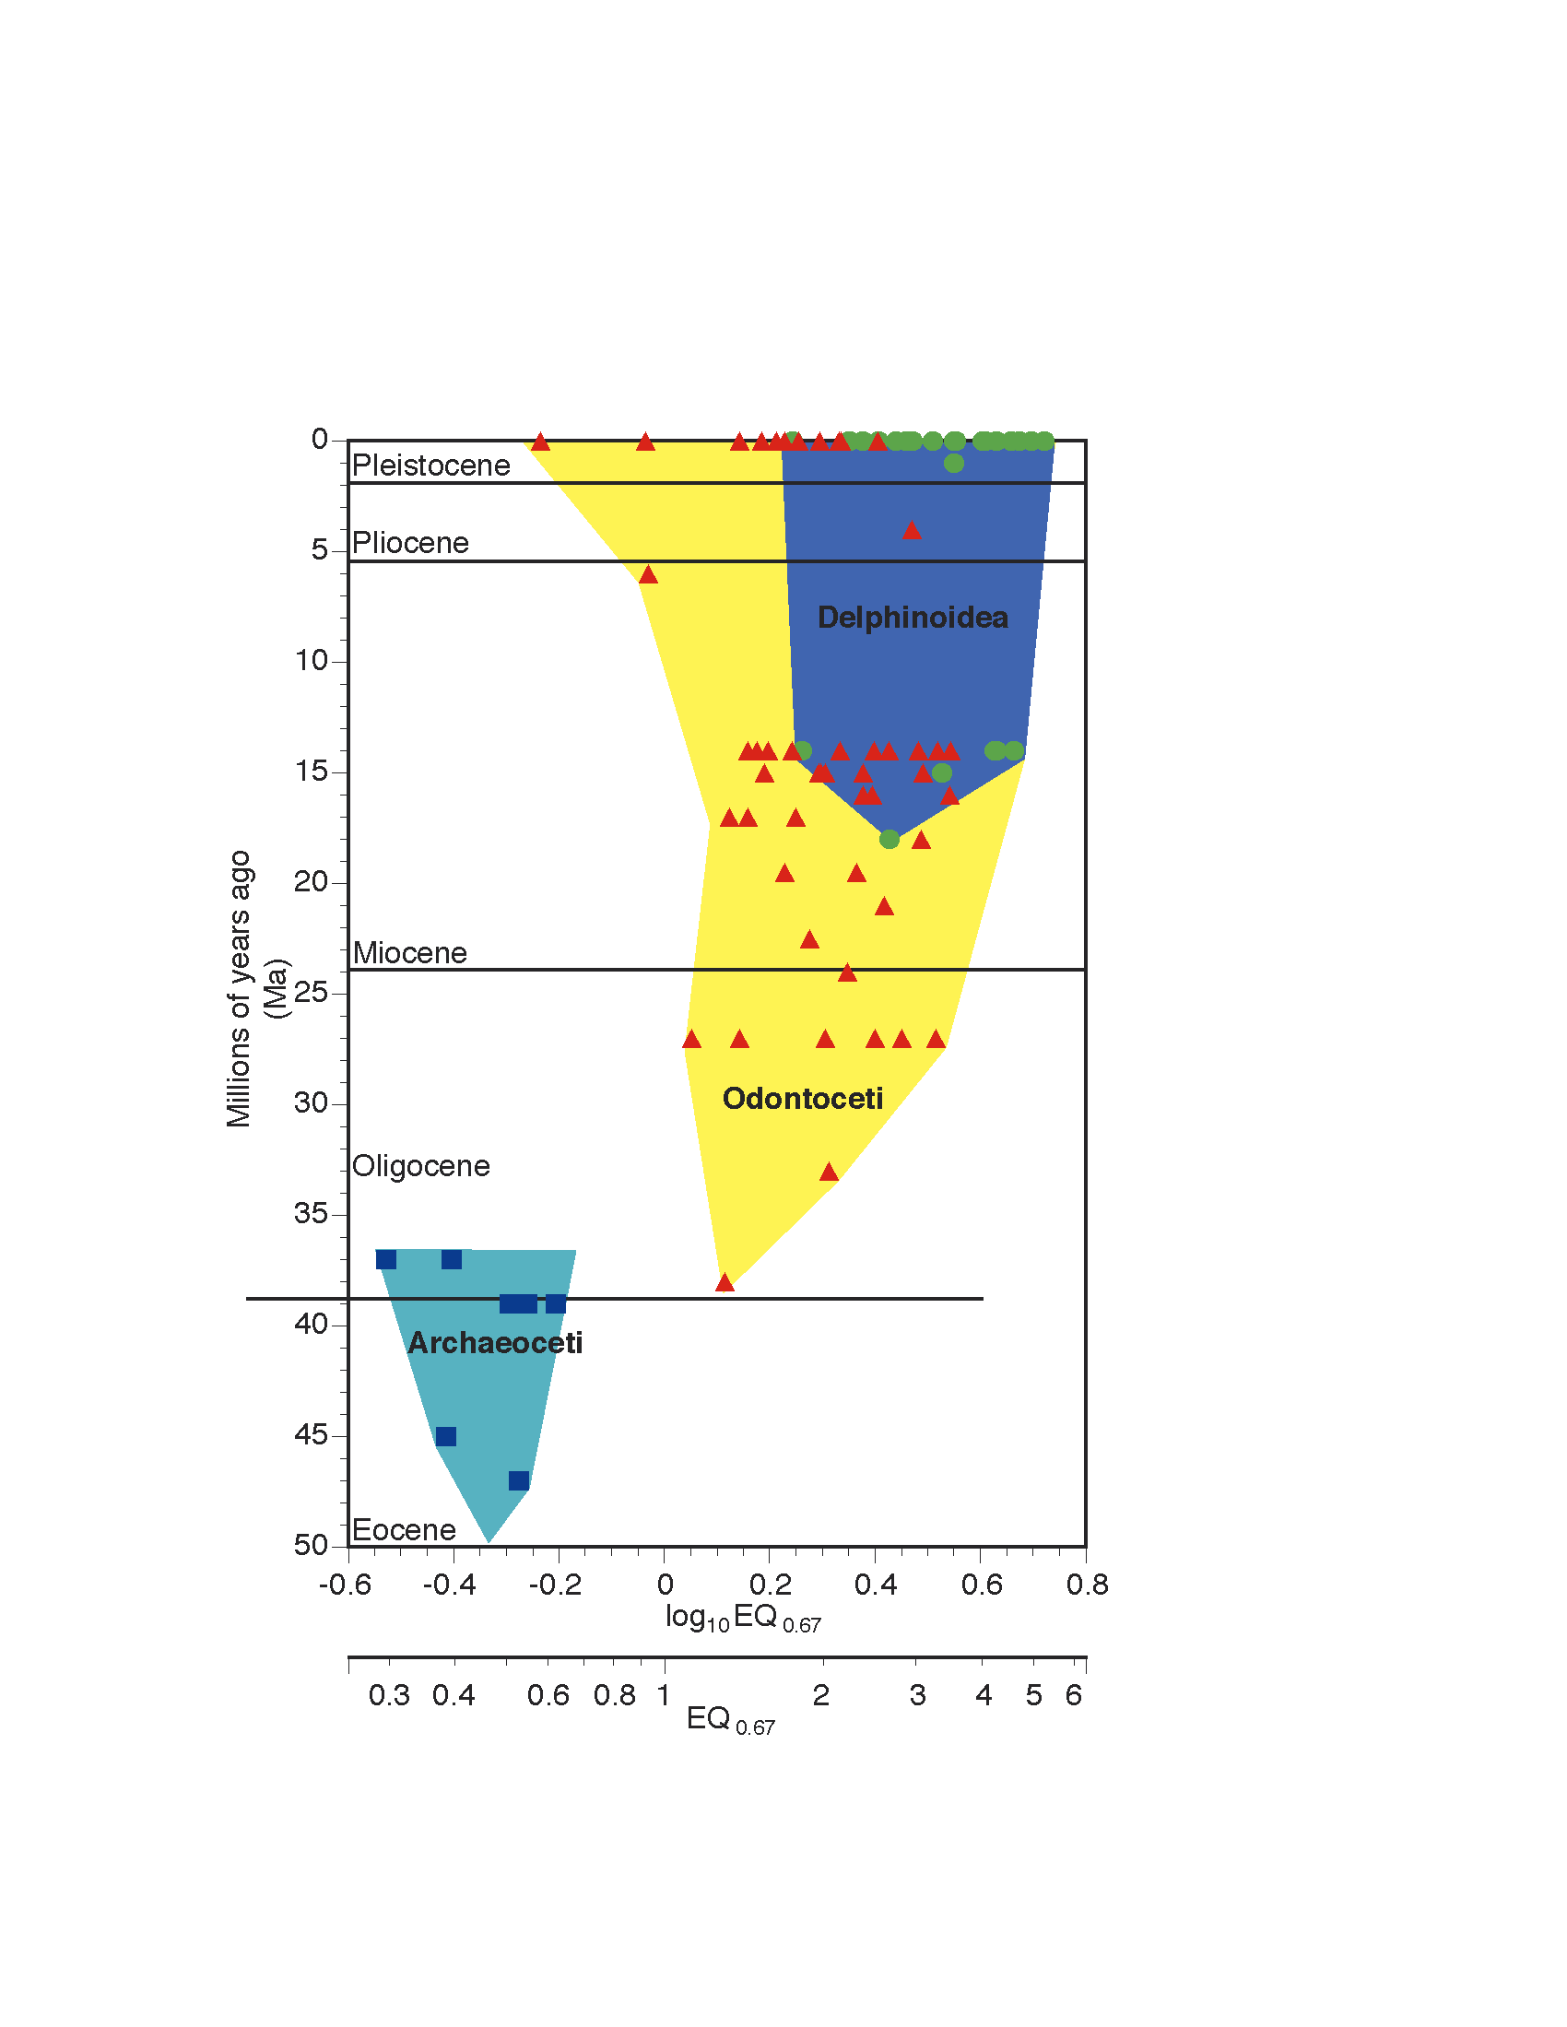
Odontocete EQ increased significantly ~ 35 mya
Marino, McShea, and Uhen (2004)
Notes:
We found that cetaceans started with very low EQ. About 35 mya there was a significant increase in EQ with the radiation of early modern groups- neocetes. There was a second increase in Delphinoids only more recently – by about 15 my. No overall changes since then.

Slide 15
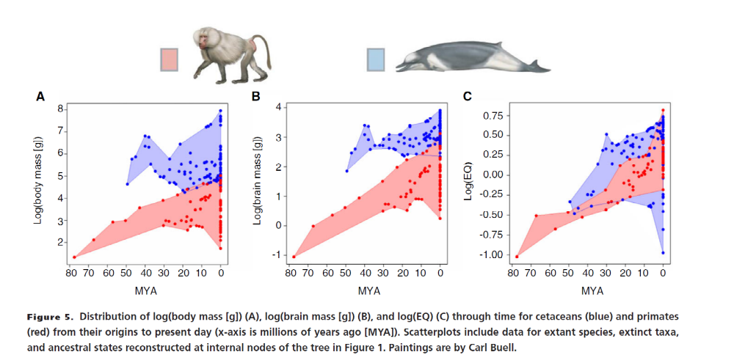
Contrasts in Encephalization Patterns
Cetaceans reached higher levels of EQ before primates (Panel C).
In contrast to cetaceans, primate evolution is characterized by a directional upward
trend in brain mass, not body mass, resulting in a strong trend toward increasing relative brain size. No such trend is found in cetaceans.
Montgomery, Geisler, McGowen, ox, Marino, Gatesy (2013)

Slide 16
When brains enlarge they do not simply become larger versions of the smaller form. When brains enlarge they reorganize and add new features in order to maintain connectivity and processing rate.
Primate and cetacean brains took two different paths (divergence) to becoming large (convergence).

Slide 17
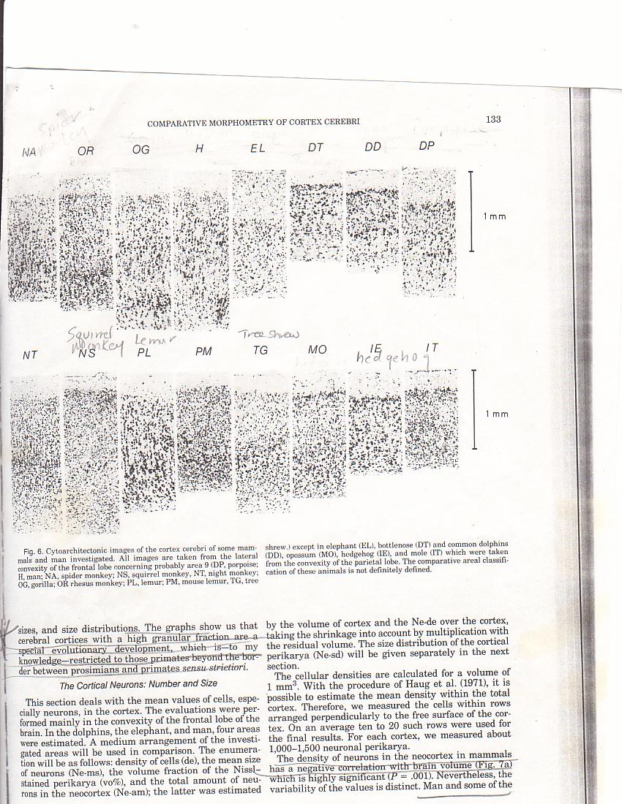
Bottlenose
Dolphin
Gorilla
Human
I
I
II
II
III
1 mm
III
V
VI
IV
V
VI
Haug, 1987
Notes:
One of the fundamental ways cetacean cortex and primate cortex is different is level of granularity.

Slide 18
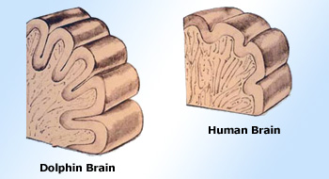
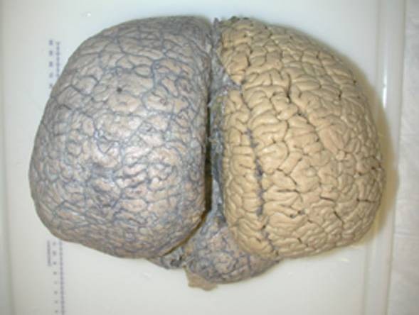
Neocortical expansion
The dolphin and whale neocortex is thinner than modern human neocortex
but has more surface area.
Surface area~3745cm²
Surface area~2275cm²
The adult orca brain is the most convoluted brain on earth.
Marino et al (2004)

Slide 19
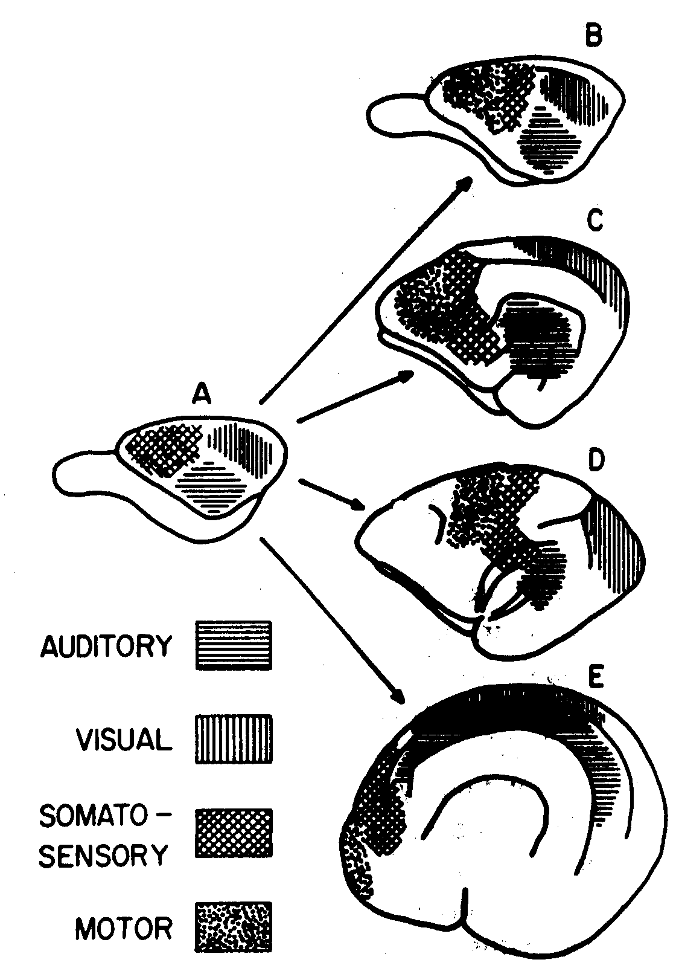
TOPOGRAPHY OF PRIMARY AND SECONDARY PROJECTION REGIONS
Rabbit
Cat
Rhesus monkey
Bottlenose dolphin
from Morgane et al. 1986

Slide 20
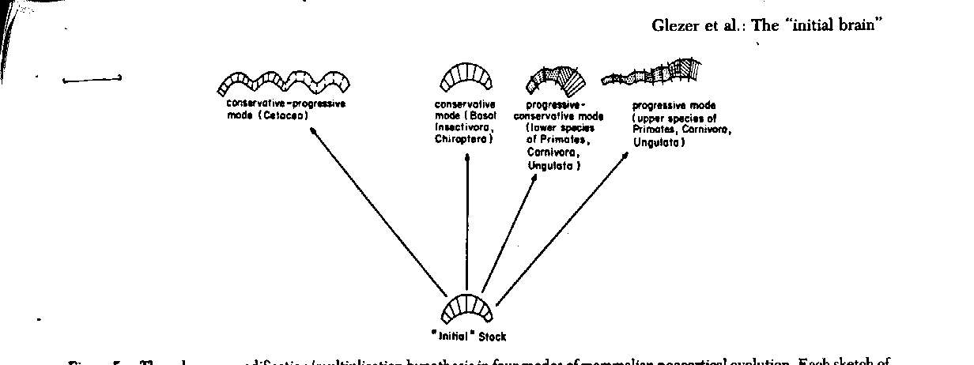
Glezer et al Hypothesis: The cetacean brain may represent the most highly developed version of a particular kind of expansion that involved substantial multiplication of vertical columns.
TWO WAYS TO BUILD LARGE BRAINS?
Cetacean mode of
neocortical expansion
Primate mode of
neocortical expansion
Emphasis on multiplication of units
Modification and
multiplication of
columns
Notes:
In 1988 Glezer et al formulated a hypothesis about neocortical expansion in cetacean neocortex. The hypothesis said that…We have been pursuing evidence for this hypothesis using software programs to identify vertical regularities in cetacean cortical tissue.

Slide 21
Cetacean and primate brains are convergent for high EQ but divergent in the way that was accomplished.
Given the two different kinds of neocortical organization represented by primates and cetaceans – is there evidence for cognitive convergence?

Slide 22
Convergent Cognition

Slide 23
Dolphins (and many other cetaceans) possess cognitive characteristics that are rare in the animal kingdom in general and typically shared with primates and a few other highly intelligent species.

Slide 24
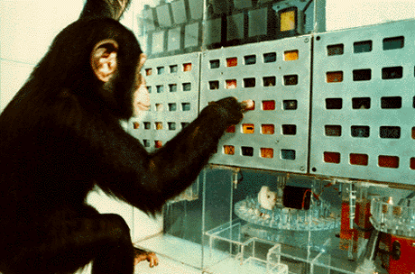
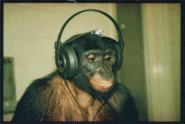

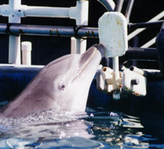
Comprehension of Symbolic Communication

Slide 25
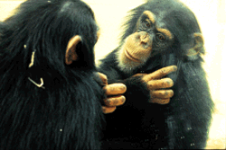
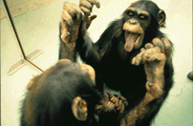
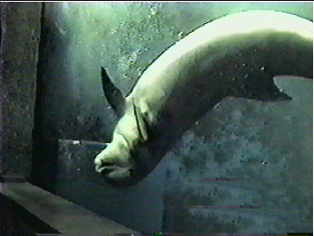
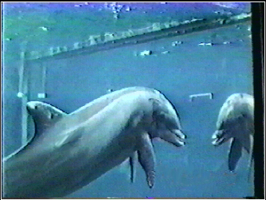
Self-recognition: the ability to recognize oneself in a mirror

Slide 26
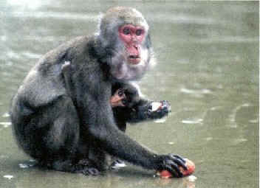
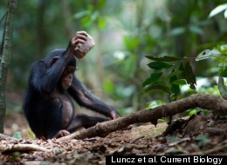
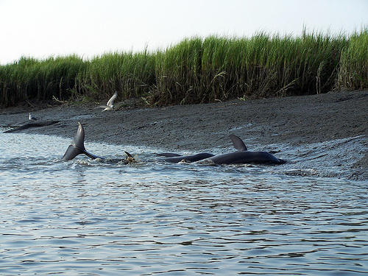
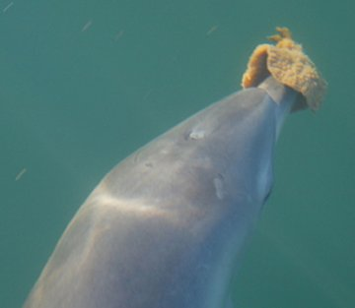
Cultural Traditions

Slide 27
At what level are these traits convergent?
Behavioral
Functional
Structural

Slide 28

Conclusion
The comparative evolutionary history of cetacean and primate brains and cognition is a powerful example of the way that brain structure-function relationships can follow a dynamic and complex pattern of divergence and convergence at different levels over time.

Slide 29
Thank you to:
Russell Powell
Irina Mikhalevich
Boston University Center for Humanities
The John Templeton Foundation
Washington University-St. Louis

