Slide 1
Structures of Racism: Causal Theories, Scientific Controversy, and Invisibility of Asbestos Diseases
Lundy Braun
Departments of Pathology and Laboratory Medicine and Africana Studies
Brown University

Slide 2
“Choices to be made depend on the kind of society we consciously envision against realities imposed from the past that may have become inseparable from our impressions of the normal.” (Njabulo Ndebele, 2016)

Slide 3
How have the processes and practices of biomedicine contributed to “impressions of the normal,” such that community and workers’ knowledge is marginalized?

Slide 4


Slide 5
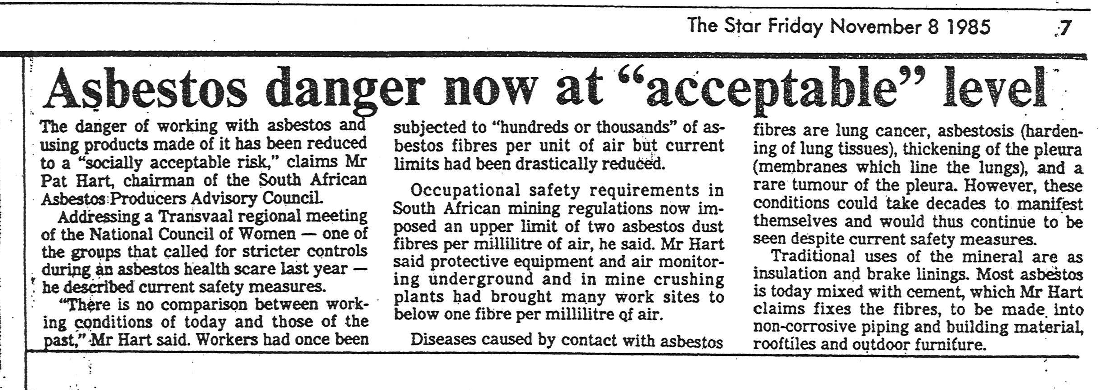

Slide 6
Causal Theories, Scientific Controversies, and Asbestos
Asbestosis: 1920s and 1930s
Lung cancer: 1940s
Mesothelioma: 1960s – present
  Amphibole hypothesis
  SV40 hypothesis
  Genetic hypothesis

Slide 7
How do historically specific scientific controversies obscure hazardous working and living conditions, especially in the global South? How do they continue to shape knowledge about the hazards of asbestos?

Slide 8
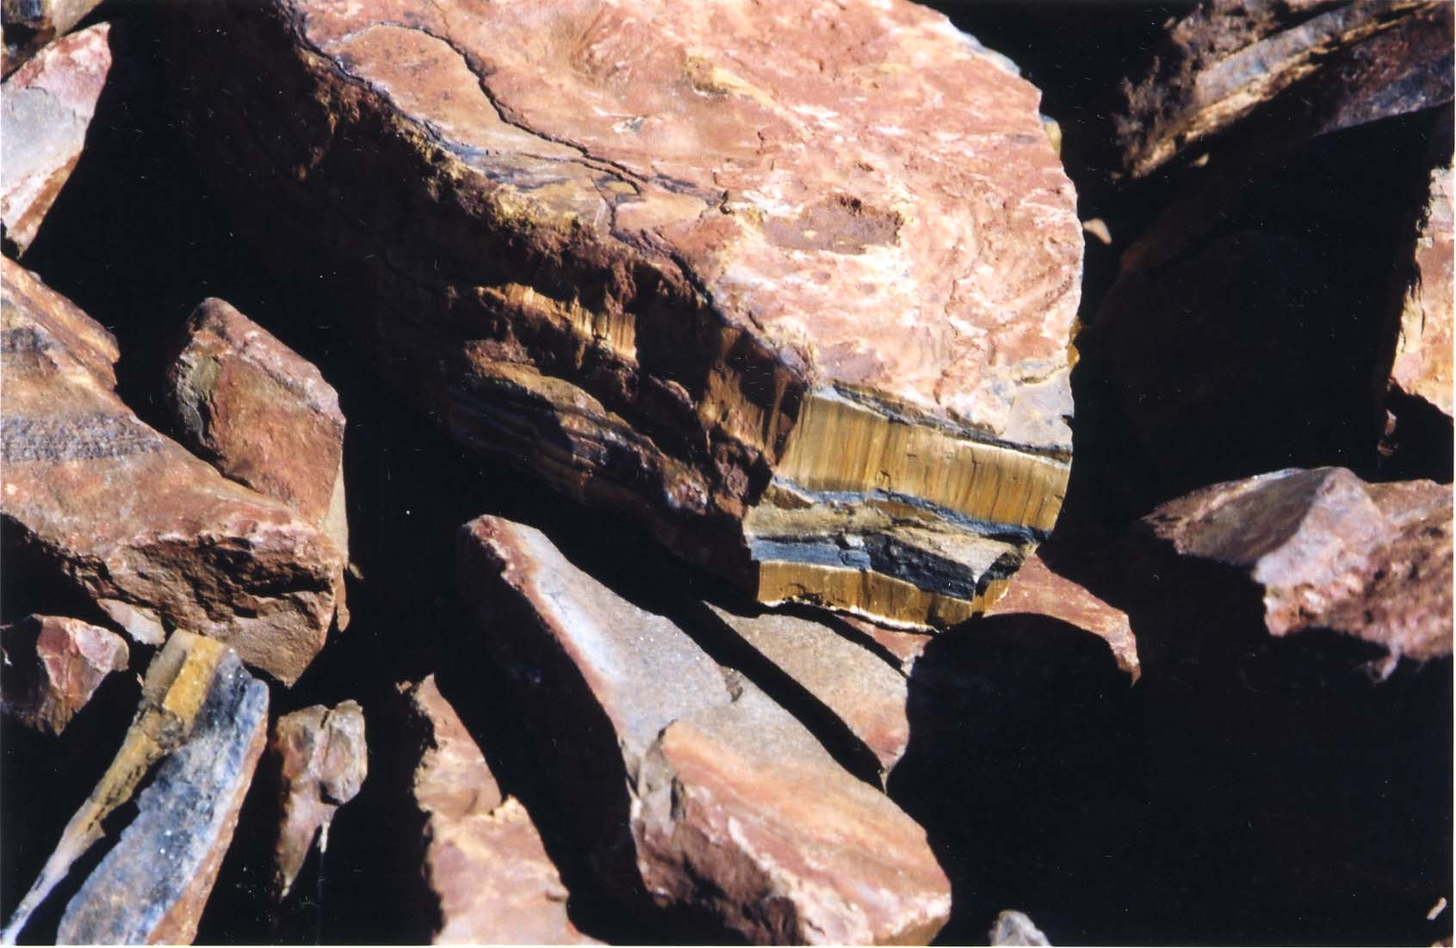
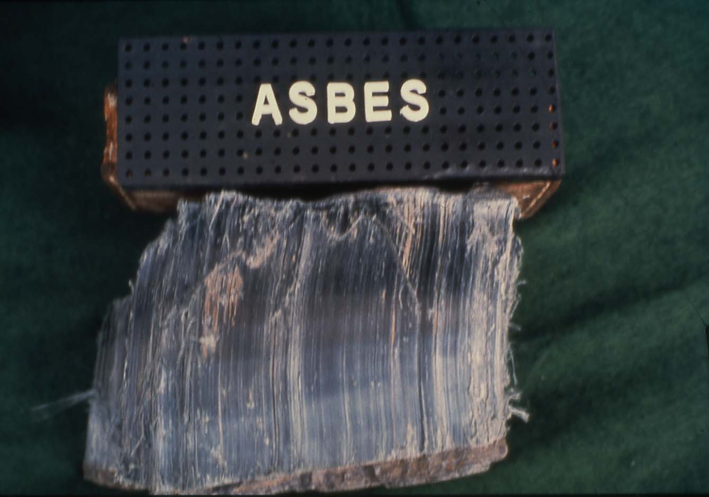
Asbestos fibers are hydrated silicates used for a large variety of commercial processes
Serpentine
  Chrysotile (white)
Amphibole
  Crocidolite (blue)
  Amosite (brown)
  Tremolite
Asbestos fibers vary in size, shape, solubility, and properties (tensile strength, fire retardant) which influence pathogenesis --

Slide 9
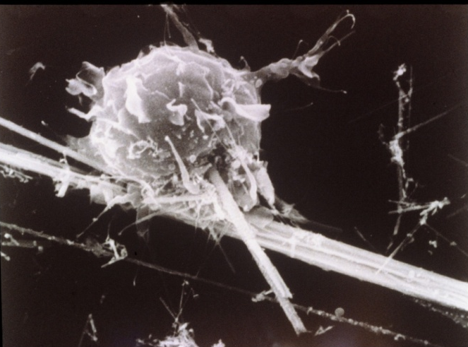
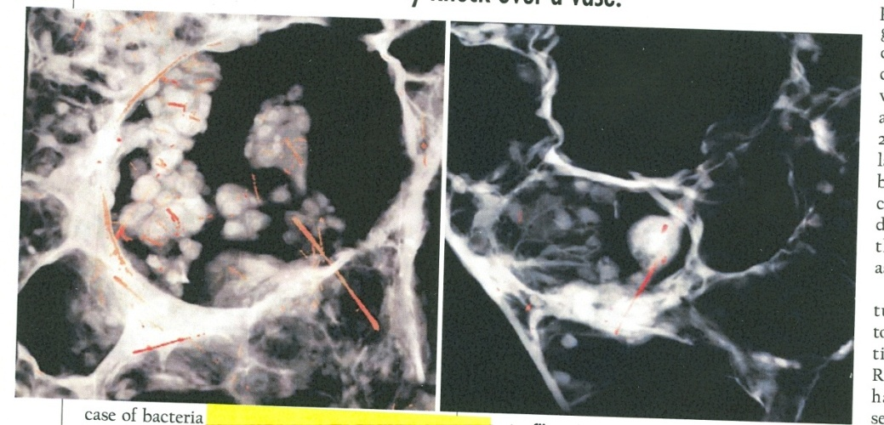
J. Brain, Harvard School of Public Health
Incomplete phagocytosis of asbestos fiber by macrophage
Penetration of asbestos fibers into alveolar Walls

Slide 10
Asbestos in South Africa

Slide 11
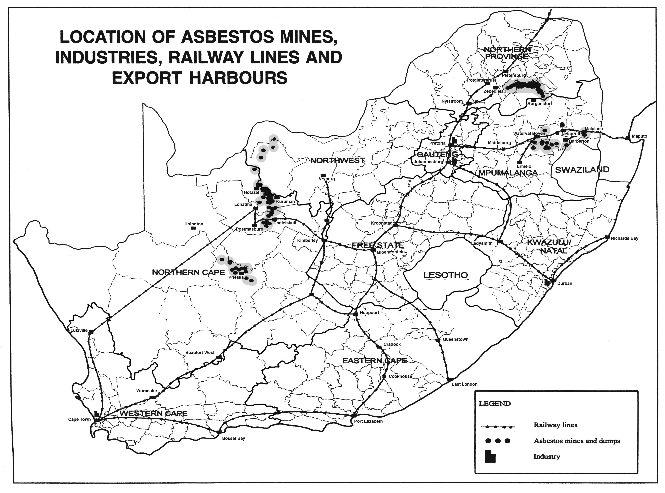
South Africa is unique in having deposits of all three types of asbestos; Mining only ceased in South Africa in 2002

Slide 12
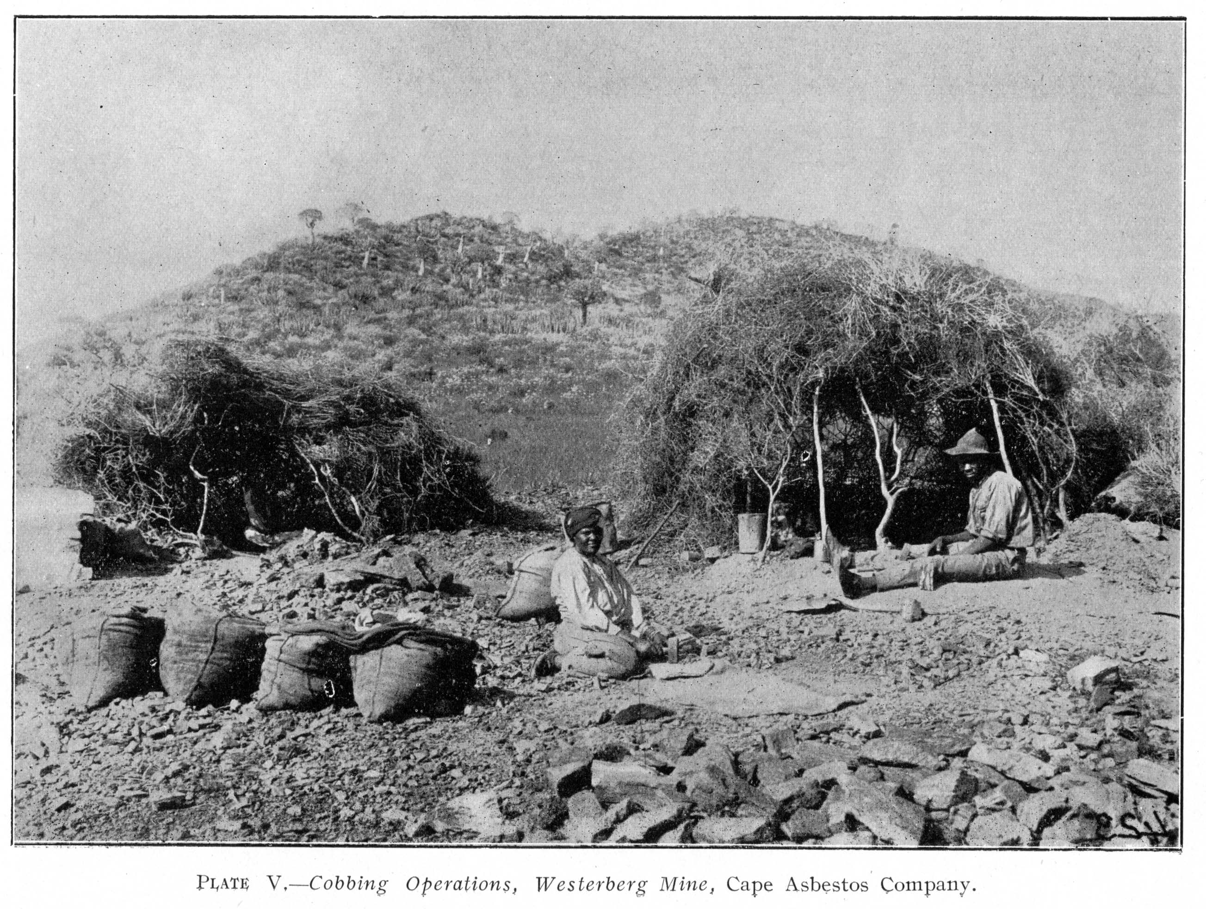
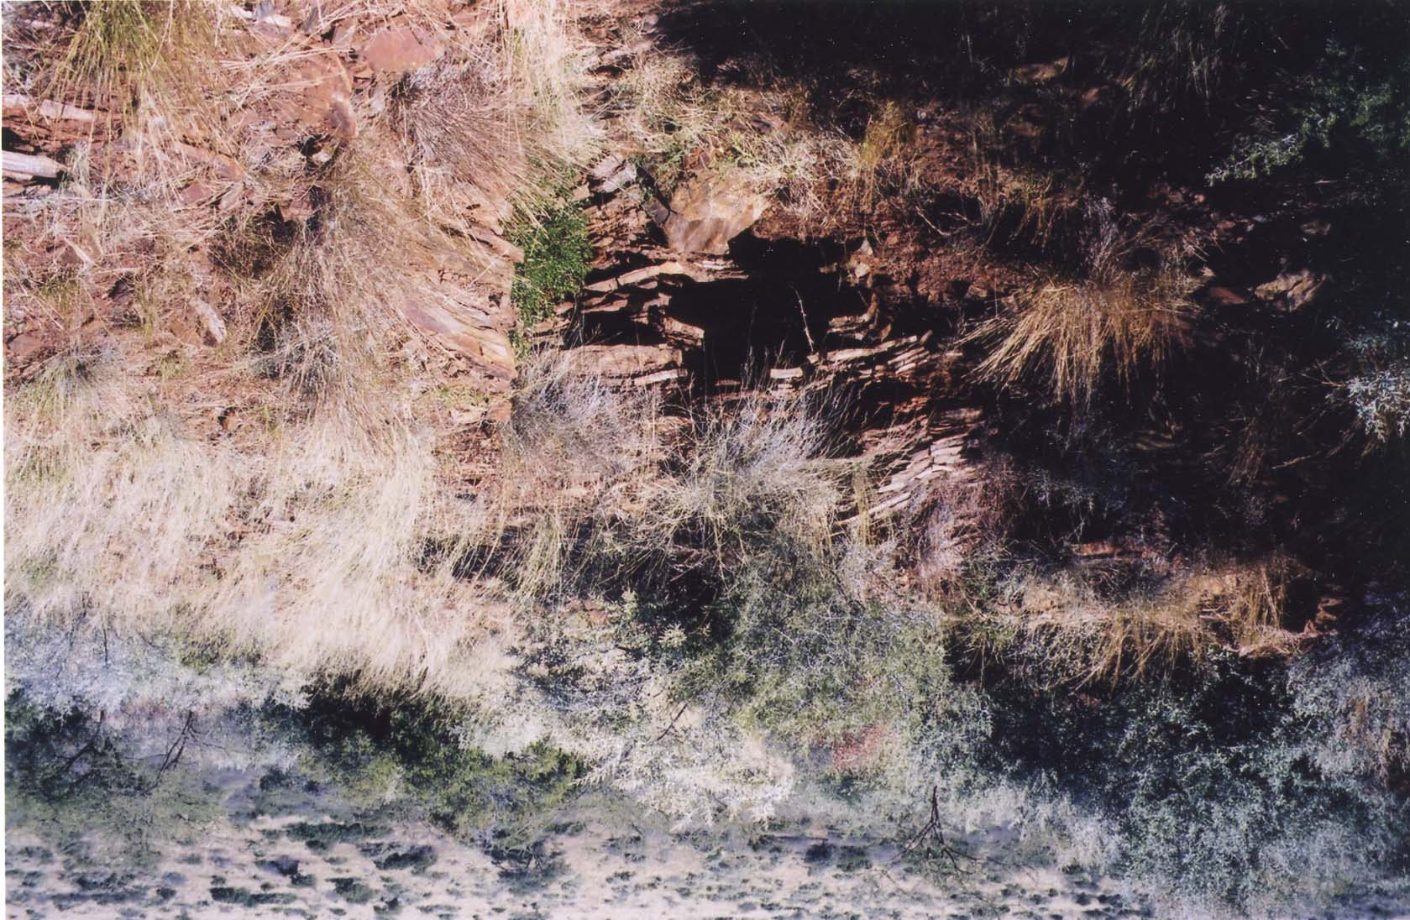
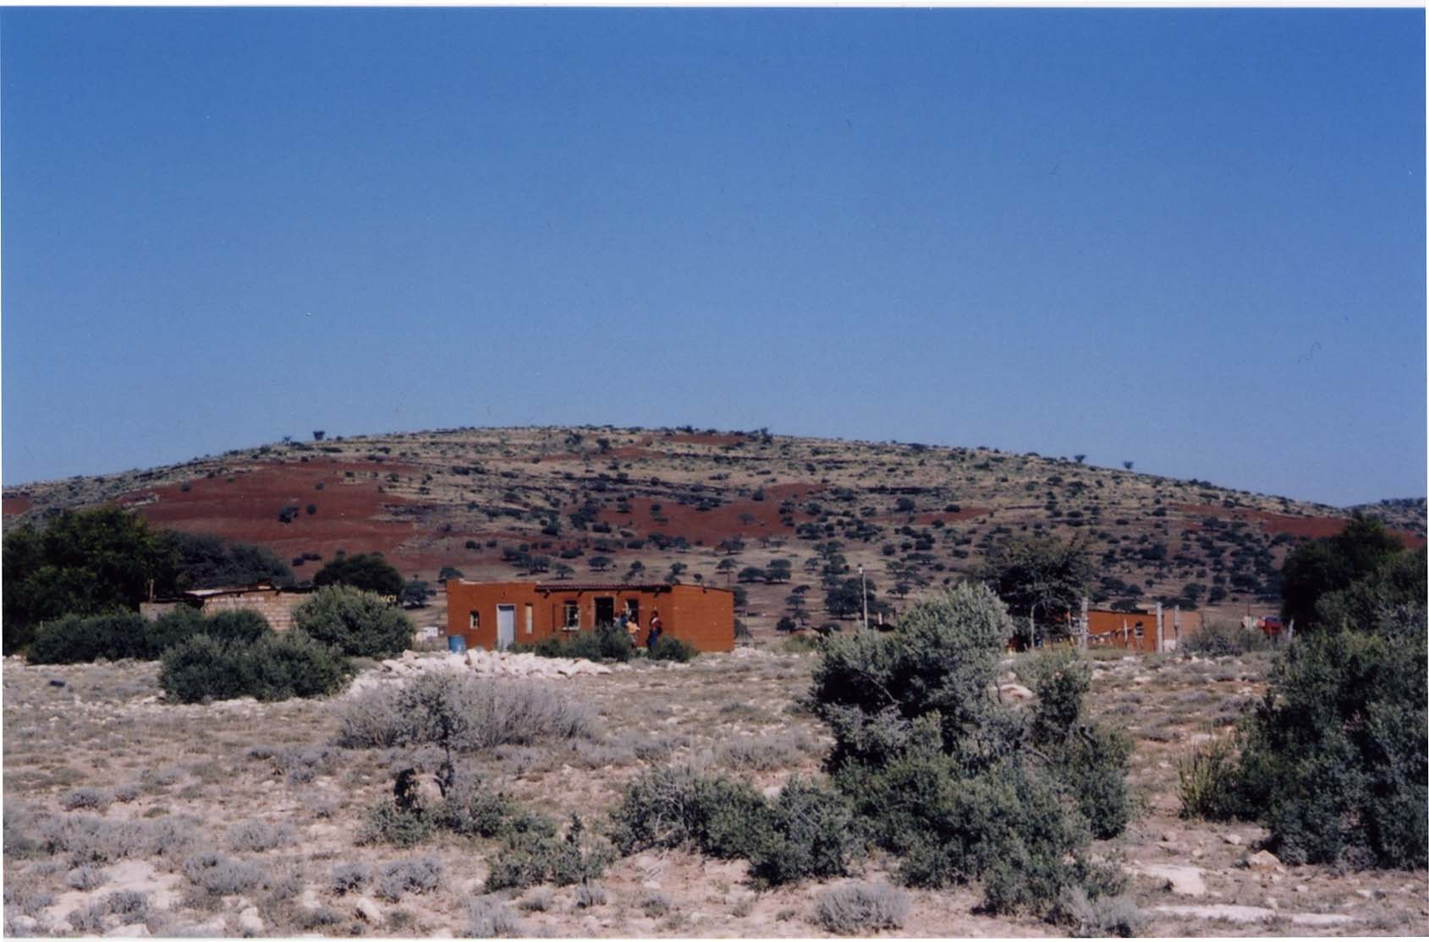
Importance of family units in small-scale mining operations
Small adit in side of hill, 2003
Larger surface mine, 2003

Slide 13
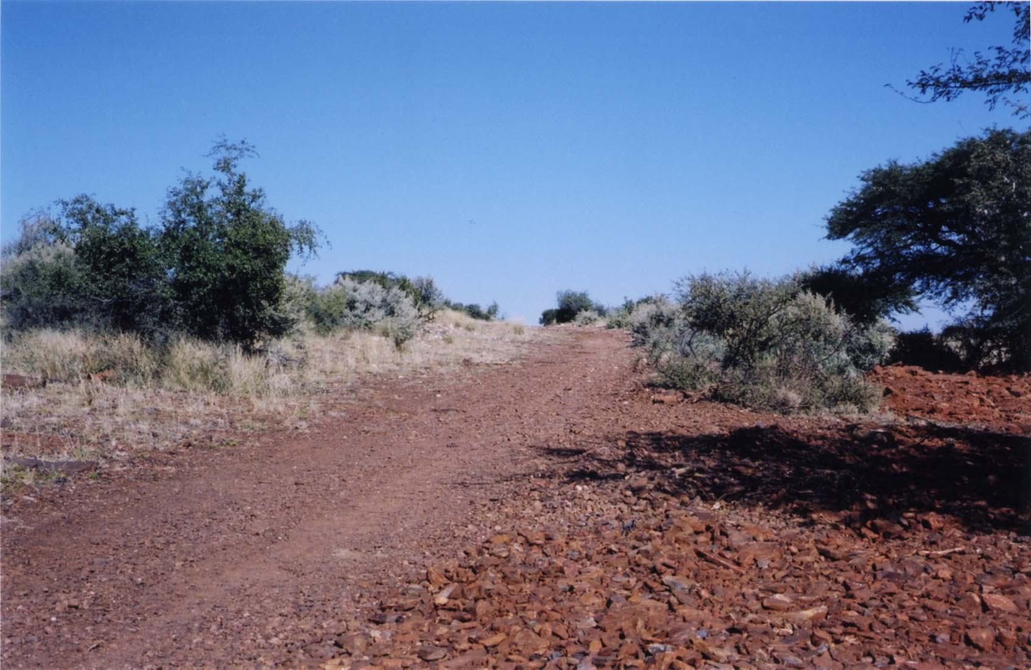
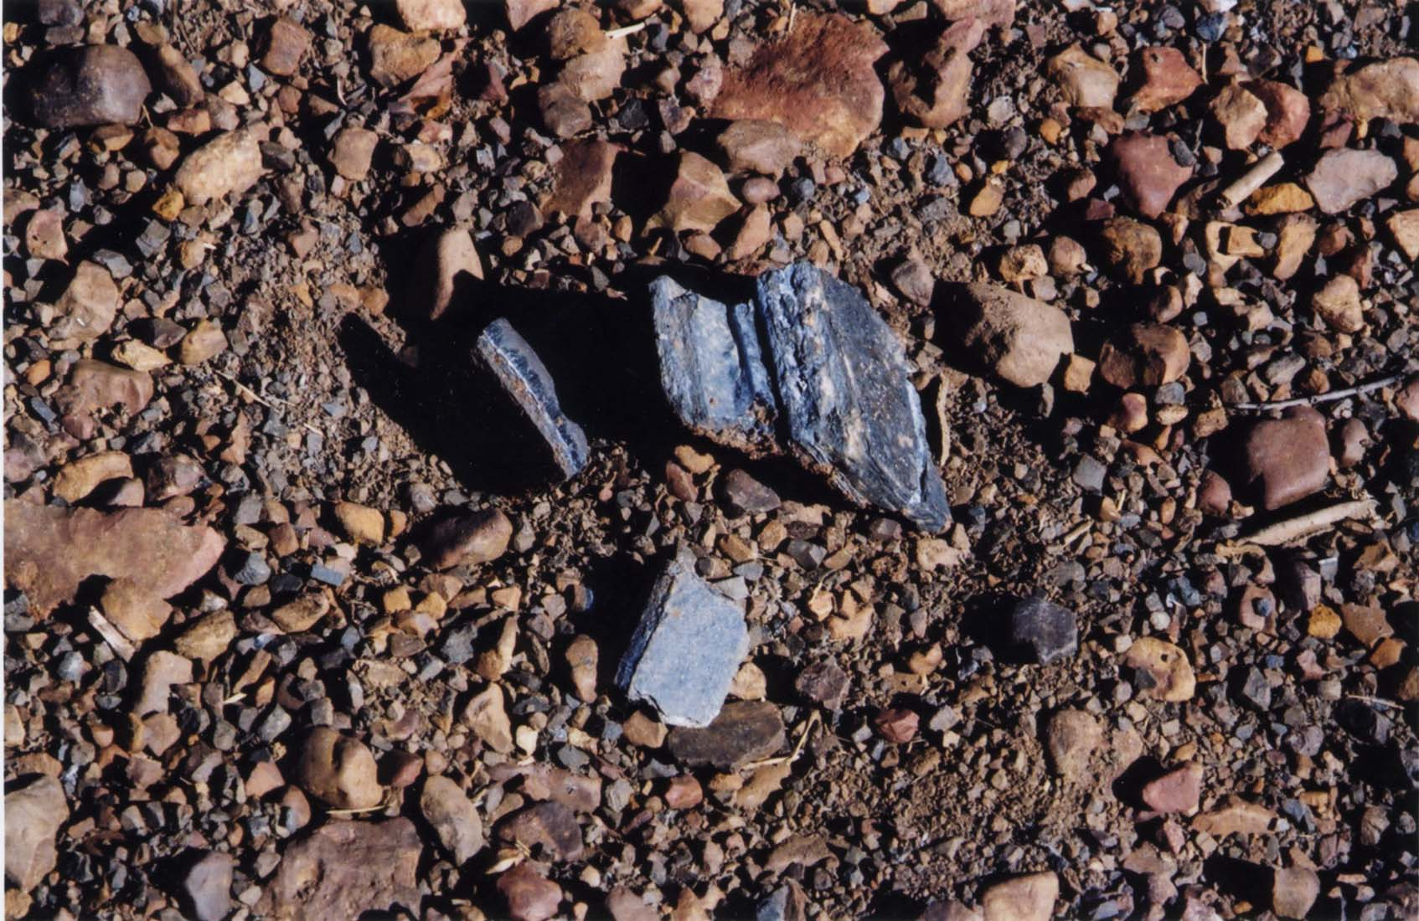
Roads constructed of asbestos tailings

Slide 14
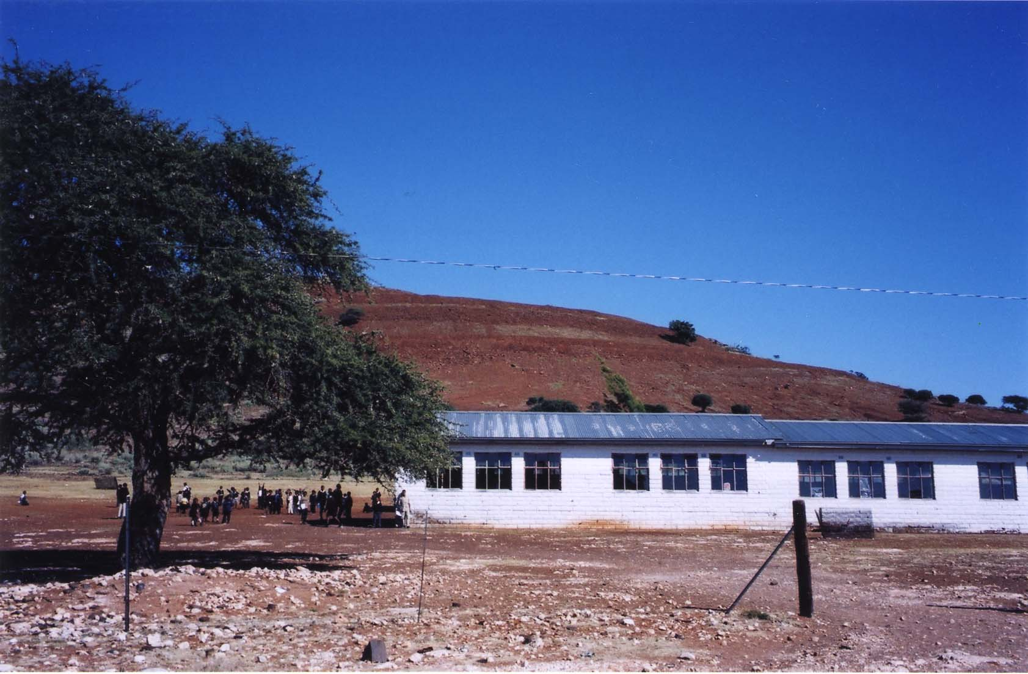
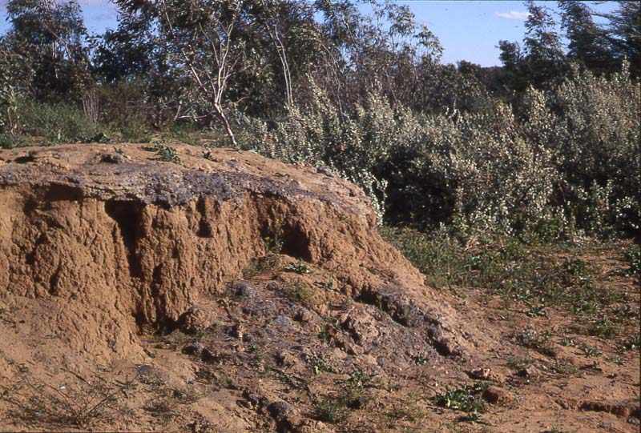
Rehabilitated asbestos mining dump behind primary school in Ncweng and asbestos-containing rocks on school grounds
Dried asbestos along banks of the Orange River

Slide 15
Reris Mine
Box 901
No date Kuruman
Magistrate
Sterkspruit
Sir,
This is a complaint from all of us natives who took up a contract [sp] with Stormberg (Mr. Mather) to Kuruman, Reris Mines – that we are ill treated here. When contract is read to us you say we are going to a nice place where we shall get good treatment and so forth but when we arrive here we find that it is not the case. We are dying in this place that is why we have decided to write to you. Our complaint is not being listened to here that is why we resorted in writing to you because we are your children.
Sir, when we decide so, there will be blood to blood (sharing of blood). After all we are dead in this manner of treatment. Our hearts are really sore by the treatment of the Manager. When we take contract with Stormberg (Mr. Mather) it is 6 months and after completing those 6 months we are told that it is written 9 months. Please verify that from Stormberg how that comes about. We want that as we live hard life answered soon. Again when we get injured or contract phthisis there is no compensation at all.
Sir, we do not know whether you will appreciate our being invalid and do not pay taxes (through injuries and phthisis) because we will be like dead people already. If one gets sick even for two days he is dismissed with allegations that he pretends to be sick and yet is lazy to work. In that dismissal you are being driven away by Police who keep on beating you as far as a certain forest and they leave you there and return to compound. If not driven away like that he will ask you where you have been on the days that you have been sick and at the same time beats you although he knows that you have been sick.
Sir, we ask you that Stomberg should come here not later than 16/10/57 because when he takes our X markers he always tells us that here is a Hospital. Again the compound is very far from town. When we arrived there for work we are being fetched by lorry but finishing contract they do not care for us but that we should see our way through.
We pay L3 for the lorry to town. Whenever we refer our complaints to the Manager he beats us saying we are his children. That is why we refer to you. You did not tell us of the things done to us here that we have been sent here to be beaten and killed.
Complaint by Employees forwarded to Native Commissioner Kuruman by Native Commissioner Sterkspruit on 16 Oct 1957

Slide 16
Structural racism, state policies, and science
National Labour Regulation Act - 1911
Native Land Act - 1913
Urban Areas Act - 1923
Native Trust and Land Act - 1936
Pass laws
Racially segregated labor movement
Racialized compensation legislation
Occupational disease databases
Differential registration of mines and differential registration of workers on mines
Research infrastructure

Slide 17
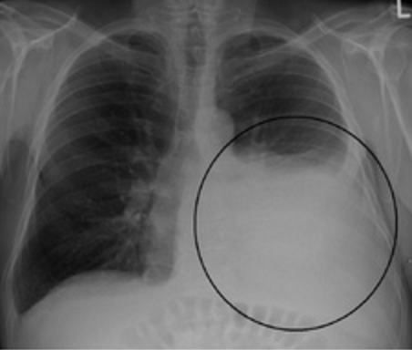
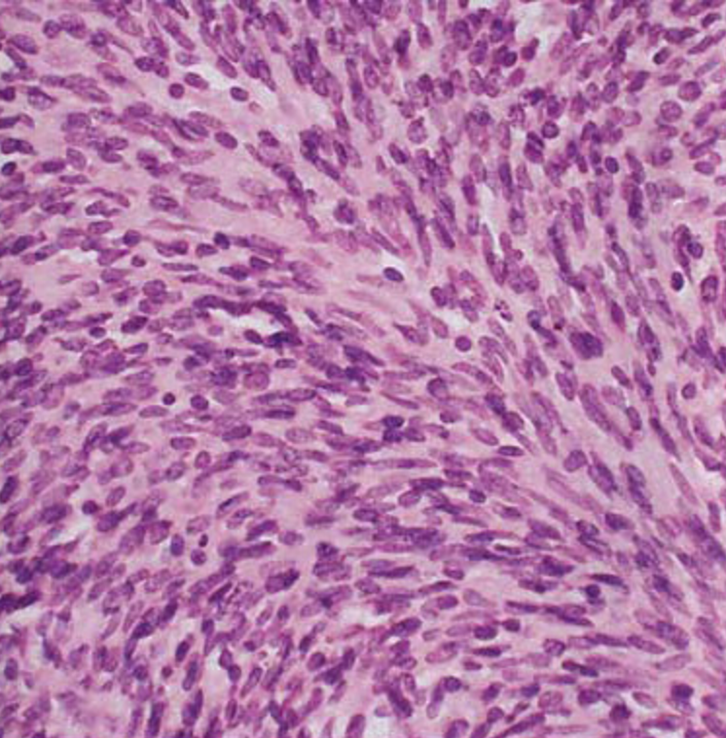
Mesothelioma
Signature asbestos-induced disease
Crocidolite a particularly potent cause
Rare, aggressive, and painful cancer of the lining of the lung cavities
Survival 2-18 months, even with good medical care
1/12 carpenters in UK will develop mesothelioma
Prevalence unknown South African historically because of exclusion of black miners

Slide 18
Scientific controversy and mesothelioma causality
Scientific context
Social context to which responding
Technological innovations
Policy implications
Epistemic consequences

Slide 19
The Amphibole Hypothesis
Outline of theory: differential pathogenicity of asbestos fibers; does only crocidolite (an amphibole) cause mesothelioma?
Social and Scientific Context: both industry-funded and non industry-funded research; public panic over asbestos in schools; international ban
Technological debates: fiber type
Policy implications: safe to use chrysotile
Epistemic consequences: invisibility of asbestos-related diseases in global South
Why do only a small proportion of exposed individuals develop mesothelioma?

Slide 20
SV40 Hypothesis
Outline of theory: role of a monkey tumor virus as co-factor in etiology of mesothelioma
Social and scientific context: government funded; identification of cancer-causing genes; heady time in molecular biology; anxieties about vaccination and government suppression of contaminated vaccines
Technological: amplification of minute amts of DNA via PCR
Policy implications: business as usual
Epistemic consequences: invisibility of asbestos as cause and of burden of ARDs in global South
Why do only a small proportion of exposed individuals develop mesothelioma?

Slide 21
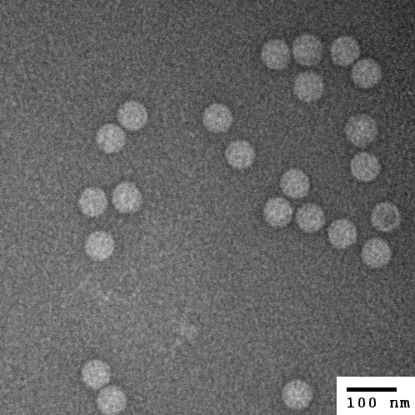
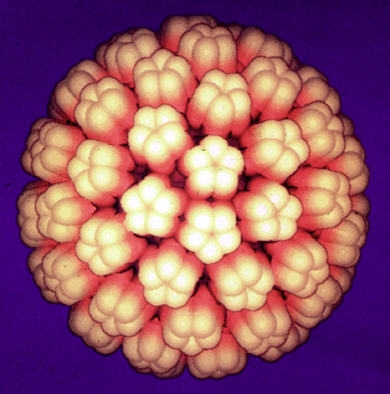
SV40 Virus
TEM
Computer simulation

Slide 23
Genetic Predisposition Hypothesis
Outline of theory: Because not all exposed people get mesothelioma, must be a genetic predisposition
Scientific and social context: high rates in some villages in Turkey and eronite; scientific credit for discovery; national interests
Technical debates: meaning of altered DNA
Policy: new therapies
Epistemic consequences: invisibility of global South
Why do only a small proportion of exposed individuals develop mesothelioma?

Slide 24
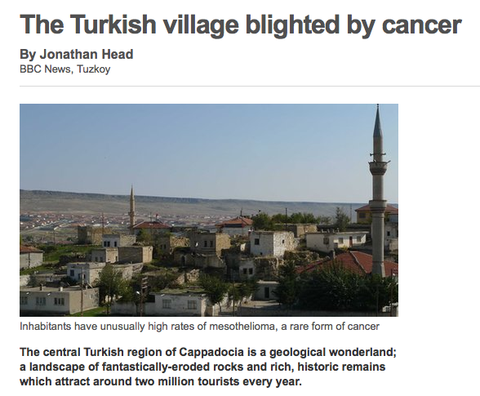
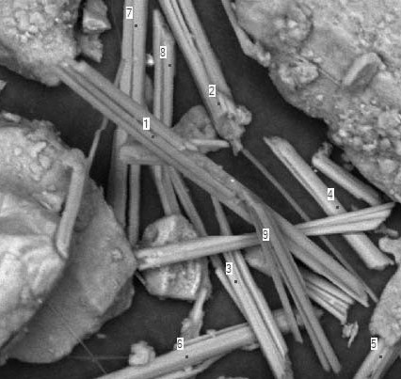

Slide 25
“…all decisions of knowledge production are never just questions of the substance of knowledge (inquiries, hypotheses, methods, procedures, acceptable values, etc.) They are at the same time also decisions on who is afflicted, the extent and type of hazard, the elements of the threat, the population concerned…measures to be taken, those responsible, and claims for compensation.”
Ulrich Beck, Risk Society

Slide 26
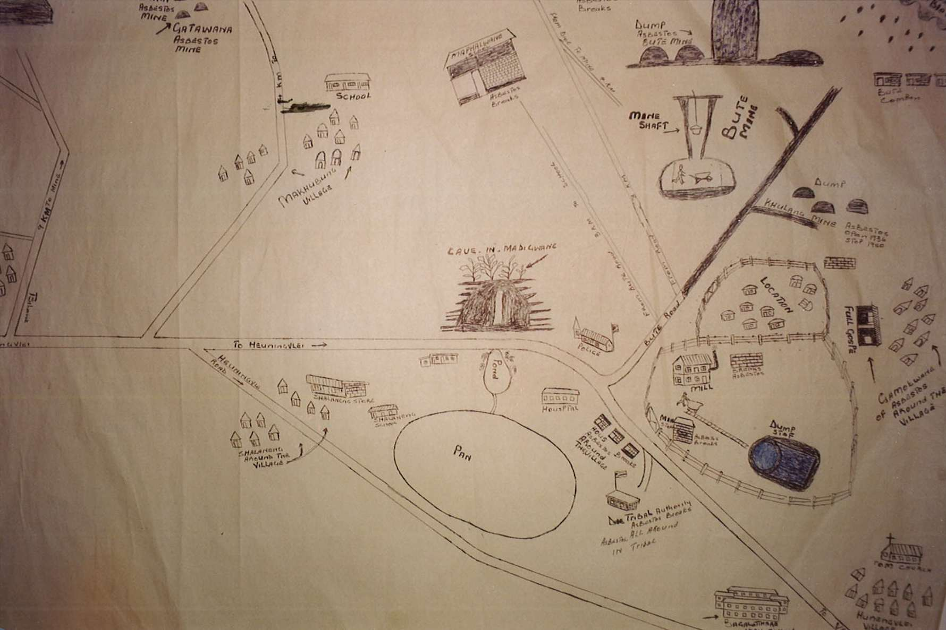
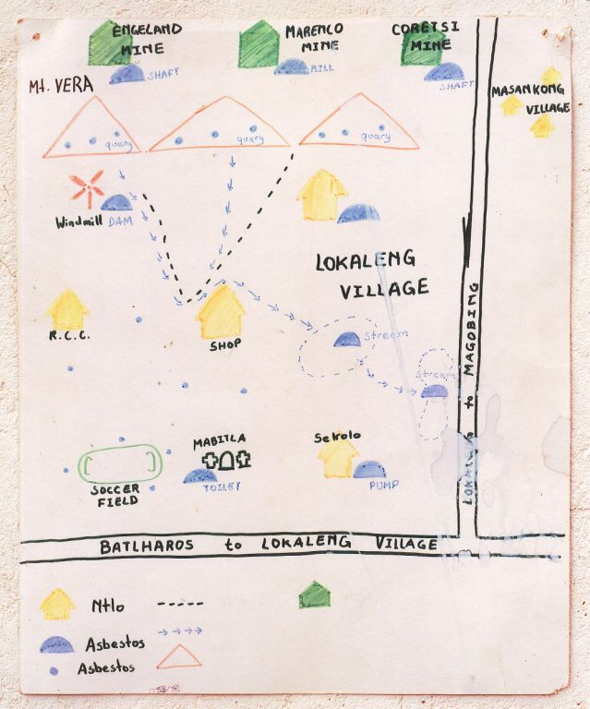
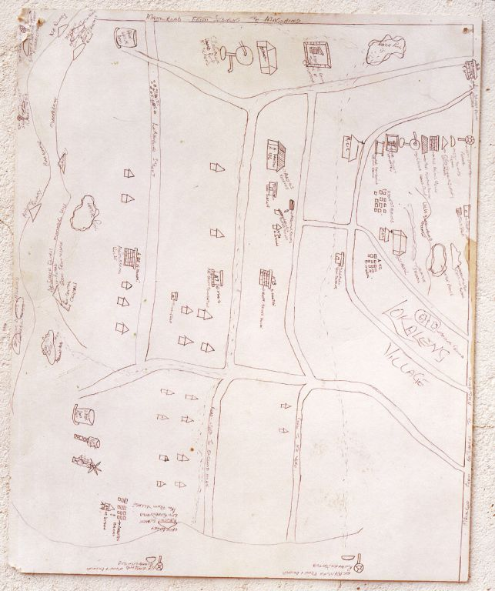
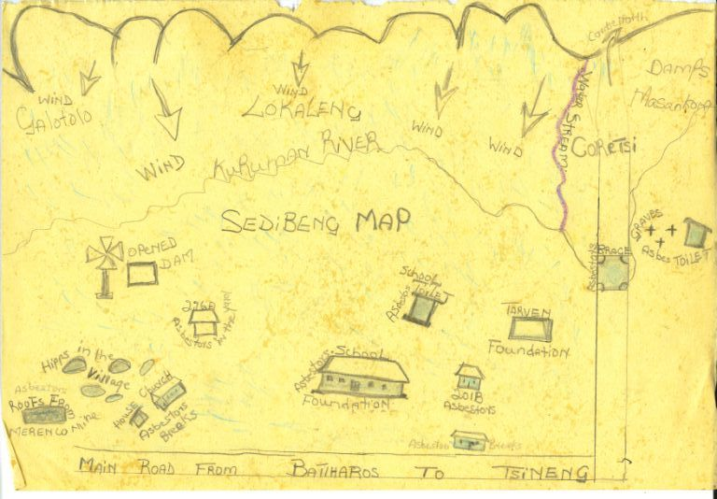
Who has knowledge?

Slide 27
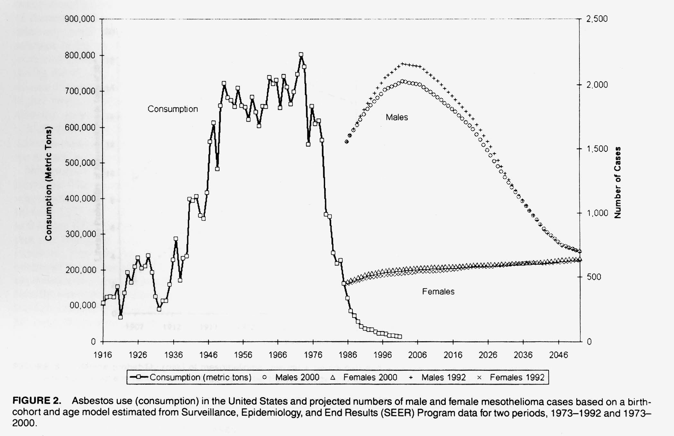
Incidence of mesothelioma in the US over time in relation to consumption of asbestos products
What is happening elsewhere in the world?

Slide 28
Conditions in the Workplace: Labor Practices informal structure of the industry
Small asbestos mine in side of hill
Larger mine

Slide 29
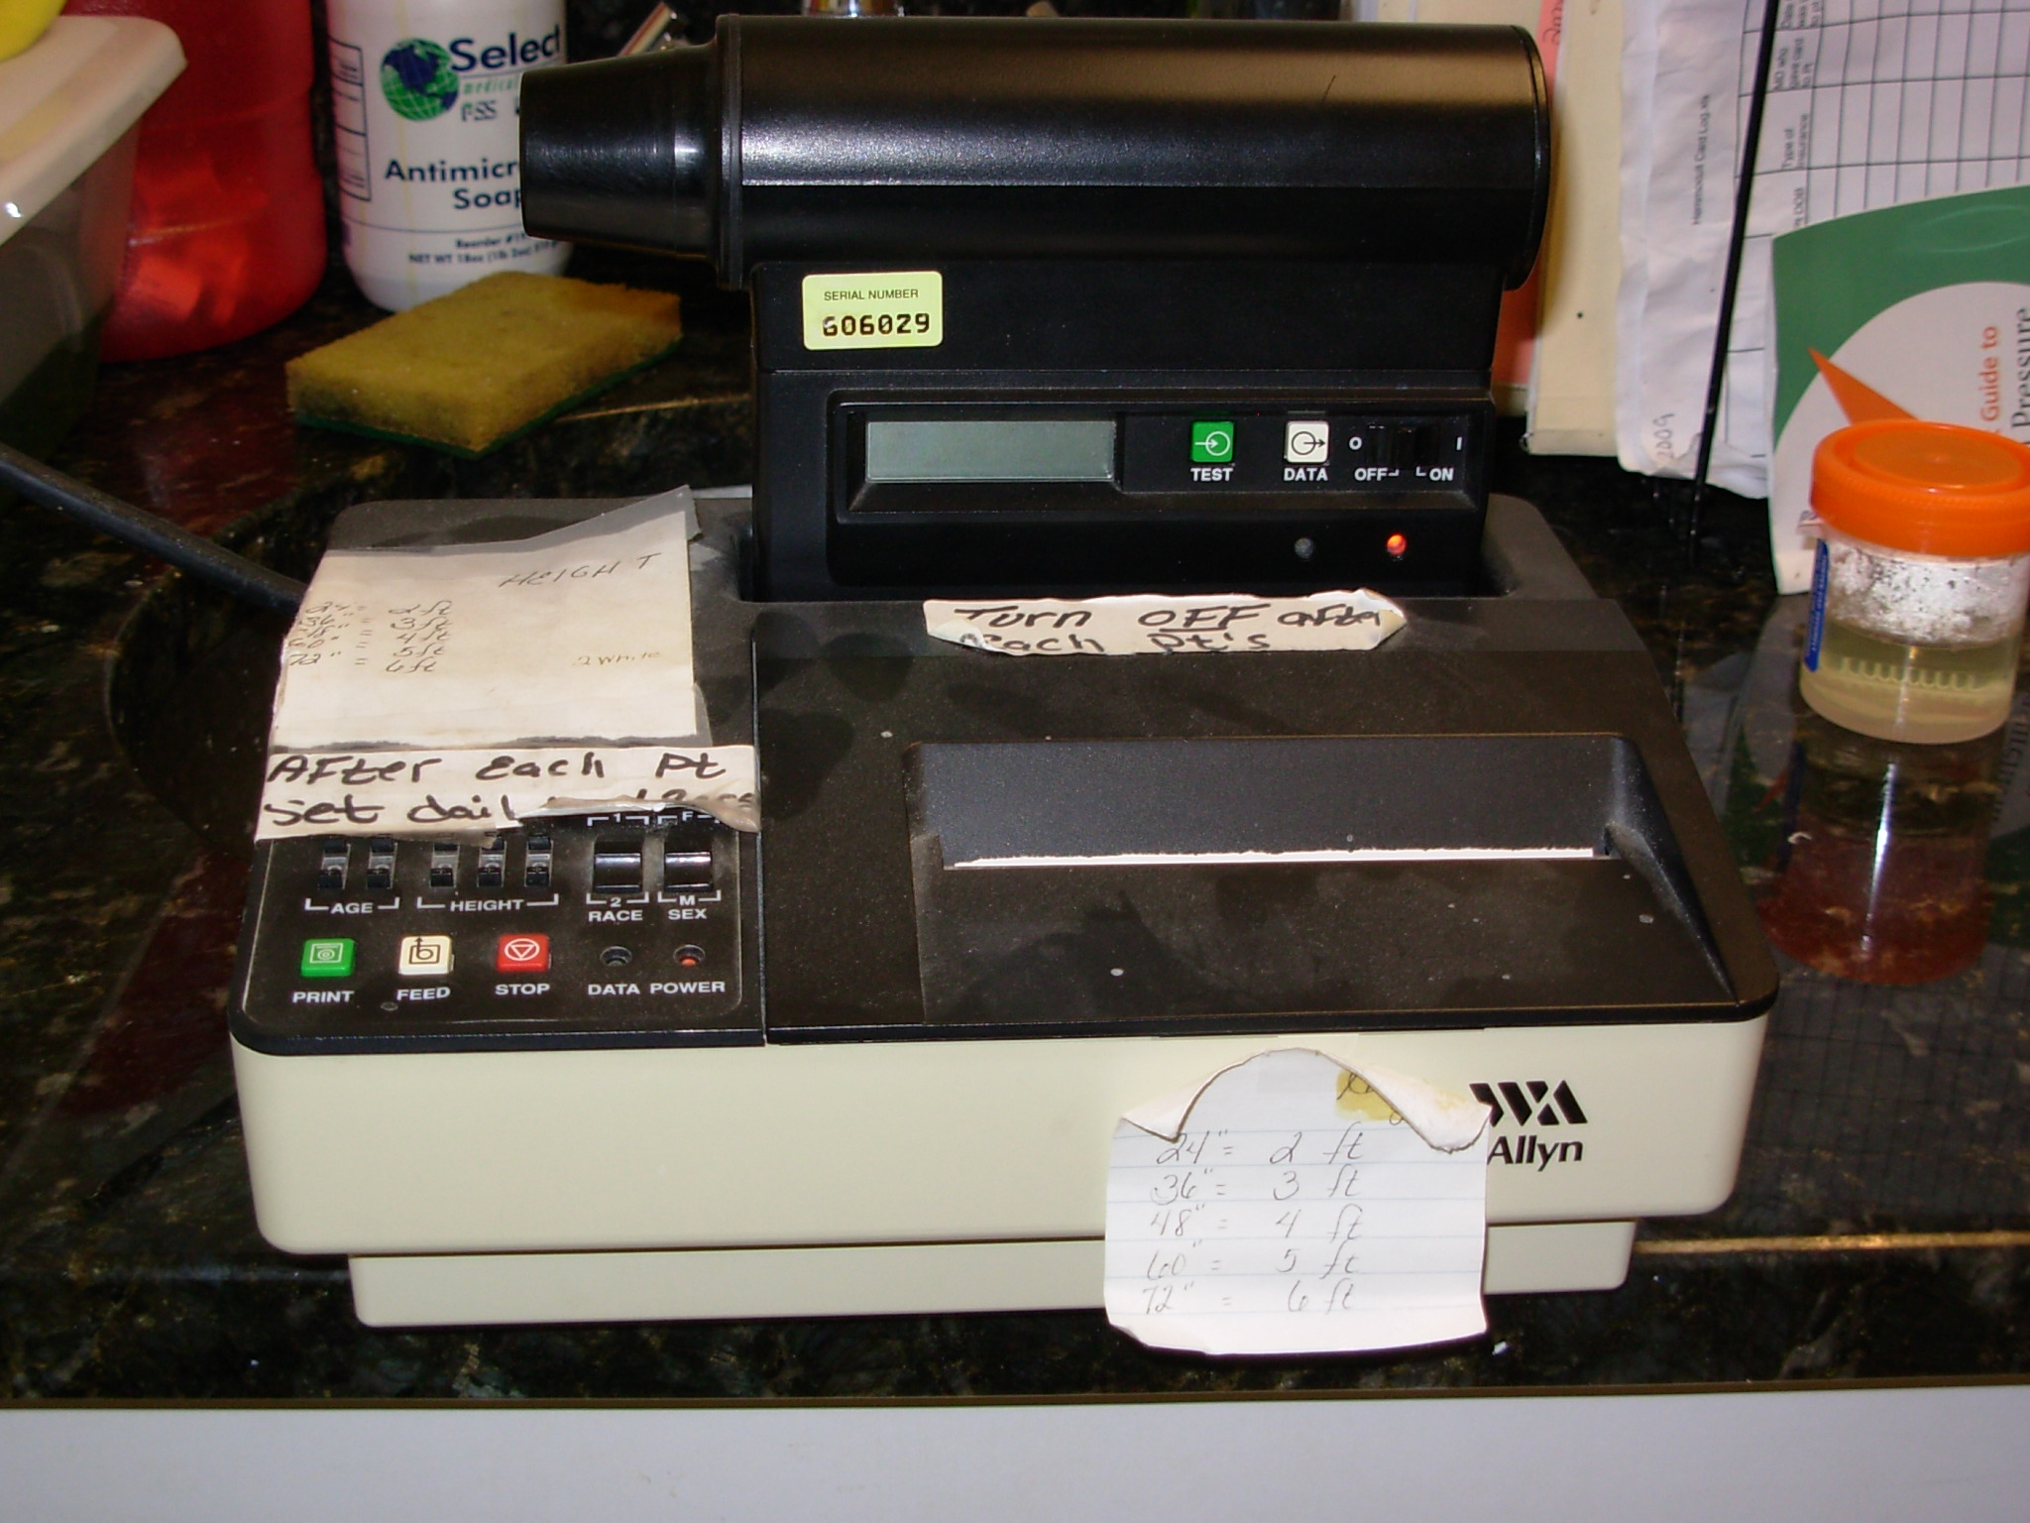
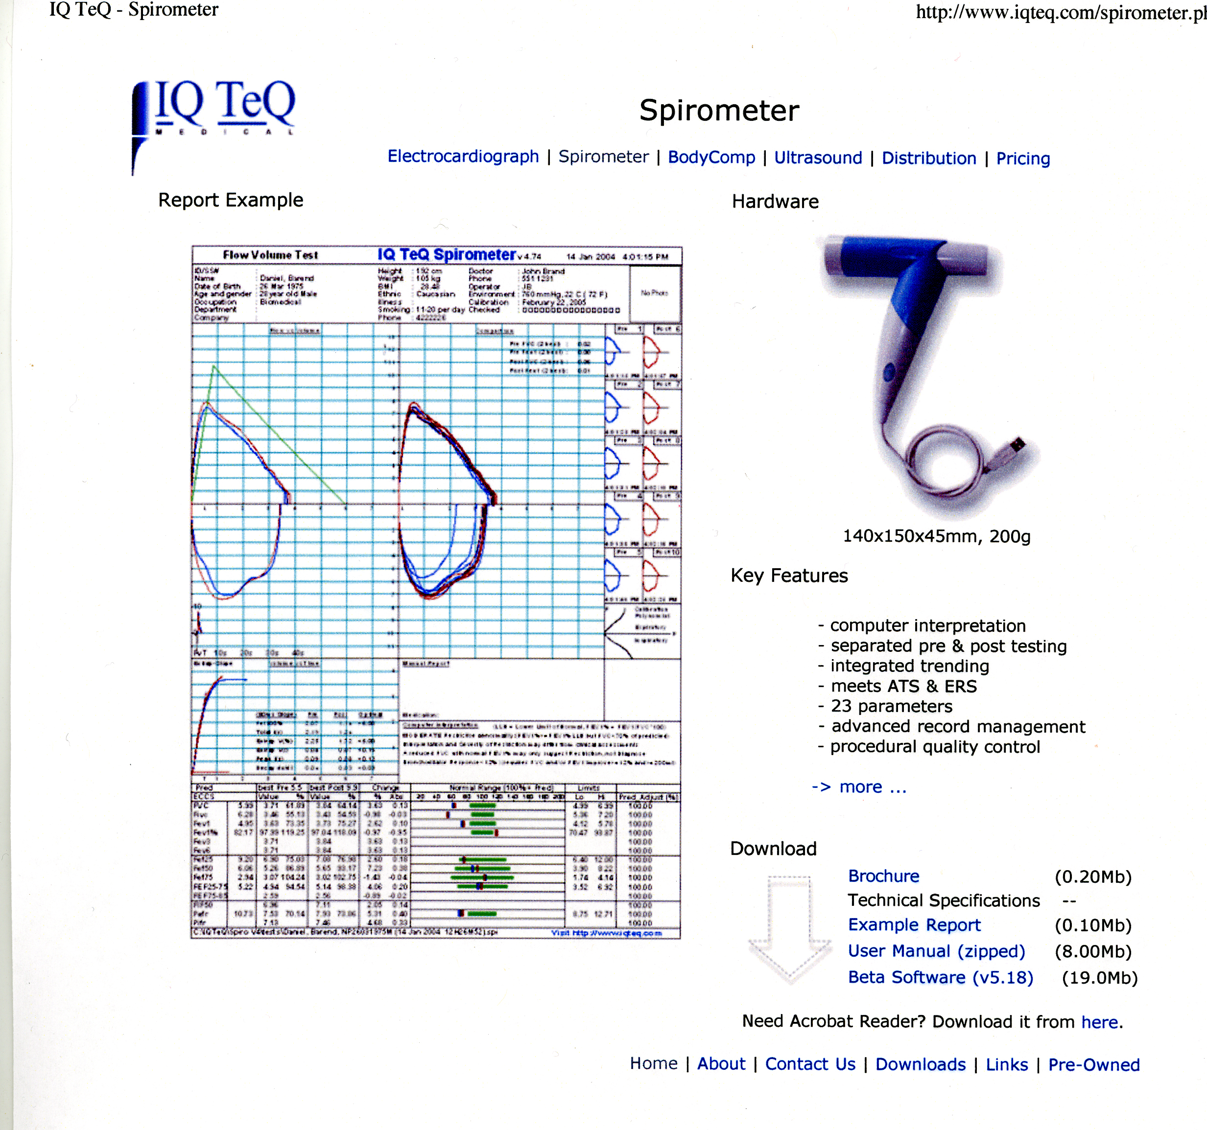
Scaling factor: 10-15%
Population-specific standards

Slide 30
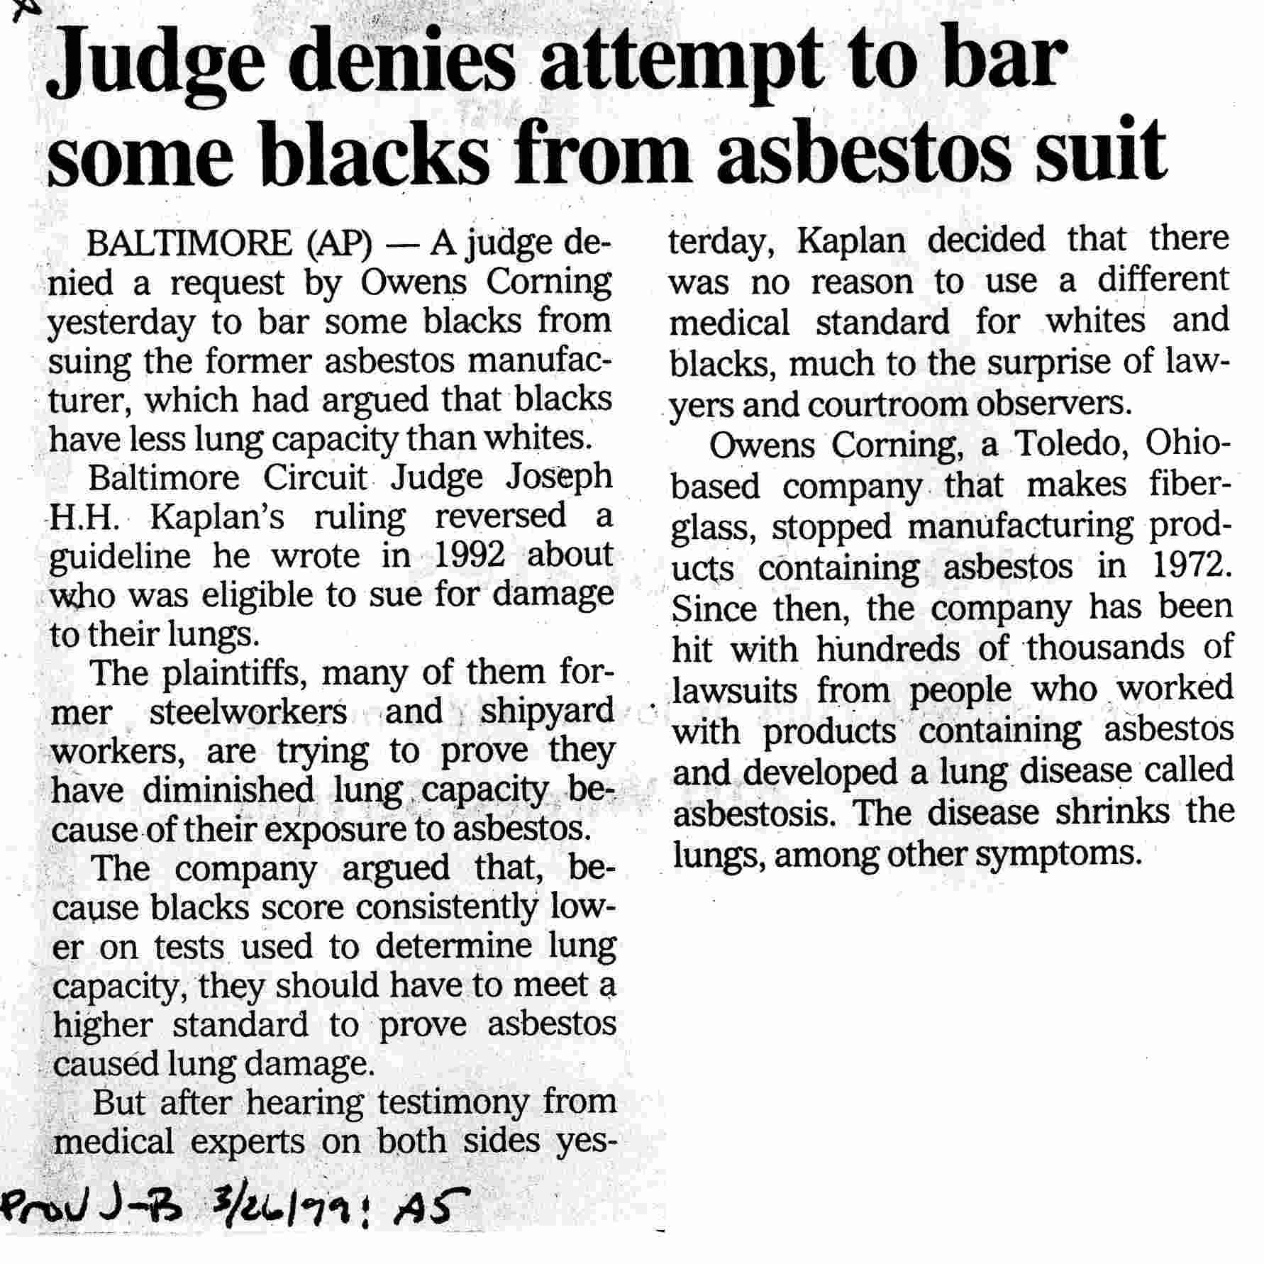

Slide 31
Asbestos fibers are hydrated silicates used in a large variety of commercial processes
Crocidolite (blue)
Amosite (brown)
Chrysotile (white)
Asbestos fibers vary in size, shape, solubility, and properties (tensile strength, fire retardant) which influence pathogenesis --

