Slide 1
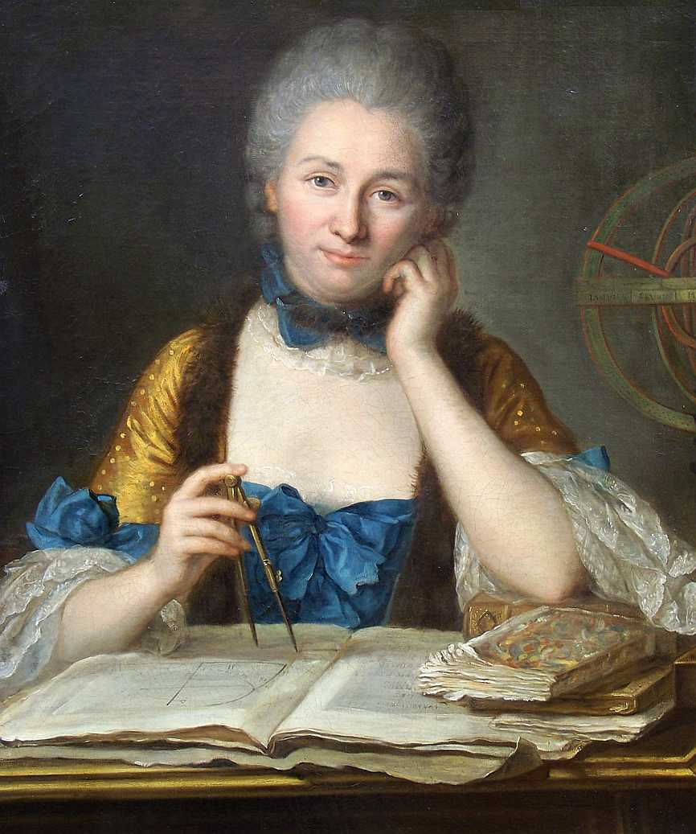
Émilie Du Châtelet & the Scope of Physics in the Early Eighteenth Century
Andrew Janiak, Duke University

Slide 2
Continental “physics” circa 1730
The scope of Continental physics at the fin-de-siècle is broad.
Rohault, Traité de physique (published repeatedly from 1671-1735): “the science that teaches us the reasons and causes of all the effects that nature produces.” He covers: planetary motion; the nature of air, water, and minerals; the human body, including the arteries, respiration, digestion; etc.
Observations curieuses sur toutes les parties de la physique (1726), extracts from Journal des savans, Phil Trans., Histoire de l'Académie des Sciences. Under the heading "physique generale," it includes: sound, light, the air, colors, the "system of M. Newton", ice, meteors, water, salt, the tides, etc.
Nicholas Hartsoeker, Cours de physique (1730), begins with the “principles of physics” and moves on to fire and light, water and air, etc.
Joseph Privat de Molières, Leçons de physique (1734), discusses gravity and the vortex theory of planetary motion; the nature of air, water, fire, salt; etc.
In sum, these treatises regard physics as what Hatfield calls “the general science of body,” or general theories of matter. Their scope is wide, covering all the different sorts of matter, including biological and chemical kinds.

Slide 3
The Institutions de Physique
Châtelet’s magnum opus is the Institutions de Physique (Paris, 1740). The text was famous in its day—known and discussed by philosophers like Wolff and mathematicians like Euler and D’Alembert—and went through subsequent editions in French (1741-2), German, and Italian (both in 1743). It was published in Paris, London, Amsterdam, Leipzig & Venice.
The text was copied nearly verbatim in many entries of Diderot and D’Alembert’s Encyclopédie through research by Samuel Formey, the Secretary of the Berlin Academy. So it has been read (unknowingly!) for generations. But it remains largely unknown today.
Institutions de physique has recently been translated (Terrall, Zinsser) as “Foundations of physics.”
Physique: a quick glance at the text will indicate that Du Châtelet has narrowed the scope of physics considerably, eschewing a discussion of various kinds of matter, focusing primarily on gravitational phenomena.
Institutions: a glance at her 21 chapters might suggest that she is providing a metaphysical foundations for a (narrow) physics.

Slide 4
Structure of the Institutions
Here is the table of contents of the Institutions, second edition, 1742:
1. Des principes de nos connoissances 2. De l’existence de Dieu
3. De l’Essence, des Attributs & des Modes 4. Des hypothèses
5. D l’Espace 6. Du tems
7. Des Elémens de la Matière 8. De la nature des Corps
9. De la divisibilité de la Matière 10. De la figure, etc.
11. Du mouvement & de repos 12.Du Mouvement, cont.
13. De la Pésanteur 14. Pésanteur, cont.
15. Découvertes de Mr. Newton sur pésanteur 16. De l’attraction Newtonienne
17. Corps sur un plan incliné 18. l’Oscillation des pendules
19. Mouvement des projectiles 20. Des forces mortes
21. De la force des corps

Slide 5
Leibniz’s metaphysics, Newton’s physics?
Châtelet’s Institutions is famous for taking the ideas of both Leibniz and Newton seriously. Indeed, it is tempting to say in particular that she takes Leibniz’s metaphysics and Newton’s physics seriously.
For instance, she endorses the PSR and something closely akin to the Newtonian laws of motion.
Since “institutions” can be translated as “foundations,” it is common now to assume that Châtelet is providing a Leibnizian metaphysics for Newtonian physics, like Kant avant la lettre.
Indeed, the temptation to read her through a Kantian lens—viz., in the light of the Monadologiam physicam (1756) and the Metaphysische Angängsgrunde der Naturwissenschaft (1786)—remains strong.
I will argue that this temptation, although perfectly reasonable, should be resisted. I will suggest that it is preferable to interpret her as providing a more systematic and principled “physics” than Newton does by employing one of Leibniz’s great principles (the PSR) and by systematically analyzing concepts that Newton largely ignored.

Slide 6
The continental reception of Newton’s physics
Upon Newton’s death in 1727, the state of physics was complex, but included at least three principal components when we consider its connection with broader philosophical topics. They are:
(1) LAWS: various versions of Newton’s three laws of motion were widely accepted, and his “mathematical” approach to understanding physical phenomena was often praised.
(2) GRAVITY: there remained significant controversy concerning the implications of the law of universal gravity. Does the acceptance of Newton’s treatment of gravity commit one to the view that gravity is either (i) a primary quality, or (ii) essential to matter? Or can one accept the law of universal gravity while denying (i) and (ii)?
  (3) SPACE: if one accepts some version of Newton’s four laws, does that commit one to endorsing his conception of absolute space? Can one distinguish absolute from relative motion without absolute space?
  Nearly every 18th-century philosopher—from Du Châtelet to Leibniz to Berkeley to Kant—rejected absolute space. However, they disagreed about the implications of Newton’s treatment of gravity.

Slide 7
Newton’s confusing view of gravity
(1) Proposition 7 of Book III states: “Gravity is in all bodies universally [Gravitatem in corpora universa fieri], and is proportional to the quantity of matter in each.”
(2) Book III, Regulae philosophandi, #3 (1713), we read:
  “Those qualities of bodies that cannot be intended and remitted and that belong to all bodies on which experiments can be made should be taken as qualities of all bodies universally. . . if it is universally established by experiments and astronomical observations that all bodies on or near the earth gravitate toward the earth, and do so in proportion to the quantity of matter in each body, and that the moon gravitates toward the earth in proportion to the quantity of its matter . . . it will have to be concluded by this third rule that all bodies gravitate toward one another . . . Yet I am by no means affirming that gravity is essential to matter. By inherent force I mean only the force of inertia. This is immutable. Gravity is diminished as bodies recede from the earth.”
(3) Confusion results:
Gravity is in or affects all bodies;
rule 3 itself suggests that gravity must be a “quality;”
but Newton carefully refers to bodies “gravitating,” which is an action; and,
finally, he muddies the waters by denying that gravity is essential to matter.

Slide 8
Newton’s confusing view of gravity, part II
Newton’s confusing remarks about gravity were consistent across many years. In particular, he apparently lacked a systematic analysis of various metaphysical concepts that would clarify gravity’s status. E.g., in a famous letter to Bentley in 1692, he writes:
“It is inconceivable that inanimate brute matter should, without the mediation of something else, which is not material, operate upon and affect other matter without mutual contact, as it must be, if gravitation in the sense of Epicurus, be essential and inherent in it. And this is one reason why I desired you would not ascribe innate gravity to me. That gravity should be innate, inherent, and essential to matter, so that one body may act upon another at a distance through a vacuum without the meditation of anything else, by and through which their action and force may be conveyed from one to the other, is to me so great an absurdity, that I believe no man who has in philosophical matters a competent faculty of thinking can ever fall into it.” (Newton to Bentley, 25 Feb 1692)
Nowhere in his correspondence with Bentley does Newton explain what innate, inherent, or essential mean.
He also does not clarify whether he regards gravity as a quality of bodies.

Slide 9
Cotes adds to the confusion
In 1713, Roger Cotes wrote a famous editor’s preface for the Principia’s second edition, attempting to clarify Newton’s potentially confusing position on gravity. He sent a draft of the preface to Clarke, who advised him to remove his contention that gravity is “Essential to Bodies” because it would provide fodder for “Cavilling.” So he struck it out.
But Cotes tells Clarke (25 June 1713) that he had intended essential to mean something stronger than intrinsic: ”I understand by Essential propertys such propertys without which no others belonging to the same substance can exist: and I would not undertake to prove that it were impossible for any of the other Properties of Bodies to exist without even Extension.”
Apparently, by essential, Cotes may mean something like an essential attribute in Descartes’s sense. For instance, thought is the essence of the mind, where the modes of a mind (ideas) depend on its essential attribute (thought). Gravity is clearly not essential in this strong sense. But is it in a weaker one?
In the published preface, Cotes argues that gravity is a “primary” quality like extension and mobility because it is independent of the other basic properties of bodies. It is also a universal quality.

Slide 10
What does “essential” mean?
Roughly speaking, “essential” can mean one of the following three distinct things within this context:
1. Common 17th century meaning: to be essential means for a property of a material body to be what we would call intrinsic. (Confusingly, this is also sometimes referred to as an innate or inherent property.) Roughly, it is compatible with loneliness; think here of the lonely corpuscle criterion for primary qualities.
2. Cotes’s meaning: to be essential means for a property to be the feature on which all of its bearer’s other properties depend. Like an essential attribute in Descartes.
3. The basic meaning: to be essential means that without this feature, a body cannot be material. That is, matter must have this feature to be considered matter. Extension is a common candidate.
Although Newton’s physics raises the basic question of whether he has discovered a new feature of matter, little attention was paid to the distinction among these three meanings.

Slide 11
The strong interpretation: gravity is essential to matter
Newton always wished to avoid controversy, so he insists in Rule 3 that he is not claiming that gravity is essential to matter. Certainly, gravity is not essential in Cotes’s sense. But it could be essential to matter in a weaker sense: viz., without gravity, and without extension, something cannot be a material body. That might be the basic meaning of the term.
First, gravity is universal: it affects all bodies. There is no body that does not gravitate. So why should Newton deny that it’s essential to matter? Even if it decreases with an increase in spatial separation, it still affects all natural bodies.
Second, Rule 3 does not specify what it means for a quality to be essential. It seems irrelevant that gravity can be increased and diminished proportional to distance, for it still it affects any body with mass. It would therefore appear to be essential to matter as such, in the weaker sense, even if it fails to meet a criterion that is important for distinguishing various kinds of qualities from one another.
This is the kind of argument various Newtonians were inclined to make. Let us call this the strong interpretation. The strong interpretation eschews Cotes’s strong version of essential, preferring the weaker version outlined above.

Slide 12
A consequence of the strong interpretation: distant action
Here is an argument indicating a consequence of the strong interpretation:
1. If gravity is essential to matter, then placing material bodies in a vacuum should not alter their gravity.
Suppose we place two material bodies into a vacuum (they are otherwise lonely).
Since they retain their gravity, they will begin to gravitate toward one another, in proportion to their distance.
This means that spatially separated bodies in a vacuum will gravitate toward one another.
Therefore, the claim that gravity is essential to matter entails action at a distance.
In his letter to Bentley, Newton seems aware of this consequence.

Slide 13
Maupertuis’s reaction to the strong interpretation
In Discours sur les differentes figures des astres (1732), Maupertuis argues that many philosophers in France—most of them are Cartesians—mistakenly regard attraction as a metaphysical monster or an “absurdity.” He thinks that they lack a proper argument to support this conclusion.
This does not mean, however, that he endorses the strong interpretation. He says that the question of whether attraction exists, or is essential to matter, is a question of fact. We should answer it as follows: does attraction explain the phenomena? Can we explain the phenomena without attraction?
He insists: Newton does not say that attraction is essential to matter; Newton actually leaves open the possibility that gravity (pesanteur) is due to some subtle matter. That possibility would entail that ordinary matter independent of subtle matter would lack attraction.
He leaves open a key question: does Newton have the evidence or the resources to show that attraction is essential to matter?

Slide 14
Du Châtelet on the strong interpretation
On my interpretation, Châtelet’s main argument has two parts:
First, in chapter 5, on space, she argues that Newton has not proven that there is empty space between the planetary bodies (and mutatis mutandis for other bodies). There may be empty space, but there may instead be some kind of medium or subtle matter. Our knowledge does not settle this question. Instead, Newton’s argument in Book III indicates that the medium (if any exists) must meet two criteria:
  1. it must provide negligible resistance to motion;
  2. it must not be heavy (i.e., must lack mass).
  And: #1, #2 are compatible with a non-massive medium.
Second, in chapter 15, she then argues that a non-massive medium may underlie gravity. In that case, we can reach two conclusions: first, that gravity is not essential to matter; and second, that distant action is not entailed by Newton’s conclusion concerning universal gravity. The medium might be causally salient for gravitational interactions. Newton’s supporters cannot rule out this possibility.
Conclusion we cannot reasonably claim that gravity is essential to matter in any of the three senses listed previously.

Slide 15
The details of her argument
1. Gravity acts universally on all bodies in proportion to their masses.
2. The argument for #1 presupposes that there is nothing massive that must be considered between the earth and moon, the planets and the sun, Jupiter and its satellites, etc.
3. The argument for #1 does not presuppose that there is empty space; it is compatible with that idea.
4. The argument is also compatible with the idea that there is a non-massive medium between the planets, say a non-material medium such as the aether.
5. If there is an aether, it may play a role in universal gravity, just as electricity and magnetism may involve—or perhaps depend upon—some kind of medium.
6. If the aether plays a role in universal gravity, it is possible that the latter depends on the presence of the former in space.
7. If there is such dependence, and matter existed in empty space, then universal gravity might differ from the force noted in #1, or might not exist.
8. Therefore, #1 does not entail that gravity is essential to matter.

Slide 16
Du Châtelet’s approach to essences
First, in chapter 3, §32, she notes that a discussion of essences, attributes and modes is needed in both physics and metaphysics. The latter is obvious; but why the former?
Initially, this may sound like a very old-fashioned approach, maybe even a Scholastic approach, to studying nature. And of course, Cartesian readers would be happy with this discussion. But now we see the real reason: Newton does not specify what it means for gravity to be essential to matter. So Châtelet must do so.
The essential properties of a body are what make it the thing it is; the attributes follow from the essence; and the modes constitute its variable determinations. E.g., a triangle is essentially an enclosed three-sided figure; its attributes are to have three angles that sum to two right angles. She also notes that essential features must be intrinsic to their bearer.
Second, in chapter 16, she is now in a position to argue that gravity cannot be essential to matter because essential properties must be intrinsic features, and gravity depends on spatial separation (citing chapter 3). This may be what Newton himself meant in Rule III, when he writes that gravity is not essential to matter because it diminishes as one recedes from the earth. But we do not know.

Slide 17
Du Châtelet’s twofold approach
Let’s review what we’ve seen so far. There are two main points to be made at this stage.
First, we have an argument concerning the evidence available to Newton, and the uses he makes of that evidence in inferring universal gravity. Newton shows that gravity is a universal force acting on all bodies with mass, but does not show that there is no medium for gravitational interactions, and therefore does not show that gravity is essential to matter. One can evade the strong interpretation.
Second, even if Newton could show that there is no medium or subtle matter, if essential properties are intrinsic properties, then we must still deny that gravity is essential to matter. Because even with a medium, gravity is still inversely proportional to the square of the distance—hence, it cannot be regarded as an intrinsic feature. In today’s parlance, and speaking loosely, it is not compatible with loneliness.
In this way, we have a systematic approach to answering one of the fundamental questions in physics in the middle of the 18th century. And that approach, as we have seen, is lacking in Newton. As a result, his followers argued and speculated endlessly about Rule 3 and its problems.

Slide 18
The contrast between Maupertuis and Du Châtelet on Newton
Difference in argument: Whereas Maupertuis argues that philosophers should not reject the strong interpretation as absurd, she argues that Newton does not have the resources to prove that attraction is essential to matter; she doesn’t think the key question is to show that attraction as a property of matter, perhaps an essential one, is not an absurdity after all.
Difference in audience: This indicates a difference in their audiences: his is Cartesian — he wants them to take the possibility of attraction seriously — and hers is Newtonian — she wants them not to overreach in their claims about gravity.
Difference in systematicity: Both of them realize that one must provide a detailed analysis of various kinds of bodily properties before broaching the question of whether gravity or attraction is essential to matter. But she spends far more time — indeed, a whole chapter — discussing what it means for something to be essential, whereas he ignores that question and seems to take it as rather straightforward or simple. That reflects her more systematic approach. Also, the evidence we’ve seen here suggests that there was considerable confusion about what “essential to matter” means.

Slide 19
Systematic physics
The red chapters enable systematic approach to gravity in the blue chapters:
1. Des principes de nos connoissances 2. De l’existence de Dieu
3. De l’Essence, des Attributs & des Modes 4. Des hypothèses
5. D l’Espace 6. Du tems
7. Des Elémens de la Matière 8. De la nature des Corps
9. De la divisibilité de la Matière 10. De la figure, etc.
11. Du mouvement & de repos 12. Du Mouvement, cont.
13. De la Pésanteur 14. Pésanteur, cont.
15. Découvertes de Mr. Newton sur pésanteur 16. De l’attraction Newtonienne
17. Corps sur un plan incliné 18. l’Oscillation des pendules
19. Mouvement des projectiles 20. Des forces mortes
21. De la force des corps

Slide 20
The scope of systematic physics
Numerous 18th century philosophers and mathematicians—including Euler and Kant—pondered the need for a metaphysical foundation for physics (or Naturwissenschaft) from at least 1730-1790. It is tempting, as we have seen, to read Du Châtelet in this way.
If one provides a metaphysical foundation for physics—say, a mechanistic approach—then one has the confidence to explicate any natural phenomenon, from gravity to heat to the nature of air, water, salt, etc. One also thinks that one can settle disputes about controversial topics such as the essence of matter or the nature of space.
In contrast, Du Chatelet uses metaphysical principles and concepts in order to answer questions raised by physics—e.g., what does our physics tell us about the essence of matter?—in a systematic way. Metaphysics enables us to avoid ad hoc answers to deep questions raised by the physics.
This employment of metaphysics does not provide a foundation for physics, and correlatively, it does not expand the scope of physics so that it can include an explication of any arbitrary natural phenomenon.
Her version of Newtonian physics avoids the excesses of the strong interpretation, something that Newton himself never accomplished. Hence her physics is more systematic in its approach to topics in the study of nature.

