Slide 1

Time in Biology
Katherine Valde - kgvalde@bu.edu
BU Center for Philosophy and History of science
29 Oct 2018

Slide 2
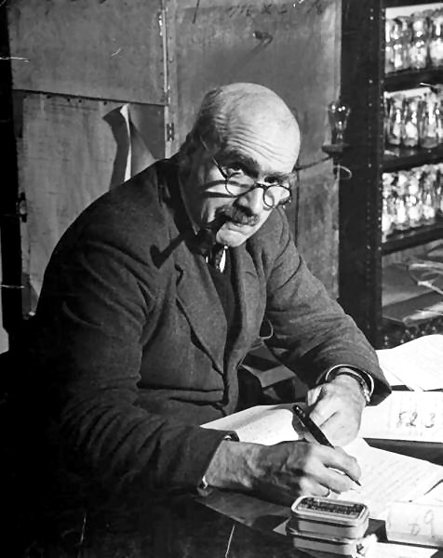
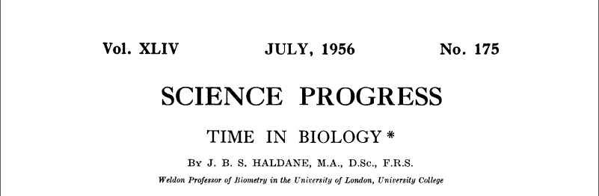

Slide 3
JBS Haldane
“[M]any of the difficulties of biology arise from the need of thinking simultaneously in several time scales. If we think too exclusively on the molecular time scale we shall be led to mechanistic materialism. If we think too exclusively on the evolutionary scale we shall be led into an exaggerated teleology.”
-JBS Haldane (1956)

Slide 4
We have not paid attention to the role of time in biology.
We need to be worried about the ways we conceive of and make assumptions about time in biology BECAUSE when we make assumptions we are obscuring something, which may have important scientific consequences.

Slide 5
Overview of Presentation
  Why does time matter for biology?
  How do the methods of biology abstract from time?
  How does imposing timescales effect biology?
  How might we put time into biology?

Slide 6
Why does Time matter for Biology?
Evolutionary/Developmental Biology
Processes!
  Evolution, Physiology, Genetics, etc.

Slide 7


Slide 8

October 2018
October 2017

Slide 9


Time in Biology
Internal vs.
External

Slide 10
Time in Biology
Internal Time
External Time
There is a scale (or scales) that are a part of any living organism.
Organisms have their own lifespan, their own circadian rhythms, etc.
Being ‘internal’ is shorthand for ‘internal to a system of interest’
Our common measure of time like seconds, hours, years, etc. are external to any biological entity.
Earth years is an internal measure of time if the system of interest is the solar system.
Being ‘external’ is shorthand for ‘external to the system of interest’.

Slide 11
Time Scales in Biology
“the timescale of X phenomenon” =
the amount of time X takes to occur
Generally given in minutes, hours, years, etc.

Slide 12
In defining the timescale in terms of some measure that is external to the phenomenon itself we are abstracting from the internal timescale of the entity we are studying.

Slide 13
What is Abstraction?
taking process out of its normal temporal context and setting it within another temporal context
            Imposing a particular timescale
            Eliminating temporal dynamics
            Sometimes both!

Slide 14
Overview of Presentation
  Why does time matter for biology?
      The subjects of biological inquiry have internal timescales.
  How do the methods of biology abstract from time?
  How does imposing timescales effect biology?
  How might we put time into biology?

Slide 15
Methodological Abstractions from Time in Biology
Or Ways Biologists Ignore Internal Time

Slide 16
Humans have our own timescale.
Our perceptual process naturally privileges a particular scale.

Slide 17
Four Types of Abstraction
Physical
Procedural
Mathematical
Conceptual

Slide 18
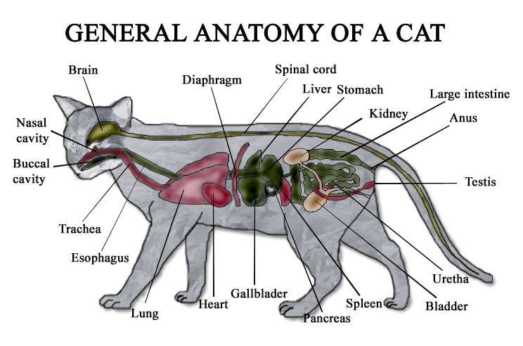
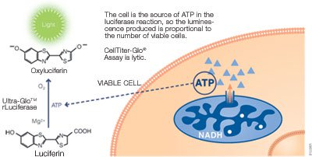
Physical Abstractions
Anatomy in deceased organisms
Cellular Proliferation Assays

Slide 19
Physical Abstractions
These methods alter the timescale by either reducing or removing the internal timescale.

Slide 20
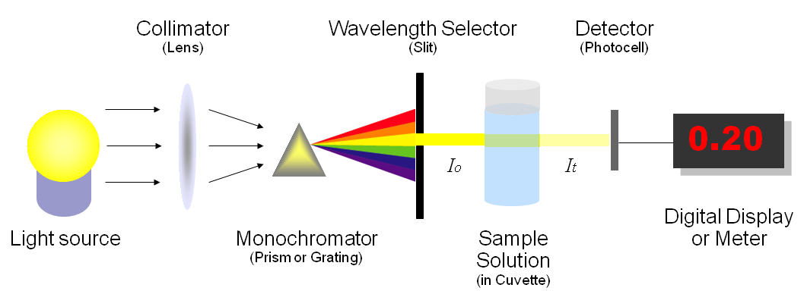
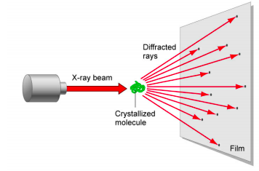
Procedural Abstractions
Spectrophotometry
X-ray crystallography

Slide 21
Procedural Abstractions
These methods remove or obscure the internal timescale by requiring sampling and thus treating the phenomenon as static.

Slide 22
Physical and Procedural Abstractions
Eliminating or freeze time
Studying things that are moving more quickly than humans can naturally perceive

Slide 23
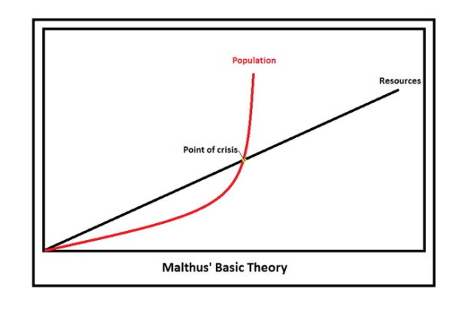
Mathematical Abstractions
Malthusian growth model

Slide 24
Mathematical Abstractions
These methods obscure the internal timescale by imposing a artificial external time scale or making false assumptions about internal timescales.

Slide 25

Conceptual Abstractions
Polymerase Chain Reaction
CRISPR - Cas-9
“Gene-centered” practice

Slide 26
Conceptual Abstractions
These practice removes the importance of internal timescale by highlighting other aspects of biological entities.

Slide 27
Methodological Abstractions
Biologists minimize the importance of the internal timescales of biological entities in a variety of ways
These abstractions from time systematically bring entities towards a “human scale” and the obscure the internal scale of the entity.

Slide 28
Overview of Presentation
  Why does time matter for biology?
      The subjects of biological inquiry have internal timescales.
  How do the methods of biology abstract from time?
      Physically, Procedurally, Mathematically, Conceptually
  How does imposing timescales effect biology?
  How might we put time into biology?

Slide 29
Time Scales in Biology
“the timescale of X phenomenon” =
the amount of time X takes to occur
Generally given in minutes, hours, years, etc.

Slide 30
Two Types of Abstraction
Eliminating
vs.
Imposing

Slide 31
Time Scales in Biology
  Help us make methodological choices
    How frequently does a process need to be sampled?
    How detailed does a representation of a process must be when incorporated into a large-scale model

Slide 32
Time Scales in Biology
Is there an alternative to understanding processes as a series of states and well-defined transition rates?
YES! We can think of the timescale itself as something to be measured and reported.

Slide 33
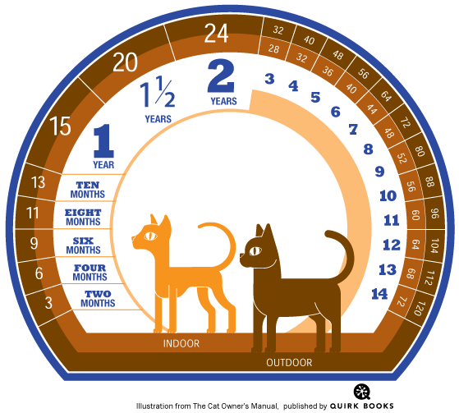
“Cat-Years”

Slide 34
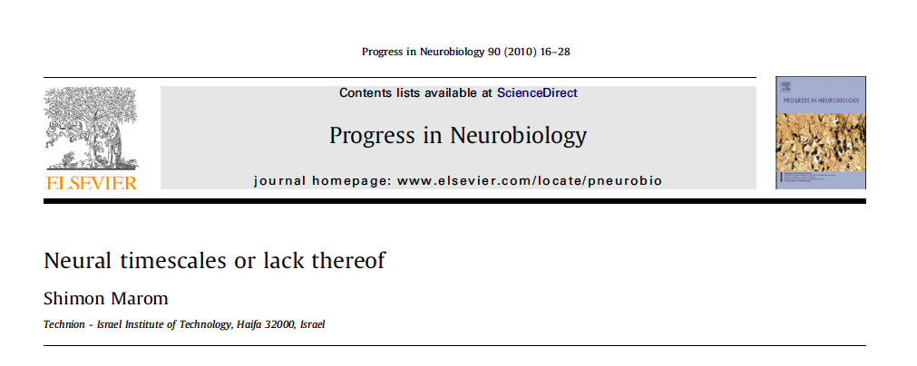
“…there seems to be no uniquely defined timescales that are inherent to the observed system […]. Rather, observed and reported timescales are the outcome of conditions imposed by the observer through the measuring procedure.”

Slide 35
Time Scales in Biology
Observed rate depends on the scale chosen by the researchers.
While researchers assumed their observed rate variation could be explained by defined rate at lower level, this has not been observed.

Slide 36
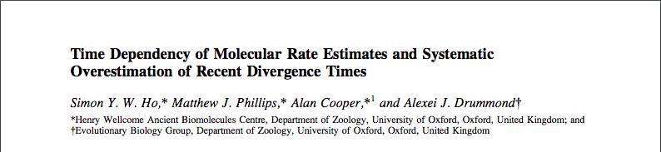
“Our results show that it is invalid to extrapolate molecular rates of change across different evolutionary timescales, which has important consequences for studies of populations, domestication, conservation genetics, and human evolution.”

Slide 37
Time Scales in Biology
Observed mutation rate depends on the timescale researchers choose
This meant that the dates evolutionary biologists assign to different events might be wrong!

Slide 38
Overview of Presentation
  Why does time matter for biology?
      The subjects of biological inquiry have internal timescales.
  How do the methods of biology abstract from time?
      Physically, Procedurally, Mathematically, Conceptually
  How does imposing timescales effect biology?
  Imposing time scales leads to problems in research.
  How might we put time into biology?

Slide 39
Putting Time Back in Biology
Or Prospects for Time-integrated Biology

Slide 40
Time-Integrated Biology
Time-dependent evolutionary models
“Active Matter”

Slide 41
Time-Integrated Biology
Time-dependent evolutionary models
    Rates of DNA mutation depends on timescale: on short scale rate estimates tend to be much quicker than on a long scale
    Create a model that allows researchers to input the timescale they were observing and get back the organism’s evolutionary rate
    Using this model researchers estimated foamy viruses emerged somewhere between 460 and 550 million years ago (much older than previously expected)

Slide 42
Time-dependent Evolutionary Models
Since researchers discovered that the rate of mutation changed depending on timescale, researchers developed a way to interpret the internal timescale of viruses.

Slide 43
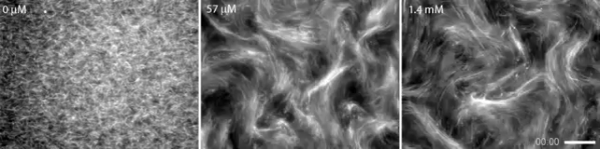
Time-Integrated Biology
“Active Matter”: 4D imaging techniques for studying microtubules
Sanchez et. al. Nature 491 (2012)

Slide 44
Active Matter
Since the Blair lab wanted to study the internal dynamics of the system they invented a way to observe the system that did not abstract from its internal timescale.

Slide 45
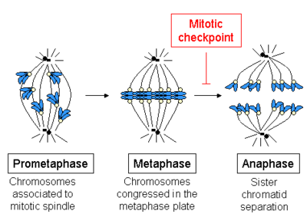
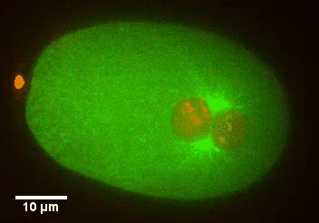
Time-Integrated Biology
“Active Matter”: Spindle Organization
The Needleman Lab (website, 2018)

Slide 46
Overview of Presentation
  Why does time matter for biology?
      The subjects of biological inquiry have internal timescales.
  How do the methods of biology abstract from time?
      Physically, Procedurally, Mathematically, Conceptually
  How does imposing timescales effect biology?
  Imposing time scales leads to problems in research
  How might we put time into biology?
    Active Matter: 4D imaging, time-dependent evolutionary models

Slide 47
Conclusion
  We need to be worried about the ways we conceive of and make assumptions about time in biology BECAUSE when we make assumptions we are obscuring something, which may have important scientific consequences.
How we understand time has methodological implications
How we understand time effects our ability to draw conclusions
Understanding time in biology has implications for philosophical debates

Slide 48
JBS Haldane
“[M]any of the difficulties of biology arise from the need of thinking simultaneously in several time scales. If we think too exclusively on the molecular time scale we shall be led to mechanistic materialism. If we think too exclusively on the evolutionary scale we shall be led into an exaggerated teleology.”
-JBS Haldane (1956)

Slide 49
JBS Haldane
“[M]any of the difficulties of biology arise from the need of thinking simultaneously in several time scales. If we think too exclusively on the molecular time scale we shall be led to mechanistic materialism. If we think too exclusively on the evolutionary scale we shall be led into an exaggerated teleology.”
-JBS Haldane (1956)

Slide 50
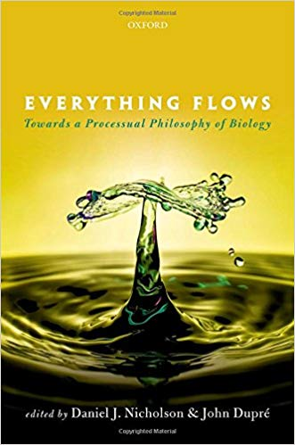
Abstracting from time has driven the dominance of substance ontology.
Taking internal timescales seriously will mean treating entities as processes.

Slide 51
Thank-you!

