Slide 1
Stem cells, lineages,
and processes
A Processual Revolution in Biology
Boston Colloquium in Philosophy of Science
October 29, 2018
Melinda Bonnie Fagan
Department of Philosophy
University of Utah

Slide 2
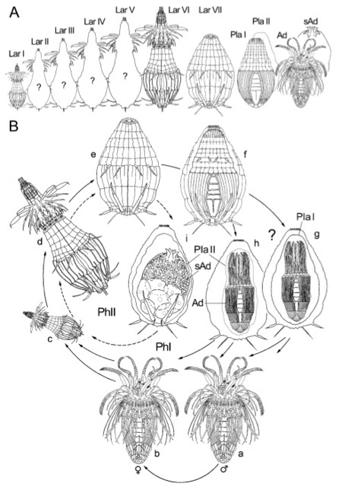

Slide 3
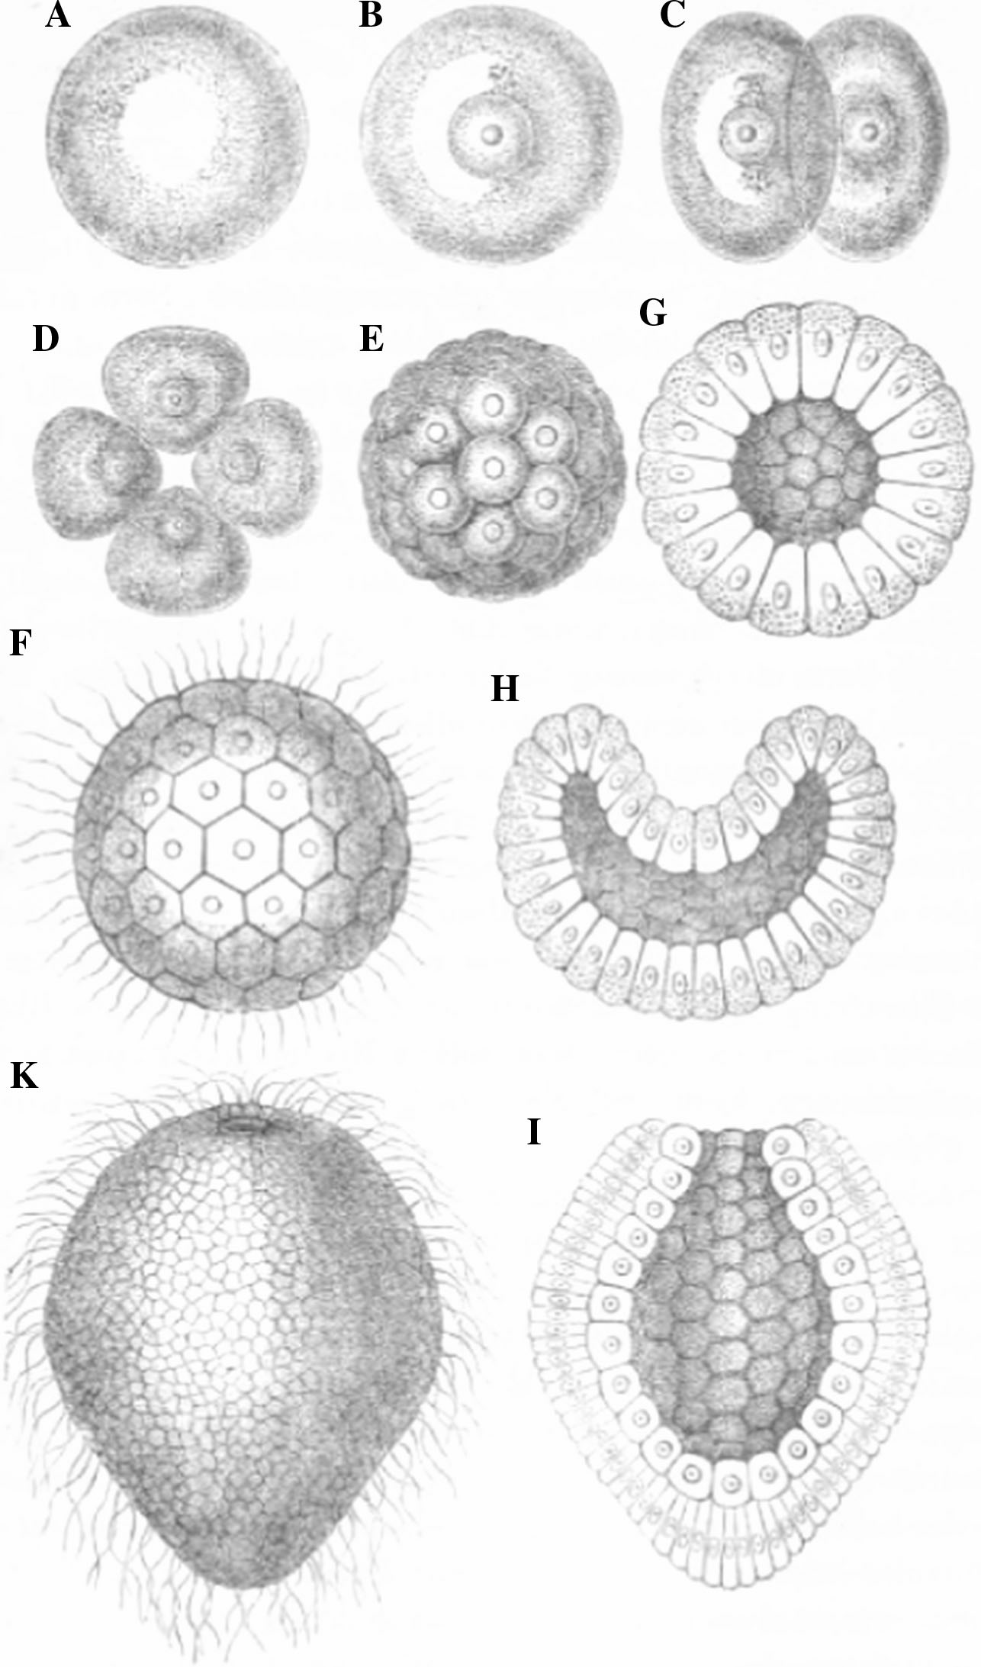
The phases of germination of a coral, starting with the (homogeneous) Monerula-stage (A) and then passing through the (nucleated) stem cell stage (B), various segmentation stages (C–I) and the gastrula-stage (K). (From Haeckel 1876, 156)

Slide 4
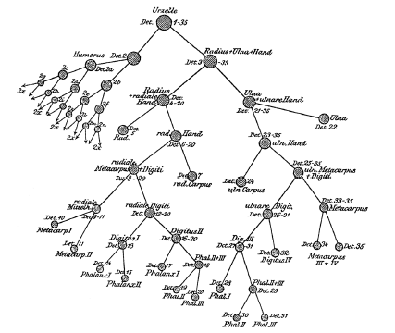
Motivation and aims:
Over-emphasis on entities? “For too long we have tried to build a biology out of nouns, a science constructed around entities. Perhaps it is time for a biology built out of verbs, a science constructed around processes.” (Keller, 2005, 9)
Proposal: an inclusive model of development, spanning all the
relevant scales and levels of organization (molecular,
cellular, tissues, organs, whole organism)
Central ideas: cell lineage trees are a
special case of network model;
stem cell lineages link cell and
organism in overall developmental
process

Slide 5
Plan of talk:
I. Introduction
II. Stem cells: lineage tree processes
III. Cell-organism relation
IV. Multi-layered model of development
V. Conclusion

Slide 6
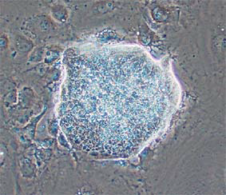

Slide 7
Cell individuation: clear criteria
(i) Cells reproduce by binary division; a parent cell divides to produce two offspring cells.
(ii) An individual cell’s existence begins with a cell division event and ends with either a second division event (producing two offspring) or cell death (and no offspring).
(iii) Generations of cells linked by reproductive division form a lineage.

Slide 8
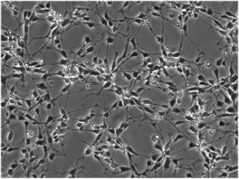
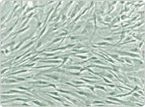
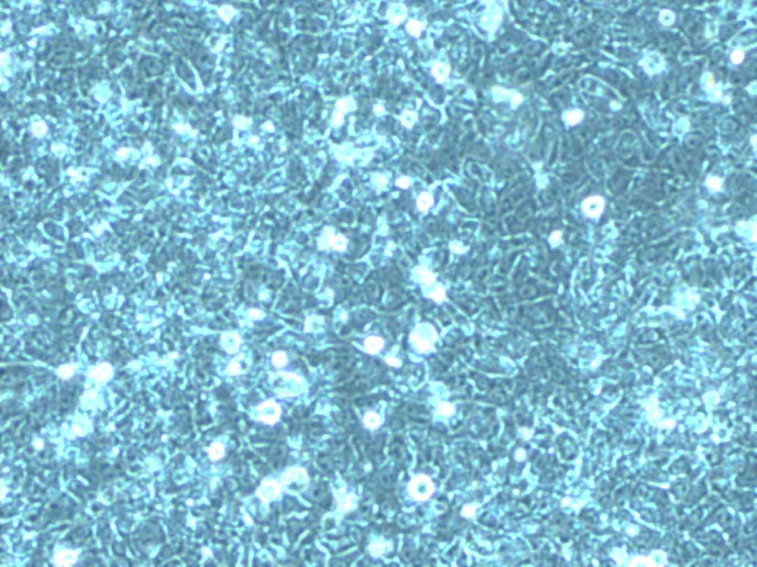
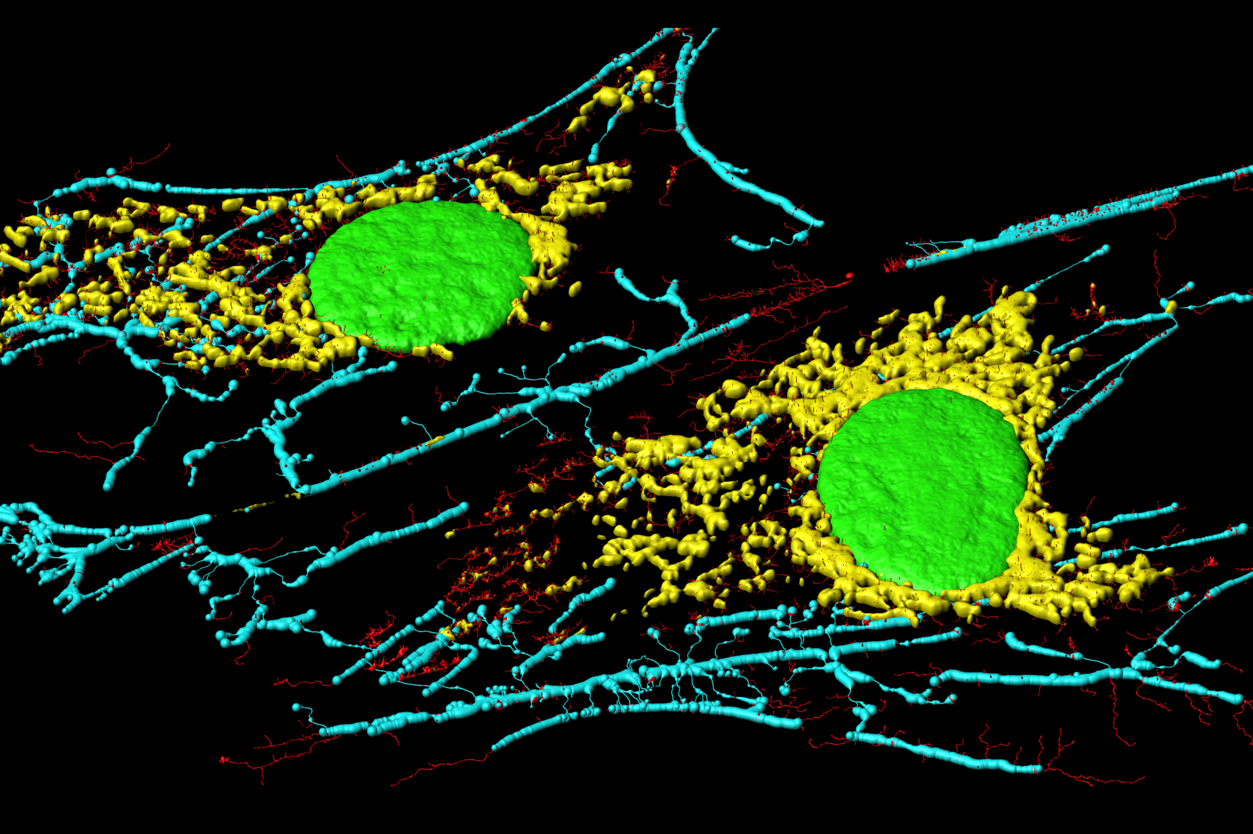
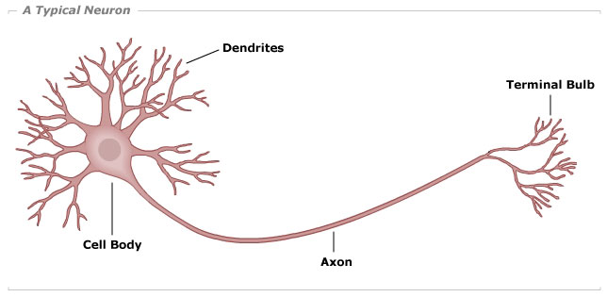
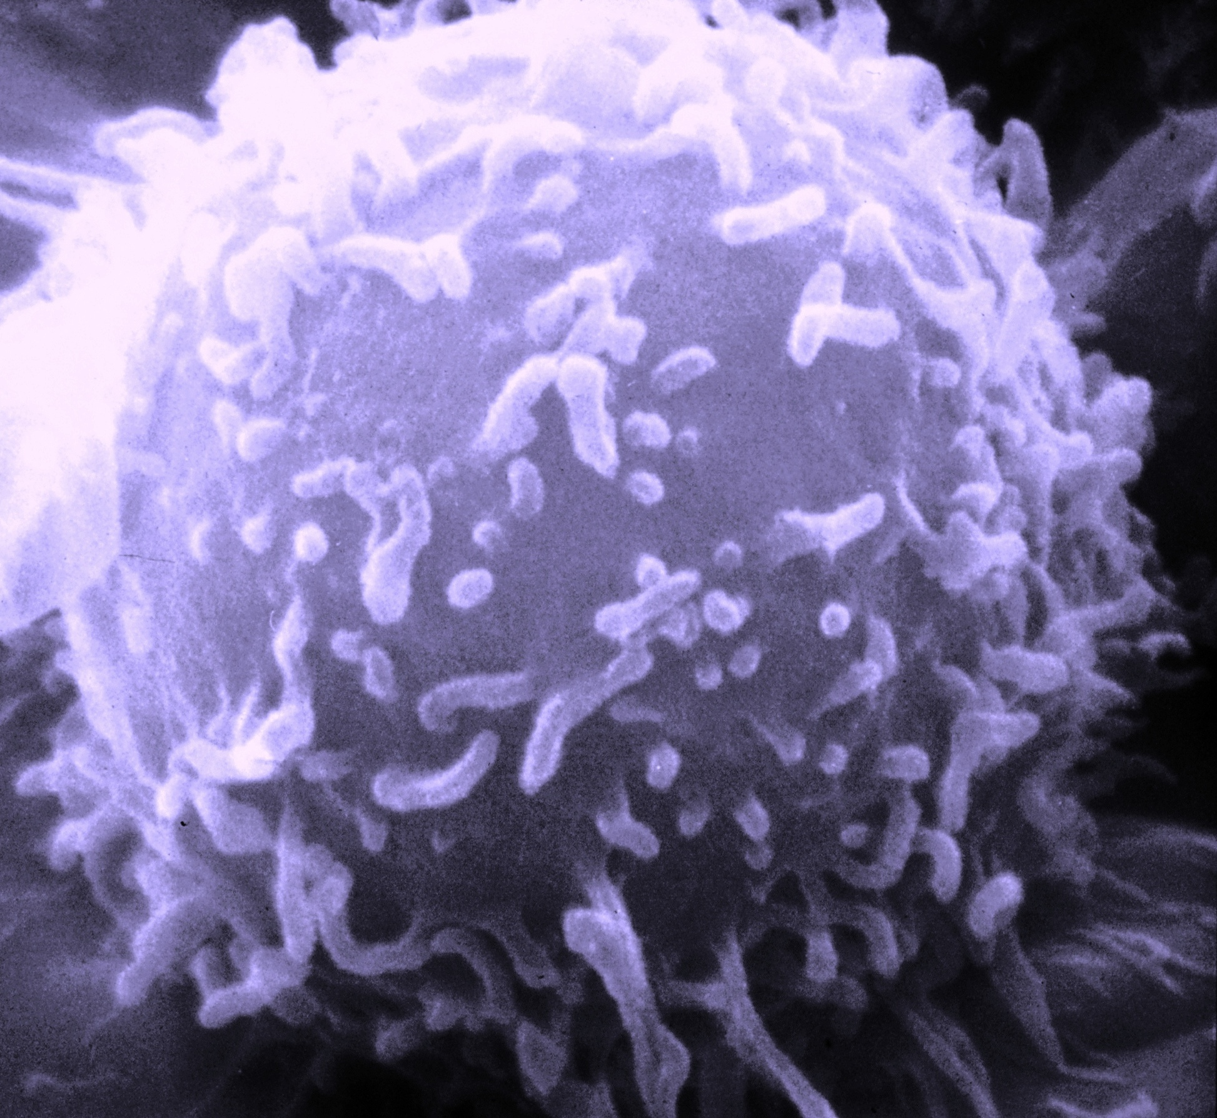
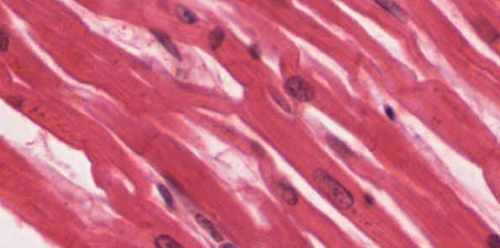
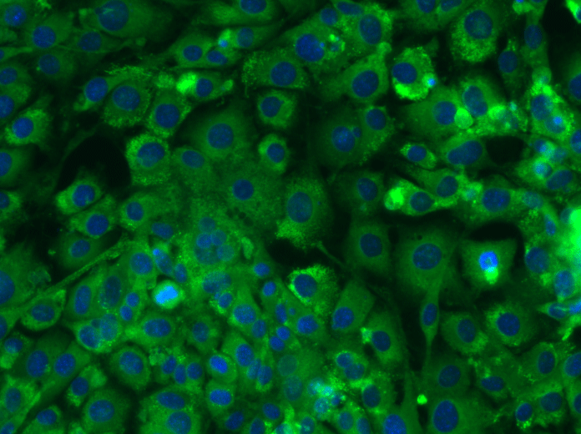

Slide 9
Stem cells are not cells: basics
• a stem cell is not a type of single, isolated cell (an entity)
• the abilities that define a stem cell involve generations of cells – a cell lineage
• lineage structure is largely determined by interactions between cells and environments
Argument:
(i) the general definition of ‘stem cell’
(ii) experimental methods used to individuate stem cells

Slide 10
What is a stem cell?
Stem cell: “functionally defined as having the capacity to self-renew and the ability to generate differentiated cells.” (Melton 2013, Essentials of Stem Biology, 7)
Self-renewal: cell division producing one or more cells similar to the parent
Differentiation: loss of developmental potential and acquisition of specialized traits of a mature cell type

Slide 11
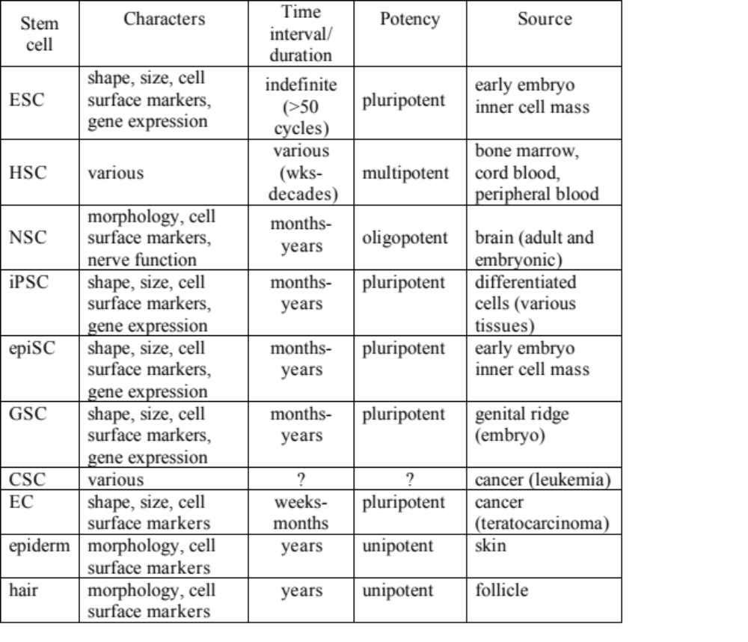

Slide 12
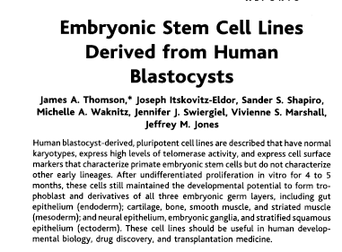
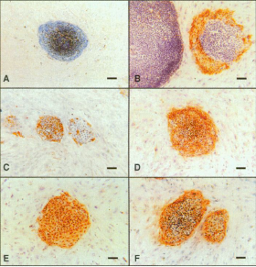
Stem cell biology: experiment-driven
• concrete experimental systems in stem cell biology embody conceptual models
of the process of development – make explicit

Slide 13

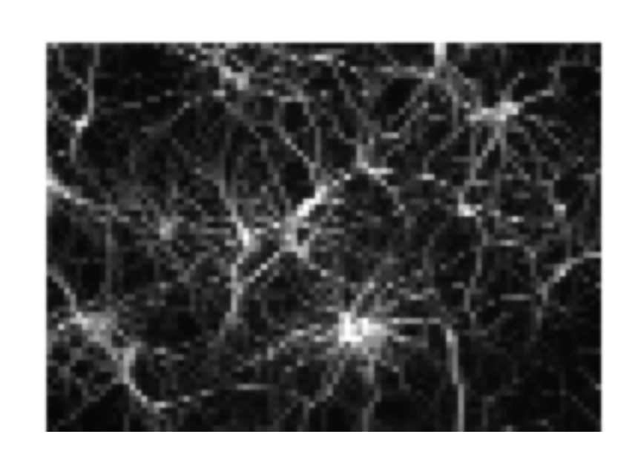
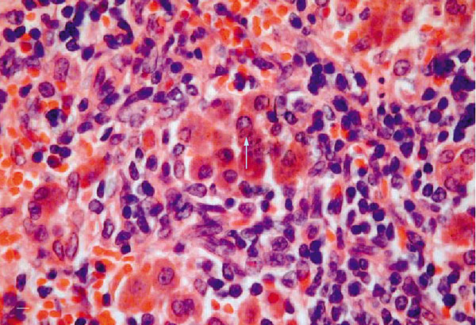
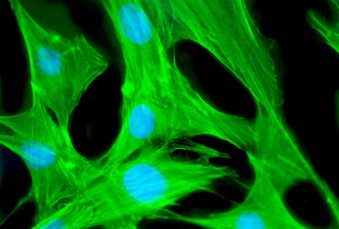
Basic experimental design:
radiation rescue
in vivo
teratoma
organismal
source (L)
characters C
in vitro

Slide 14
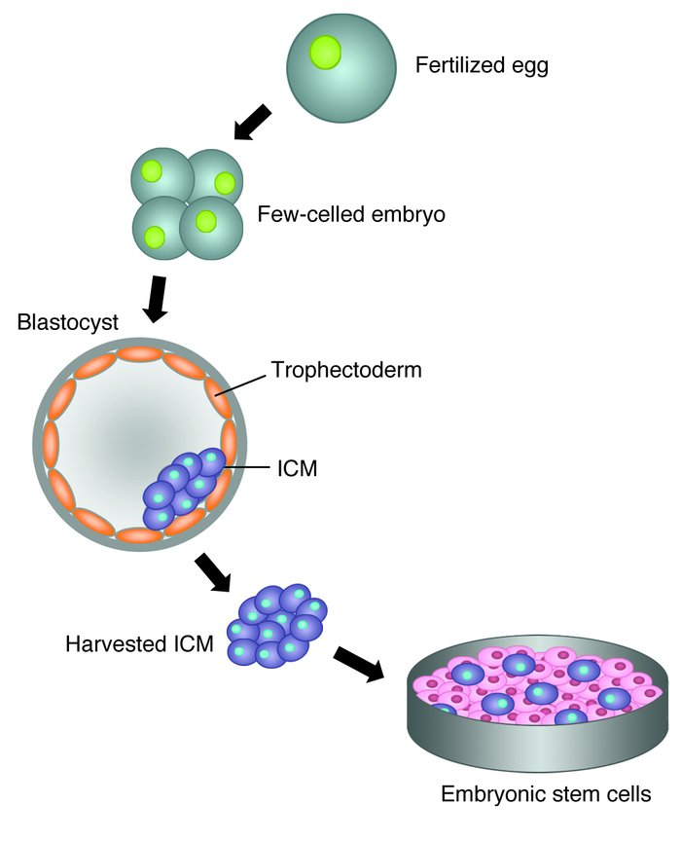
Human embryonic stem cells: method

Slide 15
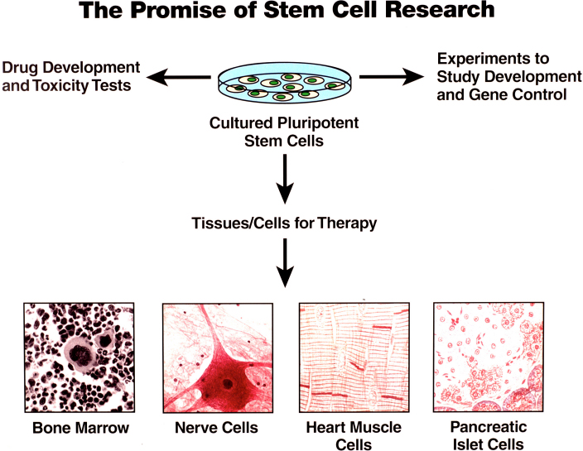
Human embryonic stem cells: method

Slide 16
‘Grades’ of stem cell potential:
Totipotency: the ability to produce an entire organism (in mammals,
this includes extra-embryonic tissues)
Pluripotency: the ability to produce all cell types of an adult organism
Multi-potency: the ability to produce some (but not all) cell types of
an adult organism
Oligo-potency: the ability to produce a limited subset of cell types in
an organism (a few)
Uni-potency: the ability to produce only one specialized cell type

Slide 17
Abstract stem cell model:
(1) origin: the multicellular organism from which the
stem cell is derived
(2) interval of persistence: number and rate of self-
renewing stem cell divisions
(3) component traits: characters of cells occupying the
various positions in a lineage
(4) process of change: positions in the lineage are
ordered by a developmental process

Slide 18
Abstract stem cell model:
(1) origin: the multicellular organism from which the
stem cell is derived S
(2) interval of persistence: number and rate of self-
renewing stem cell divisions n
(3) component traits: characters of cells occupying the
various positions in a lineage C
(4) process of change: positions in the lineage are
ordered by a developmental process D

Slide 19
TABLE 1: Model-based classification of stem cells
Type | S (source) | C | n | D
ESC | 5d embryo ICM | cell size, cell shape, gene expression, karyotype, telomerase activity, alk-phos, cell surface molecules | ≥50 divs | traits of cells from three germ layers
HSC | BM, cord, peripheral blood | cell size, density, light scatter, surface molecules, cell cycle status | >6 months | traits of main blood and immune cell lineages
NSC | basal lamina of ventricular zone | cell morphology, surface markers, gene expression, cytokine response | months to years | traits of neurons, astrocytes, and oligodendrocytes
iPSC | various (relatively mature cells) | colony shape, cell size, cell shape, nucleus/cytoplasm ratio, cell surface molecules, activity and expression of specific proteins, gene expression (specific and global), histone modifications at key locations | ≥50 divs | traits of cells from three germ layers
GSC | 5-9wk gonadal ridge | colony shape, alk-phos, surface expression (SSEA-1, SSEA-3, SSEA-4, TRA-1–60,TRA-1–81) | 20-25 wks | traits of cells from three germ layers
EC | teratocarcinoma (129) | cell shape, morphology, production of embryoid bodies, surface molecules, enzymes | unlimited | traits of cells from three germ layers, teratocarcinoma

Slide 20
Experiments fix values of variables:
radiation rescue
in vivo
teratoma
organismal
source (L)
characters C
in vitro
n
S
C
D

Slide 21
Stem cell lineage model:
Organismal source S
cell generations n
cell character values C
developmental process D

Slide 22
Lineage models: tree structure

Slide 23
Stem cell lineage trees:
• stem cell: a space of possible tree-models
• Each model has a particular number and
arrangement of developmental
- stages (depth of hierarchy) d – cell traits measured
- branch-points (branching cell states) a - intermediate stages
- termini (developmental potential) p – tests of dev potential
• values of variables in a tree model (or set
of tree models) are fixed by experimental
methods and assumptions.

Slide 24
Stem cell lineage model: conclusions
Argument:
(i) the general definition of ‘stem cell’
(ii) experimental methods used to individuate stem cells
• Stem cells are defined not by the traits they have, but by what
they can transform into; the idea of a stem cell presupposes a
cell lineage and developmental process generating that lineage.
• A stem cell is the starting point of a cell lineage; defined by its
reproductive and developmental abilities.

Slide 25
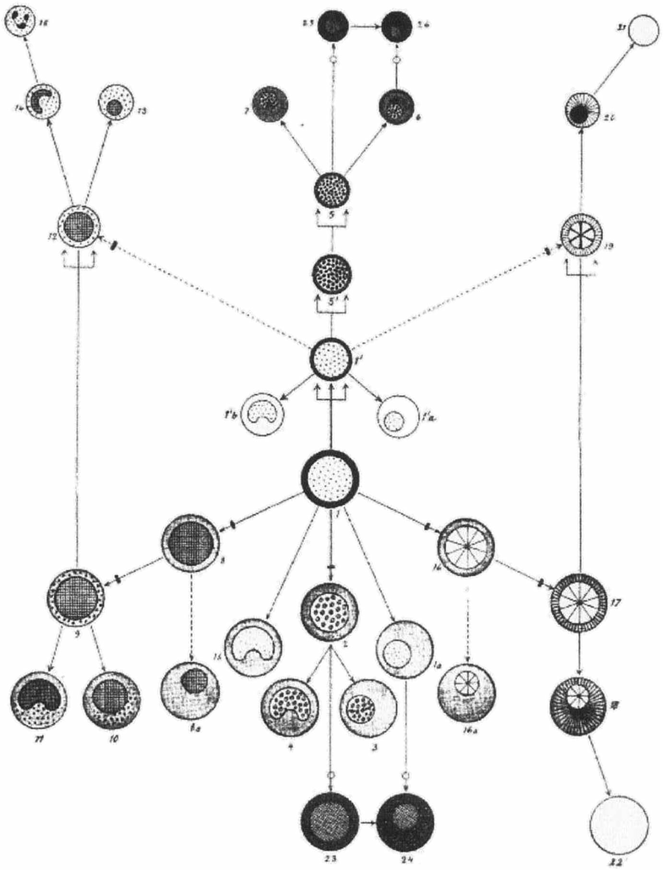
Substantivist objection?

Slide 26
Lineage tree processes: reply
• the substantivist objection treats cell lineages as abstract and isolated, contrary to practices of stem cell biology
• a stem cell is not equivalent to a lineage tree structure, but occupies a unique position within it (the point of initiation for all paths)
• stem cells are defined by capacities of self-renewal and differentiation; stem cells as entities are destroyed by the processes that define them
• ‘stemness’ is context-dependent; stem cell experiments manipulate cells’ sensitivity to environment

Slide 27
Substantivist rebuttal:
self-renewal
differentiation
cell generations
Objections:
• eliding stem cells’ context-dependence is misleading
• cell-organism transformation also implicated; cells insufficient

Slide 28
Cell-organism relation:
p
d
source organism
a
Lineage: derived from
source organism of
• species
• developmental stage
• location

Slide 29
Cell-organism relation:
p
d
source organism
developing organism
a
Lineage: derived from
source organism of
• species
• developmental stage
• location

Slide 30
Pluripotency experiments:
• embryoid bodies
• teratomas
• organoids
• embryo-like structures

Slide 31
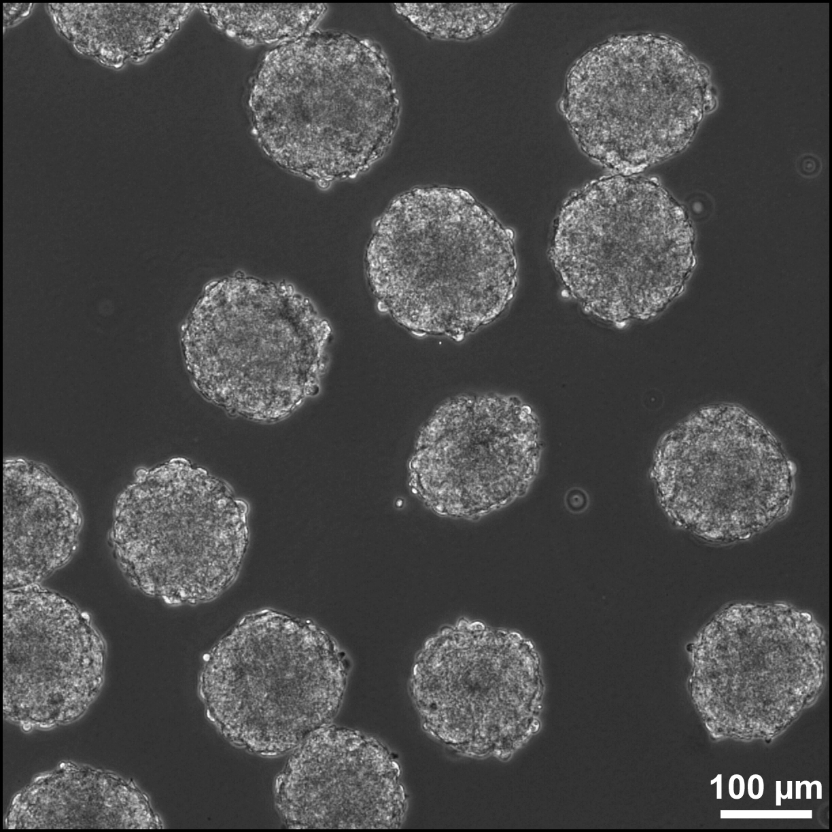
Pluripotency experiments:
• embryoid bodies
• teratomas
• organoids
• embryo-like structures

Slide 32
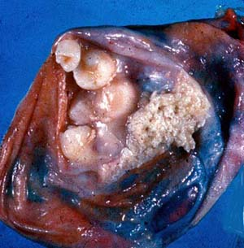
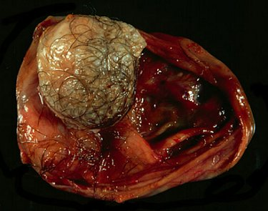
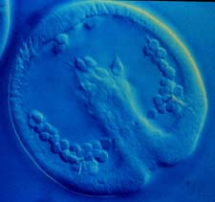
Teratomas: disorganized cell lineages
Teratocarcinomas “appear to recapitulate many of the events that occur during early embryonic development but in a disorganized manner” (Andrews 2002, 406).

Slide 33
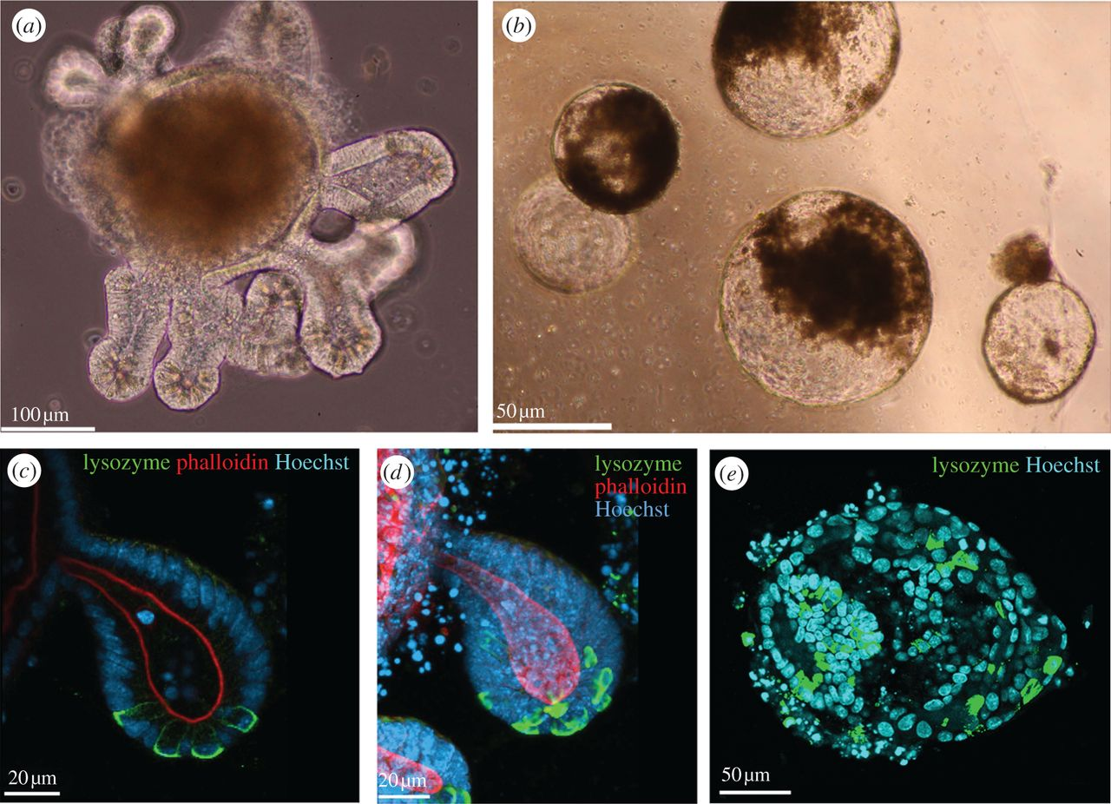
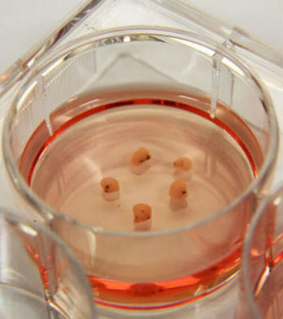
Stem cells to organoids:
“a collection of organ-specific cell types that develops from stem cells or organ progenitors and self-organizes through cell sorting and spatially restricted lineage commitment in a manner similar to in vivo.” (Lancaster and Knoblich 2014, 283)

Slide 34
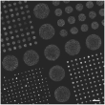
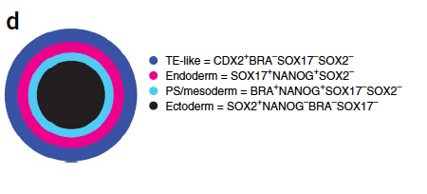

Embryo-like structures:
Warmflash et al (2014, 848) Schematic of the results of 42 h of BMP4 treatment in micro-patterned culture. TE, trophectoderm; PS, primitive streak.
Human embryonic stem cells (hESC) growing in micro-patterned cell culture. (Warmflash et al. 2014, 848, Figure 1b)

Slide 35
Pluripotency experiments:
• embryoid bodies
• teratomas
• organoids
• embryo-like structures
• directed differentiation
hESC

Slide 36
Stem cells: developmental versatility
Experiment | Mode of development | Aspect of organization
n/a | normal | all, complex, robust
embryoid body | simplified | generic cell types, simple 3D structure
teratoma | pathological | specialized cell types, 3D structure, non-robust
organoid | organ-like | specialized cell types, complex 3D structure, non-robust
embryo-like strucrure | embryo-like | generic cell types, simple 2D structure, polarity
directed differentiation | cellular | specialized cell types

Slide 37
Enkapsis: a model of development?
• ‘enkapsis’ – from the Greek for ‘encapsulation.’
enkaptic system: comprised of multiple systems, ordered by complexity, such that systems of higher complexity encapsulate (“enclose”, “have imbedded in them”) systems of lower complexity.
• “the organism encapsulates its organs, organs encapsulate their parts, the parts encapsulate cells, cells encapsulate organelles…. The organism thus forms an enkaptic divisional hierarchy....” (Rieppel 2009, 313-314).

Slide 38
Multi-layered model of development
• different layers (strata) of the developmental process related by
‘boundary-formation’
• upper layer: distinguish entities involved in development distinct
from their environment: cells, tissues, or organs
• lower layer: an interactive network, criss-crossing that boundary

Slide 39
Example: organoids
• “self-organizes through cell sorting and spatially restricted lineage commitment in a manner similar to in vivo”
cell sorting out: adhesion between matching surface molecules, leading to a thermodynamically stable pattern
lineage commitment: shift from a stem cell state into a state with more restricted potential
imposition of an artificial boundary sets up interactions among cell surface molecules together with physical forces that ‘commit’ cells to develop along particular pathways; scaffold constrains “cell fate”

Slide 40
Pluripotency experiments:
• embryoid bodies
• teratomas
• organoids
• embryo-like structures

Slide 41
Example: cells
• cell: individuated by bounding membrane
• lower layer : a network of molecular biochemical, physical
interactions
• a change imposed on that network (internal or external)
• upper layer: a boundary distinguishes an individual cell from its
environment

Slide 42
Boundary-formation across layers:
• experiments aimed at characterizing stem cell differentiation
potential specify the means of encapsulation
• a new boundary distinguishes a higher-level system (developing
body) from its environment
• layers of network models linked by boundary-relation
• the role of the environment (a complex part of the process) is
crucial at each layer

Slide 43
Multi-layered model of development:
tissues, organs
cell lineage
biochemical factors, extra-cellular matrix, mechanical forces, oxygen levels, pH, etc.
• at every stratum: importance of the environment

Slide 44
Concluding summary:
• stem cells are not a type of cell (traditional biological individual), but the starting points of lineage processes
• stem cell: a distinctive position within a generative process that includes cell reproduction, differentiation, and the appearance of aspects of organismal organization (revealed by experiments that manipulate stem cell potential:
• the latter are revealed by experiments that manipulate stem cell potential to produce teratomas, embryoid bodies, organoids, embryo-like structures, and results of directed differentiation experiments (developmental versatility)
• multi-layered model of development, spanning levels (scales) of molecules, cells, tissues/organs, and organisms via boundary-formation and ongoing lower-stratum interactions

Slide 45



Thanks!
The
Sterling M. McMurrin
Foundation

