Slide 1
Data Manipulation in SAS
CTSI BERD Core Seminar
Emily K.Q. Sisson
June 15, 2017

Slide 2
Using SAS for analysis: Overview
Have data in some foreign format (Excel, CSV, SPSS, etc.)
Import data into SAS
Look at the data in SAS
Transform the data
Prepare data for analysis
Choose SAS procedures
(Confirm that SAS did what you think it did)
Interpret results
Store data
Graph Data

Slide 3
Using SAS for analysis: Statement Rules
SAS statements must end with a semicolon (;)
SAS statements can begin in any position on a line
SAS statements may consist of multiple lines
Multiple SAS statements may appear on a single line
One or more blank spaces should exist between items in SAS statements
  Unless, the items are special characters such as =, +, or $, then blank space is not necessary

Slide 4
Using SAS for analysis: Naming Conventions
Many SAS names can be 32 characters long; some have a max length of 8.
The first character must be a letter or underscore (_). Subsequent characters can be letters, numbers, or underscores.
You can use upper or lowercase.
Blanks cannot appear in SAS names.
SAS reserves a few names for automatic variables and variable lists. For example, _N_ and _ERROR_

Slide 5
Using SAS for analysis : Name Literals
Name literals enable you to use special characters (including blanks) that are not otherwise allowed in SAS names
A SAS name literal is expressed as a string within quotation marks, followed by the letter n
When the name literal contains any character not allowed when VALIDVARNAME=V7, then you must set the VALIDVARNAME=ANY
The following is an example of a VAR statement and a name literal:
  var 'a b'n;

Slide 6
Using SAS for analysis: Overview
Have data in some foreign format (Excel, CSV, SPSS, etc)
Import data into SAS
Look at the data in SAS
Transform the data
Prepare data for analysis
Choose SAS procedures
(Confirm that SAS did what you think it did)
Interpret results
Store data
Graph data

Slide 7
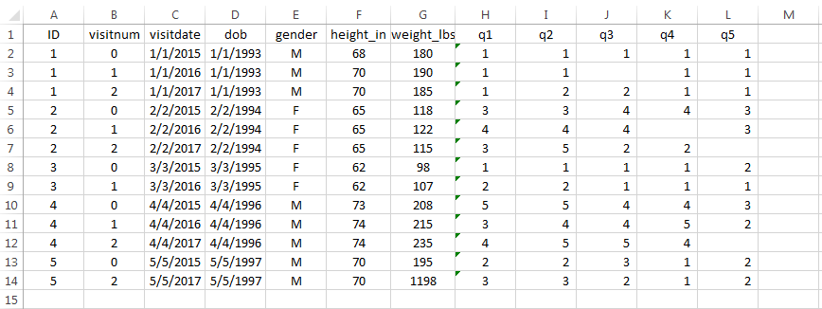
Importing Data
Excel Example using IMPORT Statement

Slide 8
Importing Data
Excel Example using IMPORT Statement
proc import datafile="c:\users\eq\desktop\example data.xls"
out=example_data dbms=excel replace;
sheet="Sheet1$"; getnames=yes;
mixed=no; scantext=yes;
usedate=yes; scantime=yes;
textsize=32767;
run;

Slide 9
Importing Data
Excel Example using IMPORT Statement
proc import datafile="c:\users\eq\desktop\example data.xlsx"
out=example_data dbms=xlsx replace;
getnames=yes;
run;

Slide 10
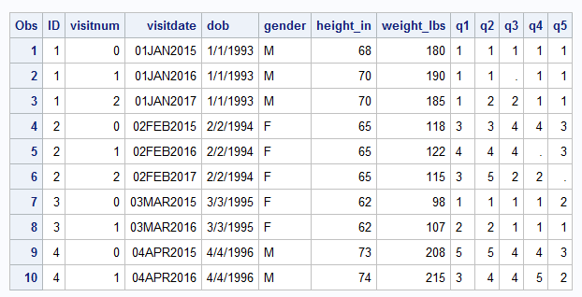
Viewing Data
PROC PRINT is an easy way to view your dataset
proc print
data=example_data(obs=10);
run;

Slide 11
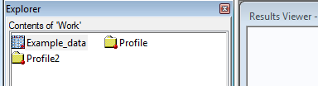
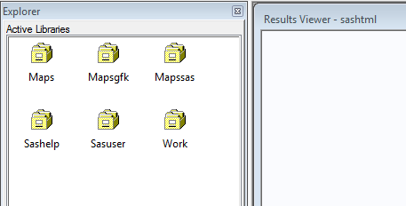
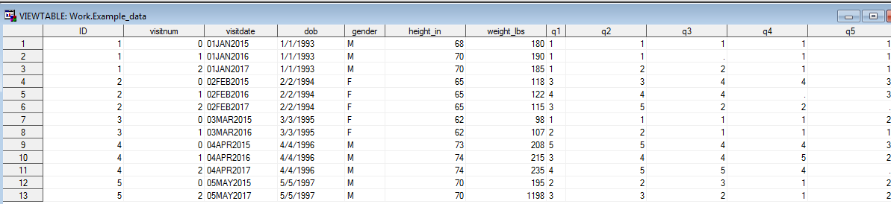
Viewing Data
SAS Explorer is a good way to peruse datasets, too

Slide 12
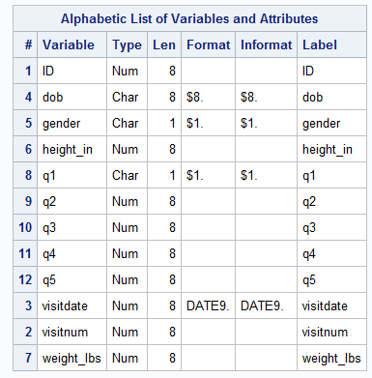
Viewing Data
PROC CONTENTS can help you determine the status of your data elements
proc contents data=example_data;
run;
Date stored as character
Survey question stored as
character

Slide 13
Transforming Data: SAS Dates
SAS stores dates as a numeric value that represents the distance from January 1, 1960 (reference date)
  January 1, 1960 is stored as 0
  January 6, 1959 is stored as -360
  October 10, 1983 is stored as 8683
When dates are stored this way, you can calculate differences in time
SAS provides a good reference page for working with dates
  https://v8doc.sas.com/sashtml/lrcon/zenid-63.htm

Slide 14
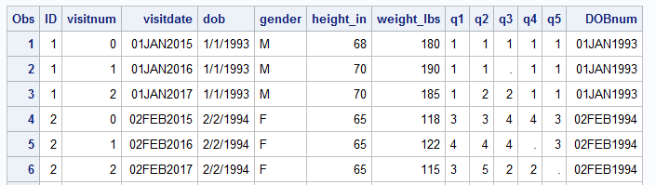
Transforming Data: SAS Dates
DOB was stored as character – important to convert for calculations!
SAS INPUT function allows you to convert a formatted character string to a numeric input:
data example_data_date;
set example_data;
DOBnum = input(dob,mmddyy10.);
format DOBnum date9.;
run;

Slide 15
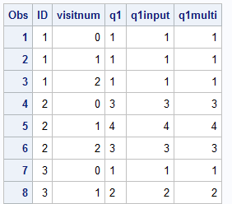
Transforming Data: Character to Numeric
INPUT function works the same way for numbers stored as character strings
Alternatively, you can use multiplication (*) to convert:
data example_data_conv;
set example_data_date;
q1input = input(q1,8.);
q1multi = q1*1;
run;
proc print;
var id visitnum q1:;
run;

Slide 16
Preparing Data: Arrays
Arrays can help simplify your program:
  Repetitive coding
  Define variables to be processed as a group
Array statement syntax:
  array array_name (n) <$> <length> array elements <(initial values)>;
    <> Statements are optional
Great SUGI paper for further reference
  http://www2.sas.com/proceedings/sugi30/242-30.pdf

Slide 17
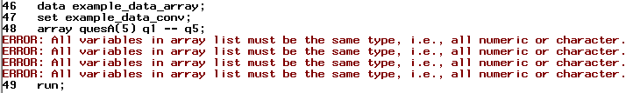
Preparing Data: Arrays
Our data – we have 5 questions (q1 – q5) that we would like to uniformly process
Set up an array:
    data example_data_array;
      set example_data_conv;
      array quesA(5) q1 -- q5;
    run;

Slide 18
Preparing Data: Arrays
Recall, we had to recode q1 into a numeric field:
    data example_data_array;
      set example_data_conv;
      array quesA(5) q1input q2 -- q5;
      array quesB(5) q1input q2 q3 q4 q5;
      array quesC(*) q1input q2 q3 q4 q5;
    run;
    (These are all valid ways to define the same array.)

Slide 19
Preparing Data: DO Loops
Using the previously established array, we can use a DO loop to apply the same code across all the variables!
For our questionnaire, if a variable is missing we want to impute its value with the average score of the other items in the questionnaire – ONLY if 1 item is missing.

Slide 20
Preparing Data: DO Loops
  data example_data_array;
  set example_data_conv;
  array quesA(5) q1input q2 -- q5;
  array quesB(5) q1input q2 q3 q4 q5;
  array quesC(*) q1input q2 q3 q4 q5;
  do i = 1 to 5;
  if quesB(i) = . and n(of q1input q2 --q5) ge 4 then quesB(i) = mean(of q1input q2 --q5);
  end;
  run;
Notes:
i comes from summation notation in mathematics – I, j, k, etc. People are taught over and over with I and so it becomes convention!

Slide 21
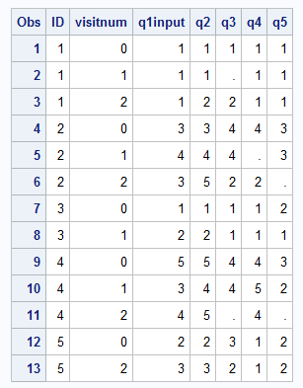
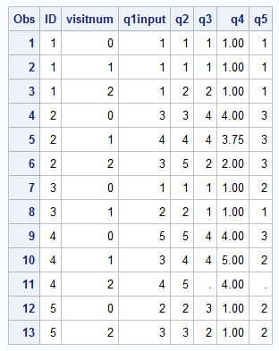
Preparing Data: DO Loops
example_data_conv: example_data_array

Slide 22
Preparing Data: Derived Variables
Creating a summary score of our questionnaire data
  sum of all items q1 – q5
data example_summary;
  set example_data_conv;
  summary_plus = q1input + q2 + q3 + q4 + q5;
  summary_sum = sum(of q1input q2 q3 q4 q5);
run;

Slide 23
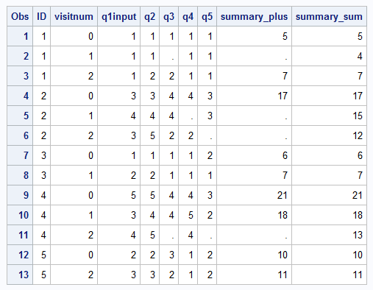
Preparing Data: Derived Variables
Creating a summary score of our questionnaire data
  Using plus signs returns null values when
  an item is null
  Using sum function removes that problem
  Be mindful creating summary scores with
  missing data – imputation may be
  necessary, or metric may be invalid

Slide 24
Preparing Data: Derived Variables
Age w/ decimal places (i.e. I am 33.5 years old):
agedeci = round(((visitdate-dobnum) / 365),0.1);
Age to the year (i.e. I am 33 years old):
agefloor = floor((visitdate-dobnum) / 365);
The above doesn’t account for leap years!
agecorrect = floor ((intck('month',dobnum,visitdate) - (day(visitdate) < day(dobnum))) / 12);
    Intck returns the number of times the first day of a month is passed
    Logical test returns 0/1 for adjustment
    Divide by 12 months

Slide 25
Preparing Data: Derived Variables
SAS has so many functions for all kinds of purposes:
  Character String Matching/Manipulation
  Date/Time
  Descriptive Statistics
  Geographic
  Mathematical
  Random Numbers
  …and MORE!
Full listing here:
  http://support.sas.com/documentation/cdl/en/lrdict/64316/HTML/default/viewer.htm#a000245860.htm

Slide 26
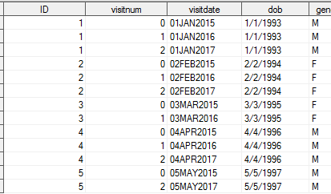
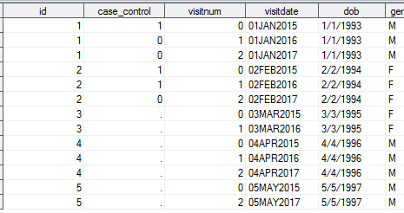
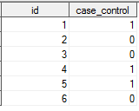
Preparing Data: Merge
data example_merge1;
merge random
example_data;
run;

Slide 27
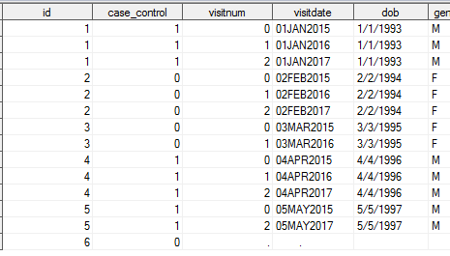
Preparing Data: Merge
options mergenoby=error;
data example_merge2;
merge random
example_data;
by id;
run;

Slide 28
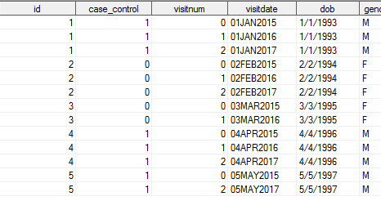
Preparing Data: Merge
data example_merge3;
merge random (in=r)
example_data (in=e);
by id;
if e;
run;

Slide 29
Preparing Data: Retain Statement
The RETAIN statement can be used to carry data points from one observation to the next
Particularly useful in assigning “baseline” values to future time points
Good overview paper:
https://www.mwsug.org/proceedings/2009/stats/MWSUG-2009-D14.pdf

Slide 30
Preparing Data: Retain Statement
proc sort data=example_data_conv;
by id visitnum;
run;
data example_data_retain;
set example_data_conv;
by id visitnum;
retain base_weight;
if first.id then base_weight = weight_lbs;
run;

Slide 31
Preparing Data: Retain Statement
Obs | ID | visitnum | visitdate | weight_lbs | base_weight
1 | 1 | 0 | 01JAN2015 | 180 | 180
2 | 1 | 1 | 01JAN2016 | 190 | 180
3 | 1 | 2 | 01JAN2017 | 185 | 180
4 | 2 | 0 | 02FEB2015 | 118 | 118
5 | 2 | 1 | 02FEB2016 | 122 | 118
6 | 2 | 2 | 02FEB2017 | 115 | 118
7 | 3 | 0 | 03MAR2015 | 98 | 98
8 | 3 | 1 | 03MAR2016 | 107 | 98
9 | 4 | 0 | 04APR2015 | 208 | 208
10 | 4 | 1 | 04APR2016 | 215 | 208
11 | 4 | 2 | 04APR2017 | 235 | 208
12 | 5 | 0 | 05MAY2015 | 195 | 195
13 | 5 | 2 | 05MAY2017 | 1198 | 195

Slide 32
Preparing Data: Transpose
Retain allowed us to move one observation to the next, but transpose can let us look at many observations side-by-side
proc transpose data=example_data_conv out=example_data_transpose;
by id;
id visitnum;
var weight_lbs;
quit;

Slide 33
Preparing Data: Transpose
Obs | ID | _NAME_ | _LABEL_ | _0 | _1 | _2
1 | 1 | weight_lbs | weight_lbs | 180 | 190 | 185
2 | 2 | weight_lbs | weight_lbs | 118 | 122 | 115
3 | 3 | weight_lbs | weight_lbs | 98 | 107 | .
4 | 4 | weight_lbs | weight_lbs | 208 | 215 | 235
5 | 5 | weight_lbs | weight_lbs | 195 | . | 1198

Slide 34
Storing Data: Permanent libraries
Once you’ve done all the manipulation to your sets, you will probably want to reaccess them again (and again and again!)
SAS allows you to assign a permanent library to store data:
libname libn "c:\users\eq\desktop";
data libn.example_permanent;
set example_merge3;
run;

Slide 35
Storing data: Labels and Formats
proc format library=libn;
  value cascon
  1 = 'Case'
  0 = 'Control';
run;
data libn.example_permanent_labfmt;
  set example_merge3;
  label case_control = "Case or Control Status";
  format case_control cascon.;
run;

Slide 36
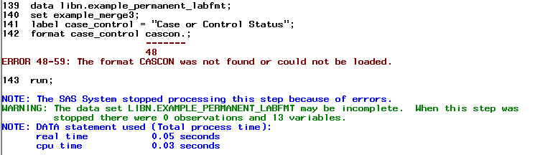
Storing data: Labels and Formats

Slide 37
Storing data: Labels and Formats
options fmtsearch = (libn.formats) nofmterr;
data libn.example_permanent_noerror;
set example_merge3;
label case_control = "Case or Control Status";
format case_control cascon.;
run;

Slide 38
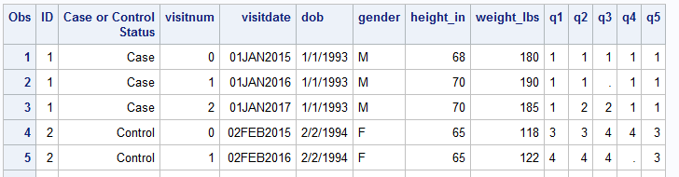
Storing data: Labels and Formats
proc print data=libn.example_permanent_noerror label;
run;

Slide 39
Storing data: Compatibility
Sets and format libraries created with 9.3 are compatible with 9.4 by default
SAS 9.4 created datasets won’t be compatible with SAS versions prior to 9.3 unless you specify the following option when creating the set in 9.4:
  options ExtendObsCounter-no;
http://support.sas.com/rnd/migration/planning/files/forward_drilldown.html

Slide 40
Graph data: ODS Graphics Designer
Traditionally, graphing in SAS was code-driven and cumbersome. Starting in 9.2, SAS introduced the ODS Graphics Designer: a point-and-click GUI that is a tool to generate GTL syntax
In SAS, select Tools → ODS Graphics Designer (or type %sgdesign(); into editor)
https://support.sas.com/resources/papers/proceedings12/153-2012.pdf

Slide 41
Graph data: ODS Graphics Designer
Demonstration

Slide 42
Contact
THANK YOU!
For questions, please contact:
Emily Sisson
Boston University SPH Data Coordinating Center
617-638-5869
eq@bu.edu

