Slide 1

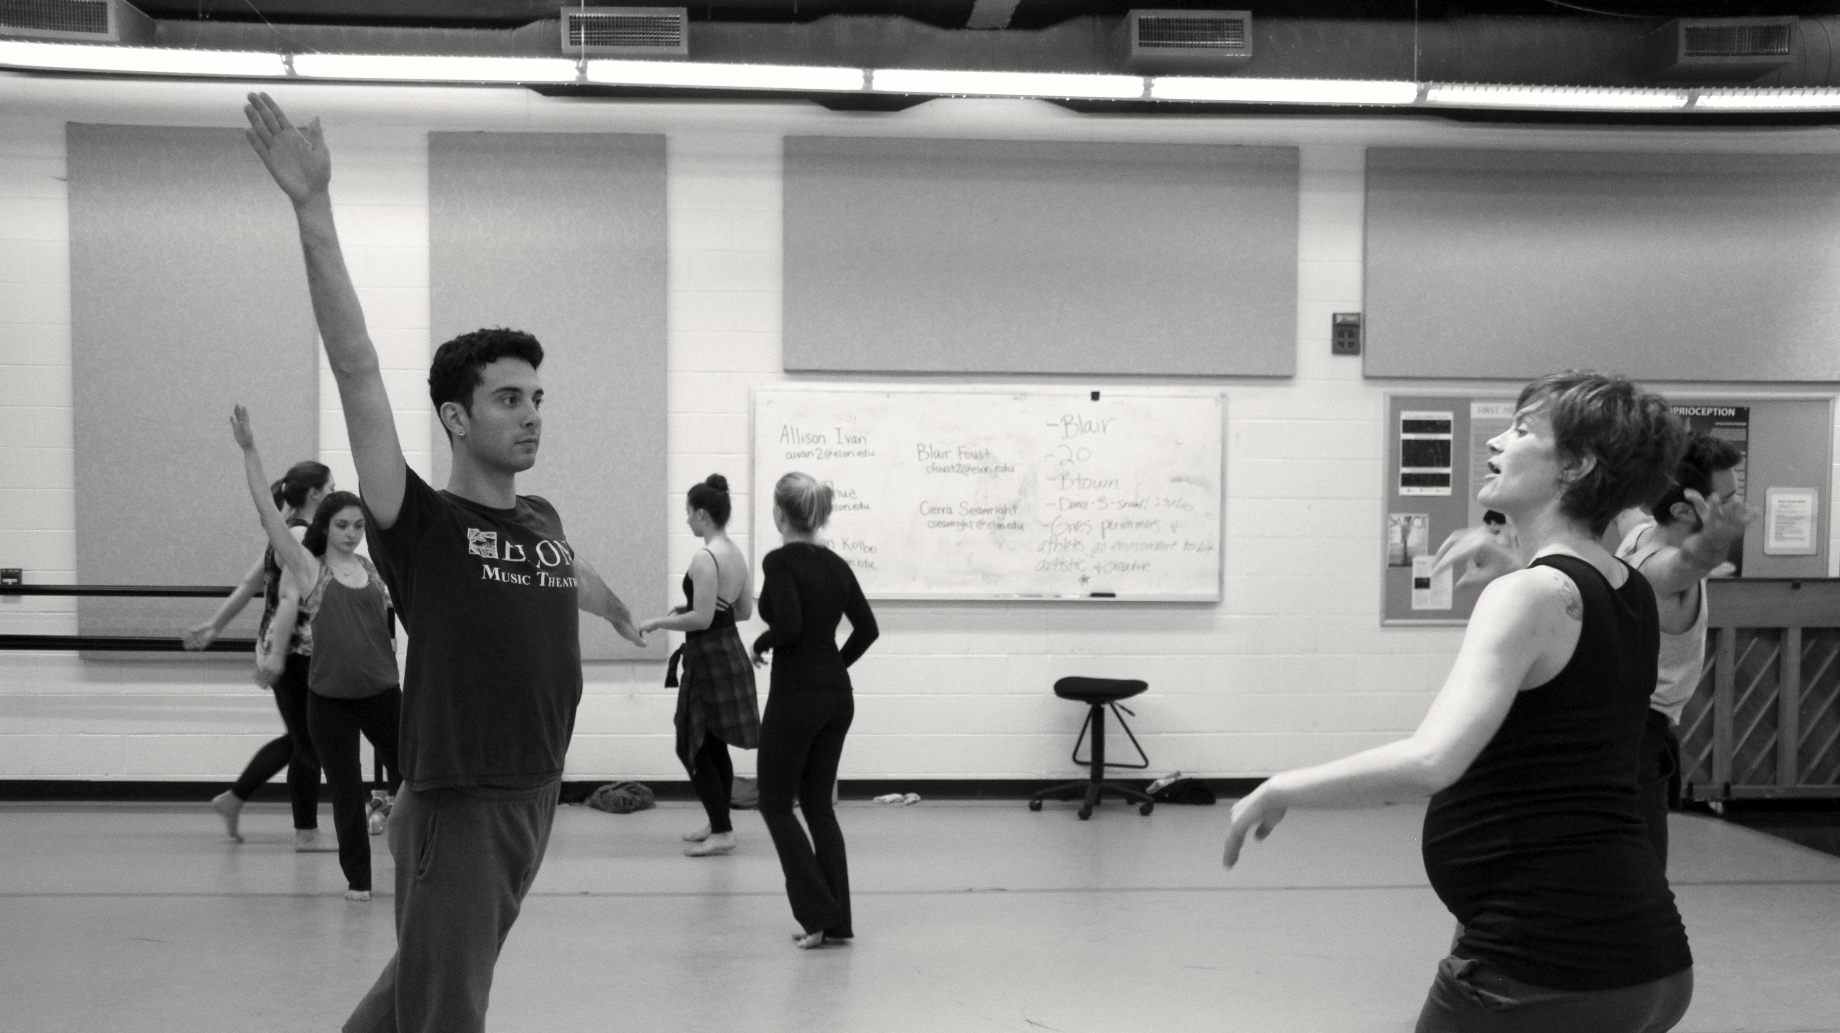
Relationship-Rich Education community and learning on the residential campus
Photos by Martin Springborg
Peter Felten | Center for Engaged Learning | Elon University
Notes:
40 minute session – including one paired discussion (5 minutes, plus 5 minutes to debrief)
8 quotes

Slide 2
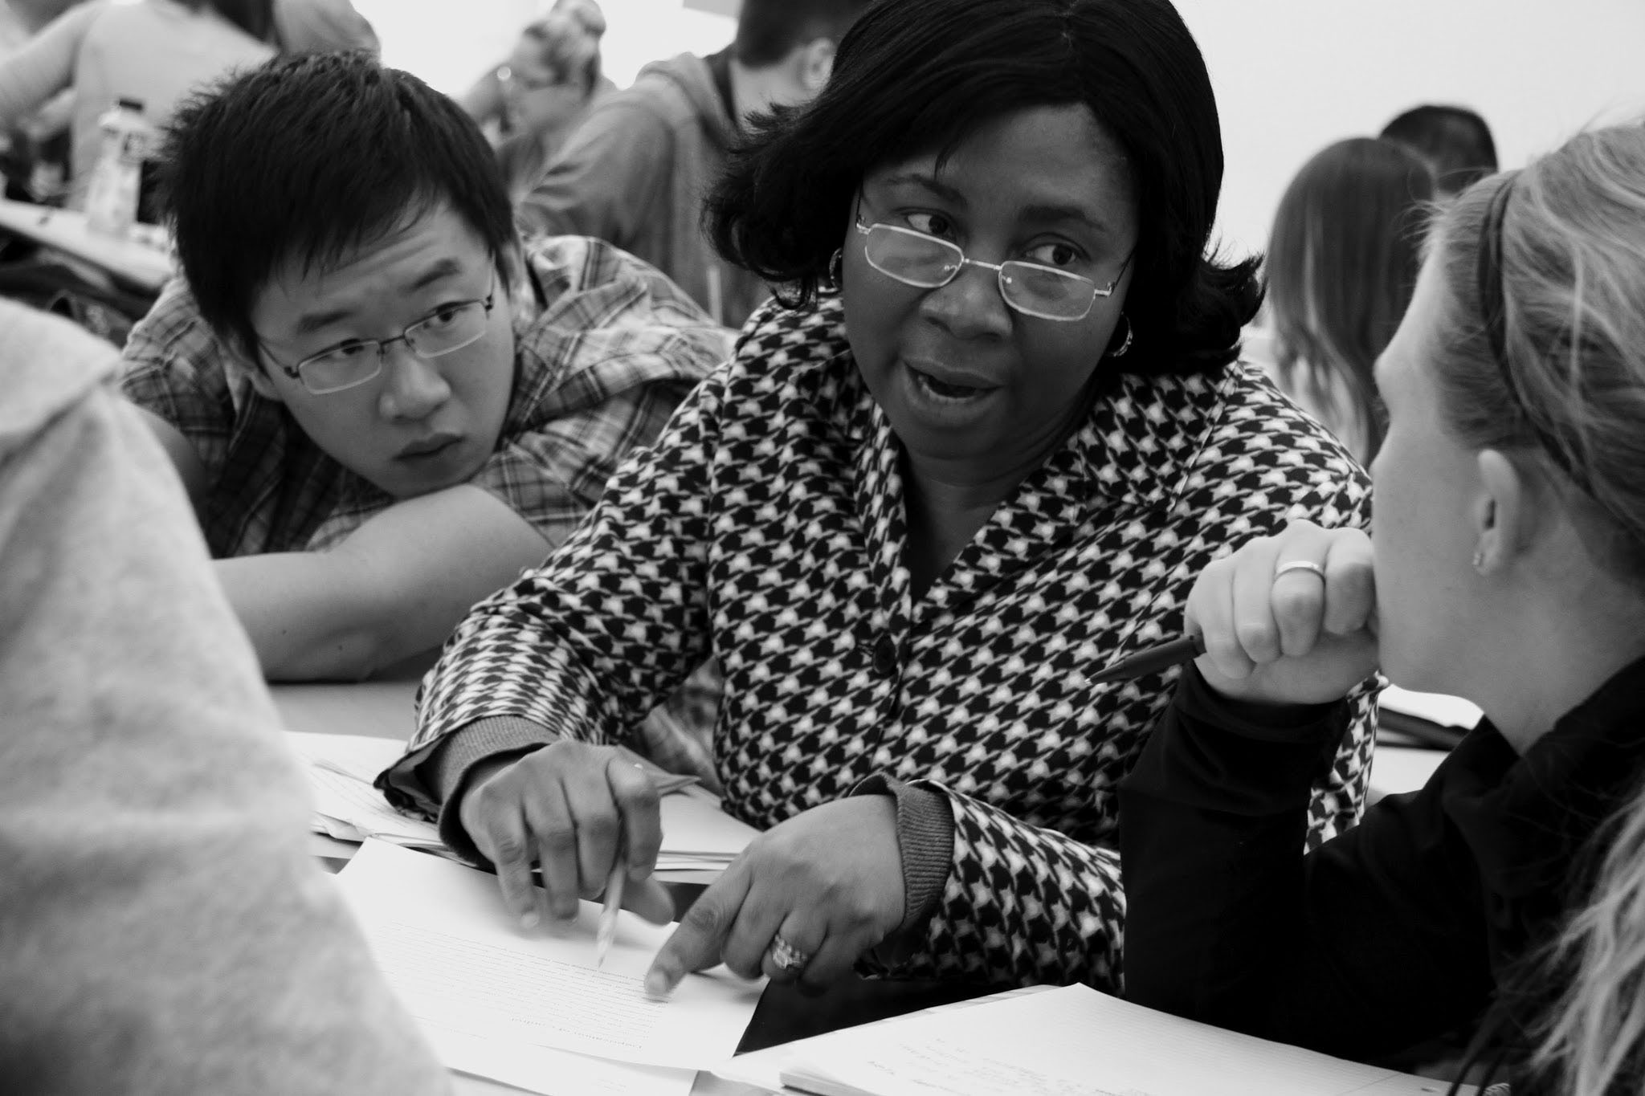
Student-faculty/staff and student-student interactions are crucial for
learning, well-being, and equity – on campus and online.
(Mayhew et al., 2016; Baik et al., 2019; Gavassa et al., 2019)

Slide 3
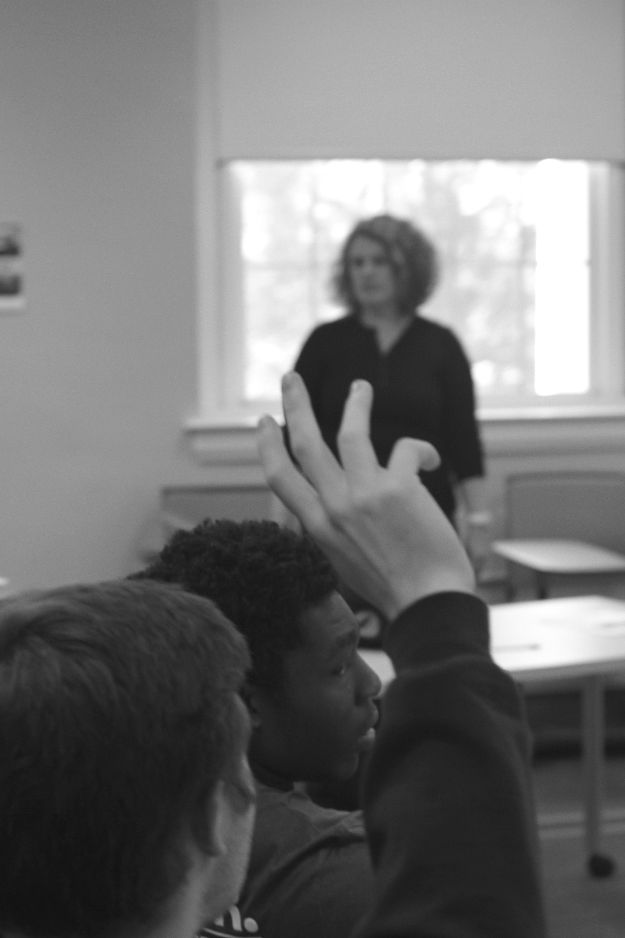
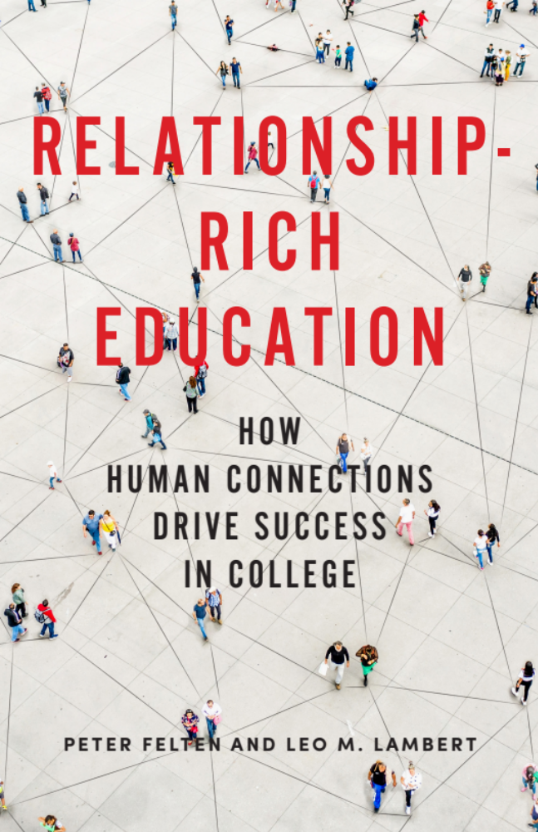

Slide 4
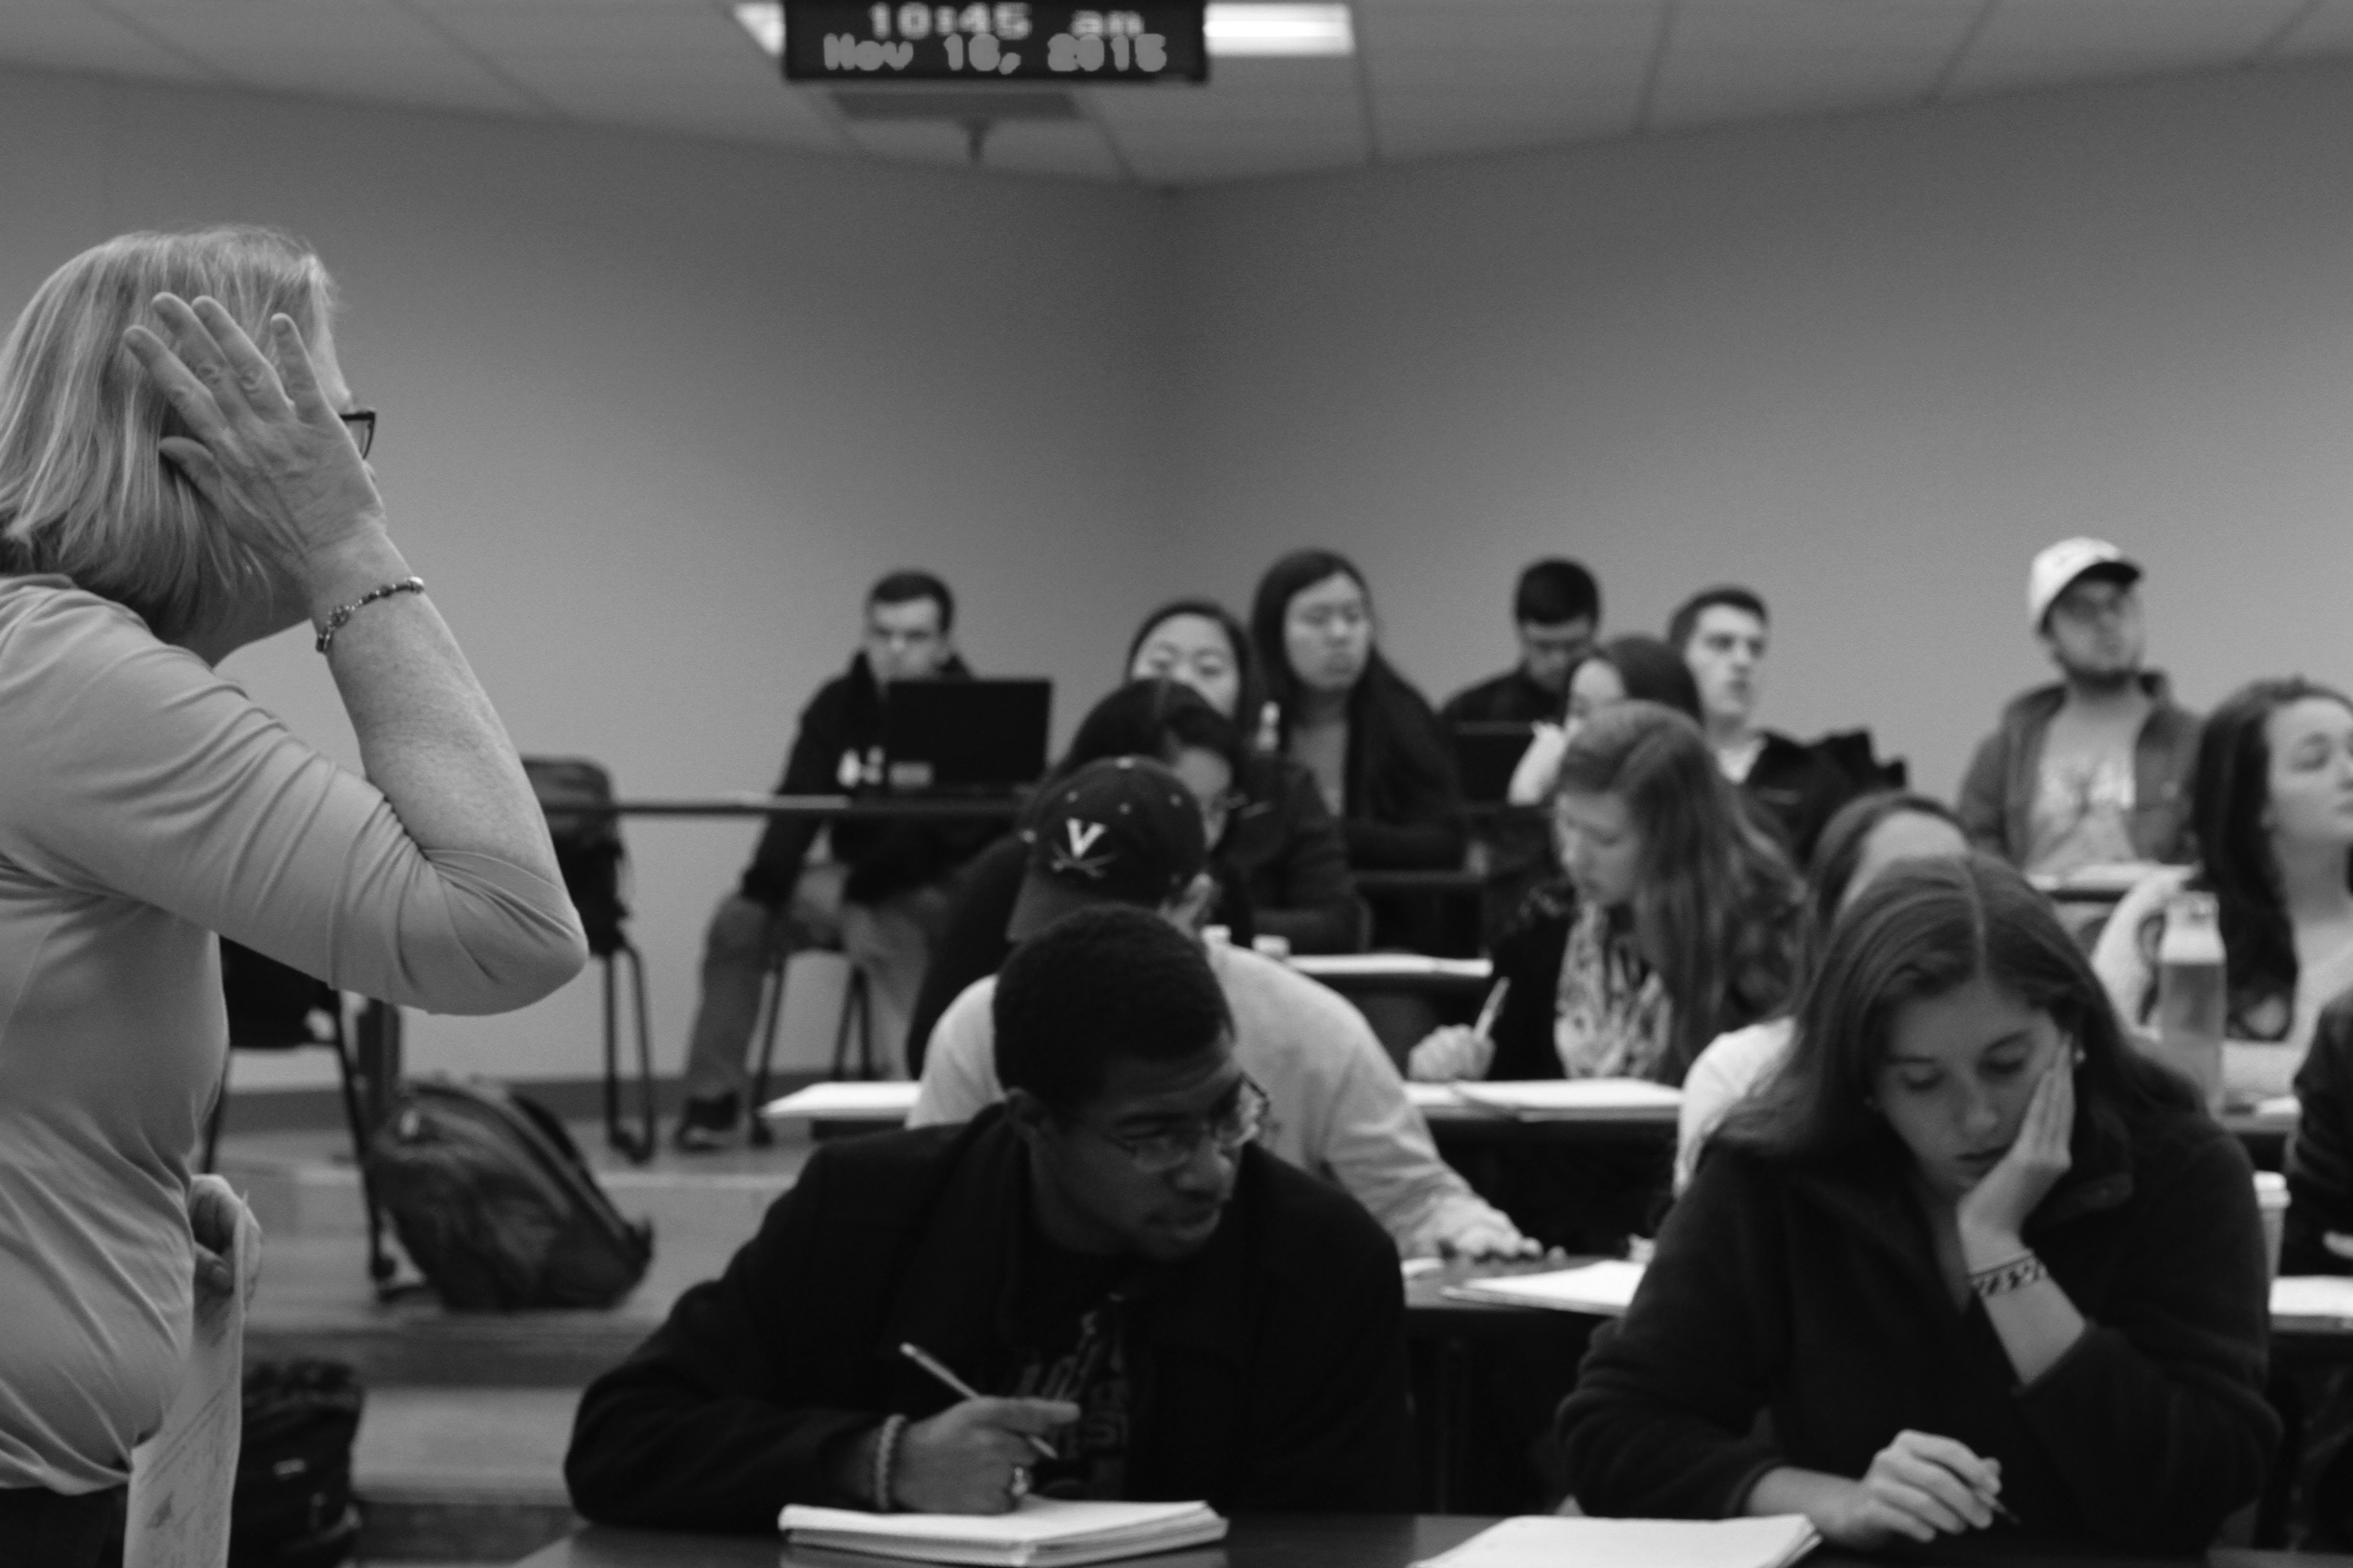
    In pairs
    Tell a (brief) story about one of your experiences with a significant (higher) educational relationship.
    What do those stories reveal about what enables – and what constrains – educational relationships?

Slide 5
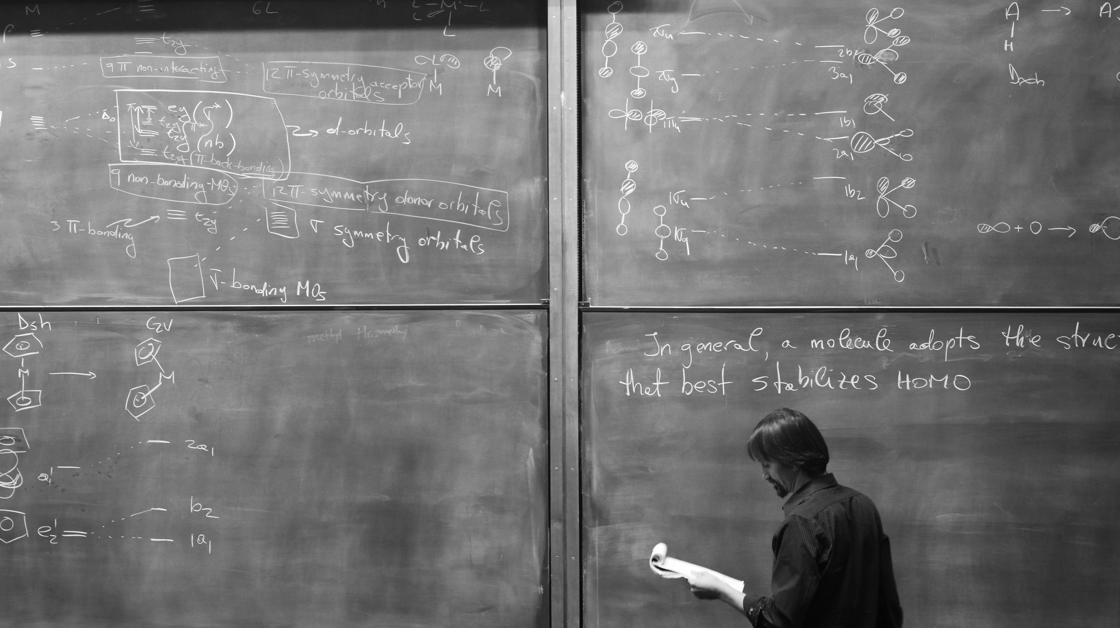
“When I moved into my dorm, I was thrilled to be at UW. But I kept thinking that as a wait-listed student I’m probably on the lower end academically here. Sitting in these large classrooms – Chemistry 142 had 500 students – I convinced myself that they’re all more successful than me. I was comparing myself to others and imagining all of their accomplishments. I was freaking out, to be honest.”
(Gigi Gaultier, University of Washington)

Slide 6
“This is not the kind of place where you ask for help.”
(Undergraduate, University of Michigan)
“When I moved into my dorm, I was thrilled to be at UW. But I kept thinking that as a wait-listed student I’m probably on the lower end academically here. Sitting in these large classrooms – Chemistry 142 had 500 students – I convinced myself that they’re all more successful than me. I was comparing myself to others and imagining all of their accomplishments. I was freaking out, to be honest.”
(Gigi Gaultier, University of Washington)

Slide 7
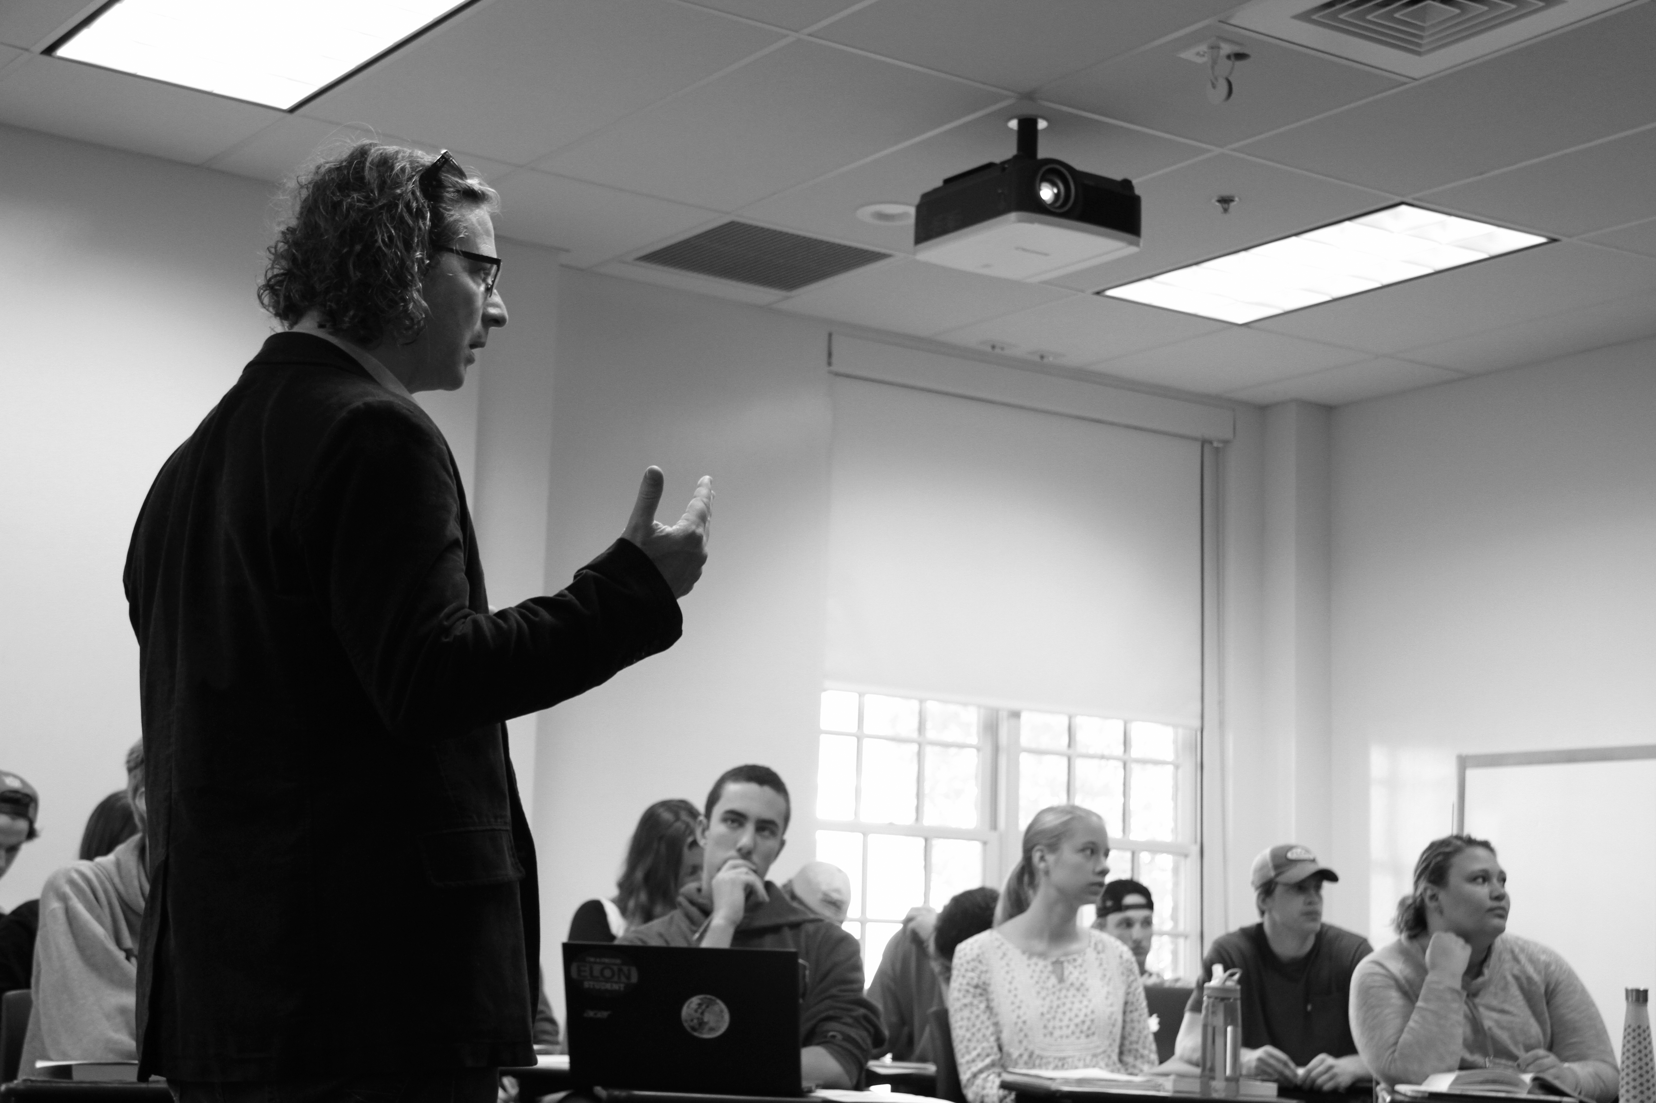
“Coming to college was a difficult experience for me. There was the just being away from home part. And then there was race. I never felt like I was a student first. I was always Black first, and then a student.
For example, during my junior year, I remember walking into class on the day after Tamir Rice was killed by police. I was distraught. I walked into class and sat there, and it seemed like no one else was fazed by it. The day went on as usual for other students. It was just so surreal to have all of this weight on me because of something that happened, and not feeling that reflected at all by the students and professors around me.”
(Khadijah Seay, Bryn Mawr College)

Slide 8
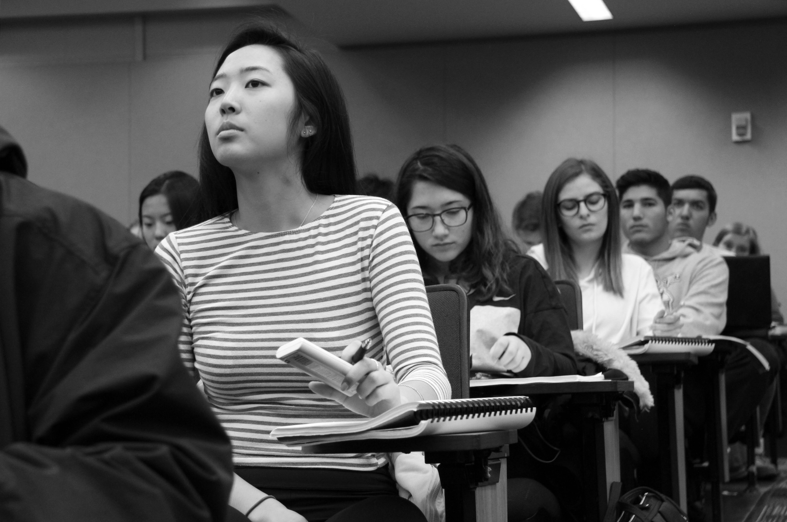
“Once students recognize that you care about them, about where they come from, about their goals and what they’re trying to accomplish, then you have a strong foundation for teaching and learning.”
(Matthew Smith, California State University Dominguez Hills)
Validation
(Rendón, 1994)

Slide 9
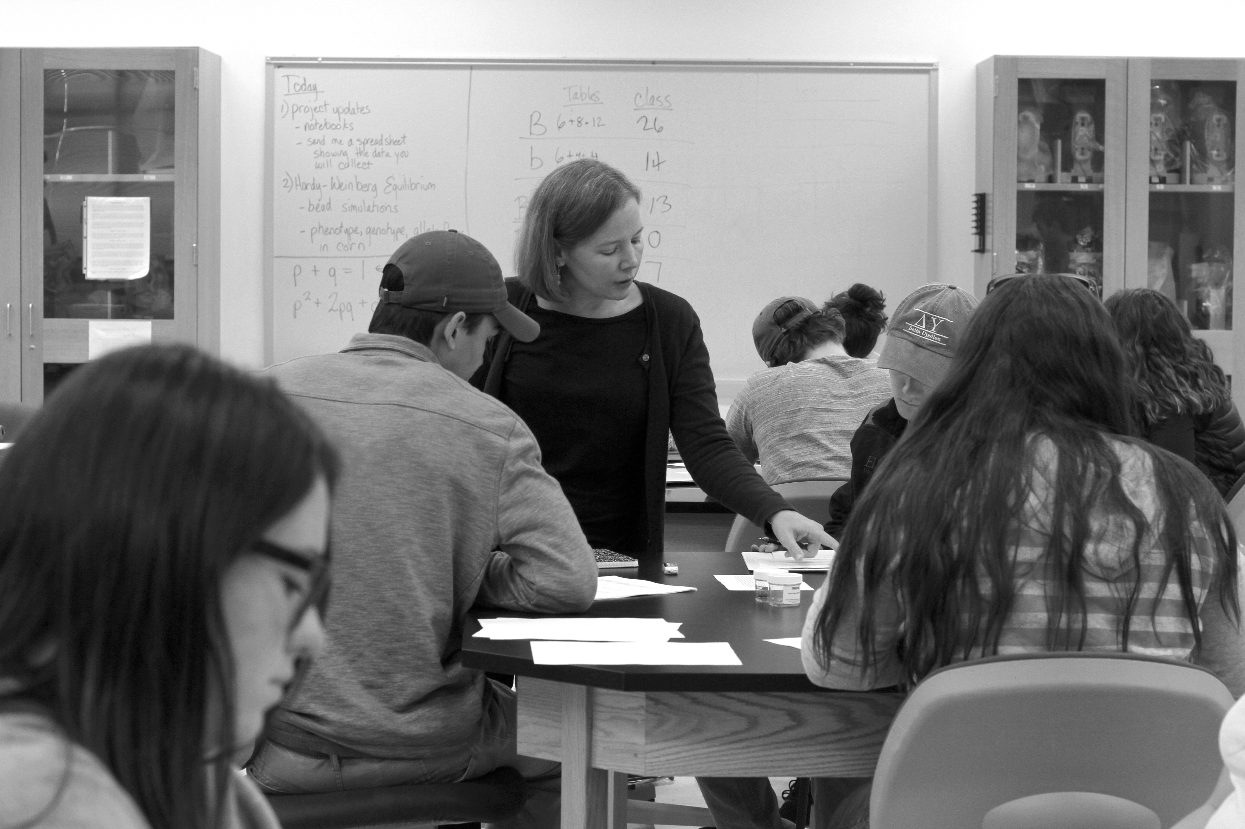
Feedback that validates conveys:
High academic standards/expectations;
Belief in the student’s capacity to meet those standards, even if their work does not do so right now;
Specific guidance about how to improve;
Availability of resources to support the student’s improvement.
(Cole, 2008)

Slide 10
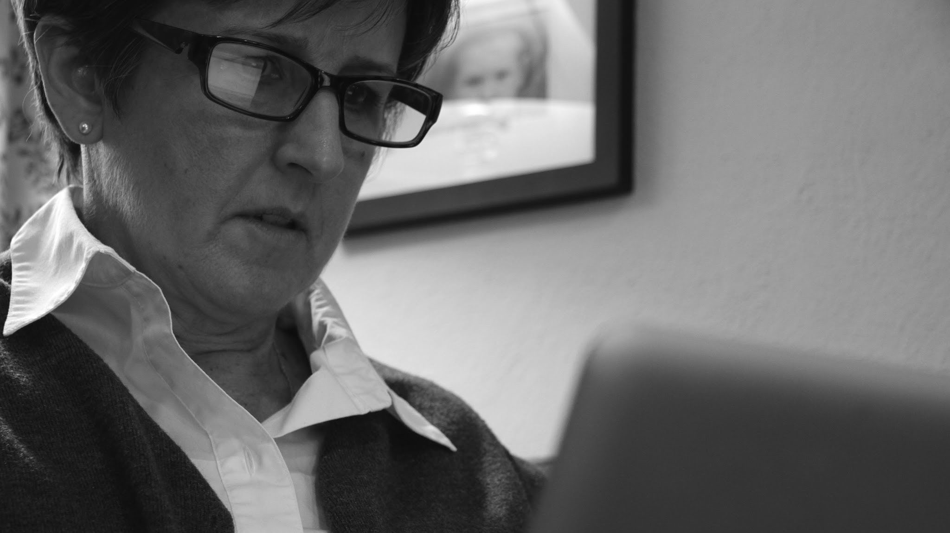
“On some papers, she would have this little paragraph in the comments saying, ‘You did this super well in your paper’ and that little bit of encouragement, even though I’m not face-to-face with this professor at all, made a world of difference to me. We’ve never met in person or even had a conversation, but she has made a huge difference in my education, which is kind of hard to imagine since we only ever interacted in writing.”
(Nellie Bourne, Texas)

Slide 11
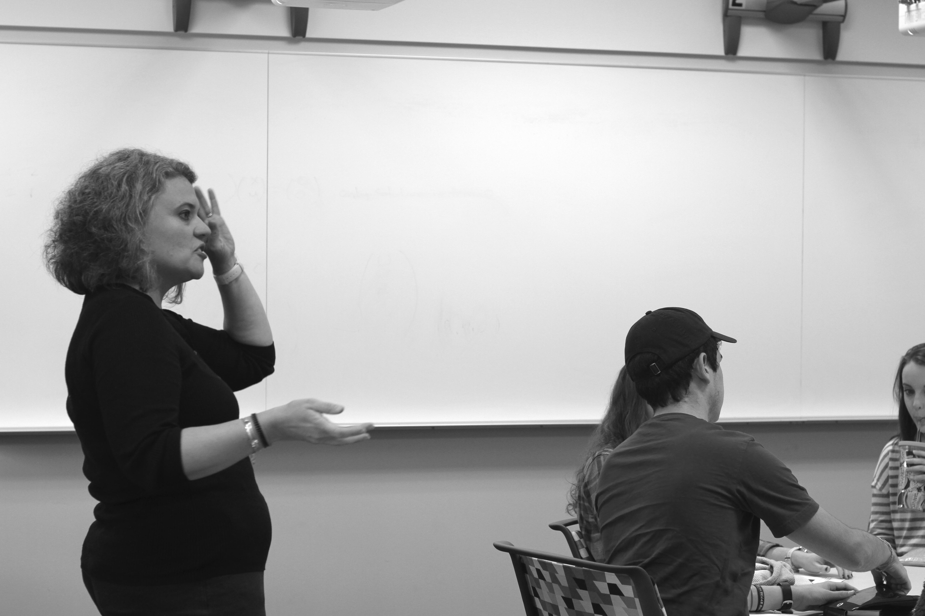
“Early in Calculus 2, we started getting into really difficult things and I suddenly began having these feelings like I didn't belong in this class -- that my education, what I was trying to achieve, wasn't possible and my goals were just obscenely farther away than I thought they were….
(Joshua Rodriguez, Oakton Community College)

Slide 12
I went to Professor Arco to say that I might have to drop out. He told me, ‘Joshua, I don't want you to do the homework tonight. I want you to look up imposter syndrome and read about it. Then come and talk to me.’ I did that, and I learned that it is extraordinarily common among students.
That interaction bolstered my confidence to realize that I'm not alone in this, that everyone has these feelings. I went from contemplating dropping out to getting tutoring help – and then getting an A in the course.”
(Joshua Rodriguez, Oakton Community College)

Slide 13
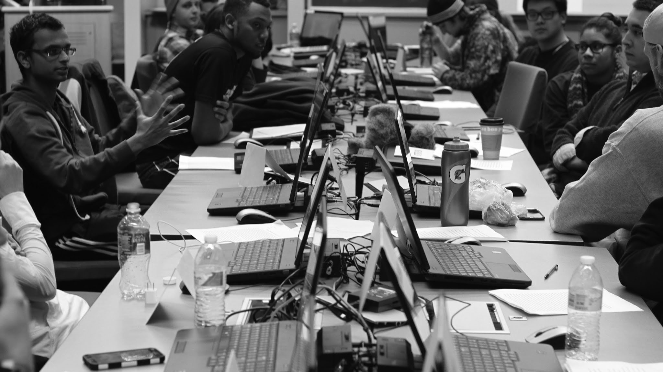
    Example 1: Office Hours
    “I hold my office hours in a residence hall. Students don’t want to come see me one-on-one, so I encourage them to come with a roommate, a study partner, or on their own but expecting not to be alone. We meet in a prominent, comfortable place in a residence hall. A lot of informal relationships evolve in ‘conference room hours’ by having them interact with both me and their peers.”
    (Shaun Vacera, University of Iowa)

Slide 14
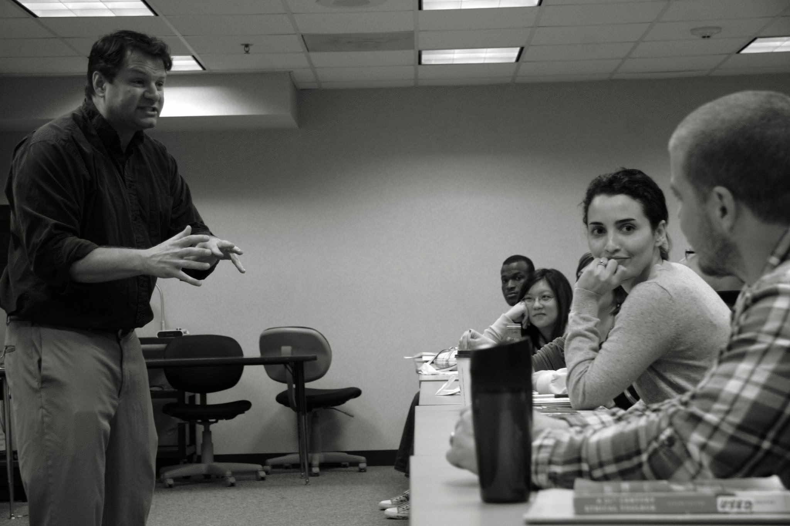
    Example 2: Problem-Solving Fellows
“I regularly hear Fellows say, ‘I wish I would have taken the Problem-Solving Fellows course and served as a Fellow when I was a freshman. The things I’m helping my peers learn and do as a Fellow are things that I could have applied in my own courses from my first semester at Brown.”
(Christina Smith, Brown University)

Slide 15
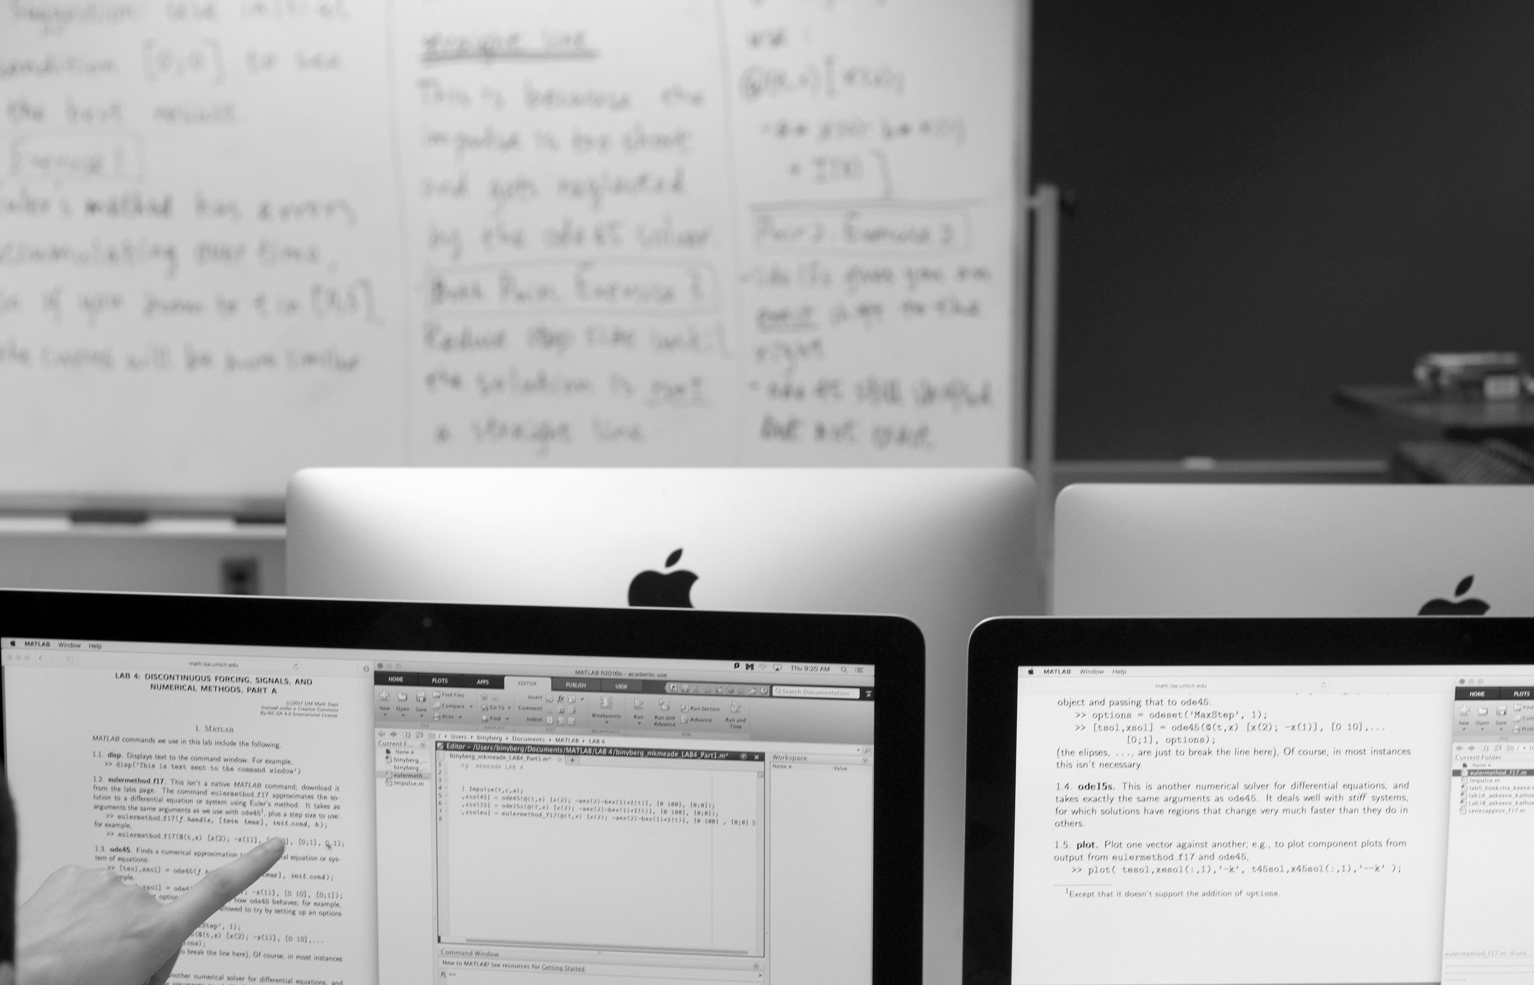
    Example 3: Informal Peer Course-Based Connections
    Online “study lounge” paired with student-set goals for average exam scores
    (Manda Williamson, University of Nebraska)

Slide 16
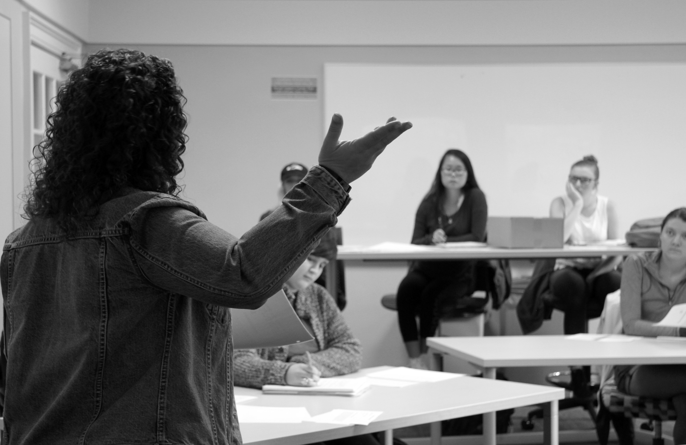
Keep doing what you already do to cultivate educational relationships.

Slide 17
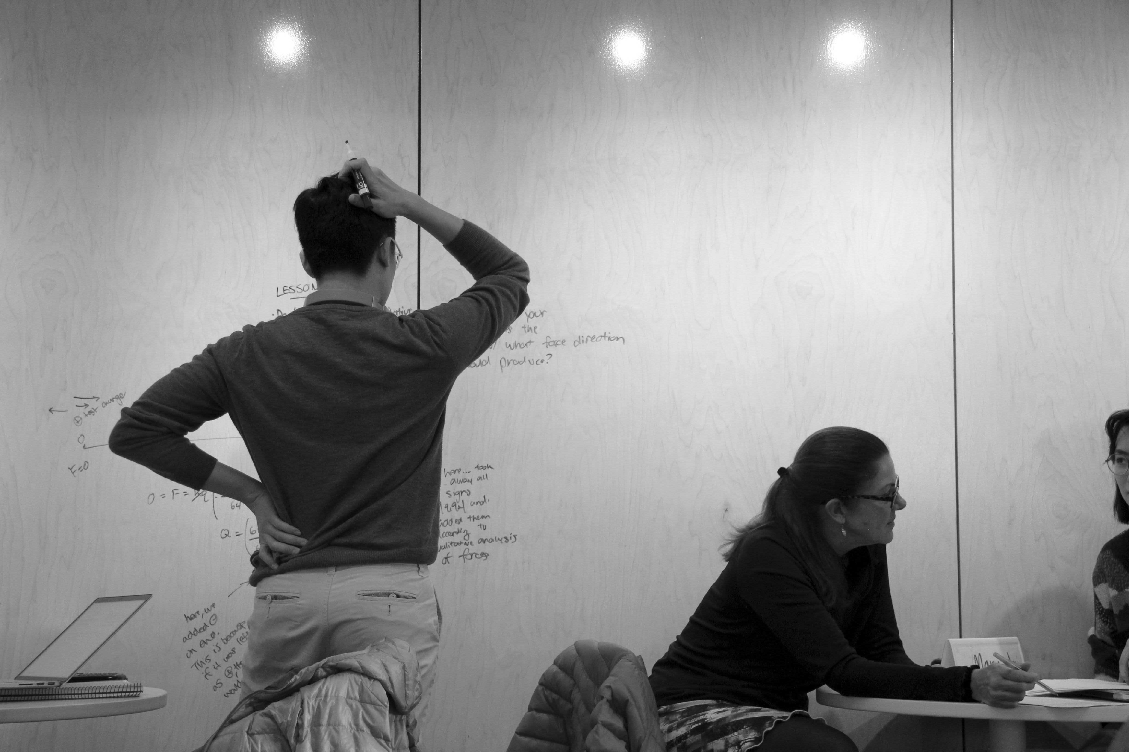
“Beyond the serious science we’re doing, there’s this whole other aspect of caring about each other’s lives. The faculty will make the time to ask, ‘How are your classes going?’ ‘What are you thinking about for next year?’ ‘What are you getting involved in outside of the lab?’ ‘Who do you want to be after you graduate?’ And then they would really listen and encourage me, even when I wasn’t sure if I knew what I was doing or where I was going.”
(Samantha Paskvan, University of Washington)

Slide 18
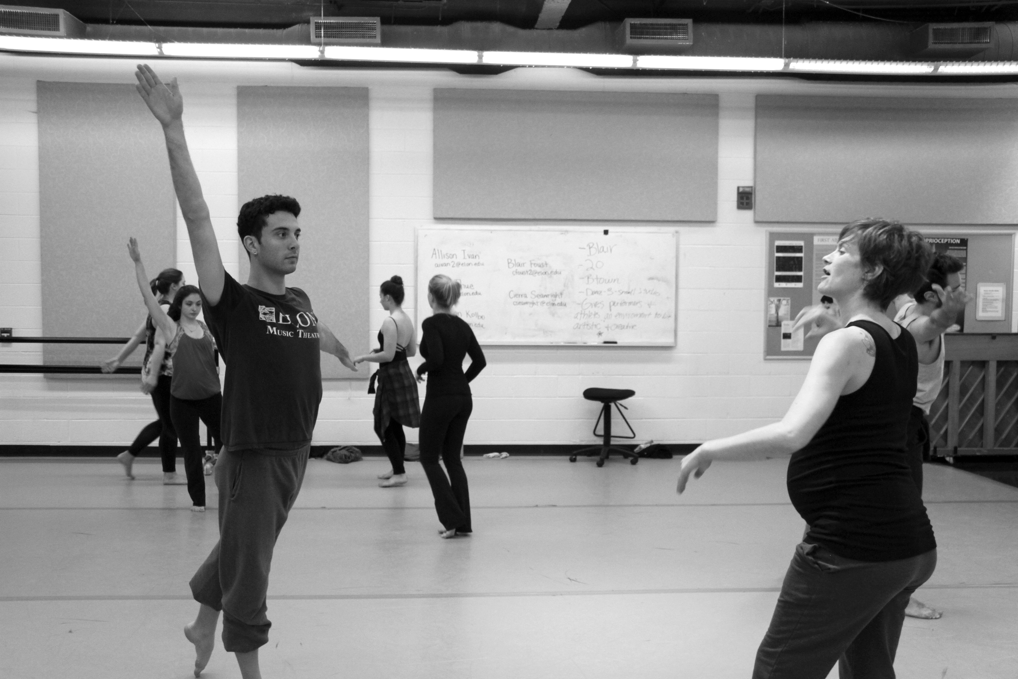
“It only takes meeting that one person who ignites a fire within you.”
(Tianna Guerra, Oakton Community College)

Slide 19
Baik, C., Larcombe, W., & Brooker, A. (2019). How Universities Can Enhance Student Mental Well-Being. Higher Education Research & Development, 38(4).
Cole, D. (2008). Constructive Criticism: The Role of Student-Faculty Interactions on African American and Hispanic Students’ Educational Gains. Journal of College Student Development, 49(6).
Gavassa, S., Benebentos, R., et al. (2019) Closing the Achievement Gap in a Large Introductory Course by Balancing Reduced In-Person Contact with Increased Course Structure. CBE—Life Sciences, 18(1).
Mayhew, M., Rockenbach, A., et al. (2016). How College Affects Students, Volume 3 (Jossey-Bass).
Rendón, L. (1994). Validating Culturally Diverse Students: Toward a New Model of Learning and Student Development. Innovative Higher Education, 19.
pfelten@elon.edu @pfeltenNC

