Slide 1

Environmental and Natural Resource Economics
5th ed.
Jonathan M. Harris and Brian Roach
Chapter 11 – Energy: The Great Transition

Slide 2
Figure 11.1 Global Energy Supplies by Source, 2018
Source: International Energy Agency, Data and Statistics, “Total Energy Supply by Source”.
Notes:
Currently the world obtains over 80% of its energy from fossil fuels. While the amount of global energy obtained from wind and solar power has tripled in the last 10 years, these sources are still only a small percentage of total energy use

Slide 3
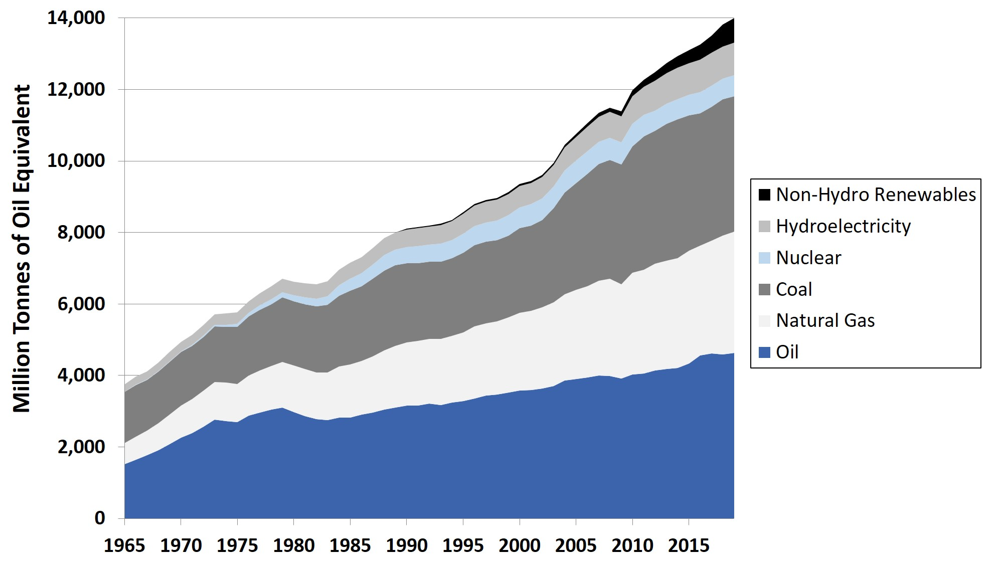
Figure 11.2 Global Energy Demand by Source, 1965-2019
Source: BP Statistical Review of World Energy, various editions.
Notes:
While the world’s consumption of renewable energy increased by a factor of 13 between 2000 and 2019, overall demand for fossil fuels is also increasing. During this same period, the global demand for oil increased by 30%, and demand for natural gas increased by 56%.

Slide 4
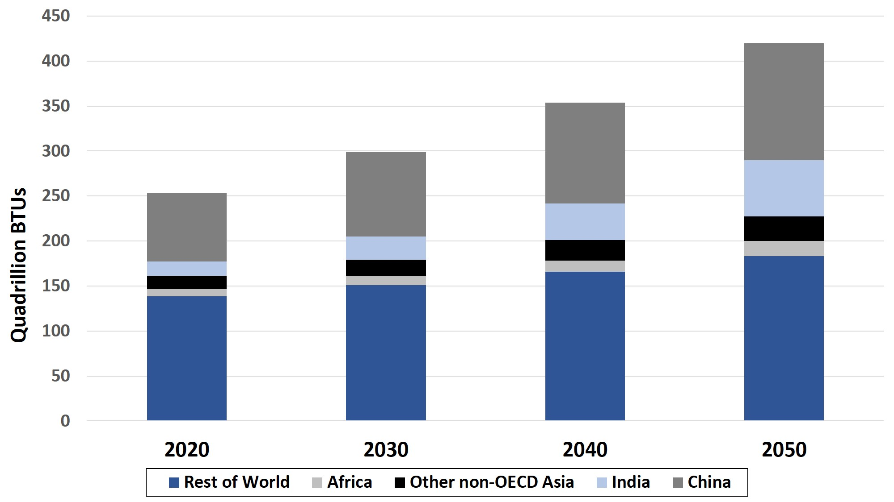
Figure 11.3 Projected Global Energy Demand 2020-2050, by Country/Region
Source: U.S. EIA, 2020.
Notes:
Most projections indicate that global energy demand will continue to increase. The U.S. Energy Information Administration (EIA) projects that the world’s energy demand will increase by 66% between 2020 and 2050. Most of this increase is expected to occur in low- and middle-income countries, with energy demand increasing by 71% in China, 116% in Africa, and 293% in India.

Slide 5
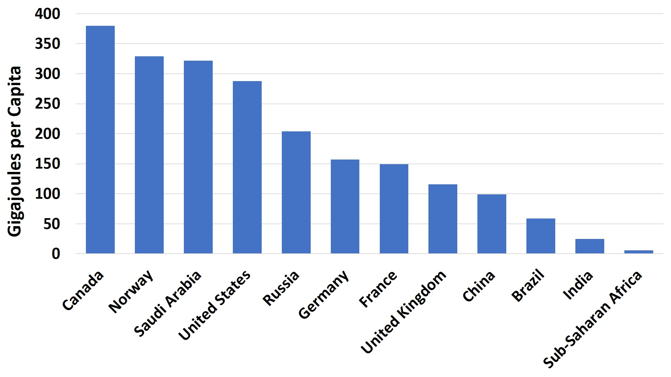
Figure 11.4 Annual Energy Consumption per Capita in Select Countries/Regions, 2019
Source: BP Statistical Review of World Energy 2020.
Notes:
The global disparity in energy consumption per capita is very large. U.S. per capita energy consumption is more than twice as much the European average, three times as much as Chinese per capita consumption, 10 times as much as in India, and 50 times as much as in Sub-Saharan Africa.

Slide 6
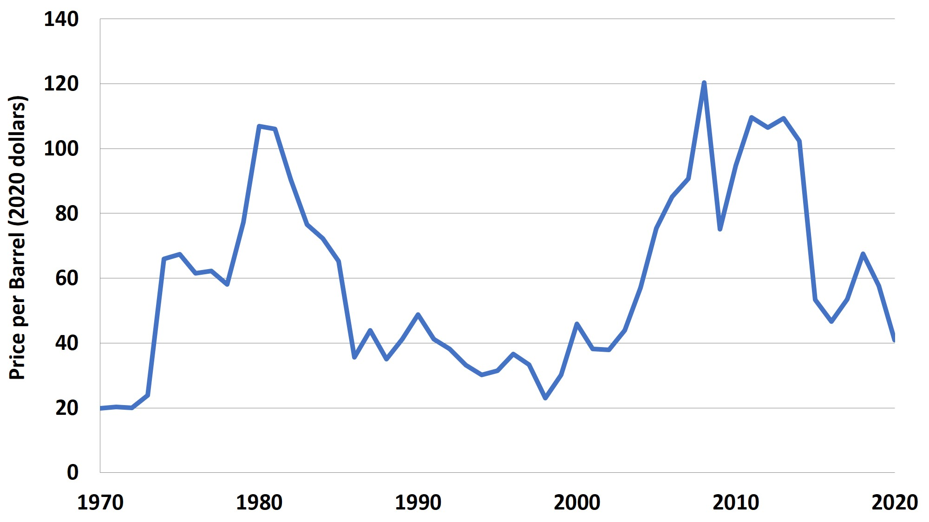
Figure 11.5 Crude Oil Prices in Constant Dollars, 1970-2020
Source: U.S. Energy Information Administration, Crude Oil Spot Prices; U.S. Bureau of Labor Statistics, Historical Consumer Price Index for All Urban Consumers.
Notes:
The price of oil tends to be volatile. In 2008-2012 oil prices rose to levels equaling those of the “oil crisis” of the late 1970s in constant dollar terms. But more recently the introduction of “unconventional” oil sources including hydraulic fracturing of rock and extraction from tar sands and oil shales has led to an increase in oil supply and falling prices.

Slide 7
Table 11.1: Human Health Impacts and Greenhouse Gas Emissions of Various Energy Sources, per Unit of Energy
Energy Source | Human Deaths from Accidents and Air Pollution per Terrawatt of Energy | Greenhouse Gas Emissions per Gigawatt of Energy (Tons)
Coal | 24.6 | 820
Oil | 18.4 | 720
Natural Gas | 2.8 | 490
Biomass | 4.6 | 78-230
Nuclear | 0.07 | 3
Hydropower | 0.02 | 34
Wind | 0.04 | 4
Solar | 0.02 | 5
Source: Ritchie, 2020.
Notes:
Local and global externality costs, measured in human life impacts and greenhouse gas emissions, are highest for coal, followed by oil and natural gas. Externality costs for renewables are generally low. ​

Slide 8
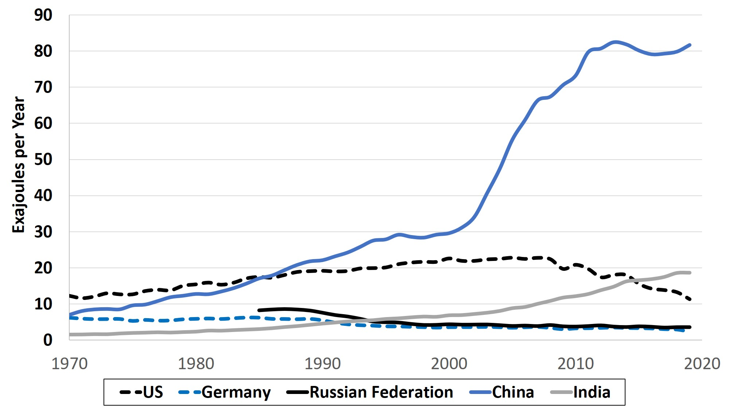
Figure 11.6 Coal Consumption, Top Five Coal Consuming Countries, 1970-2019
Source: BP, 2020b.
Notes:
Coal is the world’s second-largest source of energy, behind only oil. Coal is primarily used to generate electricity – it provides over one-third of the world’s electricity, more than any other source. China is by far the world’s largest consumer of coal, with 52% of global demand in 2019. India has recently become the second-largest coal consumer, while U.S. coal consumption has fallen.

Slide 9
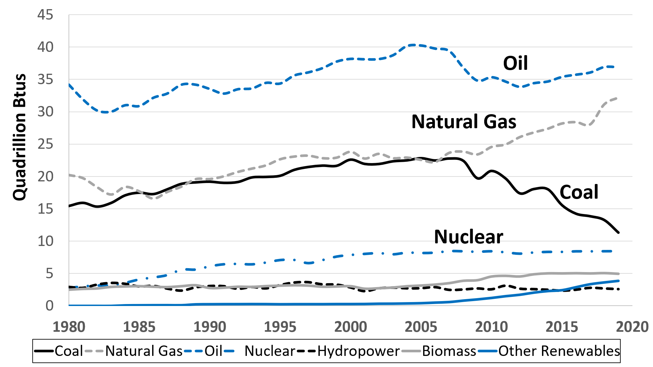
Figure 11.7 Energy Consumption in the United States, by Source, 1980-2019
Source: U.S. EIA, 2020b.
Notes:
The switch away from coal toward natural gas in the United States is shown in Figure 11.7. Up to about 2005 both coal and natural gas provided about one-quarter of the U.S.’s energy supply. But since 2005 a rapid increase in natural gas consumption has coincided with a reduction in coal consumption. Renewable energy use is also increasing rapidly, but from a relatively small base.

Slide 10
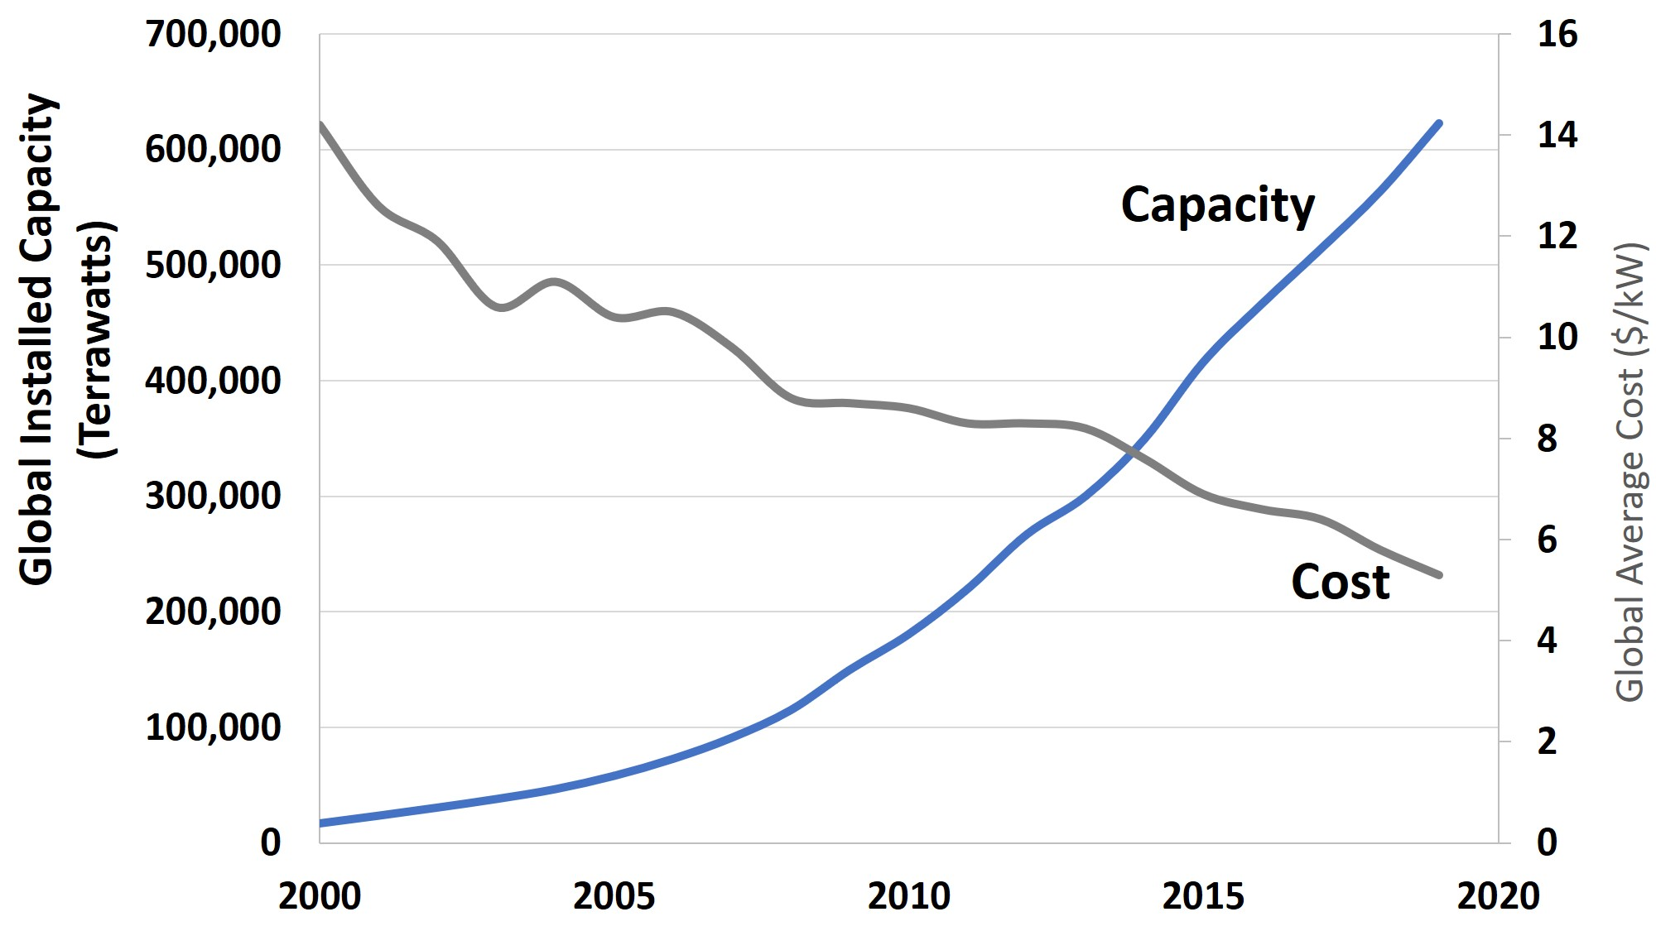
Figure 11.8 Global Wind Energy Installed Capacity and Average Cost, 2000-2019
Source: Capacity data from BP, 2020b. Cost data from IRENA, 2019b.
Notes:
Wind energy prices have declined rapidly, to the point where wind is highly competitive in many areas, both in developed and developing countries. Wind energy capacity has increased more than 30 times since 2000.

Slide 11
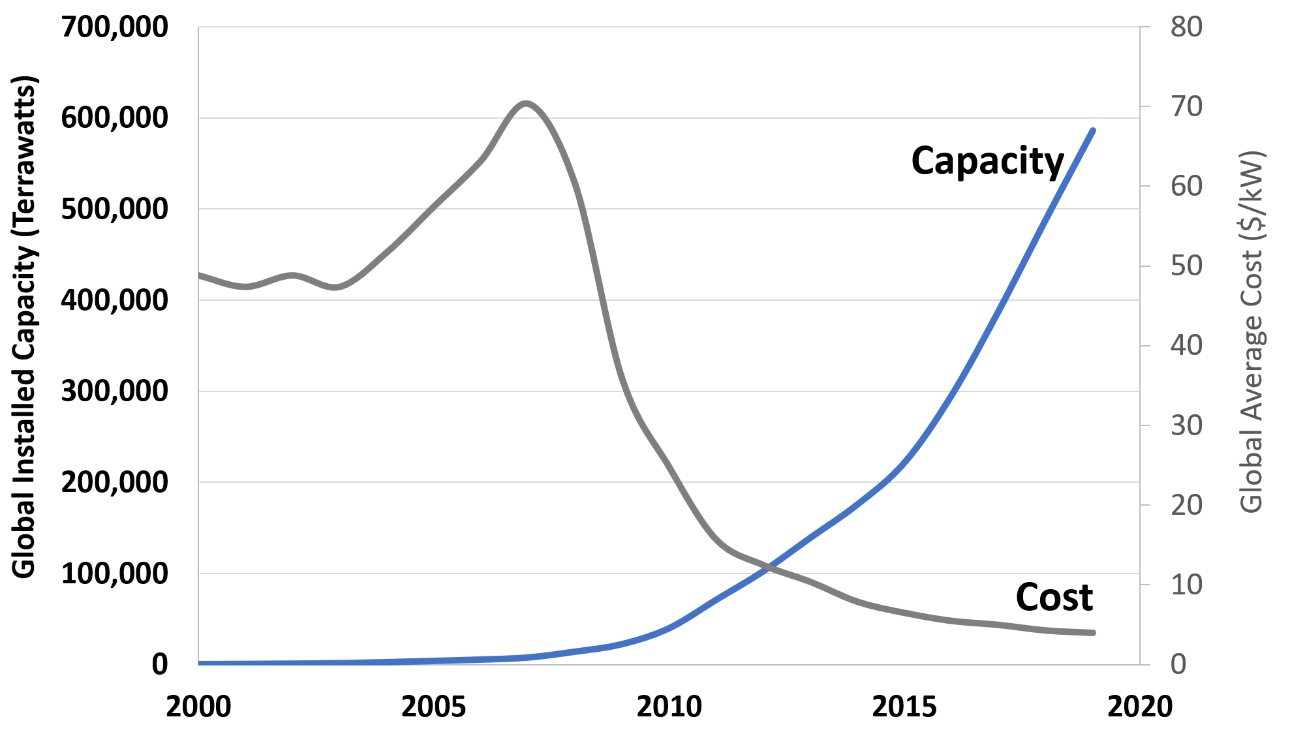
Figure 11.9 Global Solar Energy Installed Capacity and Average Cost, 2000-2019
Source: Capacity data from BP, 2020b. Cost data from Lazard, 2020 and Shahan, 2014.
Notes:
The average costs of solar installed capacity has plummeted since about 2007, and solar capacity has increased exponentially. Bloomberg Energy Finance foresees wind and solar accounting for 64 percent of new generating capacity to be installed over the next 25 years.

Slide 12
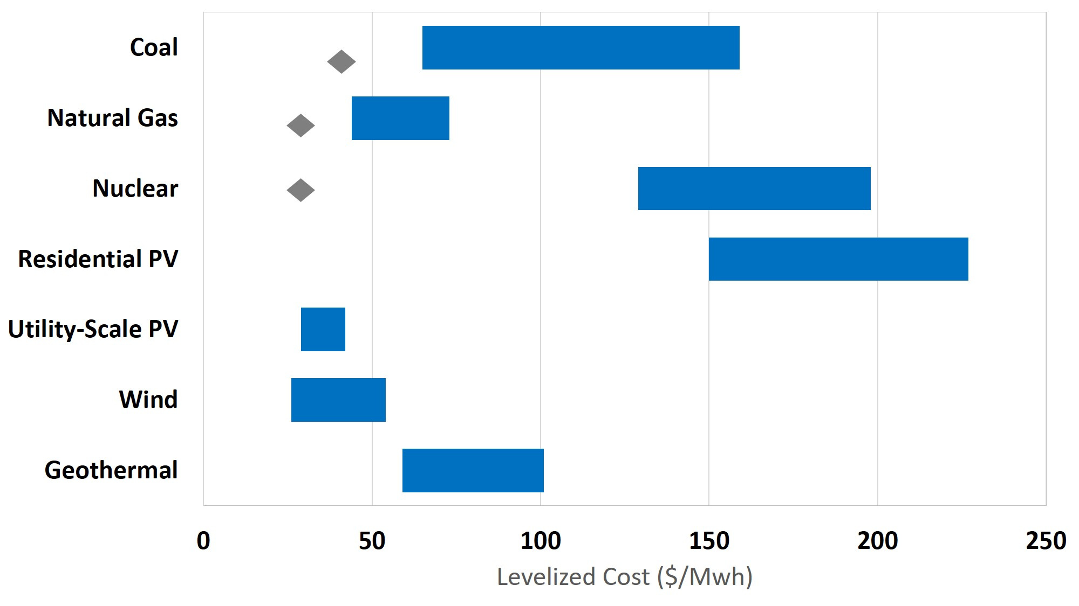
Figure 11.10 Unsubsidized Levelized Cost of Different Energy Sources
Source: Lazard, 2020.
Note: Diamond markers indicate the midpoint of marginal operation costs for fully depreciated plants.
Notes:
Utility-scale solar and wind energy is cheaper than new nuclear energy, and cheaper than new coal plants in most cases. On average, solar and wind energy is also cheaper than constructing new natural gas plants, and about equal to continuing to run existing natural gas and nuclear plants. Solar and wind energy are now, on average across the world, the two cheapest energy sources.

Slide 13
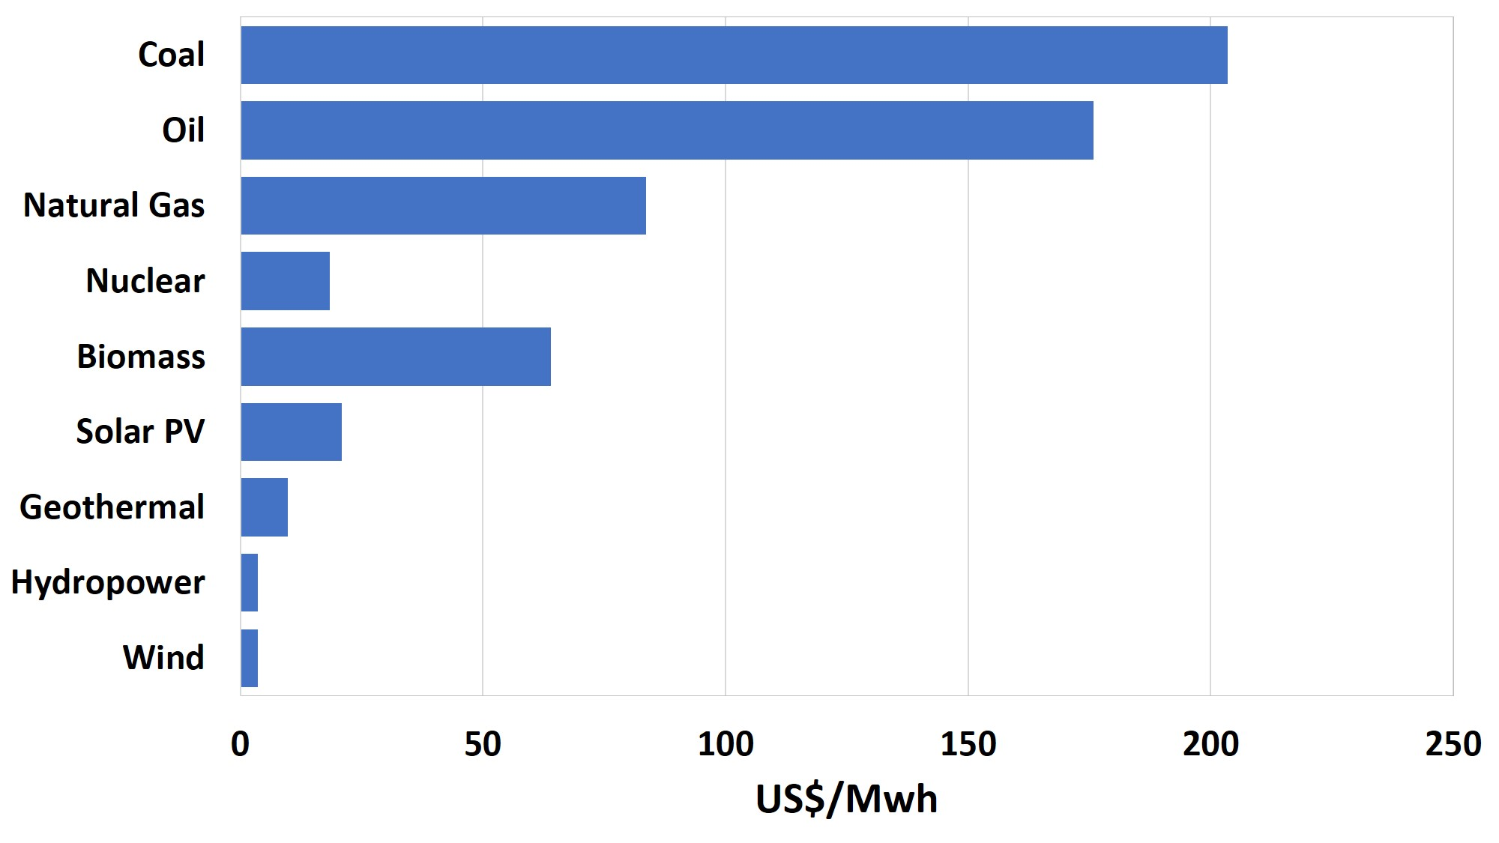
Figure 11.11 External Costs of Electricity Generation, by Energy Source
Source: Trinomics, 2020.
Note: Externality estimates are for the EU-27. Values in euros were converted to dollars.
Notes:
Externality costs are highest for coal and oil, primarily due to damage from local air pollution and carbon emissions. External costs are lowest for hydropower and wind energy. While the external costs of nuclear and solar energy are about the same, this study did not estimate any external costs from the long-term storage of nuclear wastes.

Slide 14
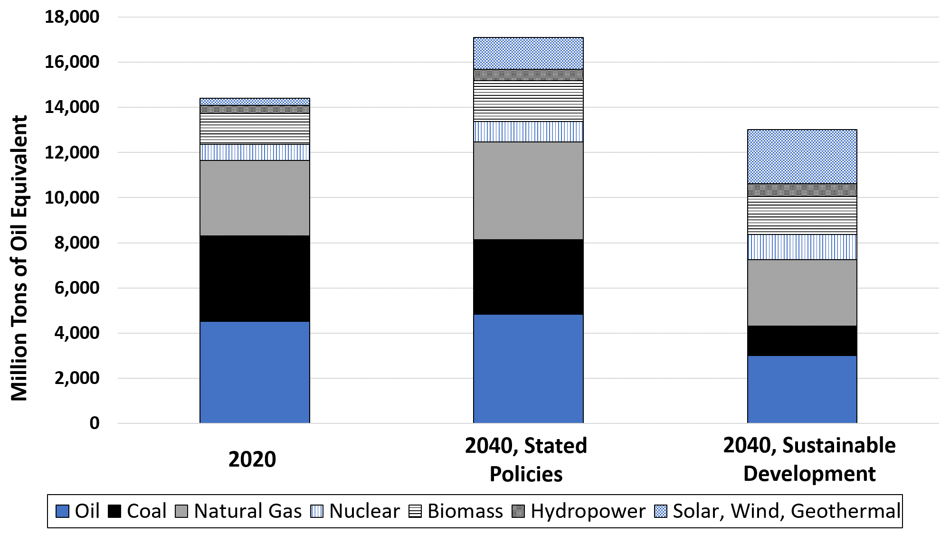
Figure 11.12 IEA Global Energy Mix, 2020 and Projections to 2040
Source: IEA, 2020a.
Notes:
The International Energy Agency’s projection based on current policies sees total global energy demand increasing by 20% between 2020 and 2040, with fossil fuel use remaining almost unchanged. In the “sustainable development” scenario global energy demand decreases by 10%, while renewable energy sources expand, leading to a reduction of 50% in fossil fuel use by 2040.

Slide 15
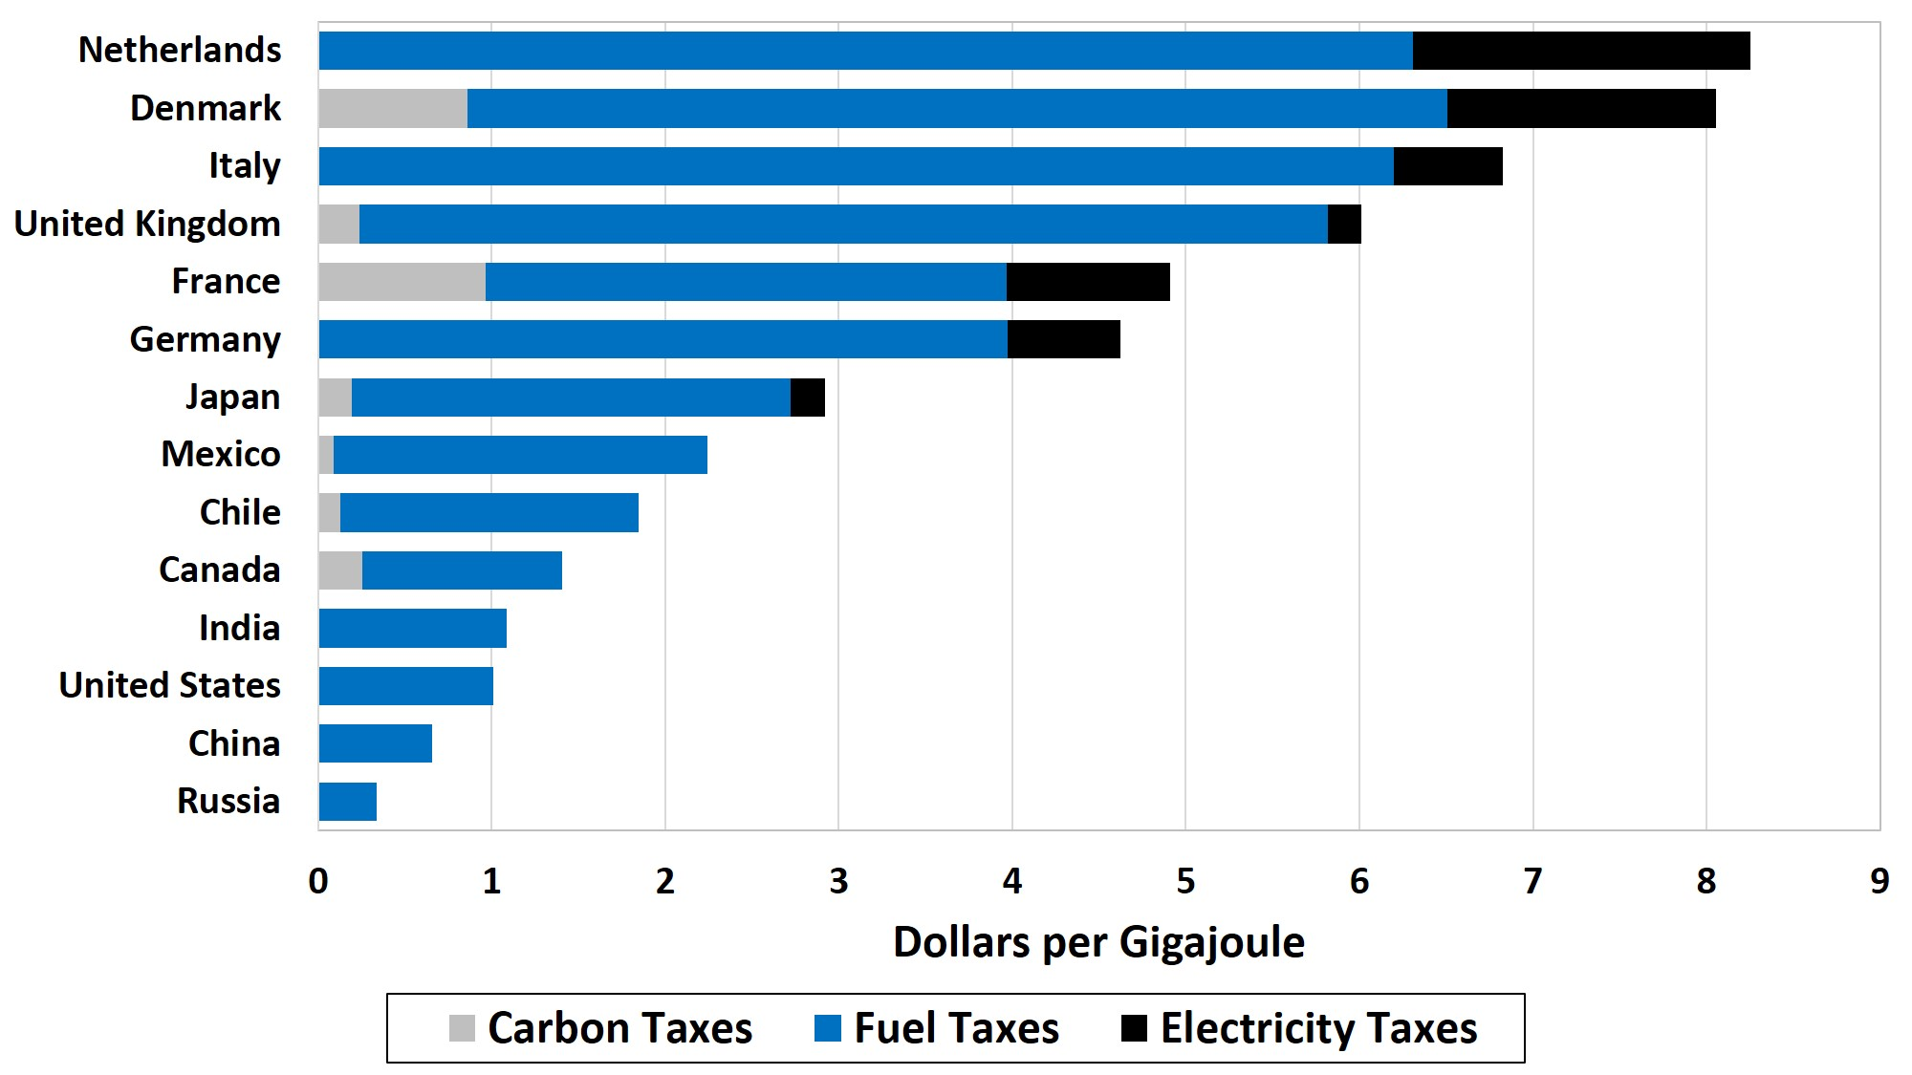
Figure 11.13 Energy Taxes, 2018, Select Countries
Source: OECD, 2019.
Note: One gigajoule contains the amount of energy in approximately 8 gallons of gasoline.
Notes:
Overall energy taxes are highest in European countries. India, the United States, China, and Russia only have taxes on motor fuels, with no national carbon or electricity taxes. In general, these taxes fall significantly short of full internalization of negative externalities.

