Slide 1
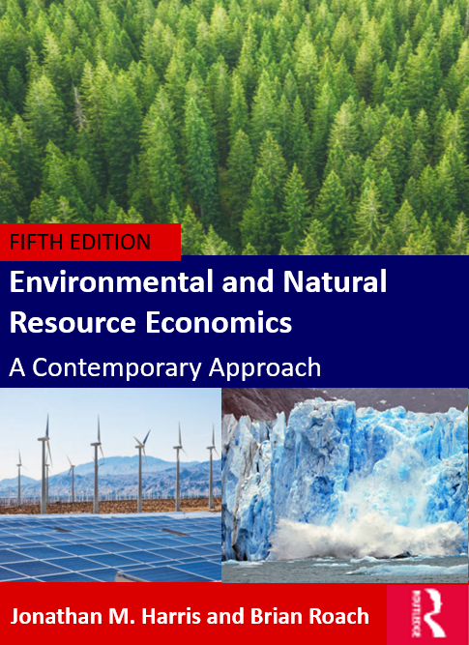
Environmental and Natural Resource Economics
5th ed.
Jonathan M. Harris and Brian Roach
Chapter 2 – Resources, Environment, and Economic Development

Slide 2
Figure 2.1: Growth in Population, Food Production,
Economic Production, and Energy Use, 1961-2019
Sources: Population, food production, and gross world product from the World Bank, World Development Indicators database; energy data from the U.S. Energy Information Administration, International Energy Statistics. Most recent food production data from FAO (FAOSTAT) and most recent energy data from BP (BP Statistical Review of World Energy).
Notes:
Current trends show almost continual growth in population, food production, energy use, and gross world product. Population growth has slowed, and energy use has become somewhat more efficient, as shown by the energy trend line falling below that of gross world product starting in the 1980s.

Slide 3
Figure 2.2: Economic Growth, 1961-2019, by
Country Income Category
Source: World Bank, World Development Indicators database.
Notes:
Global inequality is substantial, and income growth has been primarily in high and middle income countries. Since growth has many environmental impacts, this pattern indicates that the issues of inequality and environmental sustainability are linked.

Slide 4
Figure 2.3: Global Carbon Dioxide Emissions,
1960-2018, by Country Income Category
Sources: World Bank, World Development Indicators database (for data up to 2016); global and national data for 2017 and 2018 from the International Energy Agency, with author’s estimated allocations into country income groups.
Notes:
The most rapid increase in emissions has been in upper middle-income countries, including China—up 180 percent since 1990. Emissions have also increased significantly in lower middle-income countries, about 120 percent since 1990, primarily as a result of emissions growth in India. As a result, CO₂ emissions from high-income countries now comprise less than half of the global total.

Slide 5
Figure 2.4 Average Exposure to Particulate Matter Air Pollution, Selected Countries, 2017
Source: World Bank, World Development Indicators database.
Notes:
Ground-level air pollution is severe in several major developing countries, including China and India. Lower pollution levels in advanced economies reflect decades of environmental policy to control emissions.

Slide 6
Figure 2.5: Global Production of Chlorofluorocarbons, 1980-2018
Sources: Alternative Fluorocarbons Environmental Acceptability Study, www.afeas.org/index.html; Domonoske, Camila. 2018. “Banned Ozone-Depleting Chemical Is Still Being Produced Somewhere, Scientists Say.” NPR, May 17, 2018.
.
Notes:
Global production of CFCs declined dramatically after ratification of the Montreal Protocol. By 2005, CFC production had essentially ceased. Phase-outs of other ozone-depeleting substances (ODS)have also either been completed or are underway, although there is concern about treaty loopholes that allow continued production of some ODS.

Slide 7
Figure 2.6 Living Planet Index, 1970-2016
Source: Zoological Society of London and WWF, http://stats.livingplanetindex.org/.
Notes:
The Living Planet Index is based on the populations of over 4,000 vertebrate species, including mammals, birds, reptiles, and fish. The data indicate that the planet’s biodiversity has declined by 68% since 1970, with the largest losses in South America and Africa.

Slide 8
Figure 2.7: Net Change in Forest Area, by Region and Time Period
Source: Food and Agriculture Organization of the United Nations (FAO),2020. Global Forest Resources Assessment 2020:
Key Findings.
Notes:
Significant deforestation is occurring in Latin America (including the Amazon Forest in Brazil) and Africa. Reforestation in China, where an estimated 66 billion trees have been planted in recent decades, has led to a net increase in forested area in Asia.

Slide 9
Figure 2.8 World Water Withdrawals, Actual and Projected, by Sector
Source: International Energy Agency (IEA) and Organisation for Economic Co-operation and Development (OECD), Water-Energy Nexus, excerpt from the World Energy Outlook 2016.
Notes:
Global water use increased by more than a factor of five during the twentieth century, and further increases are projected for future decades. Many countries are becoming increasingly dependent upon groundwater, which is essentially a nonrenewable resource.

Slide 10
Figure 2.9 Growth of Global Chemicals Production, 1990–2019, with projection to 2030
Source: UN Environment. 2019c. Global Chemicals Outlook II: From Legacies to Innovative Solutions.
Note: Chart based on global production of basic petrochemical building blocks, including ethylene, propylene, butadiene, benzene, toluene and xylenes.
Notes:
The global chemicals industry has expanded significantly in recent decades. Prior to 2000, chemicals production took place primarily in developed nations. But since then, production has shifted to developing countries, with China now being the world’s largest producer.

