Slide 1
Ecological Economics, Energy, and Climate:
New Paradigms for the Future
by Jonathan Harris and Brian Roach
jonathan.harris@tufts.edu
brian.roach@tufts.edu
Nelson Mandela University
October 22, 2024

Slide 2
The Economic Subsystem Relative to the Global Ecosystem (Small Scale)
Solar Energy
Finite Global Ecosystem
Source Functions
Energy
Growing Economic Subsystem
Energy
Sink Functions
Resources
Wastes
Recycled Matter
Waste Heat
Source: Goodland, Daly, and El Serafy, 1992, p. 5.
Notes:
As discussed in Chapter 1, the economic system needs to be viewed in the context of the finite global ecosystem. The global ecosystem prvides the economic system both with source and sink functions: inputs of resources and energy, and absorption of waste outputs. The economy is thus an open system, while the global ecosystem is closed except for inflow of solar energy and outflow of waste heat.

Slide 3
The Economic Subsystem Relative to the Global Ecosystem (Large Scale)
Solar Energy
Finite Global Ecosystem
Growing Economic Subsystem
Energy
Energy
Source Functions
Sink Functions
Resources
Waste
Recycled Matter
Waste Heat
Source: Goodland, Daly, and El Serafy, 1992, p. 5.
Notes:
As the economic system grows, it presses up against the limits of the global ecosystem. Energy and resource demands are greater, and flows of pollution and wastes are greater. Recycling can reduce the net impact of input and waste flows, but energy cannot be recycled.

Slide 4
Planetary Boundaries
Climate change
Chemical pollution
Not yet quantified
Ocean acidification
Atmospheric aerosol loading
Not yet quantified
Stratospheric ozone depletion
Nitrogen cycle (biogeochemical flow boundary)
Biodiversity loss
Phosphorus cycle (biogeochemical flow boundary)
Land system change
Global freshwater use
Source: Rockström et al, 2009. Note: The inner (pale blue) shading represents the proposed “safe operating space” for nine planetary systems. The dark blue wedges represent an estimate of the current position for each system. The boundaries in three systems (rate of biodiversity loss, climate change and human interference with the nitrogen cycle), have already been exceeded and two others (ocean acidification and phosphorous cycle) were close to limits as of 2015.
Notes:
Note: The inner (pale blue) shading represents the proposed “safe operating space” for nine planetary systems. The dark blue wedges represent an estimate of the current position for each system. The boundaries in three systems (rate of biodiversity loss, climate change and human interference with the nitrogen cycle), have already been exceeded and two others (ocean acidification and phosphorous cycle) were close to limits as of 2009.

Slide 5
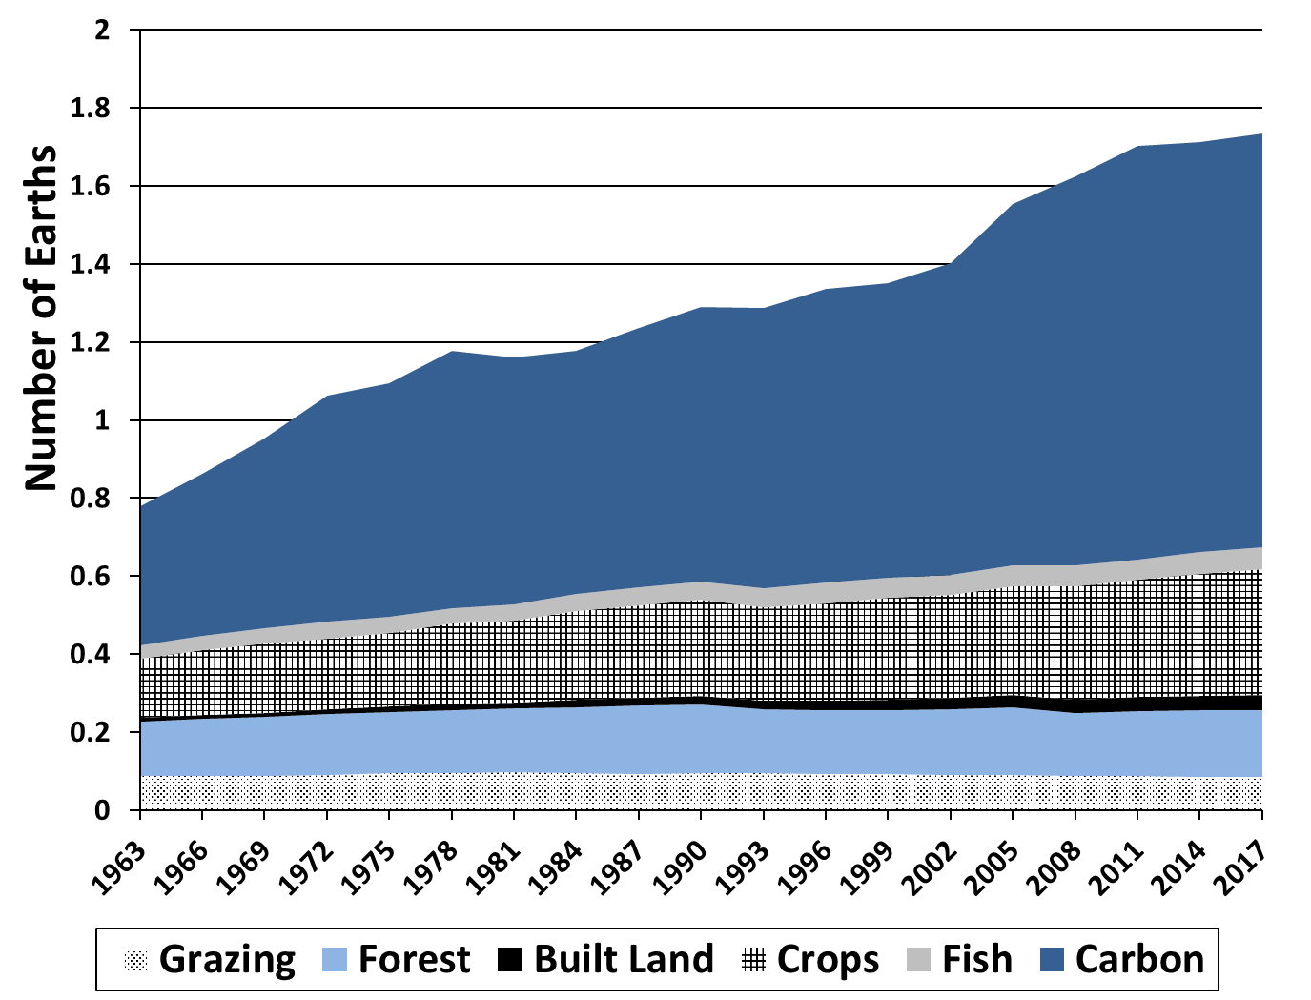
Global Ecological Footprint, by Impact Type
Source: Global Footprint Network, 2016. By 2017, humanity’s ecological footprint was 1.64 times greater than the available land on the planet.
Notes:
At the global level, humanity’s ecological footprint is 1.64 times greater than the available land on the planet (as indicated by the total global footprint exceeding the “1 earth” level around 1970.) About 60 percent of humanity’s total ecological footprint is attributed to carbon emissions, and another 20 percent is related to the growing of crops.

Slide 6
Global Population Growth with 2080 peak
Source: United Nations, World Population Prospects 2024.
Notes:
Figure 15.1
Note: Peak LDC in 2084; Peak MDC in 2030

Slide 7
“The remaining carbon budget for a 50% likelihood to limit global warming to 1.5, 1.7, and 2 ◦C has, respectively, reduced to 105 GtC, 200 GtC, and 335 GtC from the beginning of 2023, equivalent to 9, 18, and 30 years, assuming 2022 emissions levels.”
“Climate change is not a pass/fail course. There is no chance that the world will avoid the effects of warming—we’re already experiencing them—but neither is there any point at which we are doomed.”
- Sarah Kaplan, Aug. 9, 2022

Slide 8
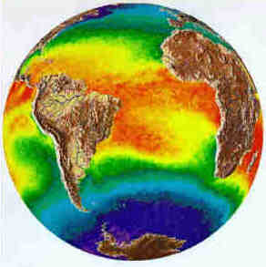
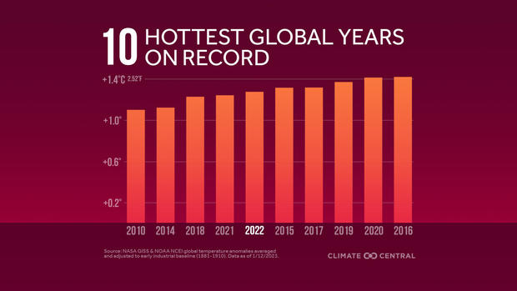
Temperature Patterns
As of 2022, 46 straight years where global average temperatures have been above the 20th century mean!
Sources: https://www.cbsnews.com/boston/news/what-is-show-your-stripes-day-graphic-climate-change-global-temperature/

Slide 9
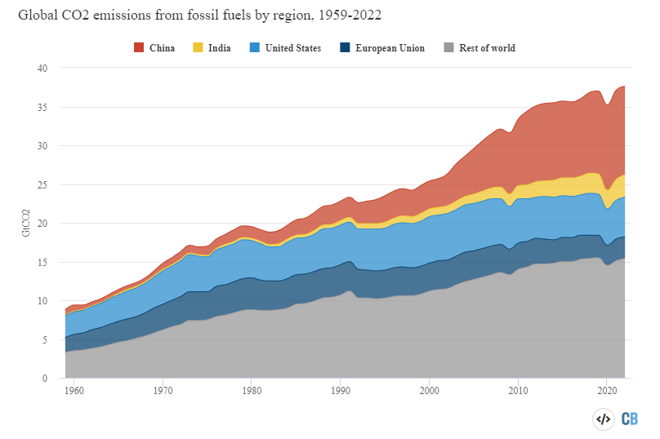
Global Carbon Emissions
Global carbon emissions fell by a record 7% in 2020 due to the COVID-19 pandemic. However, emissions rose by 6% in 2021 and 1% in 2022.
Source: https://www.weforum.org/agenda/2022/11/global-co2-emissions-fossil-fuels-hit-record-2022.

Slide 10
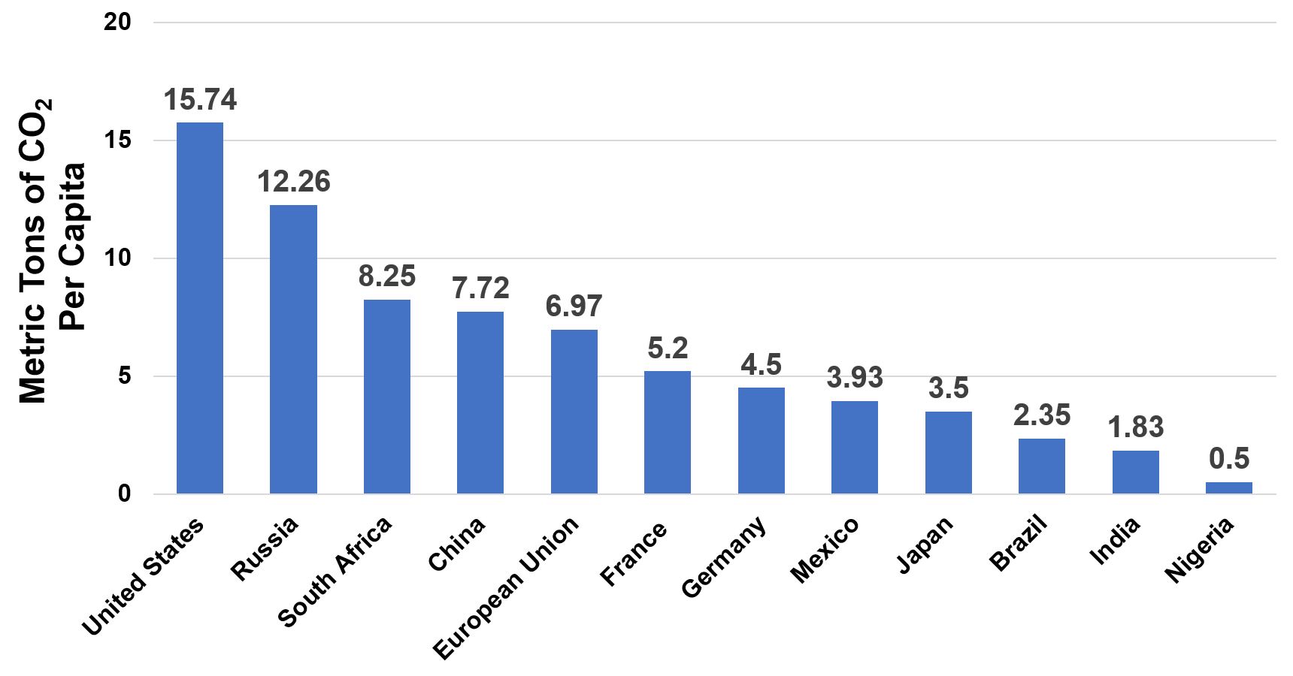
Per-Capita Carbon Dioxide Emissions, by Country
Source: European Commission EDGAR Database for Global Atmospheric Research, 2020 (data for 2017 emissions).
Notes:
Current per capita carbon emissions show a huge disparity across nations. U.S. per capita emissions are more than twice those of the European Union, while developing nations generally have much lower emissions per person. Some developing nations, such as China and South Africa, have reached per capita emissions levels similar to those of developed nations.

Slide 11
Why the 2°C Target?
(150 feet)
(50 feet)
(20 feet)

Slide 12
Energy Efficiency
Energy efficiency can reduce emissions even more than switching to renewable energy: “Lower the ceiling” and “raise the floor” to squeeze out carbon emissions.
Source: International Energy Agency, “Energy Efficiency 2018”.

Slide 13
A Global Transition
Source: https://web.stanford.edu/group/efmh/jacobson/Articles/I/CountriesWWS.pdf.

Slide 14
Declining Cost of Solar Energy
Source: https://www.freeingenergy.com/why-does-the-cost-of-renewable-energy-continue-to-get-cheaper-and-cheaper/

Slide 15
Declining Cost of Solar Energy
Source: https://rameznaam.com/2020/05/14/solars-future-is-insanely-cheap-2020/.

Slide 16
A Clean, Cheap Energy Future

Slide 17
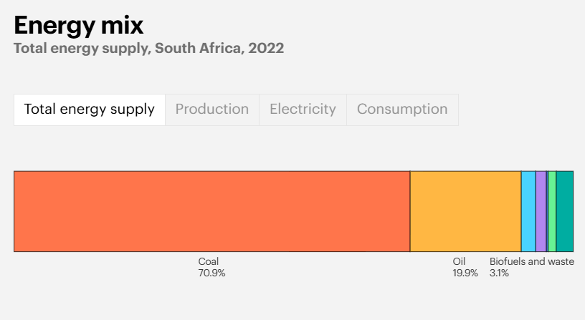
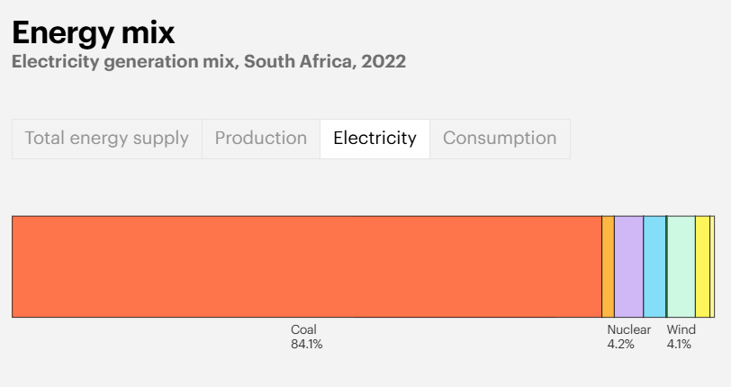
South Africa’s energy mix, and particularly its electricity generation, are heavily dependent upon coal.
Source: International Energy Agency, South Africa.

Slide 18
South Africa’s economy is the most carbon intensive in the world except for Libya.
Source: World Bank, World Development Indicators database.

Slide 19
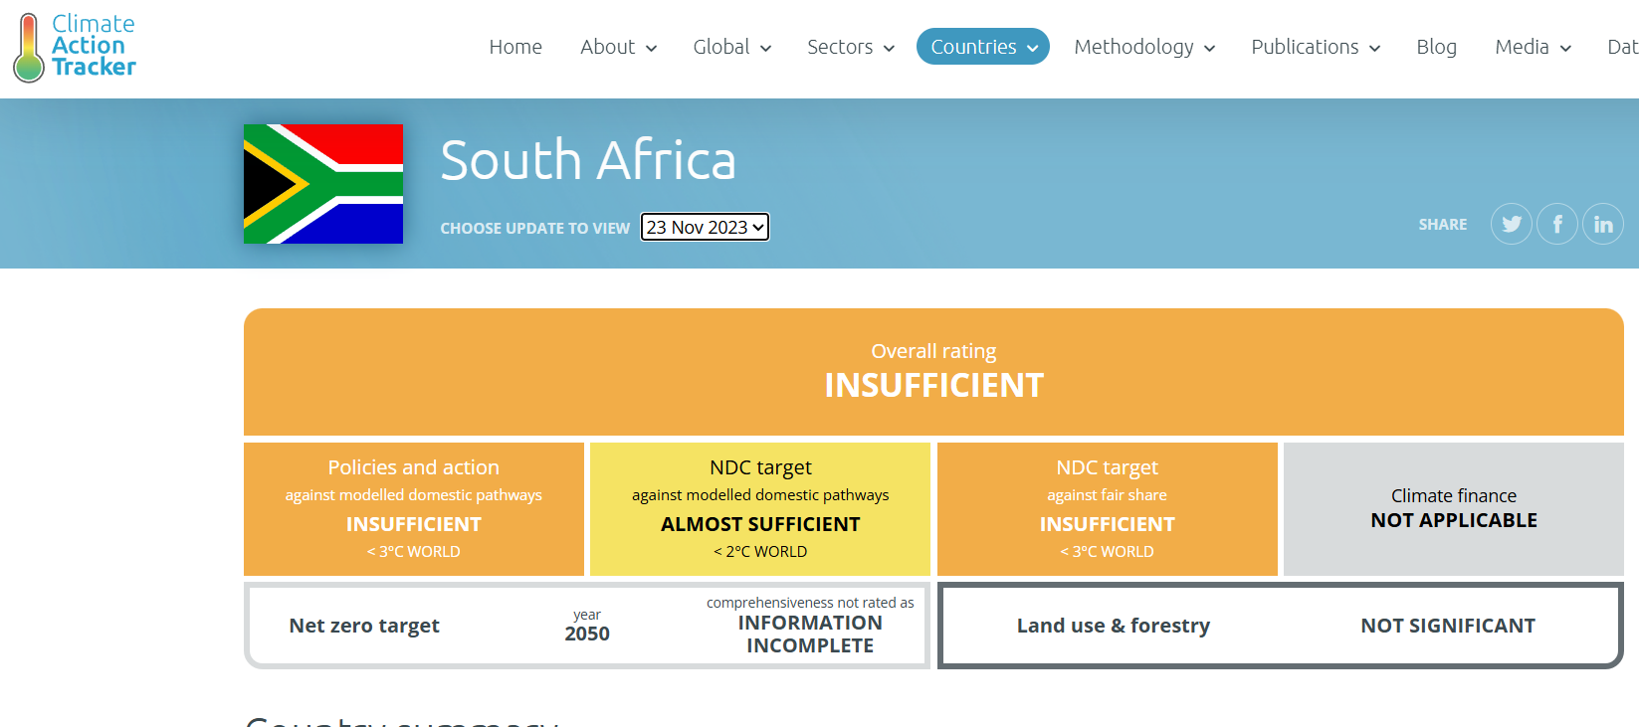
Climate Action Tracker rates South Africa’s climate policies “insufficient” while its target is “almost sufficient”.
NDC = Nationally Determined Contribution

Slide 20
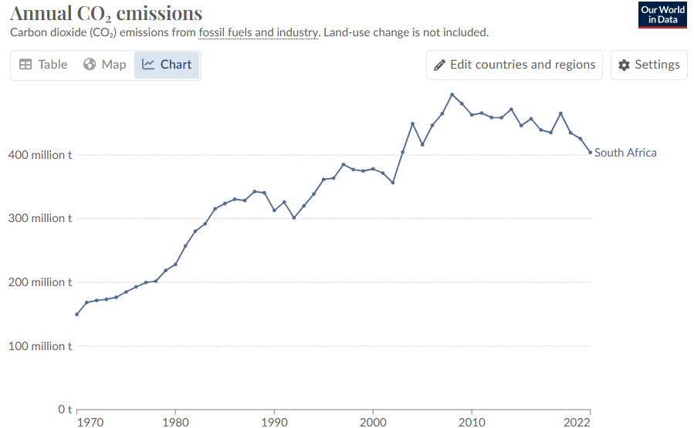
South Africa is already close to meeting its 2030 NDC target of 367-437 MtCO2e – 2022 emissions are down 13% compared to 2010.
Sources: Climate Action Tracker, South Africa; Our World in Data, South Africa: CO₂ Country Profile.

Slide 21
Source: Renewables Now, October 19, 2016.

Slide 22
South Africa's fossil fuel subsidies tripled between 2018 and 2023, hitting ZAR 118 billion (USD 7.5 billion), up from ZAR 39 billion (USD 2.9 billion) 5 years earlier.
The largest share of fossil fuel subsidies in South Africa in 2023 went to oil and gas consumption, carbon tax exemptions, and the electricity sector.
"Soaring fossil fuel subsidies in South Africa mean the country is still locked into dependence on economically volatile fuels, with ill-targeted consumer subsidies failing to protect the poorest families,"
"Carbon tax exemptions for big emitters like Eskom, as well as current plans to expand gas-generated power, are undermining South Africa’s commitments to shift away from fossil fuels.”

Slide 23
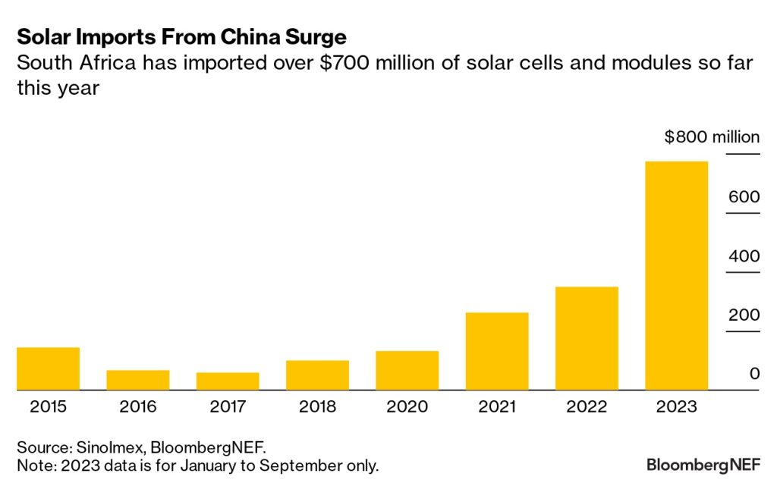
South Africa’s transition from coal to renewables is underway, benefitting from low-cost solar panels from China.
Sources: “The Cost of Coal Energy on the South African Economy,” Green Economy Journal, December 23, 2021; “Coal Declines Amid Solar Boom in South Africa, in Five Charts,” Bloomberg NEF, November 17, 2023.

Slide 24
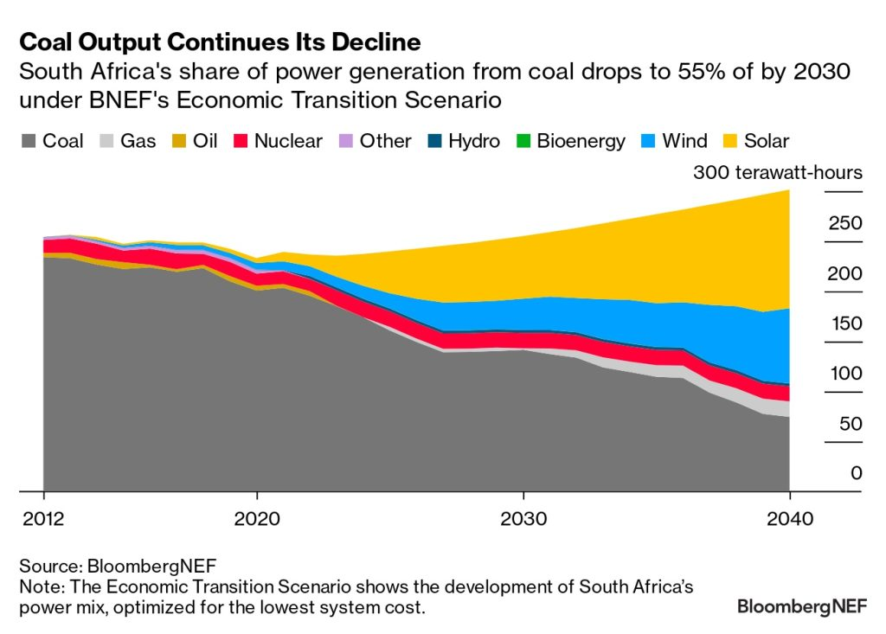
South Africa can obtain about two-thirds of its power from solar and wind by 2040 under an energy transition scenario.
Source: “Coal Declines Amid Solar Boom in South Africa, in Five Charts,” Bloomberg NEF, November 17, 2023.

Slide 25
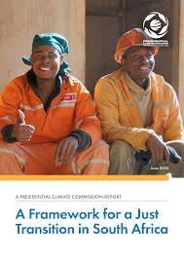
South Africa’s Just Transition Framework was adopted in May 2022.
A just transition aims to achieve a quality life for all South Africans, in the context of increasing the ability to adapt to the adverse impacts of climate, fostering climate resilience, and reaching net-zero greenhouse gas emissions by 2050, in line with best available science.
A just transition contributes to the goals of decent work for all, social inclusion, and the eradication of poverty.
A just transition puts people at the centre of decision making, especially those most impacted, the poor, women, people with disabilities, and the youth—empowering and equipping them for new opportunities of the future.
Source: “A Framework for a Just Transition in South Africa,” Presidential Climate Commission Report, June 2022.

Slide 26
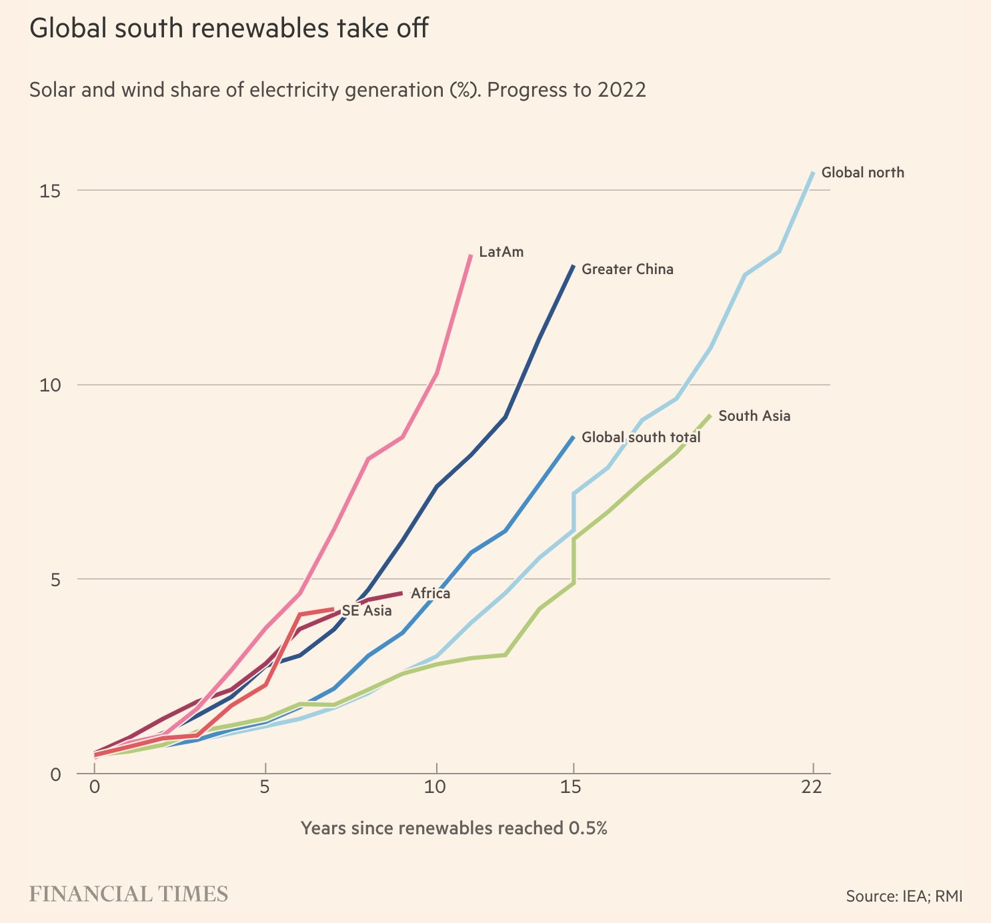

Slide 27
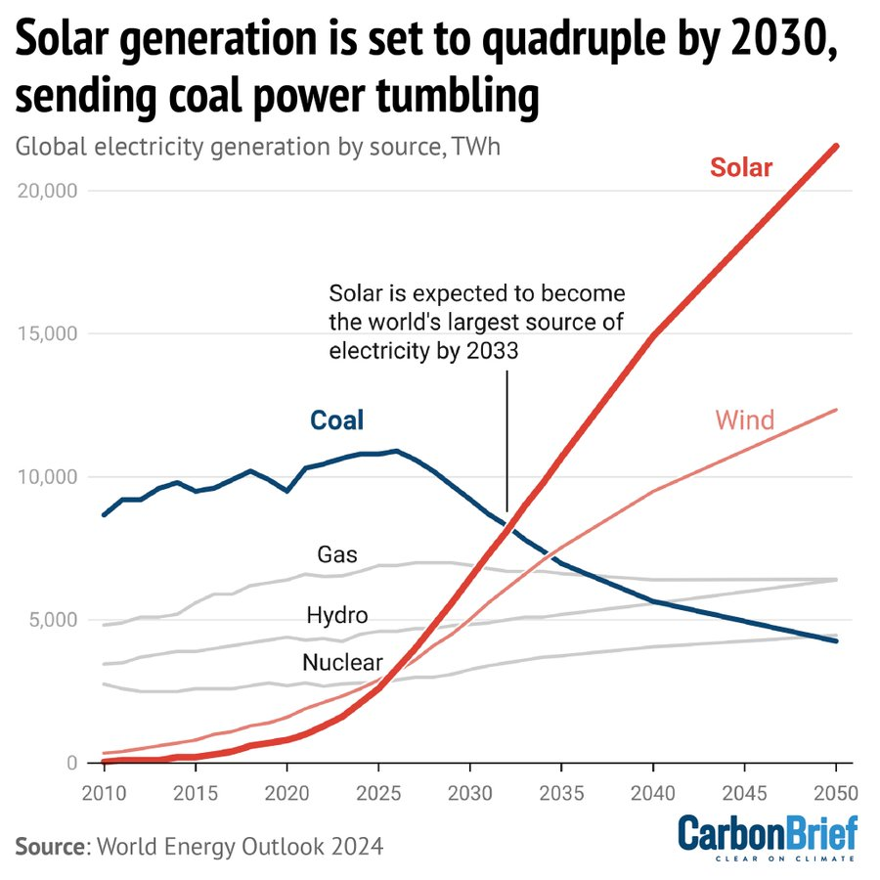

Slide 28
Renewable Energy Job Creation
Dollar-for-dollar, clean energy and other green investments generally create more jobs in the near term than unsustainable investments, according to a new analysis of studies from around the world published by World Resources Institute, the International Trade Union Confederation and the New Climate Economy.
Investing in solar photovoltaic energy creates an average of 1.5 times as many jobs as investing the same amount of money in fossil fuels.
Ecosystem restoration creates 3.7 times as many jobs as oil and gas production per dollar.
Building efficiency retrofits create 2.8 times as many jobs as fossil fuels per dollar.
Job creation rates between renewable and non-renewable industries | World Economic Forum

Slide 29
Clean Energy Jobs Growth
Energy employment reached nearly 67 million in 2022 — growing by 3.4 million over pre-pandemic levels. Clean energy sectors added 4.7 million jobs globally over the same period and stand at 35 million, while fossil fuels jobs recovered more slowly after layoffs in 2020 and remain around 1.3 million below pre-pandemic employment levels, at 32 million.
As a result, clean energy employment surpassed that of fossil fuels in 2021.

Slide 30
Energy Jobs Transition
Many fossil fuel workers have the skills and specialisations needed to fill clean energy roles. About half of workers in fossil fuel sectors have skills demanded by growing clean energy sectors. Many of these workers could switch into new roles with around four weeks of dedicated training, such as 1.2 million workers who could shift from fossil fuel heating to heat pumps and 4 million workers who could shift from internal combustion engine (ICE) manufacturing to EVs.
Transition risk is particularly acute for coal miners in emerging and developing countries. Many coal producing regions have already successfully managed coal transitions, generating important policy lessons for other regions. Targeted reskilling and community support policies for declining coal regions can help transfer these workers to other sectors, like critical minerals.
Executive summary – World Energy Employment 2023 – Analysis - IEA

