Slide 1
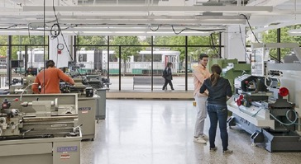
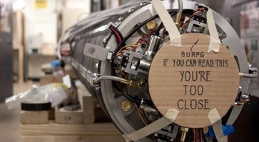

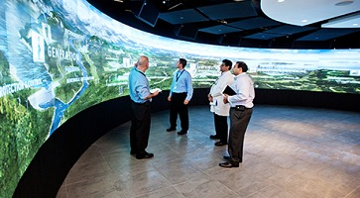


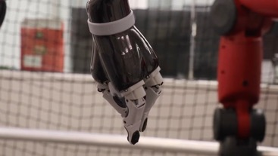
Undergraduate Concentrations Information Session
Manufacturing Engineering
Aerospace Engineering
Energy and Sustainability
Technology Innovation
Nanotechnology
Machine Learning
Oct. 13, Friday
3:30pm-4:30pm
Robotics (Pending)

Slide 2
Structure and Timeline For Concentrations
Three Courses (12 credits)
Topical
Declare the concentration (by May 1 junior year)
  Concentrations typically may one or more required courses → Check concentration webpage
  One or more courses are typically required *before* doing experience – plan ahead!
Experiential Component: Internship, lab experience, directed study, senior design
  Submit proposal *before* starting the experience
    Submit by Fall of Senior year (specific dates vary)
    Complete by Spring of Senior year (specific dates vary)

Slide 3
Concentration Topics: 5 min each
  Aerospace Engineering (Ray Nagem)
  Energy Tech. and Sustainability (Joerg Werner)
  Manufacturing Engineering (Jim Perkins)
  Technology Innovation (Tom Little)
  Machine Learning (Prakash Ishwar)
  Nanotechnology (Anna Swan)
  Robotics (Roberto Tron)

Slide 4
Aerospace Engineering
Contact
Concentration Coordinator: Prof. Nagem (nagem@bu.edu)

Slide 5
Energy Technology and Sustainability
Contact
Concentration Coordinator: Prof. Uday Pal (upal@bu.edu)

Slide 6
Energy Technology and Sustainability
Engineering breakthroughs in energy and the environment will shape our future society.
The Energy Technologies and Sustainability concentration is designed for undergraduate engineering students to acquire an understanding of the various energy generation, storage, conversion, and consuming technologies and their environmental impacts and put them in a position to pursue a career in green technology.

Slide 7
Energy Technology and Sustainability
Restricted Elective
(at least one but both can be taken)
Additional Courses: (Choose remaining courses from the list below; no more than one CAS EE course or EK 335)
ENG EK 408 – Introduction to Clean Energy and Storage Technologies
ENG EC 417 – Electric Energy Systems: Adapting to Renewable Resources
*CAS EE 250 – The Fate of Nations: Climate, Resources and Institutions
*CAS EE 304 / IR 304 – Environmentally Sustainable Development
*CAS EE 309 – Intermediate Environmental Analysis and Policy
*CAS EE 545 – Methods of Environmental Policy Analysis
ENG EK 335 – Introduction to Environmental Engineering
ENG ME 533 – Energy Conversion
ENG ME 535 / MS 535– Green Manufacturing
ENG EC 543 / ME 543 / SE 543 – Sustainable Power Systems: Planning, Operation and Markets
ENG ME 545 / MS 545 – Electrochemistry of Fuel Cells and Batteries
ENG EK 546 – Assessment of Sustainable Energy Technologies
ENG EC 573 / MS 573 – Solar Energy Systems
ENG EC 583 – Power Electronics for Energy Systems
*QST SI 453 – Strategies for Environmental Sustainability

Slide 8
Experiential Component
A senior design project, laboratory research, industrial internship or a directed study can satisfy this requirement.
Prior to proposing an experiential component, you must have completed one ET Concentration allowed courses
Experiential Component Approval form must be submitted to the Undergraduate Records Office. It must be approved by the Concentration coordinator before you start your experiential component.
After completion, a written summary of the experiential component must also be submitted for approval using the Experiential Component Approval form.

Slide 9
Manufacturing Engineering
Contact
Concentration Coordinator: Prof. Perkins (perkins@bu.edu)

Slide 10
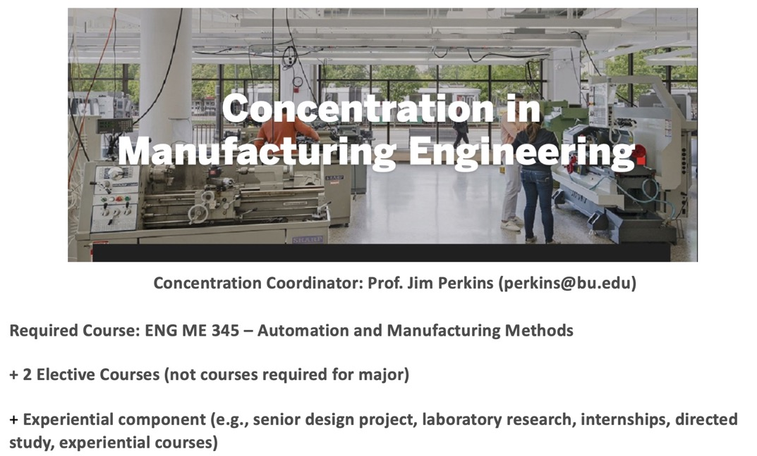

Slide 11
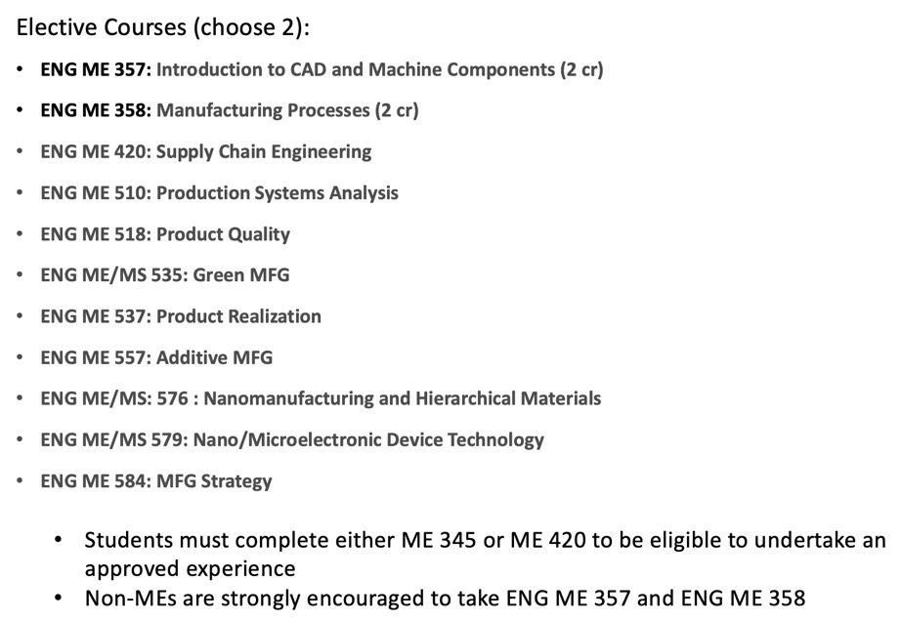

Slide 12
Technology Innovation
Contact
Concentration Coordinator: Prof. Thomas Little (tdcl@bu.edu)

Slide 13

Tech Innovation Concentration (TIC)
2 Required Core Courses
1 Elective
Experiential Component
ENG and Questrom
SI 480
The Business of Technology Innovation
SI 482
Technology and its Commercialization

Slide 14

Start with a problem: Geese
They destroy soccer fields by constant grazing and feces
→ causes a need for more spending on field maintenance
They are very territorial so they might try to fight back if provoked
→ might be dangerous to manually ward of geese
Geese are around most of the year other than the winter
→ they will continuously be a problem
They reproduce and spread very quickly
→ the problem will only get worse if it is not dealt with right now
From Matthew Hormis, TIC with Senior Design 2019

Slide 15
TIC Experience Requirements
  Customer needs gathering and analysis. Discuss needs with 3-5 end-users or potential purchasers of the target innovation
  Market study and analysis. Identify the commercial landscape for the product and will identify 1-2 target markets for investigation. This includes establishing the size of the market
  Value quantification (not cost). Estimate the value provided by the proposed work products and services and their relationship to pricing and the competitive marketplace.
  Lean Canvas. Create and populate a Lean Canvas describing the innovation and business landscape
  Financial forecast. Create a financial forecast of 3-5 years for the commercialization of the innovation.

Slide 16
Machine Learning
Contact
Concentration Coordinator: Prof. Prakash Ishwar (pi@bu.edu)

Slide 17
Machine Learning (ML) Concentration
Era of “BIG” data deluge:
  Almost 2 billion websites
  8+ hours of video uploaded to YouTube every second
  Walmart handles 1 million+ transactions per hour
  Genomes of 1000s people sequenced, each 3.8 billion base pairs long…
Surpasses human ability to observe and analyze
➔Need automated methods

Slide 18
ML = algorithms + automated systems that can:
  Learn latent patterns from observed data
  Make predictions of expected behavior on unobserved data
  Synthesize realistic new data

Slide 19
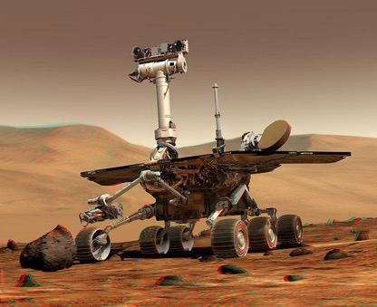
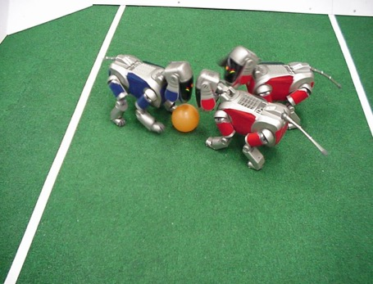
Machine Learning in Real Life:
Robotics
NASA’s Mars Spirit Rover
http://www.robocup.org/
slide by S. Seitz

Slide 20
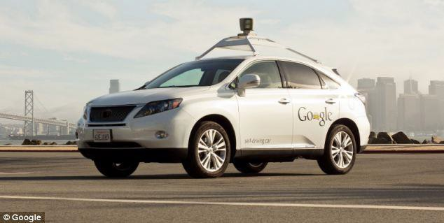
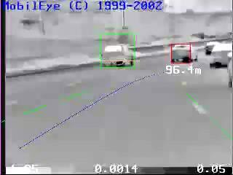
Machine Learning in Real Life:
Smart Cars

Slide 21
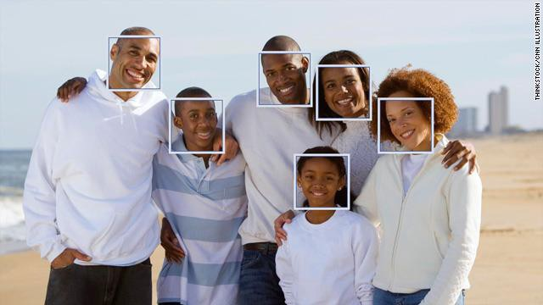
Machine Learning in Real Life:
Face Tagging in Social Media

Slide 22
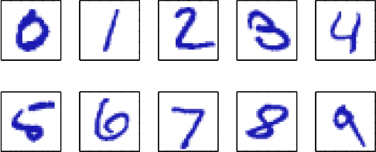
Machine Learning in Real Life:
Handwriting Recognition
Figure from J.Corso

Slide 23
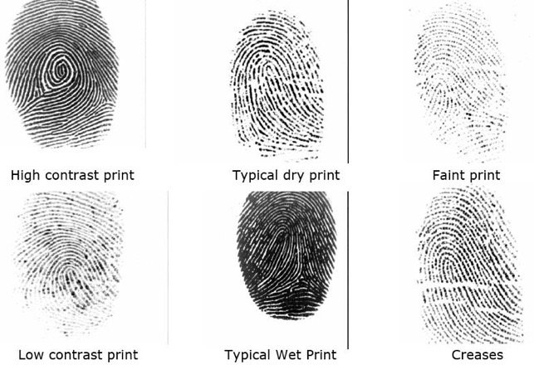
Machine Learning in Real Life:
Biometrics
Figure from J.Corso

Slide 24
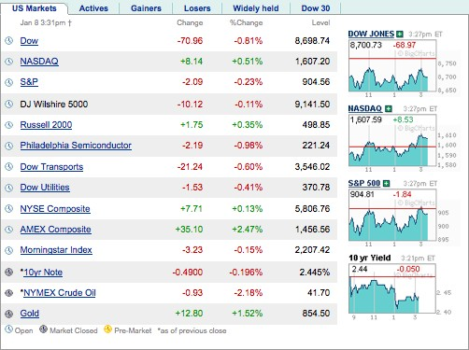
Machine Learning in Real Life:
Computational Finance
Figure from J.Corso

Slide 25
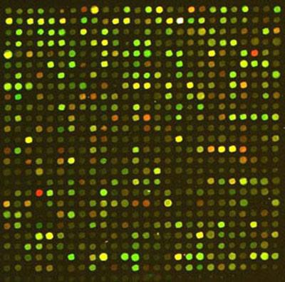
Machine Learning in Real Life:
Gene Expression Analysis

Slide 26
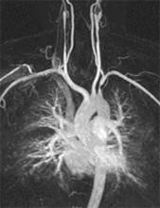
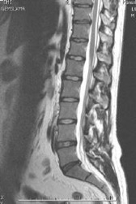
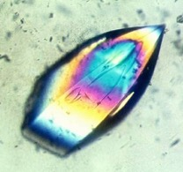
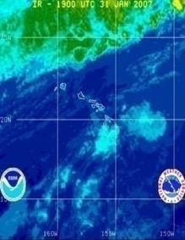

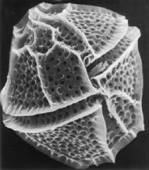
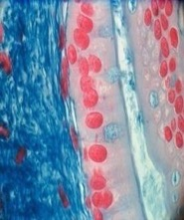
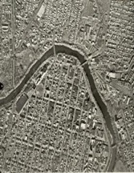

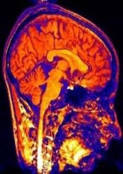
Machine Learning in Real Life:
Scientific Data

Slide 27
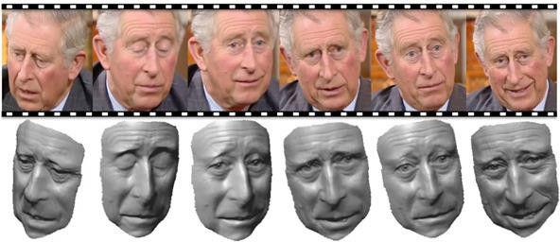
Machine Learning in Real Life:
3D Face Reconstruction

Slide 28
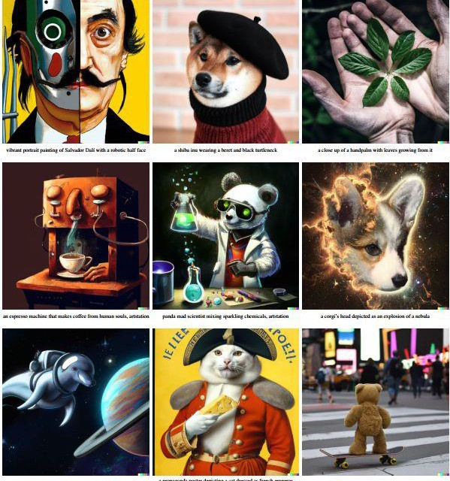

Slide 29
Goals of Concentration
Engineering Concentration in Machine Learning
Equip students with skills in:
ML algorithms: select, adapt, optimize, design, apply various ML algorithms and assess their performance.
ML software or hardware tools: gain familiarity with and apply various tools in applications.
Data: curate, visualize, analyze data of various types
Communication: read and explain methods from ML literature

Slide 30
Overview
Concentration Declaration
Coursework → Math-heavy (Prereq. EK102, EK125, MA225, EK381)
  1 Required overview course (2 choices):
    ENG EC 414: Introduction to Machine Learning
    ENG EC 503: Learning from Data
  2 Elective depth courses (24 choices across 3 pillars):
    Pillar I: Models, Learning, and Inference (6 choices)
    Pillar II: Optimization, Algorithms, and Programming (6 choices)
    Pillar III: Applications (12 choices)
Experiential component
  Proposal + Report + Self-Recorded Video Presentation + Slides
  Options: laboratory research, directed study, internships, senior design project, experiential course project, and others.

Slide 31
Nanotechnology
Contact
Concentration Coordinator: Prof. Keith Brown (brownka@bu.edu)

Slide 32

Nanotechnology Concentration
Anna Swan
10/13/2023
Nanotechnology: Where Things Get Interesting

Slide 33
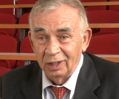
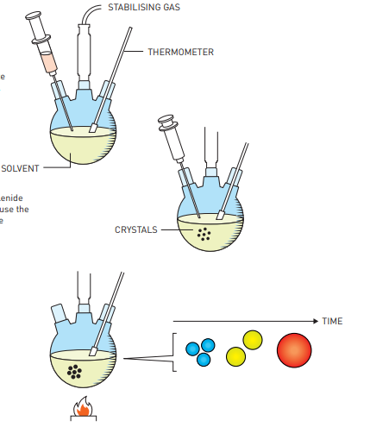
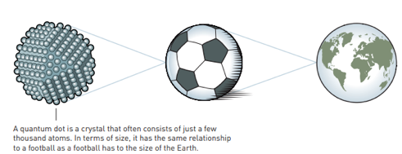

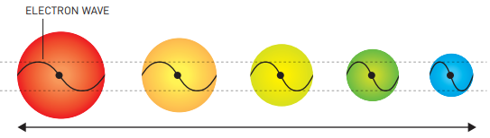

2023 Chemistry Nobel Prize
Ekimov (Nanocrystals Technology Inc)
Quantum dots!
Brus (Columbia U)
Bawendi (MIT)

Slide 34
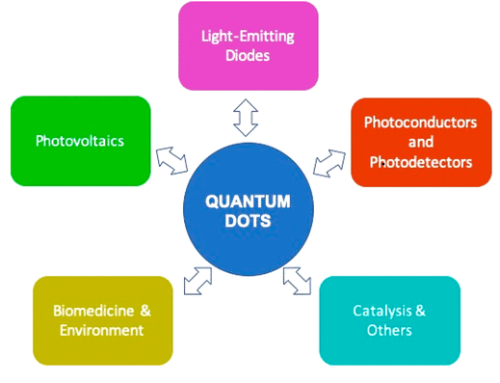
Quantum dot application areas
Cell biology research, microscopy, and medical imaging
Displays (QD TVs)
Solar cells
Lasers and LEDs
Photodetectors
Single-photon sources
Quantum computing
…

Slide 35
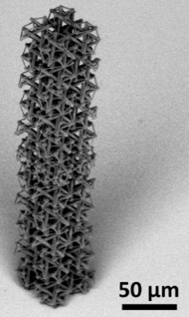

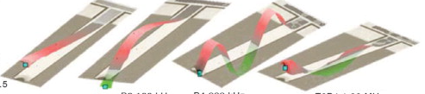
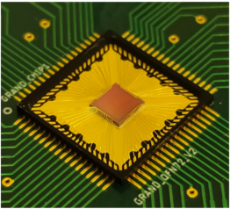
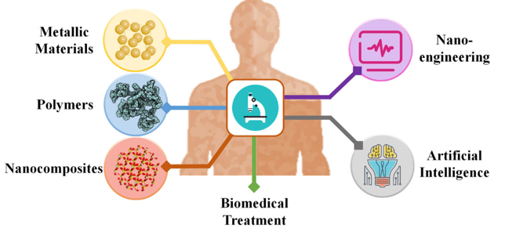
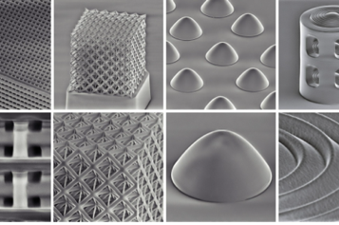
Nanotechnology is Everywhere
Tensile nano-structures
MechE
Nano needle drug delivery
nano
BME
Metamaterials
ECE
extreme control over optical fields
Notes:
Research of matter on an atomic and molecular scale is expanding in virtually all areas of engineering. The Nanotechnology concentration is designed for undergraduate engineering students to obtain foundational knowledge of the effects and applications of nanotechnology and position them for future careers in the nanotechnology field. The required courses will provide an introduction to nanotechnology, and examine how engineering works on scales as small as millionths of a millimeter. Students will explore the foundations of quantum mechanics, atomic structure and the physics of molecules and solids. The multi-disciplinary elective courses will include different approaches to biomedical engineering on the cellular and sub-cellular level; behavior of materials at atomic levels; micro-electrical mechanical devices and systems (MEMS); and photonics and fiber-optic communication. As nanotechnology expands in all fields of engineering, students entering the work force with a strong knowledge base position themselves to be future leaders the nanotechnology industry.

Slide 36
The Logistics of the Concentration
  *CAS PY 313 / 314 – Waves and Modern Physics
  *ENG EK 424 – Thermodynamics and Statistical Mechanics
  CAS PY 543 – Introduction to Solid State Physics
  ENG EK 481 – Fundamentals of Nanomaterials and Nanotechnology
  ENG BE 437 – Nanometer Scale Processes in Living Systems
  ENG BE 505 – Molecular Bioengineering I
  ENG BE 517 – Optical Microsopy of Biological Materials
  ENG BE 526 – Fundamentals of Biomaterials
  ENG BE/EC 555 / EC 555 – Introduction to Biomedical Optics
  ENG EC 471 – Physics of Semiconductor Devices
  ENG EC 560 – Introduction to Photonics
  ENG EC 571 – Digital VLSI Circuit Design
  ENG EC/MS 574 – Physics of Semiconductor Materials
  ENG EC/MS 577 / MS 577 –Properties of Materials
  ENG EC 578 – Fabrication Technology for Integrated Circuits
  ENG ME 506 – Engineering Device Applications: From Physics to Design
  ENG ME 526 / MS 526 – Simulation of Physical Processes
  ENG ME 555 / MS 555 – Fabrication and Materials
  ENG ME 576 / MS 576 – Nanomanufacturing and Hierarchical Materials
  ENG ME 579 / EC 579 – Nano/Microelectronic Device Technology
  GRS CH 629 – DNA Nanotechnology
First take one of these:
  ENG EK 481 – Fundamentals of Nanomaterials and Nanotechnology
  ENG BE 437 – Nanometer Scale Processes in Living Systems
Then take two of these
Experiential component
Notes:
* Students cannot receive credit toward the concentration for both CAS PY 313/314 and ENG EK 424.

Slide 37
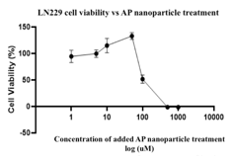
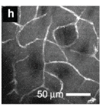
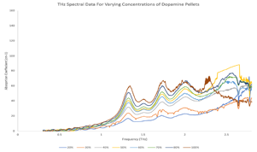
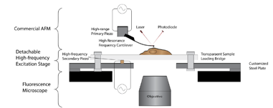
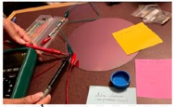

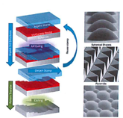
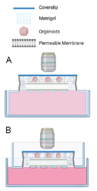
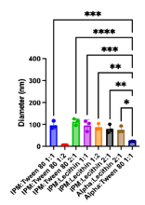
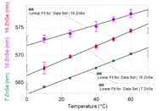

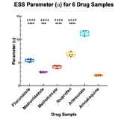
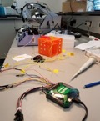

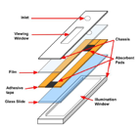
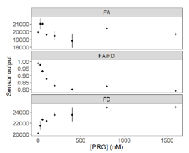
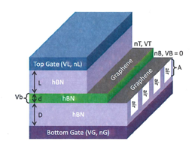

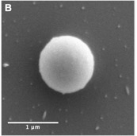


Experiential Components:
Biotech, Electronics, NEMS/MEMS
Prior to proposing an experiential component, the student must have completed ENG EK 481 or BE 437
https://www.bu.edu/nano-bu/
Notes:
These images are taken from student’s experiential components to show a cross section of what nano looks like at BU

Slide 38
Robotics
Contact
Concentration Coordinator: Prof. Roberto Tron(tron@bu.edu)
Not yet approved: expected by fall 2024

Slide 39

Concentration in Robotics

Slide 40
Motivation
Prepare for jobs in a rapidly expanding field
Builds upon the fundamentals from the undergraduate engineering curriculum
Focus on a specific subset of
  Planning, Control
  Perception
  Machine Learning
  Computation
  Design
Every ENG major is relevant
(ME, EE, CE, BME)

Slide 41
Disclaimer
The concentration
has not been approved yet
But you can still take
the relevant classes

Slide 42


Requirements
ME416 Introduction to Robotics
Experiential component
  (similar to other concentrations)
  Research
  Internship
  Senior design

Slide 43
DRAFT Requirements
Two courses among
ENG ME 404 Dynamics and Control of Mechanical Systems
ENG BE 404 Modern Control in Biomedical Engineering
ENG ME 570 Robot Motion Planning
ENG EC 518 Robot Learning
CAS CS 585 Image and Video Computing
ENG EC 444 Smart and Connected Systems
ENG EC 535 Introduction to Embedded Systems
ENG EC 545 Cyber-Physical Systems
ENG ME 568 Soft Robotic Technologies
ENG ME 571 Medical Robotics
Planning & Control
Computation
Perception
Design
ENG EC 523 Deep Learning
ENG EC 414 Intro to Machine Learning
ENG EC 503 Introduction to Learning from Data
ENG CAS CS 542 Principles of Machine Learning
ML

Slide 44
END

Slide 45
Informal Part
Faculty/coordinators are available for small group discussion and Q&A
Or contact them by email

