Slide 1


Oral Health for Pediatric and Geriatric Patients
BMC Family Medicine Department
Ana Zea, DDS
Clinical Assistant Professor
Director of Community-Based Education
Departments of General Medicine and Health Policy & Health Services Research
Global and Population Health
Boston University Henry M. Goldman School of dental Medicine

Slide 2
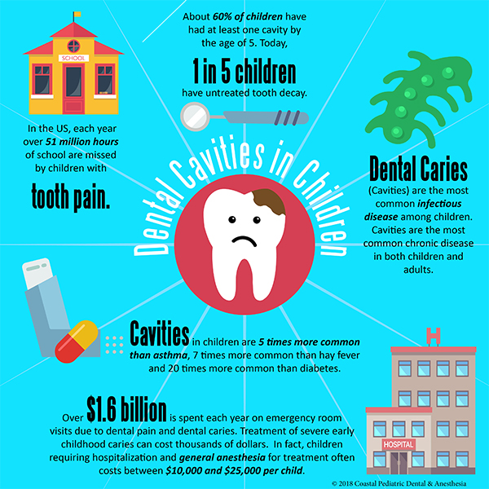

Slide 3

Why is oral health important for children
Children’s nutrition
Development of speech
Growth
Confidence and self-esteem
General health

Slide 4
DID YOU KNOW…
1 in every 13 children have hay fever (respiratory allergies) (7.7)
1 in every 7 children have skin allergies (13.5%)
1 in every 12 children have asthma (8.4%)
1 in every 4 children have dental decay*
*Cavities or caries

Slide 5
DID YOU KNOW…
Caries is 100% preventable?

Slide 6
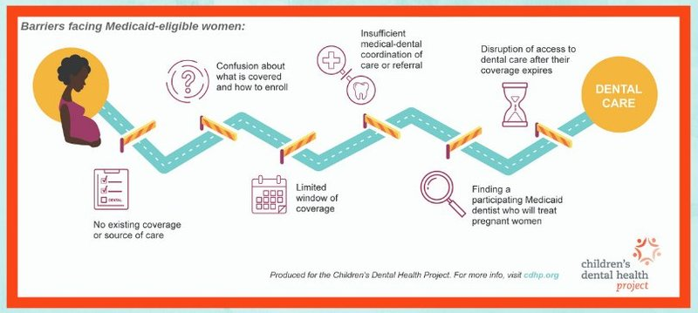

Slide 7
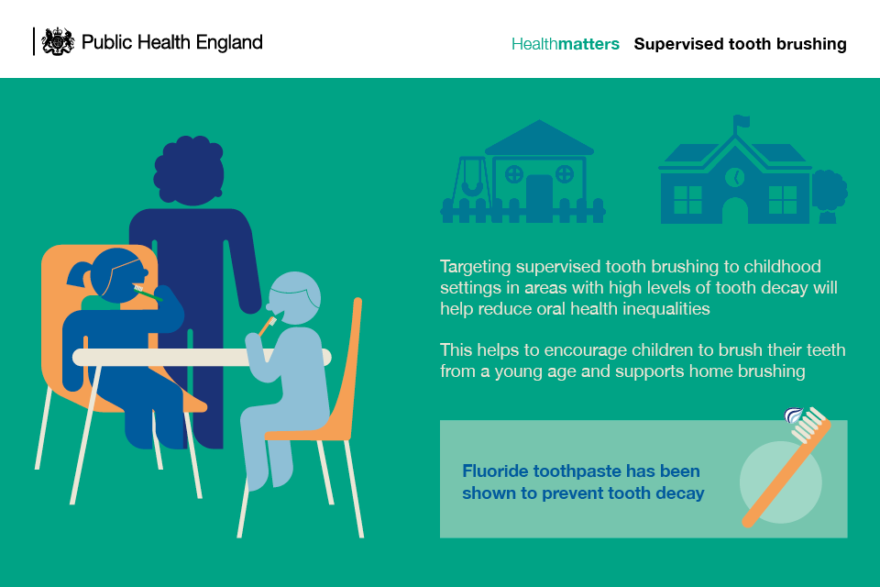

Slide 8
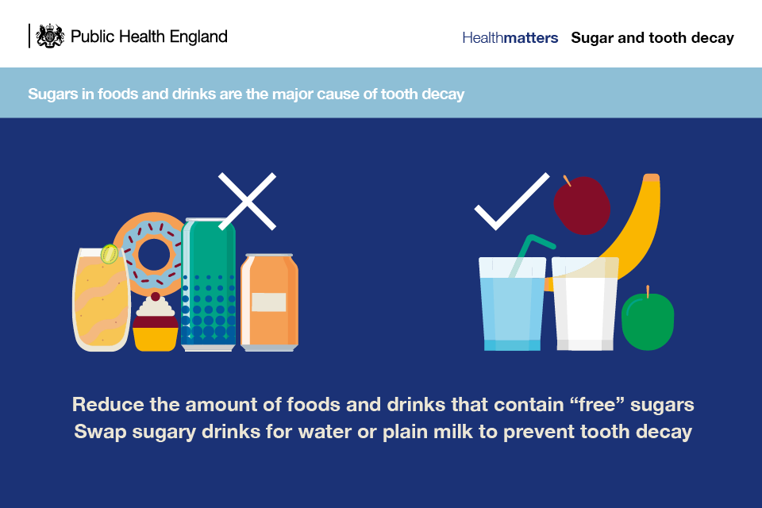

Slide 9

Never too early to find a dental home!!!
As early as first tooth, no later than 12 months
Infants and young children have higher risk
Counseling about nutrition, hygiene and habits
Become comfortable with examination
Early diagnosis and treatment of caries
Fluoride

Slide 10
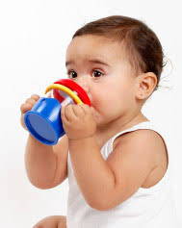
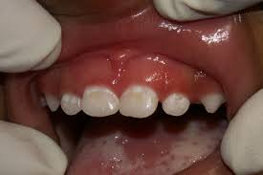
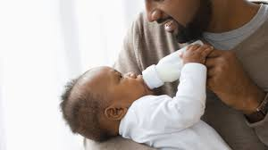
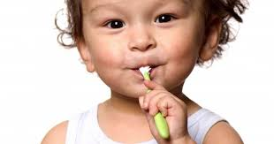
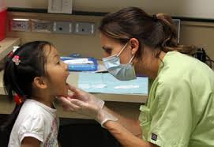
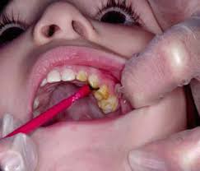
Prevention
Diet
Hygiene
Fluoride
Early Diagnosis

Slide 11
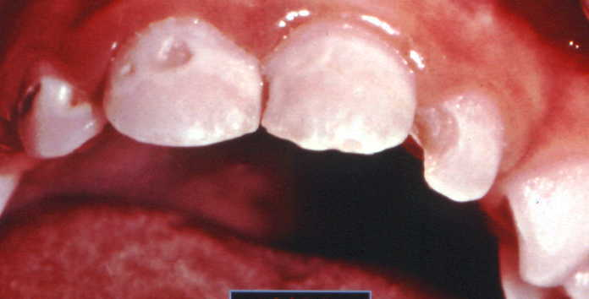
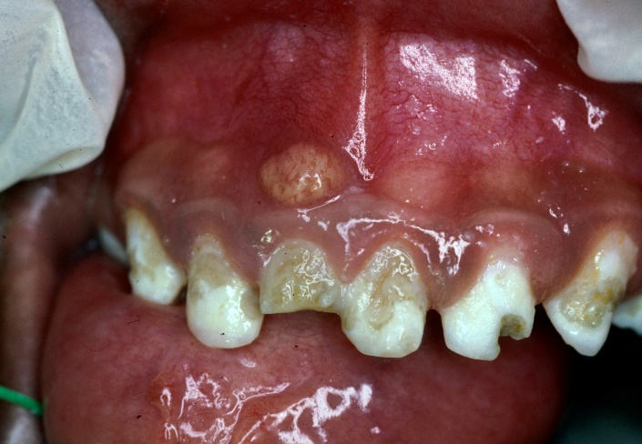
Early Childhood Caries
Chronic
Multi-Factorial
Aggressive
Rapidly Progressing
PREVENTABLE

Slide 12
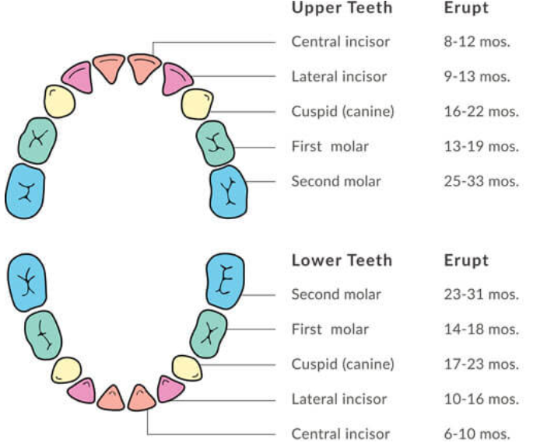
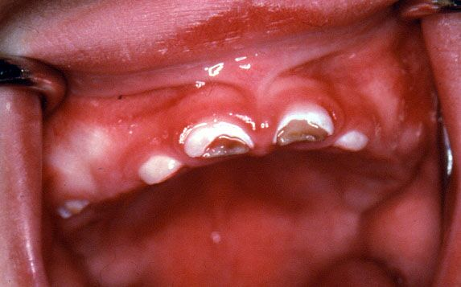

Slide 13
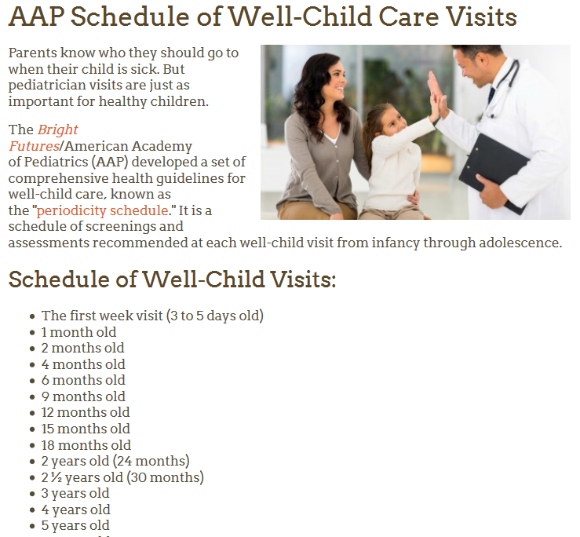

Slide 14
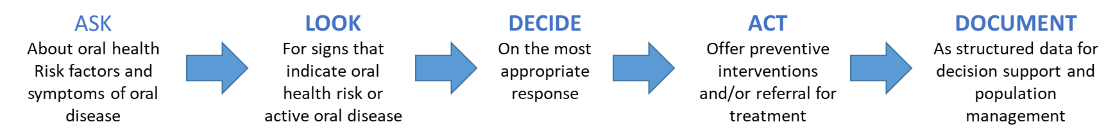
Medical-Dental Integration

Slide 15
ASK
About oral health risk factors and symptoms of oral disease
If your child is 1 or older, when did your child last see a dentist?
Within the past 6 Months
It has been longer than 6 Months
Never
If the patient has seen a dentist before, what dentist did they see?
A dentist at _____
Other Dentist
Has the parent or caregiver for the child (all day) had any cavities in the last 12 months?
Yes
No
Does your child fall asleep or take naps with a bottle containing juice or milk?
Yes
No
For provider to complete:
High Risk
Low Risk

Slide 16
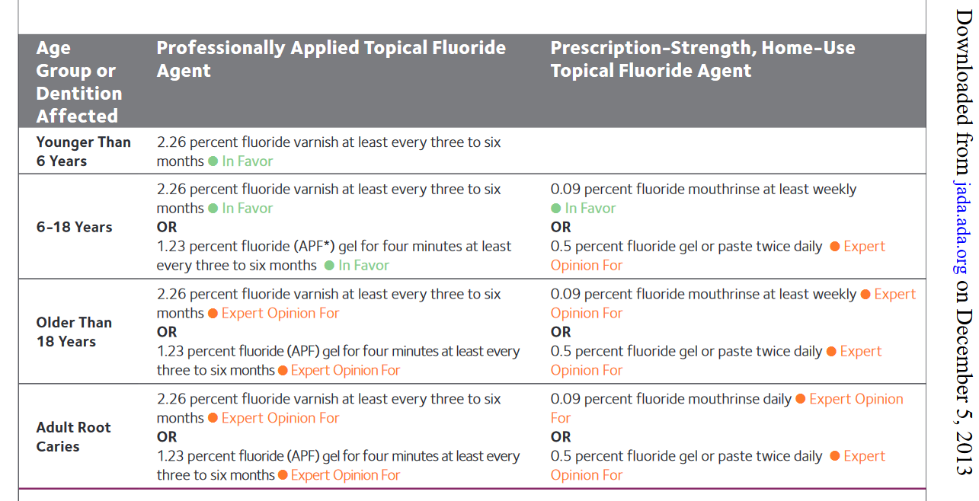

Slide 17
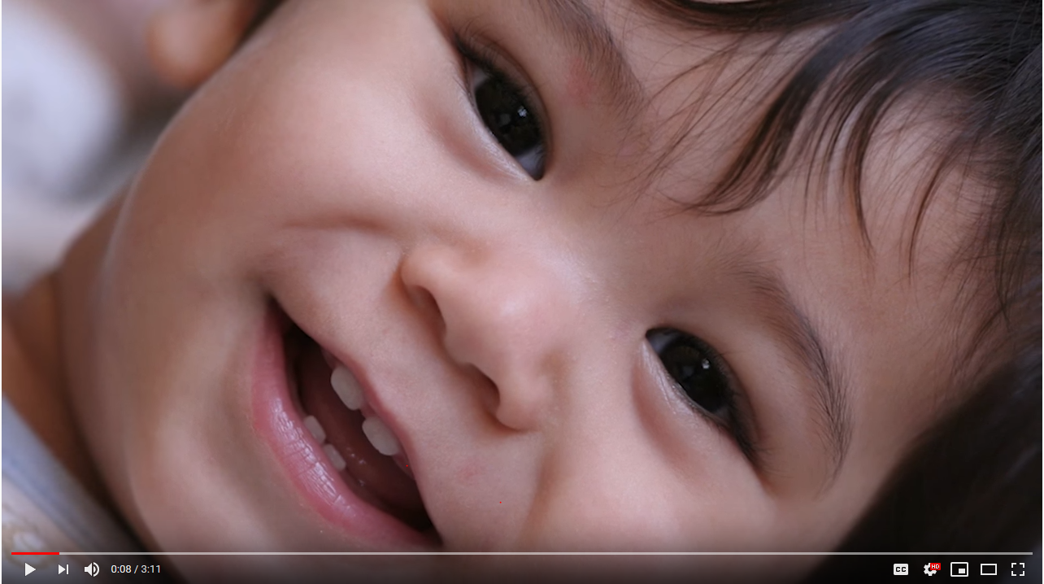
https://www.youtube.com/watch?v=OzM4UQxP67Q

Slide 18
BMC Dental Pediatrics
Yawkee Building 7th Floor
Referral Through EPIC
Page On-Call Resident through EPIC
Emergency Room
850 Harrison Ave 6th Floor, Boston, MA 02118(617) 414-4837

Slide 19
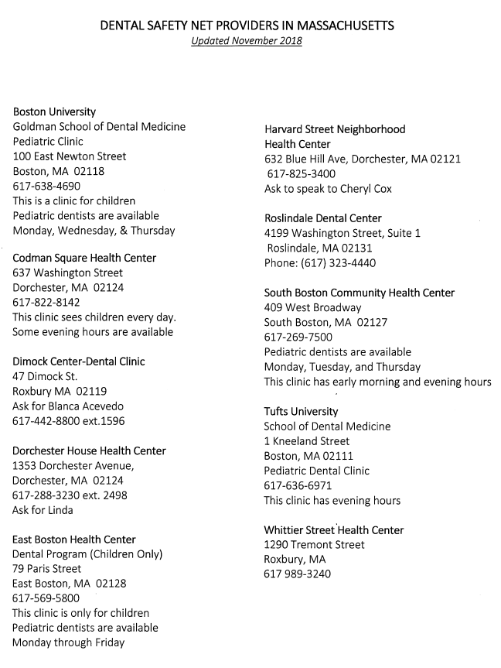

Slide 20
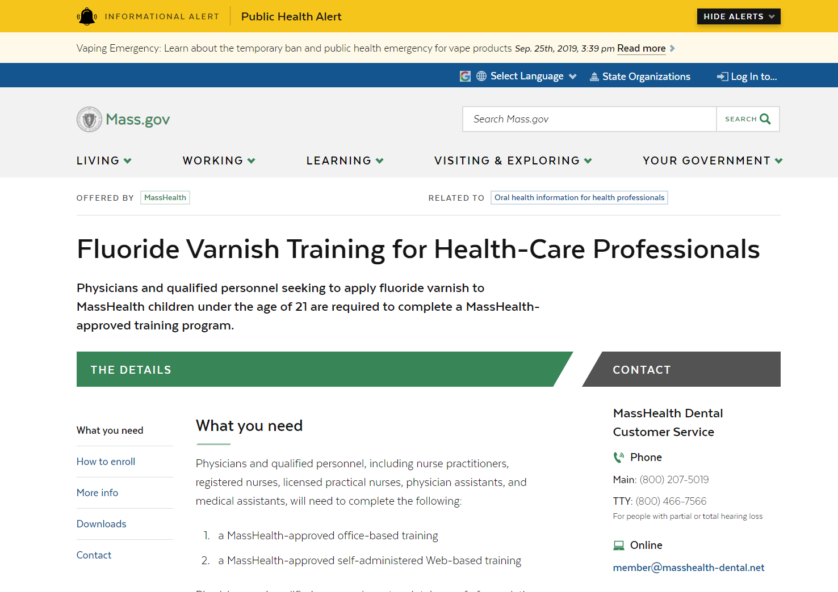
https://www.mass.gov/how-to/fluoride-varnish-training-for-health-care-professionals

Slide 21
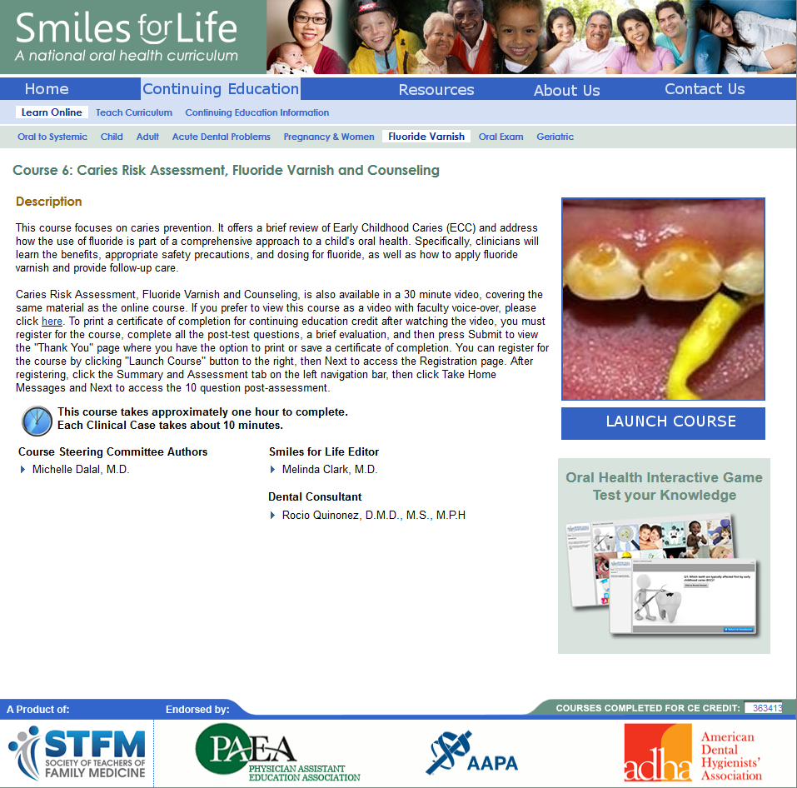
https://www.smilesforlifeoralhealth.org/buildcontent.aspx?tut=555&pagekey=101563&cbreceipt=0

Slide 22
Thank you!

