Slide 1

Clinical Updates on COVID-19
Family Medicine Grand Rounds
December 1, 2020
Kirsten Austad MD, MPH

Slide 2
Conflict of Interest
I have no relevant disclosures
Disclaimer
A lot of what I told your earlier in 2020 is untrue

Slide 3
Learning goals
Update understanding of clinical presentation of COVID-19
1
Review the evidence for and against agents used to treat COVID-19
2
Highlight complications and long-term sequalae of COVID-19 infection
3
Provide an overview of vaccines currently in development for COVID-19
4

Slide 4
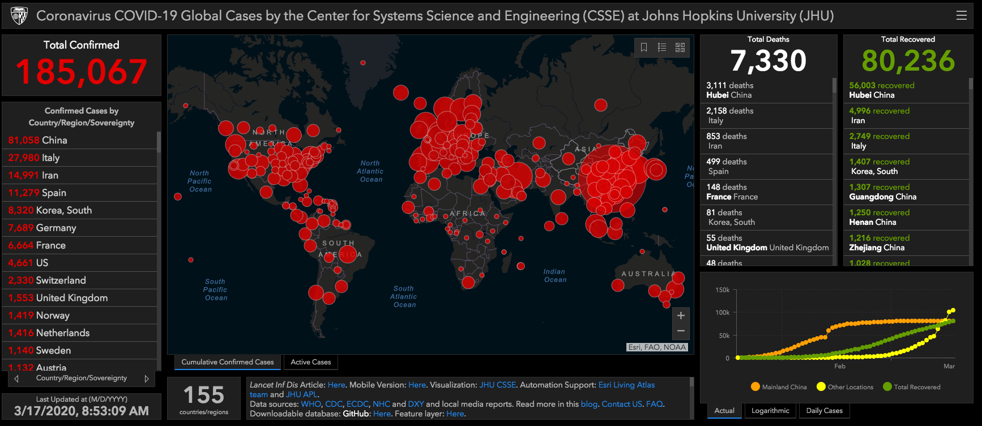
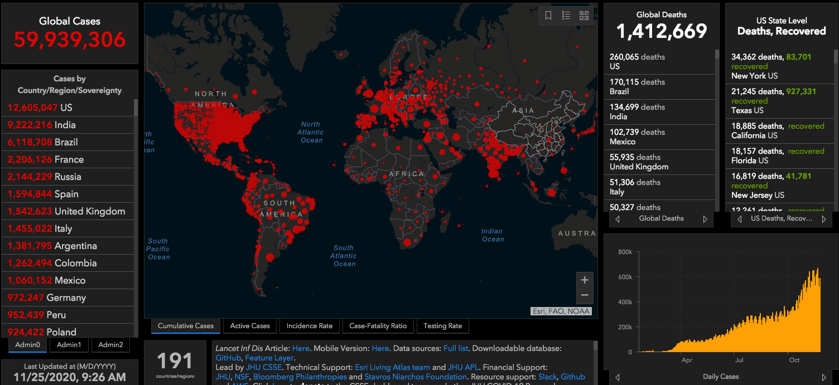
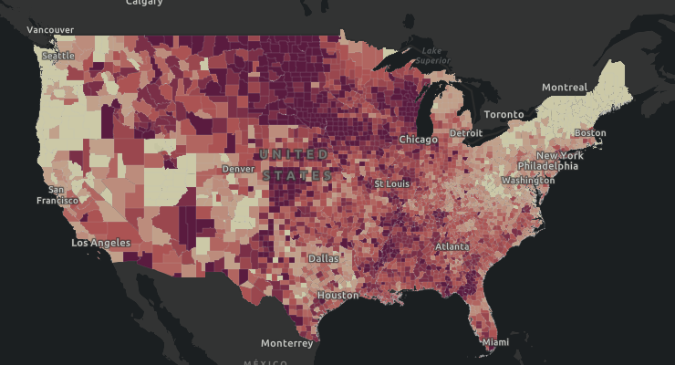
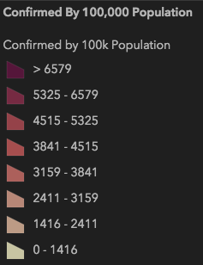
Epidemiology
March 17, 2020
November 25, 2020
https://coronavirus.jhu.edu/map.html

Slide 5

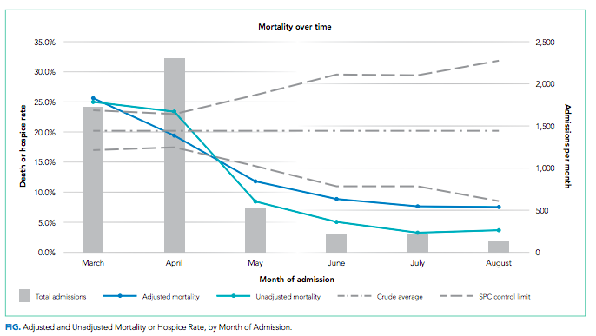
Differences from spring surge
Lower mortality rate
  Confirmed reasons: more infections are among younger people
  Speculated reasons
    Lower viral inoculates due to better masking
    Partial immunity
    Better treatments available (vs fewer harmful treatments?)

Slide 6
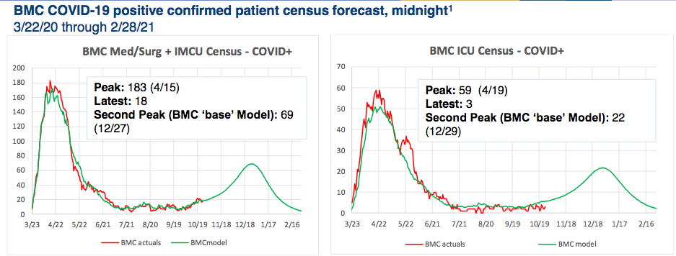
BMC projections

Slide 7

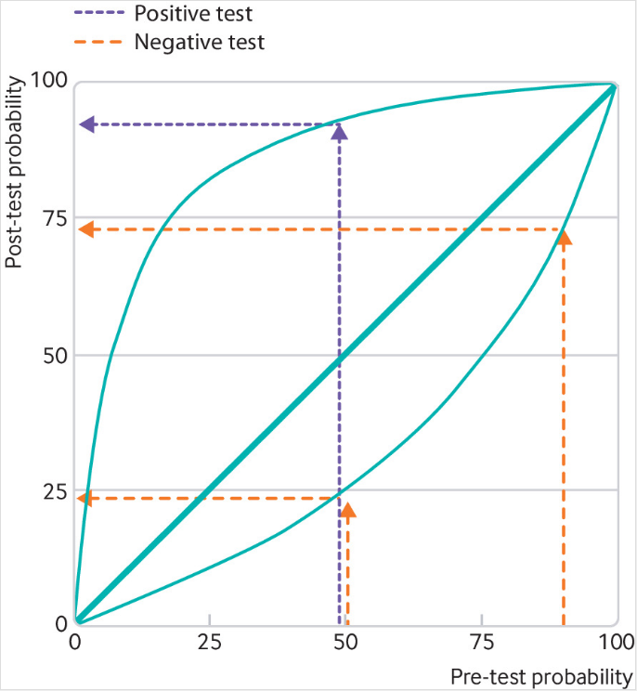
Testing for COVID-19
NAAT tests for COVID-19 have estimated false negative rate 2-29%³
  Factors that influence it include quality of specimen,
IDSA recommends nasopharyngeal, mid-turbinate, or nasal specimens over oropharyngeal
COVID-19 diagnostics in context. Weissleder R, Lee H, Ko J, Pittet MJ Sci Transl Med. 2020;12(546)
Occurrence and Timing of Subsequent SARS-CoV-2 RT-PCR Positivity Among Initially Negative Patients. Long DR, Gombar S, Hogan CA, Greninger AL, O'Reilly-Shah V, Bryson-Cahn C, Stevens B, Rustagi A, Jerome KR, Kong CS, Zehnder J, Shah NH, Weiss NS, Pinsky BA, Sunshine J Clin Infect Dis. 2020
³Arevalo-Rodriguez I, Buitrago-Garcia D, Simancas-Racines D, et al. False-negative results of initial RT-PCR assays for covid-19: a systematic review. medRxiv

Slide 8

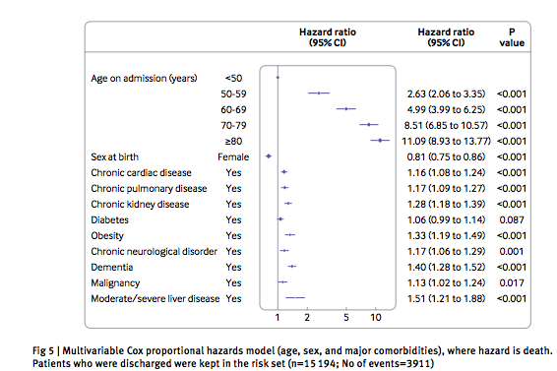
Risk Factors for Serious COVID Infection
Other
Blood group: highest risk of infection in blood group A, lowest in blood group O
Pregnancy: increased risk of ICU admission, intubation, ECMO, and death
Non-white
Socioeconomic disadvantage

Slide 9
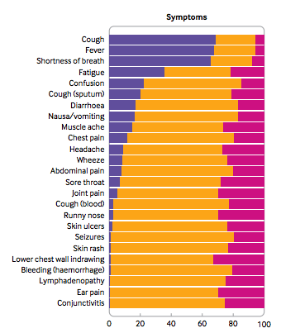
Clinical Presentation: Symptoms

Slide 10
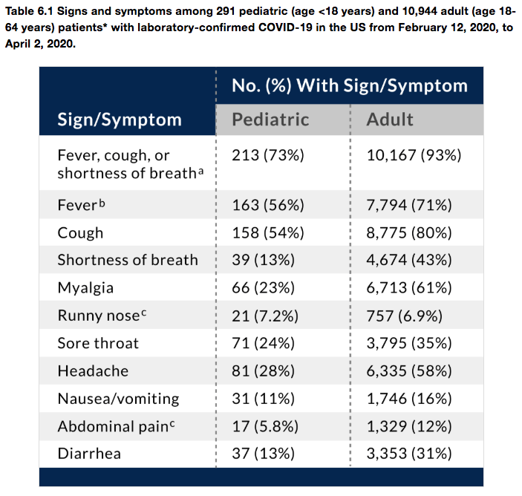

Clinical presentation: US COhort

Slide 11
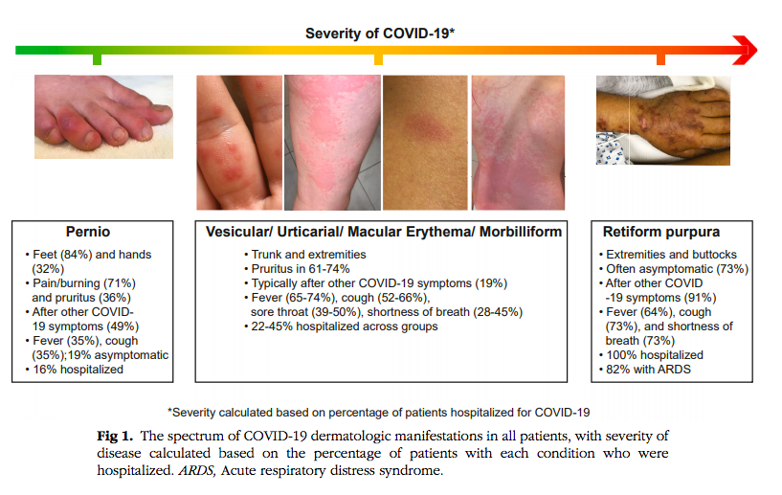
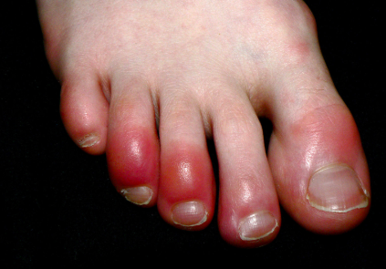
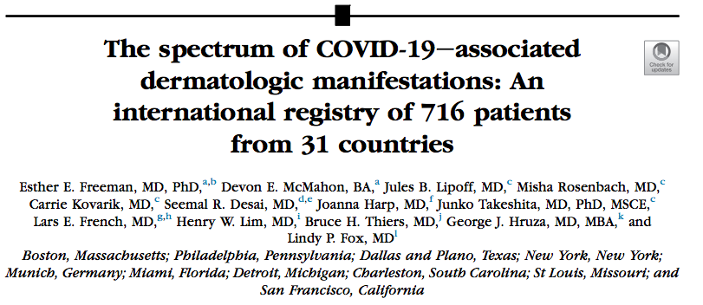
Atypical presentation
Neurologic
  Encephalopathy, agitation/confusion
  Corticospinal tracts
  Motor/sensory deficits, ataxia
  Seizures
  Acute stroke
Dermatologic
  Chilblains

Slide 12
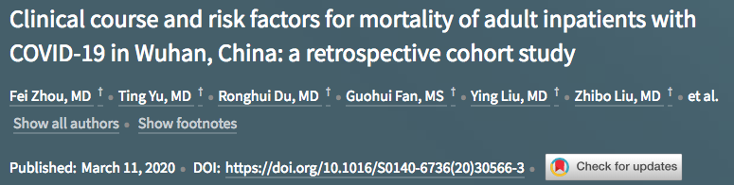
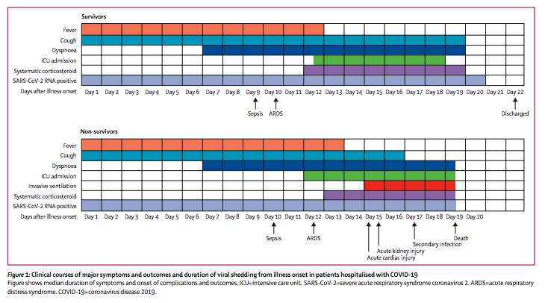

Slide 13
Who should be admitted?
Working Draft of BMC ED Admission Guidelines
Medical
  Any dyspnea* or RR > 30
  Any pt with O2 sat < 94% on RA or PaO2/FiO2 < 300 mmHg
  Clinical concern for risk of outpatient failure based on high-risk status
    Age > 65, serious CV disease, COPD or other pulmonary dz, DM, malignancy, BMI > 30, CKD, immunocompromised (solid organ transplant, recipient of immunosuppression, pregnancy, sickle cell disease), asthma (moderate to severe), CVA
Social
  Have reliable phone number and follow-up
  Ability to follow self-isolation recommendations
  No household members who are pregnant, immunosuppressed, or have hx ESRD

Slide 14
Treatment: IDSA Guidelines
Hydroxychloroquine (+/- azithromycin): NOT recommended
Remdesivir: recommended only for severe disease (hospitalized patients with saturation < 94% on RA)
  Limitations: use with caution in GFR < 30 (removed by dialysis)
  Side effects: nausea/vomiting, elevation AST/ALT
Dexamethasone: recommended only for severe disease (hospitalized patients with saturation < 94% on RA)
Biologics: research purposes only
  IL-1 inhibitors (Anakinra)
  IL-6 inhibitors (tocilizumab, sarilumab)
  Jak-kinase inhibtors (baricitinib)
  Spike protein neutralizing antibodies (bamlanivimab)
Convalescent plasma: research purposes only
Source: https://www.idsociety.org/practice-guideline/covid-19-guideline-treatment-and-management/#toc-10

Slide 15
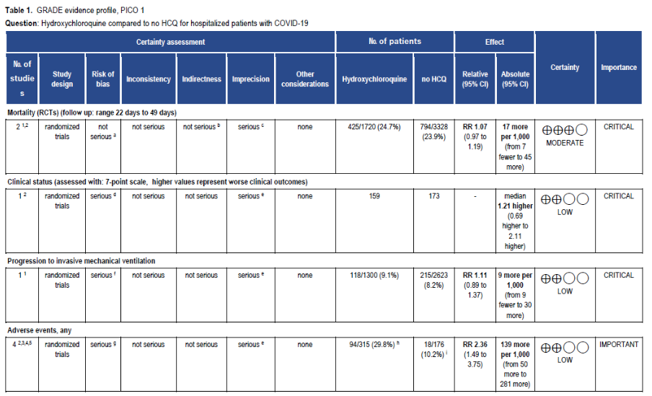
Hydroxychloroquine

Slide 16
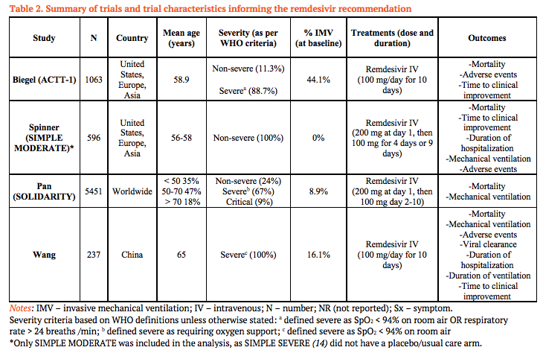
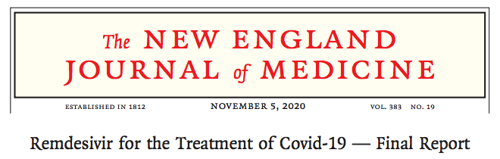

Remdesivir (1)

Slide 17
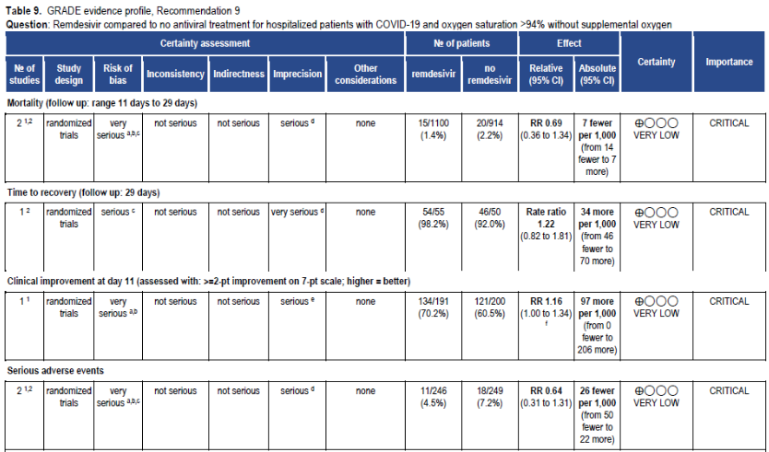
Remdesivir: Non-severe disease

Slide 18
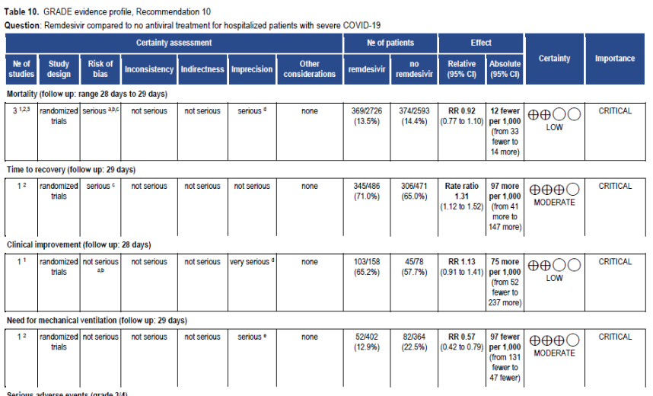
Resmdesivir: severe disease

Slide 19
baricitinib
ACTT-2: double-blind placebo controlled RCT for use of baricitinib in combination with remdesivir
  Reduced recovery time by 1 day within 29 day after initiating treatmnted (vs placebo)
  7 days vs 8 days, p=0.047 (CI 1.00-1.1)
  Mortality rate by date 29: 4.7% intervention group vs 7.1% placebo group (non-significant)
  Baricitinib increases risk of thrombosis
  FDA approved for Emergency Use Authorization on 11/19/2020
  Not currently recommended given relative safety of dexamethasone

Slide 20
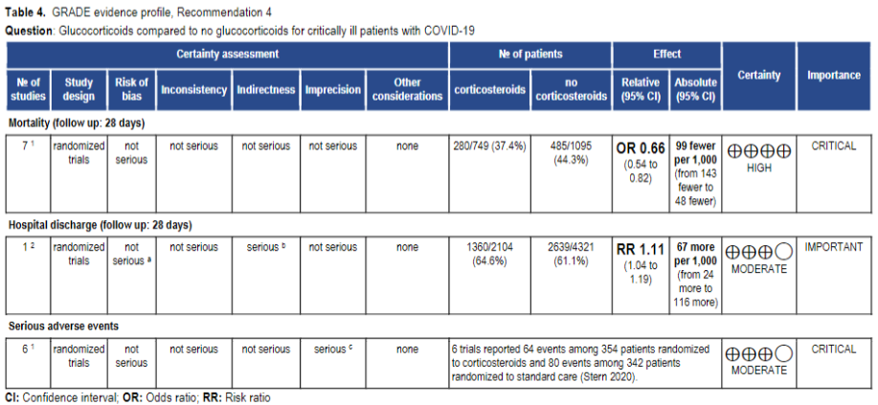
Dexamethasone: critically ill

Slide 21
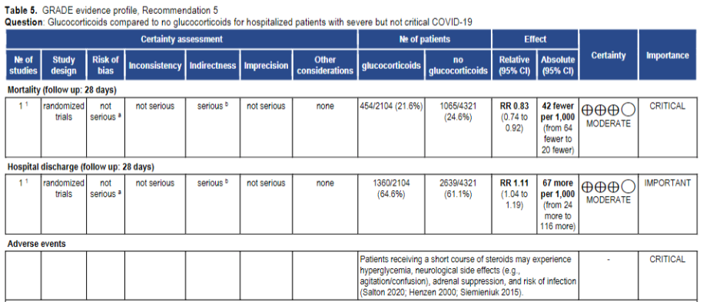
Dexamethasone: non-severe disease

Slide 22
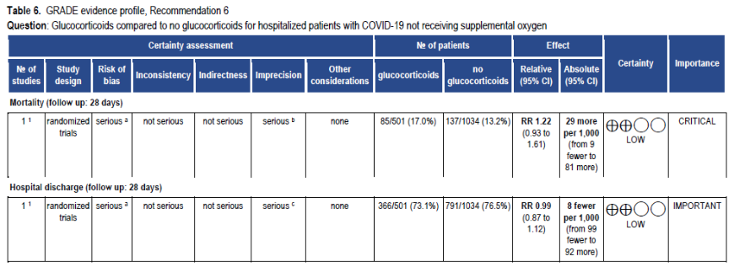
Dexamethasone: No oxygen requirement

Slide 23
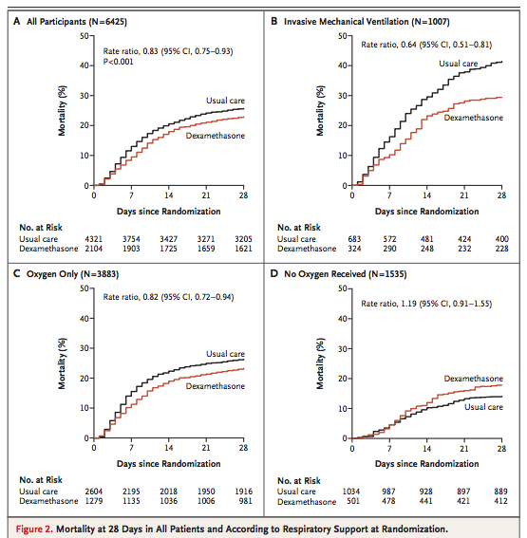
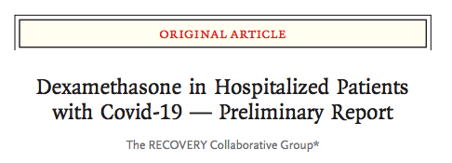

Slide 24
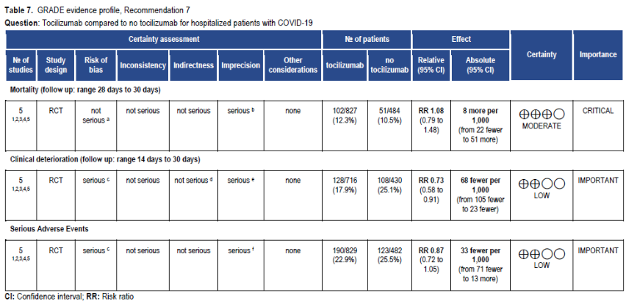
tocilizumab
https://www.idsociety.org/practice-guideline/covid-19-guideline-treatment-and-management
Notes:
Strong bias in studies because reduction in CRP is

Slide 25
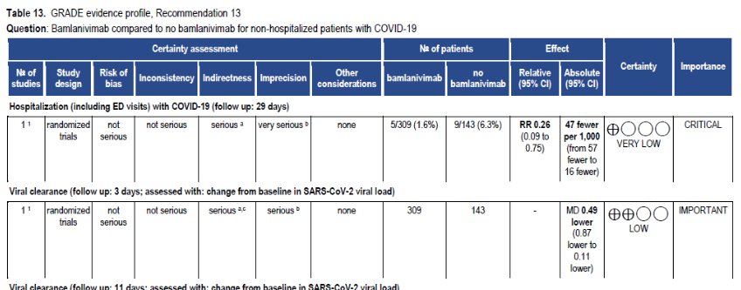
Bamlanivimab

Slide 26
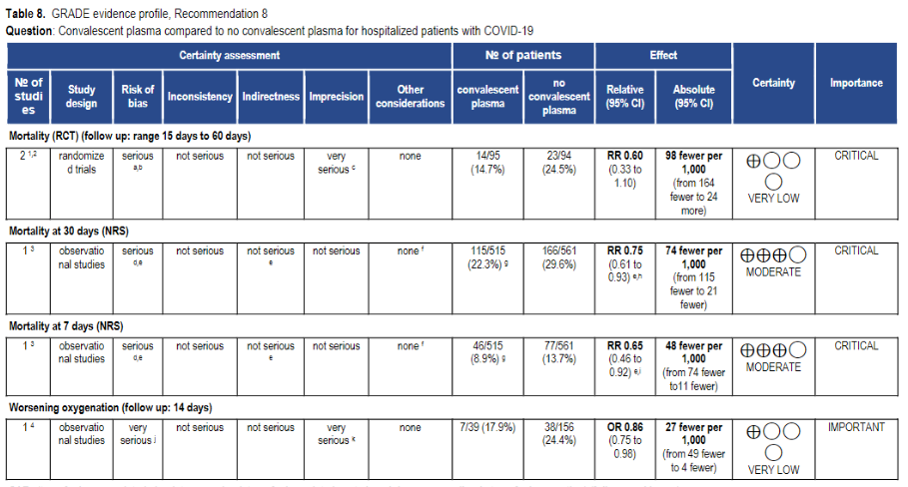
Convalescent plasma

Slide 27
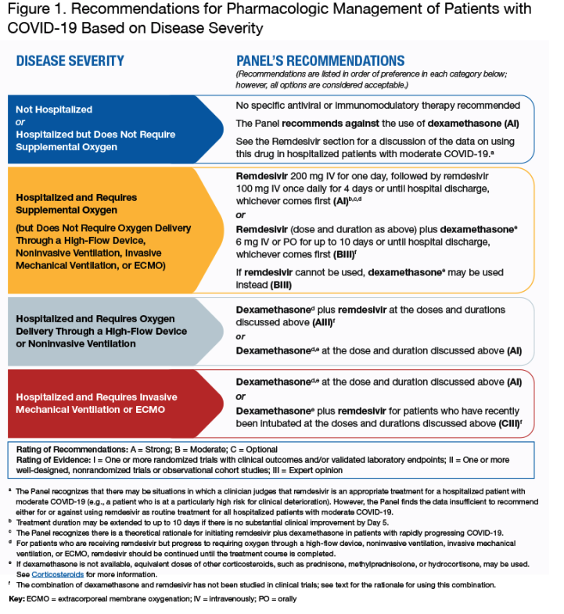
https://www.covid19treatmentguidelines.nih.gov/therapeutic-management/

Slide 28
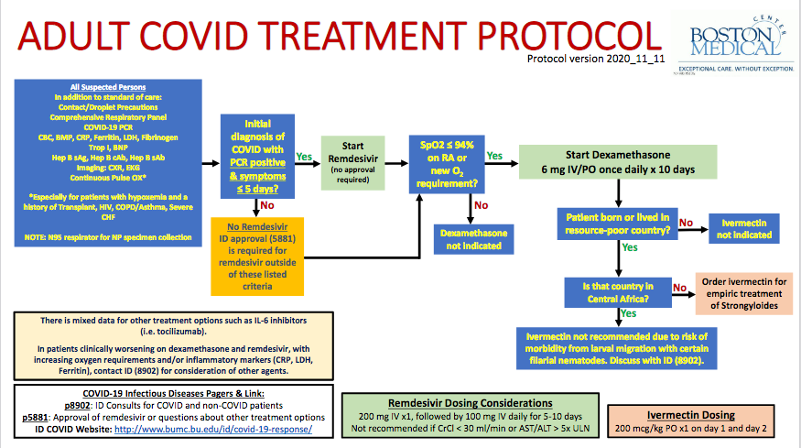
Notes:
G6PD testing
QTc monitoring

Slide 29
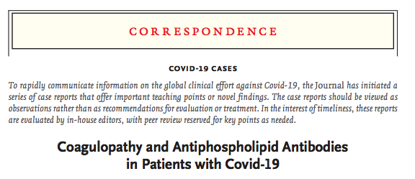
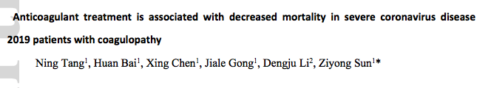
hypercoagulability
Elevated D-dimer correlates with risk of VTE and mortality
Antiphospholipids may be present
Cumulative incidence of thrombosis 31% (Klok et al 2020 Thrombosis Research)

Slide 30
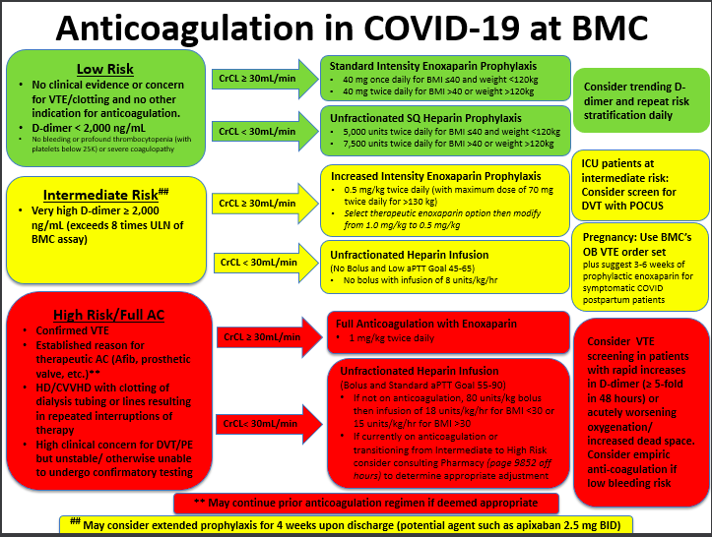

Slide 31
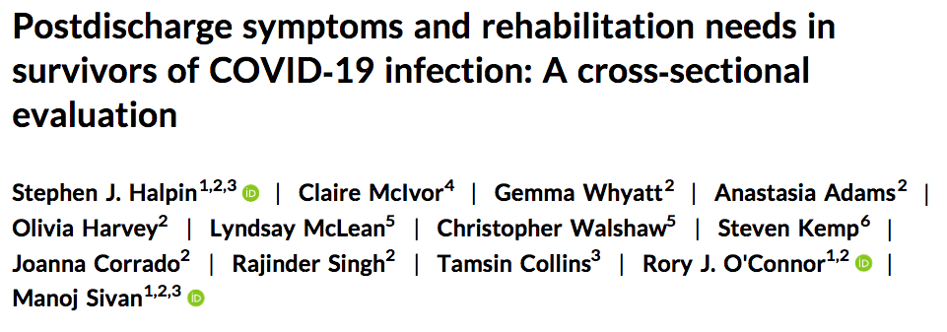
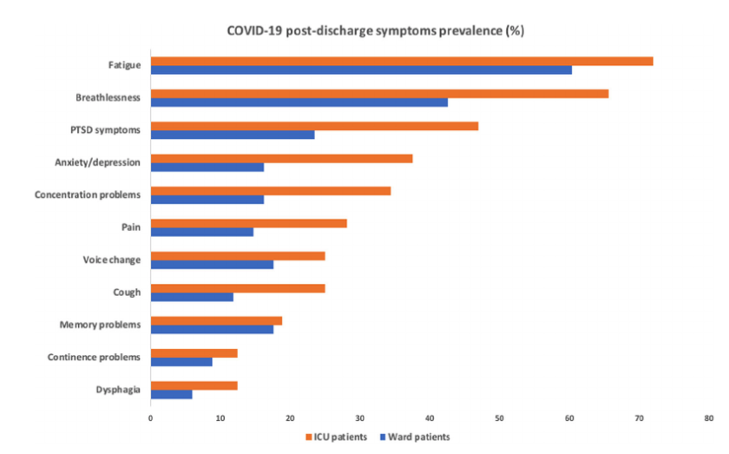
Post-covid syndrome
About 10% of patients have persistent symptoms post-COVID infection
Most common symptoms include fatigue, cough, dyspnea, arthralgias, chest pain
More common in older patients and those with multiple medical comorbidities
  57% of patients with > 3 chronic conditions reported they had not yet returned to baseline health status (median interview time 16 days post-confirmed positive)

Slide 32
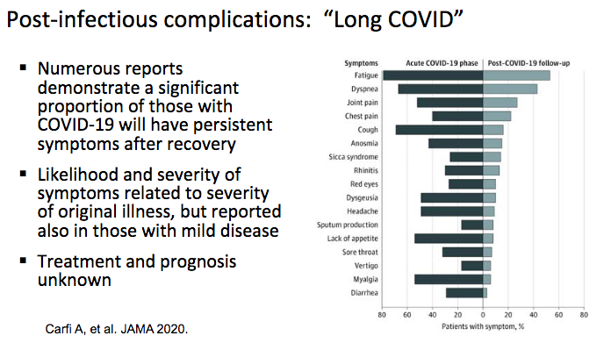
Post-covid syndrome (2)

Slide 33
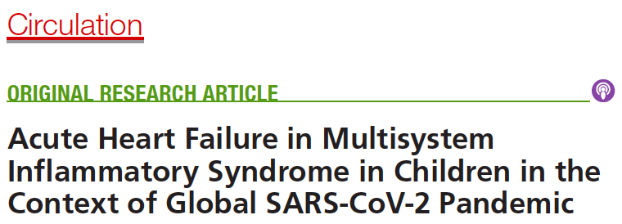
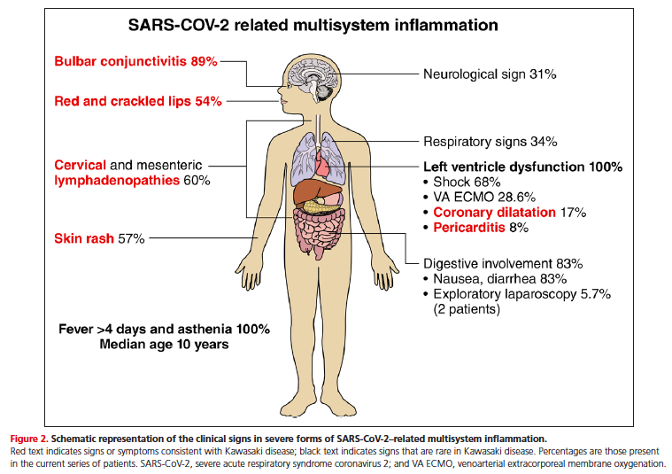
Multisystem inflammatory syndrome

Slide 34

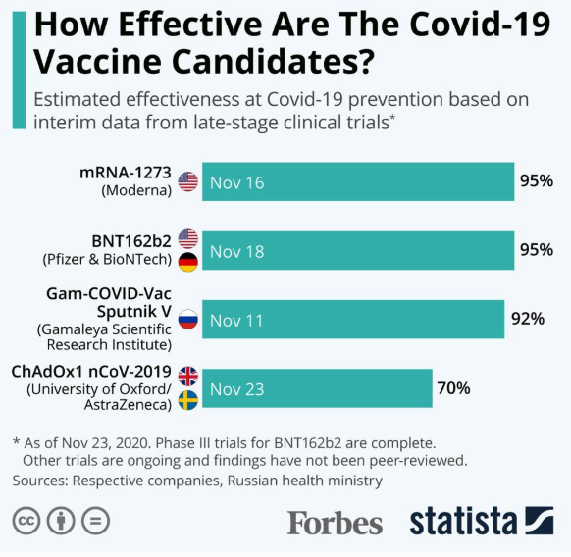
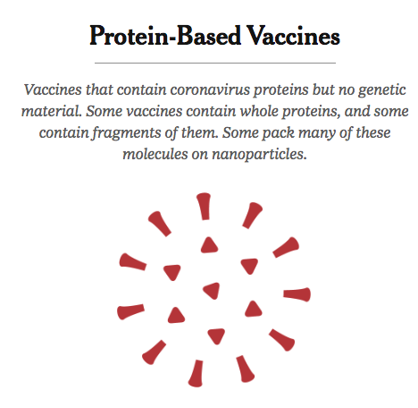
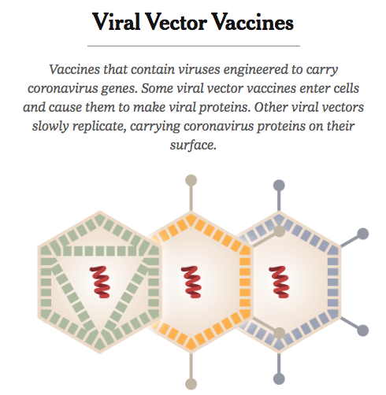


Covid-19 vaccines

Slide 35
Thank you
All of you for helping BMC care for COVID and non-COVID patients alike
DFM leadership
Hospitalist Medicine Group, General Internal Medicine, and residents/fellows who have joined inpatient COVID teams

Slide 36
questions

