Slide 1
Helicobacter Pylori Infection
Jaime Gallegos, MD
Infectious Disease

Slide 2
Disclosures
I Have no disclosures to report

Slide 3
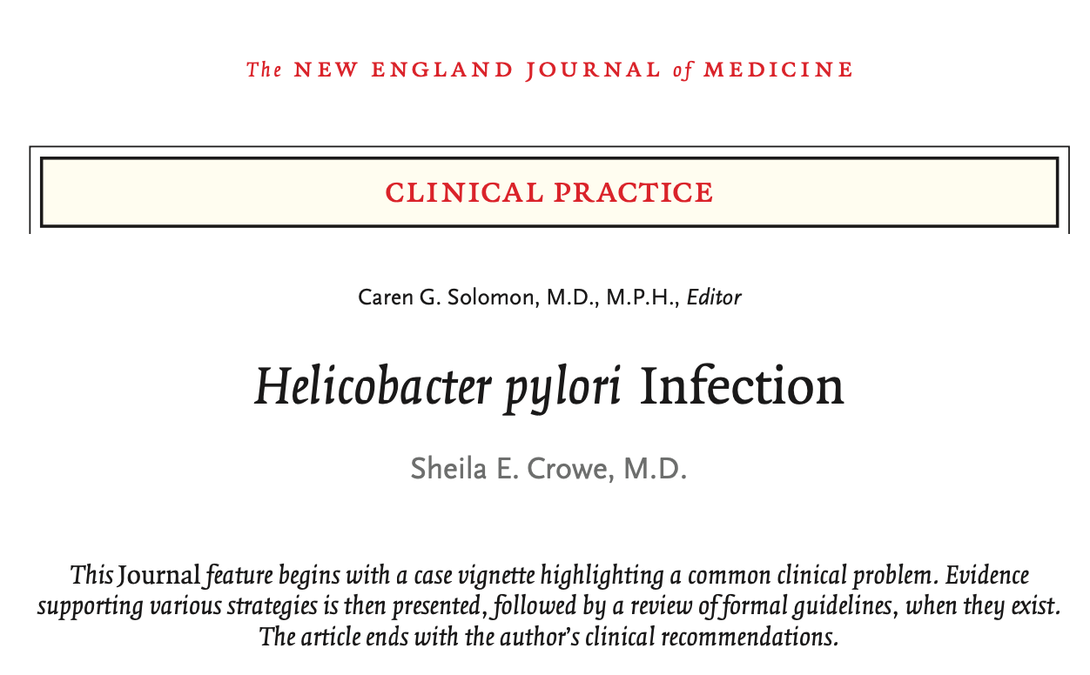
Helicobacter pylori
Recent review N Eng J Med 2019; 380: 1158-65
Notes:
This review article showed on this slide is from last year is from Dr. Sheila Crow, and is really a useful review, and will likely be helpful

Slide 4
Microbiology: Helicobacter pylori
Gastric Mucosa
Spiral-shaped
Flagellated
Non-Invasive
Agar
Slow-growing (3-7 days)
Gram negative rod
Microaerophilic (5%O₂)
  Catalase +
  Oxidase +
  Urease + → Survival
  Urea→CO₂+NH₃→↑pH Colonization
  Diagnostic testing
First isolated in 1982
Nobel Prize
(Marshall & Warren, 2005)
2010. NEJM. McColl. H. pylori infection
Notes:
Lets talk about the organism itself, is a spiral shaped bacteria, it has flagella, so it is motile, and it is not invasive
First isolated in 1983, and the fox that discovered this relationship between Helicobacter, and ulcer disease won a Nobel Prize for the work
“The first isolation of H. pylori in pure culture and recognition of its association with gastritis and peptic ulcer disease led to the awarding of the Nobel Prize in Medicine in 2005 to Barry Marshall and Robin Warren, two physicians in Australia.”
This is a slow growing organism, gram negative rod, and does have a curve appearance, it is catalase +, and oxidase +, and something that is really important to know is that it is urease +, and that means that it has the ability to make urease which can break down urea, into carbon dioxide, and ammonia, and this then increase the ph around the bacteria, which allow hims to survive in an acidic environment, helps it to colonize the stomach, and we take advantage of that, by using the production of carbon dioxide for example as a way to diagnose this with a breath test for example

Slide 5
Question
A young woman undergoes upper endoscopy for unexplained nausea, and vomiting.
  The stomach appears normal.
  Surveillance gastric biopsies are taken and the gastric biopsies urease test is positive. The biopsies are most likely to show:
  Helicobacter pylori organism, but no gastric or esophageal inflammation
  Helicobacter pylori organism plus gastric inflammation (gastritis)
  Helicobacter pylori organisms plus esophagitis
  Neither Helicobacter pylori organisms, nor inflammation because the urease test is often false positive with a normal endoscopy
Notes:
So here is a question
Answer B
h pylori produce gastritis

Slide 6
Question
A young woman undergoes upper endoscopy for unexplained nausea, and vomiting.
  The stomach appears normal.
  Surveillance gastric biopsies are taken and the gastric biopsies urease test is positive. The biopsies are most likely to show:
  Helicobacter pylori organism, but no gastric or esophageal inflammation
  Helicobacter pylori organism plus gastric inflammation (gastritis)
  Helicobacter pylori organisms plus esophagitis
  Neither Helicobacter pylori organisms, nor inflammation because the urease test is often false positive with a normal endoscopy
Notes:
And I tell you the most correct answer is B
We will go over that

Slide 7
Helicobacter pylori: Key points
Humans are the only natural Helicobacter pylori host
Infects>50% of the world’s population
  US ~20-40%*
A leading chronic infections in humans, similar to dental caries
Majority are asymptomatic but all have chronic active gastritis
Severity of gastritis varies depending on the Helicobacter pylori strain & the host
*At greater risk, African Americans, Hispanics, Native Americans
2019. NEJM. Crowe. H. pylori infection
2010. NEJM. McColl. H. pylori infection
2017. Gut. Ho. Cumulative burden of inflammation
Notes:
This slide has some key points about helicobacter pylori
First of all, humans are the only natural host for this organism
Is very common, hp Infects half the world’s population, although in US is only around ~20-40%
And certain race ethnicities are more likely to be infected than others
African American, Hispanics, native americans for example have higher rates of colonization or infection with h. pylori
This is a leading cause of chronic infections in humans, similar in that regard to dental caries
THE majority of people who are infected with h pylori are asymptomatic but very interesting all have chronic active gastritis, and that is an important point. Which is why the answer to that question, is that you see gastritis,if you tested positive and saw organism
Severity of gastritis varies depending on the particular strain of Helicobacter pylori strain & the host factors

Slide 8
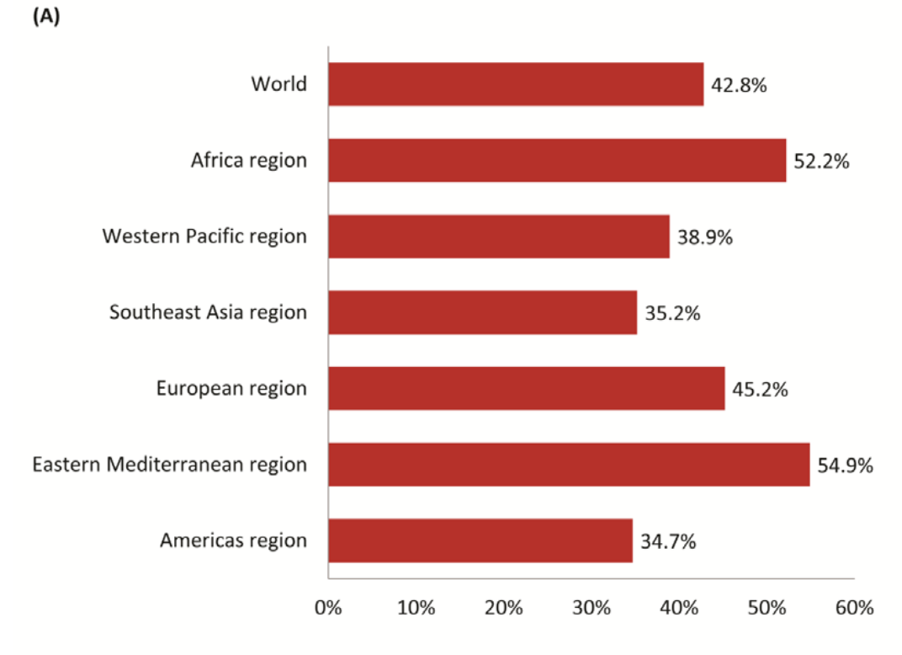
Epidemiology
Updated global prevalence of H. pylori infection: Prevalence of H. pylori in adults
2020. Gut. Liou. Screening and eradication of Helicobacter pylori for gastric cancer prevention: The Taipei global consensus

Slide 9
Question
What is the most likely source for humans to acquire H. pylori infection?
Perinatally from mother
Ingestion of raw vegetables
Ingestion of undercooked meat
Ingested tap water from a municipal source
Contact with infected secretions from another human
Notes:
E

Slide 10
Question
What is the most likely source for humans to acquire H. pylori infection?
Perinatally from mother
Ingestion of raw vegetables
Ingestion of undercooked meat
Ingested tap water from a municipal source
Contact with infected secretions from another human
Notes:
E

Slide 11
Transmission of Helicobacter pylori
Exact route of transmission is not known
Likely fecal-oral or oral-oral
Intra-familial spread- (person to person, especially mother-to-child)
Low socioeconomic status, poor sanitation, crowding associated with increase transmission
1999. JAMA. Parsonnet. Fecal & Oral sheeding of Hp
2019. NEJM. Crowe. H. pylori infection
Up-to-date (2020)
Notes:
Lets talk about transmission, so we do not know totally known exactly how hp is transmitted
But it sure does appear to be fecal-oral or oral-oral, and there is evidence of Intra-familial spread- (person to person, especially mother-to-child)
Low socioeconomic status, poor sanitation, crowding associated are all associated with increase transmission

Slide 12
Disease paths for Helicobacter pylori infection
Asymptomatic gastritis 85-90%
Peptic ulcer (DU, GU) 1-10%
Gastric cancer 0.1-3%
MALT lymphoma <0.01%
DU, duodenal ulcer
GU, gastric ulcer
MALT, mucosal-associated lymphoid tissue
2002, NEJM. Helicobacter pylori Infection
2017. Gut. Ho. Cumulative burden of inflammation
Notes:
So what diseases are associated with hp infection
First and foremost is asymptomatic gastritis
Second is peptic ulcer disease, duodenum, and stomach
Gastric cancer is also, but is less common.
Far less common but still strongly associated with Hp infection,

Slide 13
Helicobacter pylori; disease associations
#1 cause chronic gastritis
PUD: 95% DU, 70% GU
MALT lymphomas (72-98%)
Gastric cancer (60-90%)*
Iron deficiency anemia, B12 deficiency, ITP
Eradication Helicobacter pylori neither causes nor exacerbates GERD
  Helicobacter pylori possibly reduces risk for Barrett’s esophagus/esophageal CA
Helicobacter Pylori is classified by WHO as a Class 1 carcinogen
MALT: Mucosal-associated lymphoid tissue
* all gastric cancer
Helicobacter pylori Causal
2017, GUT, Maastricht V.
2020, Infec Drug Resist, Kasahun GG
Notes:
As I mention before, hp is the number 1 cause of chronic gastritis
If you diagnosed pUD, and DU, hp is associated with those quite frequently
Malt lymphoma have an associated upwards that is 98% with hp
And gastric cancer somewhere between 60-90%
There are a collection of maladies that maybe associated with Hp and that are clearly not
Iron deficiency anemia, B12 deficiency, ITP, are all associated with Hp infection, but whether those are casual or not is not entirely clear
The other thing to know is that eradication Helicobacter pylori that is not affect GERD, and that is important;
In addition there is some evidence that been infected with Helicobacter pylori possibly reduces risk for Barrett’s esophagus/esophageal CA

Slide 14
Question
A 25 year old African American woman complains of 6 weeks of symptoms consistent with dyspepsia unrelieved by current use of antacids & OTC PPI.
The best approach to the diagnosis is of H. pylori infection in this patient is:
Immediate H. pylori serology
Immediate H. pylori stool antigen
Endoscopy with rapid urease test (RUT)
Immediate 13C Urea breath test
D/C PPI for 2 weeks then H. pylori stool antigen EIA
Notes:
Answer E, D/C PPI for 2 weeks then HP stool antigen EIA

Slide 15
Question
A 25 year old African American woman complains of 6 weeks of symptoms consistent with dyspepsia unrelieved by current use of antacids & OTC PPI.
The best approach to the diagnosis is of H. pylori infection in this patient is:
Immediate H. pylori serology
Immediate H. pylori stool antigen
Endoscopy with rapid urease test (RUT)
Immediate 13C Urea breath test
D/C PPI for 2 weeks then H. pylori stool antigen EIA
Notes:
Answer E, D/C PPI for 2 weeks then HP stool antigen EIA

Slide 16
Diagnosis of Helicobacter pylori Infection
Non Invasive (global) | Sensitivity | Specificity
Urea Breath Test (¹³C) | > 90->95% | > 90-95% | Live H. pylori
Stool Antigen (monoclonal) | > 90-95% | > 90-95% | Live & dead H. pylori
Serology | 85% | 79% | Detects Exposure
Biopsy-based (sampling error) | Sensitivity | Specificity
Urease test | 90% | 95% | 2-5 Bx recommended
Histology | 90-95% | 95-98%
Culture | 73% | 100% | Difficult
UBT considered “best test”
Use only monoclonal stool Ag tests
Histology requires 104 organism to visualize
2012, BMJ, Braden
Notes:
Lets talk about diagnostic
Right now there are two main diagnostics test that are use commonly
One is the urea breath test, which takes advantage of the ability of urease produce by Hp to cleave radiolabeled urea, into carbon monoxide that is stil radiolabeled, and this can be detected in the breath
Stool ag that use a monoclonal ab is also very sensitive, and specific but this can detect both life and death
Serology testing really does not have an important role, other than just epidemiology, because just detect exposure, and not necessarily active infection.
Urease test on bx are also quite sensitive and specific, if someone gets bx should get more than one done, 2-5
Histology is very sensi/spec
Culture poorly sensitive, highly specific

Slide 17
Testing Limitations for Helicobacter pylori
PPI
Antibiotics
Bismuth
Bleeding
Interfere with
All Helicobacter pylori tests
False negatives due to decrease Helicobacter pylori burden
Recommend delay diagnostic testing until:
PPI stopped for 2-4 weeks (OTC antacids & H2RA do not affect UBT/SA testing)
Antibiotics, bismuth stopped for 4 weeks
Bleeding stopped for 4-8 weeks
2019. NEJM. Crowe. H. pylori infection
Up-to-date. 2018

Slide 18
Initial Diagnosis of H. pylori with Dyspepsia
Urea breath test (UBT)
  Test and treat in younger population (<60yo)
Stool antigen test (SAT)
Endoscopy mandatory if >60 yo or “Alarm symptoms or signs”:
  Unexplained iron-def anemia
  GI bleeding
  Unintended weight loss
  Palpable mass
  Severe abdominal pain
  Persistent vomiting
  Progressive dysphonia/odynophagia
2019. NEJM. Crowe. H. pylori infection
Up-to-date. 2018
Notes:
So in terms of initial dx, if someone is under 60, and does not have alarm symptoms they can be tested with a UBT, and if positive then they can get treated
For older adults, where cancer, and others causes of ulcer disease maybe important to rule out other causes of dyspepsia, is recommended EGD
The listed ones are not typical for h.pylori

Slide 19
Question
Which of the following is the most appropriate next step for evaluating a 29 year old previously healthy but overweight male patient with typical retrosternal heartburn symptoms?
  Stool antigen test for H. pylori
  Urea breath test for H. pylori
  No testing for H. pylori
  Serological testing for H. pylori
  Empiric therapy for H. pylori regardless of testing
Notes:
Answer C

Slide 20
Question
Which of the following is the most appropriate next step for evaluating a 29 year old previously healthy but overweight male patient with typical retrosternal heartburn symptoms?
  Stool antigen test for H. pylori
  Urea breath test for H. pylori
  No testing for H. pylori
  Serological testing for H. pylori
  Empiric therapy for H. pylori regardless of testing
Notes:
Answer C

Slide 21
Explanation
H. pylori is not implicated as an etiological factor in gastroesophageal reflux disease
Treatment for (eradication of H. pylori) can increase the risk for Barret’s esophagus and esophageal adenocarcinoma
Serology is not recommended test for H. pylori anymore
2018, AJM, Siddique O, et al.

Slide 22
Question
A 23 year old Eastern European woman presents with persistent epigastric discomfort diagnosed as Helicobacter pylori + gastritis by endoscopy. Fecal Helicobacter pylori antigen is also positive. As a child, she was treated repeatedly with Penicillin/Amoxicillin for recurrent tonsillitis.
What do you recommend for therapy?
Clarithromycin+ Amoxicillin + PPI
Metronidazole+ erythromycin + PPI
Bismuth subsalicylate +TCN+ metronidazole +PPI
Metronidazole +Amoxicillin + PPI
PPI Therapy alone given her age
Notes:
Answer C: Bismuth Subsalicylate +TCN+ Metronidazole+PPI

Slide 23
Question
A 23 year old Eastern European woman presents with persistent epigastric discomfort diagnosed as Helicobacter pylori + gastritis by endoscopy. Fecal Helicobacter pylori antigen is also positive. As a child, she was treated repeatedly with Penicillin/Amoxicillin for recurrent tonsillitis.
What do you recommend for therapy?
Clarithromycin+ Amoxicillin + PPI
Metronidazole+ erythromycin + PPI
Bismuth subsalicylate +TCN+ metronidazole +PPI
Metronidazole +Amoxicillin + PPI
PPI Therapy alone given her age
Notes:
Answer C: Bismuth Subsalicylate +TCN+ Metronidazole+PPI

Slide 24
Question
After treatment of this patient for Helicobacter pylori gastritis, the Helicobacter pylori stool antigen test should repeated:
On the final day of H. pylori therapy
Two weeks after completion of H. pylori therapy
Eight weeks after completion of H. pylori therapy
The test should not be repeated to assess cure
Notes:
Answer: C

Slide 25
Question
After treatment of this patient for Helicobacter pylori gastritis, the Helicobacter pylori stool antigen test should repeated:
On the final day of H. pylori therapy
Two weeks after completion of H. pylori therapy
Eight weeks after completion of H. pylori therapy
The test should not be repeated to assess cure
Notes:
Answer: C

Slide 26
Questions: explanation
Clarithromycin resistance in Helicobacter pylori is really common in Eastern Europe
Repeated exposure to amoxicillin could increase risk for resistant Helicobacter pylori
Tetracycline is better than doxycycline
Test of cure should be done at least 4 weeks after therapy is completed
2019. NEJM. Crowe. H. pylori infection
Notes:
Clarithromycin resistance in Helicobacter pylori is common worldwide, but is really common in Eastern Europe
Also we got this hx of repeated exposure to amoxicillin and that could increase risk for resistant Helicobacter pylori
Tetracycline is better than doxycycline for eradication of hp
Test of cure should be done at least 4 weeks after therapy is completed

Slide 27
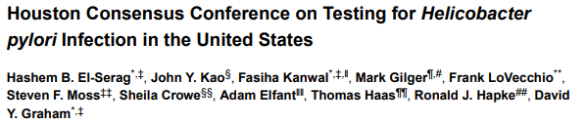
Who should be treated for H. Pylori infection?
“We recommend that all patients with active H. pylori infection be treated”
“infection causes chronic progressive damage to the gastric mucosa that in 20%-25% of individuals will result in life threatening clinical outcomes such as peptic ulcer or gastric cancer”
2018. Clin Gastroenterol. El-Sarag HB
Notes:
The next slides talks about who should be treated for hp and I get this from a consensus conferences published a couples of years ago.
Couple of quotes from this
“We recommend that all patients with active H. pylori infection be treated”
“infection causes chronic progressive damage to the gastric mucosa that in 20%-25% of individuals will result in life threatening clinical outcomes such as peptic ulcer or gastric cancer”

Slide 28
Who should be tested & treated for H. pylori infection?
Established Indications
PUD (Active/prior Hx)
MALT lymphoma
Atrophic gastritis
After gastric CA resection
1st degree relative/gastric Ca
Consider
Non-ulcer dyspepsia*
Use of NSAIDs/ASA
Long term PPI use
Fe deficiency anemia (unexplained)
ITP (low evidence base)
Live in high gastric cancer region
Asymptomatic Infection **
* Estimate~10% respond
** Goal: eradicate prior to atrophy or metaplasia. Treatment reverses atrophy but not metaplasia.
2019. NEJM. Crowe. H. pylori infection
2019. Am J Gast. Chey w
Notes:
The question is not which Hp patient should be treated, but really in whom should we look for infection
PUD (Active/prior Hx)
MALT lymphoma
Atrophic gastritis
After gastric CA resection
1st degree relative with gastric Ca
Softer
Consider
Non-ulcer dyspepsia*
Use of NSAIDs/ASA
Long term PPI use
Fe deficiency anemia (unexplained)
ITP (low evidence base)
Live in high gastric cancer region
Asymptomatic Infection **

Slide 29
Principles of Helicobacter pylori Therapy
Goal: To use a regimen with >90% therapeutic success
Ask about antibiotics exposure history (clarithromycin/Metronidazole/fluoroquinolones)
Discuss adherence
Use high dose PPI ( BID dose; increase gastric pH>4-5)
Longer (14 days) rather than shorter treatment courses
Combination drug therapy
Consider antibiotics resistance patterns & testing*
Outcome is determined:
Helicobacter pylori antibiotic sensitivity
Drug dosing
Treatment duration
Treatment compliance
Smoking inhibits therapeutic responses.
* Clarithromycin, metronidazole, levofloxacin
2016. Gastroenterology. Fallone CA
Notes:
You want to use a regimen with >90% rate success
* Omeprazole 40mg BID or equivalent, esomeprazole, rabeprazole, pharmacokinetics unaffected by CYP2C19 status
Prevention of Treatment Failures: Think about resistance
– Especially to clarithromycin, metronidazole, and levofloxacin
• Explain regimen & reinforce compliance
– Write it out for them, especially quad therapy
– Discuss side effects, and encourage patients to call before stopping it prematurely
• Consider sensitivity testing – after 2, 3, or 4 failed regimens?
– Increasingly available via commercial labs

Slide 30

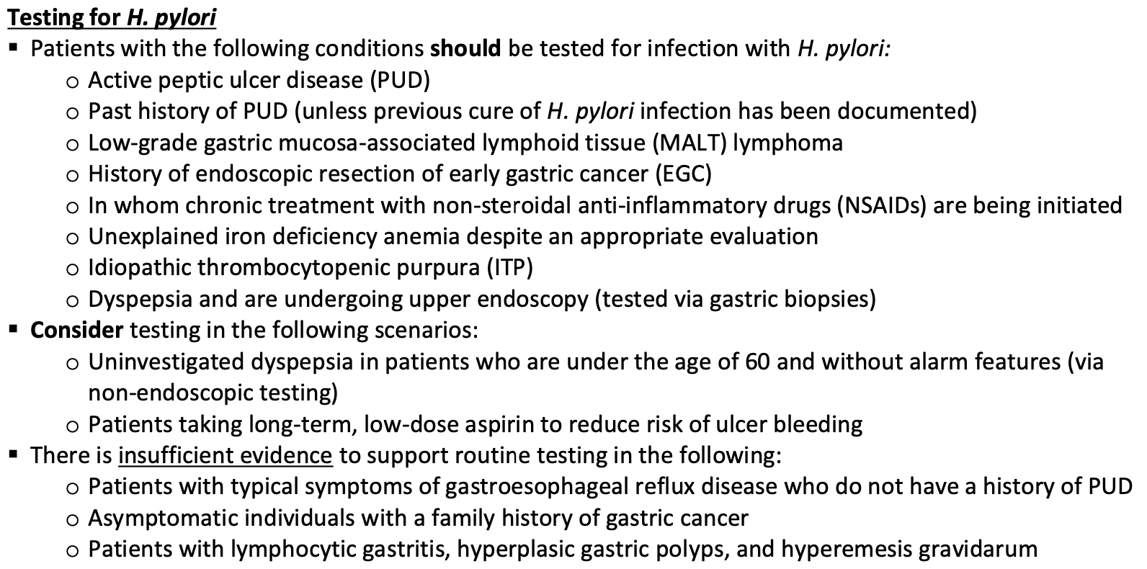

Slide 31
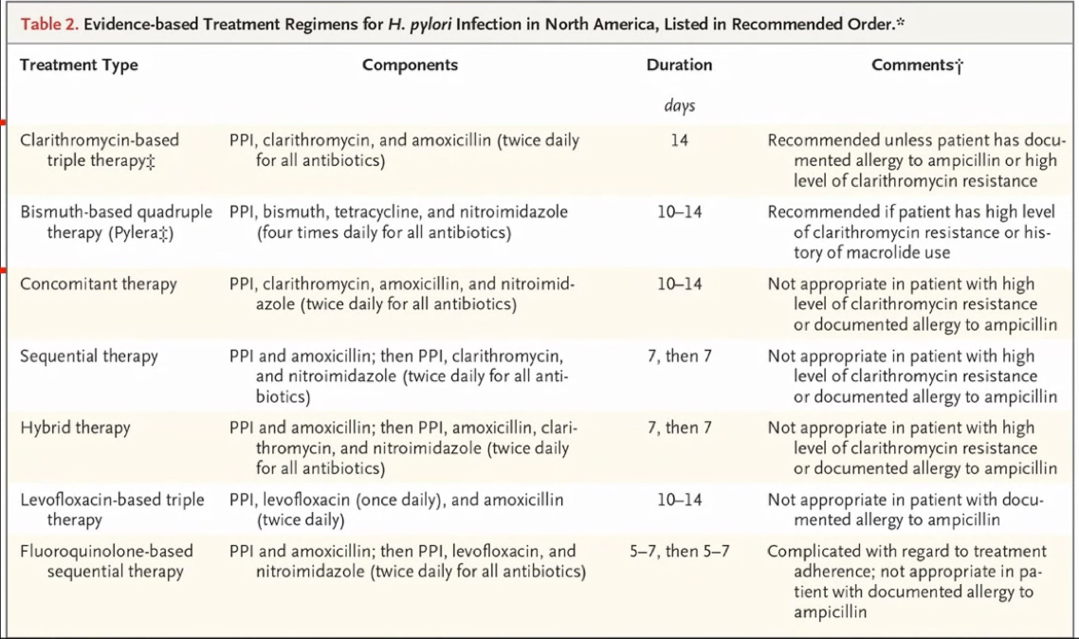
Evidence-based treatment regimens for H. pylori infection in North America
Listed in Recommend order
2019. NEJM. Crowe. H. pylori infection
2019. Am J Gast. Chey w
Notes:
This table, which I pulled from the review on the NEJM, is worth your self reviewing, it has a lot of different cocktails
But I think you need to know the main two
The first one is macrolide based triple therapy, unless someone I allergic to penicillin, or know of has high level of clarithromycin resistance in the area, or are know to be resistant
The second quadruple bismuth base cocktail, as a bismuth, tetracycline, PPI, nitroimidazole (which is metronidazole)
Treatment consists of a combination of antimicrobials and often includes an agent to diminish gastric acidity.
Macrolide based triple therapy
Quadruple, bismuth based quadruple therapy

Slide 32
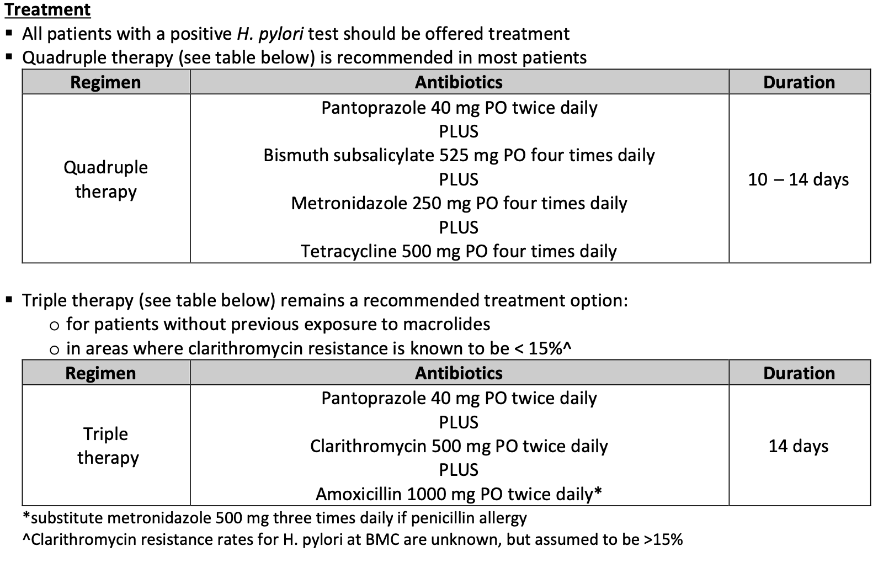
Notes:
Limited information on H. pylori resistance in the US assume clarithromycin resistance is > 15% unless local resistance is known
Macrolide use is common and patients don’t remember if they have taken it in their lives
Generally avoid “triple therapy”
Bismuth “quad therapy” increasingly used as 1st line

Slide 33
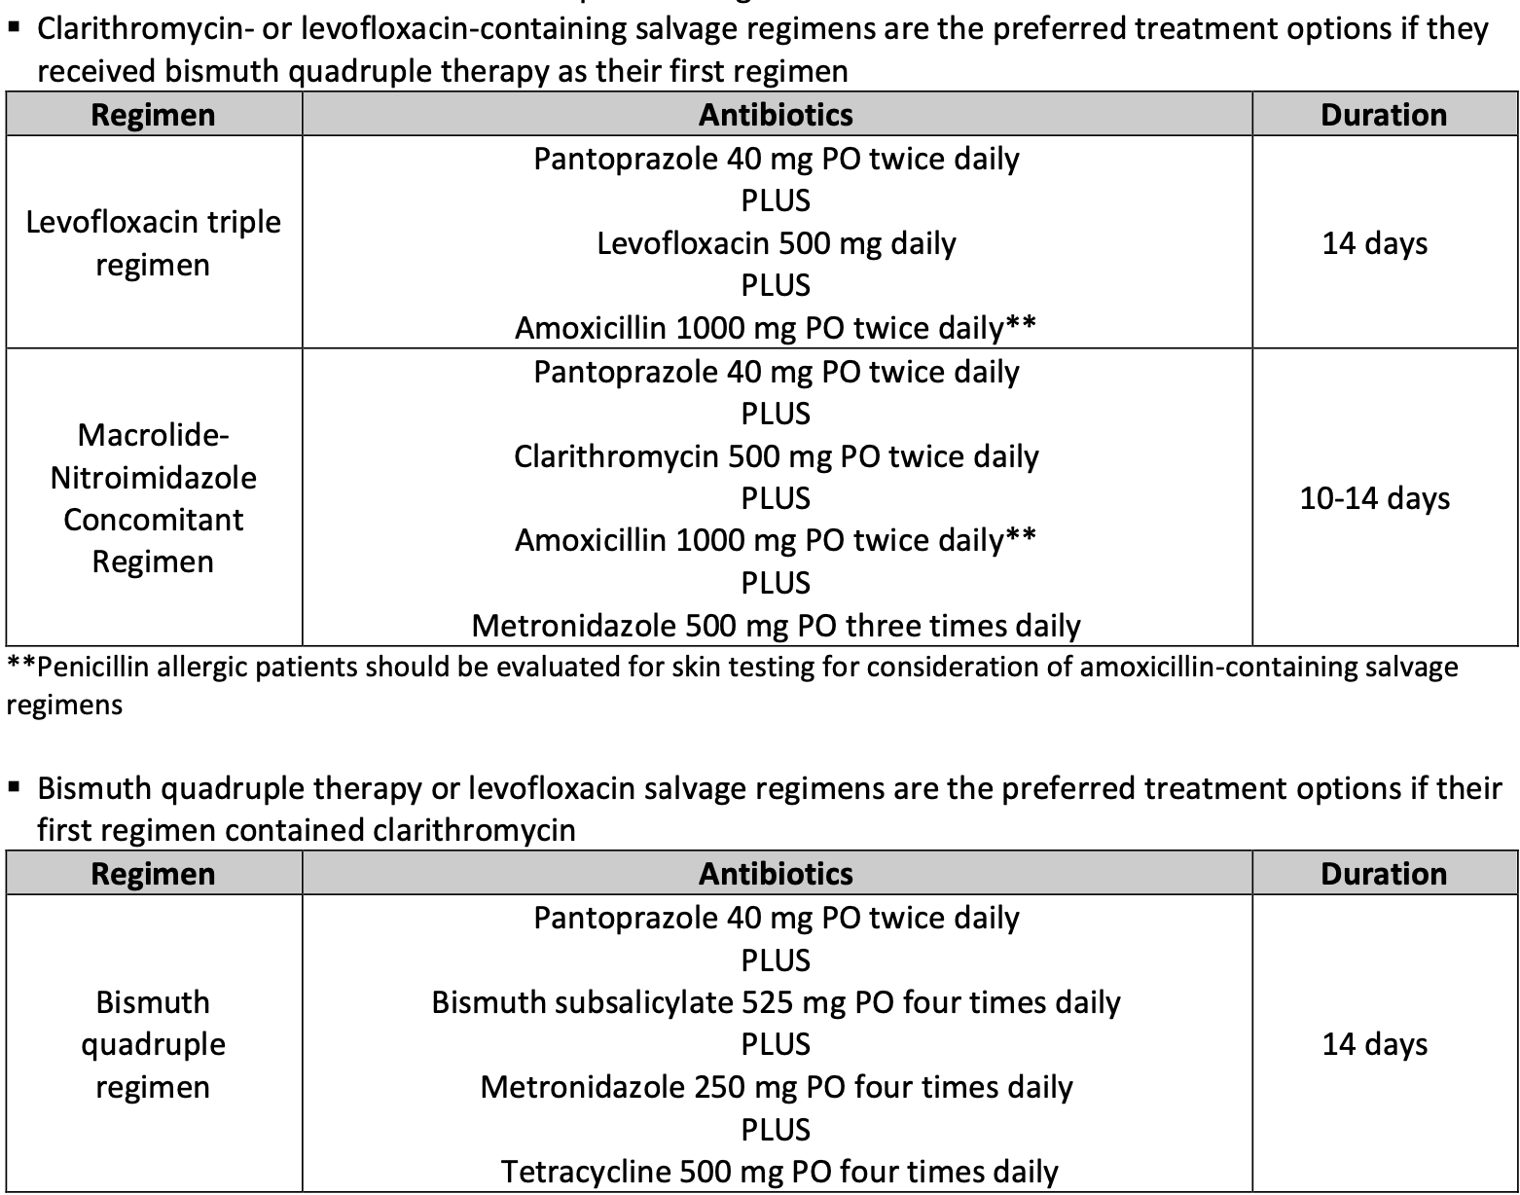
Notes:
Consider Penicillin Allergy Testing:
Most patients with a history of penicillin (PCN) allergy do not have true PCN hypersensitivity
– 5-10% of US population report PCN allergy→90% have negative skin testing and can tolerate PCN
Consider referral for allergy testing after failure of a first-line treatment to see if an amoxicillin-containing regimen can be given

Slide 34
H. Pylori & Antimicrobial Resistance
Amoxicillin Low (<5-10%)
Tetracycline Low (<5-10%)
Clarithromycin High (10-50%)
Metronidazole High (10-80%)*
Levofloxacin High? (5-30%)
Query antibiotic history: clarithromycin, quinolones & metronidazole
Rates of resistance shows substantial geographic differences.
Prior, even distant, antibiotic history can inform likelihood of Helicobacter pylori antibiotics resistance.
* Nitroimidazole resistance may be overcome by increased dosing (>1500 mg/day)
NOTE: treatment with amoxicillin&tetracycline yields low responses rates.
2016, Aliment Pharmacology Therapy
2017, Gut, Maastricht V.
2020, Infec Drug Resist, Kasahun GG
Notes:
In terms of antimicrobial resistance, is really the macrolides, metronidazole, and fluoroquinolones that are gaining resistance world wide
Amoxicillin, tetracycline remain low, but the combination of just those two drugs does not really work.
In general:
– Clarithromycin, metronidazole, and fluoroquinolones should not be used again due to concern for resistance
– Amoxicillin and tetracycline can often be reused as resistance is rare
An increasing proportion of strains show resistance to antibiotics. Knowledge of antimicrobial susceptibility allows optimization of treatment regimens.

Slide 35
Management Issue:
Test of Cure for H. pylori Infection
Stool antigen test Perform > 4 weeks post-rx *
Urea breath test Perform > 4 weeks post-rx
  Some recommend testing 6-8 weeks post-rx
  Endoscopy required if gastric ulcer, for example
  * FDA-Approved
2017, Gut, Maastricht V.
Notes:
Prevention of Treatment Failures
Think about resistance
– Especially to clarithromycin, metronidazole, and levofloxacin
• Explain regimen & reinforce compliance
– Write it out for them, especially quad therapy
– Discuss side effects, and encourage patients to call before stopping it prematurely
• Consider sensitivity testing – after 2, 3, or 4 failed regimens?
– Increasingly available via commercial labs

Slide 36
Key Takeaways
How to diagnose
In most: Stool Helicobacter pylori antigen test, UBT
If >60 years old or alarm symptoms or signs, then endoscopy is mandatory

Slide 37
Key Takeaways
How to treat:
Triple or quadruple therapy
Increasing emphasis on antibiotic resistance testing
  Fecal or biopsy genotypic testing for clarithromycin resistance
  MIC testing for clarithromycin, nitroimidazole, FQ resistance

Slide 38
Key takeaways
How to follow
TOC mandatory (Stool Hp antigen test, UBT)
At least 4 weeks after completion of therapy

Slide 39
Common Treatment Questions
Substitute doxycycline for tetracycline: Probably Not
Substitute Azithromycin for clarithromycin: probably not
PCN allergic patient:
  Clarithro/Metro/PPI (Low clarithro resistance)
  Quadruple Therapy (High clarithro resistance
  Levofloxacin/Clarithromycin/PPI (second line)
HIV –infected patient on protease inhibitors
  Dose adjust clarithromycin
  Quadruple therapy

Slide 40
Tetracyclines
Food may reduce absorption by 50%
Should not be administered concurrently with foods or drugs containing divalent or trivalent cations (i.e. antacids, sucralfate, didanosine, multivitamins)
  Separate administration from bismuthol by two hours
Chronic ethanol ingestion
Diuretics, oral anticoagulants, oral contraceptives

Slide 41
Thanks

