Slide 1
Topic | Person | Time | format
Current Data mAb Therapies & BMC system oral antivirals & Risk stratification | Charlie Jai Marthe Charlie Charlie | 5 min 5-10 min 10 min | Lecture/case
Vaccinations | (Charlie) | 5 min | Panel + slide
Testing & follow up | Cheralyn SBCHC Ian H Codman | 5 min 5 min | Panel + slides (if desired)
Outpatient care – ILI clinics Access and TH and Employee health | Jaime (Charlie) (+/- Jason Worcester) | 5 min | Panel + slide
Triage and ED considerations | Charlie | 3 min | Panel + slide
Inpatient | Kirsten A. | 5-7 min | Panel + slide
Wrap up & Q/A | Charlie | <2 min

Slide 2
Caring for Communities in a pandemic
COVID-19 Update #4: treatments and challenges
Charles Telfer Williams, MD; Kirsten Austad, MD; Jai Marthe, MD; Jason Worcester, MD; Cheralyn Johnson, NP; Ian Huntington, MD; Jaime Gallegos, MD; Aimee Williams,MD
BU Family Medicine Grand Rounds
1/18/2022

Slide 3
Objectives
At the end of the presentation, you will be able to:
State current Community data on COVID19 and Omicron variant
Discuss current COVID ambulatory Treatments
Describe the effectiveness of COVID-19 Vaccines
Articulate current challenges, adaptations / best practices for COVID-19 care for: testing, ambulatory care, healthcare workers & management of hospitalized patients

Slide 4
Novel Monitoring approaches
https://www.mwra.com/biobot/biobotdata.htm (accessed 11/30/2020)

Slide 5
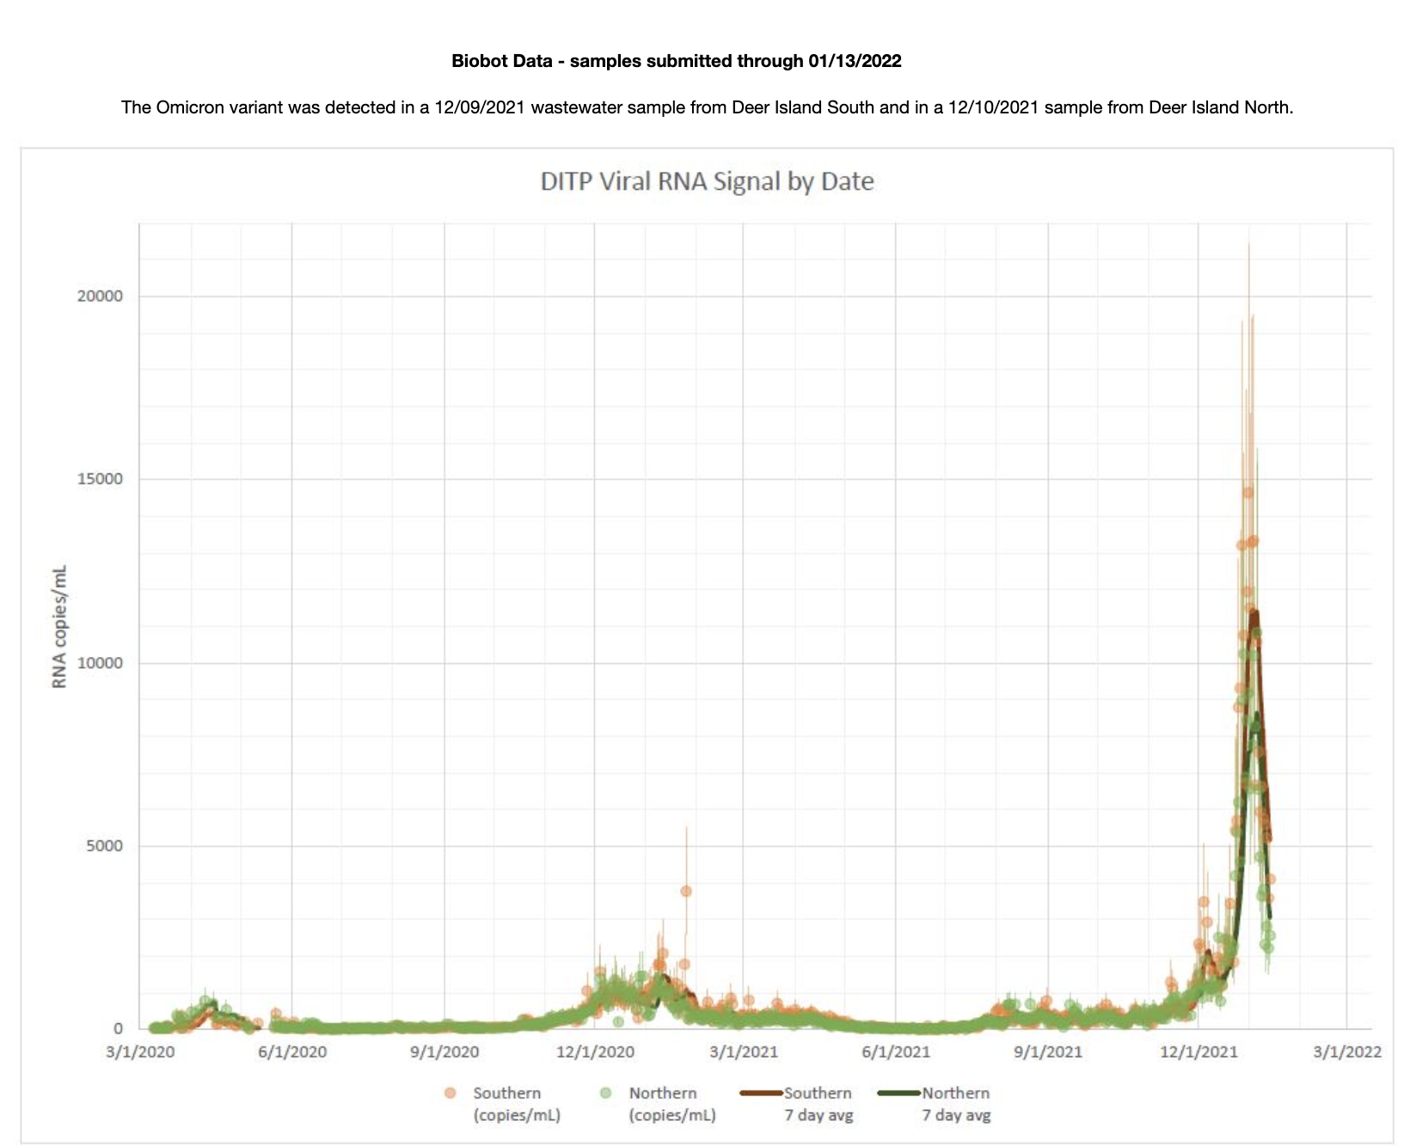
Effluent Monitoring –tried and true
https://www.mwra.com/biobot/biobotdata.htm (accessed 1/17/2022)

Slide 6
Case definitions – from NIH guidelines
Asymptomatic or Presymptomatic Infection: Individuals who test positive for SARS-CoV-2 using a virologic test (i.e., a nucleic acid amplification test [NAAT] or an antigen test) but who have no symptoms that are consistent with COVID-19.
Mild Illness: Individuals who have any of the various signs and symptoms of COVID-19 (e.g., fever, cough, sore throat, malaise, headache, muscle pain, nausea, vomiting, diarrhea, loss of taste and smell) but who do not have shortness of breath, dyspnea, or abnormal chest imaging.
Moderate Illness: Individuals who show evidence of lower respiratory disease during clinical assessment or imaging and who have an oxygen saturation (SpO₂) ≥94% on room air at sea level.
Severe Illness: Individuals who have SpO₂ <94% on room air at sea level, a ratio of arterial partial pressure of oxygen to fraction of inspired oxygen (PaO₂/FiO₂) <300 mm Hg, a respiratory rate >30 breaths/min, or lung infiltrates >50%.
Critical Illness: Individuals who have respiratory failure, septic shock, and/or multiple organ dysfunction.
https://www.covid19treatmentguidelines.nih.gov/overview/clinical-spectrum/

Slide 7
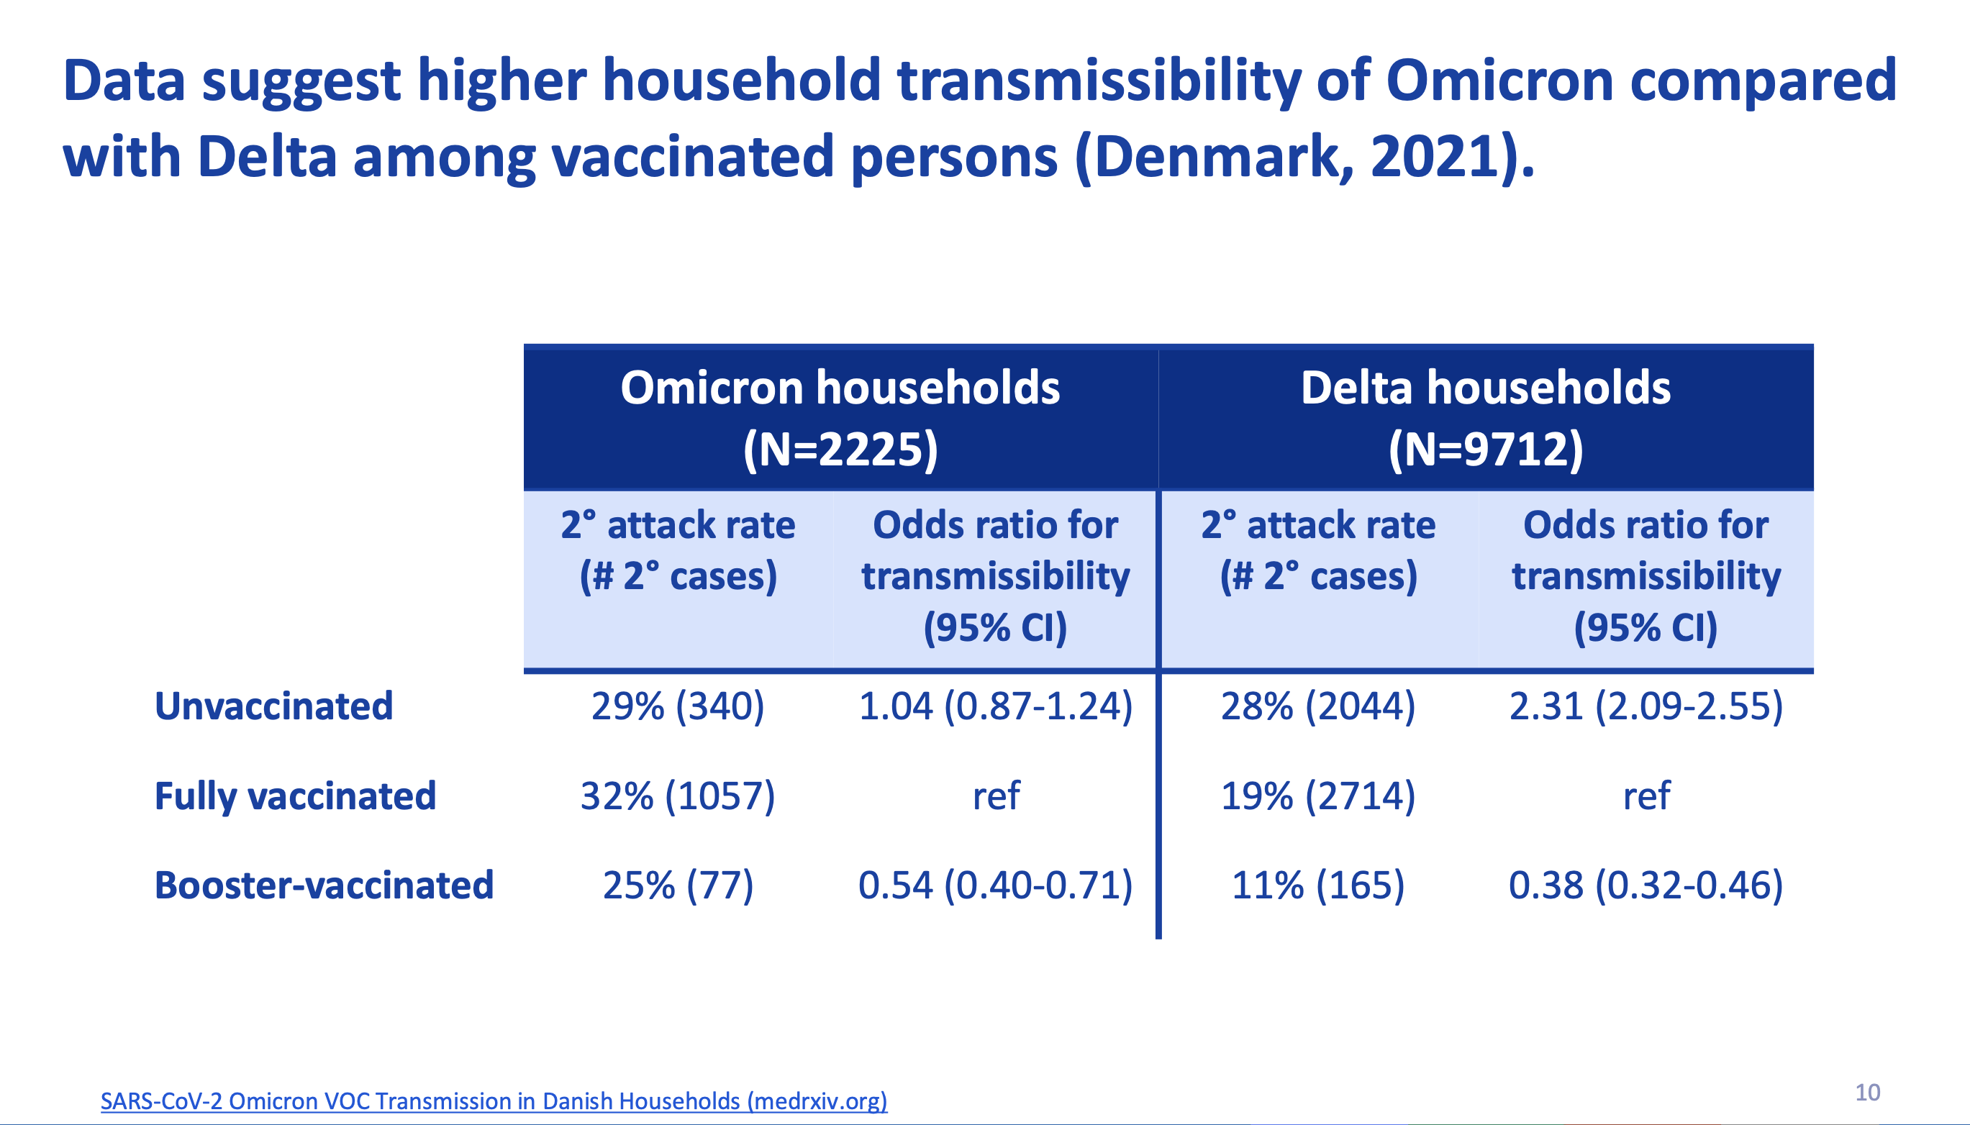

Slide 8
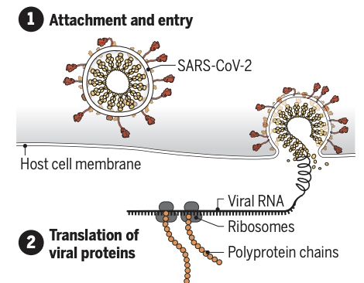
Monoclonal Ab
https://www.science.org/doi/pdf/10.1126/science.acx9605 (accessed 1/17/22)

Slide 9
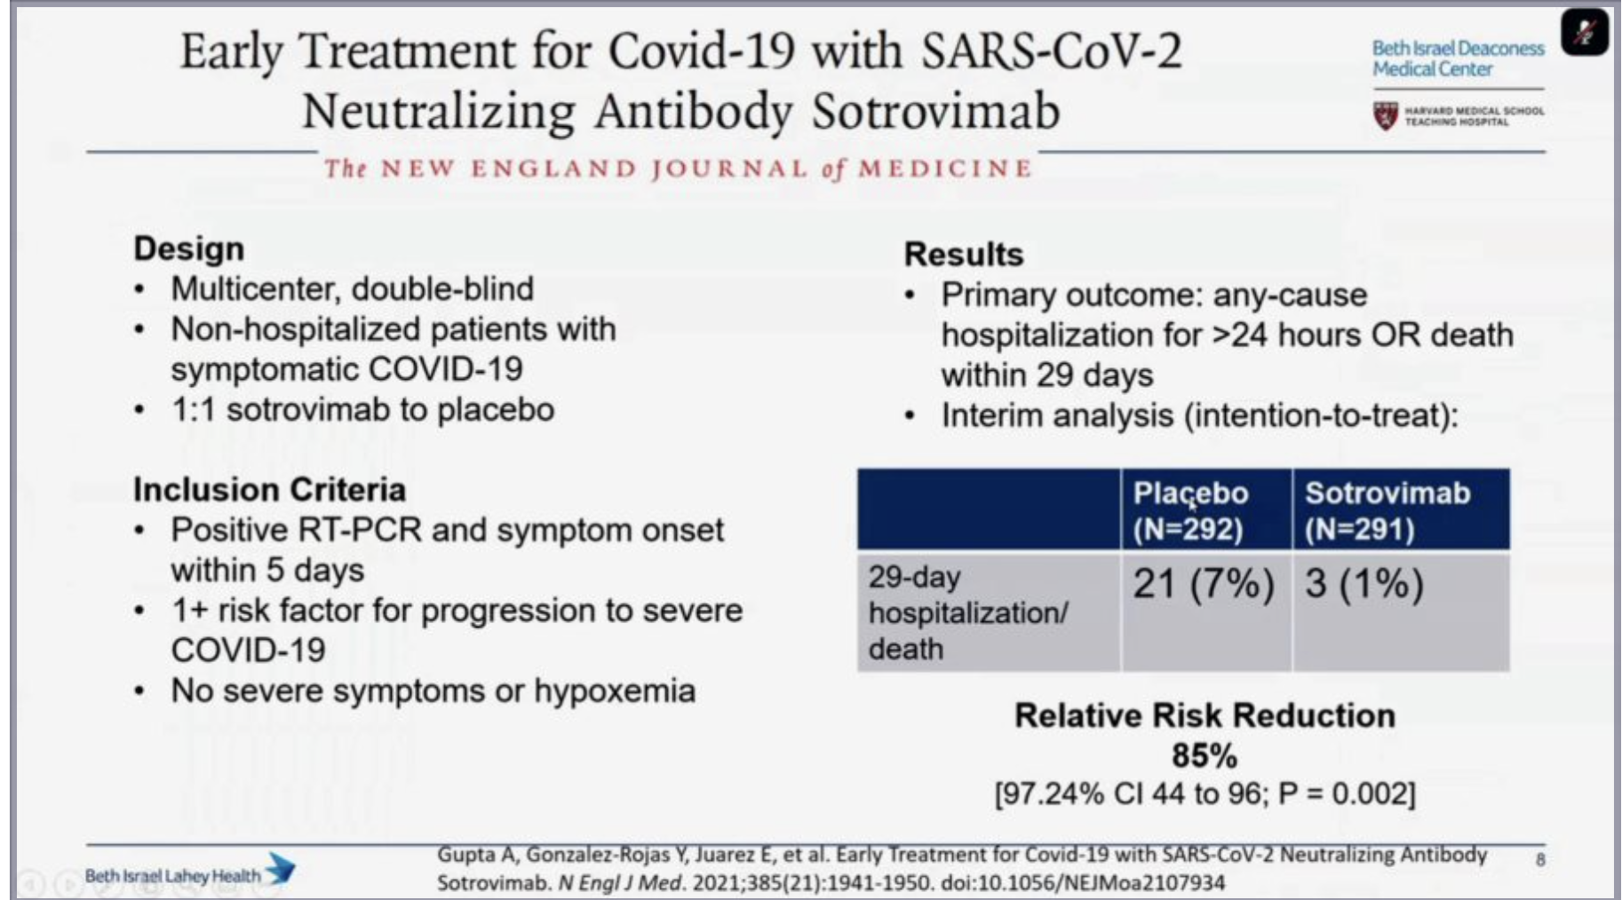
Sotrovimab – (IV) - post-exposure

Slide 10
Tixa/Cliga (IM)

Slide 11
Antivirals
Nirmatrelvir w/ ritonavir (oral)
Molnupiravir (oral)
Remdesivir (IV)

Slide 12
EPIC-HR trial :: Nirmatrelvir w/ ritonavir
 | Hospitalization or death | Death | ARR | RRR | Adverse events (AE) | Serious AE | Drug stopped
NTV + rtv | 8/1039 (0.8%) | 0 | 5.5% NNT= 18 | 88% | 23% | 1.6% | 2.1%
placebo | 66/1046 (6.3%) | 12 |  |  | 24% | 6.6% | 4.2%
 | n = 2246
Study population:
Unvaccinated
Non-hospitalized (mild to moderate)
No oxygen requirement
0-5 days or Positive test
https://www.pfizer.com/news/press-release/press-release-detail/pfizer-announces-additional-phase-23-study-results (accessed 1/18/22)

Slide 13
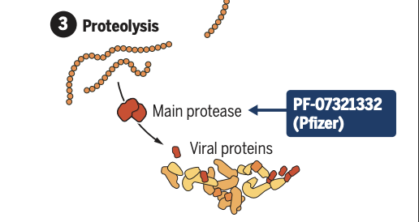
Nirmatrelvir
Evidence – EPIC-HR trial
Therapy considerations – DRUG INTERACTIONS:
EUA Fact sheet
Drug interaction checker
Treatment pop: age >12 (and >40kg), high risk, + test 0-5 days of sx, not hospitalized, no new O2 requirement.
Dosing:
GFR >60 :: NTV 300mg (150mg two tablets) + rtv 100mg one tablet BID for 5 days (with or without food)
GFR 30-60 :: NTV 150mg one tablet + rtv 100mg one tablet BID for 5 days (with or without food)
GFR < 30 :: contraindicated
Side effects (NTV/rtv v placebo)
Dysgeusia (6% v 1%)
Diarrhea (3% v 2%)
HTN (1% v <1%)
Myalgia (1% v <1%)
Nirmatrelvir w/ritonavir
https://www.science.org/doi/pdf/10.1126/science.acx9605 (accessed 1/17/22)

Slide 14
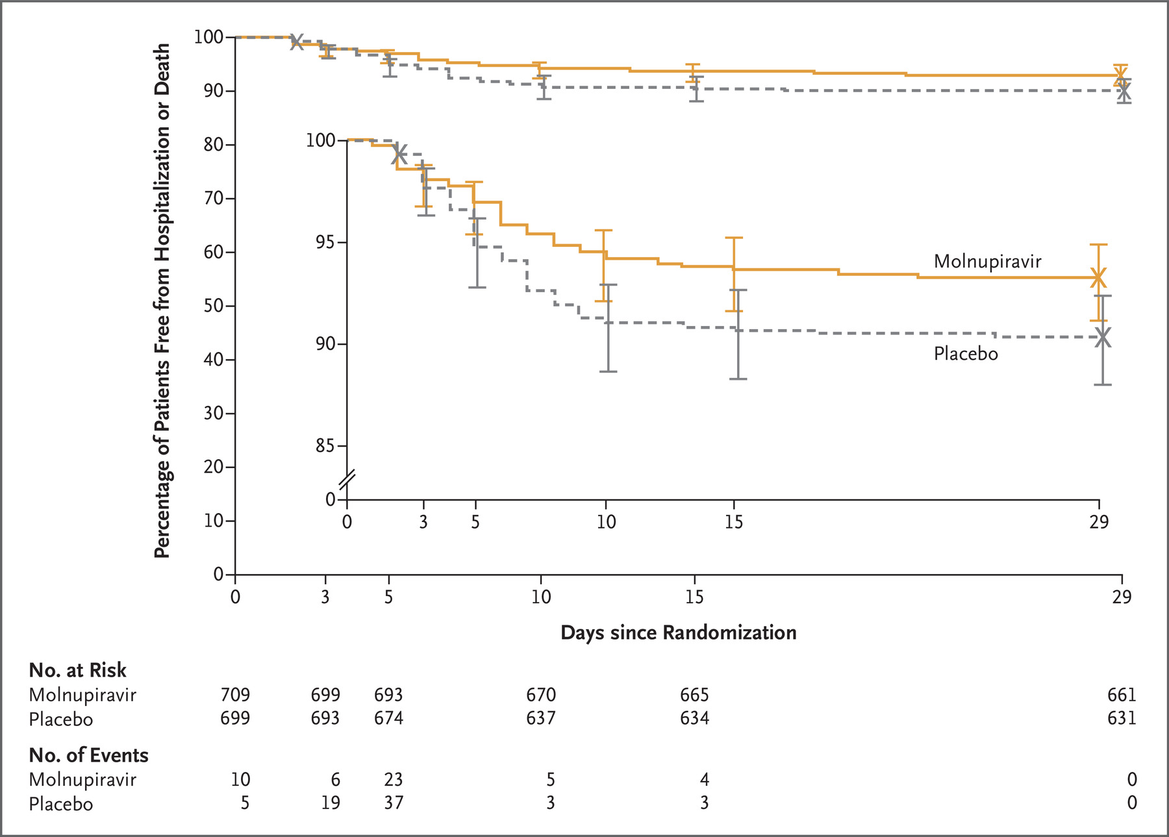
MOVe-OUT trial :: Molnupiravir
 | Hospitalization or death | Death | ARR | RRR
Drug (710) | 48/709 (6.8%) | 1 | 3.0% NNT= 31 | 30%
Placebo (701) | 68/699 (9.7%) | 9
 | n = 1411
Study population:
Unvaccinated
Non-hospitalized (mild to moderate)
No oxygen requirement
0-5 days or Positive test
High risk >17y
https://www.nejm.org/doi/full/10.1056/NEJMoa2116044 (accessed 1/18/22)

Slide 15
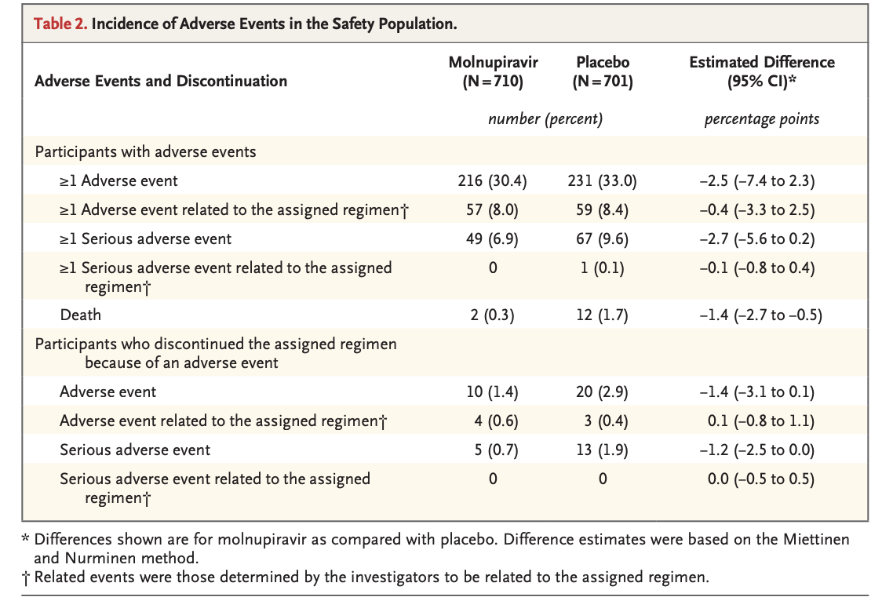
https://www.nejm.org/doi/full/10.1056/NEJMoa2116044 (accessed 1/18/22)

Slide 16
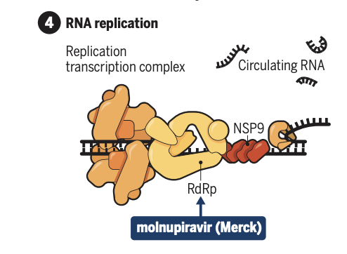
molnupiravir
Evidence –
Therapy considerations – mutagen risk:
EUA Fact sheet
Reproductive concerns: contraception for 3 months
Breast feeding (can start 4 days after stopping medicine)
Treatment pop:
age >17, high risk, + test 0-5 days of sx, not hospitalized, no new O2 requirement. Not in pregnancy
When other treatment not available
Dosing:
Molnupiravir 800mg (200mg four tablets) every 12h for 5 days
Side effects (drug v placebo)
Diarrhea (2% v 2%)
Nausea (1% v 1%)
Dizziness (1% v 1%)
https://www.science.org/doi/pdf/10.1126/science.acx9605 (accessed 1/17/22)
Notes:
https://www.fda.gov/media/155054/download (accessed 1/18/22)
Study pop
AA 6%
Latinx 50%

Slide 17
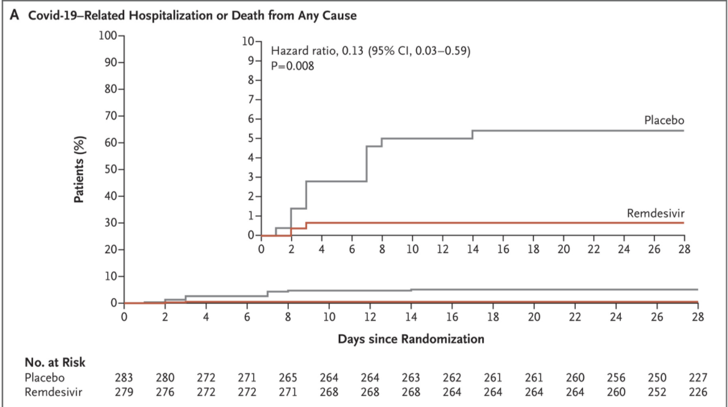
remdesivir
Inhibits RNA polymerase – chain termination
Trial (n = 562)
Placebo 15/227 (5.3%)
Rx 2/226 (0.7%)
RRR = in 87% decrease hospitalization
No deaths in either group
https://www.nejm.org/doi/full/10.1056/NEJMoa2116846 (accessed 1/17/22)
Notes:
PINETREE trial
Stopped early for admin reasons

Slide 18
Clinical Risks for hospitalization and death
Immunocompromised (high)
Age (the older the higher)
Unvaccinated
Other risk factors (1-2x)

Slide 19
Risk of Hospitalization and Death pre-vaccination CDC 11/30/2020
Cohort by age and risk of : | Infection | Hospitalization | Death
0-4 years |  | 4x lower | 9x lower
5-17 years |  | 9x lower | 16x lower
18-29 years |  | Comparison Group
30-39 years |  | 2x higher | 4x higher
40-49 years |  | 3x higher | 10x higher
50-64 years |  | 4x higher | 30x higher
65-74 years |  | 5x higher | 90x higher
75-84 years |  | 8x higher | 220x higher
85+ years |  | 13x higher | 630x higher
CDC ref accessed 11/3/20 https://www.cdc.gov/coronavirus/2019-ncov/covid-data/investigations-discovery/hospitalization-death-by-age.html

Slide 20
Risk of Hospitalization and Death
(partial vax) CDC 11/22/2021
Cohort by age and risk of : | Infection | Hospitalization | Death
0-4 years old | <1x | <1x | <1x
5-17 years old | 1x | <1x | <1x
18-29 years old | Reference group | Reference group | Reference group
30-39 years old | 1x | 2x | 4x
40-49 years old | 1x | 2x | 10x
50-64 years old | 1x | 4x | 25x
65-74 years old | 1x | 5x | 65x
75-84 years old | 1x | 8x | 150x
85+ years old | 1x | 10x | 370x
CDC ref accessed 11/3/20 https://www.cdc.gov/coronavirus/2019-ncov/covid-data/investigations-discovery/hospitalization-death-by-age.html
Notes:
Current data speficially looked at reference age group
https://covid.cdc.gov/covid-data-tracker/#demographics (accessed 1/17/22)
18-20 yo 5526 deaths / 11,021,235 cases = 0.0005014 rate or 5/10,000 or 1:1994 (1 in 2000)

Slide 21
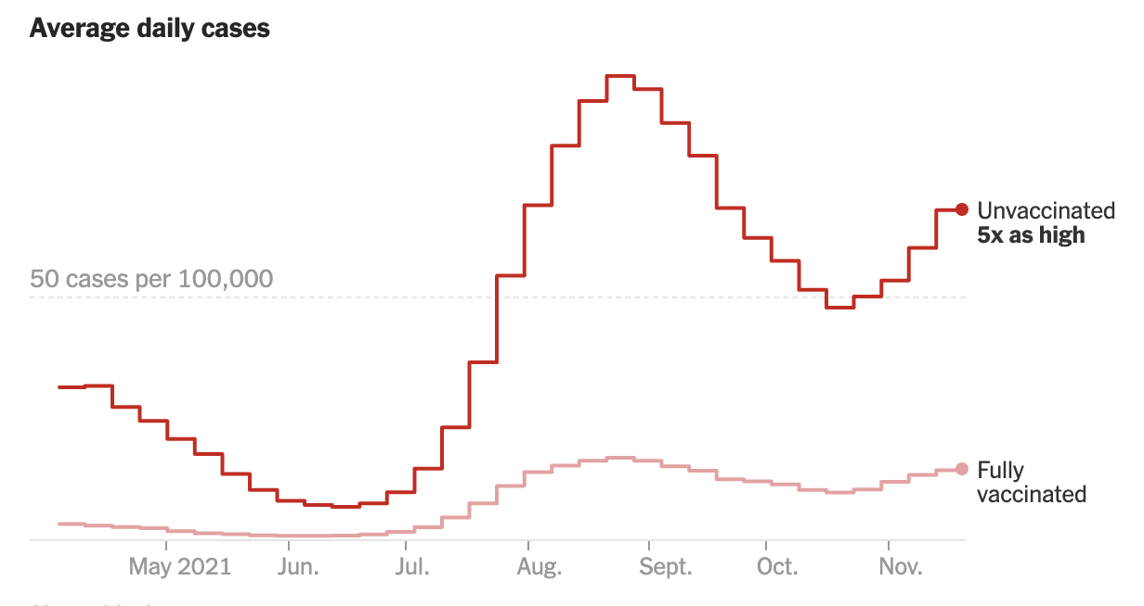
https://www.nytimes.com/interactive/2021/us/covid-cases.html (accessed 1/17/22)

Slide 22
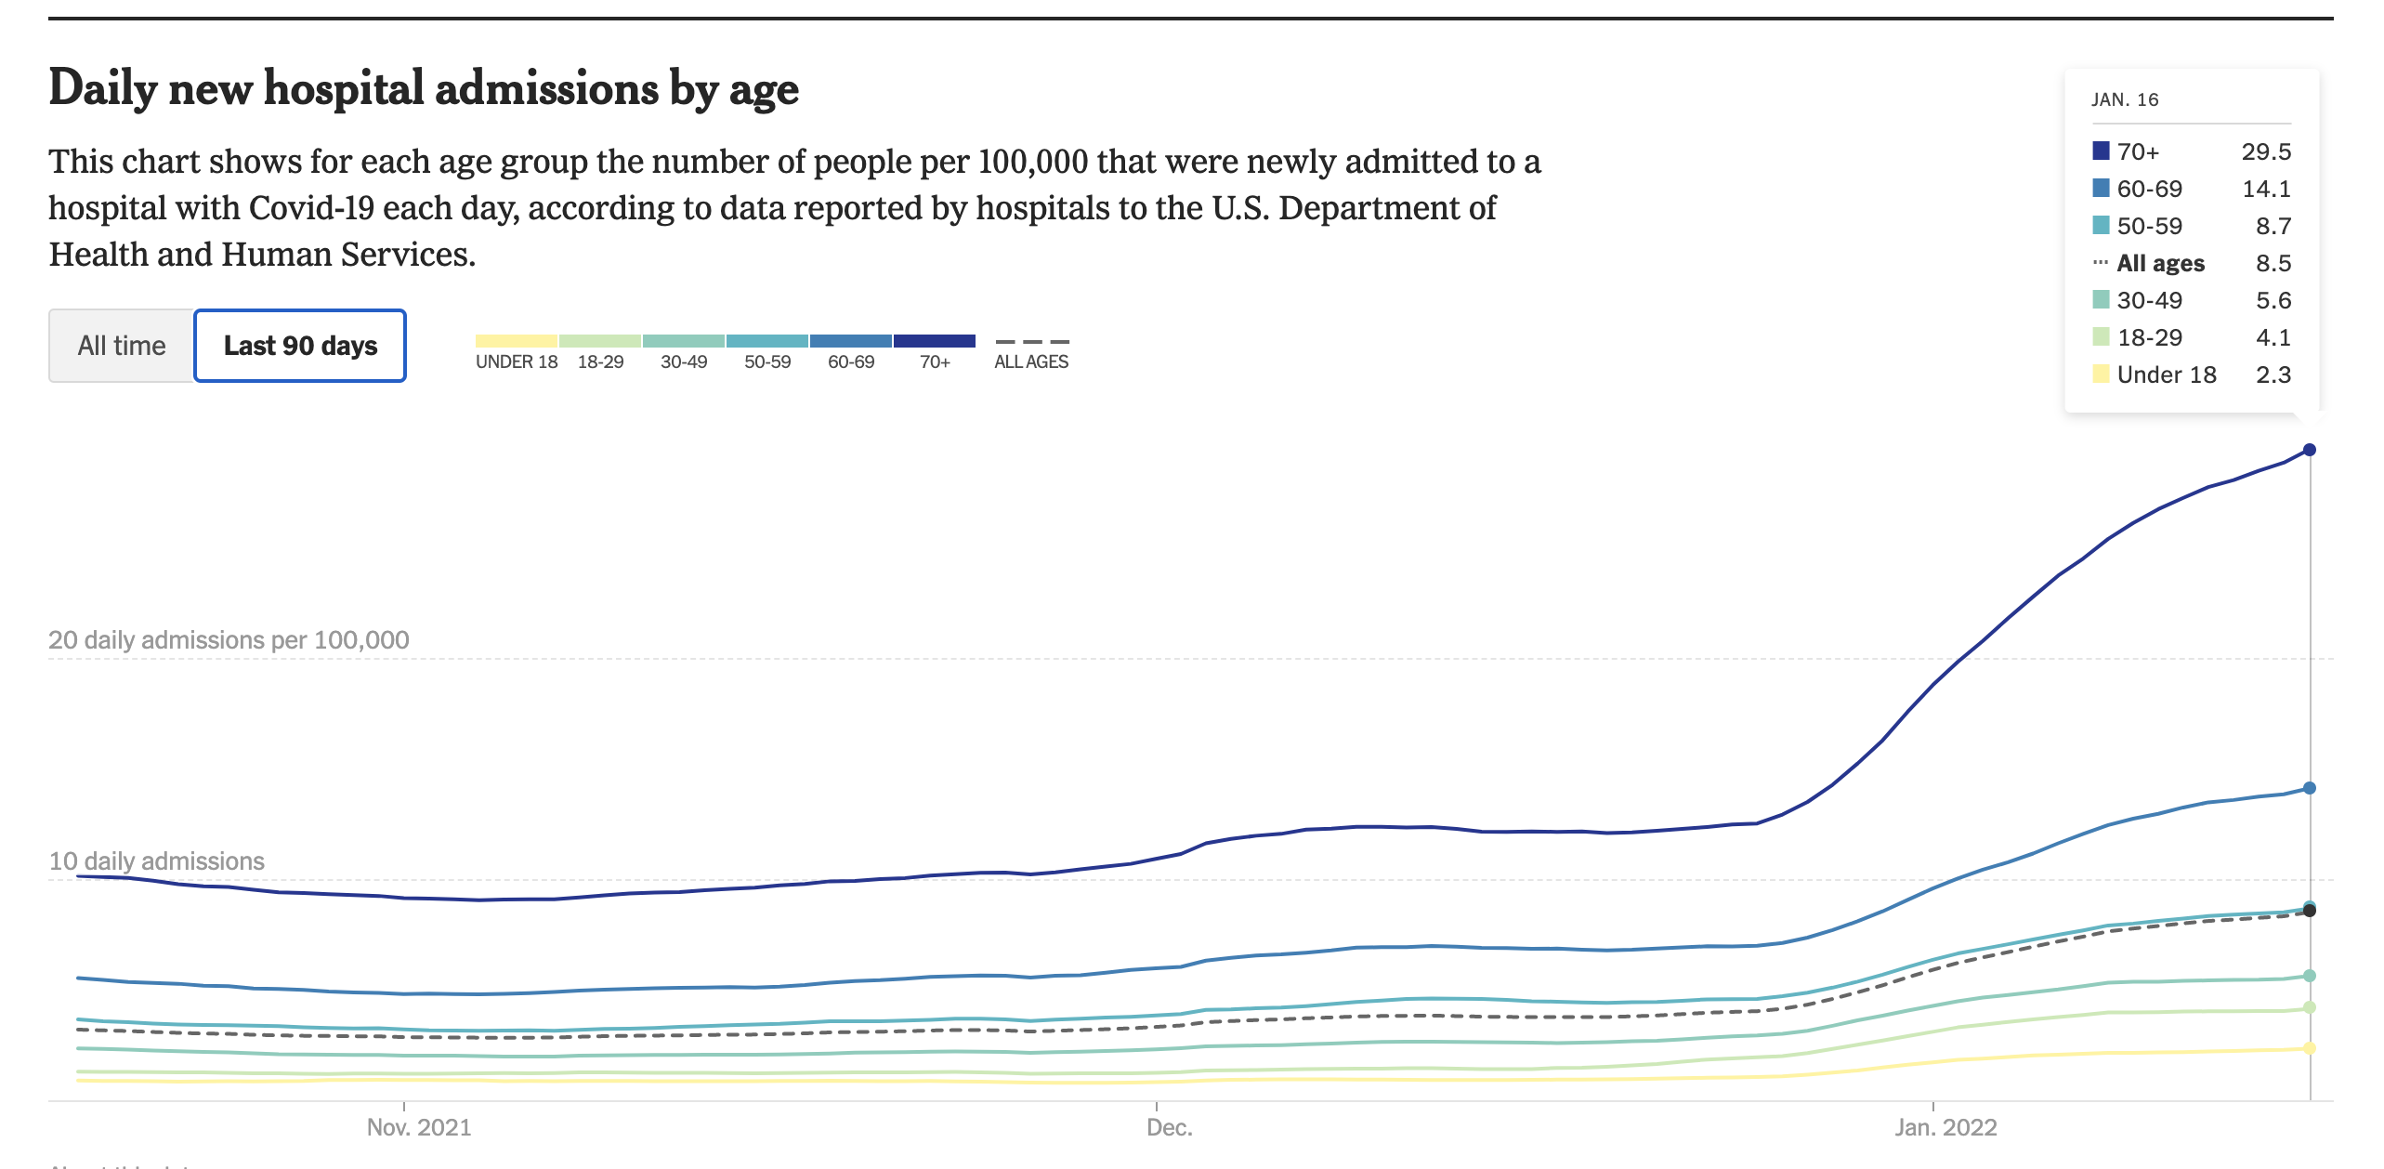
https://www.nytimes.com/interactive/2021/us/covid-cases.html (accessed 1/17/22)

Slide 23
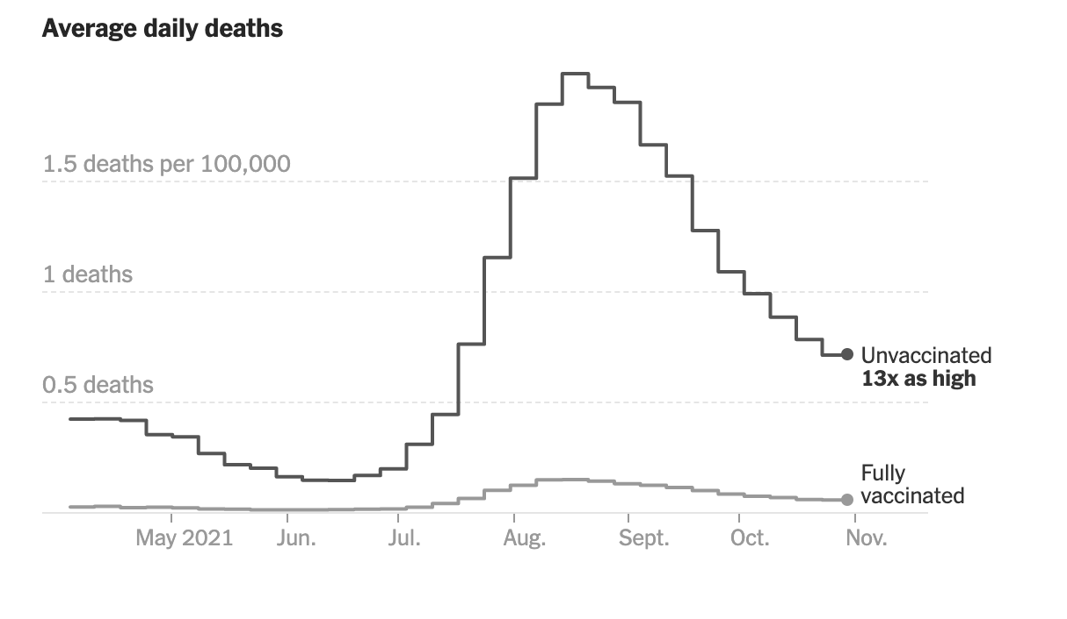
https://www.nytimes.com/interactive/2021/us/covid-cases.html (accessed 1/17/22)

Slide 24
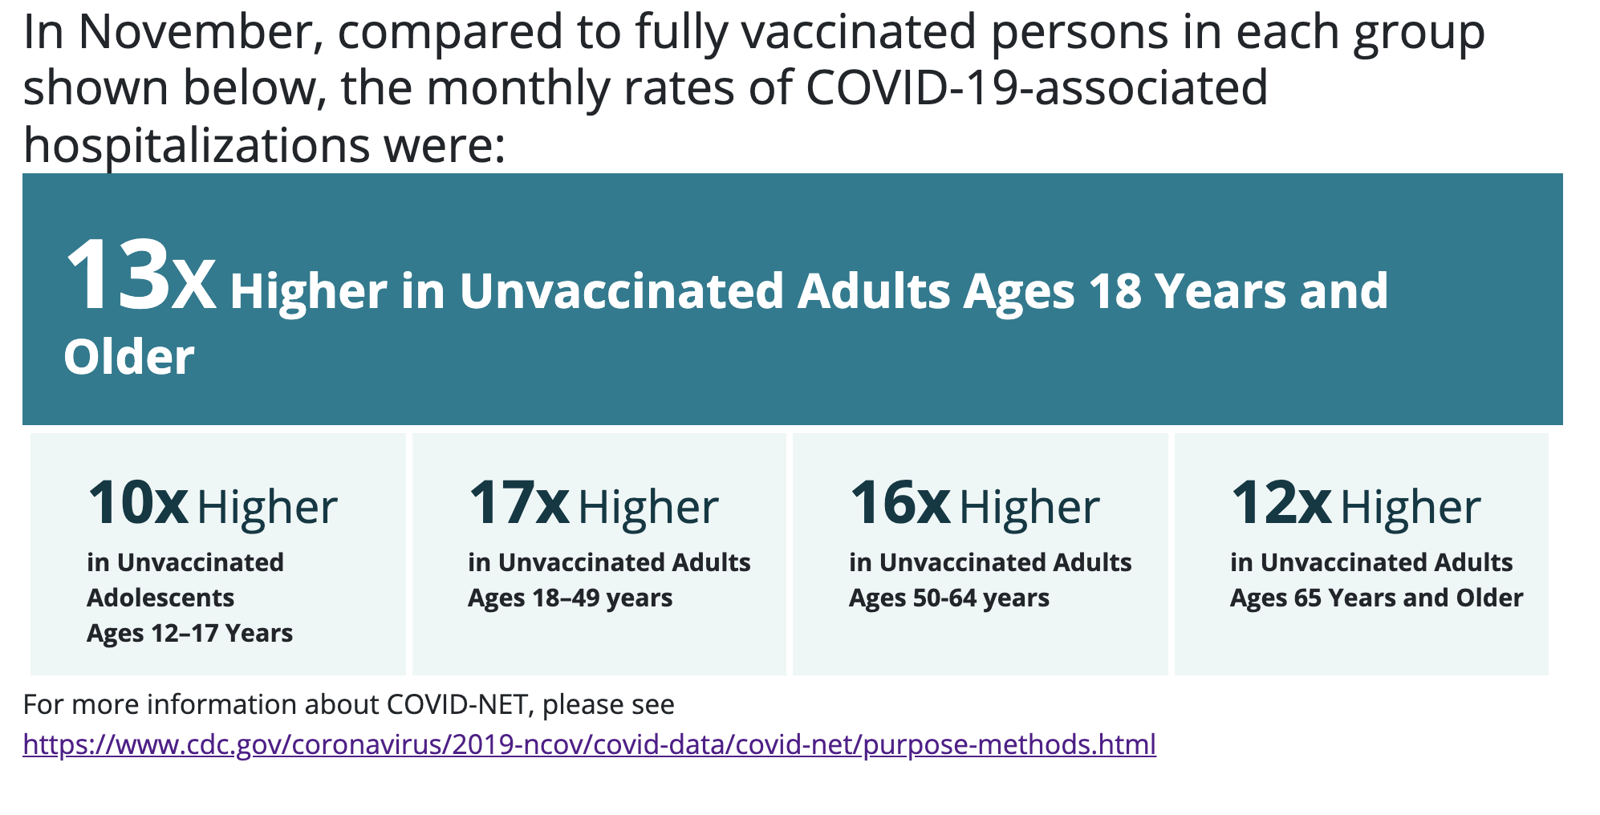
https://covid.cdc.gov/covid-data-tracker/#covidnet-hospitalizations-vaccination (accessed 1/17/22)

Slide 25
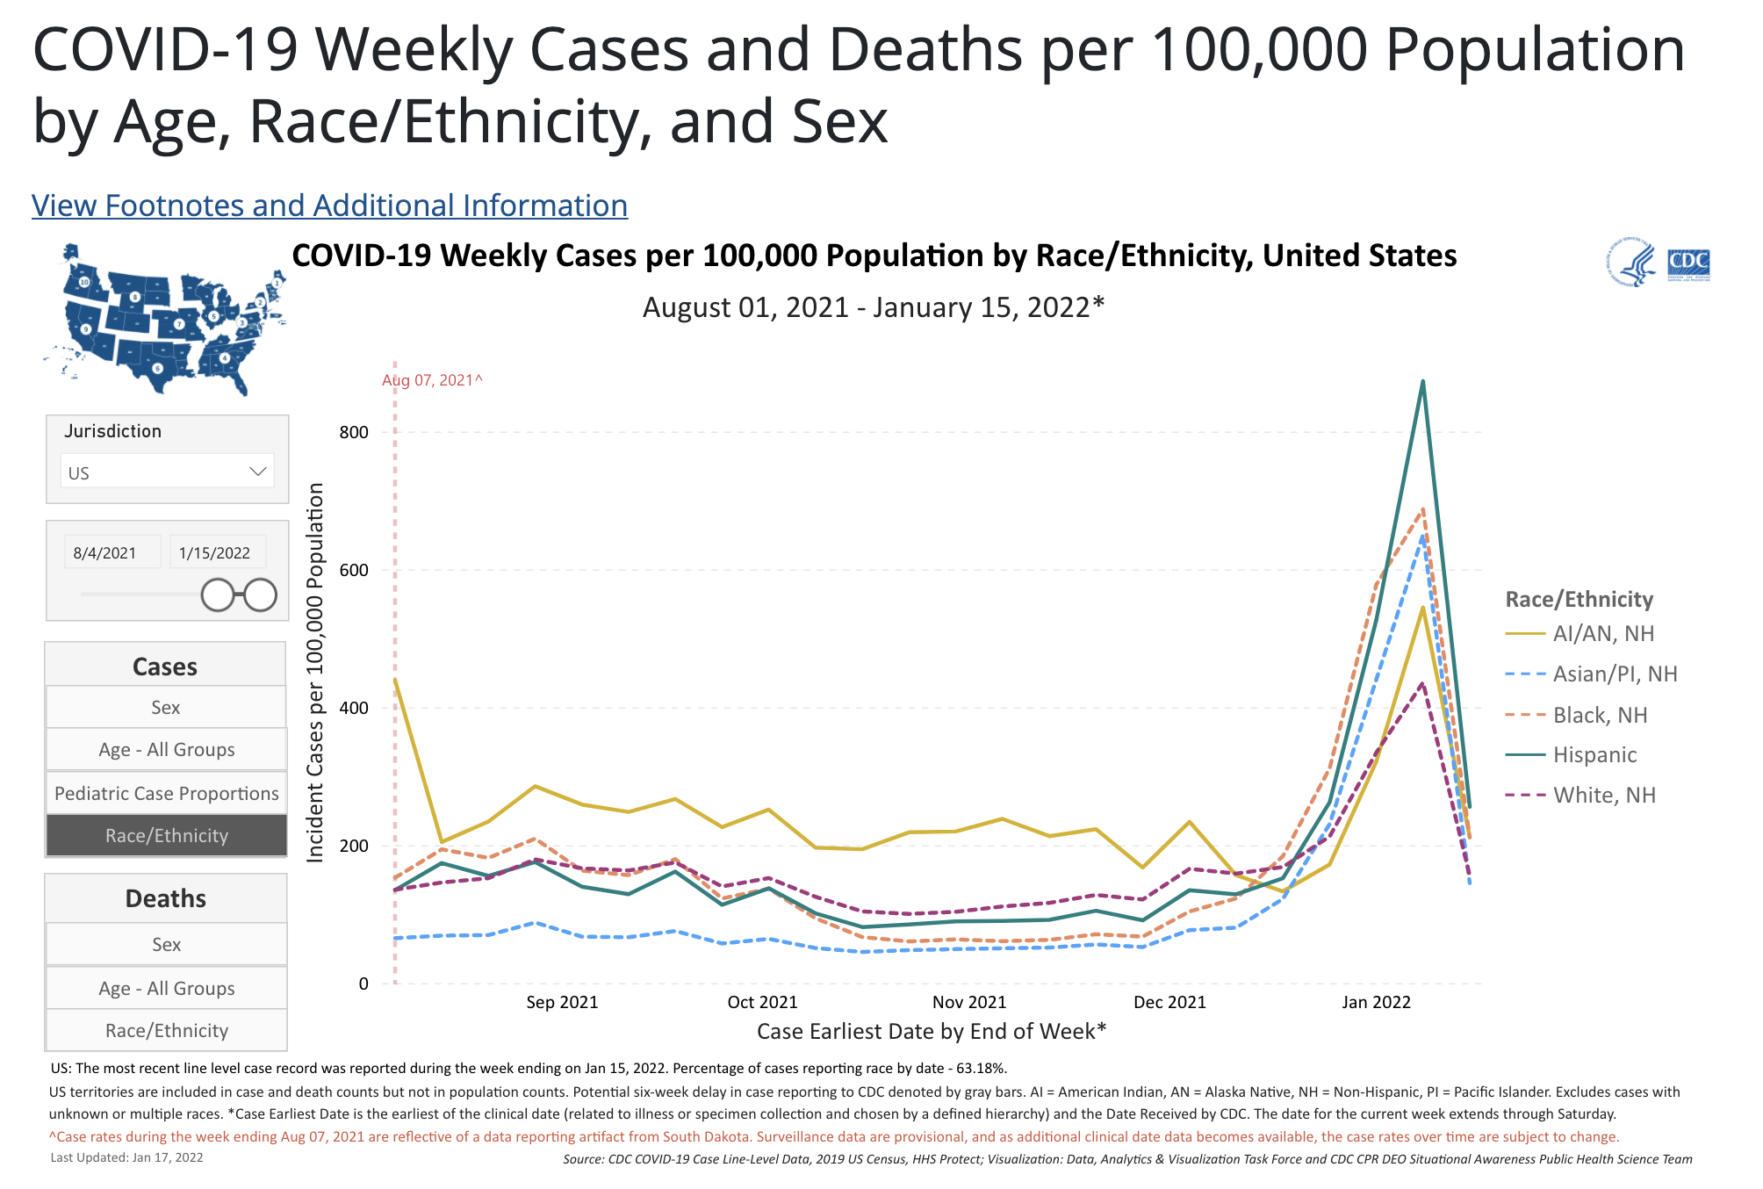
https://covid.cdc.gov/covid-data-tracker/#demographicsovertime (accessed 1/17/22)
Notes:
https://covid.cdc.gov/covid-data-tracker/#demographicsovertime (accessed 1/17/22)

Slide 26
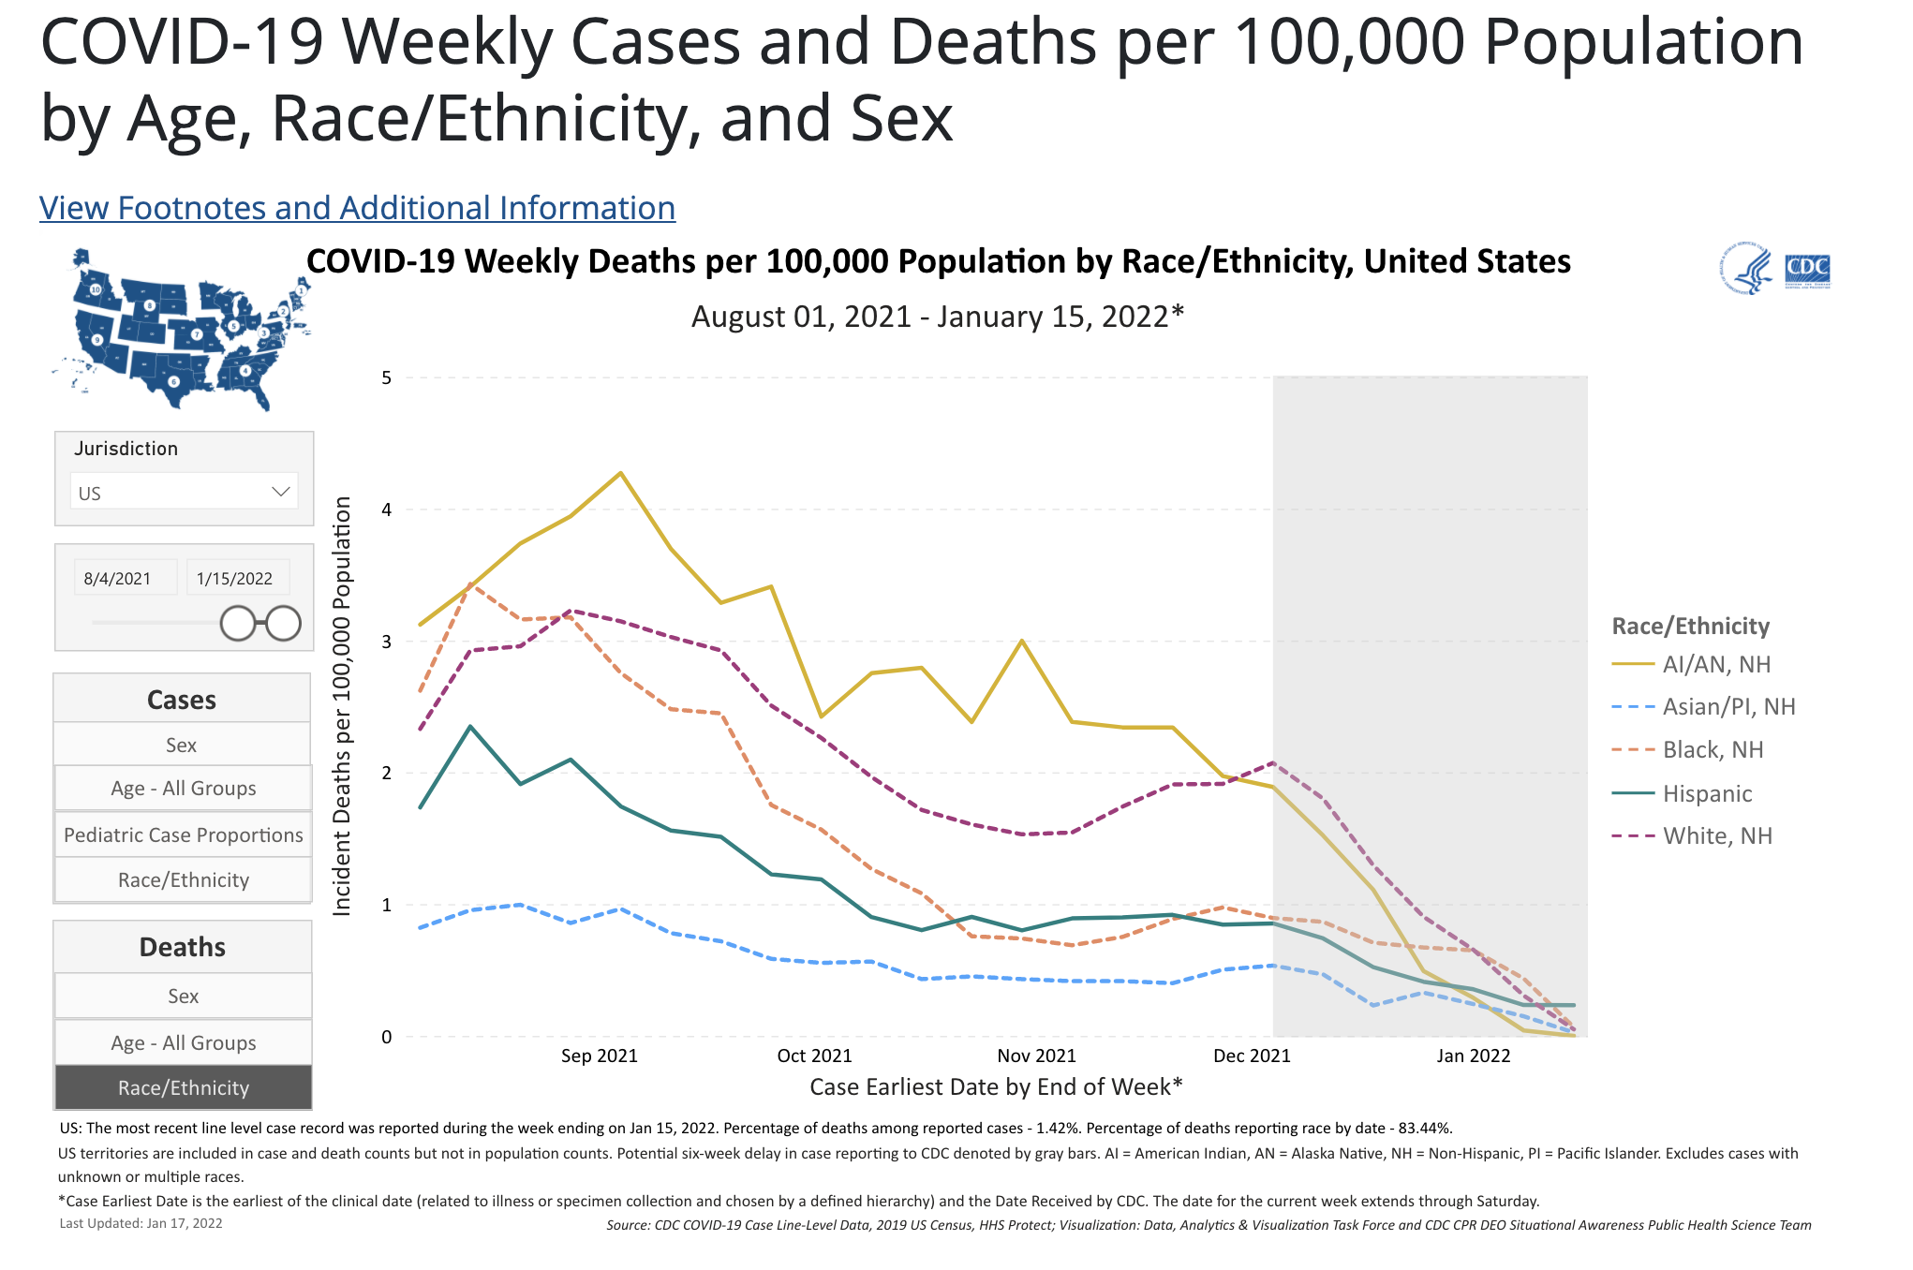
https://covid.cdc.gov/covid-data-tracker/#demographicsovertime (Accessed 1/17/22)
Notes:
https://covid.cdc.gov/covid-data-tracker/#demographicsovertime (Accessed 1/17/22)

Slide 27
Clinical Guidance on Therapeutics for COVID-19 [Mass DPH]
Issued January 12, 2022
Tier | Patient characteristics* | Within 5 days of symptom onset*** | Between 5 – 10 days of symptom onset
1 | Moderate to severe immunosuppression | Monoclonal antibody or remdesivir or nirmatrelvir/ritonavir. If these therapies are not available, molnupiravir may be used. | Monoclonal antibody
 | Not fully vaccinated and age ≥ 75 years
 | Not fully vaccinated and age ≥ 65 years plus additional risk factor
2 | Not fully vaccinated and age ≥ 65 | Remdesivir. If remdesivir not available, molnupiravir may be used****
 | Not fully vaccinated and age < 65 plus additional risk factor
3 | Vaccinated** and age ≥ 75
 | Vaccinated and age ≥ 65 years plus additional risk factor
4 | and age ≥ 65 years
 | Vaccinated and age < 65 plus additional risk factor
Notes:
*Clinical risk factors include cancer, cardiovascular disease, chronic kidney disease, chronic lung disease, diabetes, immunocompromising conditions or receipt of immunosuppressive medications, obesity (body mass index ≥30), pregnancy, and sickle cell disease. For additional information on medical conditions and other factors that are associated with increased risk for progression to severe COVID-19, see the CDC webpage People With Certain Medical Conditions. The likelihood of developing severe COVID-19 increases when a person has multiple high-risk conditions or comorbidities. Medical conditions or other factors (e.g., social determinants of health)not listed may also be associated with high risk for progression to severe COVID-19. Sotrovimab and nirmatrelvir/ritonavir may be considered for patients with multiple high-risk conditions or comorbidities and factors that are not listed in the EUAs. The decision to use mAb or antivirals for a patient should be based on an individualized assessment of risks and benefits. Use of mAb or antivirals that departs from tiering recommendations is permissible if based on clinical judgement.
**Vaccinated individuals who have not received a COVID-19 vaccine booster dose are at higher risk for severe disease.
***Remdesivir may be used within seven days of symptom onset.
****While supplies of sotrovimab and nirmatrelvir/ritonavir are constrained, pregnant individuals (vaccinated or unvaccinated) should be treated with remdesivir to prevent severe COVID-19. Molnupiravir is contraindicated during pregnancy.

Slide 28
Treatment summary
 | sotrovimab | nirmatrelvir/ritonavir | remdesivir | molnupivir
NNT (ARR) | 17 (7% ->1%) | 18 (6.3% -> 0.8%) | 22 (5.3% -> 0.7%) | 31 (9.7% -> 6.8%)
Relative Risk reduction | 85% | 88% | 87% | 30%
Pregnancy | Monoclonals usually in pregnancy | ritonavir safe in pregnancy | Studied in pregnancy | No
Administration | IV x 1 dose | Oral x 5 days | IV x 3 days | Oral x 5 days
Drug interactions | Few | Many | Few | Few
Side effects | Infusion | GI |  | mutagen - reproductive warning; cancer caution

Slide 29
Panel Discussion
-
Realm | Panelists
Vaccines | Charlie Williams (EB) Cheralyn Johnson (SB) Ian Huntington (Codman) Jaime Gallegos (EB) Jason Worcester (BMC) Aimee Williams (Mattapan) Kirsten Austad (BHN/FM)
Testing & follow up | Cheralyn Johnson (SB)
ILI clinics | Jaime Gallegos (EB)
Healthcare workers (employee health) | Jason Worcester (BMC)
Access and Telehealth | Aimee Williams (Mattapan)
Hospitalized Patients | Kirsten Austad (BHN/FM)
Please speak to the following questions in your realm of activity:
What has been learned in the last year?
What are the current challenges and adaptations/best practices?
What about equity?

Slide 30

Thank you
CDC / IDSA weekly
https://www.idsociety.org/globalassets/covid-19-real-time-learning-network/media/1-8-22-clinician-call.pdf
This Photo by Unknown Author is licensed under CC BY

Slide 31
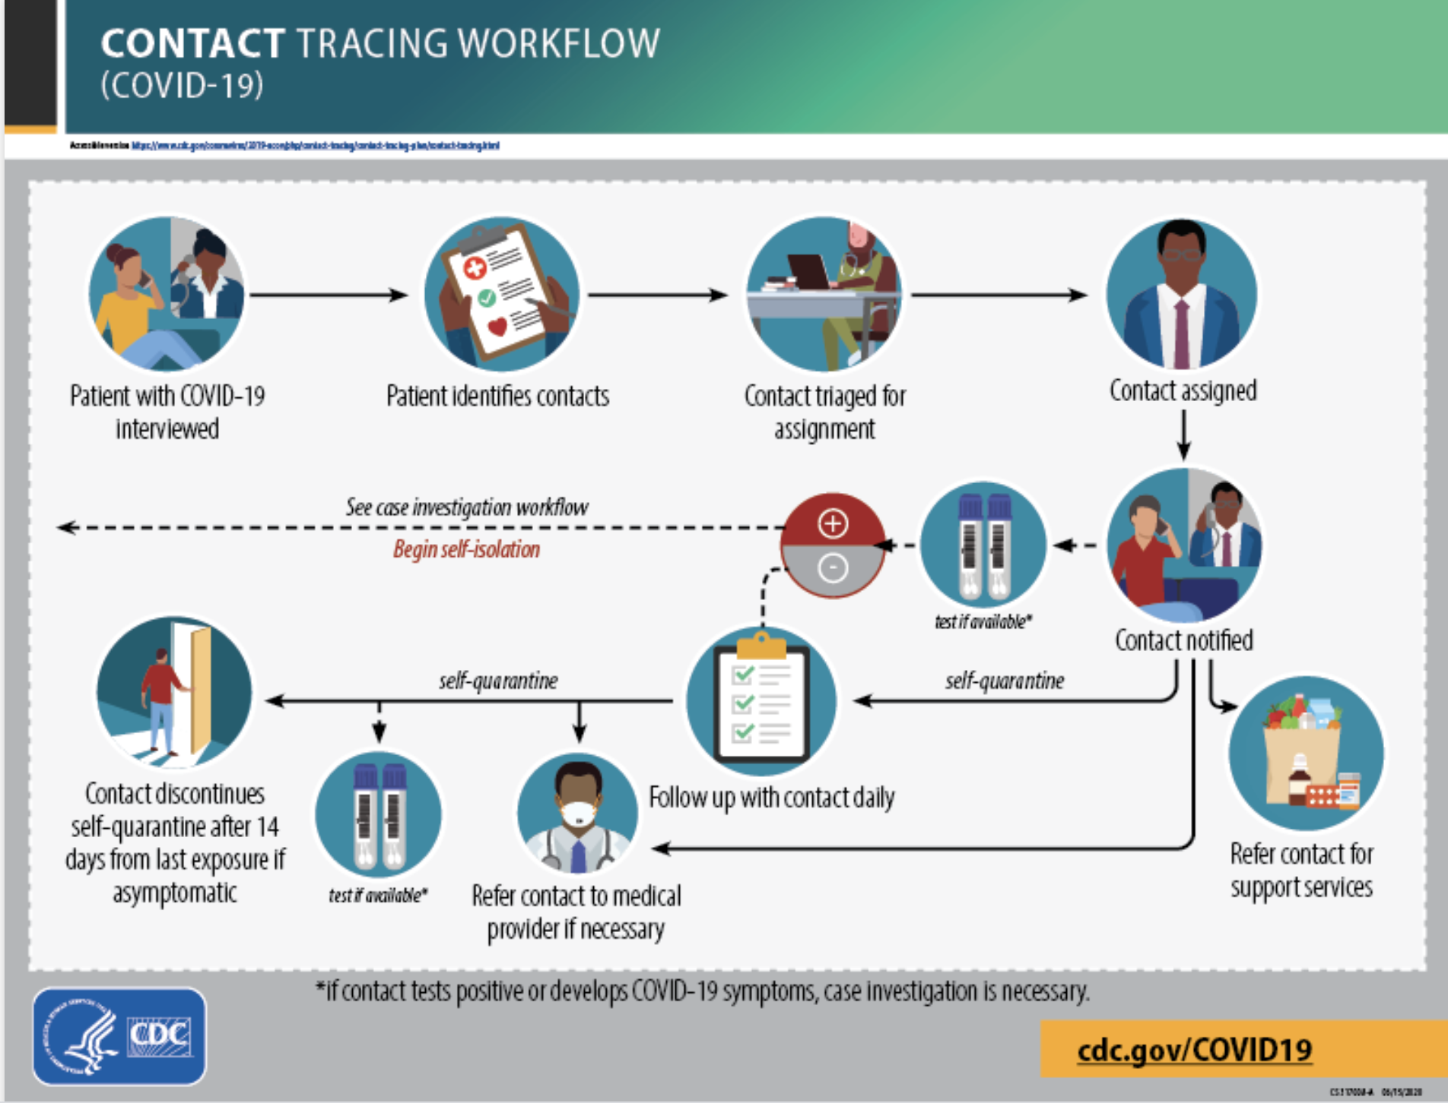
https://www.cdc.gov/coronavirus/2019-ncov/php/contact-tracing/contact-tracing-plan/contact-tracing.html (accessed 12/1/2020)

Slide 32
Contact Tracing
Steps in tracing contacts
Reach Cases
Collect Contacts
Reach Contacts
Quarantine Contacts
Primary Care’s role
Education, Testing & Care
Test liberally and inform people to expect a call
Ask people to write down names of close contacts
Explain quarantine behaviors
Advocate for payment (sick time)

Slide 34
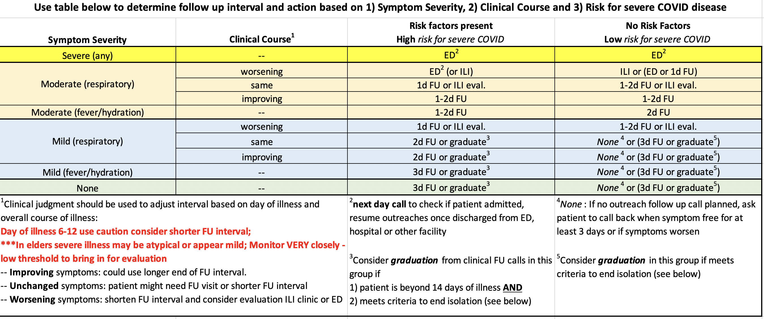
Outreach Frequency Guide for follow up on COVID19 patients (known or suspected)

Slide 35
CDC - Symptom-based strategy to end isolation
Accumulating evidence supports ending isolation and precautions for persons with COVID-19 using a symptom-based strategy. Specifically, researchers have reported that people with mild to moderate COVID-19 remain infectious no longer than 10 days after their symptoms began, and those with more severe illness or those who are severely immunocompromised remain infectious no longer than 20 days after their symptoms began. Therefore, CDC has updated the recommendations for discontinuing home isolation as follows:
Mild to Moderate Disease - Persons with COVID-19 who have symptoms and were directed to care for themselves at home may discontinue isolation under the following conditions:
1) At least 10 days* have passed since symptom onset and
2) At least 24 hours have passed since resolution of fever without the use of fever-reducing medications and
3) Other symptoms have improved.
Severe Disease - A limited number of persons with severe illness may produce replication-competent virus beyond 10 days, that may warrant extending duration of isolation for up to 20 days after symptom onset. Consider consultation with infection control experts. See Discontinuation of Transmission-Based Precautions and Disposition of Patients with COVID-19 in Healthcare Settings (Interim Guidance).
Never Symptomatic - Persons infected with SARS-CoV-2 who never develop COVID-19 symptoms may discontinue isolation and other precautions 10 days after the date of their first positive RT-PCR test for SARS-CoV-2 RNA.
CDC ref accessed 11/3/20 https://www.cdc.gov/coronavirus/2019-ncov/hcp/disposition-in-home-patients.html

Slide 36
Check in – External Support Person “Buddy System”
Do you have a support person?
Ideally all people, but especially those with high risk factors should have a “buddy” who is not in the same household and well enough to support them by:
    Helping with daily logistics: (help bring food, get prescriptions, drive them if needed)
    Checking in: Call/text 2-4 times a day (low risk 2x, high risk 3-4x)
    Reviewing self-monitoring:
      Check temperature 2-3 times daily
      Worsening symptoms call or go to ED
      Breathing trouble call or go to ED

Slide 37
COVID19 Outreach – part 4 - Patient Education
Education
Review with patient at end of each call:
Isolation practices and quarantine (household members who are not sick, 14 days)
Call if symptoms worsening (if at high risk call early)
Home symptom check, support person, isolation ending parameters (in follow-up guide)
Use “teach back” technique to ensure understanding for key points
At the end of call, for clarity, review basic message again with “Teach Them 3”.
Teach Them 3*
Q | What is your diagnosis? | A | COVID19 suspected or test positive
Q | What to do about it? | A | Isolate and call if worsening
Q | Why is it important to do this? | A | Keep your family and other safe
*This is the reverse of the “Ask Me 3” patient tool used in health literacy

