Slide 1


Opportunities for MPH Students
Centers for Disease Control and Prevention
Stephen Ko, MD, MA, MPH, MDIV
Research Assistant Professor of Global Health
Center for Global Health and Development
Boston University

Slide 2

CDC’s Mission
Protecting America from health, safety, and security threats, both foreign and in the U.S.
  Diseases:
    Acute of chronic
    Curable or preventable
    Human error or deliberate attack

Slide 3
CDC’s Role
Detecting and responding to new and emerging health threats
Tackling the biggest health problems causing death and disability for Americans
Putting science and advanced technology into action to prevent disease
Promoting healthy and safe behaviors, communities, and environment
Developing leaders and training the public health workforce

Slide 4
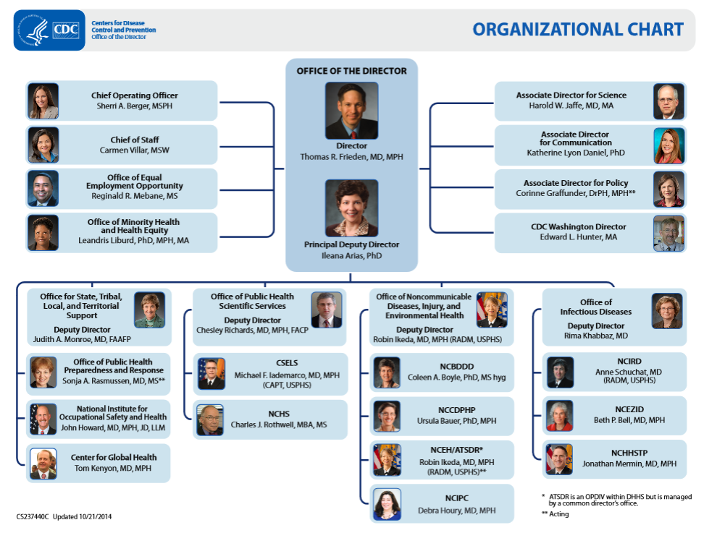

Slide 5
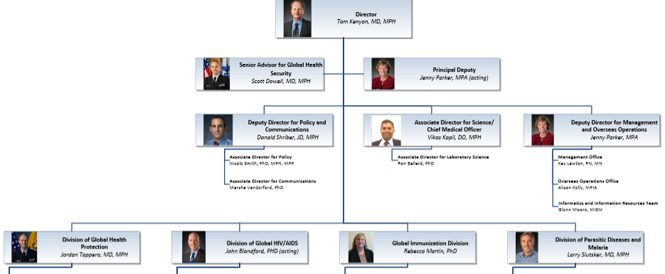
Center for Global Health

Slide 6
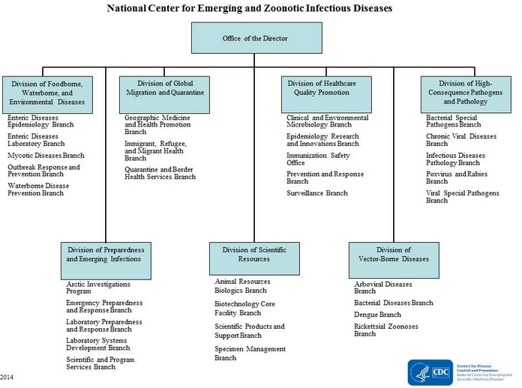

Slide 7
Internships and Practicums
Typical Requirements
  Enrolled as a full-time student in public health graduate program
  Have at least 3.0 GPA on 4.0 scale
  Ability to commit to the length of practicum or internship
  US Citizen or Permanent Resident

Slide 8
Ferguson Emerging Infectious Disease Fellowship Program
CDC-funded, 9 week summer program
  Provides educational and professional development opportunities in infectious disease and health disparities research
Orientation: 1 week in Baltimore, MD (Kennedy Krieger Institute)
Mentored Research: 8 weeks at CDC, Kennedy Krieger, Maryland DHMH, Bloomberg SPH

Slide 9
Ferguson Emerging Infectious Disease Fellowship Program
Dates: May-July
Benefits
  $4,000 Stipend
  Housing and Round Trip travel (out of state)
  Membership to APHA
  Sponsorship to present at national scientific meeting
Application Deadline: January 31, 2015

Slide 10
CDC Graduate Environmental
Health Internship
CDC funded, 10 week summer internship
  Providing educational and professional development experiences for those interested in environmental health
Orientation: 1 week in Atlanta
Mentored Research: 9 weeks at NCEH

Slide 11
CDC Graduate Environmental
Health Internship
Dates: June 10th to August 15th (2015)
Benefits
  $780/week stipend
  Attend Field trips with other interns
  Potential to travel to local meetings and conferences on environmental health topics
Application Deadline: February 25, 2015

Slide 12
CDC Public Health Jobs
Public Health Advisor
Epidemiologist
Health Scientist
Health Policy Analyst
Quality Assurance Specialist

Slide 13
CDC Career Training Fellowships
Typical Requirements
  Graduation from Accredited MPH program
  US Citizen or Permanent Residence
  Stellar Academic Record
  Interpersonal Skills
  Strong Letters of Recommendation

Slide 14
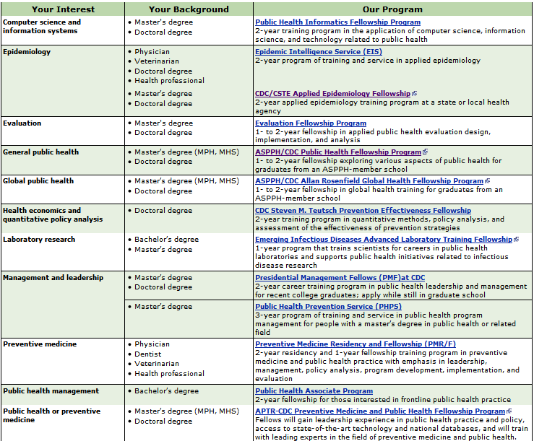
CDC Career Training Fellowships

Slide 15
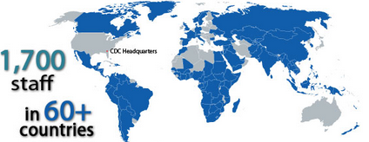
Rosenfield Global Health Fellowship
What?
  1-2 years of practical, first-hand
  global health experience
Where?
  CDC Atlanta HQ
  50+ foreign countries (CDC presence)
Requirements:
  Strong interest in a career in global public health
  US Citizen or Permanent Resident
  Graduate from accredited MPH program
  Willingness to relocate at fellow’s expense

Slide 16
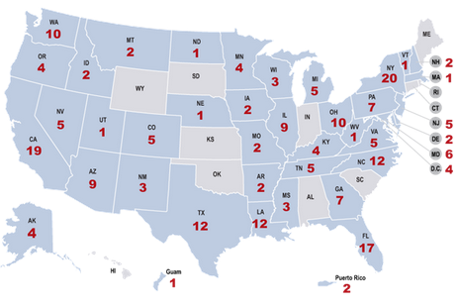
Public Health Associate Program
What?
  2 year field training and service
  program
Where?
  2 field assignments (1 year each) to state, local, territorial public health agencies (or CDC Quarantine Stations) in the US
Requirements
  Strong interest in public health career
  US Citizen or Permanent Resident
  Graduate from accredited MPH program
  Willingness to relocate at associate’s expense

Slide 17

CDC/CSTE Fellowship
What?
  2 year field training program to train graduates in applied epidemiology
  Program Areas: Chronic Disease, Environmental Health, Infectious Disease, Injury, Maternal/Child Health, Occupational Health, Oral Health, Substance Abuse
Where?
  Field assignments at state or local public health agency
Requirements
  Strong interest in applied epidemiology and desire for long term career at state or local level
  Graduate from accredited MPH program
  US Citizen or Permanent Resident

Slide 18
CDC Evaluation Fellowship
What?
  1 year field training program in program evaluation and improvement (likelihood for 2nd year renewal)
Where?
  CDC HQ under CDC’s Chief Evaluation Officer
Requirements
  Strong interest in program evaluation and improvement
  US Citizen
  Graduate Degree (strong record of applied evaluation projects)

Slide 19

CDC ORISE Research
Participation Programs
What?
  1 year research participation programs (up to 4 years renewable)
Where?
  CDC HQ, CDC field offices
Requirements
  Strong interest in applied research
  Current enrollment in accredited college or university
  Graduate degree within 5 years of start date

Slide 20
CDC ORISE Research
Participation Programs
Current Openings
  Public Health Analyst Fellowship
  Sexual and Reproductive Health Capacity Fellowship
  Environmental Epidemiology Fellowship
  Computational Exposure Assessment Fellowship
  Tobacco Surveillance Fellowship
  Behavioral Economics-Nutrition and Obesity Fellowship
  Public Health Informatics Fellowship

