Slide 1

Understanding Microsoft Teams
Meetings and Chats

Slide 2

Demo
https://teamsdemo.office.com/mobile/index.html#/

Slide 3
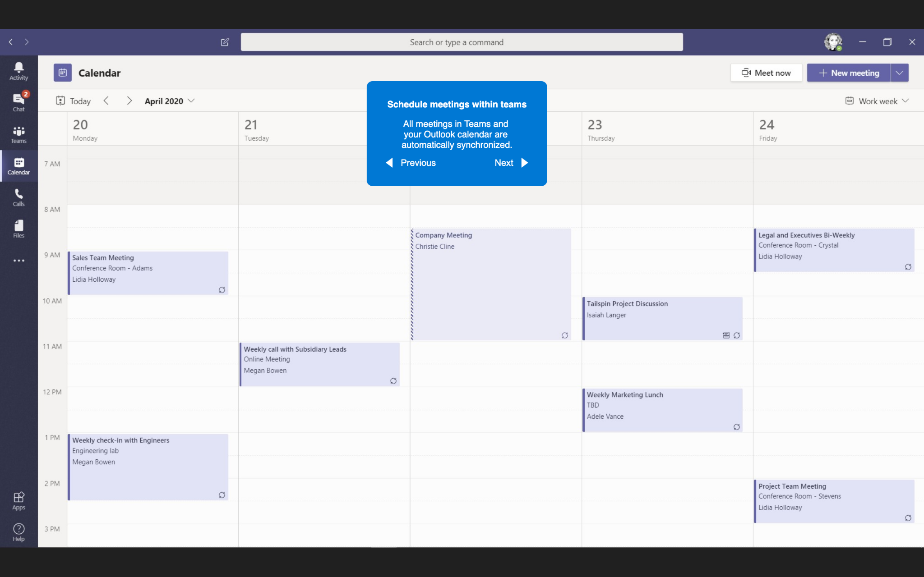
Scheduling Meetings
Schedule meetings within teams
All meetings in Teams and your Outlook calendar are automatically synchronized.

Slide 4
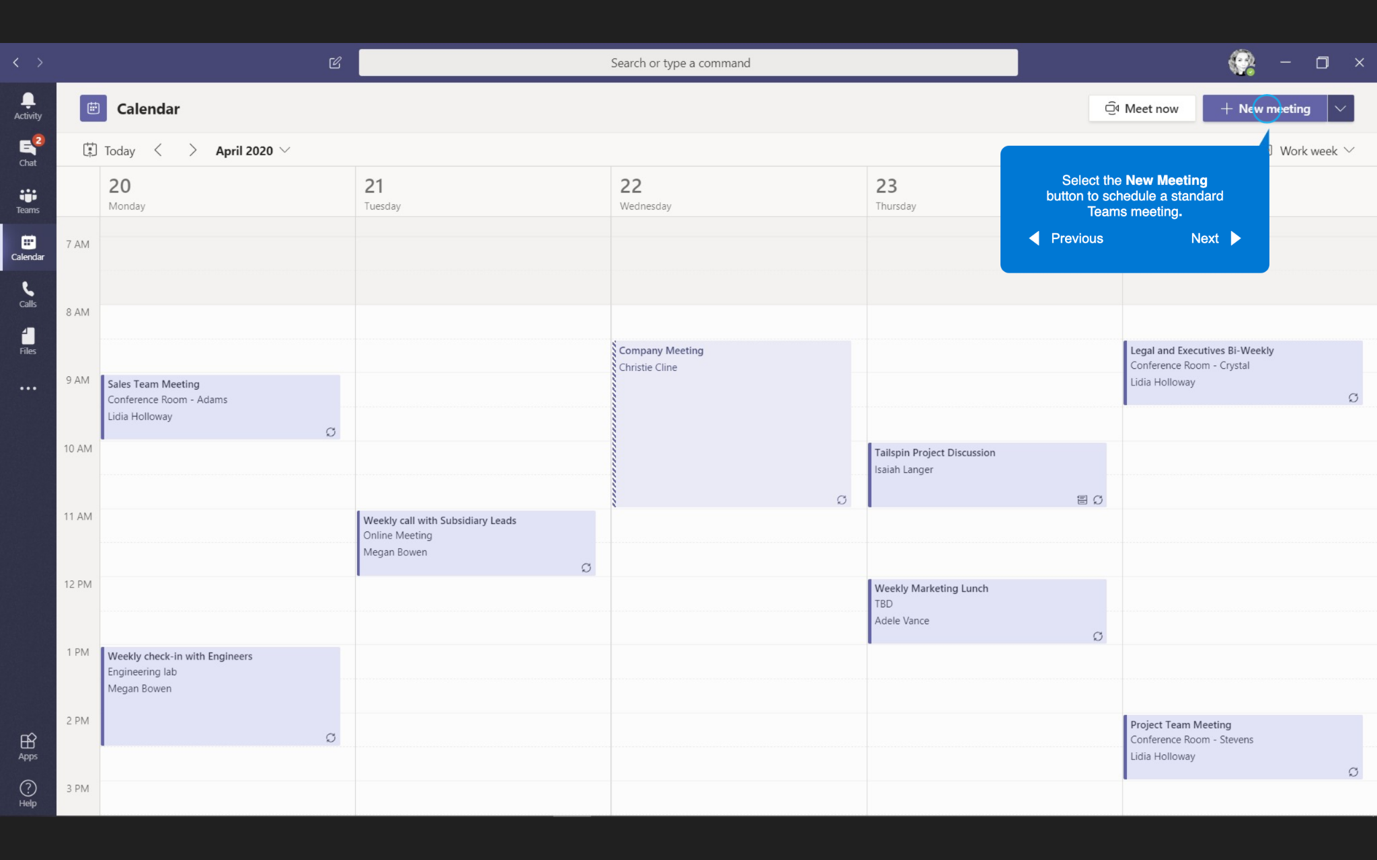
Scheduling Meetings
Select the New Meeting button to schedule a standard Teams meeting.

Slide 5
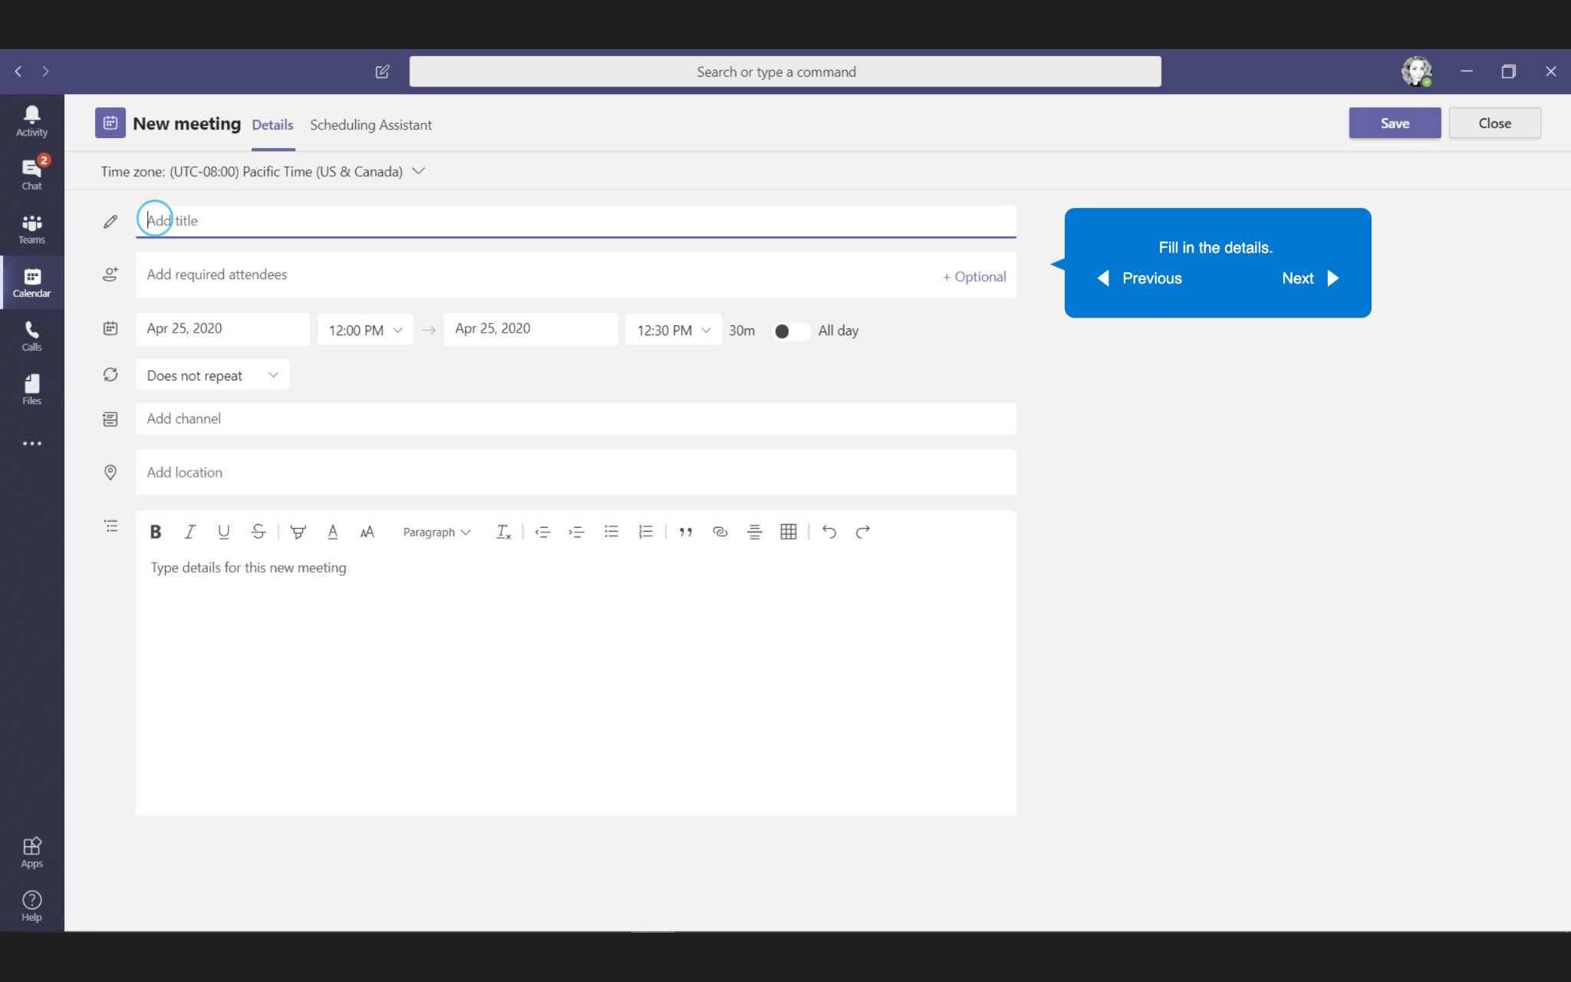
Scheduling Meetings
Fill in the details.

Slide 6
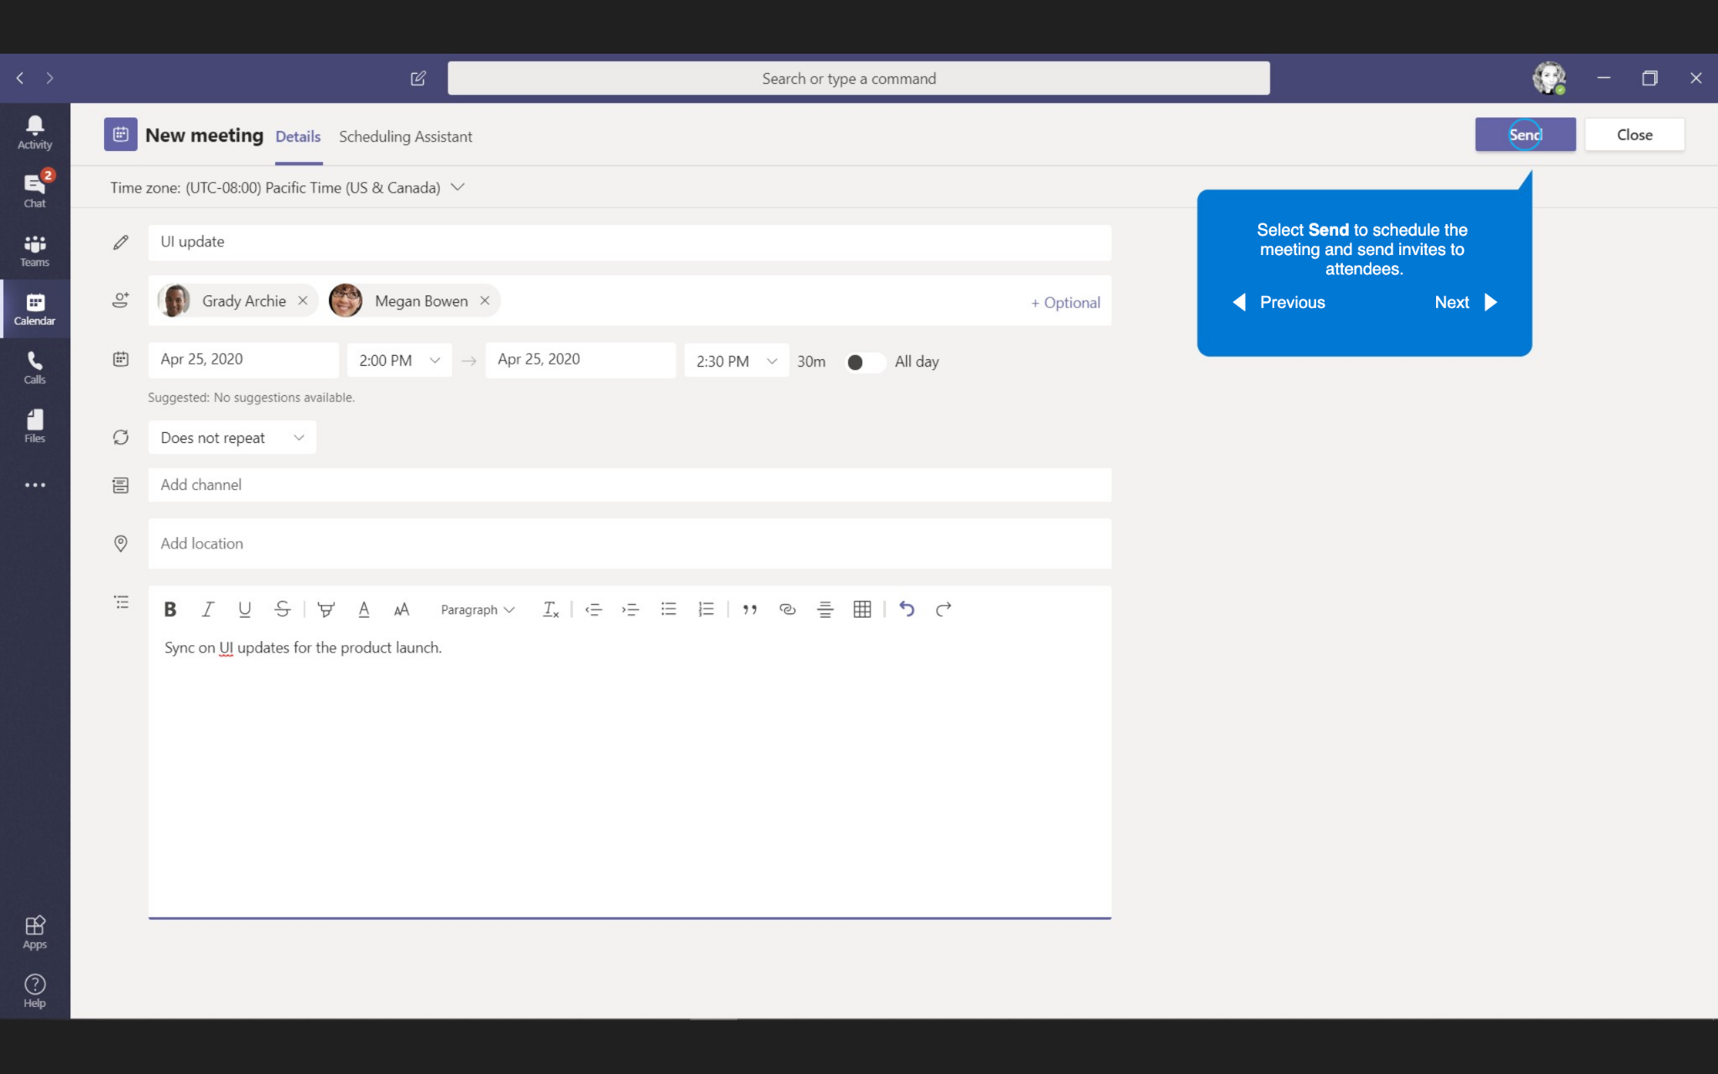
Scheduling Meetings
Select Send to schedule the meeting and send invites to attendees.

Slide 7
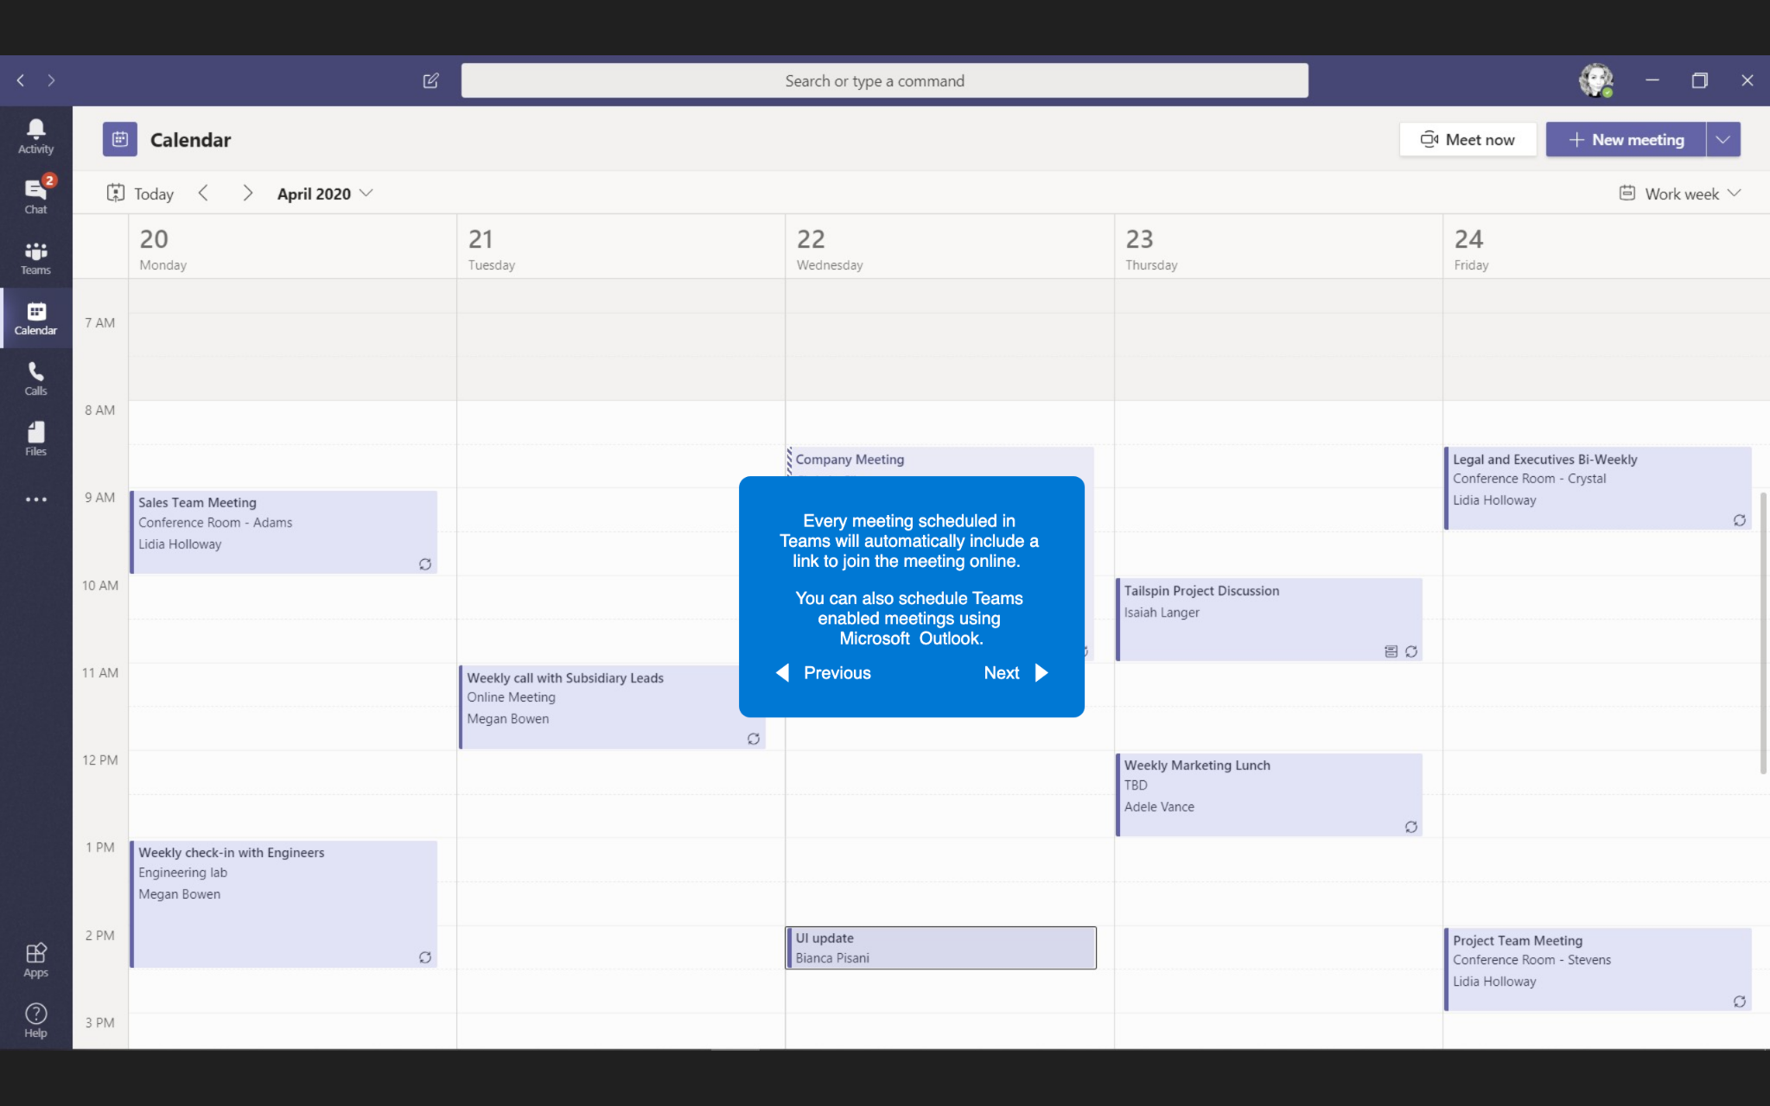
Scheduling Meetings
Every meeting scheduled in Teams will automatically include a link to join the meeting online.
You can also schedule Teams enabled meetings using Microsoft Outlook.

Slide 8
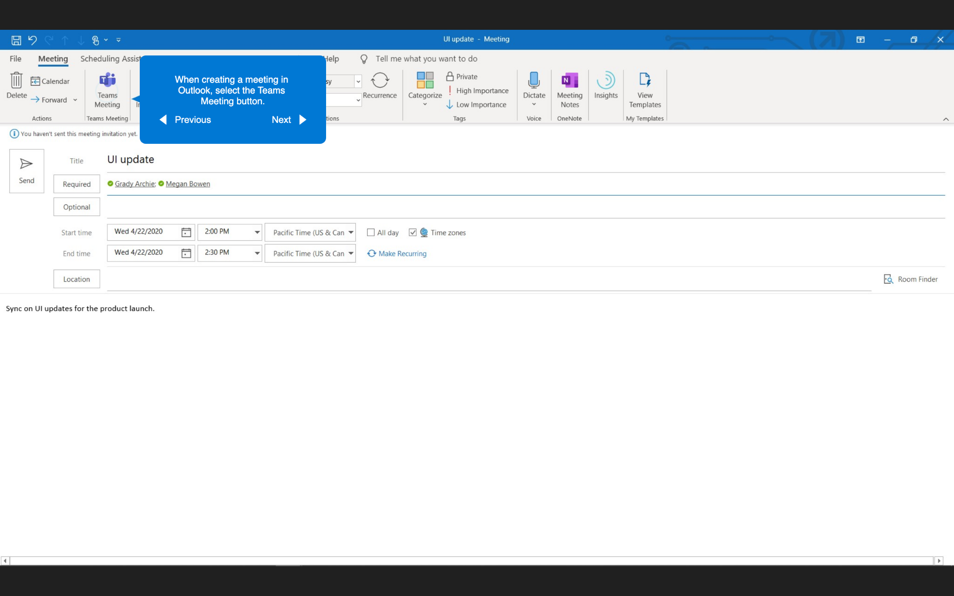
Scheduling Meetings
When creating a meeting in Outlook, select the Teams Meeting button.

Slide 9
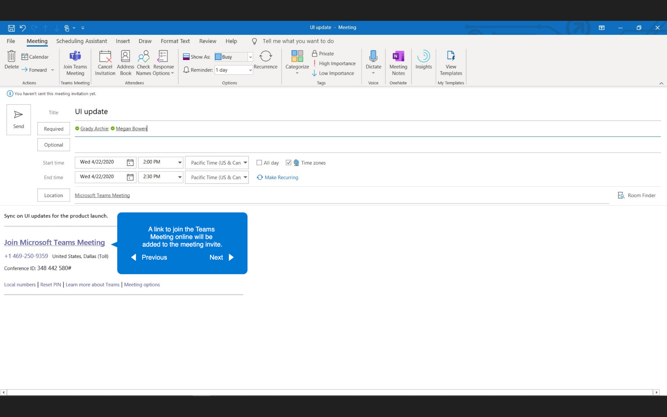
Scheduling Meetings
A link to join the Teams Meeting online will be added to the meeting invite.

Slide 10
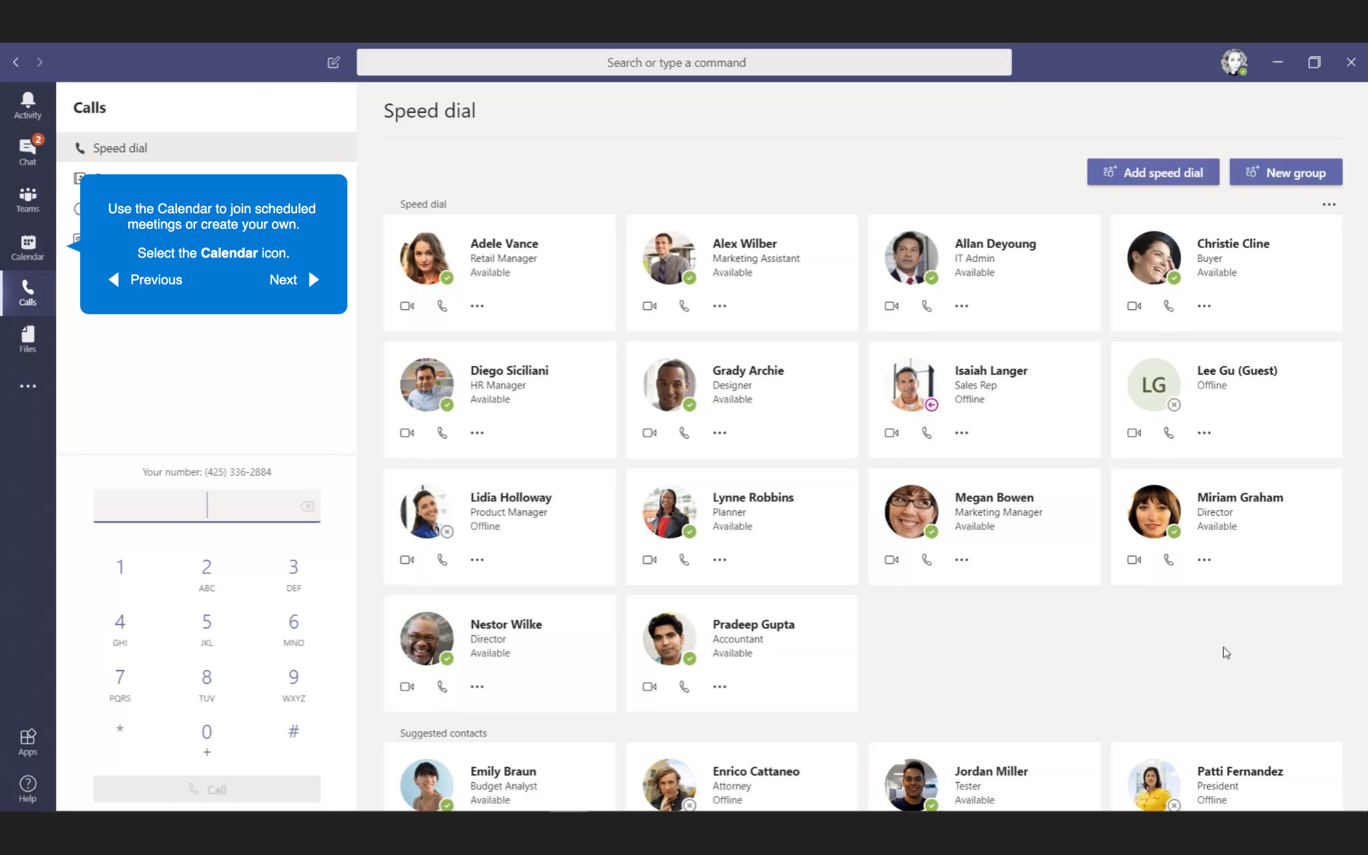
Joining Meetings
Use the Calendar to join scheduled meetings or create your own.
Select the Calendar icon.

Slide 11
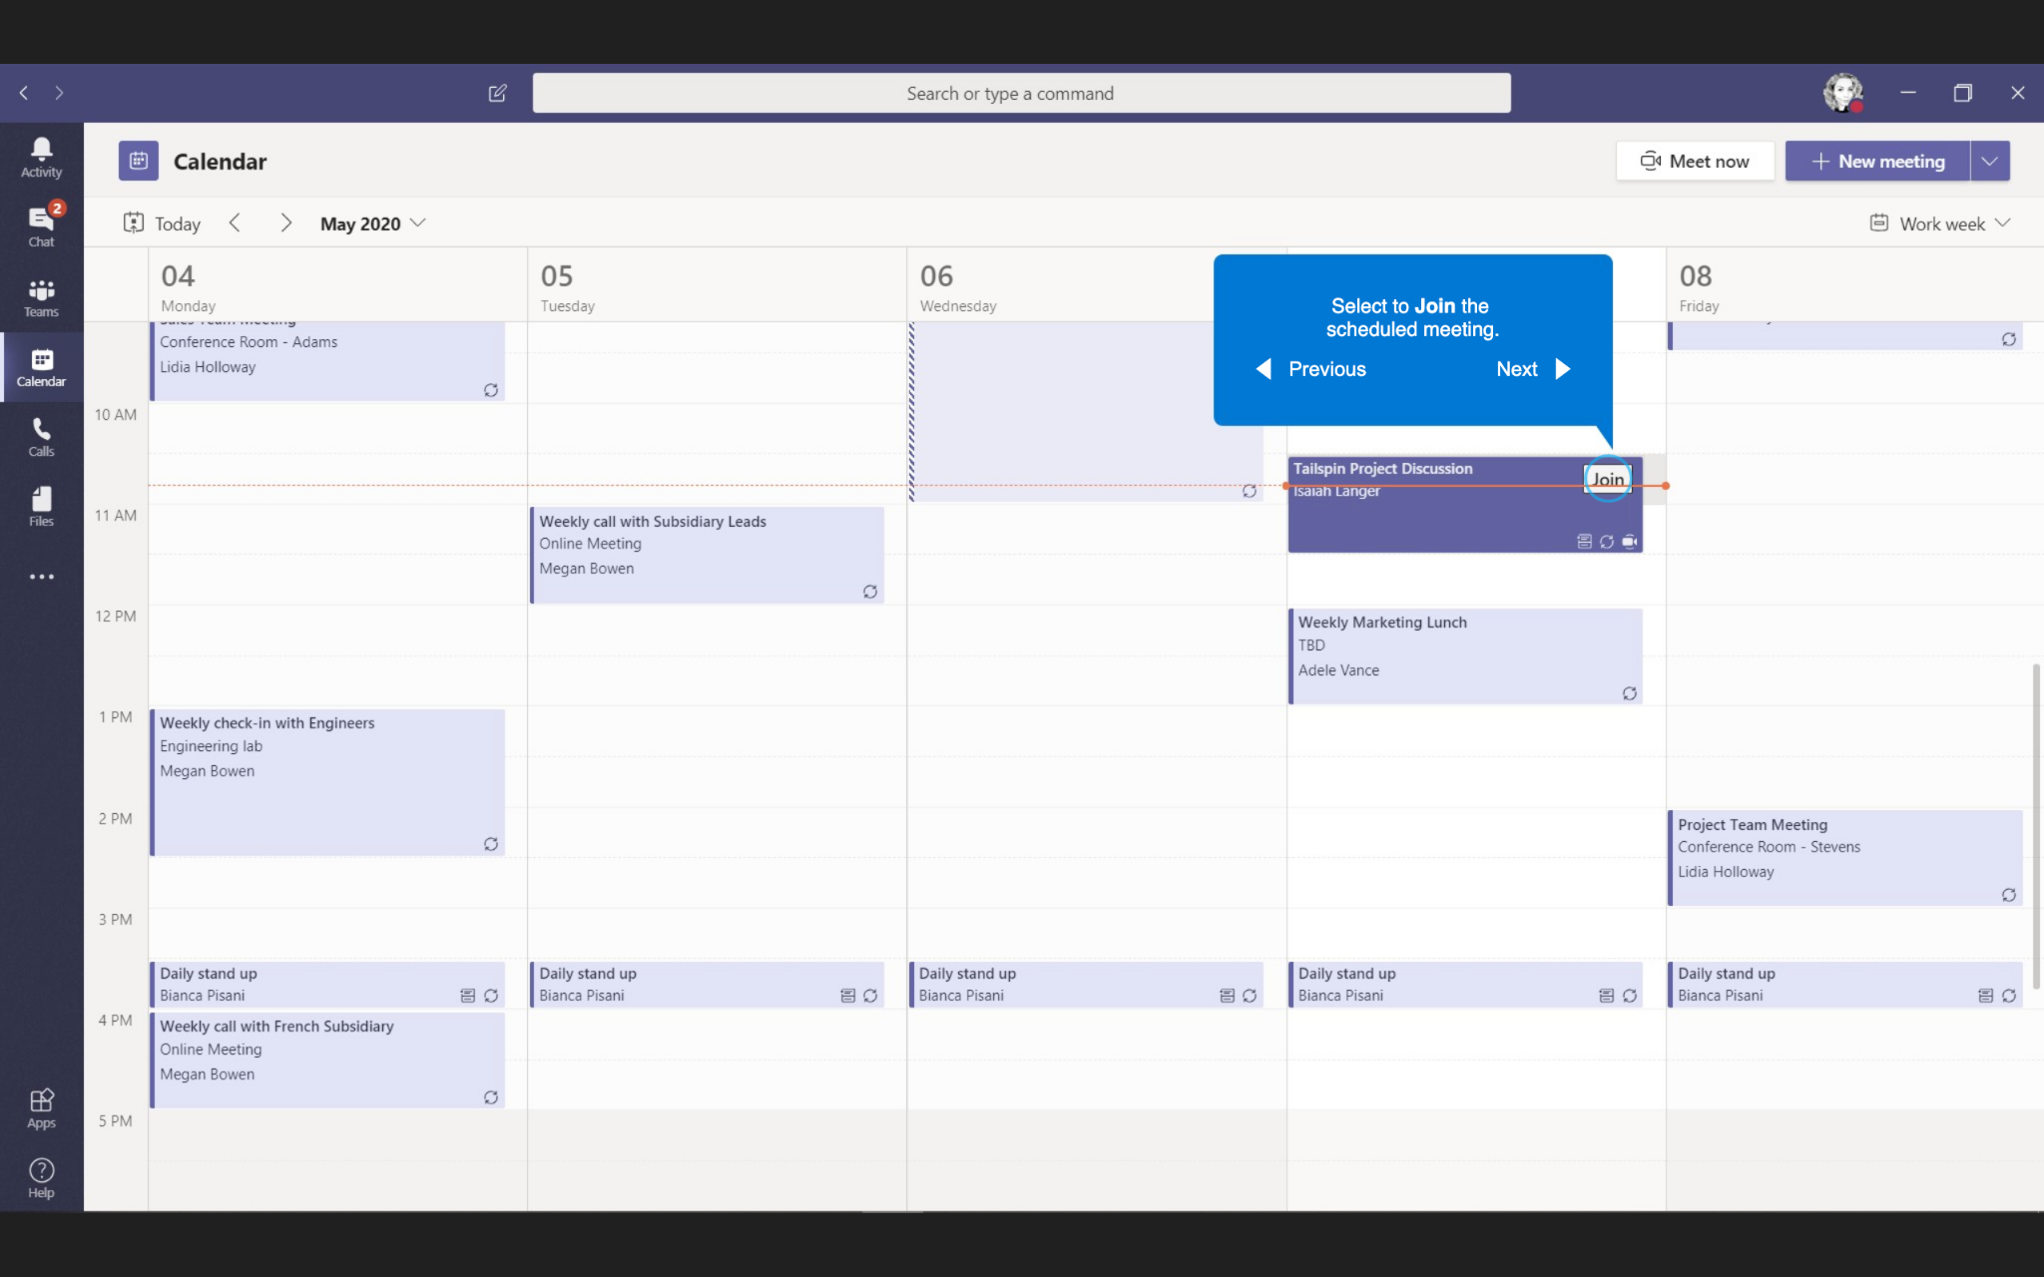
Joining Meetings
Select to Join the scheduled meeting.

Slide 12
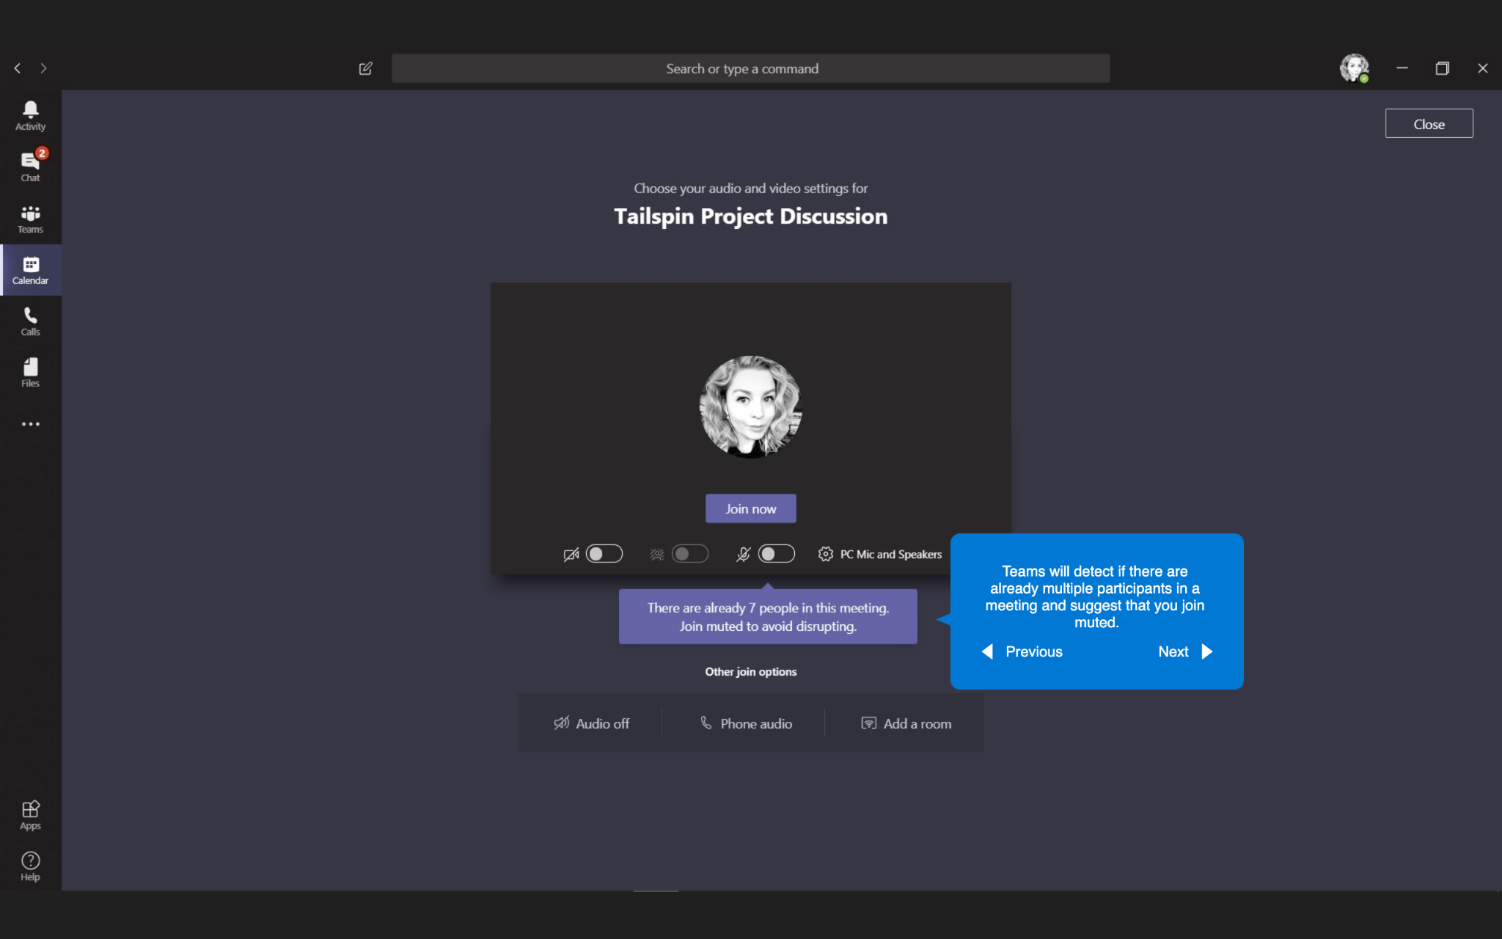
Joining Meetings
Teams will detect if there are already multiple participants in a meeting and suggest that you join muted.

Slide 13
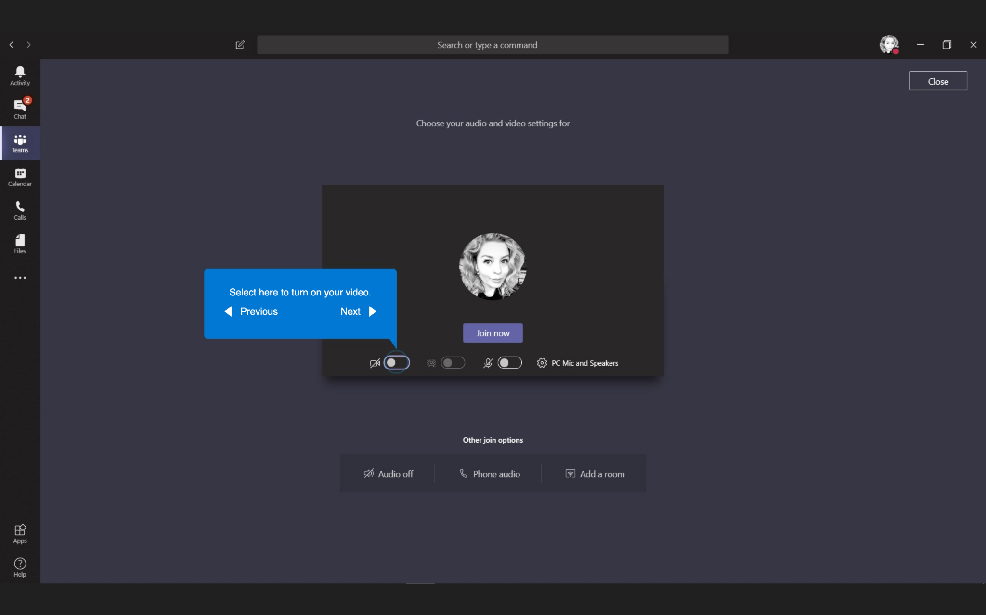
Joining Meetings
Select here to turn on you video.

Slide 14
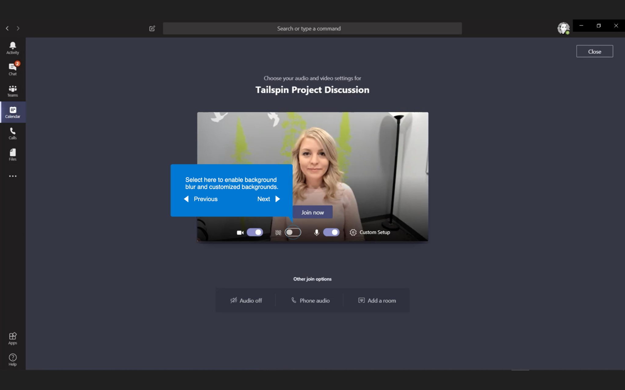
Joining Meetings
Select here to enable background blur and customized backgrounds.

Slide 15
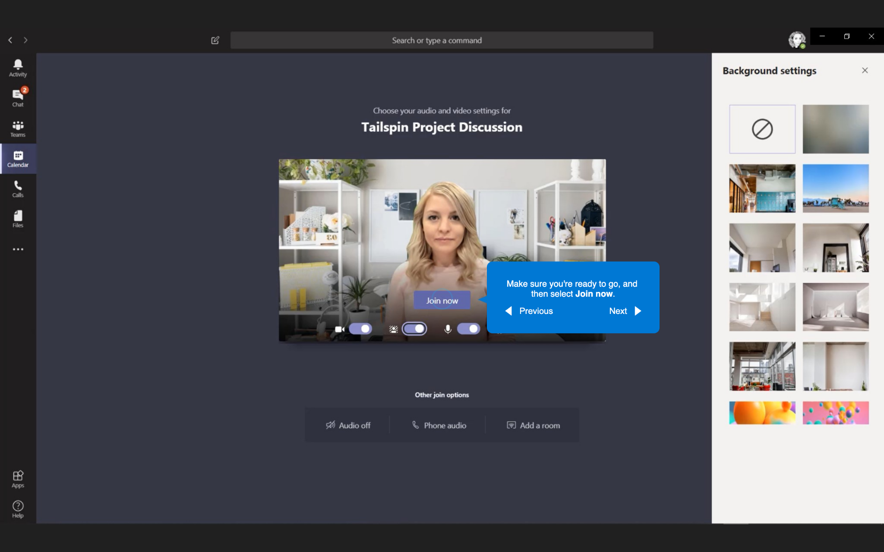
Joining Meetings
Makes sure you’re ready to go, and then select Join now.

Slide 16
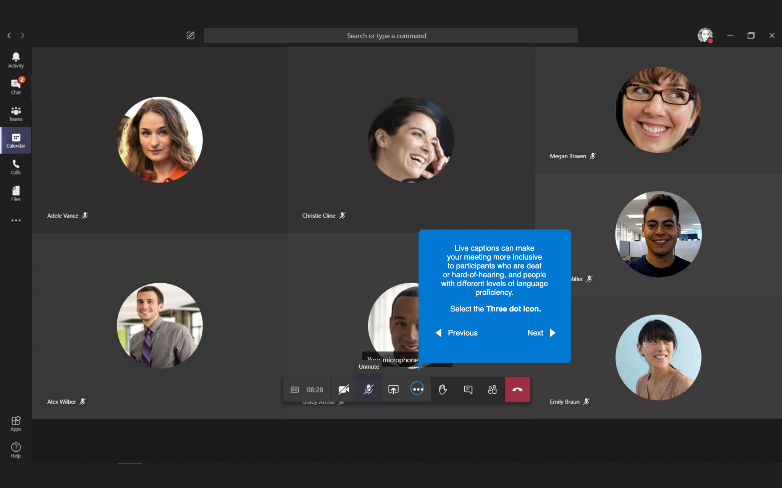
Joining Meetings
Live captions can make your meeting more inclusive to participants who are deaf or hard-of-hearing, and people with different levels of language proficiency.
Select the Three dot Icon.

Slide 17
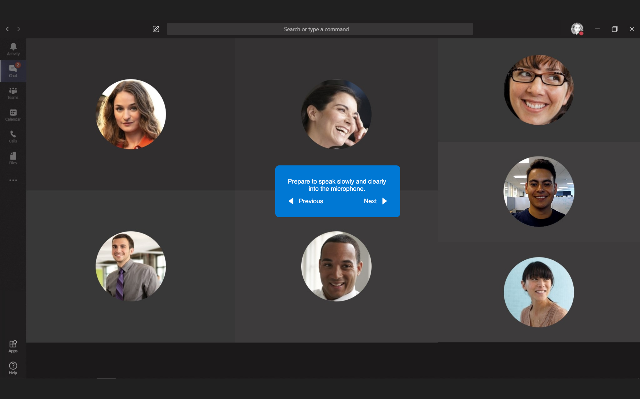
Joining Meetings
Prepare to speak slowly and clearly into the microphone.

Slide 18
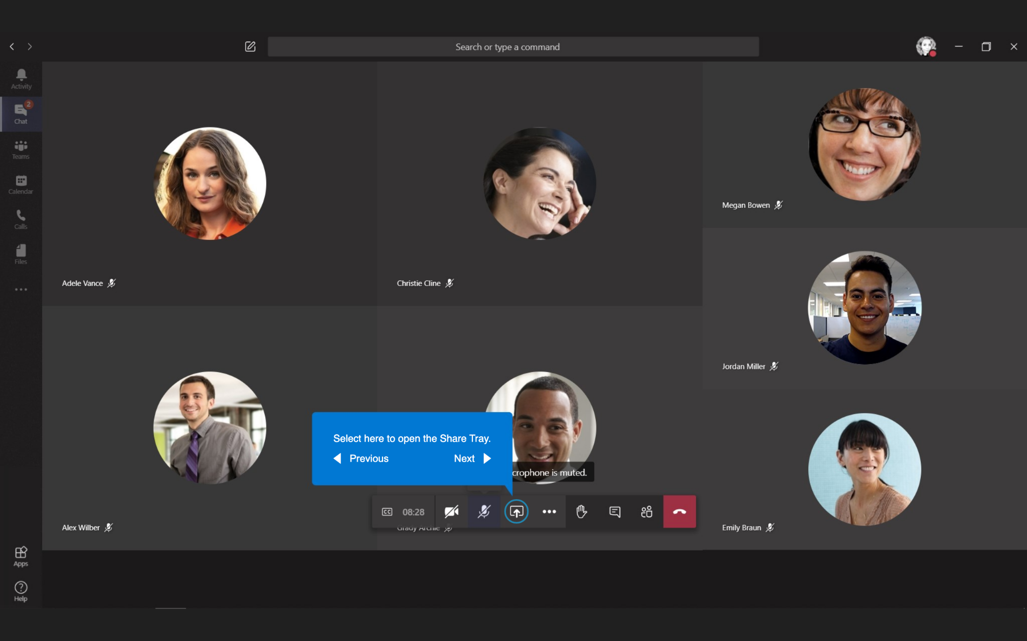
Joining Meetings
Select here to open the Share Tray.

Slide 19
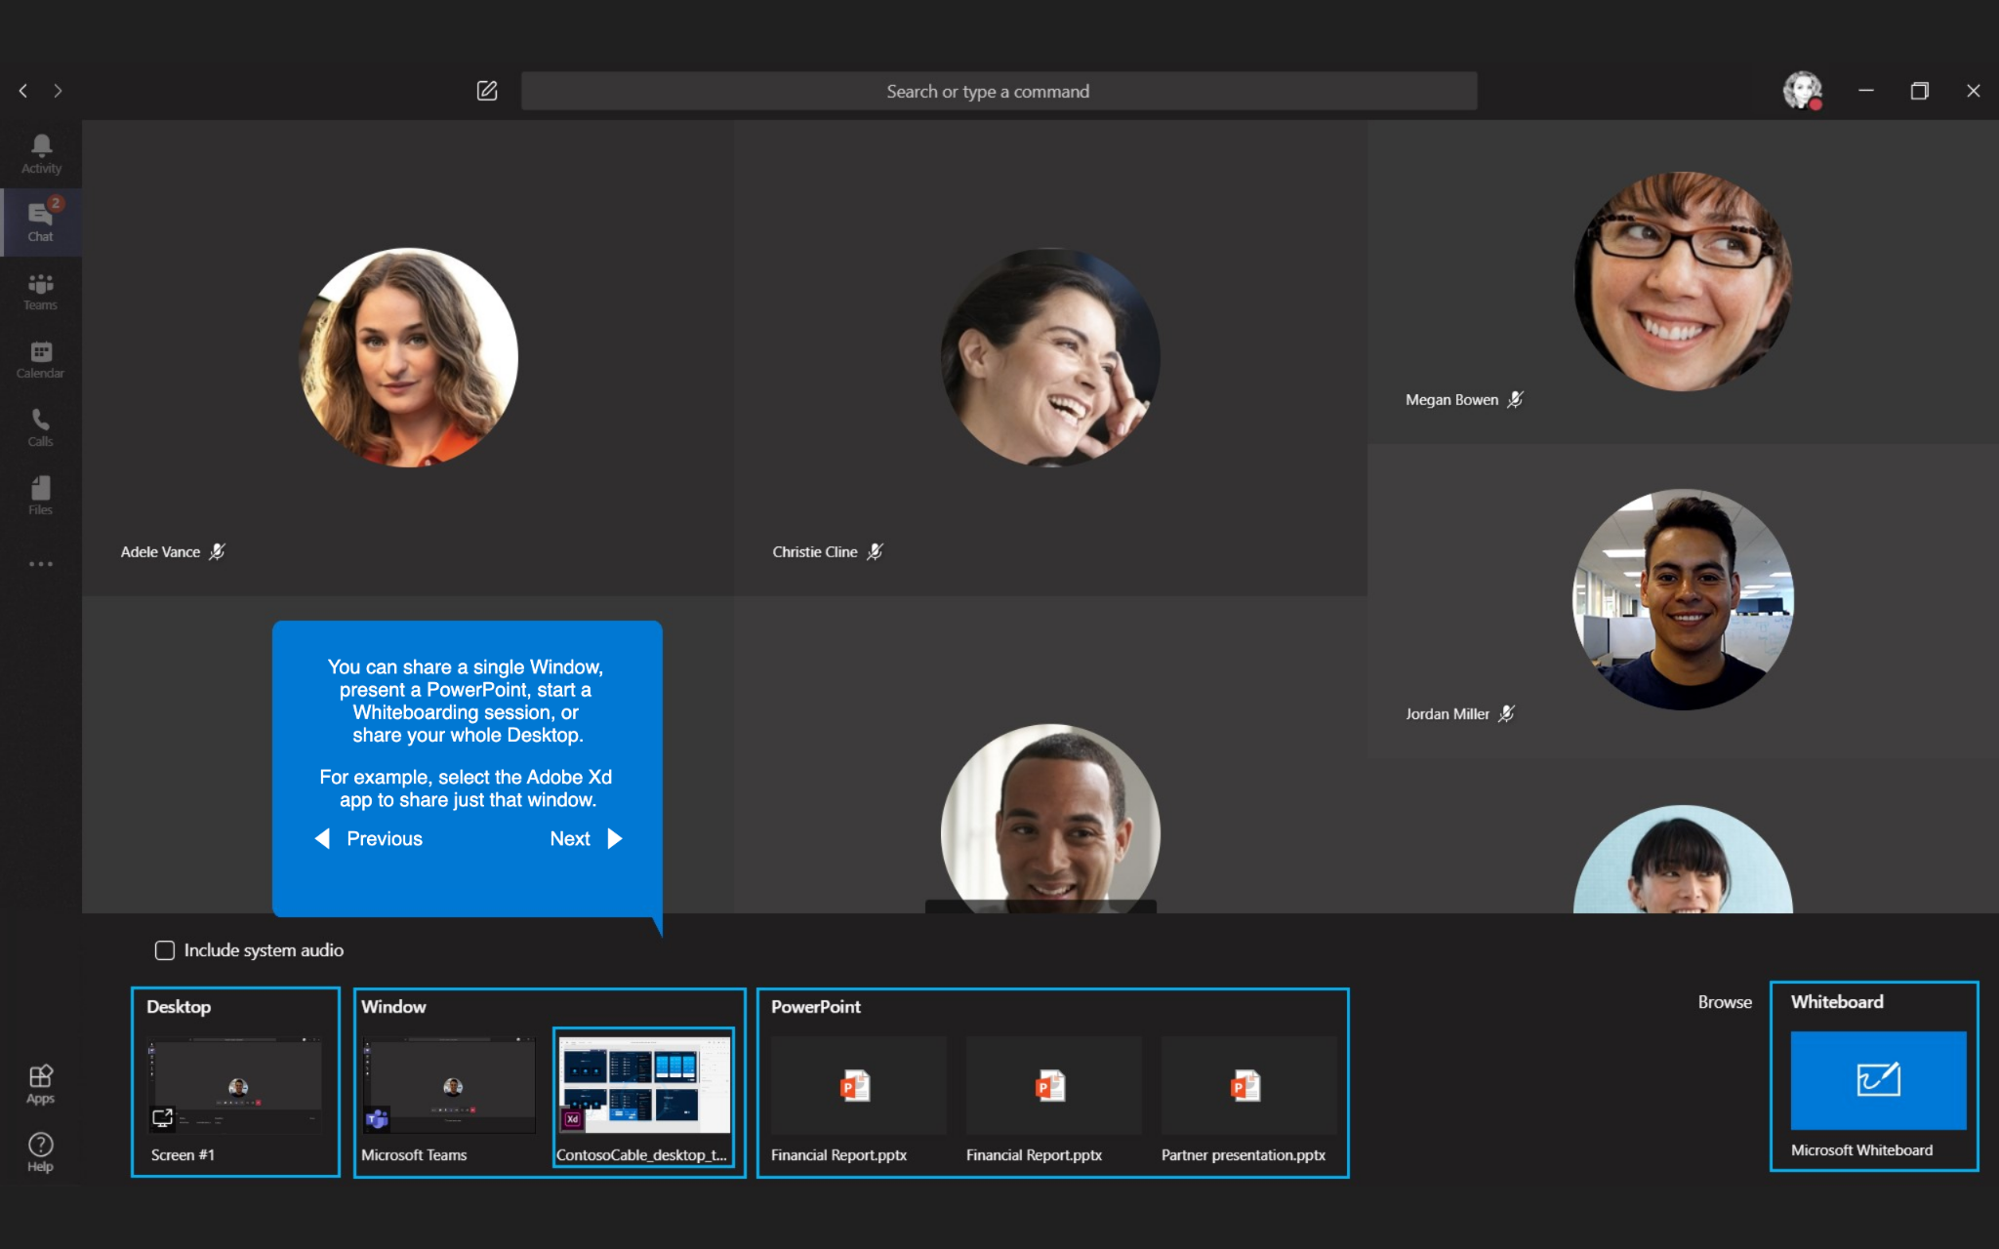
Scheduling meetings
You can share a single Window, present a PowerPoint, start a Whiteboarding session, or share your whole Desktop.
For example, select the Adobe Xd, app to share just that window.

Slide 20
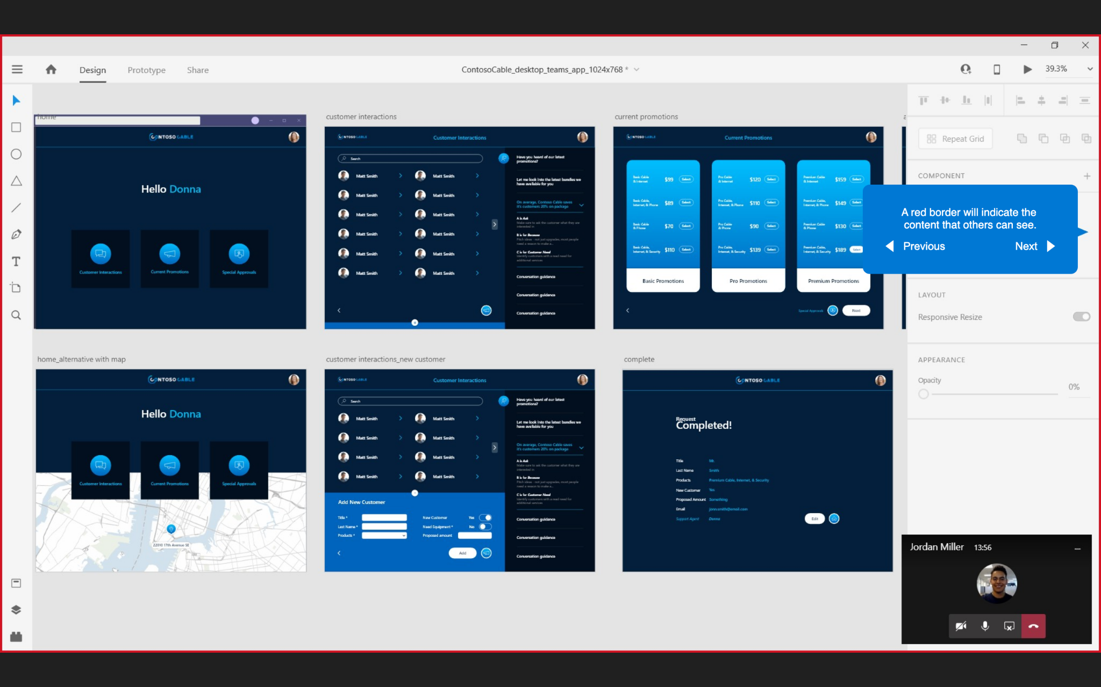
Joining Meetings
A red border will indicate the content that others can see.

Slide 21
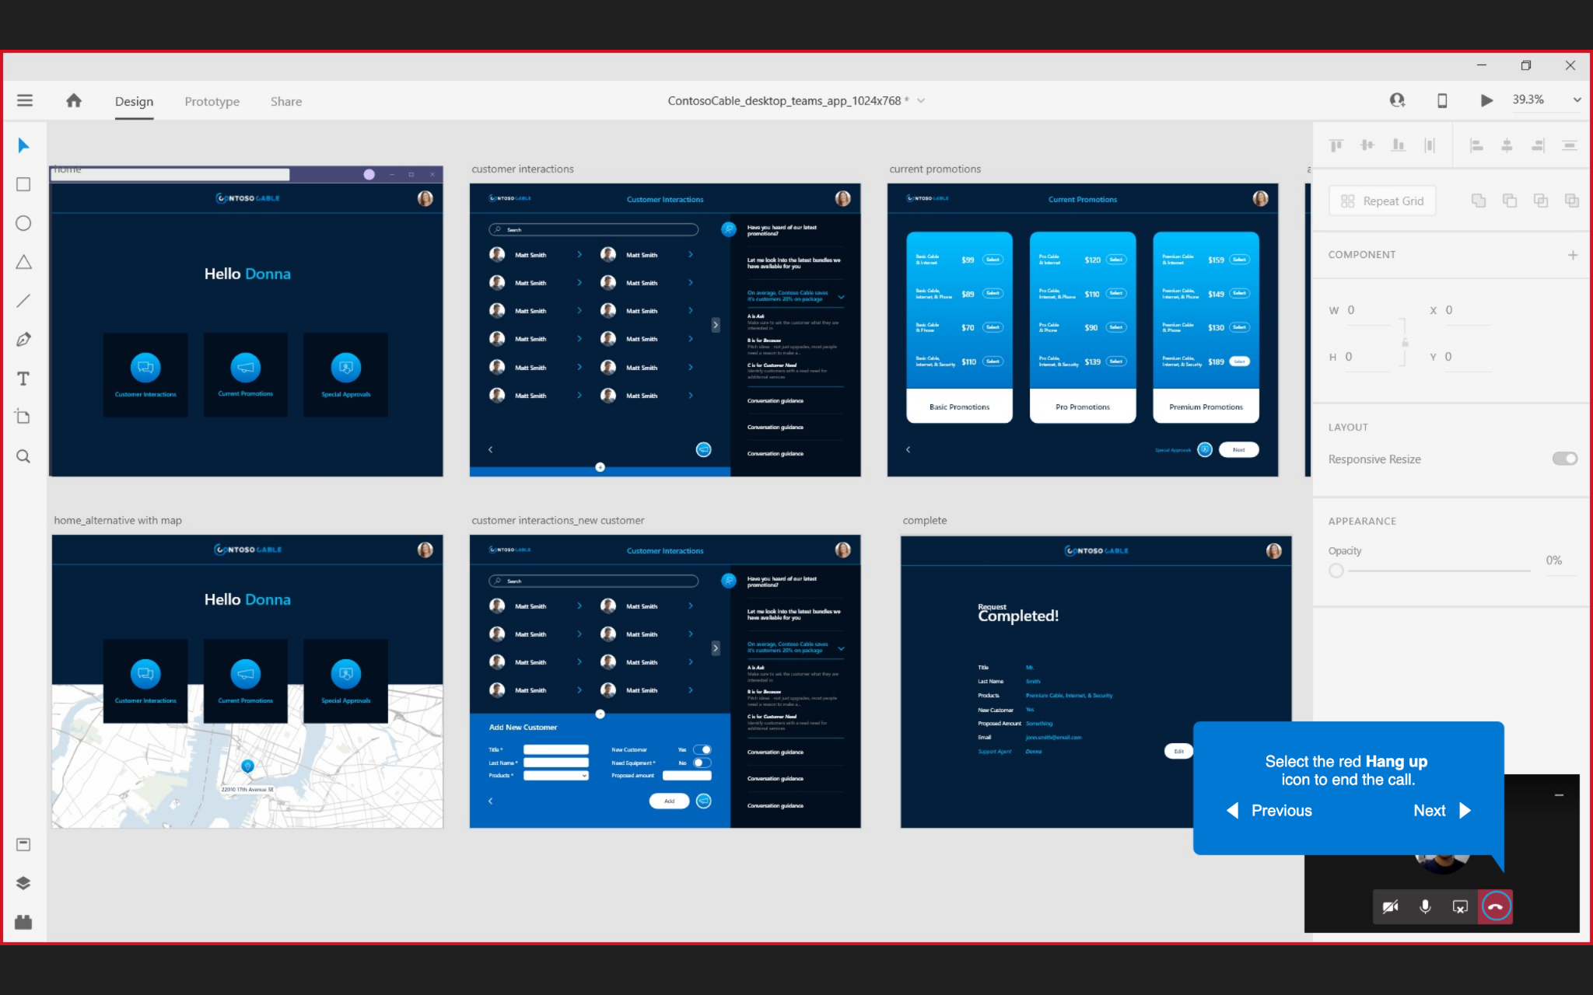
Joining Meetings
Select the red Hang up icon to end the call.

Slide 22
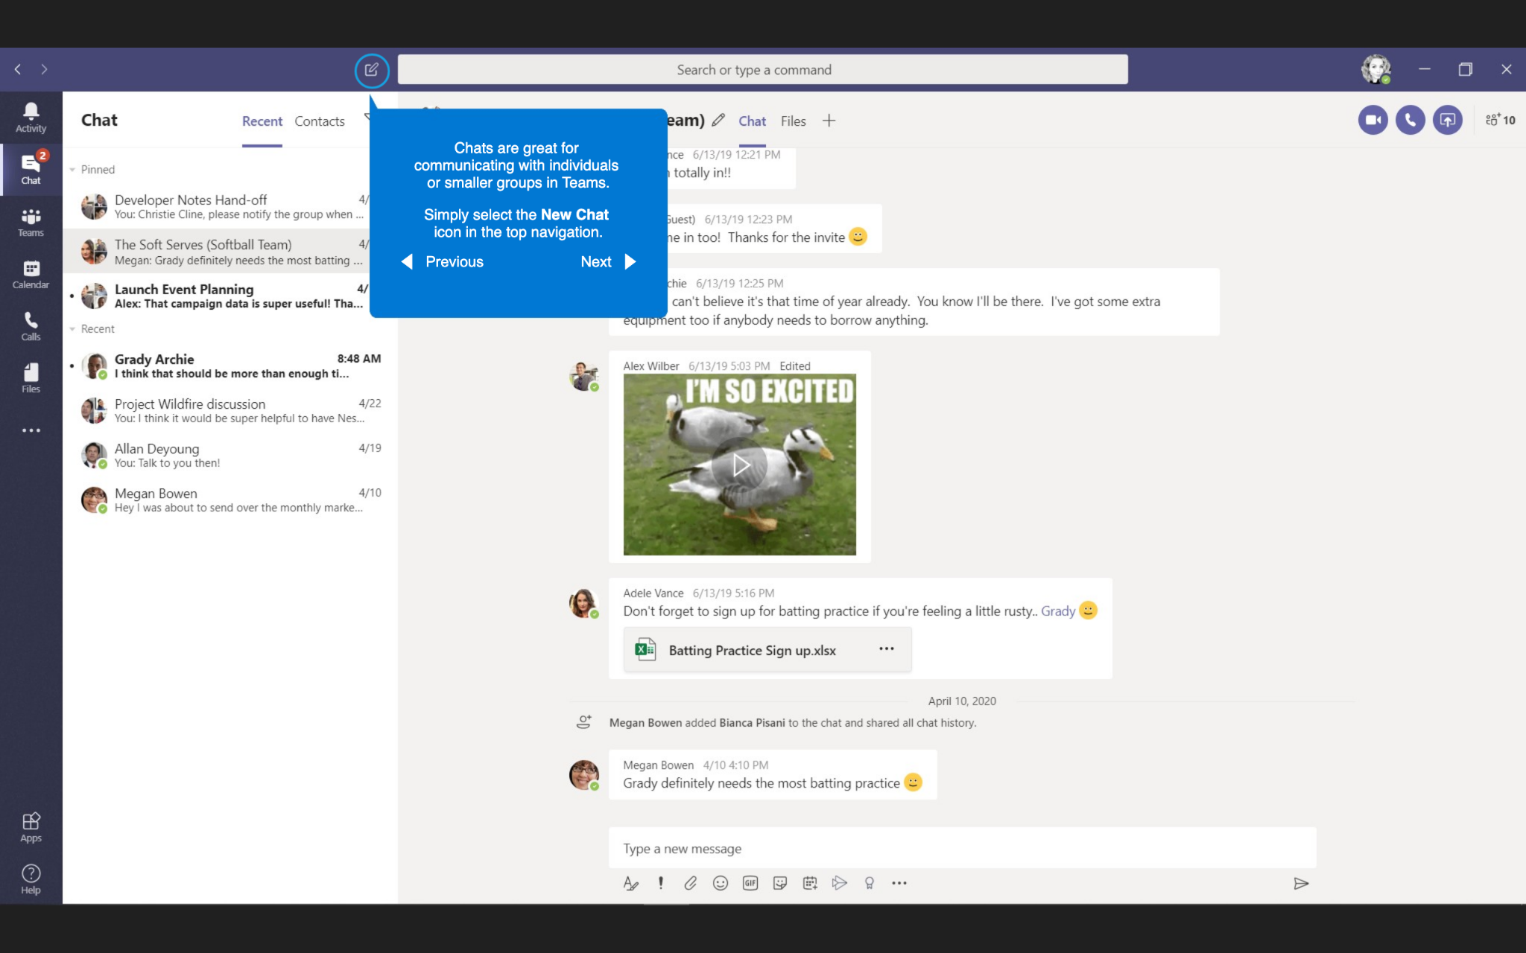
Chats
Chats are great for communicating with individuals or smaller groups in Teams.
Simply select the New Chat icon in the top navigation.

Slide 23
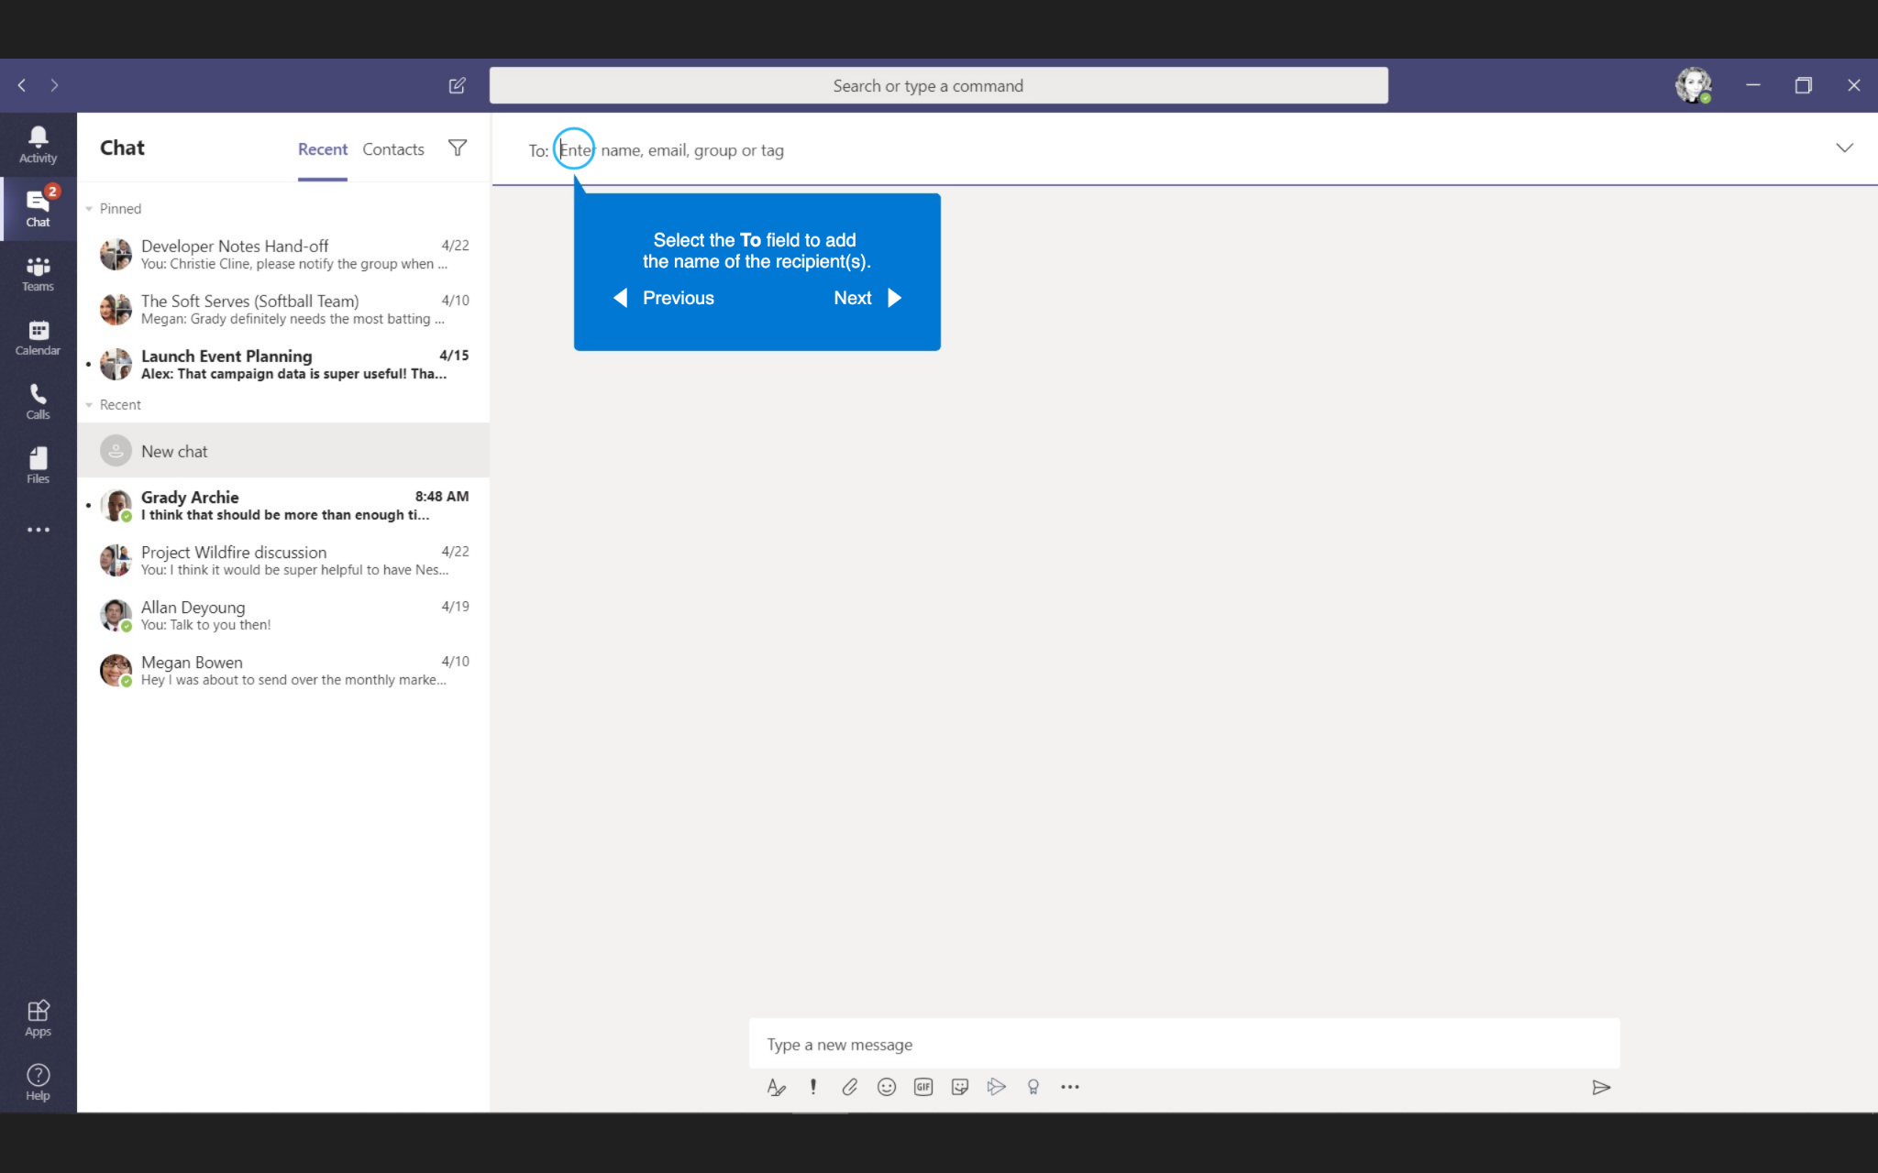
Chats
Select the To field to add the name of the recipient(s).

Slide 24
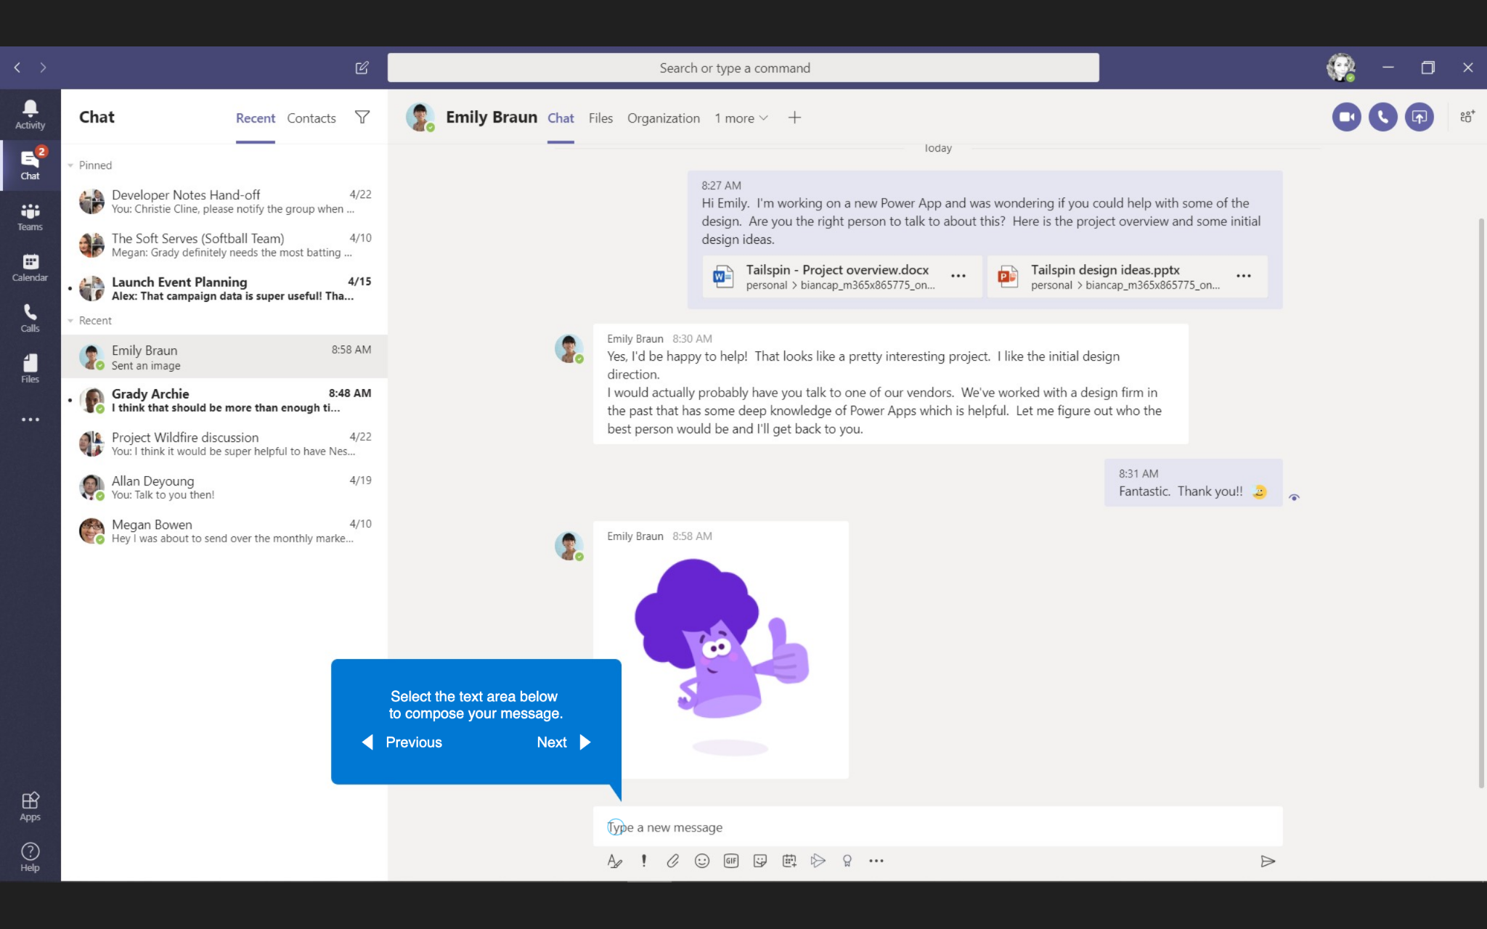
Chats
Select the text area below to compose your message.

Slide 25
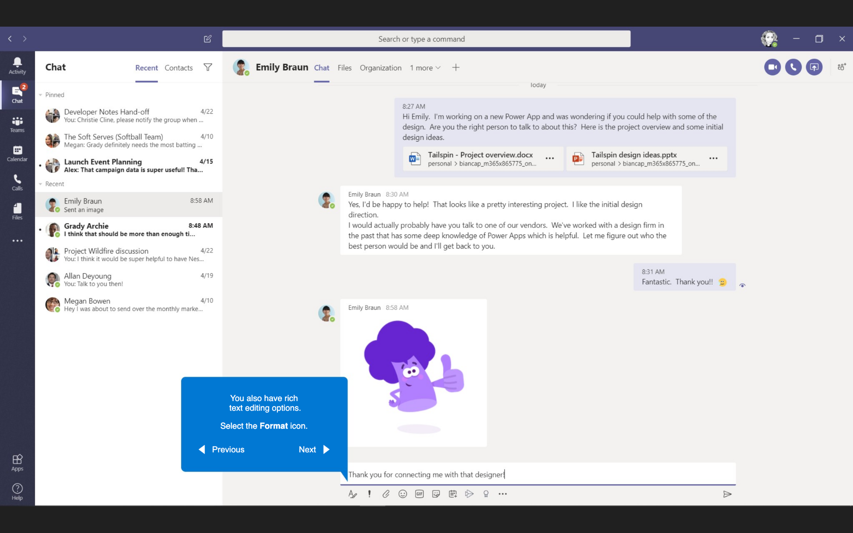
Chats
You can also have rich text editing options.
Select the Format icon.

Slide 26
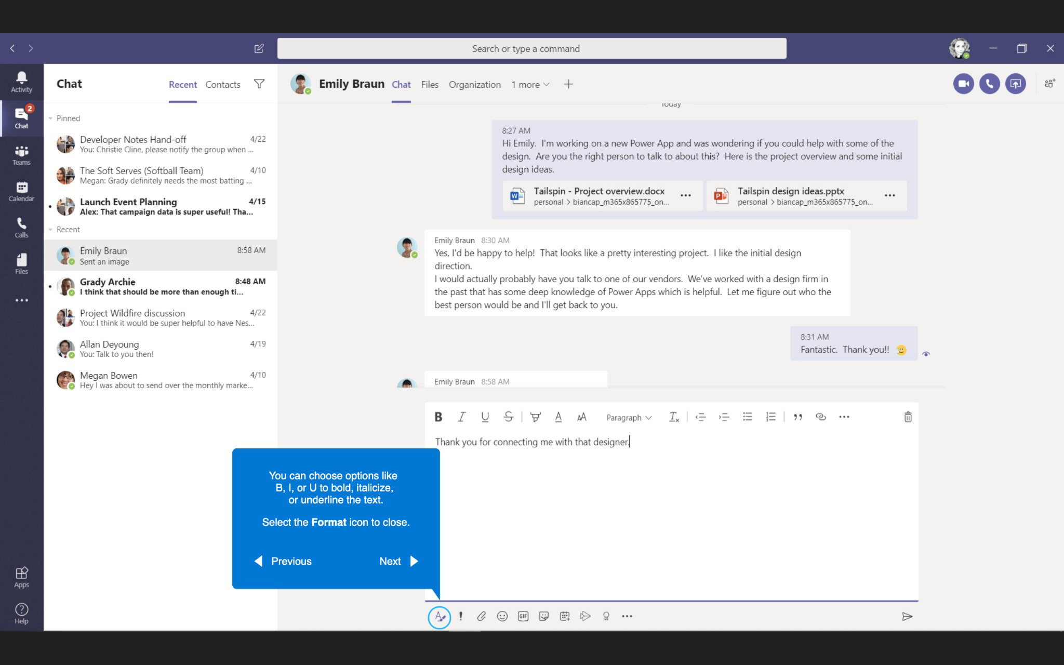
Chats
You can choose options like B, I, or U to bold, italicize, or underline the text.
Select the Format icon to close.

Slide 27
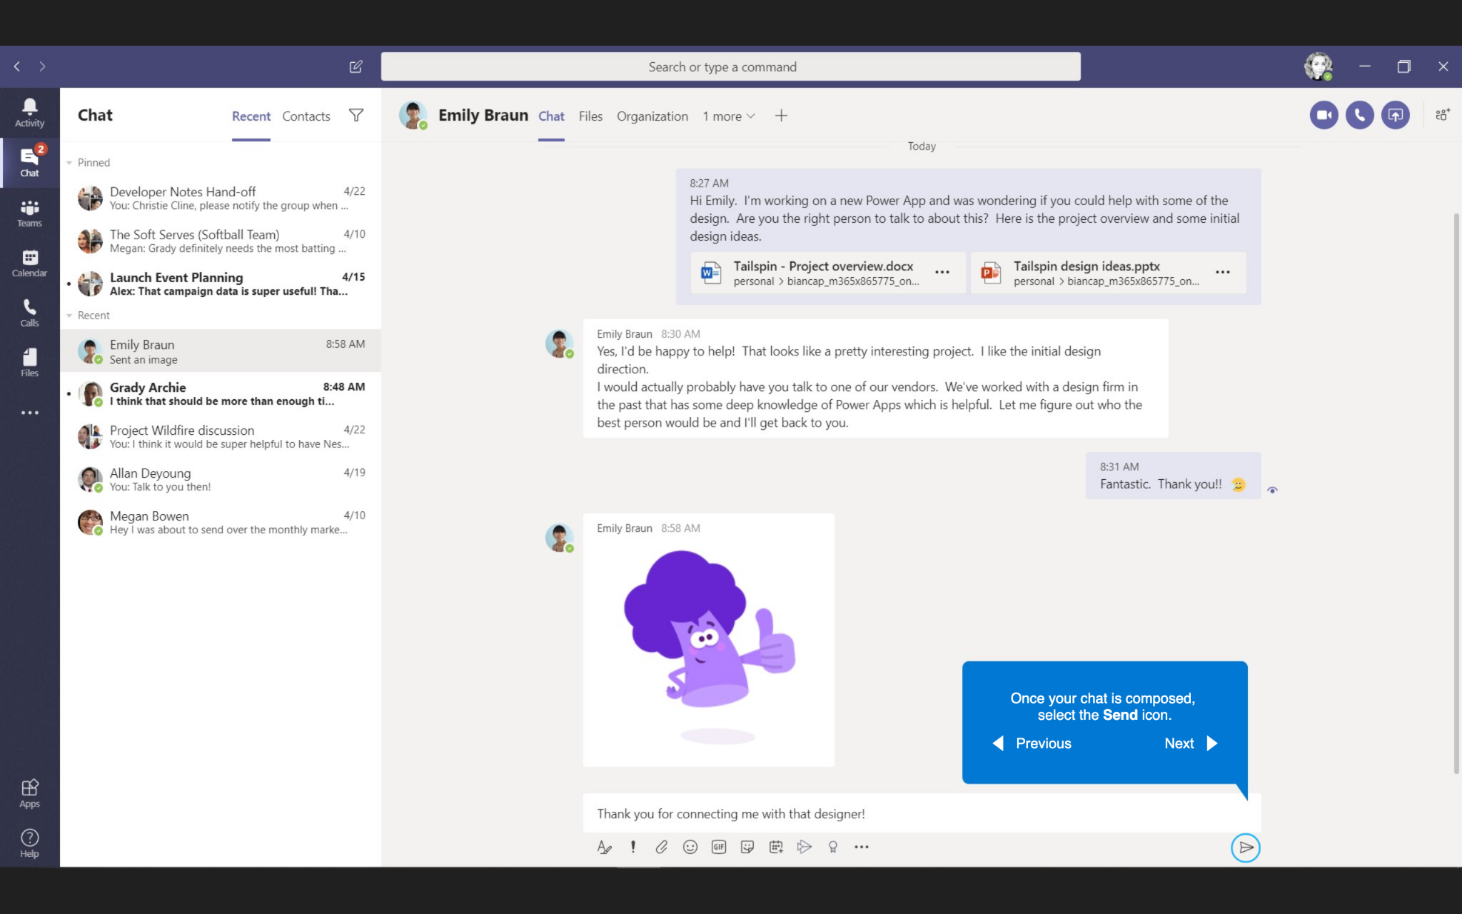
Chats
Once your chat is composed, select the Send icon.

Slide 28
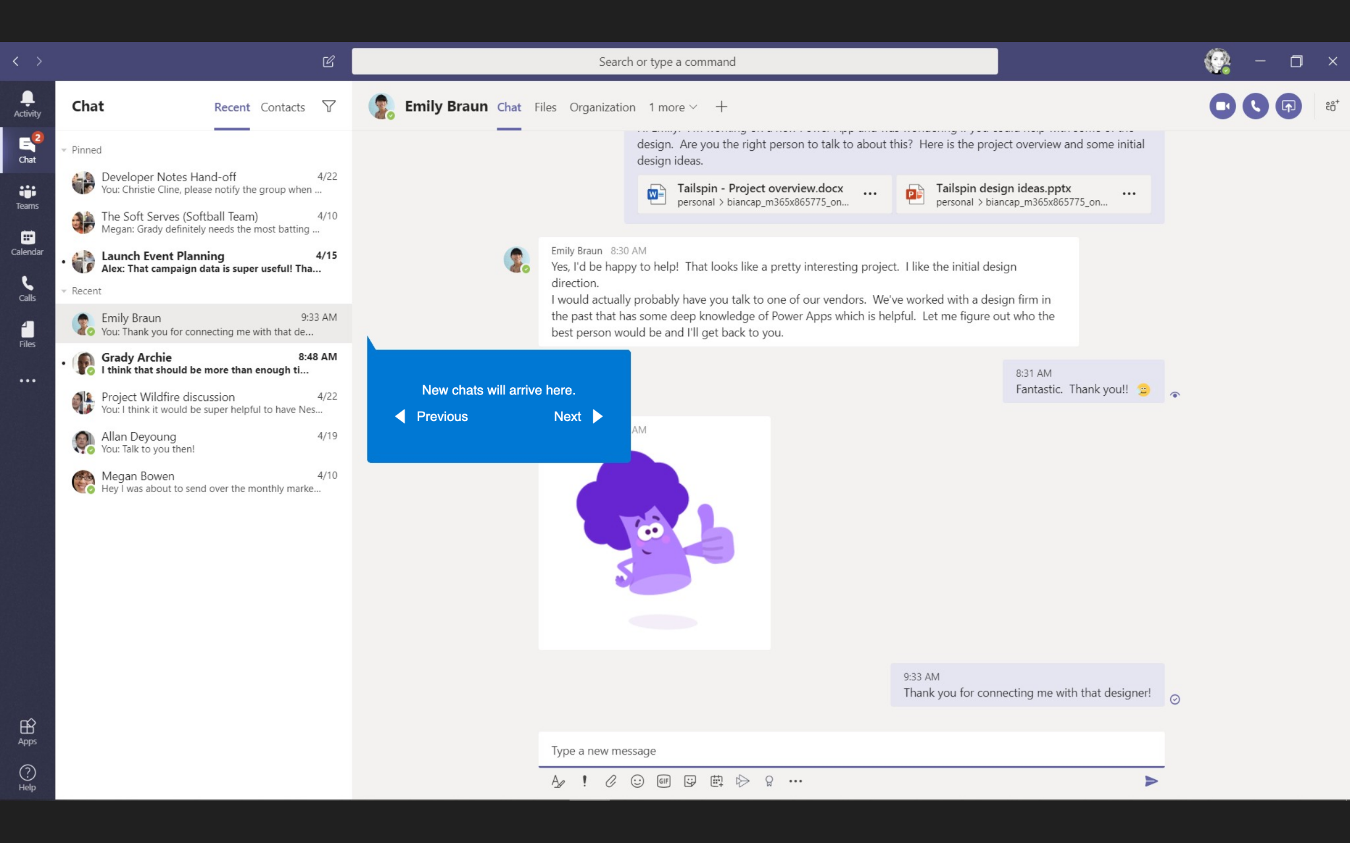
Chats
New chats will arrive here.

Slide 29
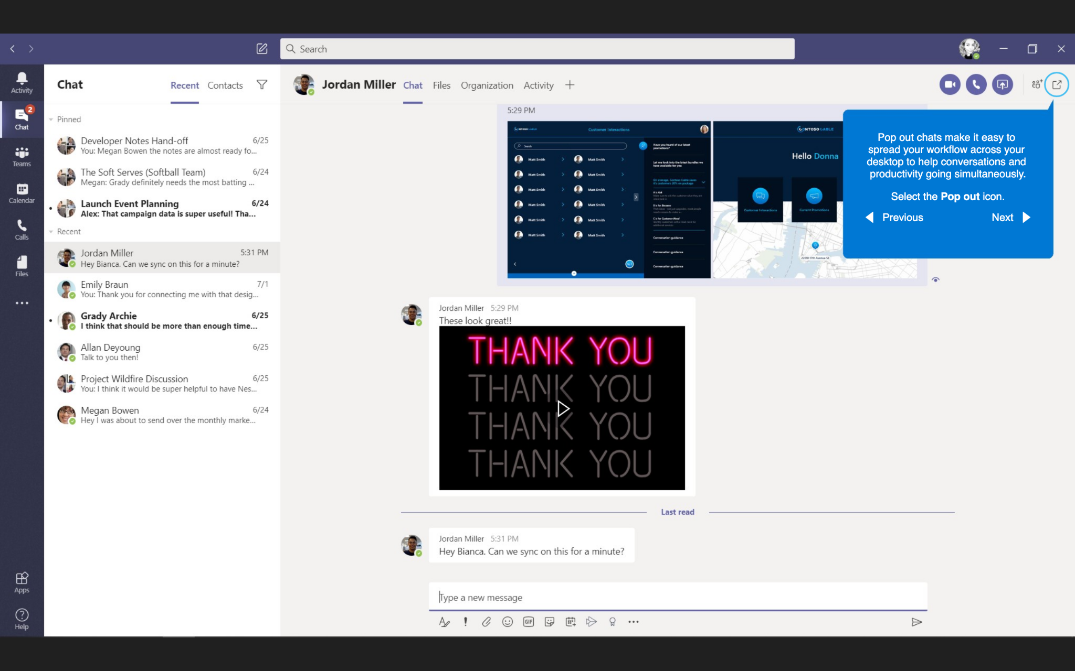
Chats
Pop out chats make it easy to spread your workflow across your desktop to help conversations and productivity going simultaneously.
Select the Pop out icon.

Slide 30
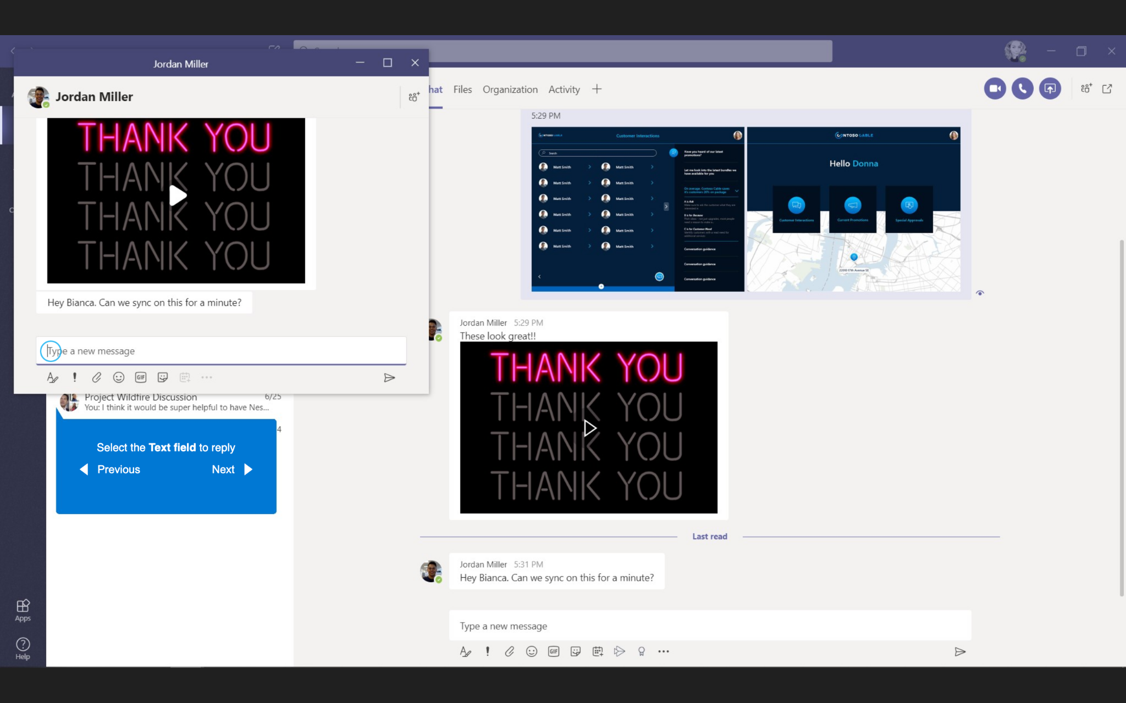
Chats
Select the Text field to reply.

Slide 31
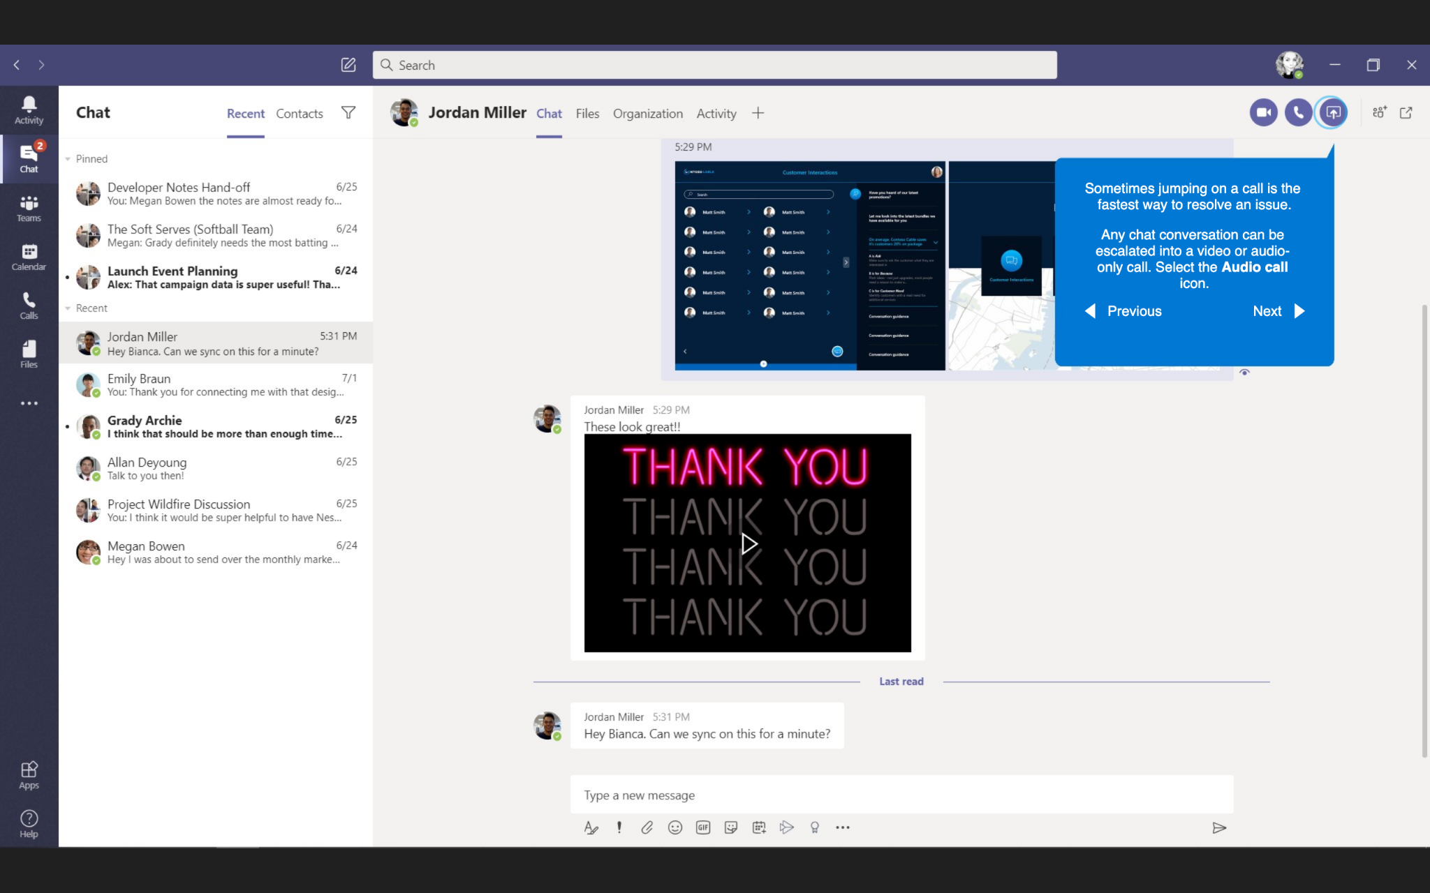
Calling
Sometimes jumping on a call is the fastest way to resolve an issue.
Any chat conversation can be escalated into a video or audio-only call. Select the Audio call icon.

Slide 32
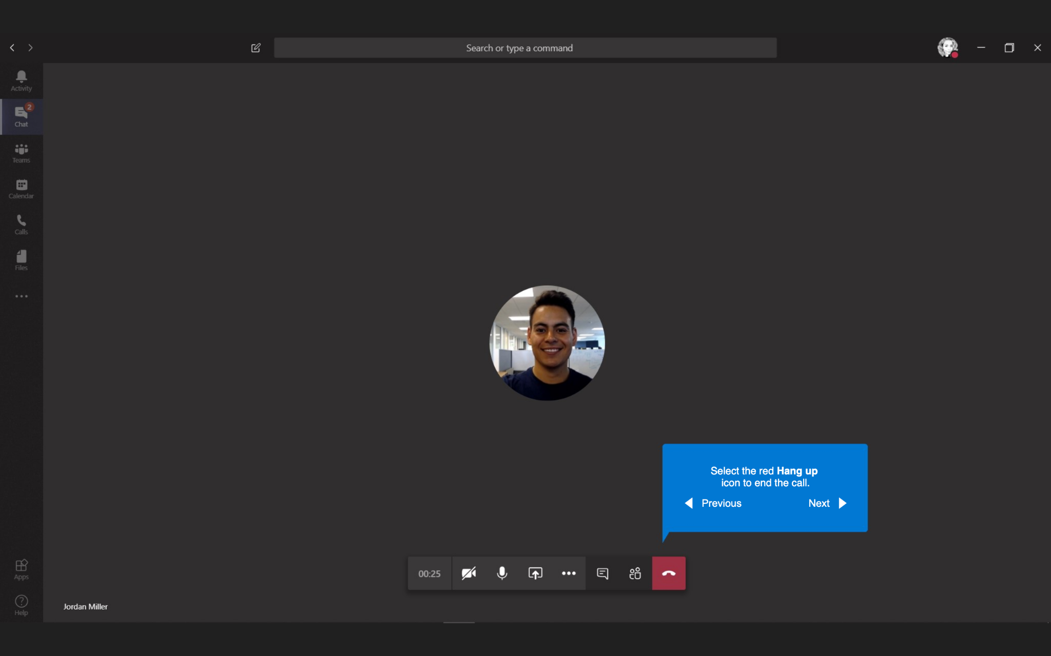
Calling
Select the red Hang up icon to end the call.

Slide 33
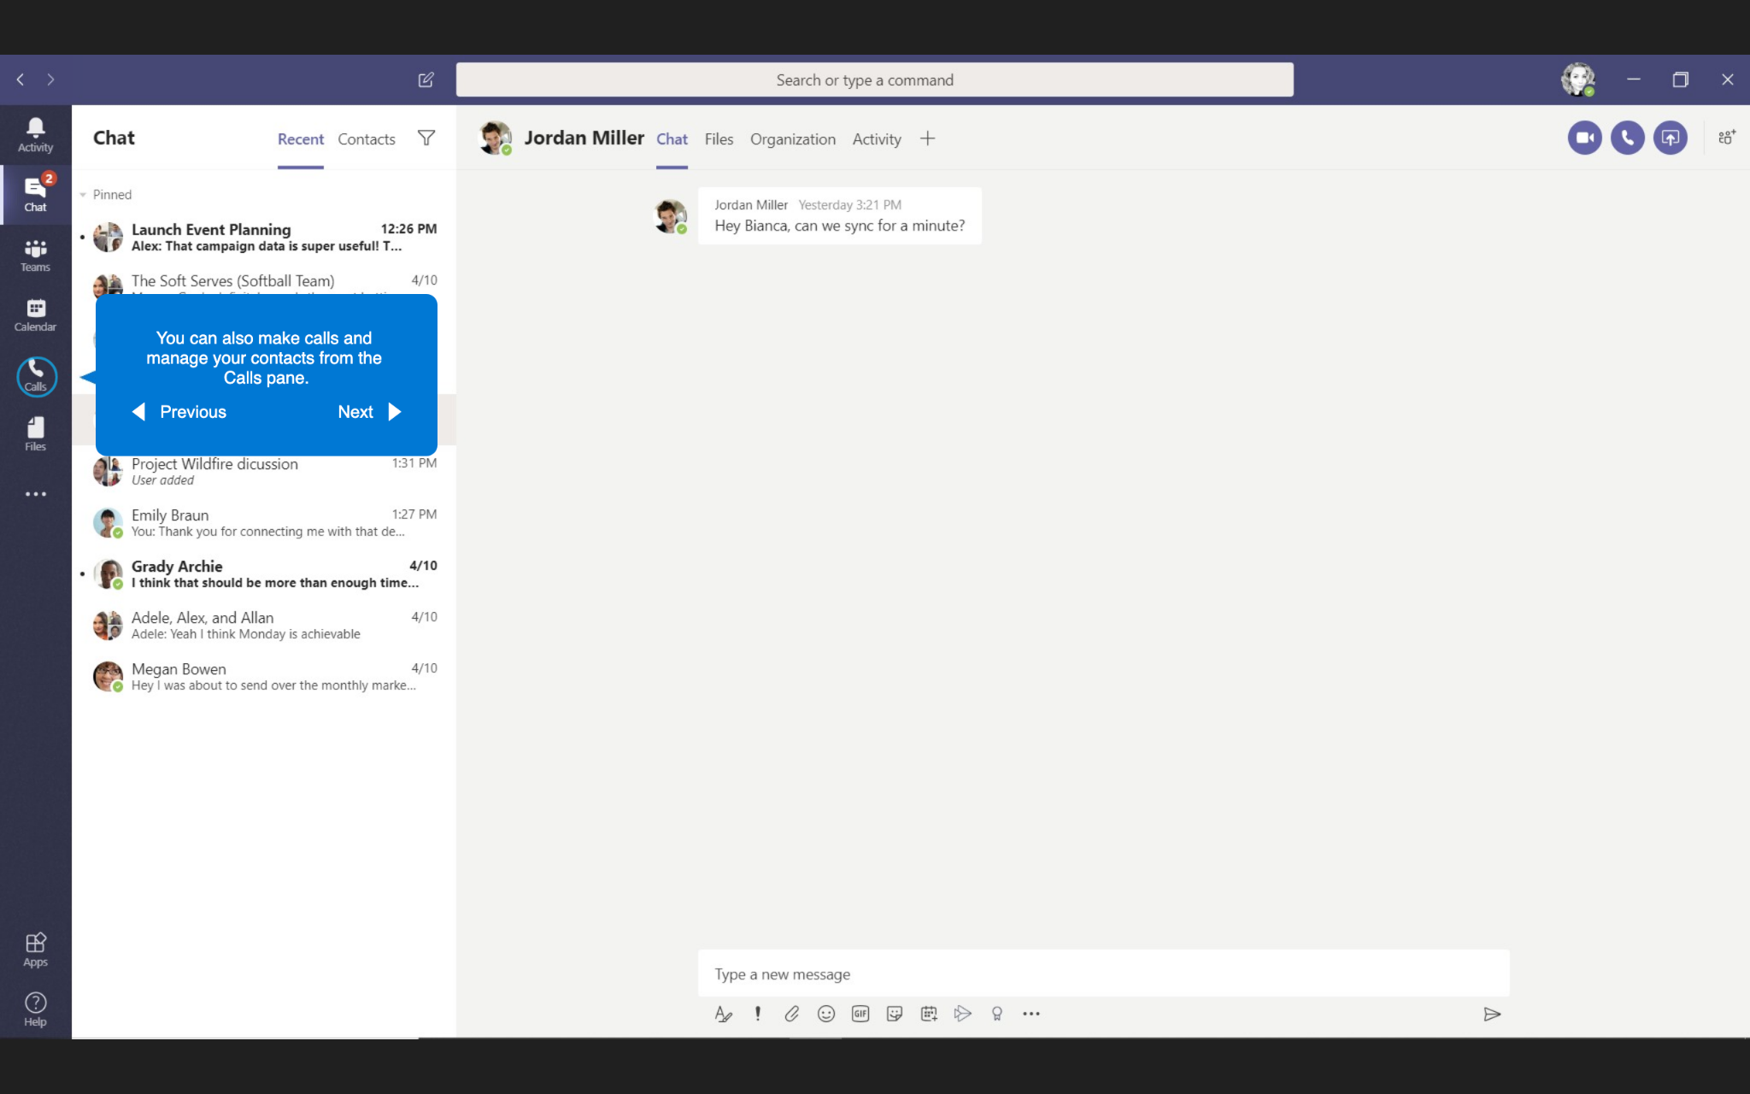
Calling
You can also make calls and manage your contacts from the Calls pane.

Slide 34
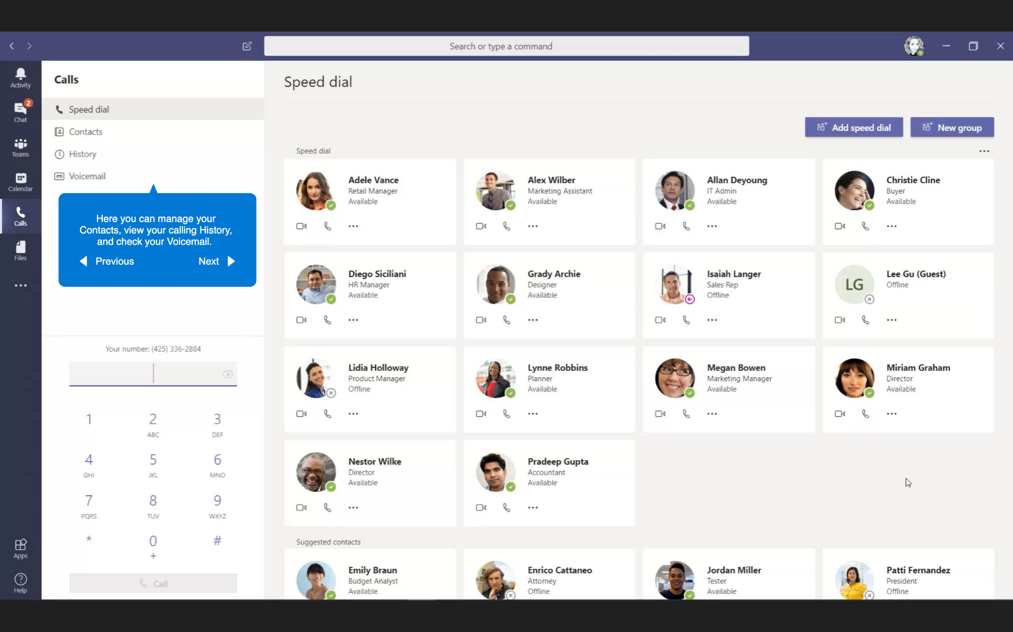
Calling
Here you can manage your Contact, view your calling History, and check your Voicemail.

