Slide 1

Understanding Microsoft Teams
Teams Basic Desktop Demo

Slide 2

Demo
https://teamsdemo.office.com/TipsAndTricks/index.html#/0/0

Slide 3
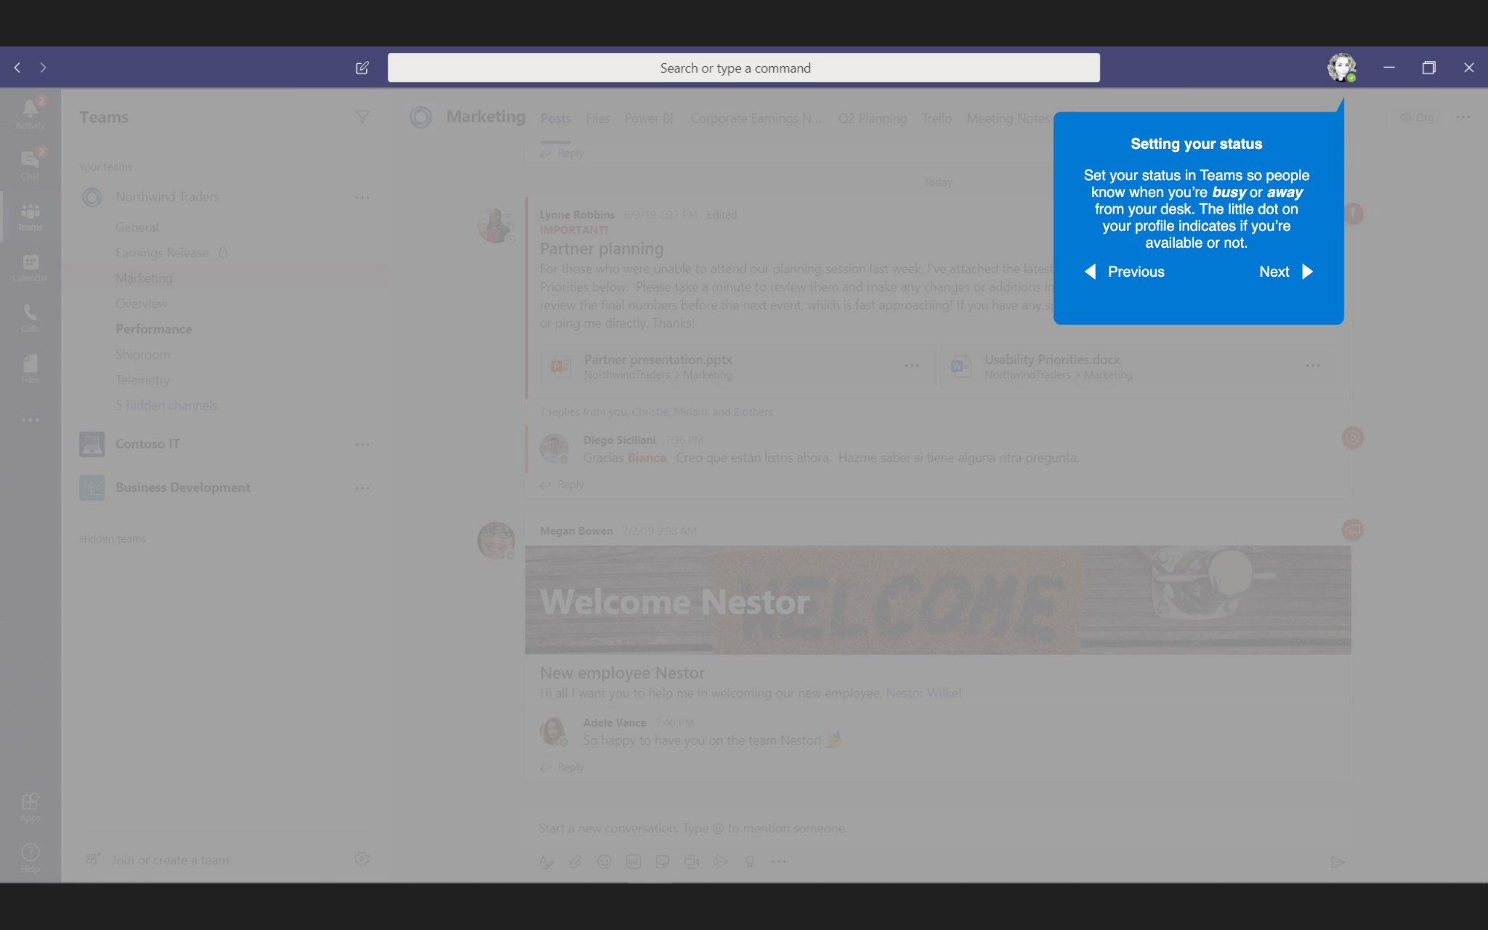
Setting your status
Setting your status
Set your status in Teams so people know when you’re busy or away from your desk. The little dot on your profile indicates if you’re available or not.

Slide 4
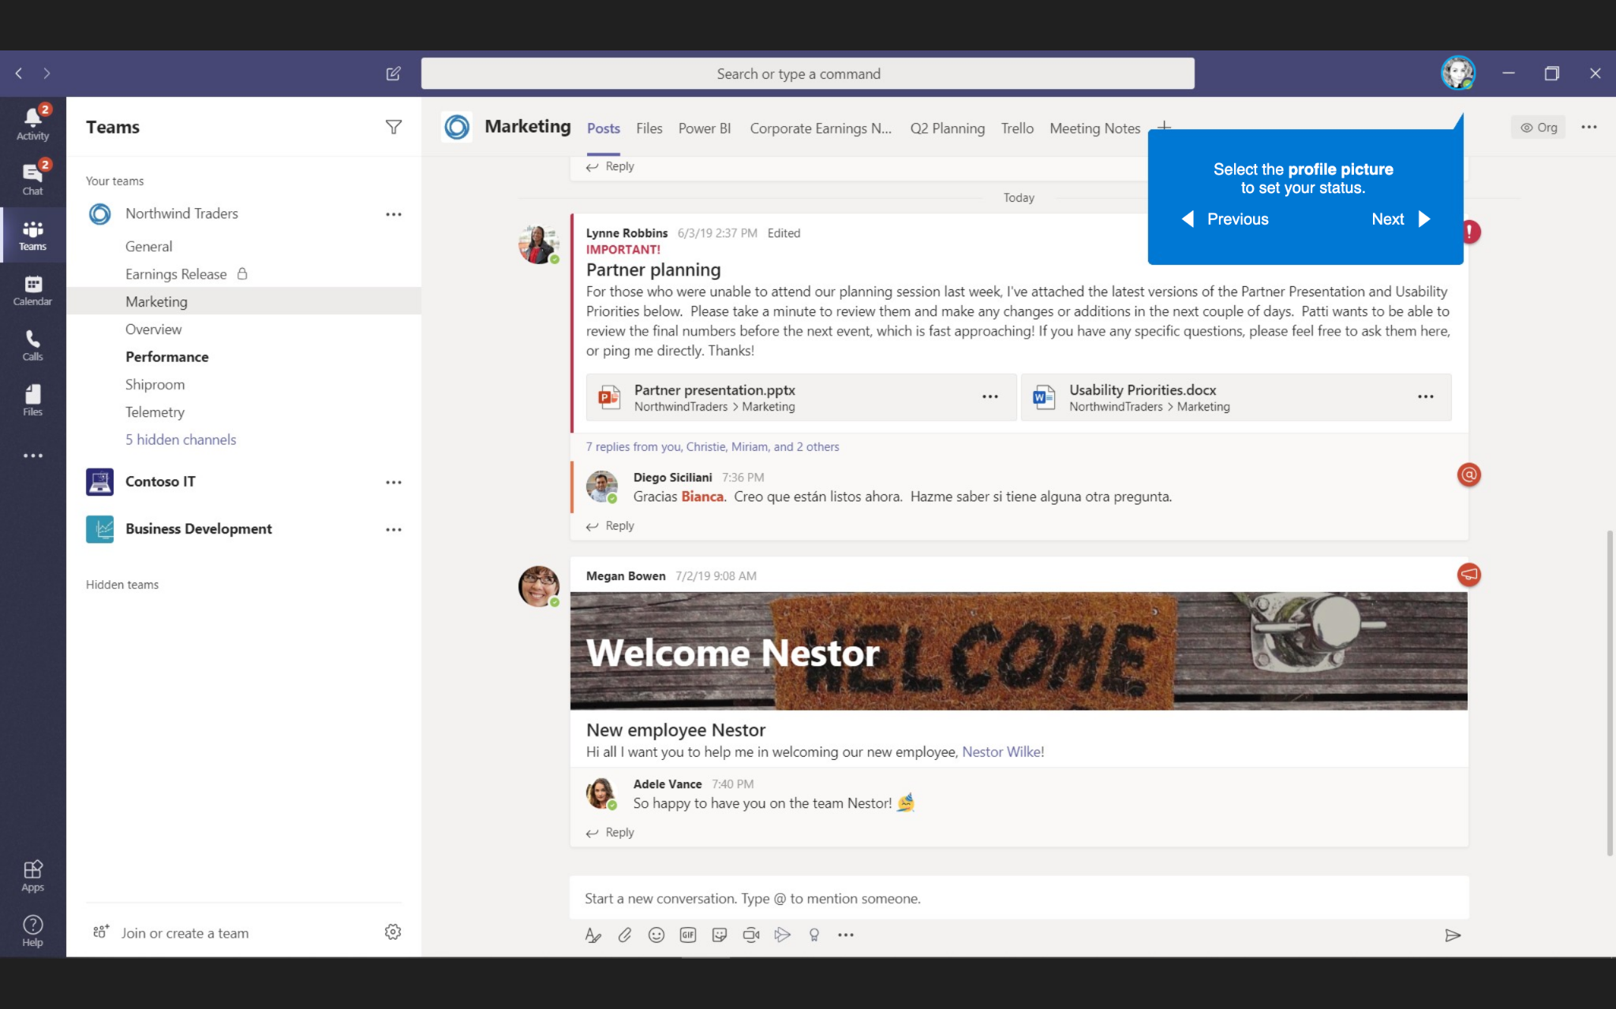
Setting your status
Select the profile picture to set your status

Slide 5
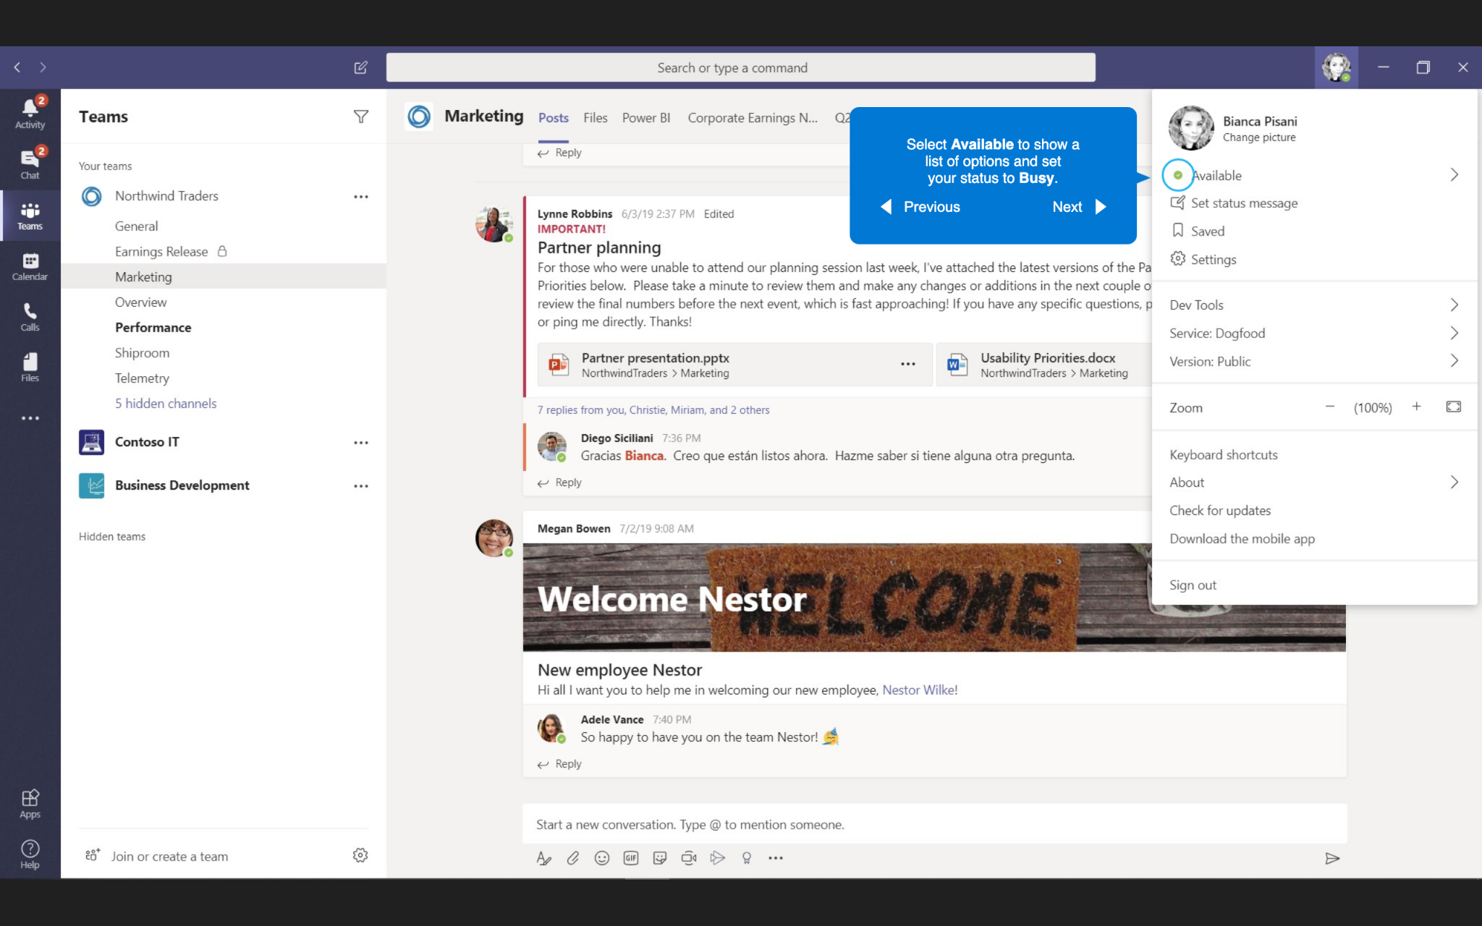
Setting your status
Select Available to show a list of options and set your status to Busy.

Slide 6
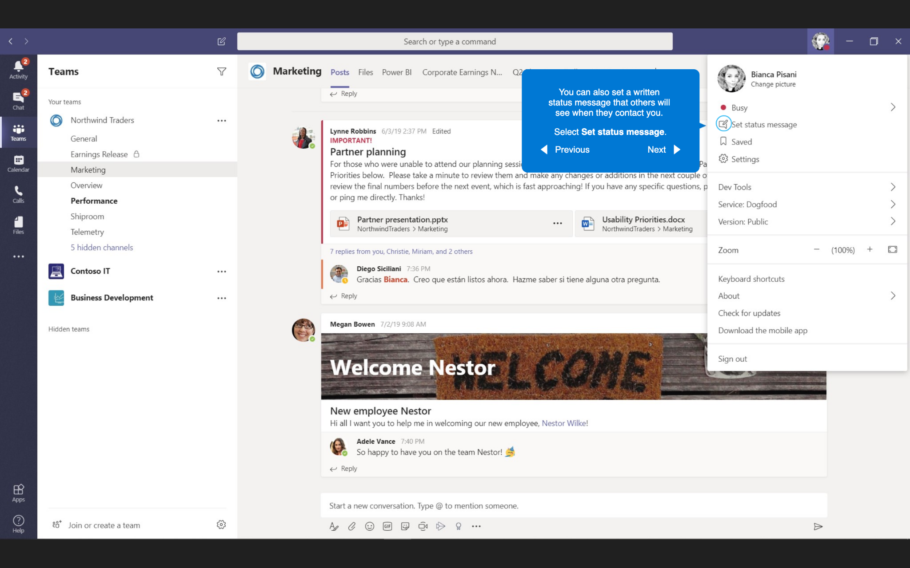
Setting your status
You can also set a written status message that others will see when they contact you.
Select Set status message.

Slide 7
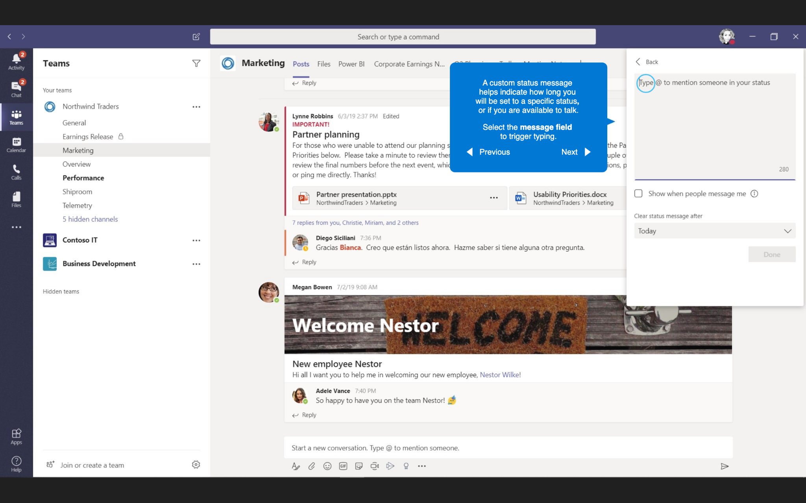
Setting your status
A custom status message helps indicate how long you will be set to a specific status, or if you are available to talk.
Select the message field to trigger typing.

Slide 8
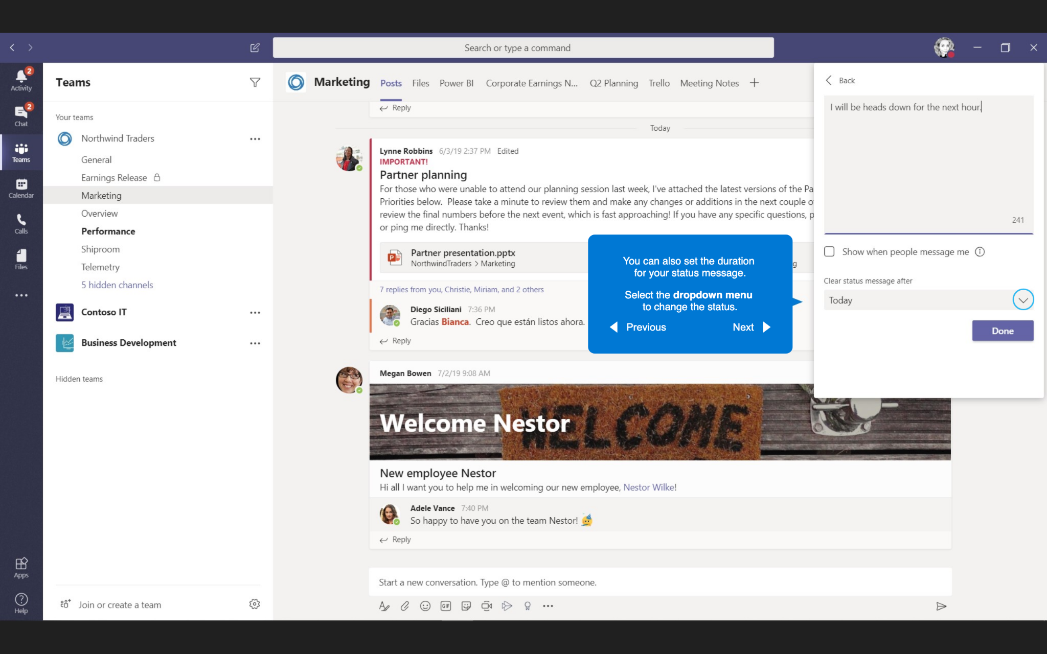
Setting your status
You can also set the duration for your status message.
Select the dropdown menu to change the status.

Slide 9
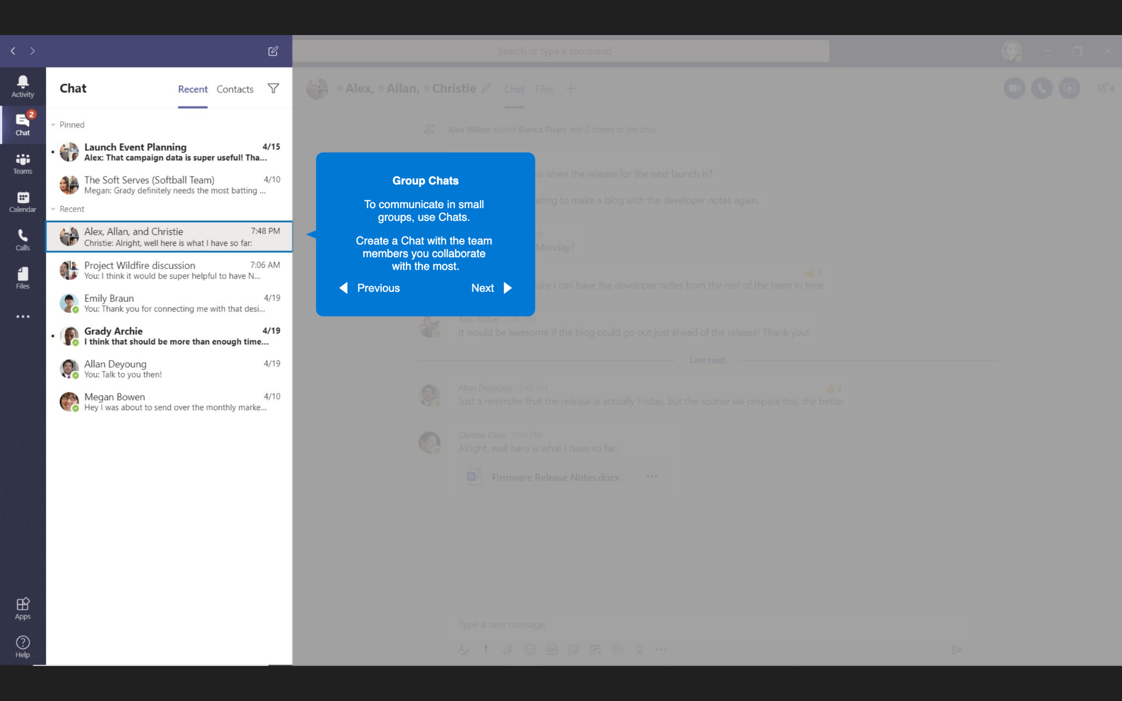
Group Chats
Group Chats
To communicate in small groups, use Chats.
Create a Chat with the team members you collaborate with the most.

Slide 10
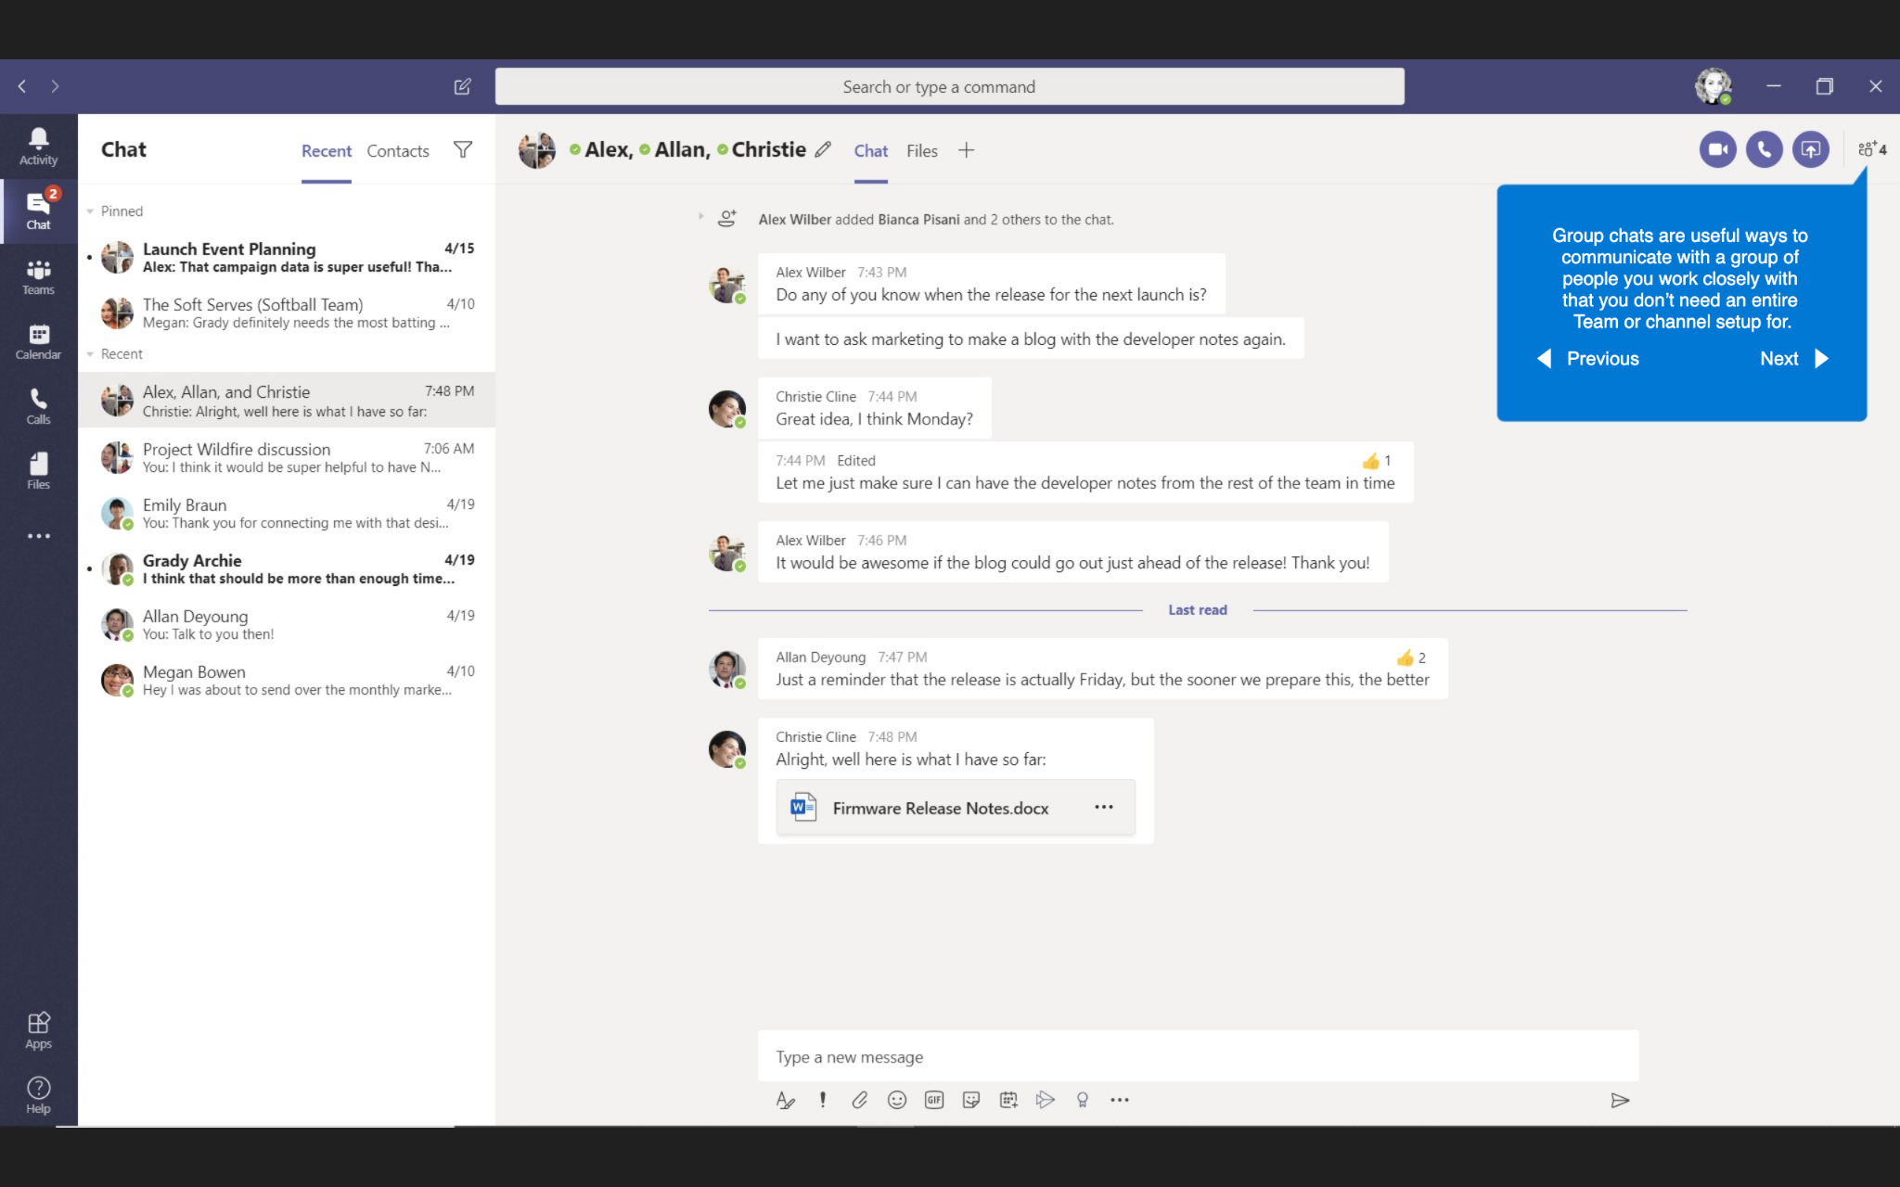
Group Chats
Group chats are useful ways to communicate with a group of people you work closely with that you don’t need an entire Team or channel setup for.

Slide 11
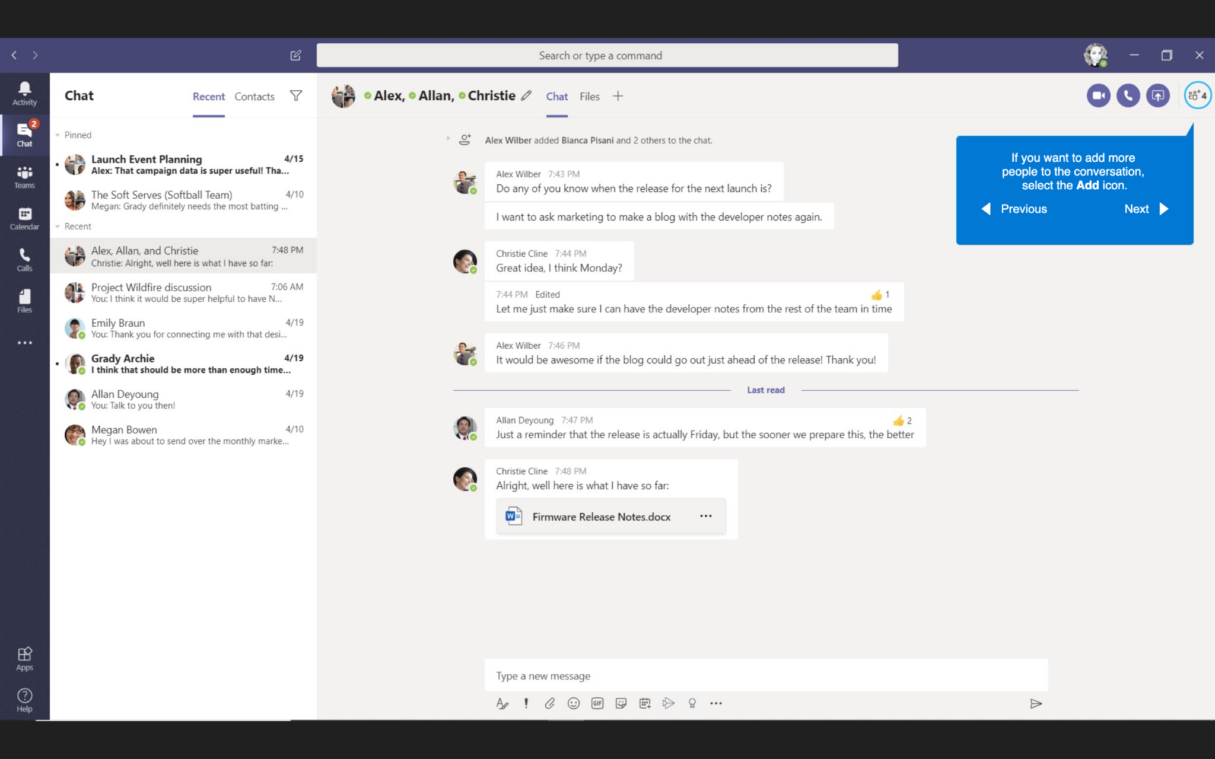
Group Chats
If you want to add more people to the conversation select the Add icon.

Slide 12
Group Chats
group

Slide 13
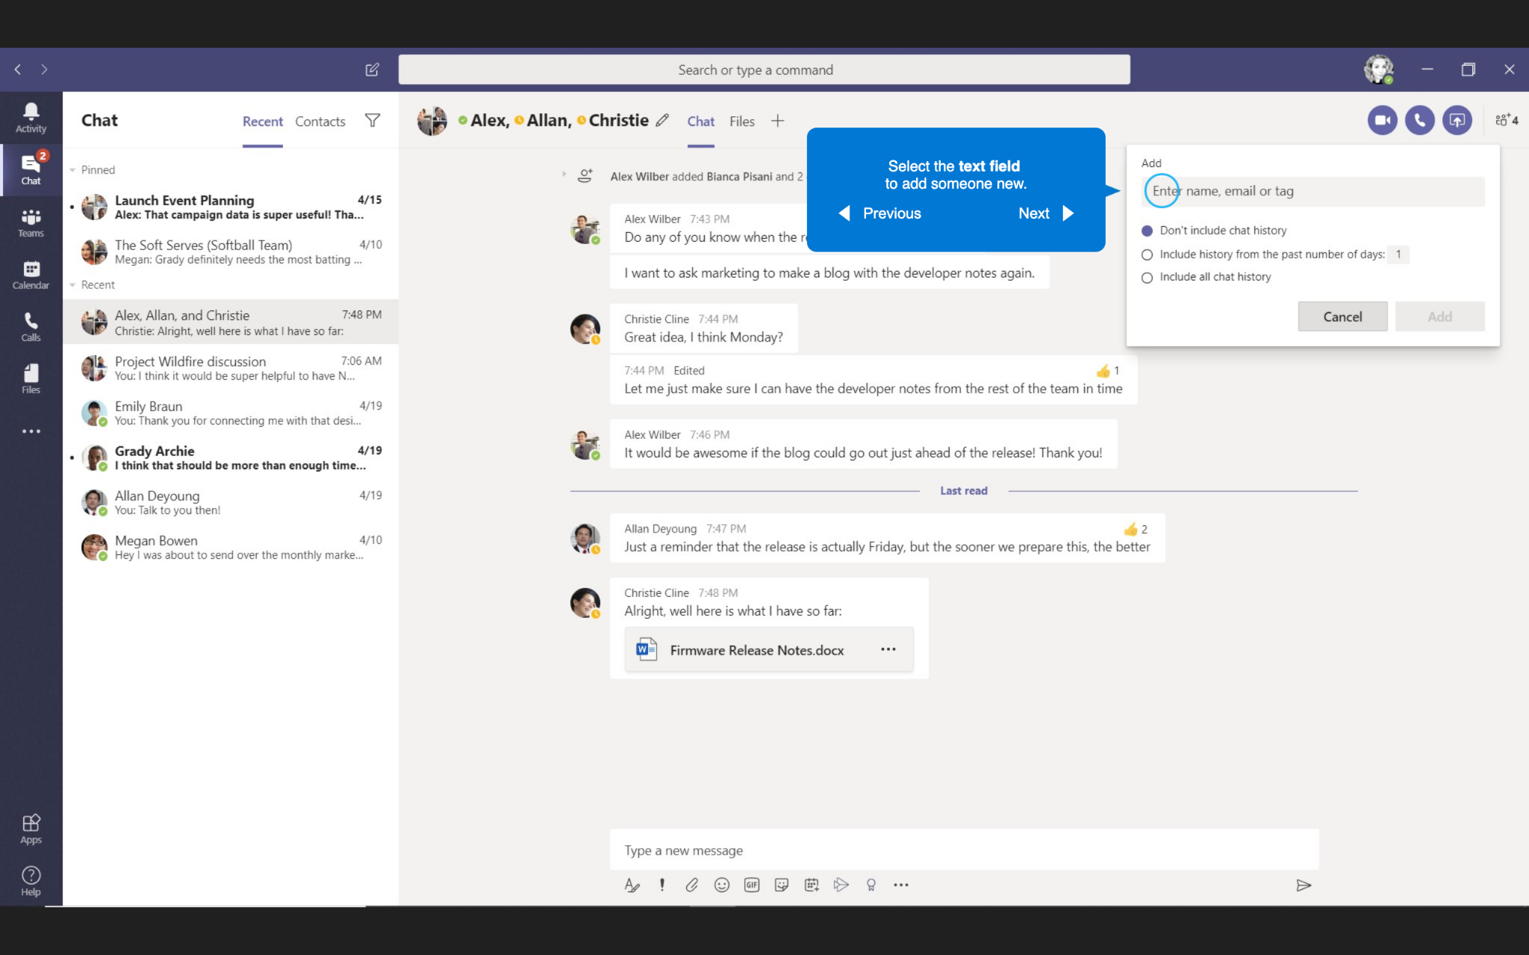
Group Chats
Select the text field to add someone new.

Slide 14
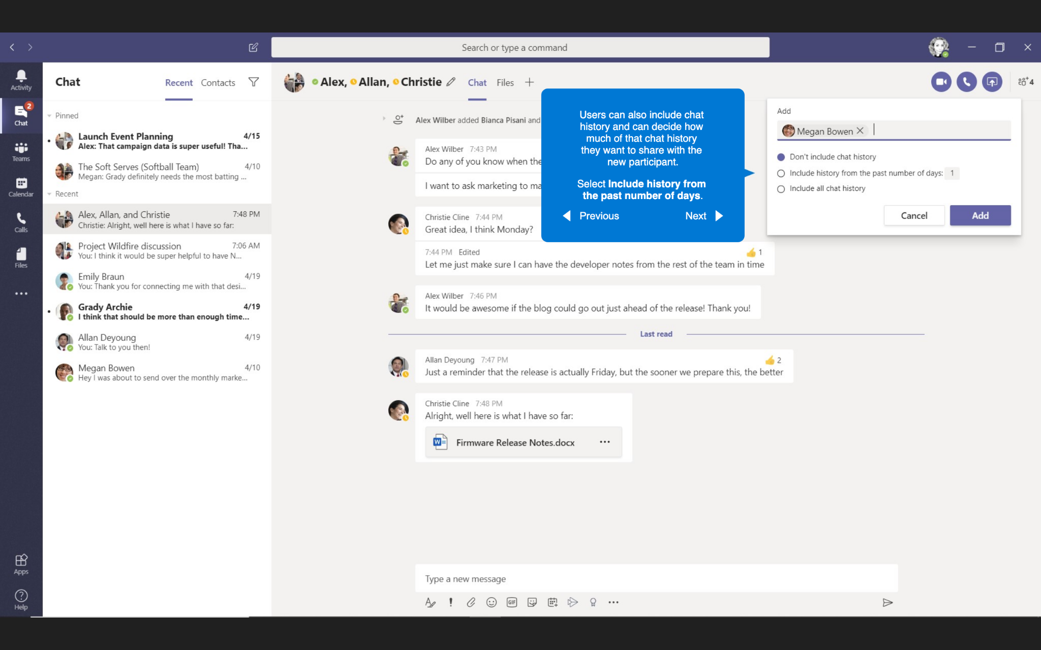
Group Chats
Users can also include chat history and can decide how much of that chat history they want to share with the new participant.
Select Include history from the past number of days.

Slide 15
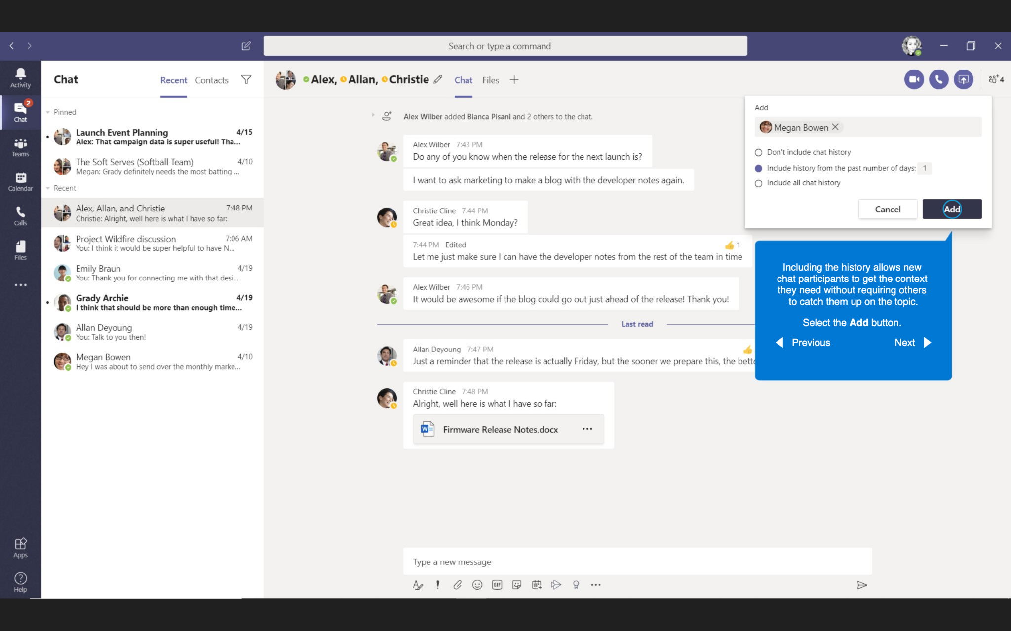
Group Chats
Including the history allows new chat participants to get the content they need without requiring others to catch them up on the topic.
Select the Add button.

Slide 16
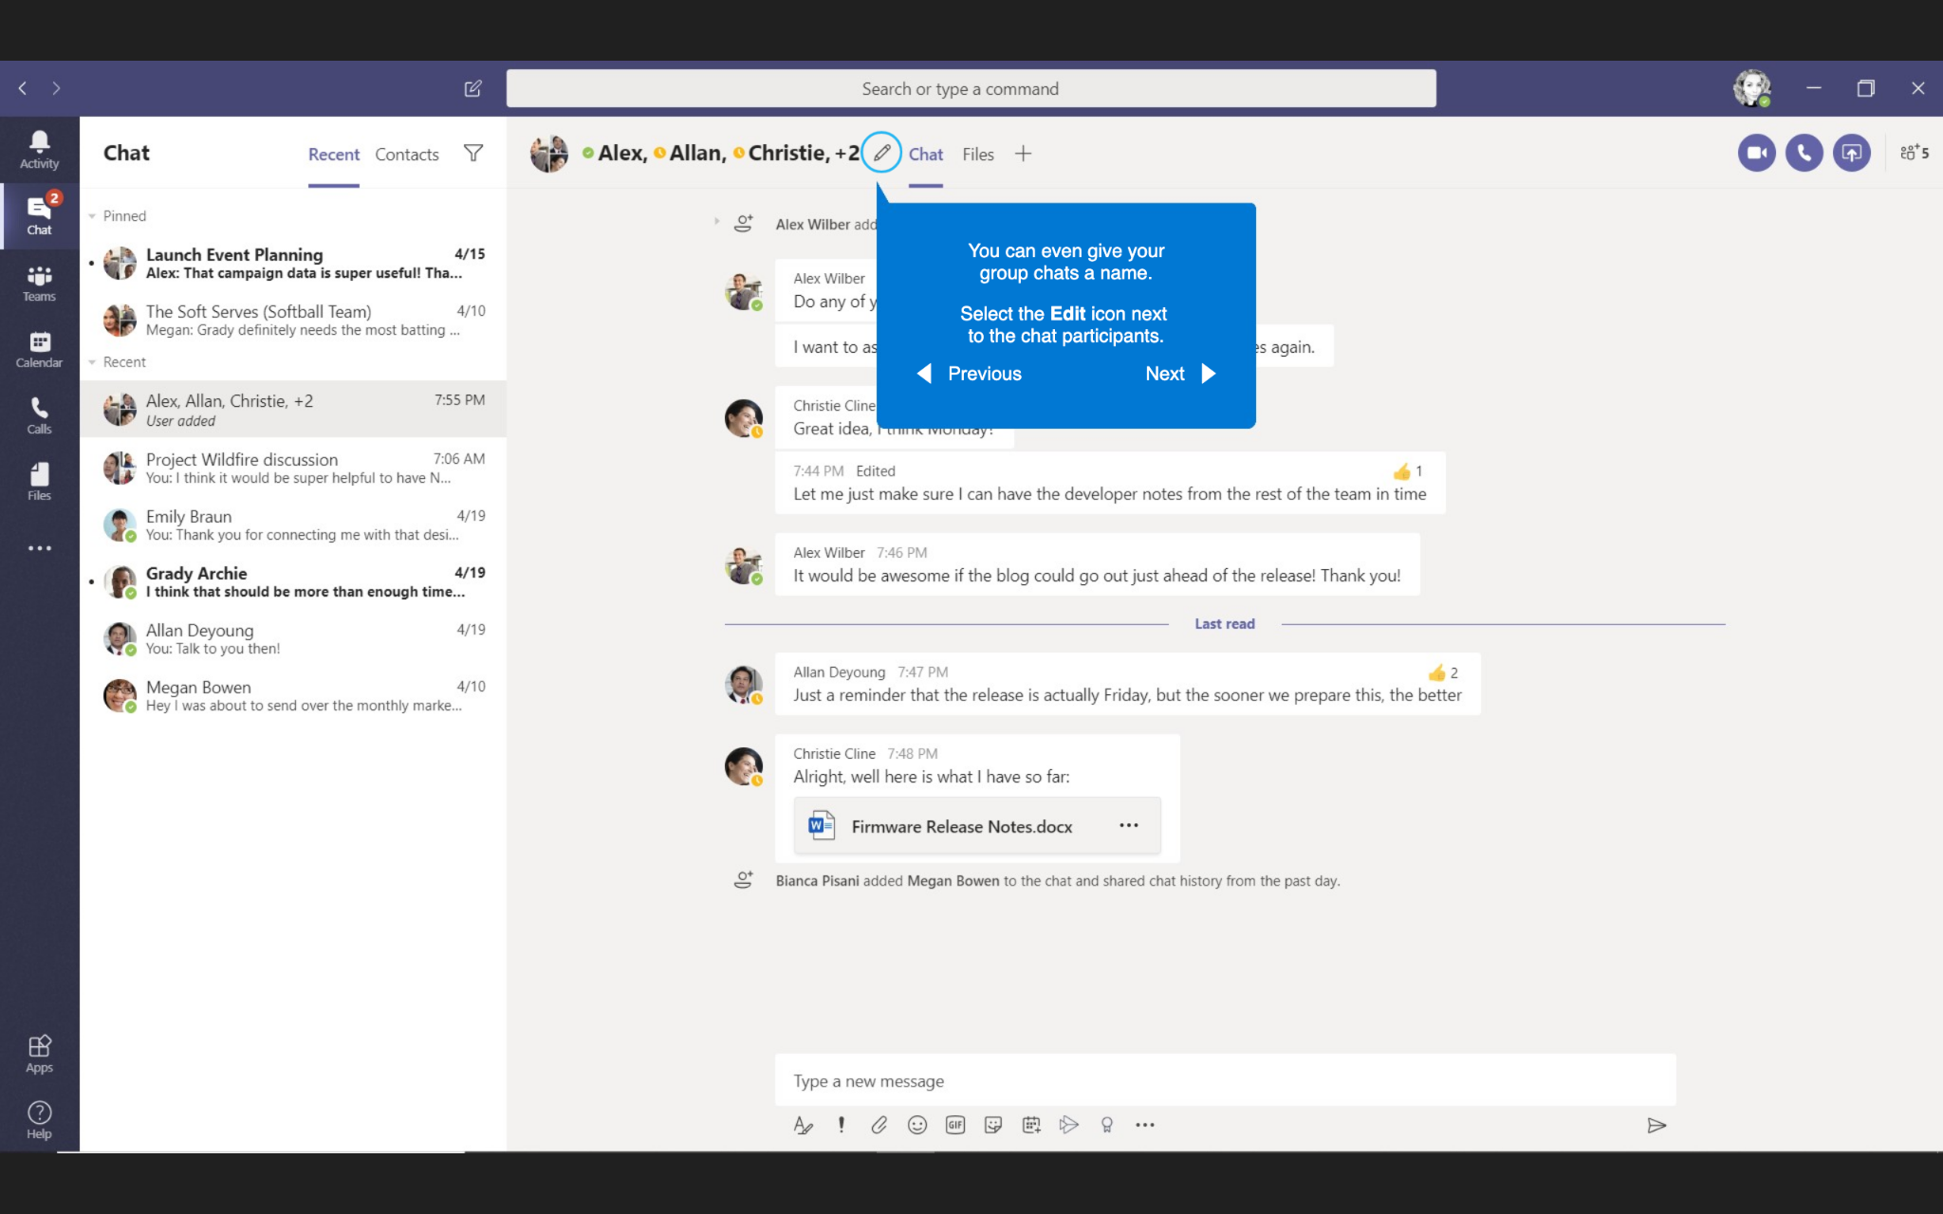
Group Chats
You can even give your group chats a name.
Select the Edit icon next to the end participants.

Slide 17
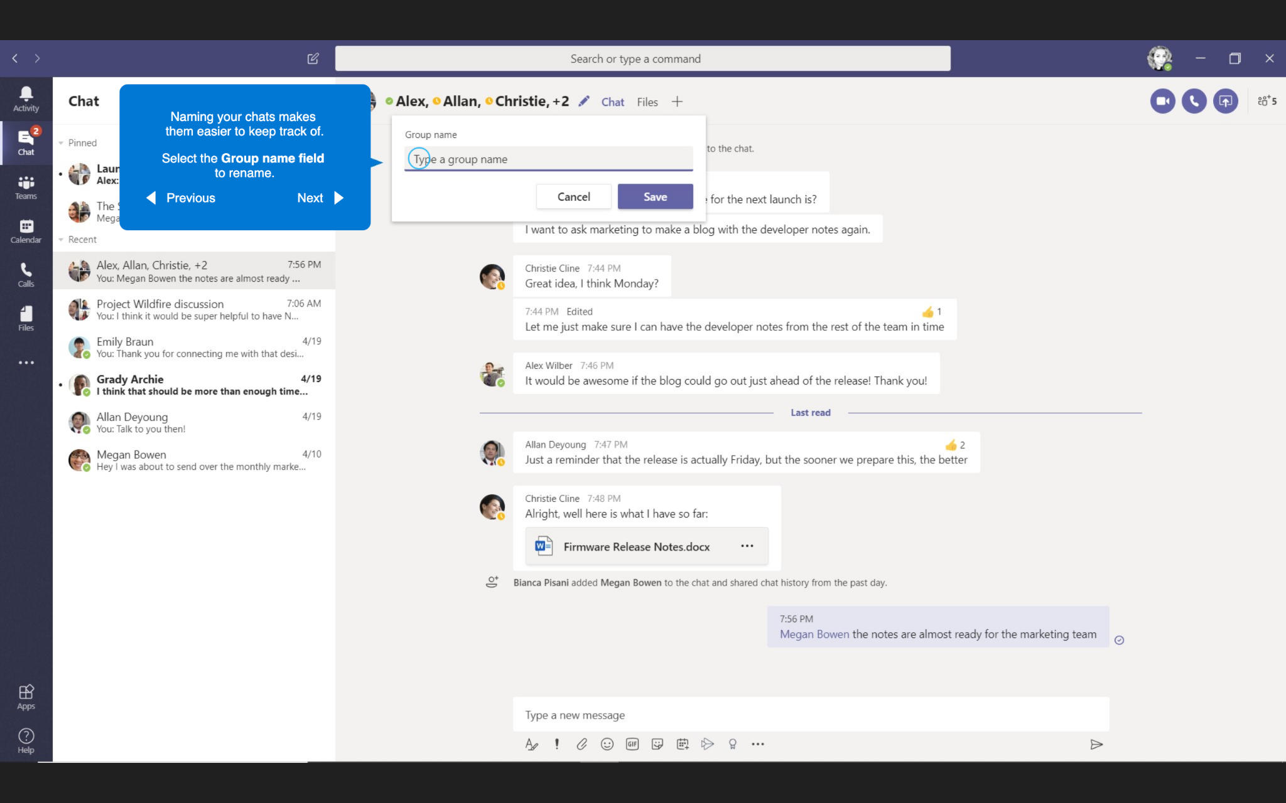
Group Chats
Naming your chats make them easier to keep track of.
Select the Group name field to rename.

Slide 18
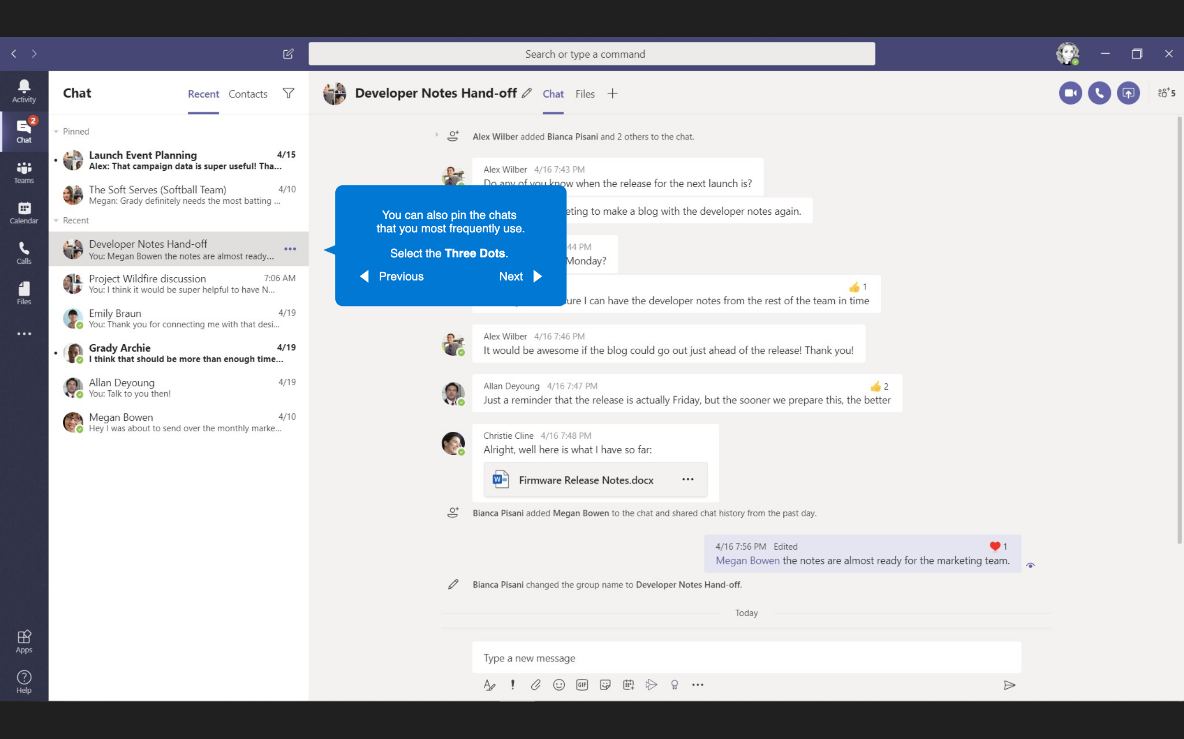
Group Chats
You can also pin the chats that you most frequently use.
Select the Three Dots.

Slide 19
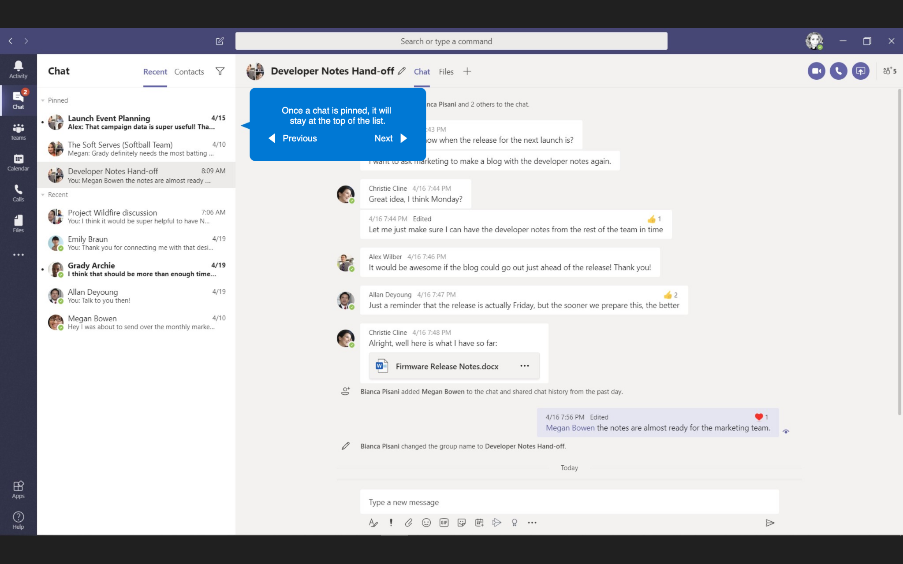
Group Chats
Once a chat is pinned, it will stay at the top of the list.

Slide 20
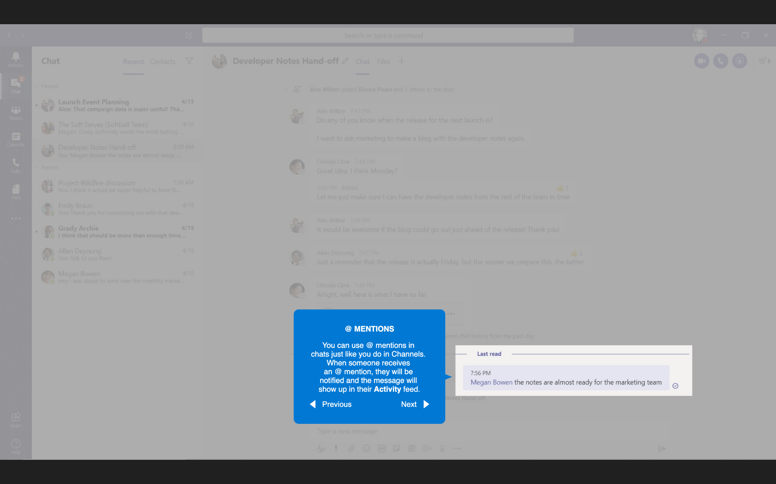
@ Mentions
@ Mentions
You can use @ mentions in chats just like you do in Channels. When someone receives an @ mention, they will be notified and the message show up in their Activity feed.

Slide 21
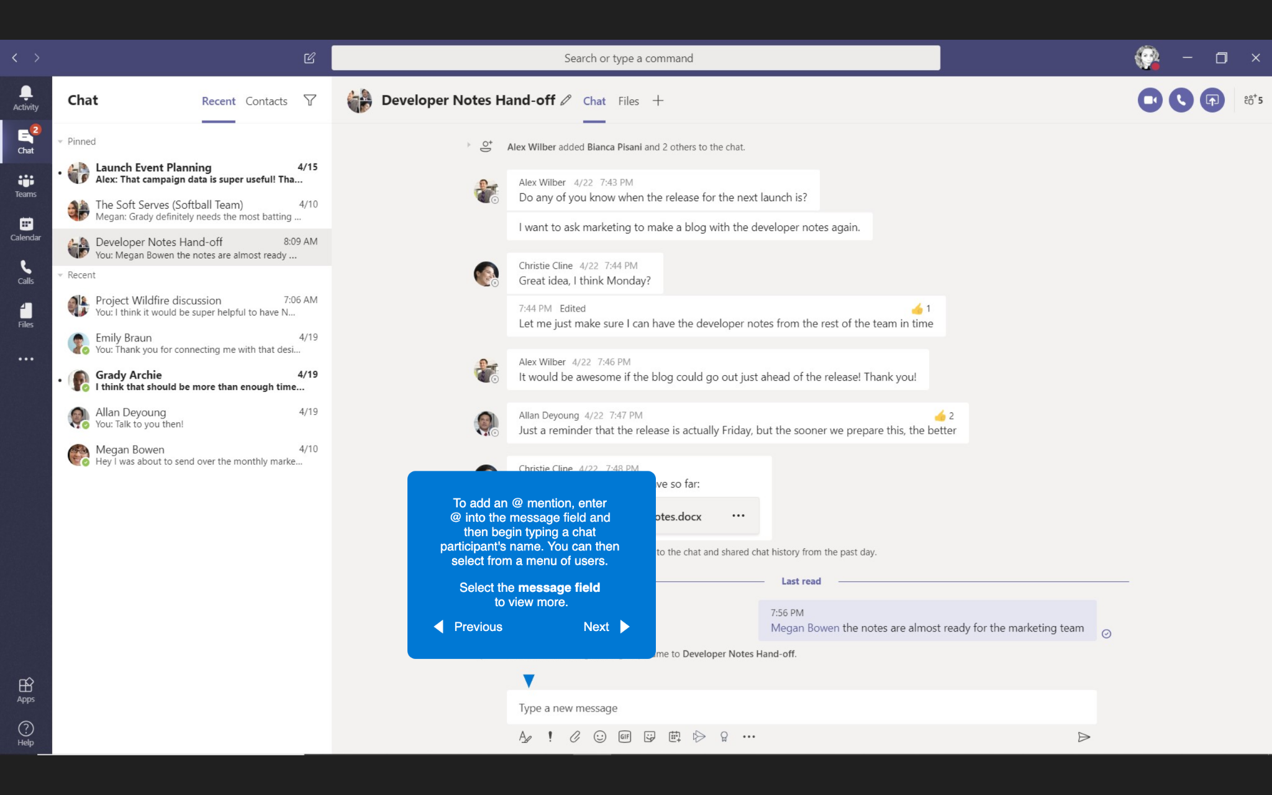
Group Chats
To add an @ mention, enter @ into the message field and then begin typing a chat participant’s name. You can then select from a menu of users.
Select the message field to view more.

Slide 22
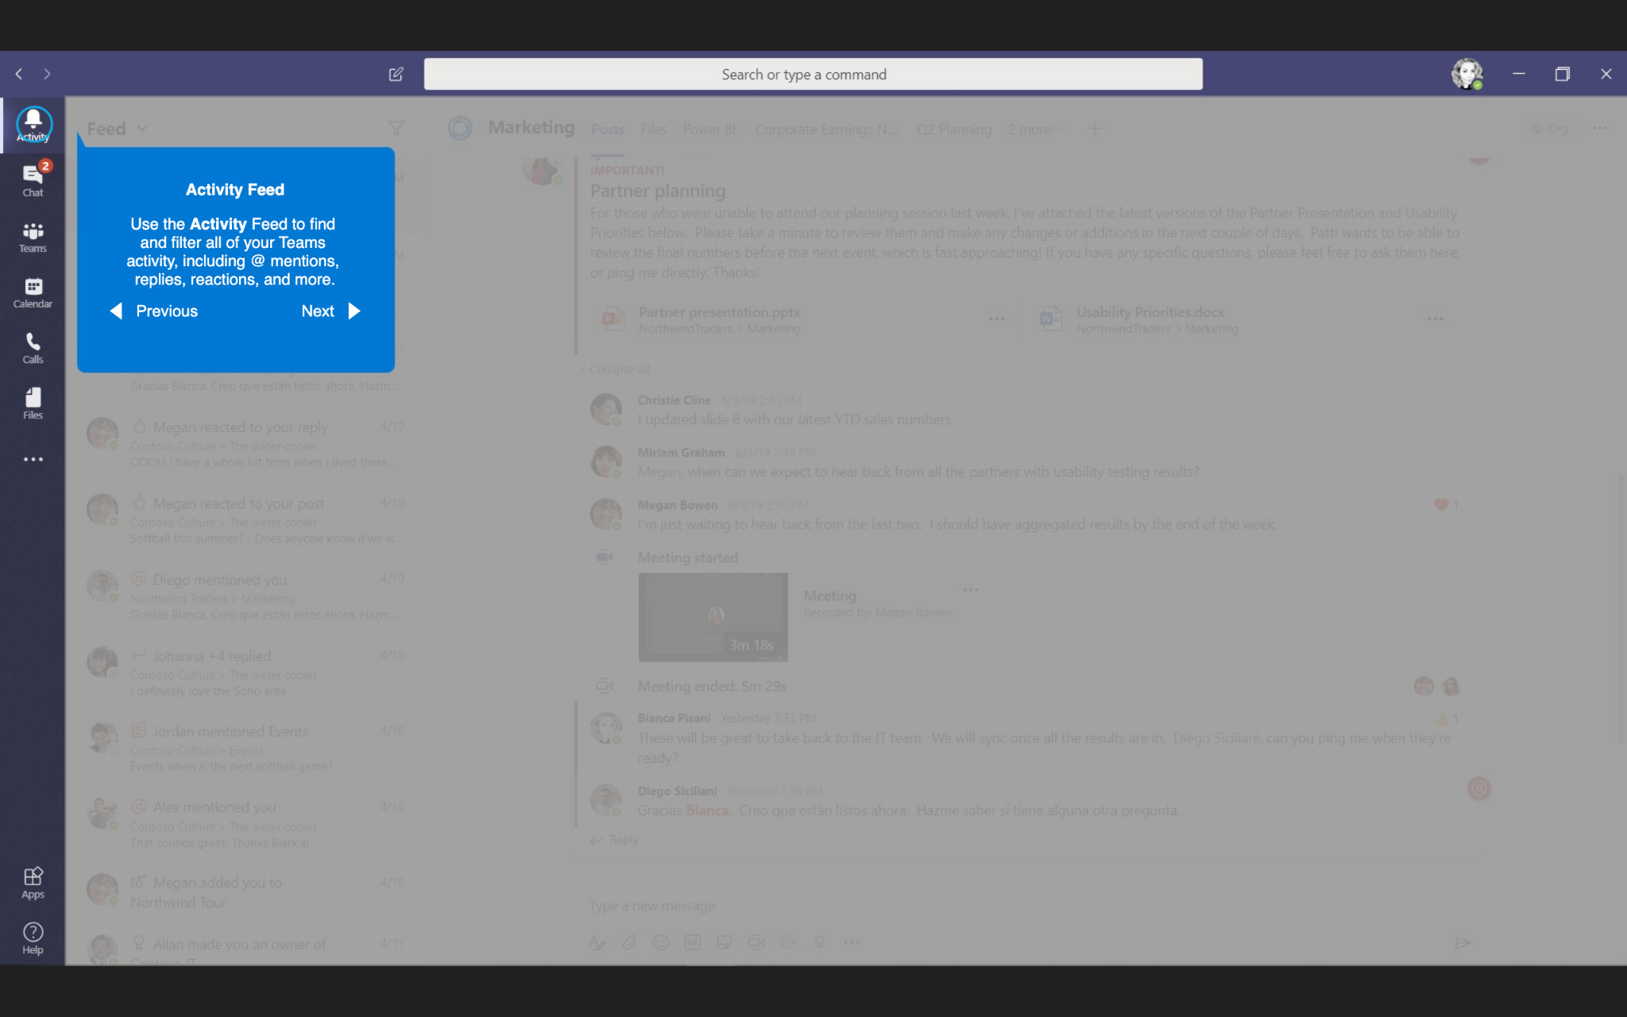
Activity Feed
Activity Feed
Use the Activity Feed to find and filter all your Teams activity, including @ mentions, replies, reactions, and more.

Slide 23
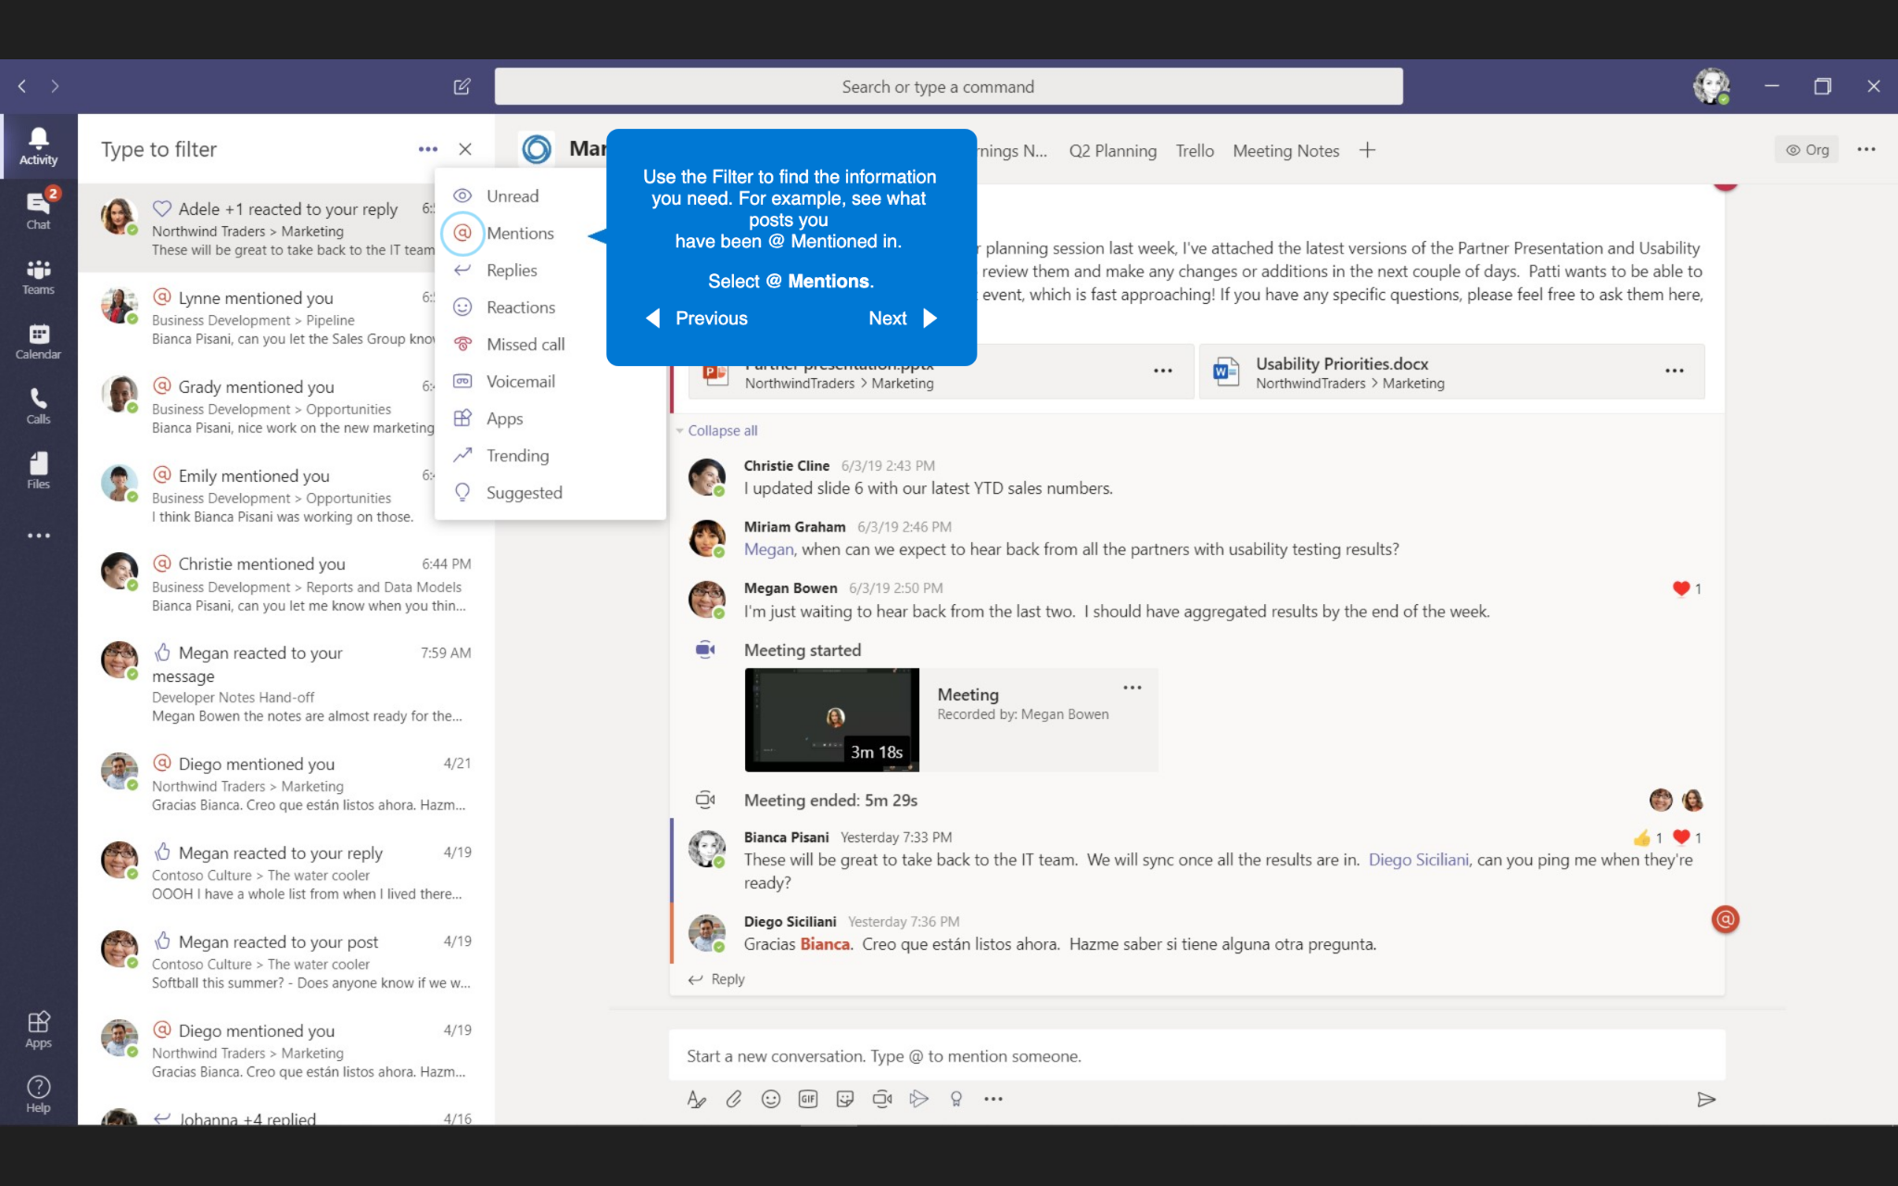
Activity Feed
Use the Filter to find the information you need. For example, see what posts you have been @ Mentioned in.
Select @ Mentions

Slide 24
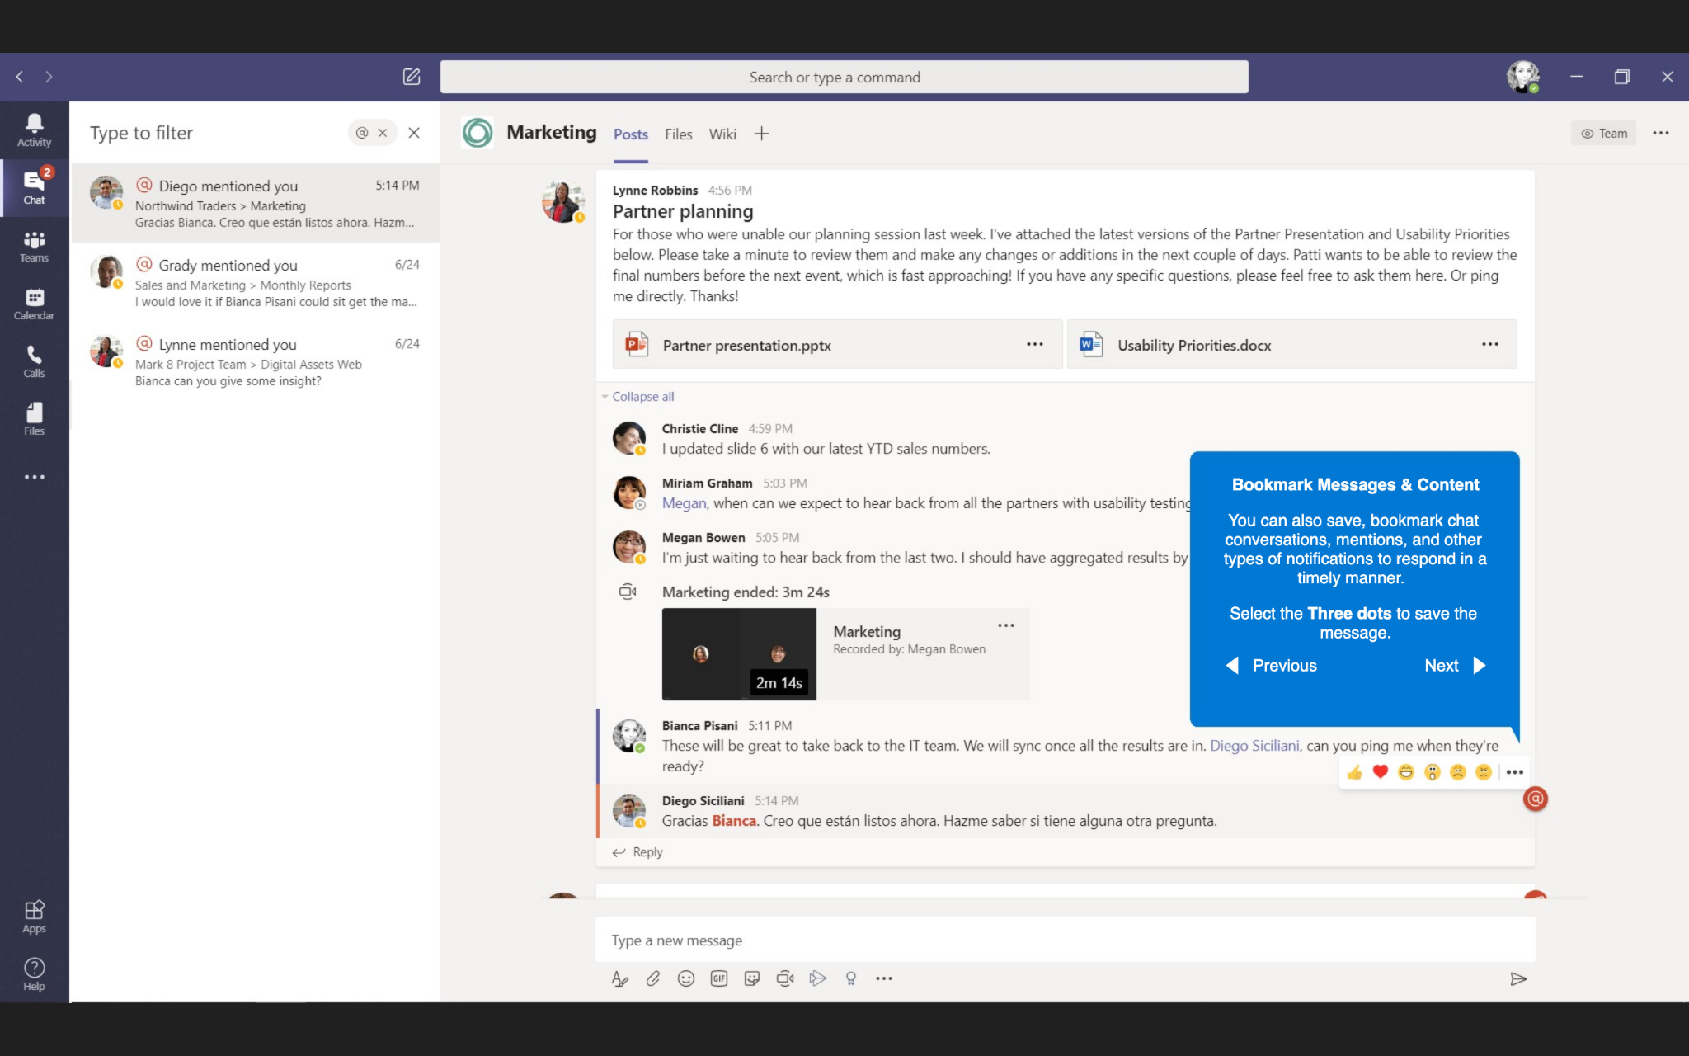
Bookmark Messages & Content
Bookmark Messages & Content
You can also save, bookmark chat conversations, mentions, and other types of notifications to respond in a timely manner.
Select the Three dots to save the message.

Slide 25
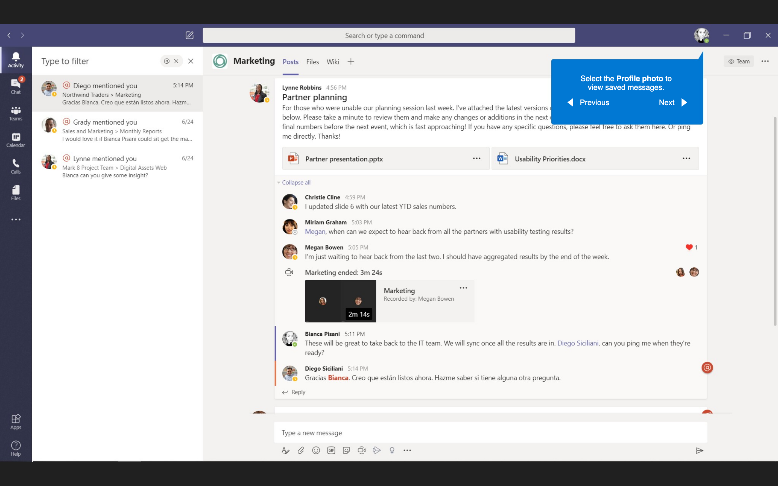
Bookmark Messages & Content
Select the Profile photo to view saved messages.

Slide 26
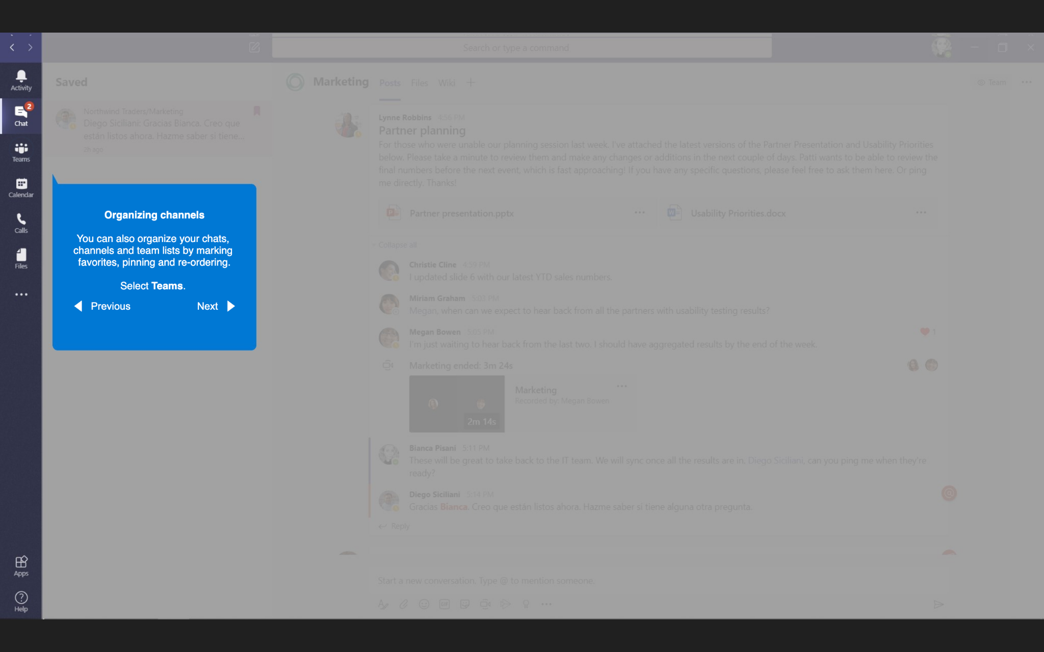
Organizing channels
Organizing channels
You can also organize your chats, channels and teams lists by marking favorites, pinning and re-ordering.
Select Teams.

Slide 27
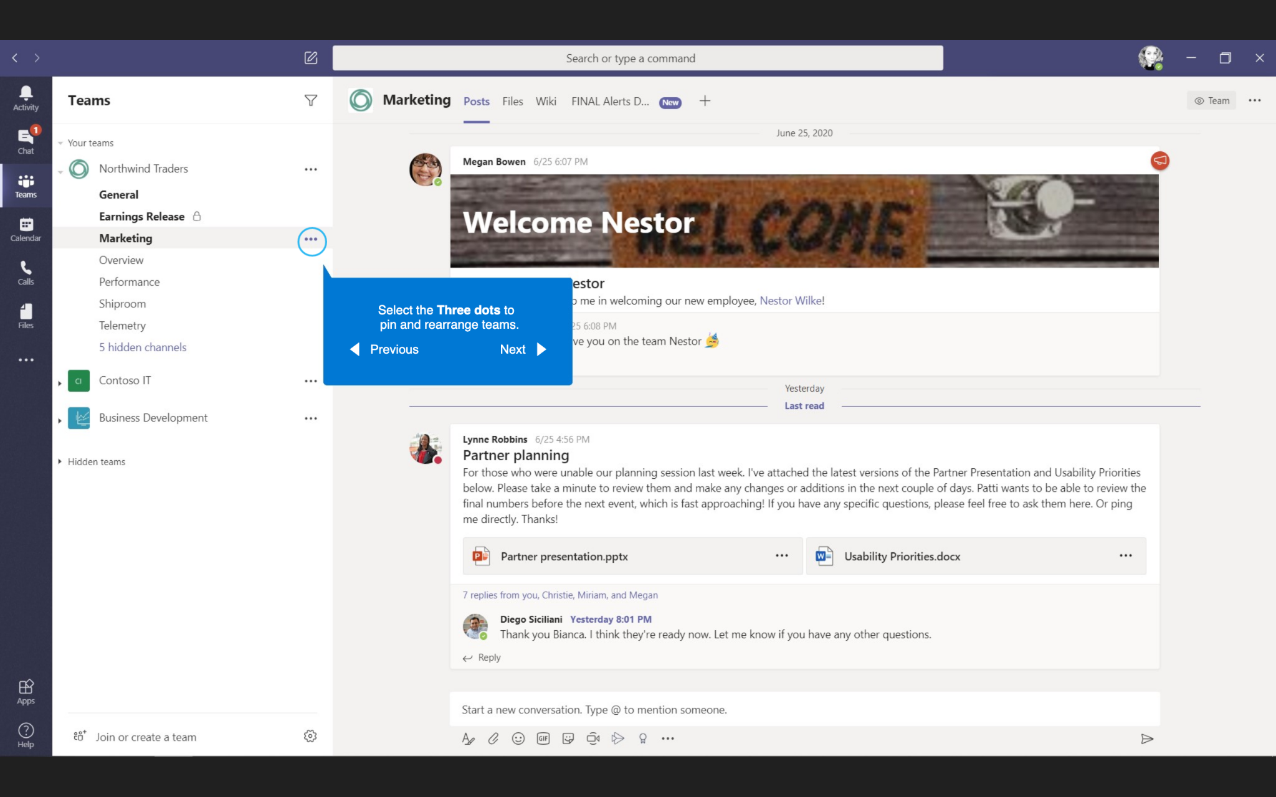
Organizing channels
Select the Three dots to pin and rearrange teams.

Slide 28
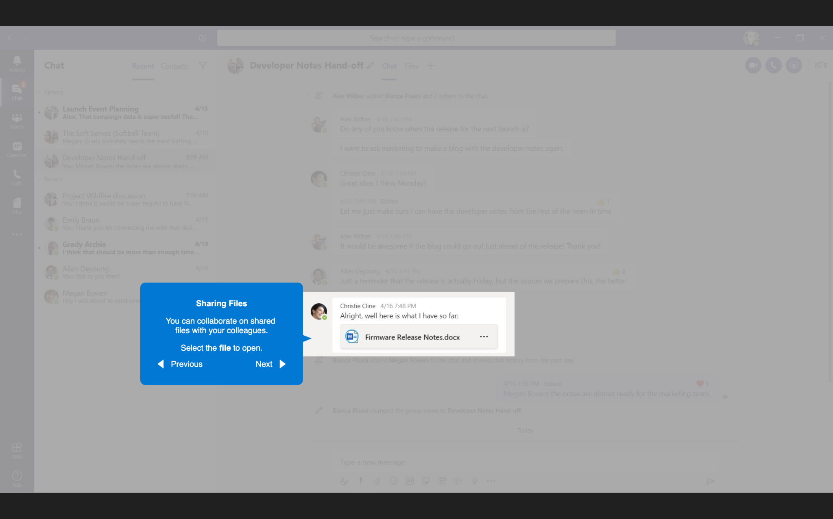
Sharing Files
Sharing Files
You can collaborate on shared files with your colleagues.
Select the file to open.

Slide 29
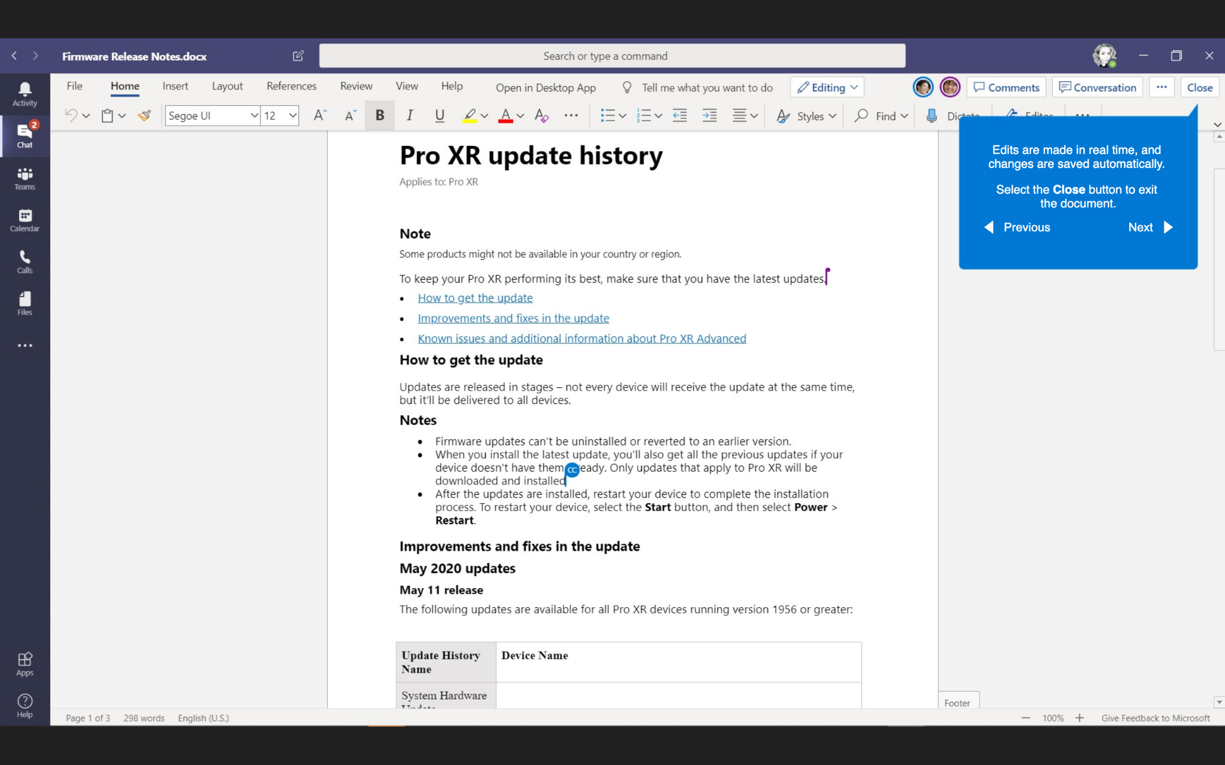
Sharing Files
Edits are made in real time, and changes are saved automatically.
Select the Close button to exit the document.

Slide 30
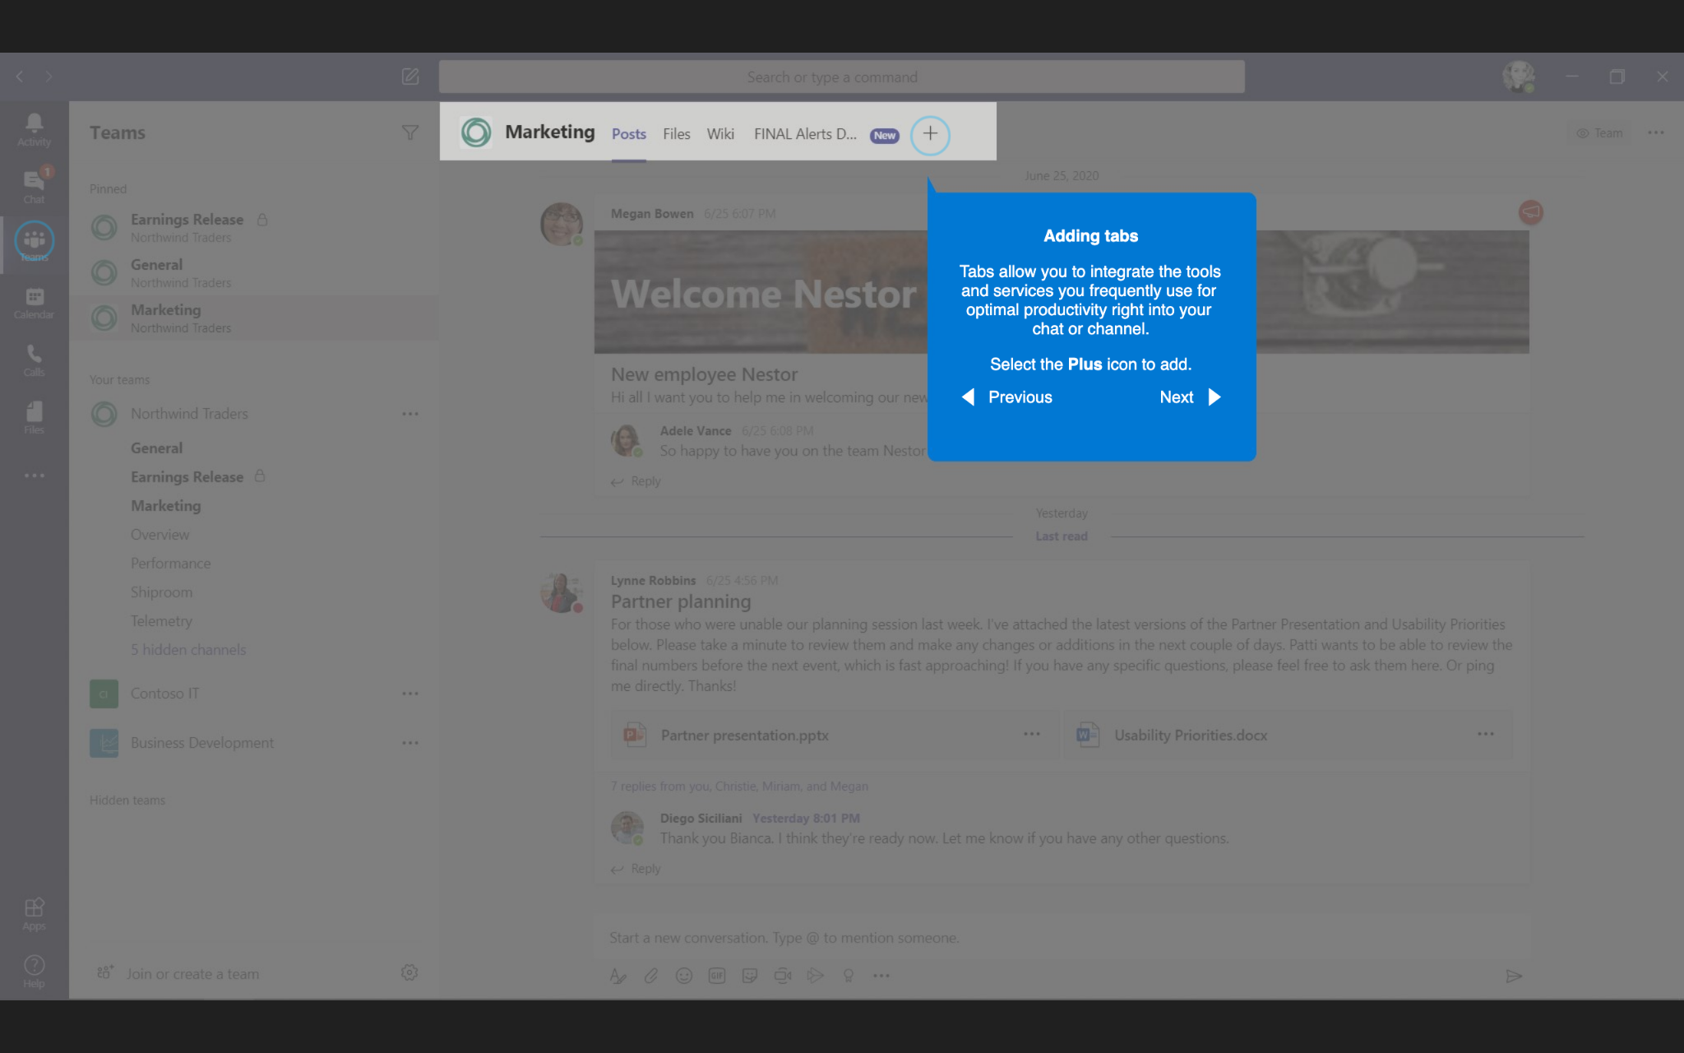
Adding tabs
Adding tabs
Tabs allow you to integrate the tools and services you frequently use for optimal productivity right into your chat or channel.
Select the Plus icon to add.

Slide 31
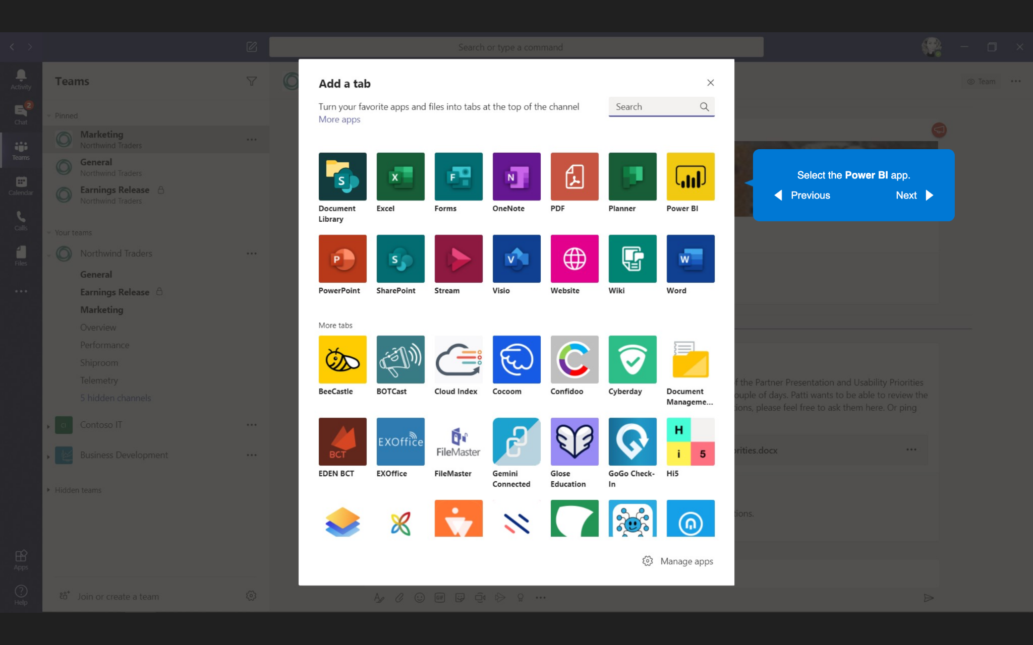
Adding tabs
Select the Power Bl app.

Slide 32
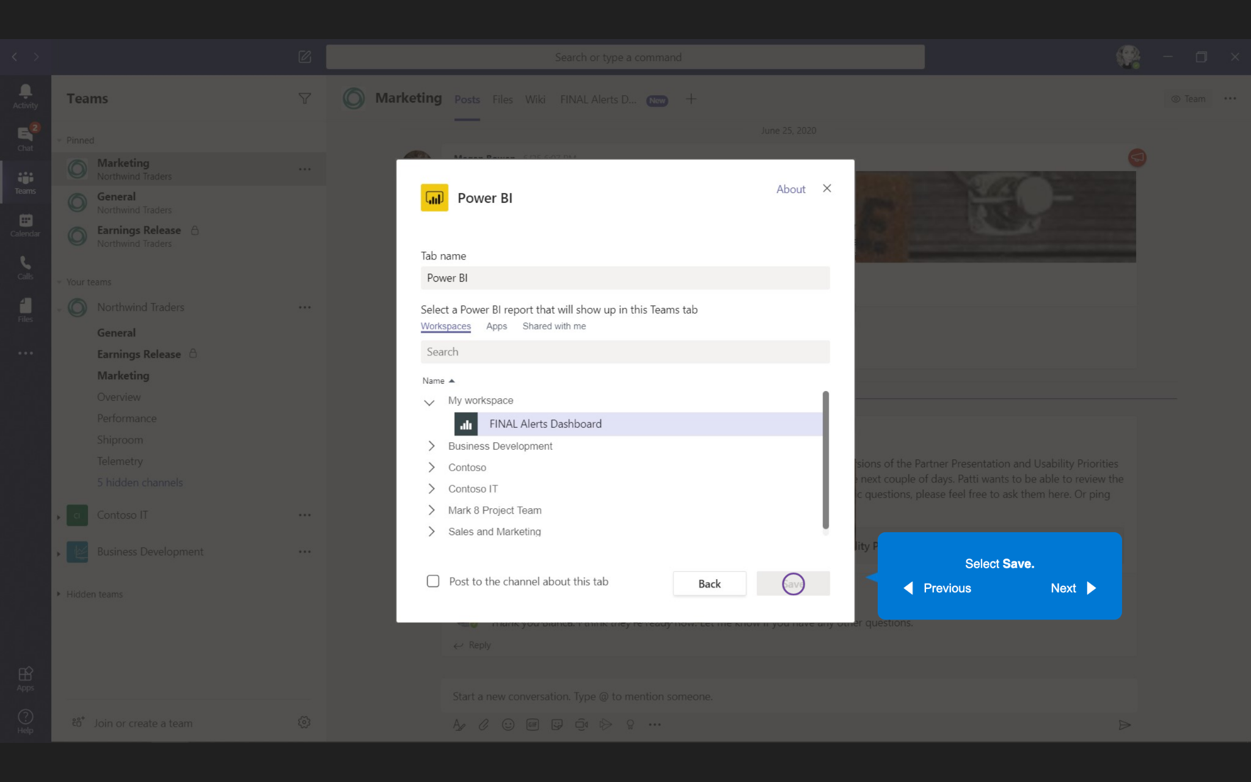
Adding tabs
Select Save.

