Slide 1
Rising Seas and the Rising Need for Collaboration Between
Academia, Public Agencies, NGOs
Bud Ris
SLR and Future of Coastal Cities
November 14, 2014

Slide 2
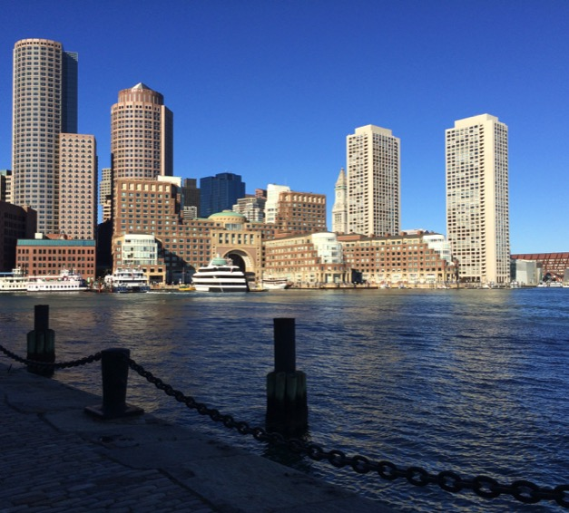
Some Context
Projections become reality - the shift to adaptation…
Some change now inevitable … but mitigation still critical
2100 not so far away…and little room for delay
Some useful collaboration precedents between academia, NGOs, and public agencies
Huge academic and NGO resource in Boston region

Slide 3
Potential Topics for Collaboration
Translate science into planning guidance
Communicate risk/vulnerability
Synthesize known/projected risks to establish planning/implementation priorities
Develop site specific solutions
Assess feasibility and impact of comprehensive solutions
Make Boston region a leader in resilience financing

Slide 4
Translate Science Into Planning Guidance
IPCC reports
National Assessments
Regional Assessments
100s-1000s of Studies/Papers
FEMA maps
TBHA maps
Planners, regulators, developers need clarity and predictability
Planning guidance must correlate with capital life of buildings, infrastructure, etc.
Update guidance regularly as science evolves (5-10 year cycles?) and trends become clear – need for permanent consortium of science advisors?

Slide 5
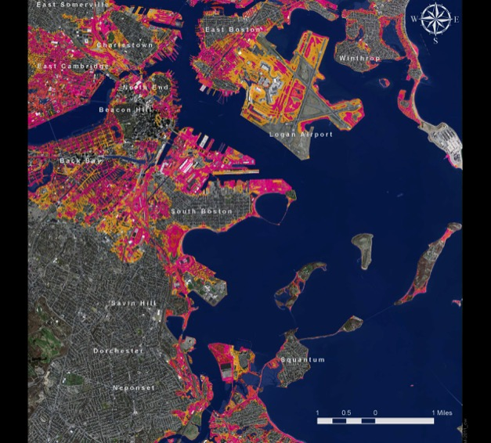
Prelim FEMA and TBHA Maps

Slide 6
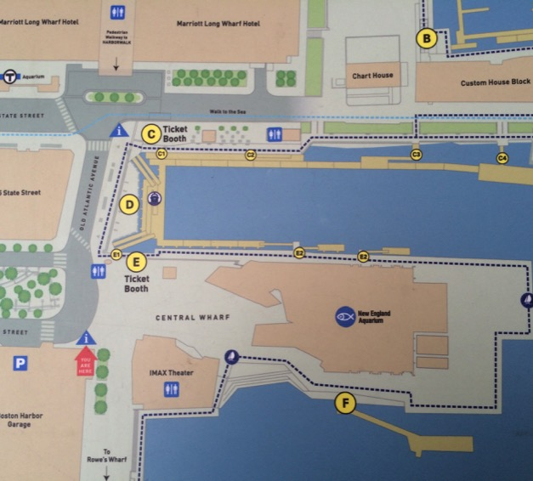
Scenario Planning - NEAq
FEET |  | KEY REFERENCE ELEVATIONS AND FLOOD HEIGHTS
15.0 |  | NEAQ MAIN BUILDING 1ST FLOOR
13.0-14.0 |  | PRELIM 2013 FEMA 100 YEAR FLOOD DOWNTOWN (INCL WAVE ACTION)
12.3 |  | TBHA MHHW +7.5 FT (NO WAVE ACTION)
11.6 |  | CHARLES RIVER DAM
11.0 |  | NEAQ IMAX 1ST FLOOR
10.0 |  | PRELIM 2013 FEMA 100 YEAR FLOOD AT CR DAM (NO WAVE ACTION)
9.8 |  | TBHA MHHW + 5.0 FEET (NO WAVE ACTION)
9.6 |  | HIGHEST OBSERVED WATER LEVEL (1978)
9.4 |  | FEMA 2008 100 YEAR FLOOD
7.3 |  | TBHA MHHW + 2.5 FEET (NO WAVE ACTION)
4.8 |  | MHHW
0.0 |  | MSL
-4.8 |  | MLLW (APPROX)
 |  | ("WICKED HIGH TIDE" ADDS APPROX 2 FEET TO MHHW)

Slide 7
Communicating the Risks
Complicated issues:
  Inherent uncertainties re: climate sensitivity and emissions trajectories
  But – strong scientific consensus and growing evidence of change
  Incremental SLR v storm surge/flooding
  “100 Year Storm” vocabulary
In absence of another Sandy near miss – will memories fade?
How can universities and NGOs help?
Examples: San Diego Climate Education Partners; NOCCI (NEAq, WHOI, etc)

Slide 8
Synthesizing Risk Assessments
Many underway: FEMA/City Review, MA DOT (Big Dig), MASSPORT, BSWC, MWRA, City of Cambridge, FEMA, Private Utilities, Universities, Private property owners, etc
Need to synthesize:
  identify neighborhoods, property, infrastructure most at risk
  prioritize solutions and investment
Role for universities and NGOS -- or private contractors for public agencies?

Slide 9
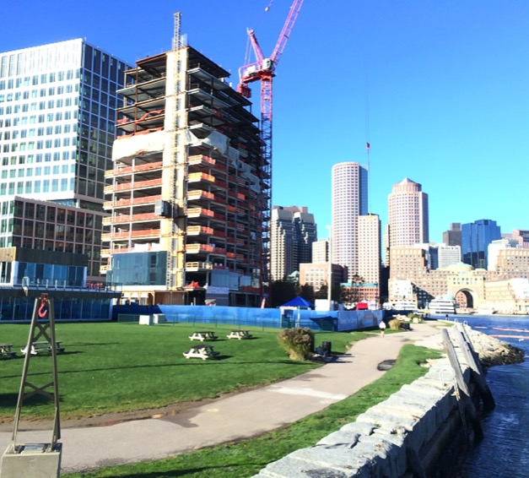
Developing Site-Specific Solutions
Enhance resilience for near term and “best case” scenarios by 2100
Can focus on individual buildings, properties, infrastructure
Case studies for course work in engineering, architecture, landscape architecture, urban planning, real estate development, etc.
Internships in public/private sector
Facility planners can share best practices
Existing buildings – biggest challenge.

Slide 10
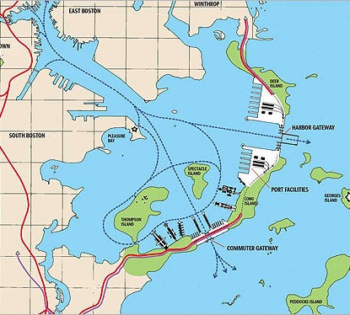
Assessing Options for
Comprehensive Solutions
SLR by 2100 + storm surge
Interdisciplinary approach needed:
  engineering feasibility
  impacts on harbor uses
  environmental impacts
  cost/ financing
  Etc.
Relationship to site-specific solutions
DiMambro & Associates

Slide 11
Make Boston A Leader in Preparedness Financing
Relocation of high value assets not feasible in many cases
How to protect an important component of city’s tax base?
How to incentivize private property owners to implement resilience measures?
  Regulatory measures to provide flexibility for, and reward, best practices
  Insurance incentives – create value by reducing risks
  Synergies between green building/energy efficiency initiatives and resilience measures?
  Create resilience fund from insurance fee or other mechanism?
Equity issues – how to ensure low/middle income neighborhoods become more resilient?
Role for public policy programs? Business schools? Economists? Social science?

Slide 12
GRC Higher Ed Working Grp – City of Boston Partnership
Five tiers of engagement with increasing level of commitments:
  Knowledge exchange
  Integrate city content into course materials
  City internships for students
  City-commissioned research
  University research consortium

Slide 13
Challenges
Applied v basic research – matching up City’s objectives v academic objectives
University projects must support professional/career objectives of academics
Faculty/universities must balance teaching v research v community service
Planning time scales differ: universities - long term, politicians - one term; private sector – tomorrow?
Funding

Slide 14
