Slide 1
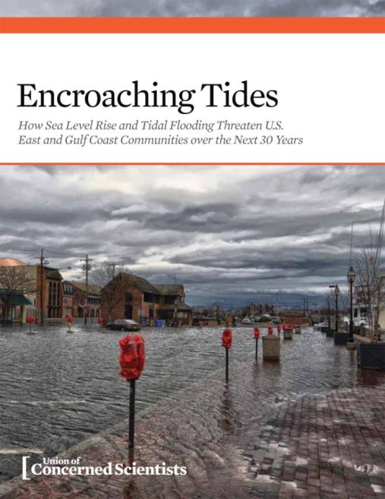
Erika Spanger-Siegfried
Senior Analyst
Union of Concerned Scientists
www.ucsusa.org/encroachingtides
esiegfried@ucsusa.org

Slide 2
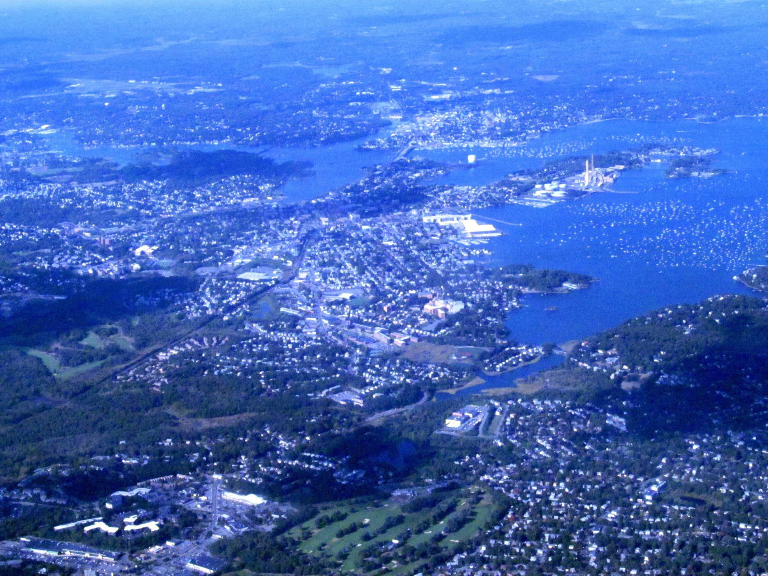
© Picasa/Pi.1415926535

Slide 3
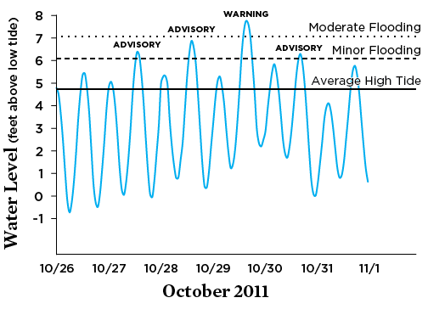
Extreme tides can = tidal floods

Slide 4
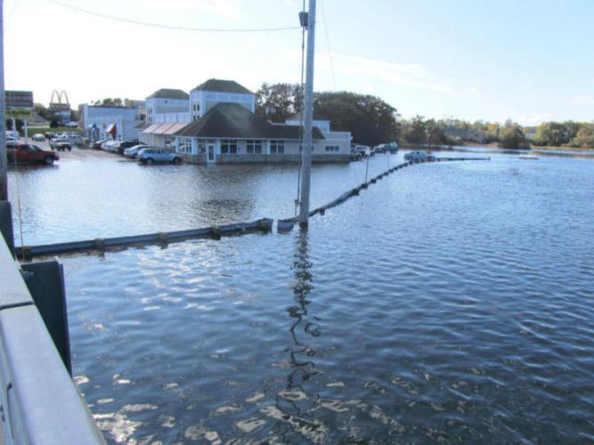
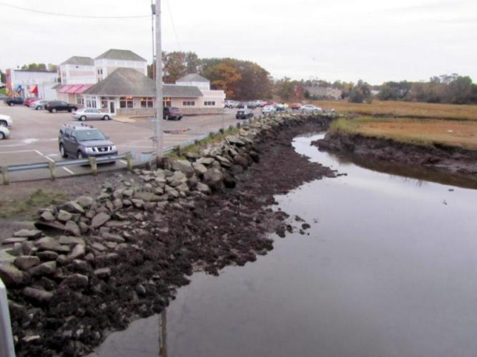
Jim Lee

Slide 5
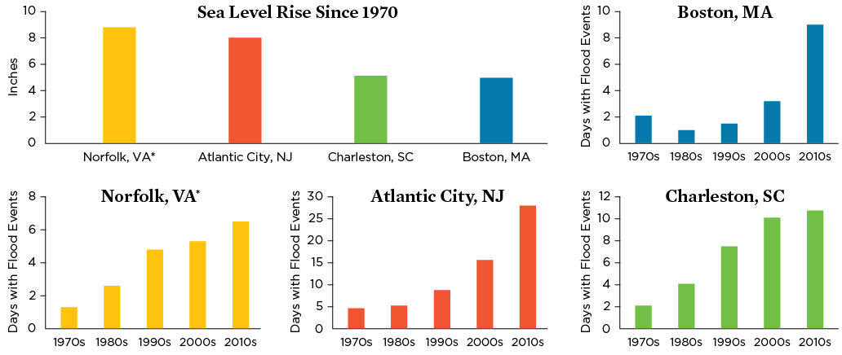
Local SLR and Tidal Flooding,
1970- -2012

Slide 6
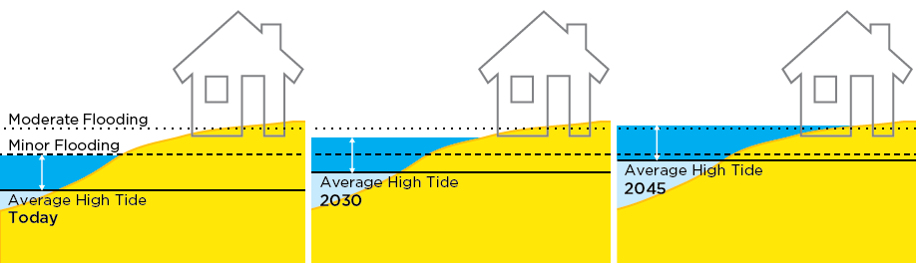
Sea Level Rise and Tidal Flooding

Slide 7


Slide 8
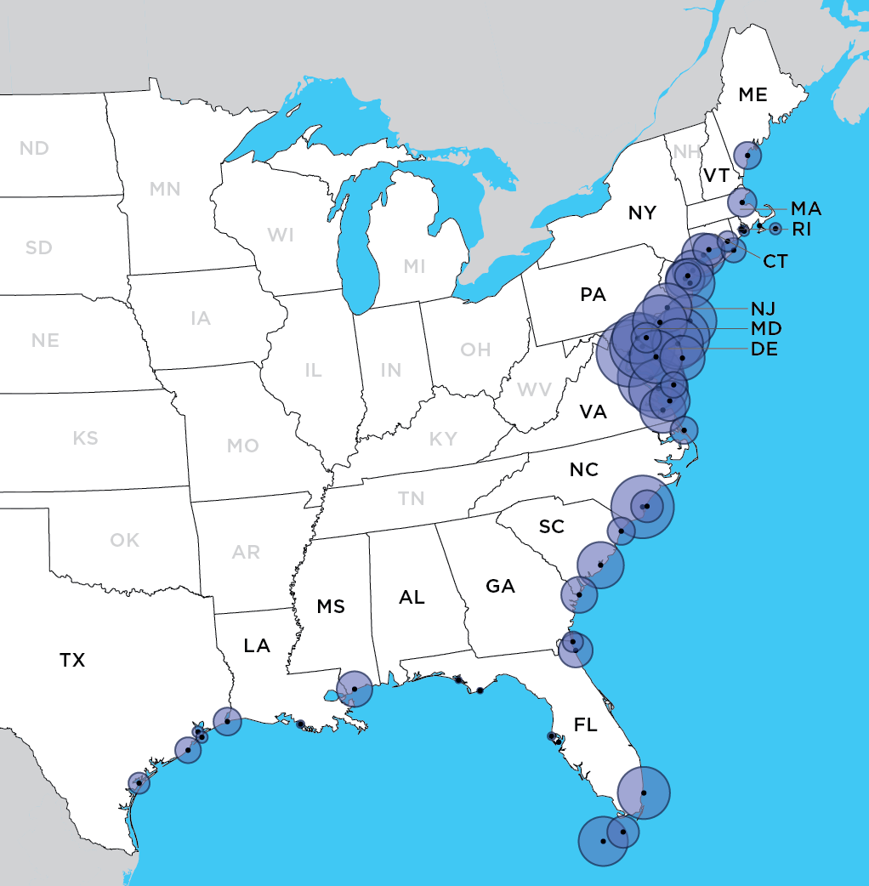
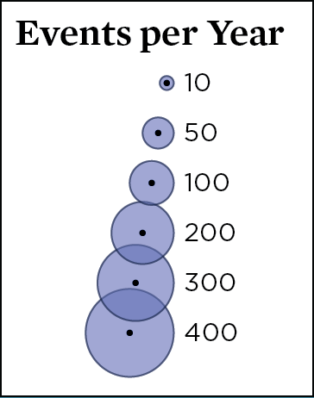
Tidal Flooding in 2045: Widespread, frequent, disruptive

Slide 9
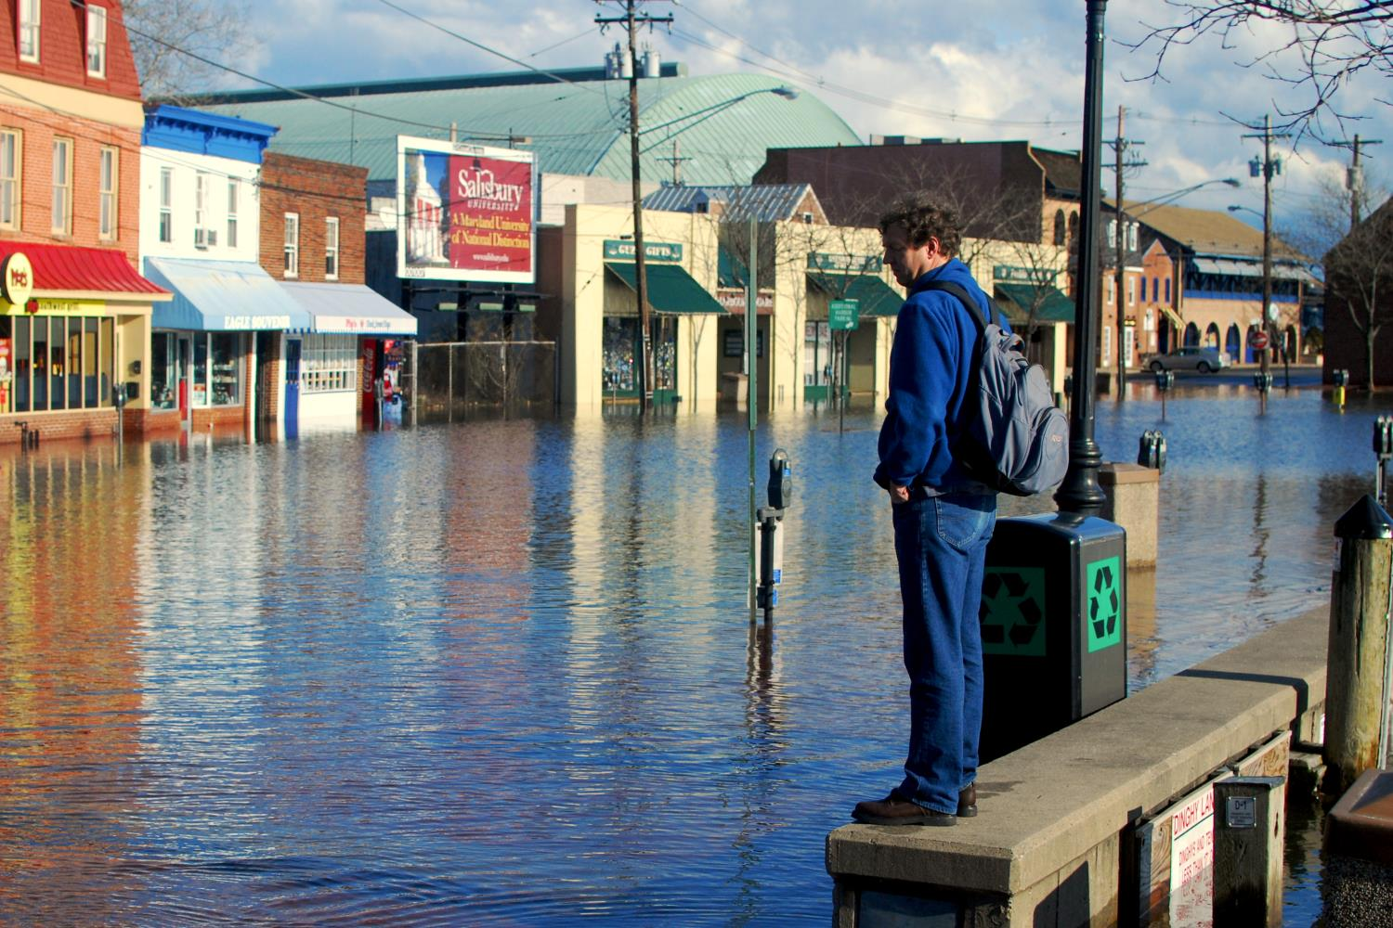
Thank You www.ucsusa.org/encroachingtides esiegfried@ucsusa.org
© Chesapeake Bay Program/Flickr

Slide 11
Extra slides

Slide 12
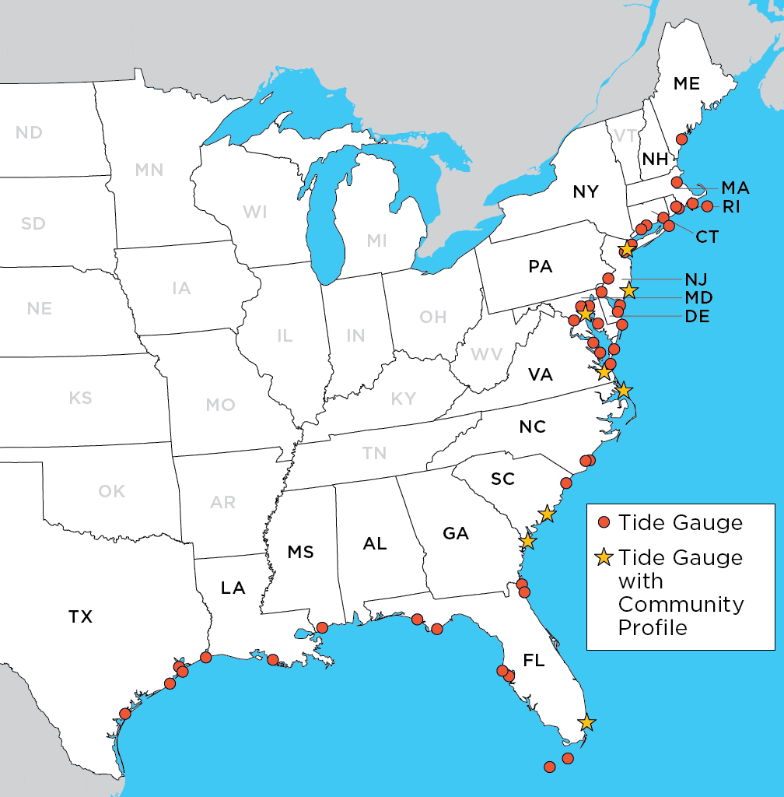
This Report….
Looks at 52 locations on the U.S. East and Gulf Coasts
Uses local minor and moderate flooding thresholds, correlated with local flooding
Uses localized NCA SLR projections for 2030 & 2045,
Projects the frequency and duration with which future tides exceed flooding thresholds
Shares stories about communities’ experiences
Notes:
We have taken a reasonable sea level rise projection straight out of the U.S. National Climate Assessment – and we’ve simply asked the question “what does that really mean on the ground in the near future”? With the help of NOAA and the research group Climate Central, we’ve used data from 52 different tide gauges along the East and Gulf Coasts, together with localized sea level rise projections [from Climate Central’s Surging Seas Risk Finder].
And we’ve looked at how flooding -- at high tide -- will change as sea level rises in the next 15 and 30 years.
The report is a compilation of data – but most importantly stories about places that are already dealing with tidal flooding on a regular basis.
Find the report here:
www.ucsusa.org/encroachingtides

Slide 13
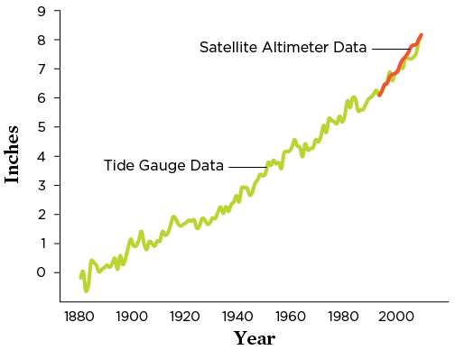
Recent Historical Sea Level Rise
Global rise of 8 inches over last century
Currently rising at a rate faster than ever before
Notes:
The data we used comes from NOAA tide gauges along the East and Gulf Coasts. We know from tide gauge records over the last century or more that sea level is rising, and now satellite data confirms that these trends are continuing.
Global sea level rose roughly eight inches from 1880 to 2009. That rise occurred because global warming accelerated the melting of land-based ice into the oceans, and because seawater expanded as it absorbed heat from a warming atmosphere. Sea level rise is accelerating globally today, and at especially fast rates along parts of the East Coast.
We know high tides are having a greater impact on U.S. communities today than in decades past for two reasons. First, our shores are more heavily developed, so higher tides affect more people and infrastructure. Second, these tides are now occurring on top of elevated—and rising—sea levels.

Slide 14
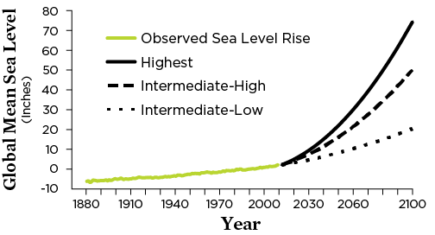
Sea Level Rise Projections
Intermediate High Scenario from U.S. NCA
Global sea level rise of 5 inches above 2012 levels by 2030, and about 11 inches by 2045.
Notes:
In our analysis, we’ve used three different possible future sea level scenarios. These are all from the National Climate Assessment and are known as the intermediate-low, the intermediate-high, and the highest SLR projection. Each represents different assumptions about how oceans and land-based ice will respond to future warming to project global sea level rise. These scenarios show a range of 1.5 feet to 6.3 feet of sea level rise above 2012 levels by 2100. The rate and magnitude of the loss of land-based ice—primarily the ice sheets of Greenland and Antarctica—account for much of the difference in the projections.
You can find the results for all three SLR scenarios in our background technical document on the report landing page:
www.ucsusa.org/encroachingtides
For our report, we chose to highlight one of these scenarios – the intermediate-high scenario – to project coastal flooding at our 52 chosen tide gauges. We based projections for sea level rise at our 52 locations on the assessment’s intermediate-high scenario, which projects a global sea level rise of about five inches above 2012 levels by 2030, and about 11 inches by 2045.
In addition, we included a local component of sea level rise due to changes in land uplift and subsidence, ocean currents and density, groundwater extraction and sea floor topography. So the SLR rates for each locations add this local component to the global sea level rise (and those results can be found on page 52-53 of the report) .
SOURCES: CLIMATE CENTRAL N.D.; WALSH ET AL. 2014; PARRIS ET AL. 2012.

Slide 15
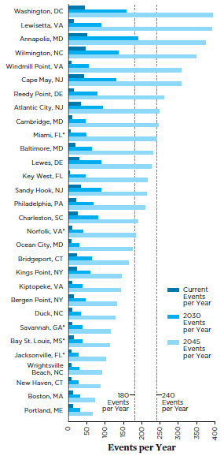
Minor flood events per year for the present, 2030, 2045
Notes:
In the next 15 years, two-thirds of these communities could see a tripling or more in the number of high-tide floods each year.
What is shown here are the number of flood events per year that are higher than the minor flood level. There are two vertical bars that show 180 and 240 flood events per year.
Of the 52 locations we examined, 30 (shown here) can expect at least two dozen tidal floods per year, on average, by 2030. (Note that some communities, such as Broad Channel in Jamaica Bay, NY, see roughly this much flooding today; however, this flooding is not captured by the closest tide gauge.) And tidal flooding will occur even more often in many locations.
By 2045, one-third of the locations we analyzed can expect 180 or more tidal floods per year.
And nine locations could average 240 or more tidal floods a year by 2045.
I will point out that on the east coast there are two tides a day in most places, so for many places this represents two floods a day at some times of the month.

Slide 16
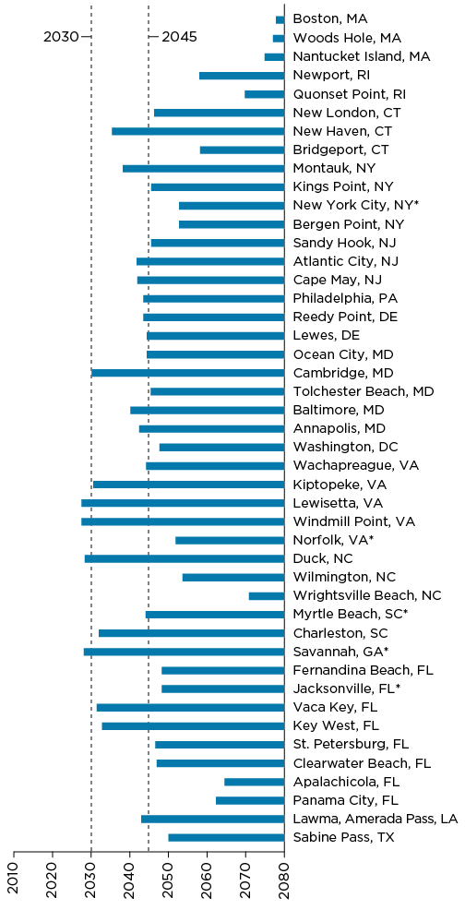
Tides that Cause Minor Floods on Track to Cause Moderate Floods in Year….
Notes:
Tides that cause minor, or nuisance, flooding today will be rolling in on higher seas in the future. The year when those tides begin to cause moderate, or more extensive, flooding, varies with the location. The time frame reflects the difference between today’s minor and moderate flooding thresholds in each location, as determined by the National Weather Service, and the projected pace at which local sea level rise will close the gap between the two.
This graph shows the present on the left and future years on the right. The two vertical lines are the years 2030 and 2045. As you move across to the right you start to see a blue line that represents the year that what is today a minor flood would in the future with SLR be a moderate flood. The graph is ordered geographically from north to south by state. And this is just for tide gauges that have a moderate flooding threshold (not all of them do).
So, for instance, in Lewisetta VA, local SLR rates mean that under a mid-range scenario just before 2030 all the minor floods of today (14 of them) would be moderate floods.
So, for instance, in Atlantic City NJ, local SLR rates mean that under a mid-range scenario just before 2045 all the minor floods of today (32 of them) would be moderate floods.
(Some locations included in our analysis, like Miami, do not have a defined threshold for moderate flooding. Locations are shown from north to south by state, wrapping around Florida to the Gulf Coast.)
* Data for these locations are represented by nearby tide gauges; see the appendix for tide gauge locations.

Slide 17
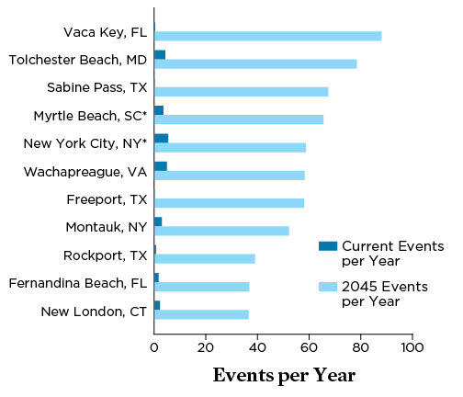
More Locations Join the Tidal Flooding Front Line
Notes:
Sea level rise will bring regular tidal flooding to many communities where it is rare today, especially along the Gulf Coast. Communities listed here now average fewer than five tidal floods per year. However, they can expect to average two dozen or more by 2045, and all face more than a 10-fold increase in the average number each year.
(Note that some communities in Jamaica Bay, which is represented by the New York City, NY, tide gauge, currently flood far more frequently than shown here.)
Tides that cause so-called nuisance flooding today are expected to cause extensive flooding by 2045 in five of these communities: Vaca Key, Tolchester Beach, Myrtle Beach, Wachapreague, and Montauk.
What we are looking at is a vastly different landscape for many cities and towns along the East and Gulf Coasts in the very near future.

Slide 18
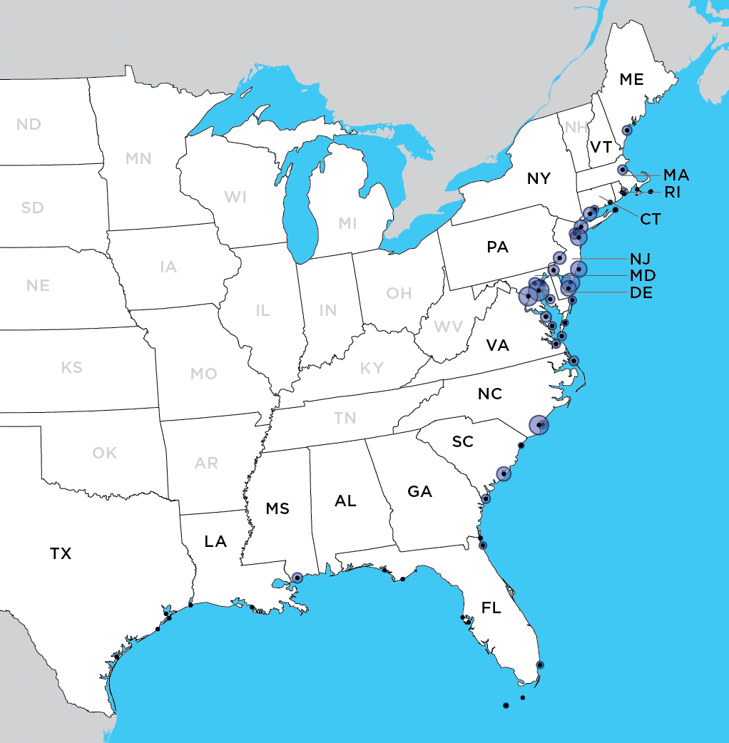
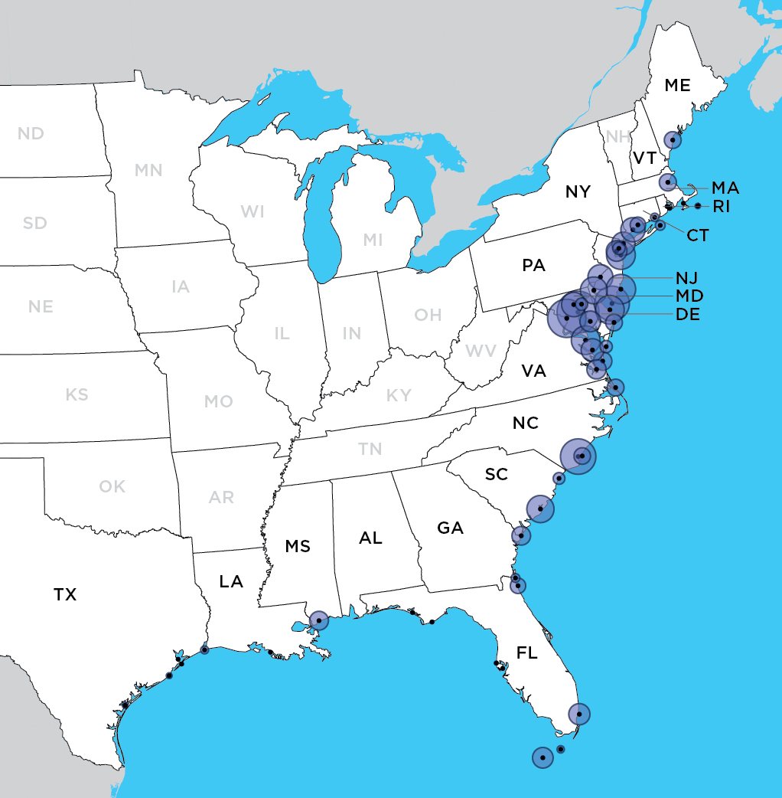
Growing Frequency and Spread of Tidal Flooding in 2045
Notes:
On this map, the area of the circle represents the average number of flood events per year in 2045.
By 2045, many communities can expect a 10-fold increase in the frequency of tidal floods.
Cambridge, MD, Atlantic City, NJ, and Washington, DC, could average more than 240 per year by 2045. Some places may have over 400 tidal flood events per year.
The tidal floods will cluster around new and full moons. So, for example, with a projection of 388 tidal floods per year in Washington DC, this would mean around 32 events a month, which might be flooding (for example) 16 times at the full and new moons, or eight days in a row twice a month where every high tide floods. This is what we mean about constantly dealing with floods.
Only five of our locations would average fewer than five a year: Woods Hole, MA, Quonset Point, RI, and Panama City, Apalachicola, and St. Petersburg, FL.

Slide 19
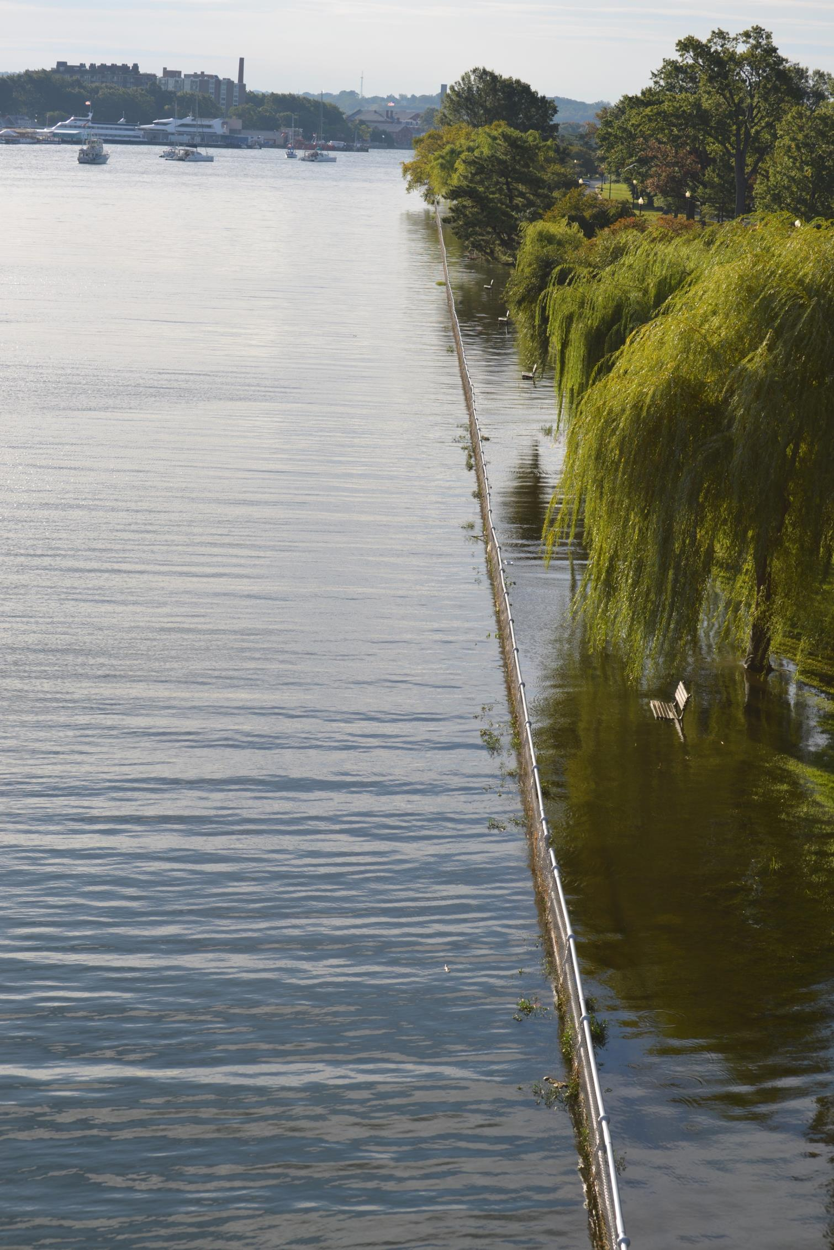
© Brenda Ekwurzel
Notes:
This photo of the banks of the Potomac was taken by our colleague in October on her way to work in DC. Amidst what were the highest tides of the year in some locations, tidal flooding disrupted business as usual in areas of Queens, Annapolis, Charleston, Key West, and many in between.

Slide 20
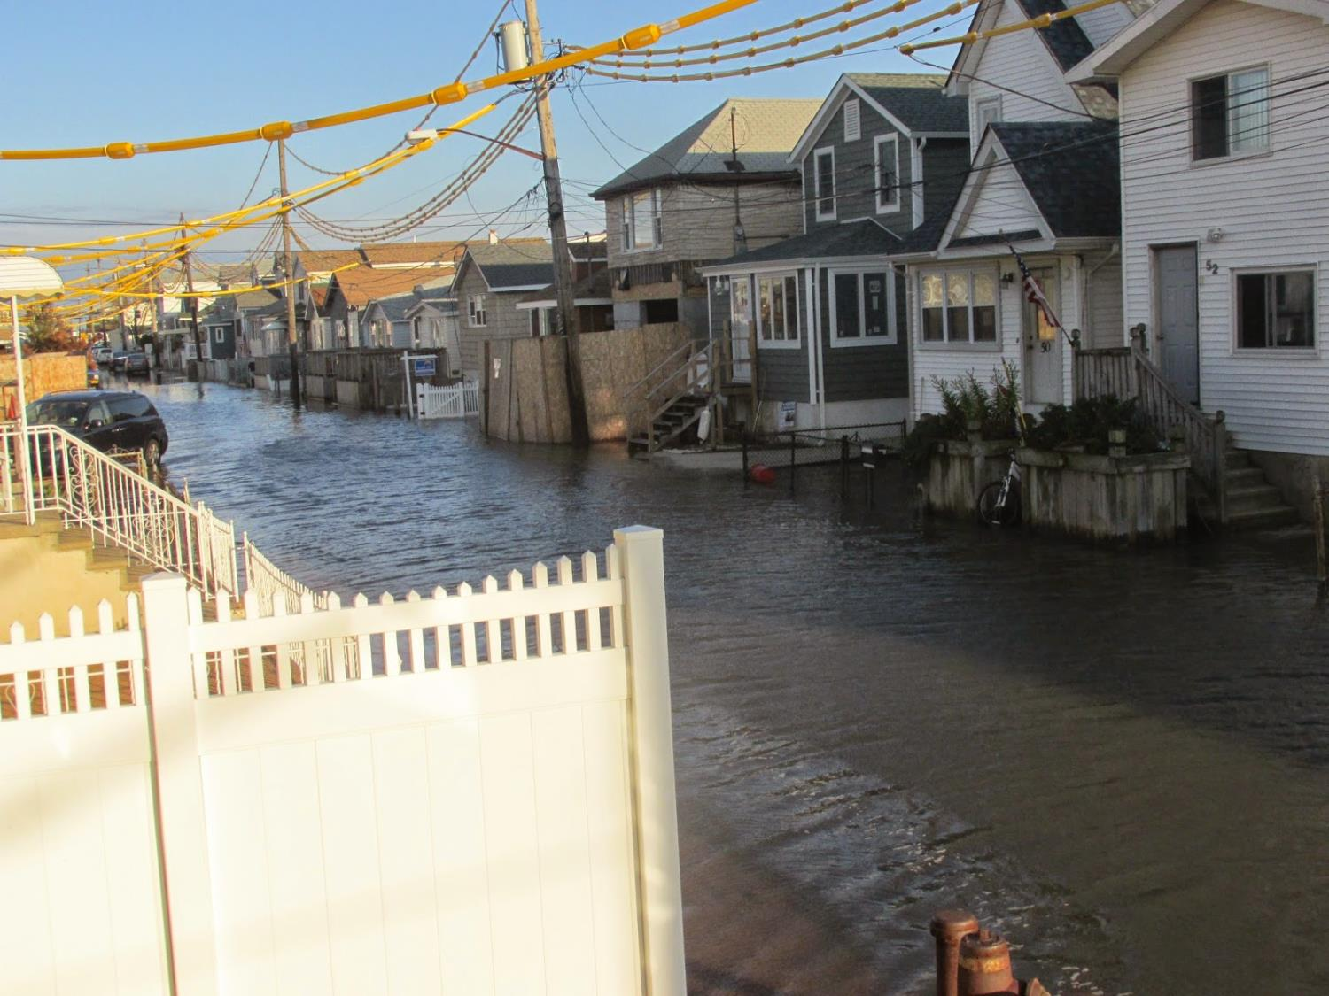
Jamaica Bay, NYC
© Peter Mahon / West 12th Road Block Association
Notes:
This is Jamaica Bay, and specifically the Broad Channel neighborhood of Queens. This photo was taken Saturday Oct 4 and is typical of the new and full moon flooding they see.
Over the last century, the water level in Jamaica Bay (as measured at the nearby Battery tide gauge) has risen nearly a foot, owing to both sea level rise and local subsidence of the land (NOAA 2012a).
Minor flooding events in the Broad Channel area now occur once or twice a month, or more.
EXTRA MATERIAL (again, includes results so will tend to skip here)
Working-class communities along an urban coast contend with the impacts of rapid increases in tidal flooding on daily life.
Today, mostly working-class neighborhoods enjoy spectacular water views, but must contend with frequently flooded streets and sidewalks during high tides and heavy rainfall, and worse impacts during larger storms.
Because drainage infrastructure is aging, flooding today sometimes causes combined sewage and stormwater to overflow into streets.
FEMA flood-risk maps released in 2013 show that most of the Rockaways and Broad Channel neighborhoods—which have high poverty rates—are already high-flood-risk zones
And our analysis shows that continued sea level rise means that the frequency of flooding events in Jamaica Bay will triple by 2030, and increase nearly 10-fold by 2045, compared with today.

Slide 21
“Fifteen years ago I didn’t believe in sea level rise, but I do now. Flooding has become so common that we live by the tidal cycles in Broad Channel.”
- Dan Mundy, Sr., retired fire chief and former neighborhood association President
Notes:
Here’s a quote we include in our report from a long-time resident of Broach Channel.

Slide 22
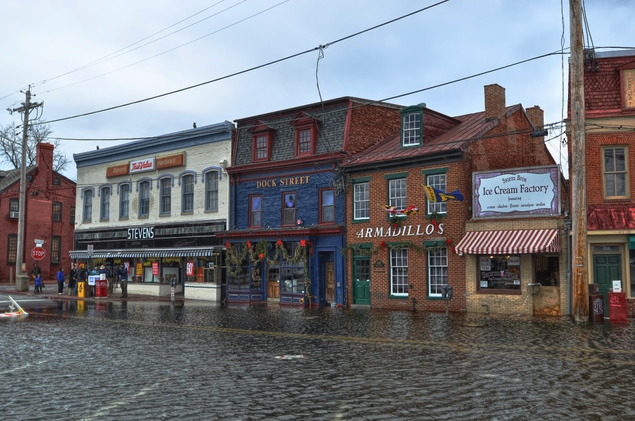
Annapolis MD
Blah, blah (replace thumbnail with high res, add credit)
© Amy McGovern/Flickr
Notes:
Annapolis
Capitol of MD. Home of the U.S. Naval Academy, Annapolis is coping with seas that are rising faster than the global average.
The low-lying city of Annapolis is well-acquainted with coastal flooding, as it faces regular disruptions to downtown streets and parking.
A more than fourfold increase in tidal flooding since 1970 has made Annapolis among today’s most frequently flooded East Coast cities.
Today the popular City Dock sees flooding 40-50 times a year during high tides.
EXTRA MATERIAL (but gets into results, so will generally skip):
During such flood events, seawater can move into downtown areas and surrounding neighborhoods, and push water out of storm drains and onto surrounding streets, even on fine sunny days with no wind or storms.
In 2030, just 15 years from now, projections show that Annapolis may see another half-foot of sea level rise, and a tripling of flood events to around 180 a year.
By 2045, projections of sea level rise of around a foot mean that Annapolis would face more than 360 flood events a year—about 50 of them extensive.

Slide 23
"I walk […] to lunch and I anticipate, on some high-tide days, that I'm not going to be able to walk back; I'm going to have to take the long way around.“
- Lisa Craig, Chief of Historic Preservation, City of Annapolis
http://www.npr.org/2014/10/08/354166982/climate-change-worsens-coastal-flooding-from-high-tides

Slide 24
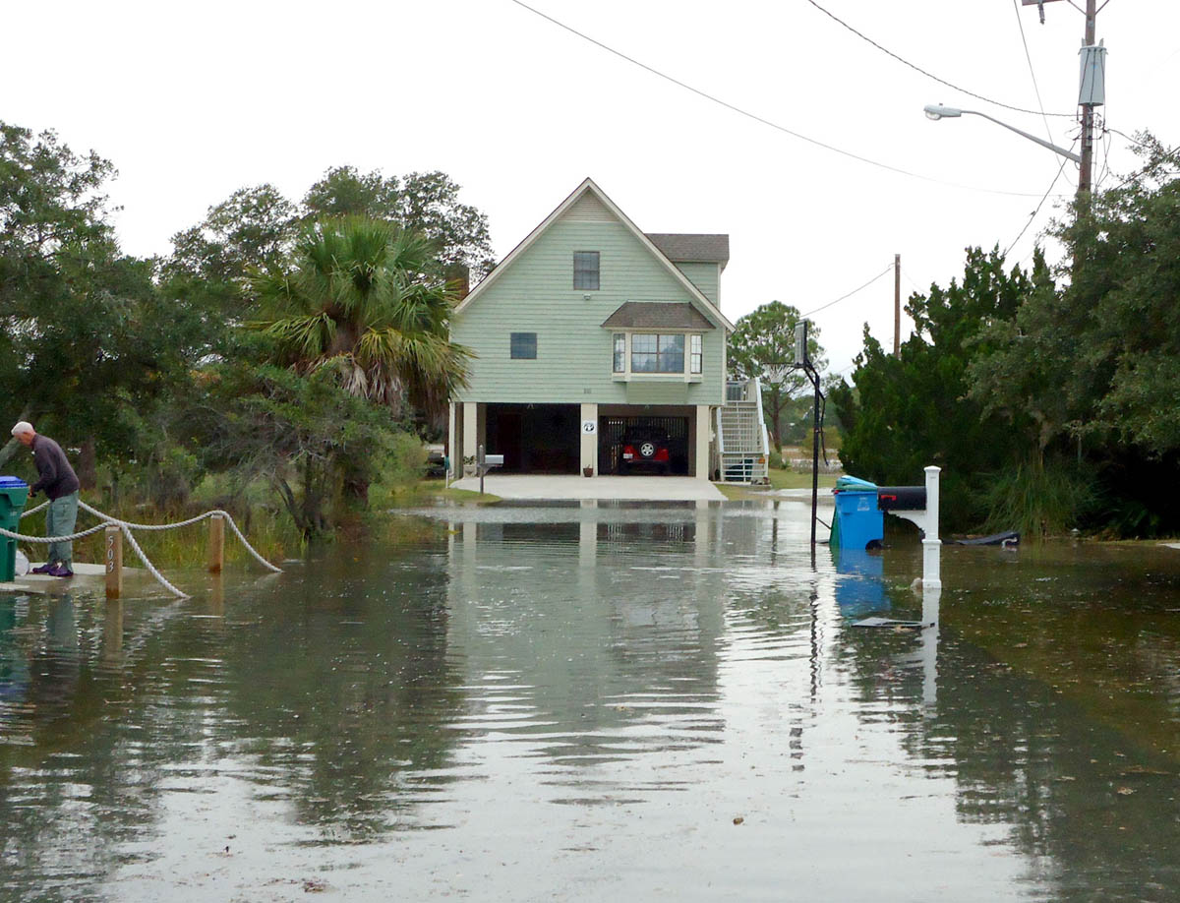
Savannah and Tybee Island, GA
Blah, blah, add photo credit (Jason Evans)
© Jason Evans / Georgia Sea Grant
Notes:
This is Tybee Island during tidal flooding, a neighbor of Savannah
Floods in the Savannah area, including Tybee Island, now occur about 10 times a year—up from an average of just five or fewer some 40 years ago (Sweet et al. 2014).
Among other impacts, the island is served by a single highway, Highway 80, which has become particularly prone to tidal flooding and closure during a full or new moon.
EXTRA MATERIAL:
Projections show that by 2030, just 15 years from now, Savannah could see more than 30 tidal floods a year—a threefold increase compared with today.
And sea level rise of almost half a foot will transform today’s nuisance tidal floods into more dangerous and damaging ones, with conditions that now occur only during the worst tidal floods.
Projections for 2045 are stark: Savannah could see a foot of sea level rise and a 10-fold increase in tidal flood events— to more than 100 annually. Each year, about 10 of those floods would fall into the extensive category, affecting highways, houses, businesses, infrastructure, and parks, across an expanded area of the city and region.

Slide 25
“Now is the time to plan and budget for infrastructure that we’ll need 20, 50, and 100 years from now to deal with the impacts of sea level rise.”
- Paul Wolff, Tybee Island’s longest-sitting city council member
Notes:
And here’s a quote from Tybee’s long-time City Council member, Paul Wolff.

Slide 26
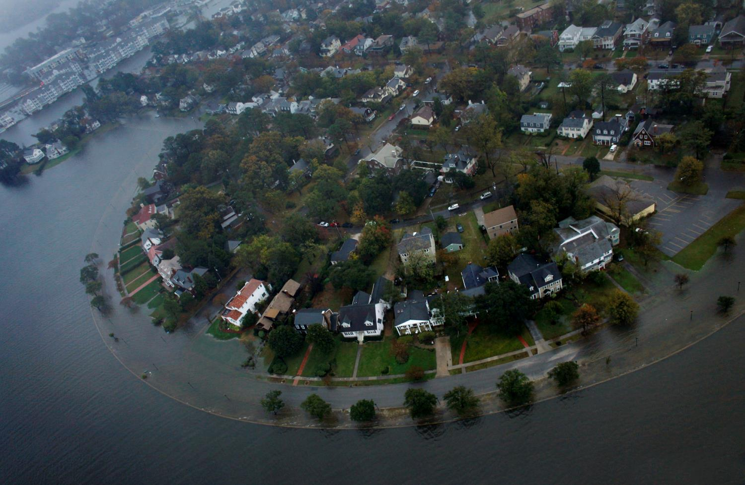
Notes:
This is a flood-prone neighborhood at high tide, in the wake of a Nor’easter.
But fast forward with me to 2030 and imagine that this degree of flooding is tidal and is happening 8 times a month. How should a community like this go about adapting to those tides? Should it build a berm or floodwall system here? Should it elevate all these homes and prevent new development? Should it plan for an eventual buyout?
We would say, at the simplest level, that it should start by getting very clear NOW about its tidal flood risks and by folding these risks into its ongoing strategy for dealing with sea level rise and the changes its bringing. To be clear: resilience to storms is the priority in most coastal communities, and that shouldn’t change. But as we’re planning, investing, upgrading, rebuilding, implementing, etc., we should ensure that we are building resilience to tidal flooding, too. If we’re lucky, we’ll mobilize resources to invest in resilience-building measures in a timely, serious way; we’re unlikely to have the luxury of a re-do.

Slide 27
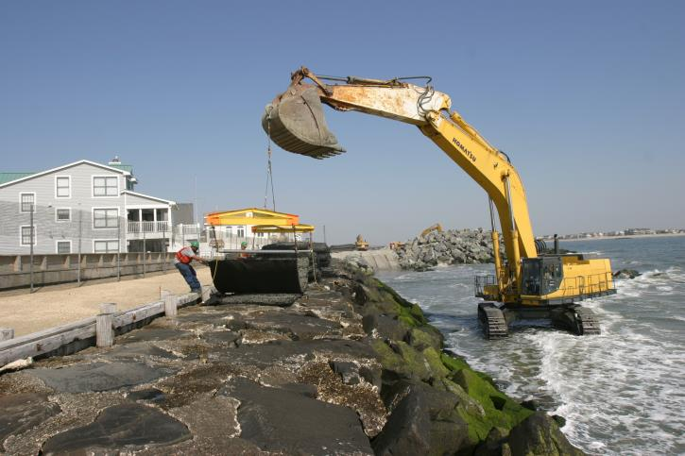
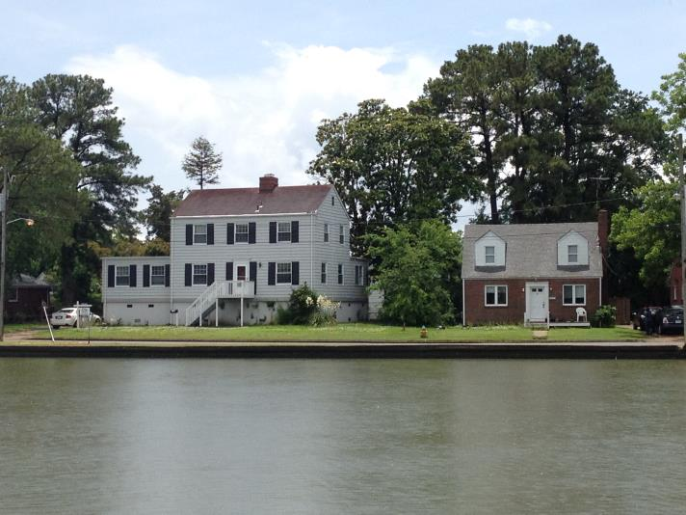
Resilience principles
Communities can…
Upgrade the built infrastructure in harm’s way.
Avoid putting anything new in harm’s way.
Consider the risks and benefits of adaptation measures.
Have a long-term vision.
Notes:
In the report, we outline some practical approaches or “principles” communities can apply:
Upgrade the built infrastructure in harm’s way. With help, communities can prioritize and incentivize flood-proofing of homes, neighborhoods, and key infrastructure, such as sewer and stormwater systems.
Avoid putting anything new in harm’s way. Communities can use a range of regulatory and planning tools to curtail new development in coastal locations subject to tidal flooding now and in the future.
Consider the risks and benefits of adaptation measures. Some measures to limit the impact of coastal flooding can provide multiple benefits, while others can alter shoreline dynamics and damage neighboring areas and ecosystems. Decision makers need to ensure that a rush to protect coastal communities builds broad-based resilience.
Develop a long-term vision. Communities that create a vision for both near-term protection and long-term resilience in the face of sea level rise—and craft plans for building better, safer, and more equitably—will be best positioned to thrive in the future.

Slide 28
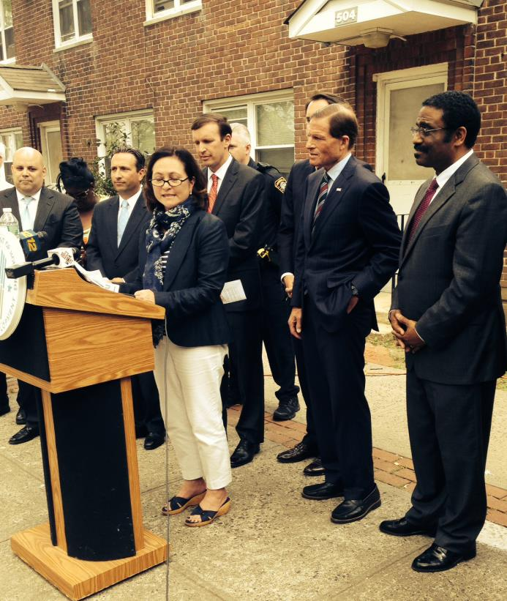
State and Federal Support
Coastal monitoring and data-sharing system
Encourage or mandate the use of good scientific information
Support planning
Mobilize funding
Improve risk management
Ensure equitable investments
Reduce heat-trapping emissions
Notes:
But local communities can’t go it alone—coastal challenges are too great, the costs are too steep, and too many people are at risk. Instead, we need a coordinated, well-funded national response to our country’s coastal vulnerability involving federal, state, and local collaboration. Federal and state governments can help build local resilience by supporting, incentivizing, regulating, and even mandating action. They can:
Build and maintain a coastal monitoring and data-sharing system equal to the threat. Key federal agencies can sustain and expand efforts to monitor and project sea level rise and flooding, and ensure that local decision makers have access to the data.
Encourage or mandate the use of good scientific information. Agencies can require that communities and other applicants for state and federal funds use the best-available data, and demonstrate that new development and redevelopment projects can withstand projected tidal flooding and storm surge.
Support planning. More federal support for state and local planning and collaboration can accelerate efforts to build coastal resilience.
Mobilize funding. Adapting to sea level rise will require major, sustained investment. Federal policy makers need to develop new funding sources to support resilience-building efforts at the state and local level.
Improve risk management. The true costs of living on the coast are not reflected in the price of flood insurance and other risk management tools. But big increases in the cost of insurance are hard for many to bear. Federal incentives to reduce some property owners' risks and costs can aid the transition to a more solvent flood insurance system and better risk management.
Ensure equitable investments. Federal investments in coastal resilience can prioritize households and communities with the greatest needs.
Reduce heat-trapping emissions. Near-term increases in sea level rise and tidal flooding may be locked in, but changes later this century and beyond are not. To slow the rate of sea level rise—and enable coastal communities to adapt in affordable and manageable ways—we must reduce our global warming emissions.

Slide 29
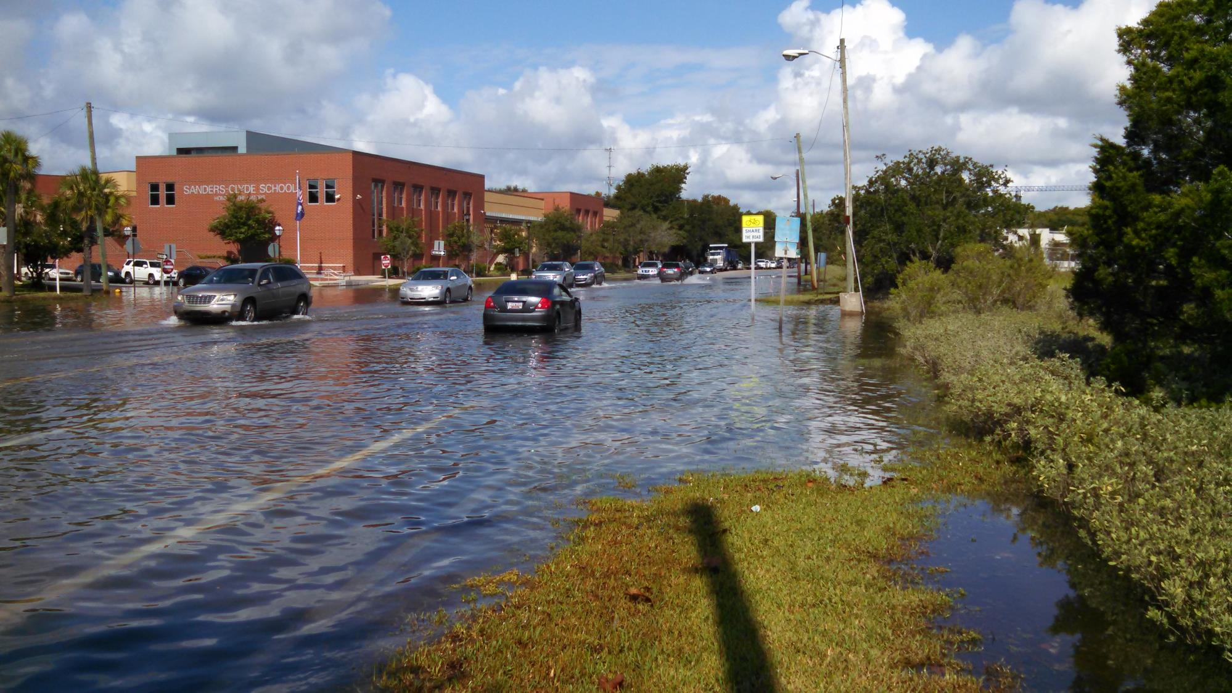
Charleston, SC
© Sean Bath
Notes:
Last community to touch on is Charleston, which saw repeated tidal flood warnings last week and into this week. [ADD CHARLESTON NOTES]
The tidal flooding in this photo is from last month (September 2014)
EXTRA MATERIAL:
That means regardless of the weather, tourists and locals alike frequently slosh through shin-deep water in downtown Charleston, including historic Market Street. Residents know to move their cars and vacate the area early— often using social media such as Twitter to spread the word.
By the time today’s toddlers graduate from high school just 15 years from now, and given a mid-range scenario for sea level rise, the city would
face nearly 80 tidal floods a year. Because of this, South Carolina recognizes long-term sea level rise as a serious concern (SCDNR 2013).
By 2045, under the same mid-range scenario, Charleston would see more than 180 tidal floods a year. And because
sea levels will be higher, flooding would be more extensive
and persist for about 400 hours a year. Under rising seas, an average high tide could inundate the historic district and flood low-lying neighborhoods as often as every other day. Charleston will face a constantly inundated landscape and
much more damage. Even in the very near future, the community needs to
tackle the impacts of tides on daily life. The city is already spending hundreds of millions of dollars on a drainage
improvement project for Market Street, to cope with flooding
from rain during a high tide (City of Charleston 2013). Very
costly pumping stations will channel excess rainwater into
the ocean—although they will become less effective as tides
rise higher.
The city is also installing a multimillion-dollar seawall
off the tip of the peninsula (City of Charleston n.d.). However,
seawalls are effective only if they prevent tides from filtering
up through the ground, and can compound problems when
they prevent rainwater from draining out. Ultimately, the city
will need more creative solutions.

Slide 30
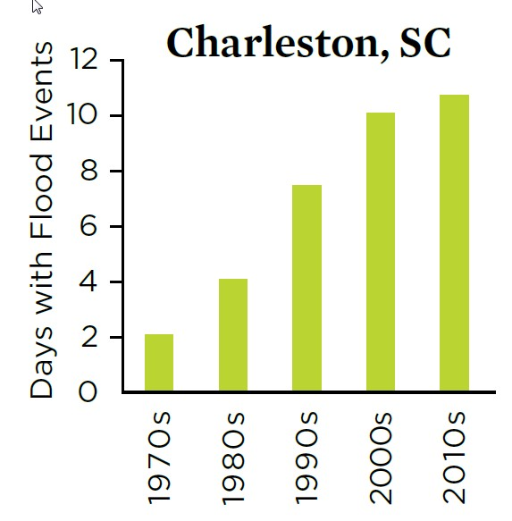
© Sean Bath
Notes:
So, what’s going on?
Sea level at Charleston has risen by more than five inches over the last 40 years, and the number of tidal floods has increased steadily.
Today, these tides cause about two dozen floods a year, or roughly a dozen days with flooding.
Driving these historic changes is the global rise in sea level – roughly 8 inches since 1880.
Today that rate is accelerating. So, how will tidal flooding respond? These cities need to know, and though they and others like them may be on the front line of tidal flooding, others are going to follow close behind, and they need to know, too. To discuss how we expect tidal flooding to respond to rising sea level, I’m going to hand it over to my colleague, Mel Fitzpatrick….

Slide 31
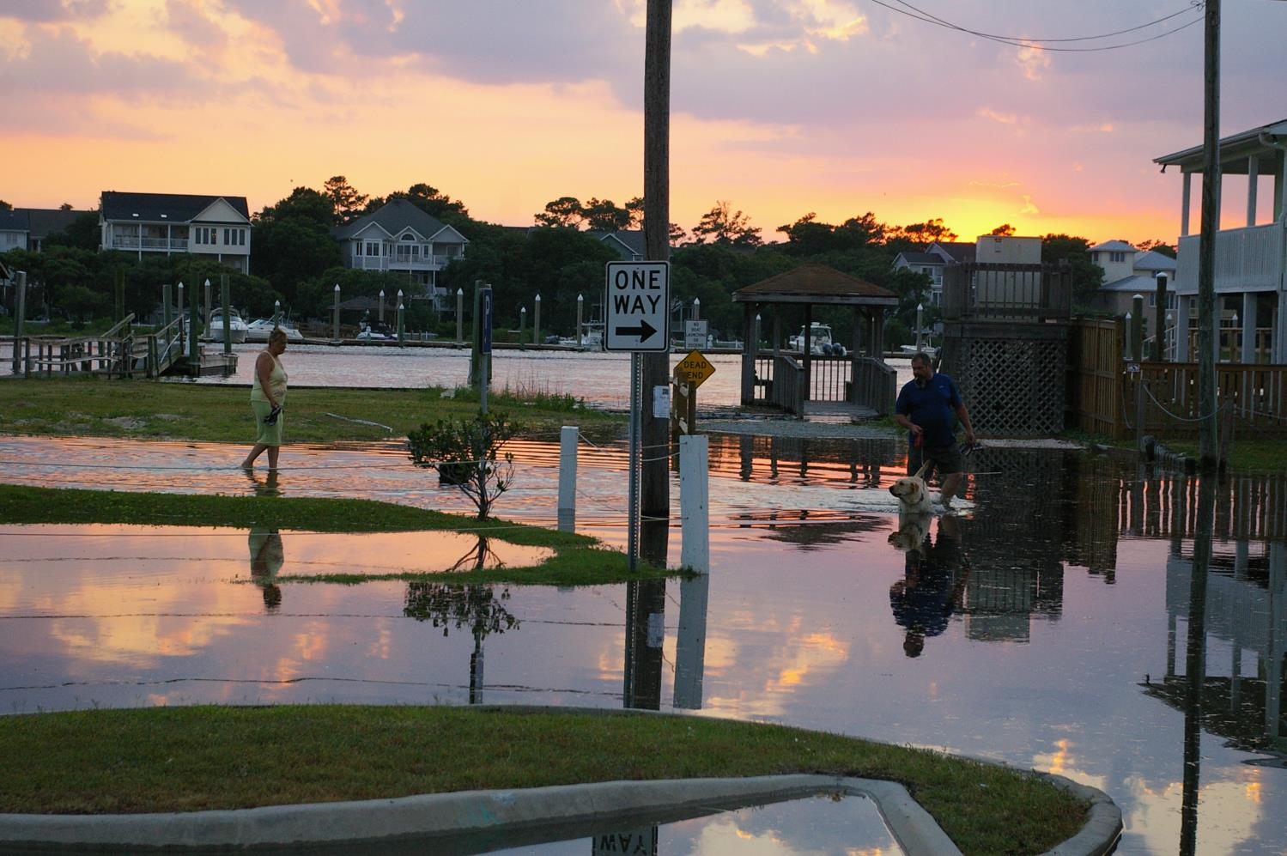

Slide 32
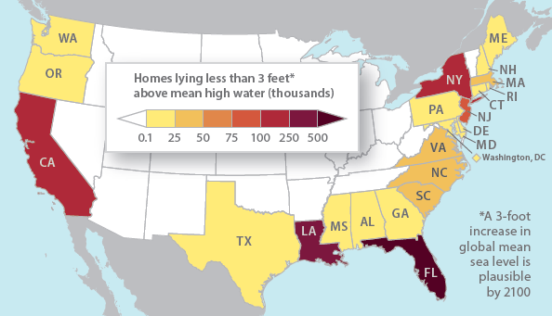
People and Property at Risk
Almost three million people, and their homes, reside within three feet of mean high water
Notes:
In 2012 the total insured value of residential and commercial property in coastal counties for 18 Atlantic and Gulf Coast states was $10.6 trillion; the amount insured through NFIP, as of May 2013, for these 18 states is close to $1.1 trillion (and almost 85% of all NFIP insurance in-force)

Slide 33
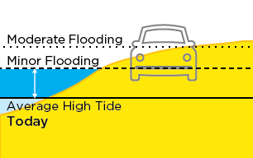
Sea Level Rise
Text here

Slide 34
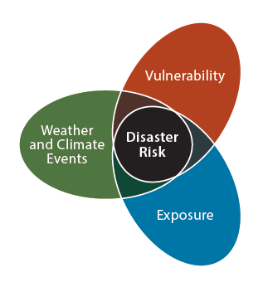
Coastal Communities at Risk
Increasing coastal populations
Increasing coastal development
Climate factors
Notes:
Text from Rachel’s insurance report webinar:
Population growth – coastal populations are expected to increase by 140% by 2100
Development – coastal homes more than double from 1960 to 2008 going from 16.1 million to 36.3 million
Climate Change:
Sea level rise – average of ~8in since Industrial Revolution but predictions range between another 8in and 6.6ft by 2100, this due primarily to melting sea ice and thermal expansion of the ocean; can lead to more coastal erosion, degradation, and flooding
Increased storm surge – amplified by sea level rise , which allow for it to reach further inland
Increased storm intensity – rising temperatures, both sea and air, contribute to the intensity of tropical cyclones; through higher wind speeds (thereby more destruction) and heavier rainfall (as warmer air can hold more water vapor)

