Slide 1
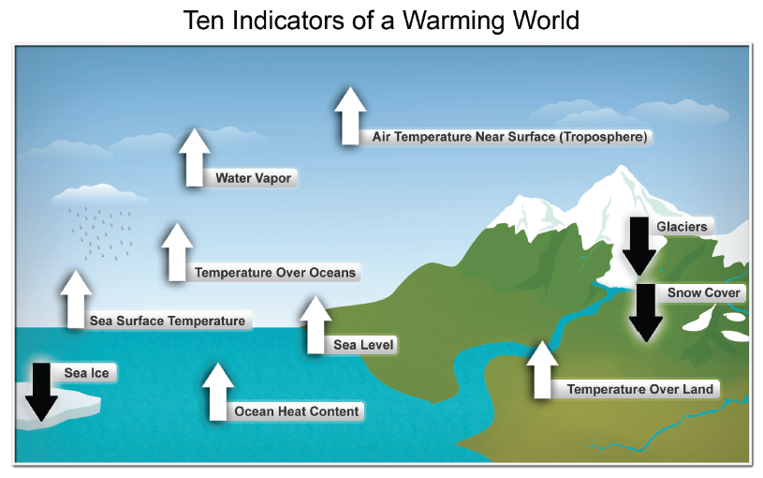
Global Climate is Changing Now
Notes:
These are just some of the many indicators that have been measured globally over many decades and that show that Earth’s climate is warming. White arrows indicate increasing trends, black arrows indicate decreasing trends. All the indicators expected to increase in a warming world are increasing, and all those expected to decrease in a warming world are decreasing. (Figure source: NOAA NCDC)
From Ch2: Our Changing Climate, KM #1

Slide 2
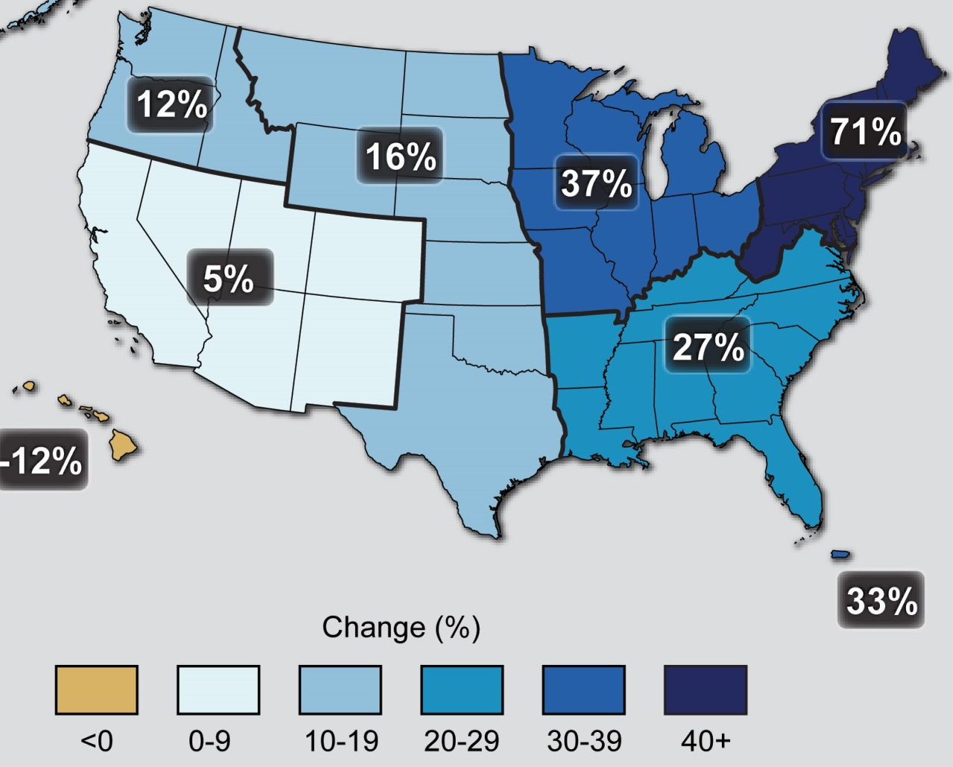
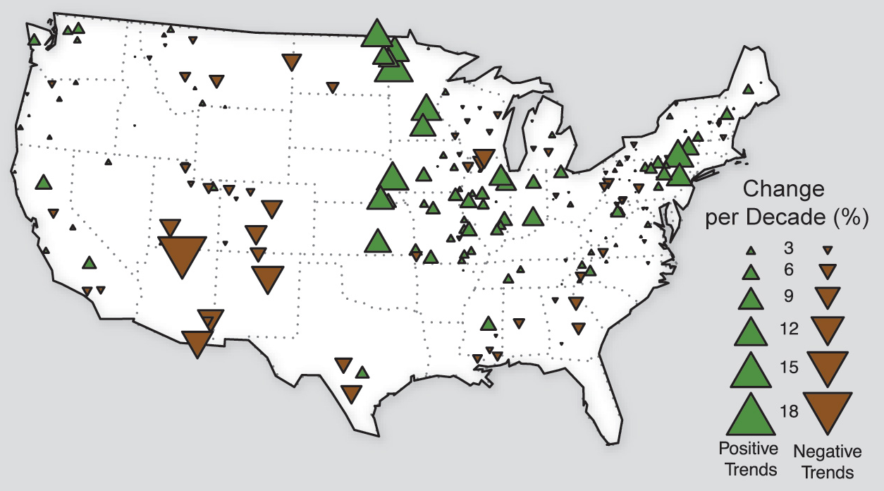
More Intense Precipitation Events & Flooding in Northeast
Observed Change in Very Heavy Precipitation
Observed U.S. Flooding
Notes:
The colors on the map show annual total precipitation changes for 1991-2012 compared to the 1901-1960 average, and show wetter conditions in most areas. The bars on the graph show average precipitation differences by decade for 1901-2012 (relative to the 1901-1960 average). The far right bar is for 2001-2012. (Figure source: NOAA NCDC / CICS-NC).

Slide 3
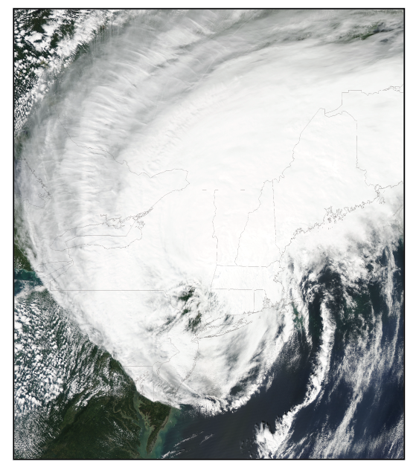
Tropical Storms, Coastal & Inland Flooding

Slide 4
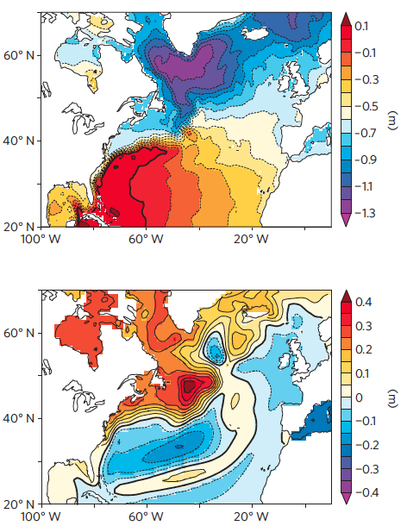
Oceanography & Dynamic Sea-Level
Dynamic sea-level
Change in dynamic sea-level
Yin et al. Nature Geosci. 2009

Slide 5
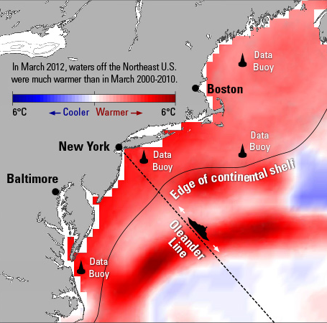
Coastal Ocean Warming (2011-2012)
Chen et al.
J. Geophys. Res. Oceans (2013)

Slide 6
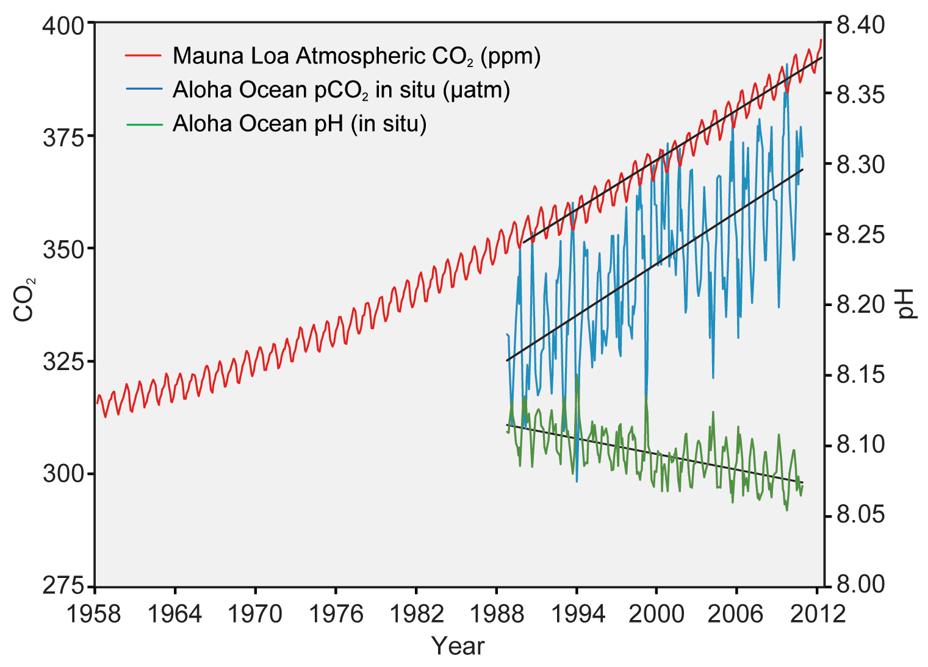

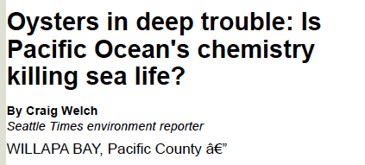
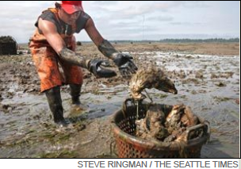
Ocean Acidification
Feely et al. Oceanography 2009
Notes:
The correlation between rising levels of carbon dioxide in the atmosphere (red) with rising carbon dioxide levels (blue) and falling pH in the ocean (green). As carbon dioxide accumulates in the ocean, the water becomes more acidic (the pH declines). (Figure source: modified from Feely et al. 2009).

Slide 7
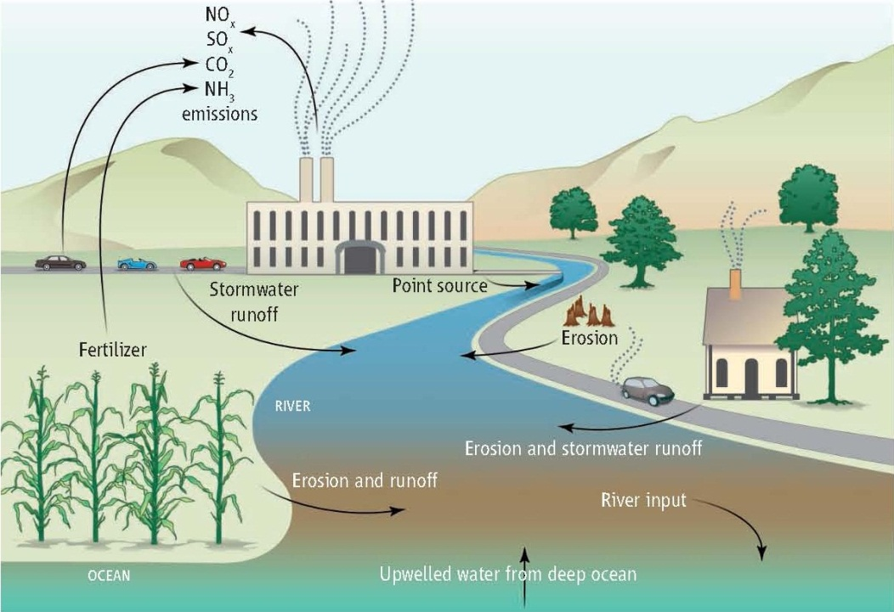
Coastal Water Quality & Acidification
Doney et al. PNAS 2007; Doney Science 2010; Kelly et al. Science 2011

Slide 8
Extra Slides

Slide 9
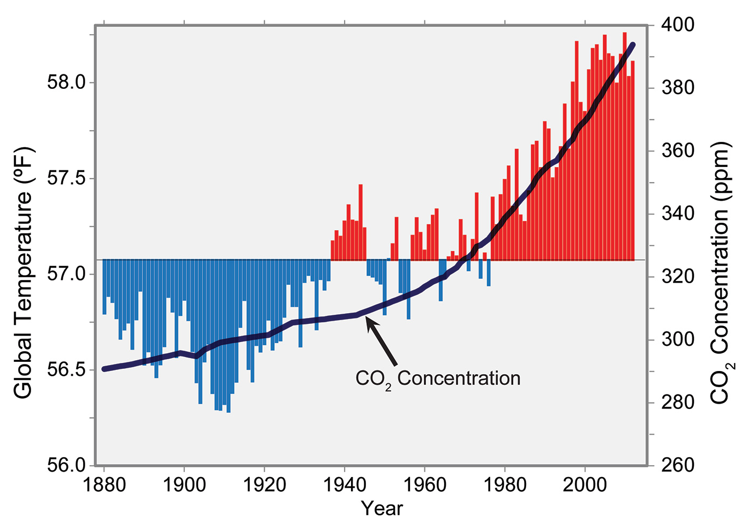
Climate Change & the Ocean
“Thus human beings are now carrying out a large scale geophysical experiment…”
Revelle and Suess, Tellus, 1957
Notes:
Fellows and Staff of the Radcliffe Institute for Advanced Study, Harvard University

Slide 10
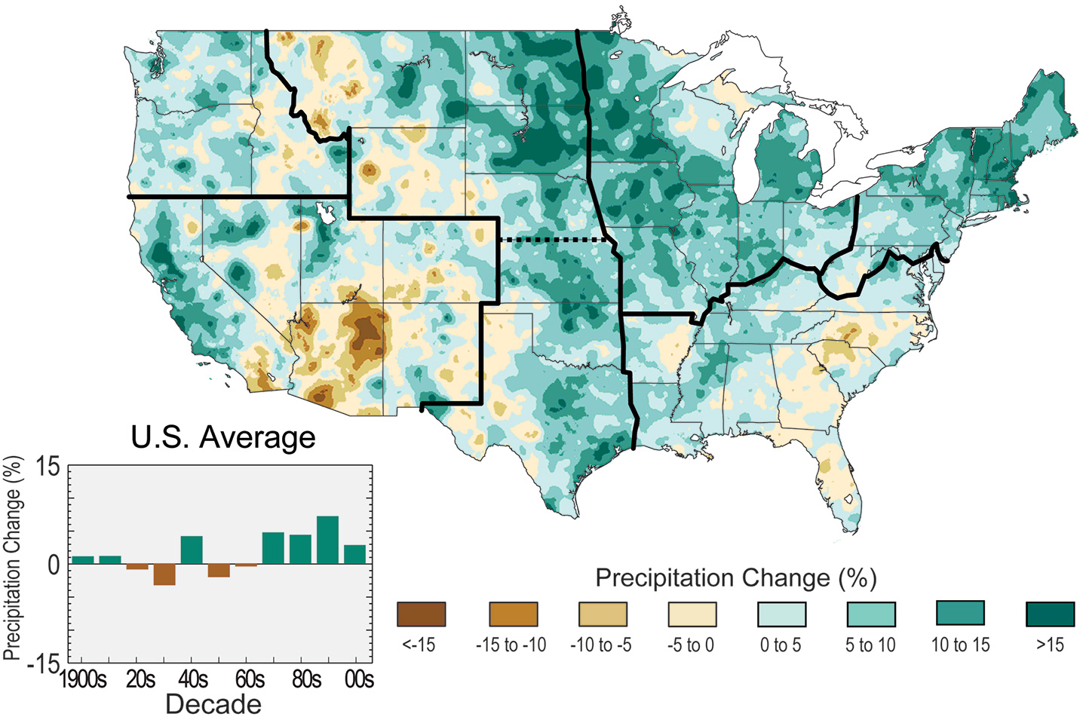
Observed U.S. Precipitation Change
Notes:
The colors on the map show annual total precipitation changes for 1991-2012 compared to the 1901-1960 average, and show wetter conditions in most areas. The bars on the graph show average precipitation differences by decade for 1901-2012 (relative to the 1901-1960 average). The far right bar is for 2001-2012. (Figure source: NOAA NCDC / CICS-NC).

Slide 11
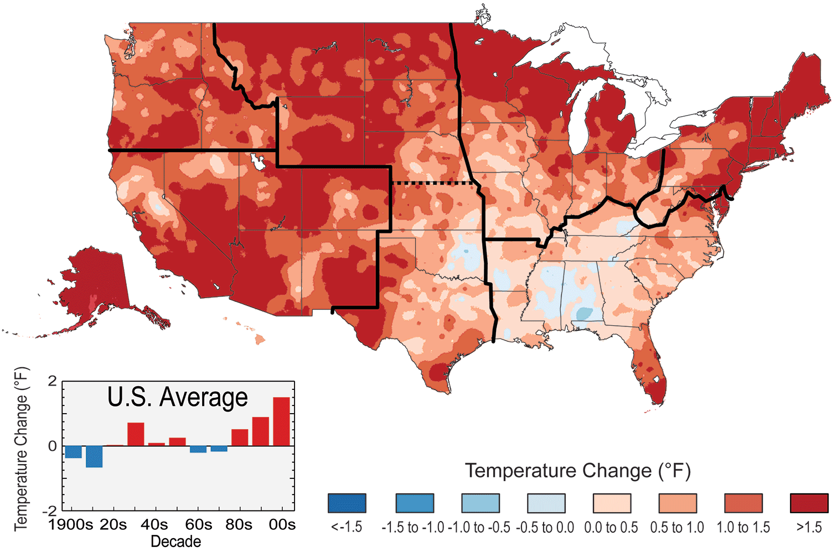
Observed U.S. Temperature Change
Notes:
The colors on the map show temperature changes over the past 22 years (1991-2012) compared to the 1901-1960 average. The bars on the graph show the average temperature changes by decade for 1901-2012 (relative to the 1901-1960 average). The far right bar (2000s decade) includes 2011 and 2012. The period from 2001 to 2012 was warmer than any previous decade in every region. (Figure source: NOAA NCDC / CICS-NC).

Slide 12
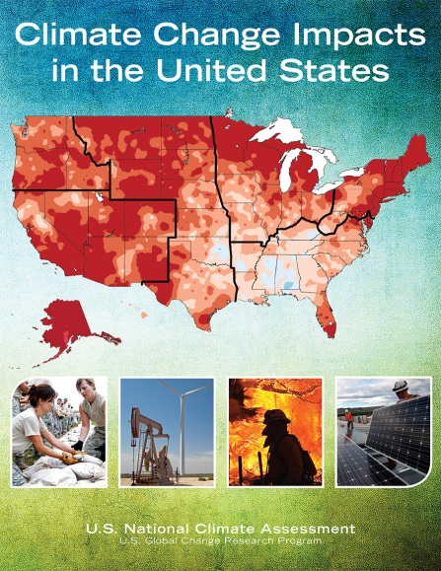

Third National Climate Assessment
http://nca2014.globalchange.gov

