Slide 1
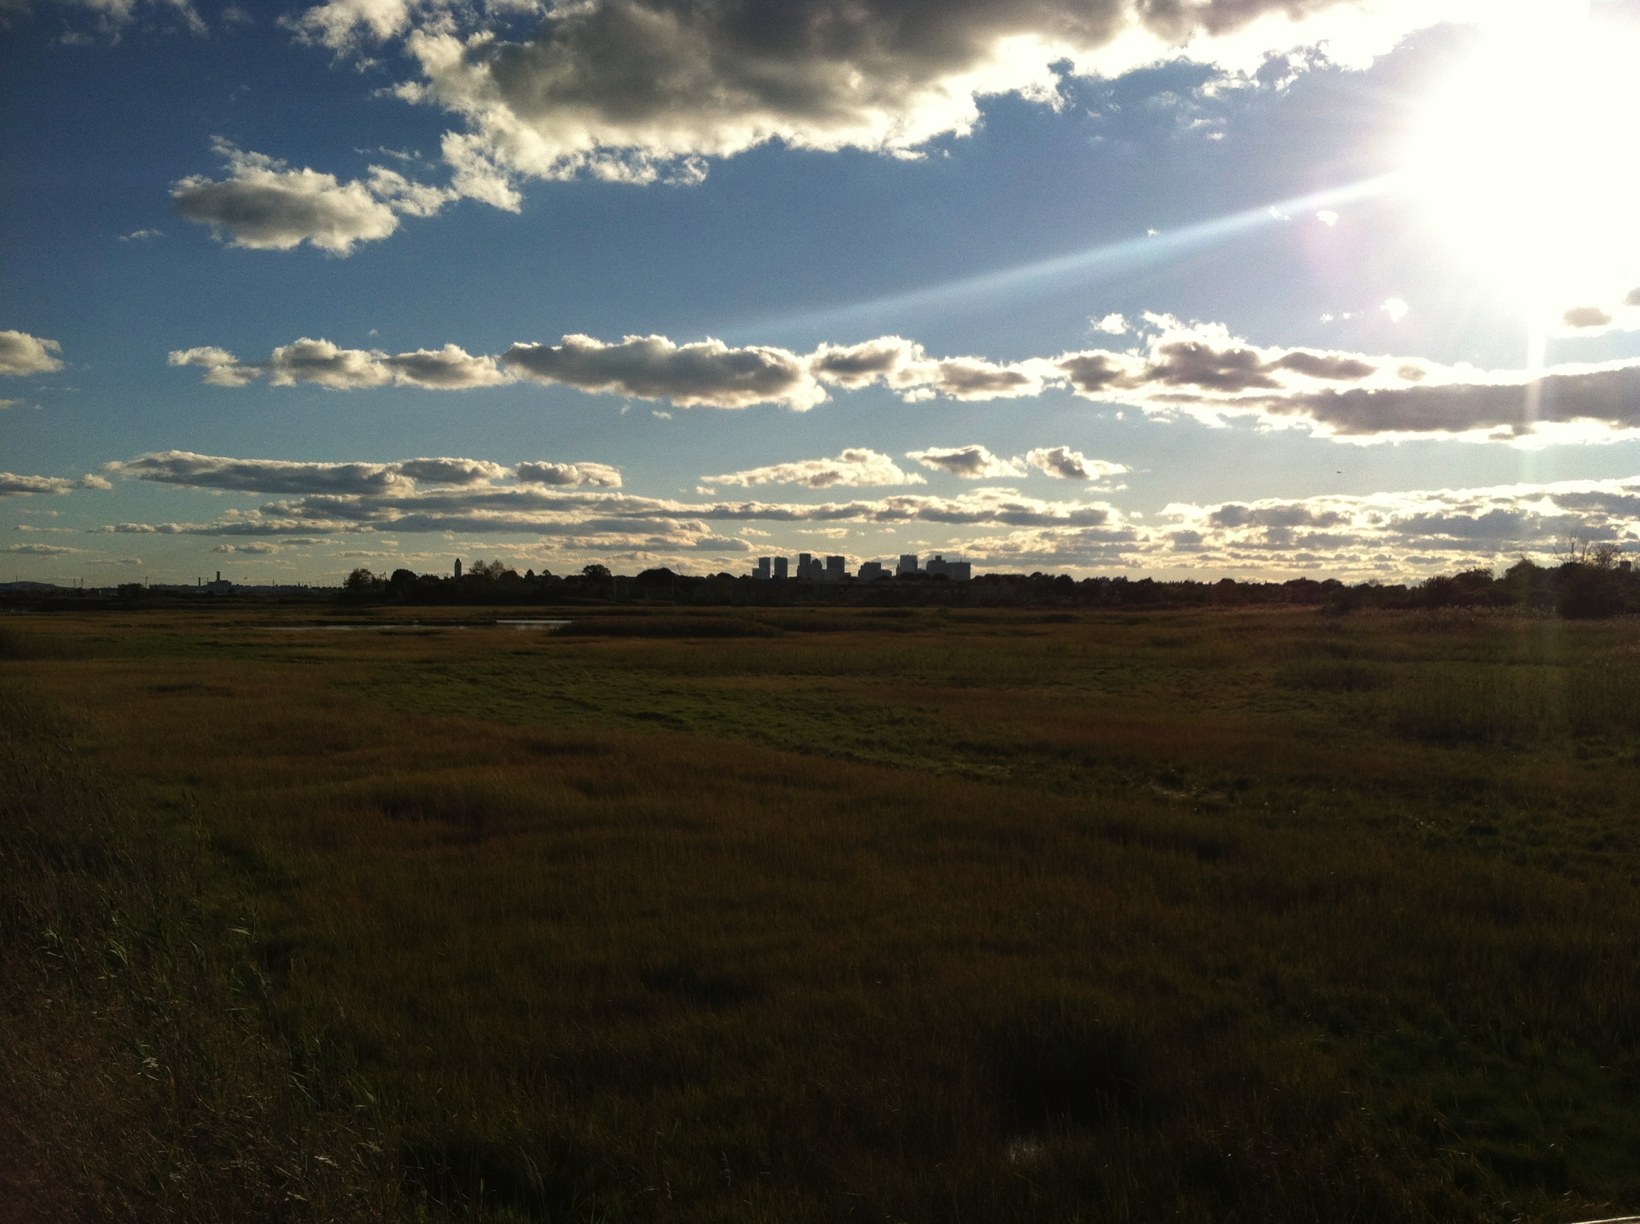
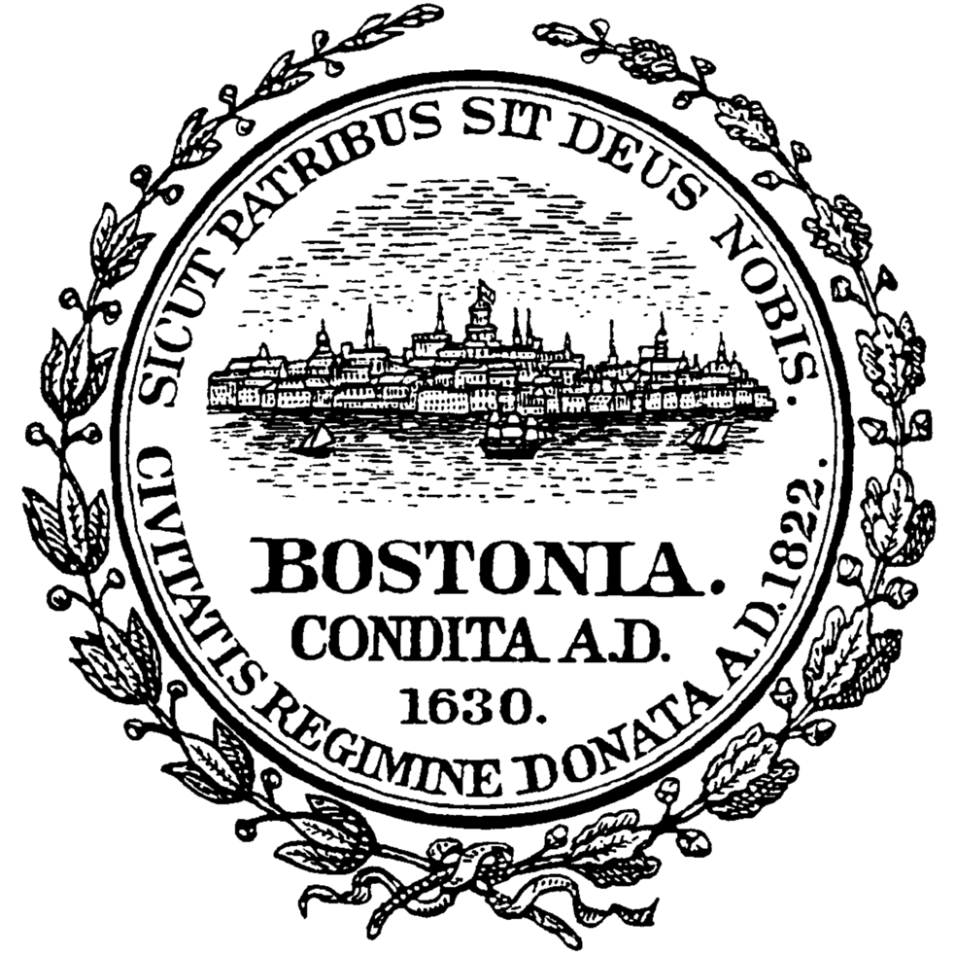
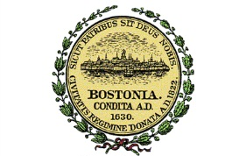

Climate Ready Boston
Brian R. Swett, Chief of Environment, Energy and Open Space, City of Boston

Slide 2
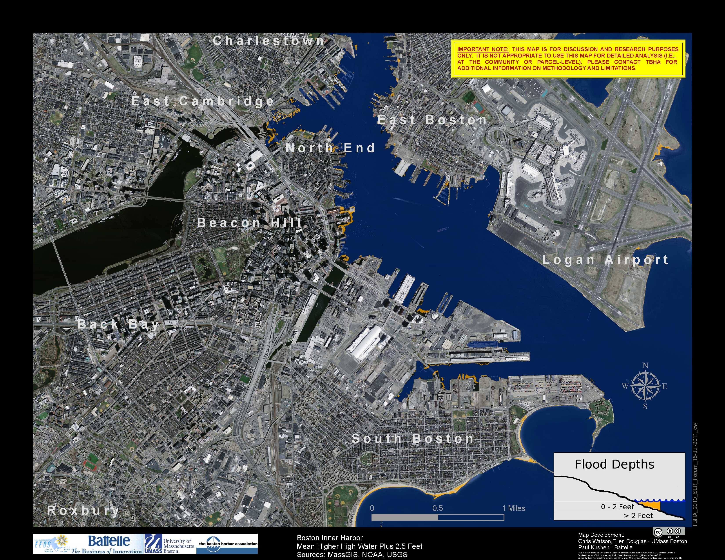
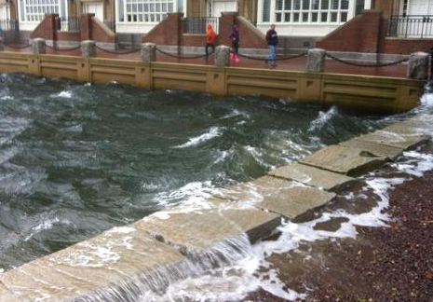
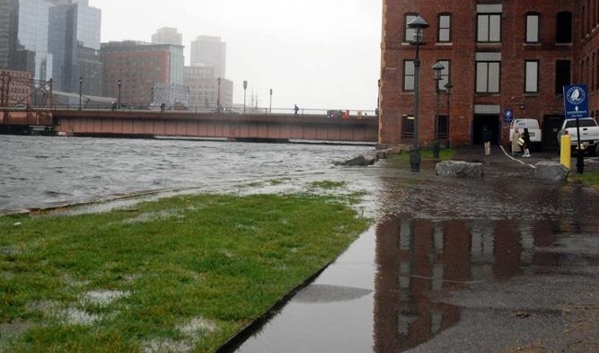
Mean High High Water +2.5 feet
Projected to occur by mid-century
Similar to flooding from Hurricane Sandy

Slide 3
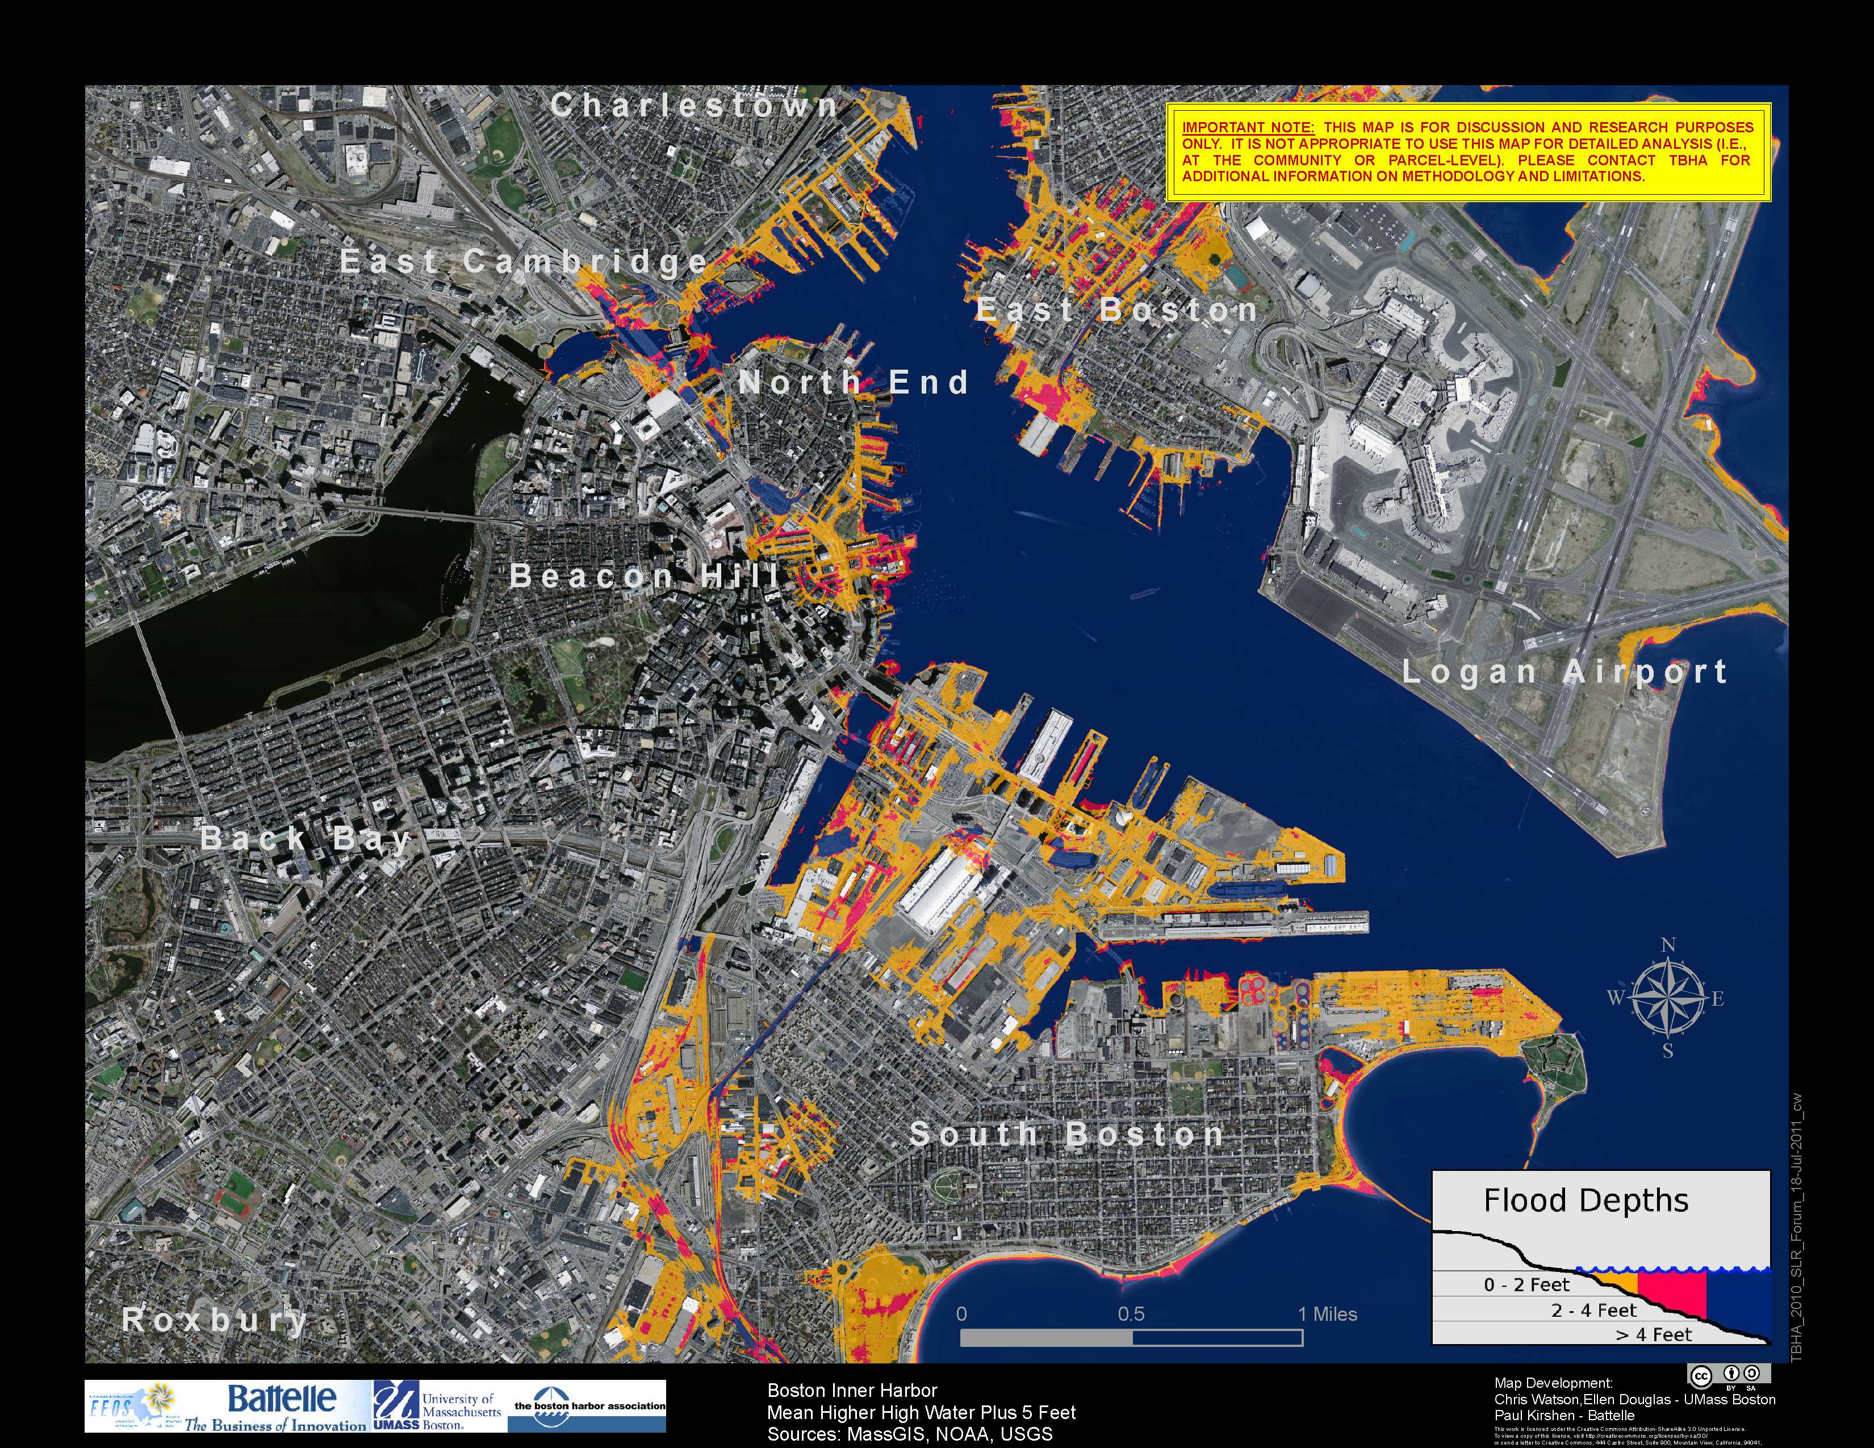
Mean High High Water +5’
Projected to occur by mid- to late-century
Equivalent to flooding from Hurricane Sandy if it hit during high tide

Slide 4
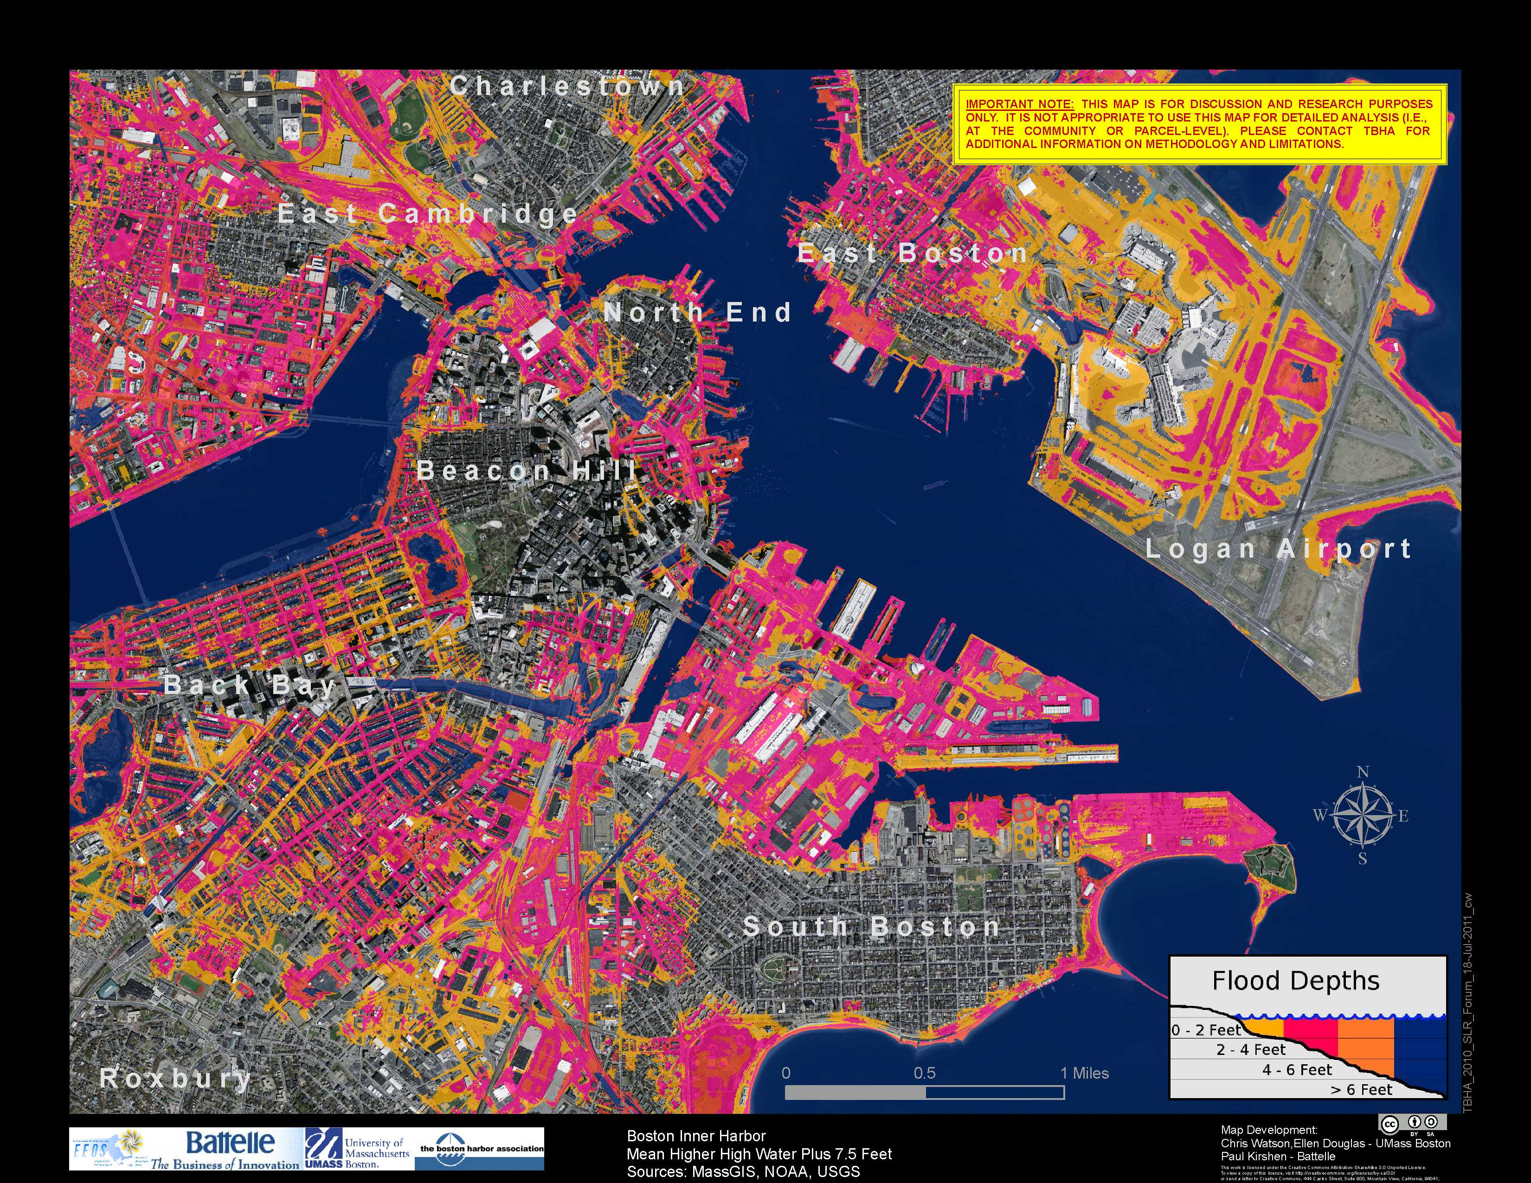
Mean High High Water + 7.5’
Could occur by late-century
Charles River Dam is over-topped
Sandy at mid-century

Slide 5
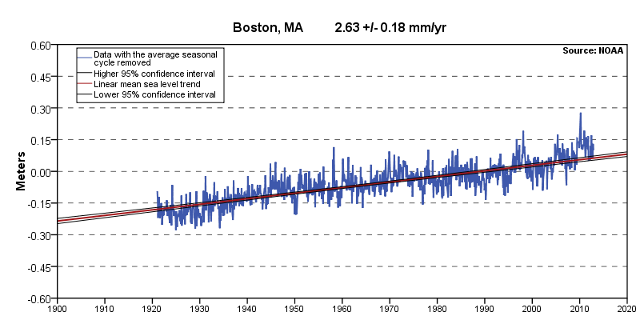
Sea-level ≈ 10” over past 100 years
Boston Harbor Tide Gauge

Slide 6
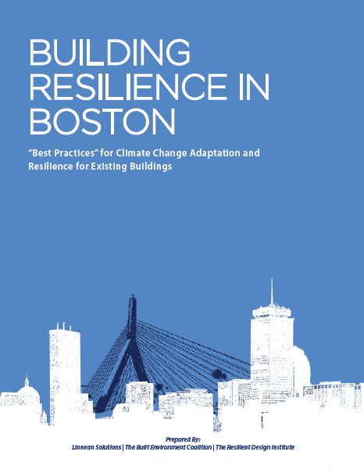
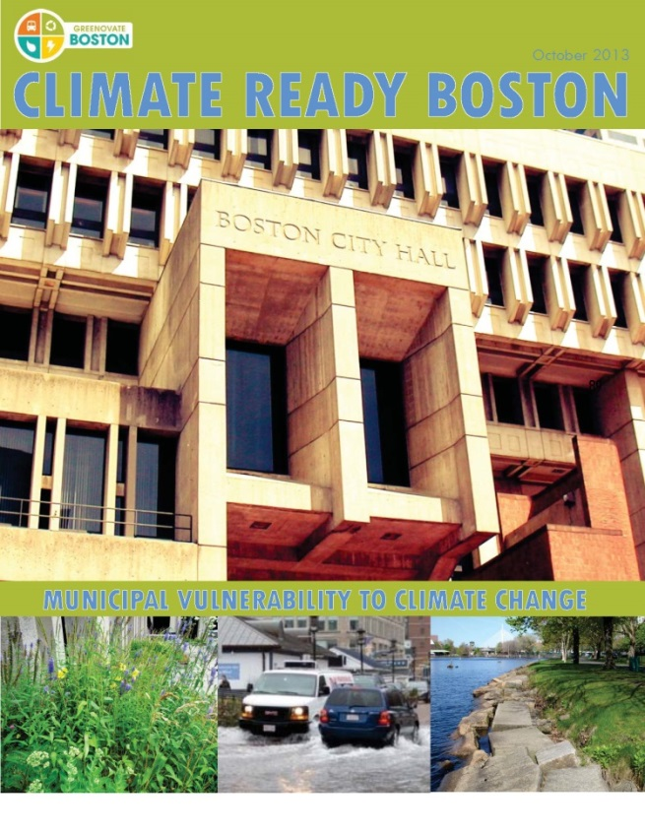
Planning
Climate Preparedness Task Force in City Hall
Green Ribbon Commission working group focused on climate adaptation
Climate Ready Boston
Feb. 2013
Existing Buildings
Assess vulnerabilities of buildings and infrastructure through BRA survey
Better enforcement of flood proofing building standards
New Buildings
Incorporate climate change adaptation guidelines into Article 80
Wetlands Ordinance and new floodplain maps
Emergency Response
Review emergency operation planning

Slide 7
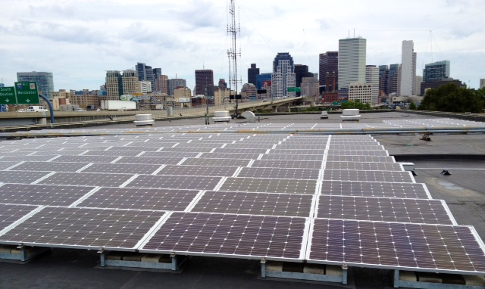
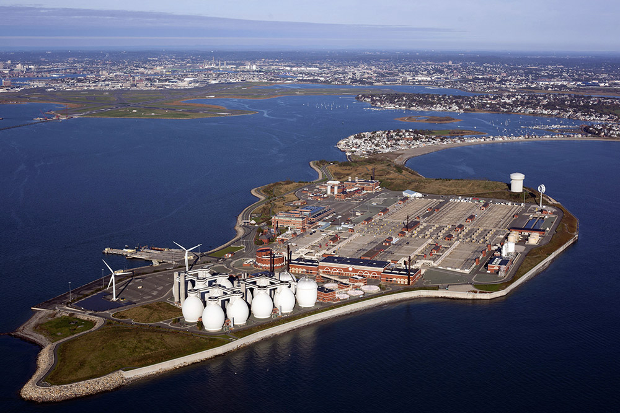
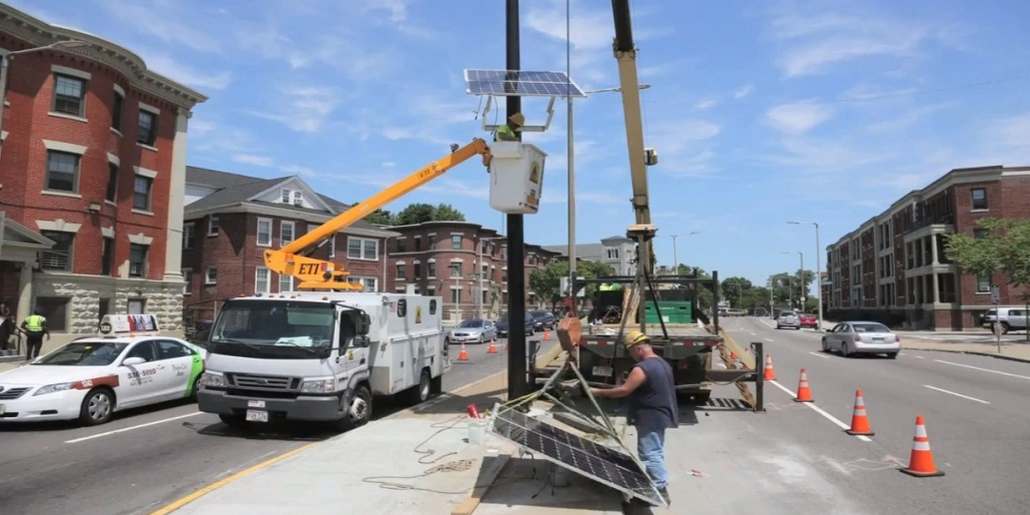
Solar Powered Fueling Stations for Emergency Vehicles at 400 Frontage Road 120 kW
Deer Island Constructed to Withstand 2 Feet of Sea-Level Rise
Solar Powered Traffic Signals Along Evacuation Route

Slide 8
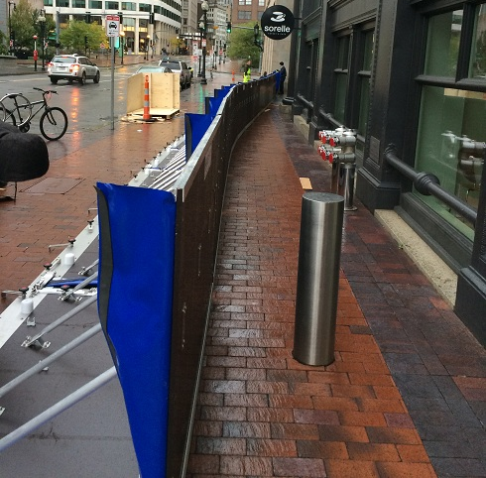
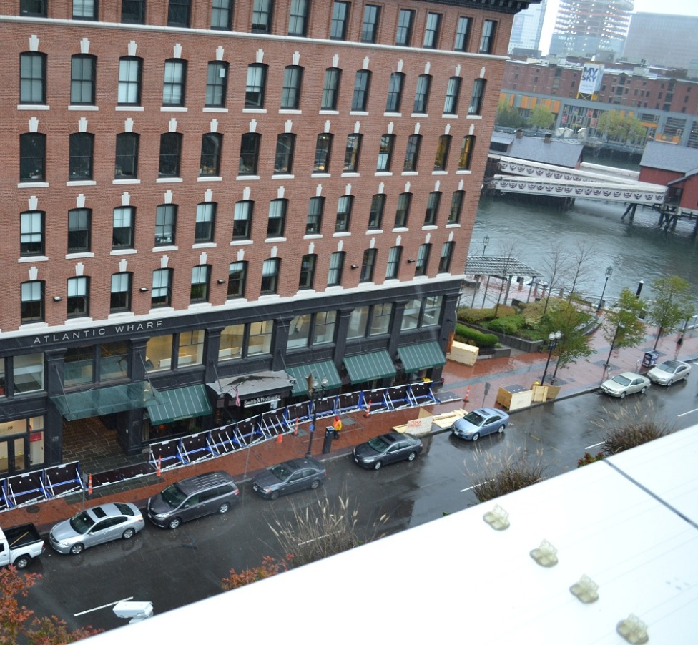
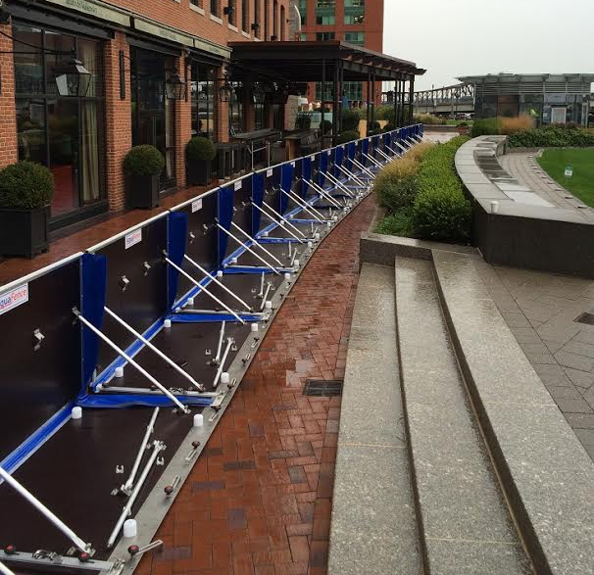
Aquafence in Fort Point Channel
Protecting existing buildings & infrastructure against flooding

Slide 9
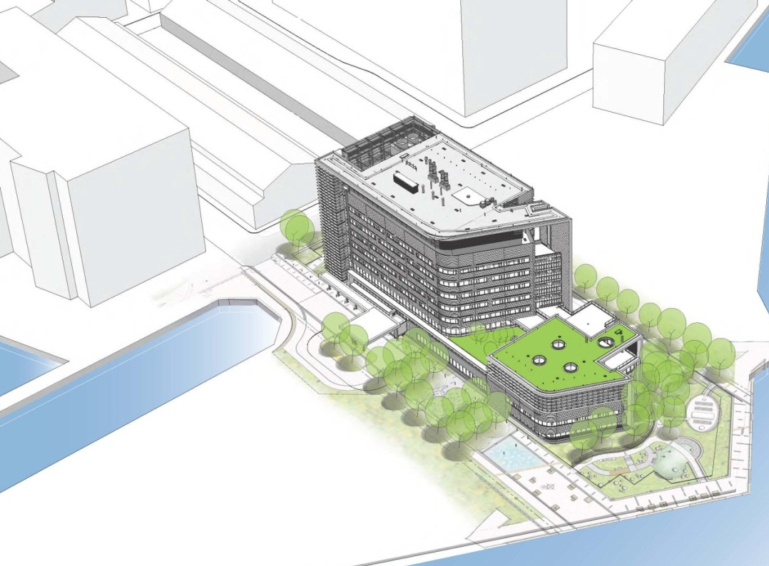
Mechanical, electrical and emergency services on roof out of harm’s way
Key floors above 2085 High Estimate 100-year Flood
Operable windows keyed open in event of systems failure
Critical patient programs above ground floor
Spaulding Rehabilitation Hospital

Slide 10
Additional Climate Preparedness
Planning & Initiatives
2014 Climate Action Plan Update
Neighborhood Planning
City/University Climate Partnership
National Preparedness Month (September)
Regional Climate Preparedness Summit
“Living With Water” Design Competition
Notes:
Climate Action Plan Update:
MJW announced “climate change preparedness as a high-priority”
focus on climate preparedness,
Neighborhood planning:
Plan for East Boston – NOAA- funded, lead by Umass Boston & UNH’s research on seal level rise vulnerability & ej in East Bos (in progress)
National Preparedness Month in September:
Collaboration btw Greenovate Boston, BPHC and OEM → OEM Emergency Preparedness Fair, daily announcement of tips & resources for preparedness
City & Higher ed partnership
Current working with GRC to develop a model for city/higher ed partnership on climate
Examples of previous/current collaboration: Tufts U’s study of heatwave vulnerability across Boston neighborhoods (2011); Columbia’s SLR modeling for the Boston Harbor (2015)
Regional Climate Preparedness Summit with GRC
Upcoming Living With Water Design Competition

Slide 11
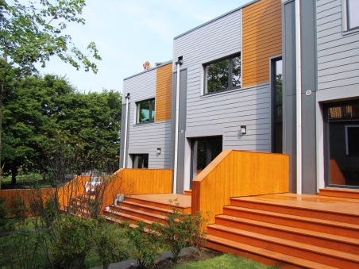
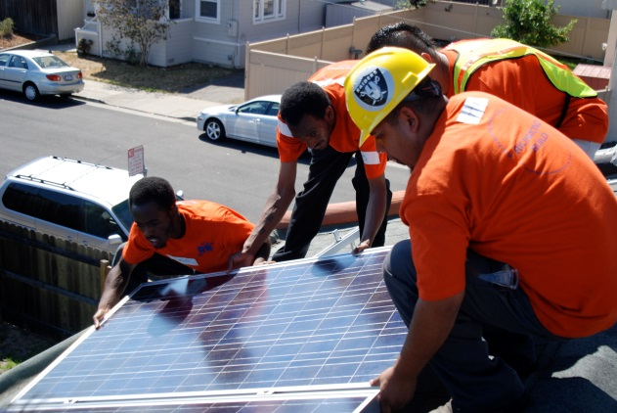
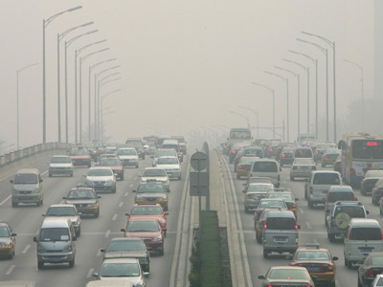
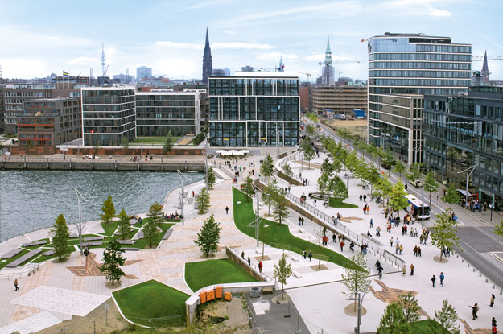
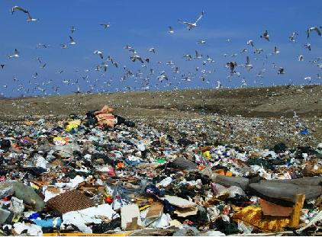
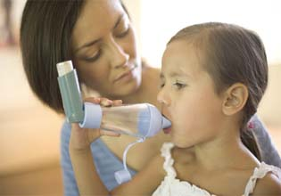
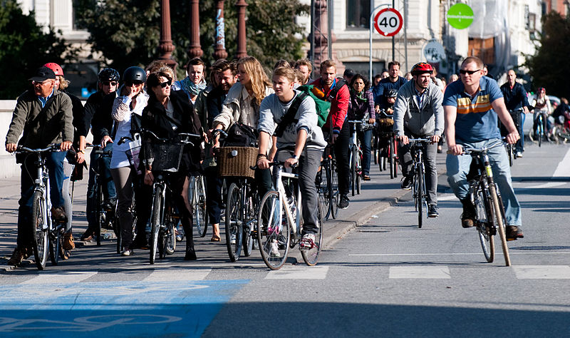
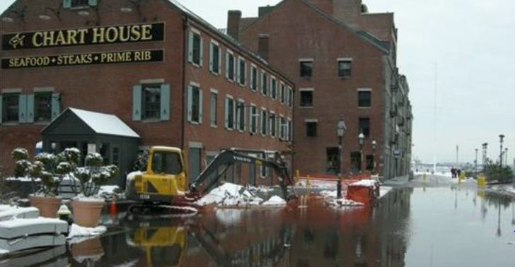
We have options.

Slide 12



Thank You
Brian R. Swett
Chief of Environment, Energy and Open Space
Email:
EnvironmentalEnergy@cityofboston.gov
Visit:
www.cityofboston.gov/EEOS/ & www.greenovateboston.org
Like us on Facebook Greenovate Boston
Follow us on Twitter
@GreenovateBos

