Slide 1
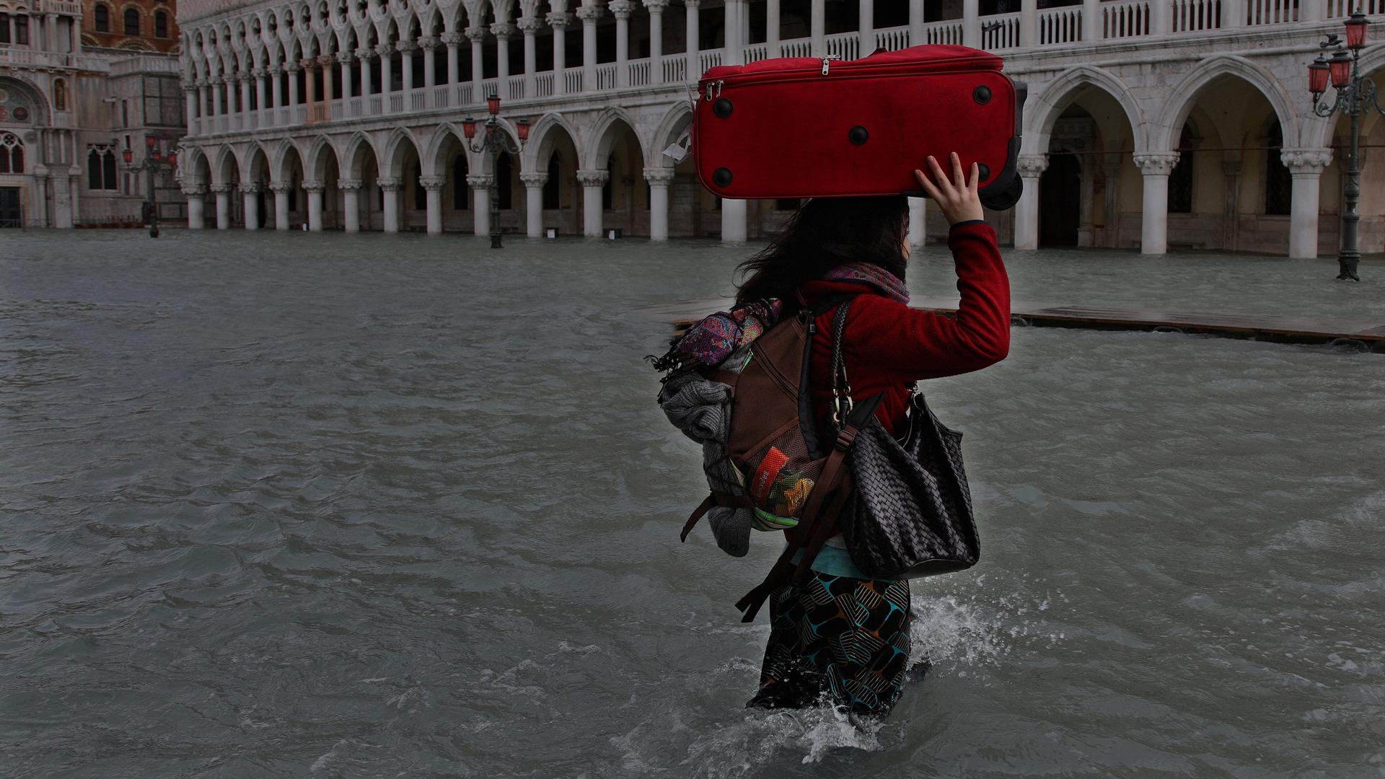

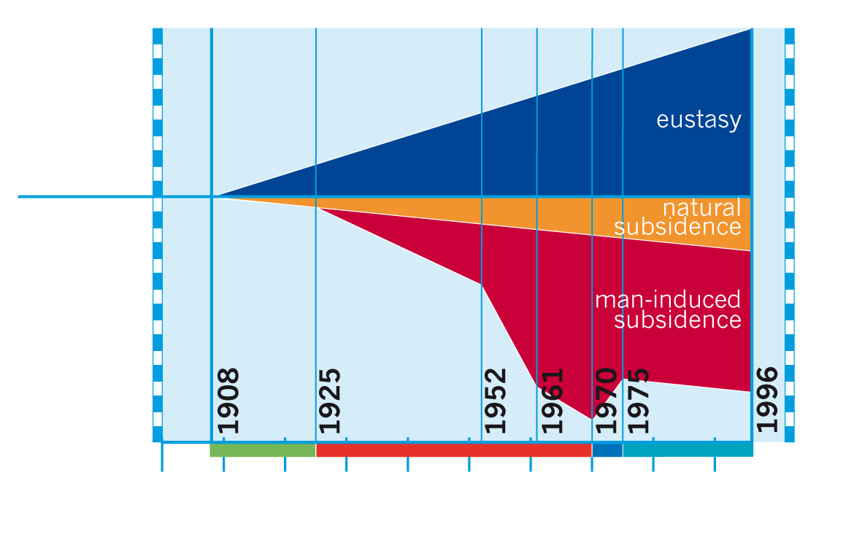
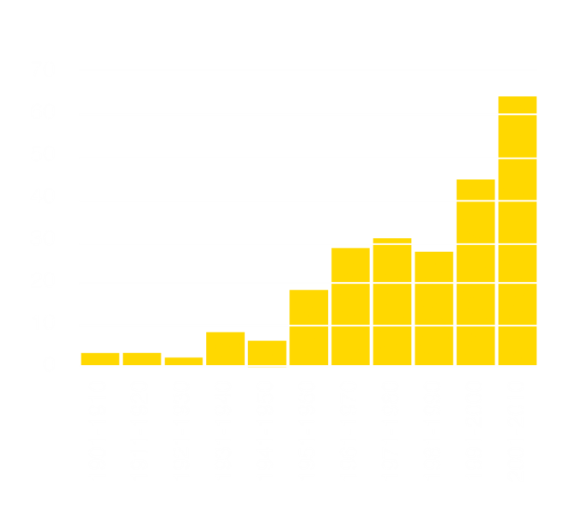
Venice is sinking

Slide 2

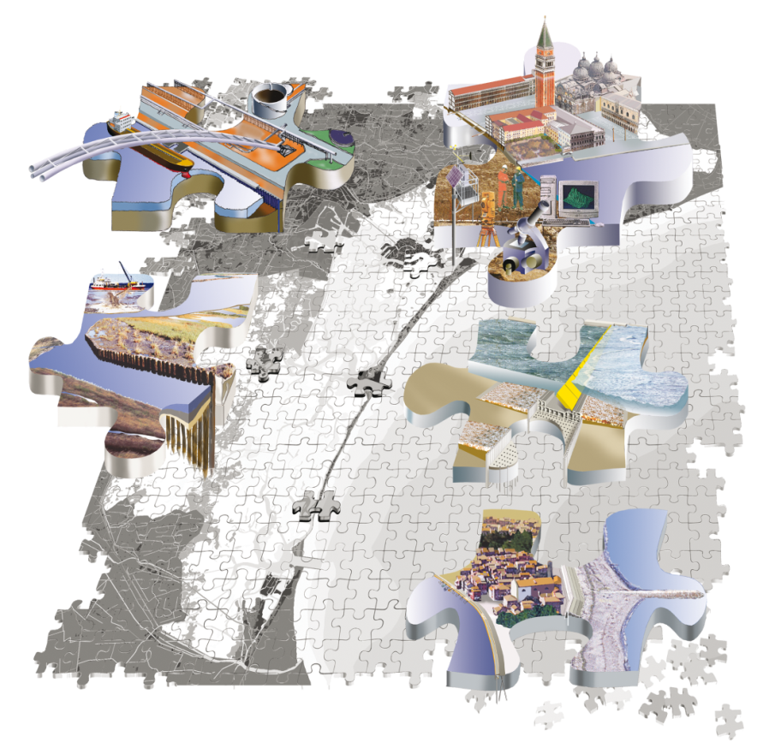
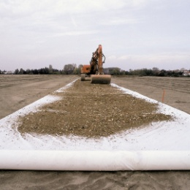
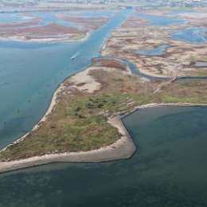
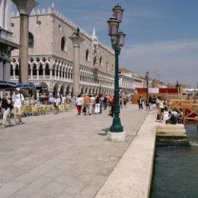
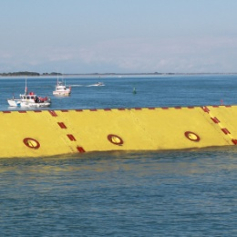
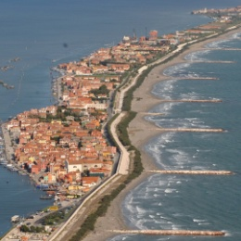
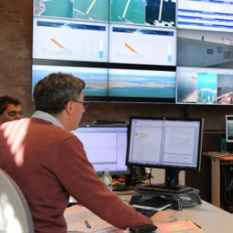
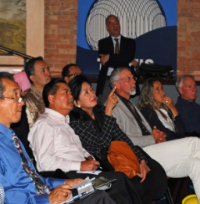
Integrated solution for a complex system
1
2
3
4
3
1
7
6
40 km
of industrial
canals secured
and 7 former
dumps confined
16 km²
of salt marshes
reconstructed
100 km
of urban shores
raised
and reinforced
4 mobile barriers
realized (85%)
to defend
from floods
2
4
5
6
7
5
56 km
of new beaches
and 12 km
of coastal dunes rebuilded
Control
and management
Made in Italy
know-how

Slide 3
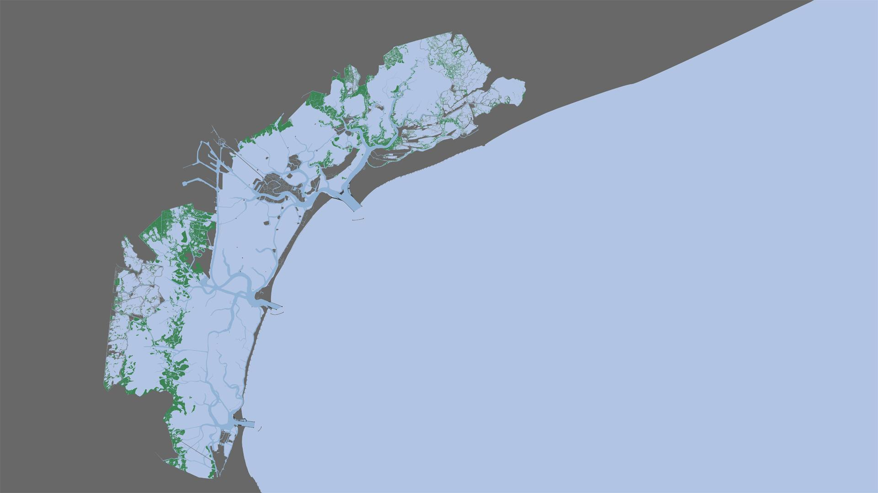
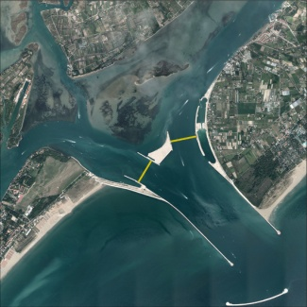
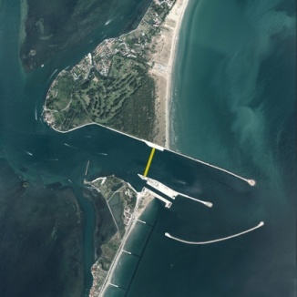
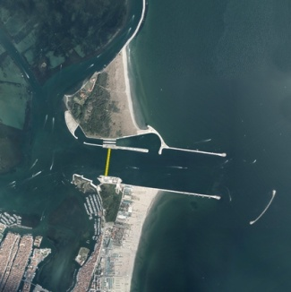
The Mose System to defend against floods
4 Barriers / 78 Gates
Venice
Lido Inlet
2 barrier (41 gates)
Malamocco Inlet
1 barrier (19 gates)
Chioggia Inlet
1 barrier (18 gates)

Slide 4
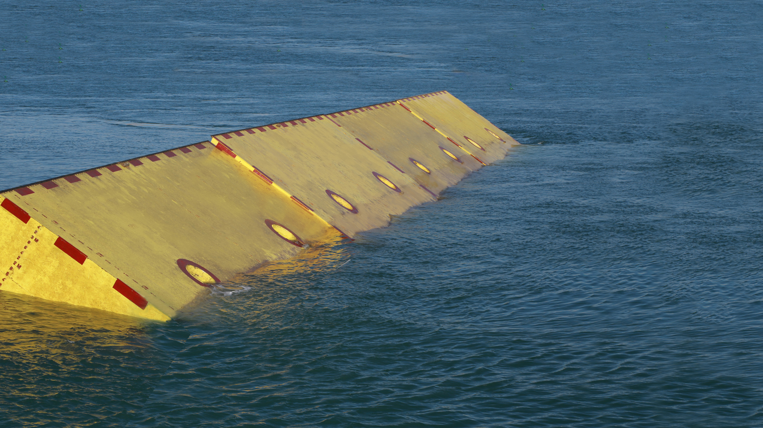
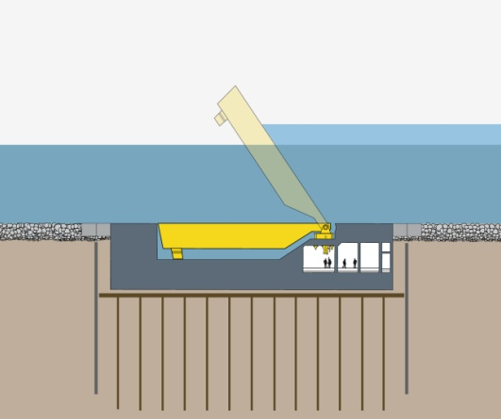
The gates in operation
1. Gates in operation; 2. Gates in stand-by; 3. Gates foundations;
4. Gates operating plant; 5. Sub-soil consolidation
1
< Lagoon
Sea >
2
3
4
5

Slide 5
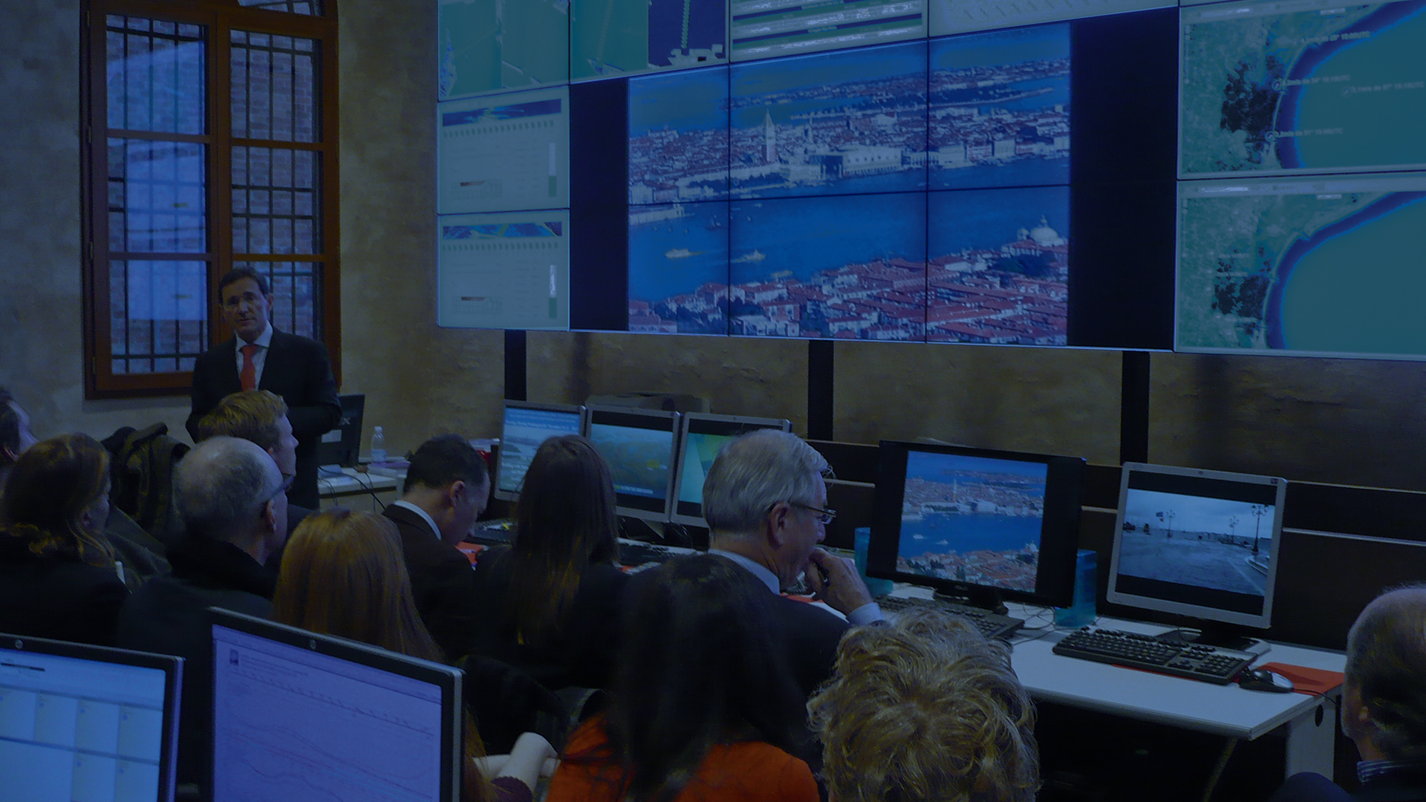
Sea level rise and Mose barrier operation
Mose will carry out its protective action for a growing number of ordinary and exceptional storm surges.
With a 30 cm sea level rise there could be 60-70 flooding storms (at present 5 storms per year). The risk of extreme events, will increase of 8 times and return period will be reduced from 250 to 30 years only.
The number of complete closures will be limited to 30%, thanks to the flexibility of the Mose system by the use of partial closures.
The environmental effects of the closures will remain limited, given the short duration of 4 hours and the season of the year with cold windy weather and therefore low risk of anoxia in comparison with the usual three day neap tide stagnation occurring all over the year.
The effects on port traffic will be limited by the redirection of traffic through the Malamocco locks

