Slide 1
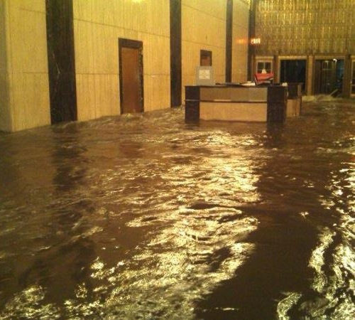
Boston Properties: Resiliency 101
Bryan J. Koop, SVP Regional Manager
A New York Story
Notes:
Verizon Headquarters – NYC – Hurricane Sandy

Slide 2
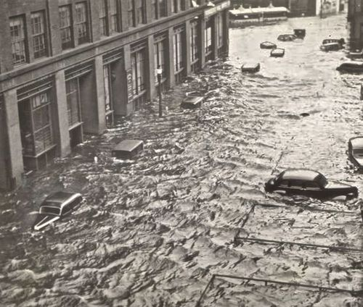
(Biblical Idiots)
1938 New England Hurricane
Notes:
The New England Hurricane of 1938 (or Great New England Hurricane, Yankee Clipper, Long Island Express, or simply the Great Hurricane of 1938) was the first major hurricane to strike New England since 1869. The storm formed near the coast of Africa in September of the 1938 Atlantic hurricane season, becoming a Category 5 hurricane on the Saffir-Simpson Hurricane Scale before making landfall as a Category 3 hurricane^{[1]} on Long Island on September 21. The hurricane was estimated to have killed 682 people,^{[2]} damaged or destroyed over 57,000 homes, and caused property losses estimated at US$306 million ($4.7 billion in 2014).^{[3]} Even as late as 1951, damaged trees and buildings were still seen in the affected areas.^{[4]} It remains the most powerful and deadliest hurricane in recent New England history, eclipsed in landfall intensity perhaps only by the Great Colonial Hurricane of 1635. In 2012 Hurricane Sandy did far more property damage in terms of dollars, regardless of the fact it made landfall in southern New Jersey and was a similar in size storm, just two categories less. The 1938 storm still stands as the second costliest storm to strike New England.

Slide 3
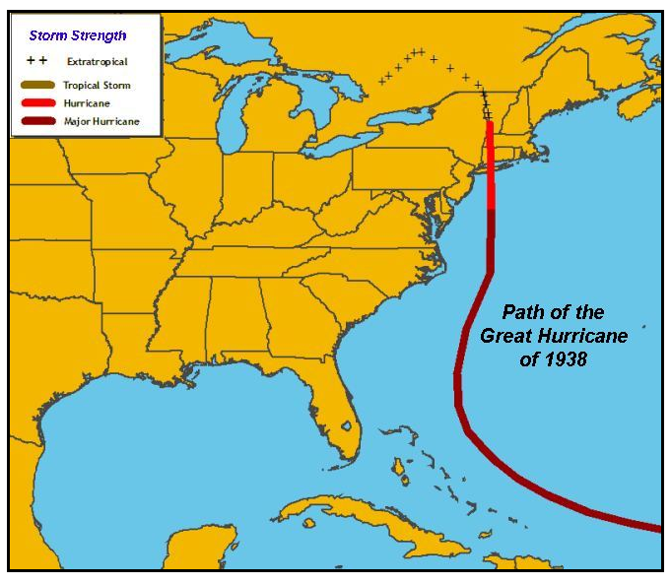
1938 New England Hurricane
Notes:
Verizon Headquarters – NYC – Hurricane Sandy

Slide 4
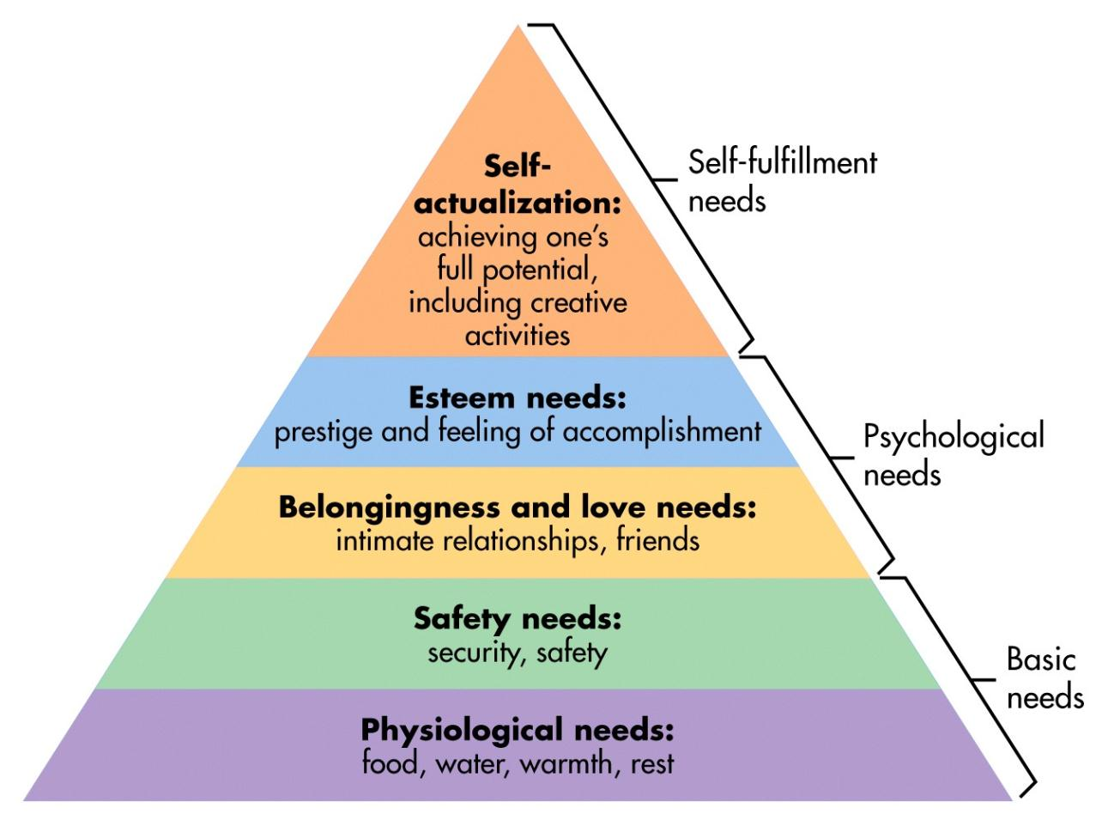
Maslow's Hierarchy of Needs

Slide 5





Koop’s Hierarchy of Resilience
Private
Public/
Quasi Public
1 Week Duration

Slide 6
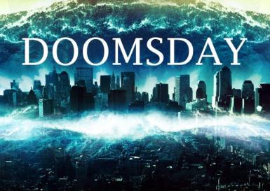
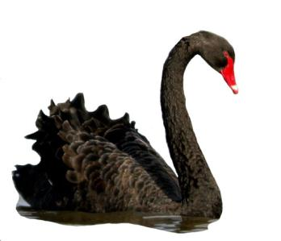
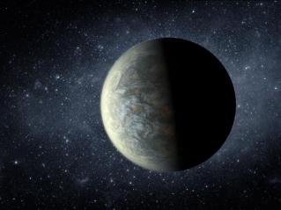
Boston Properties: Resiliency 101
Tres Resiliency
Doomsday Triage
Black Swan Resiliency
New Planet

Slide 7
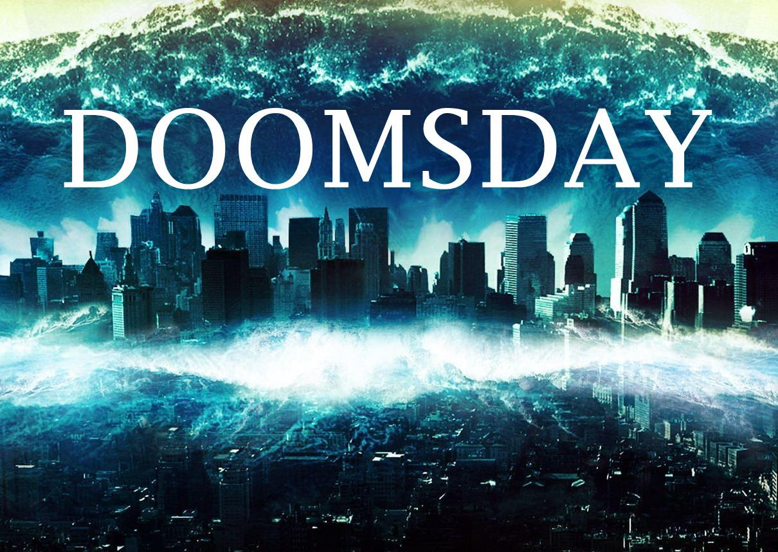
Photo Credit: National Geographic

Slide 8

Doomsday Triage
Notes:
Emergency Planning and “Response Protocols”
Places of Refuge
Maximize passive survivability

Slide 9

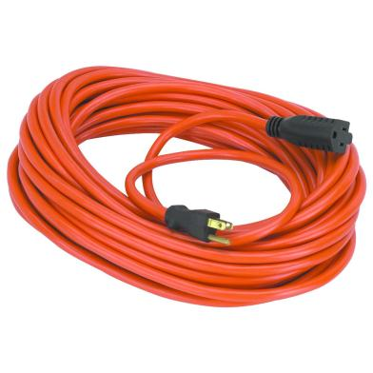


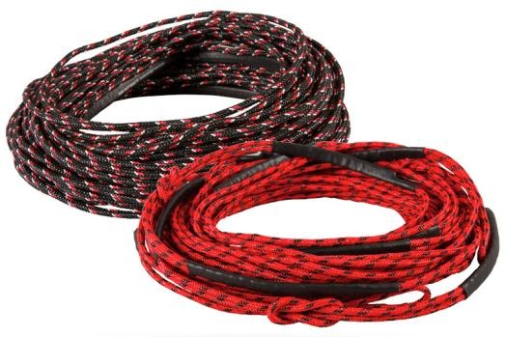
Doomsday Triage
On Site
Notes:
1.87 years of no one home
4 charges every 10 years
Not being done
Flipping of building

Slide 10
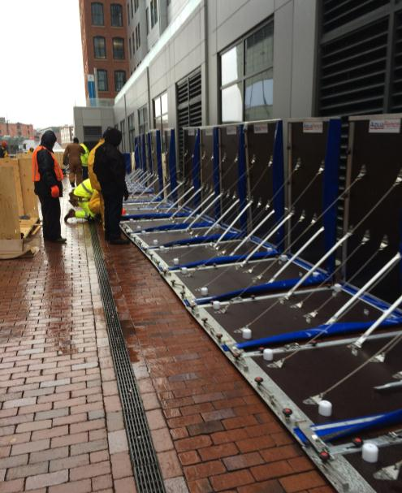
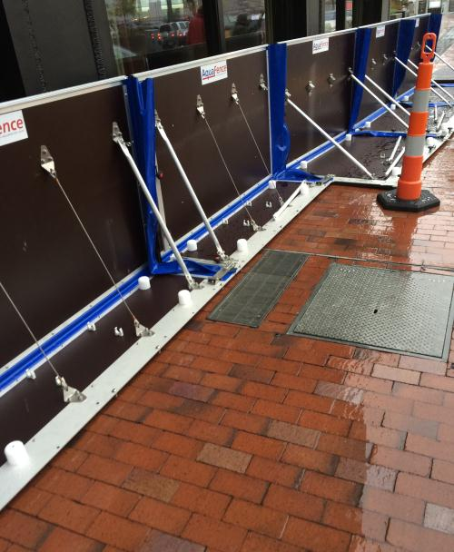
Doomsday Triage
Aquafence
On Site

Slide 11
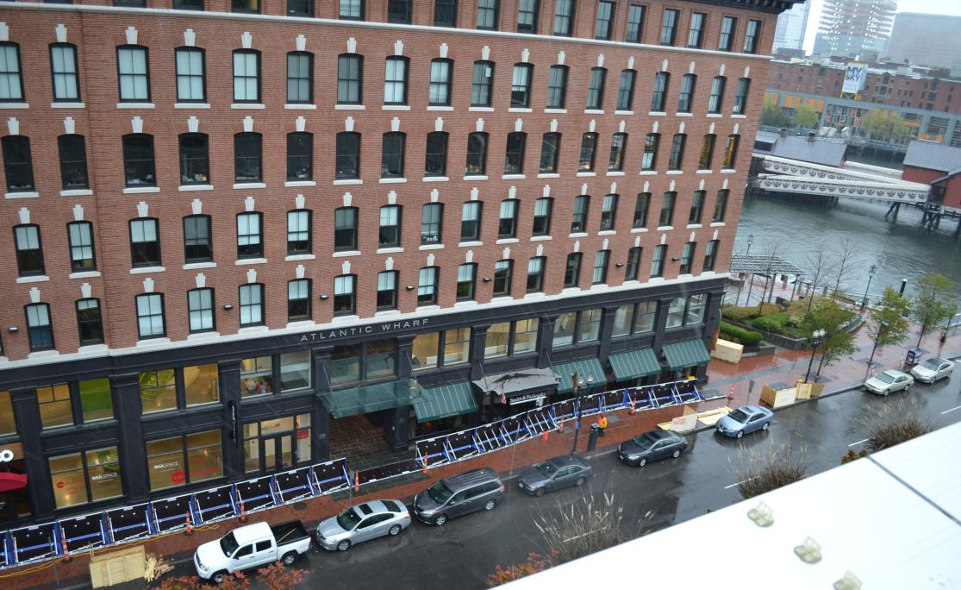
Doomsday Triage
Aquafence

Slide 12
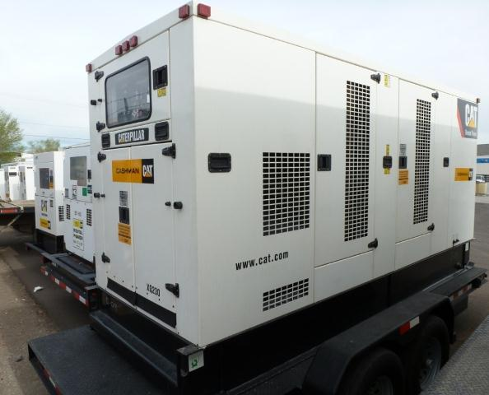
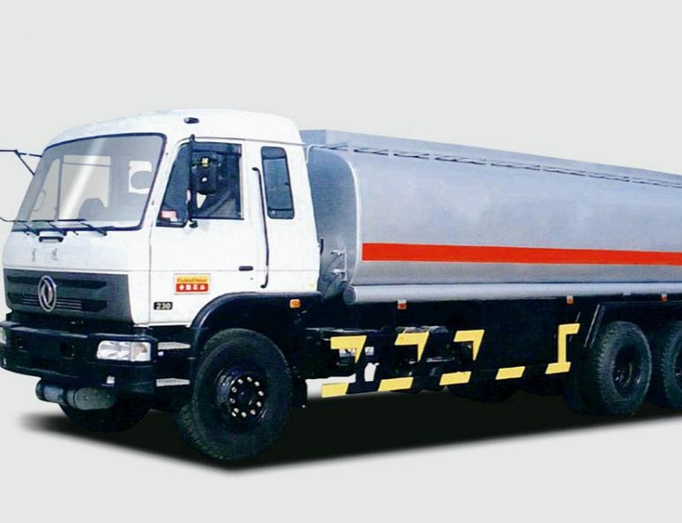
Doomsday Triage
Off Site

Slide 13

Black Swan Theory
Notes:
Fooled by Randomness
Metaphor by Taleb describes an event that comes as a surprise; has a major impact and is often inappropriately rationalized after the event with hindsight.
Extreme outlier event
Carries extreme impact
Retrospectively predicted. Someone must be responsible.
Talebs: point not to attempt to predict.
Black swan events, but build robustness against negative
Events and exploit the positive ones

Slide 14
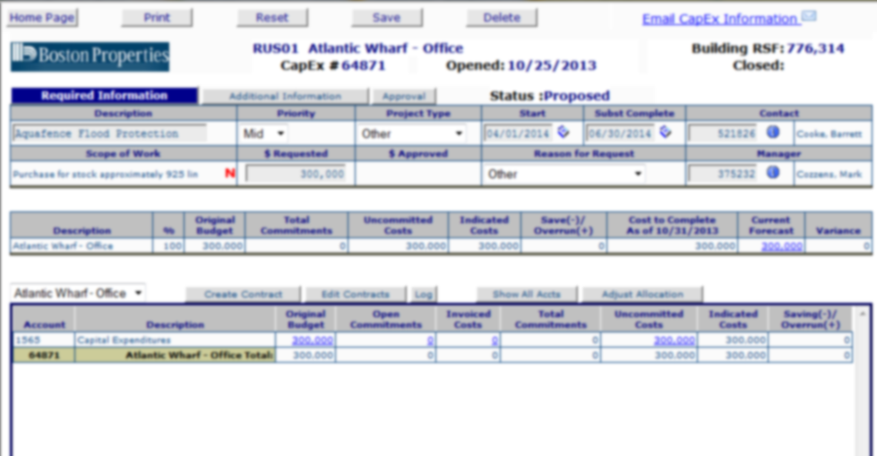
Black Swan - Existing Building
Notes:
End of useful life
Replacement of Equipment

Slide 15
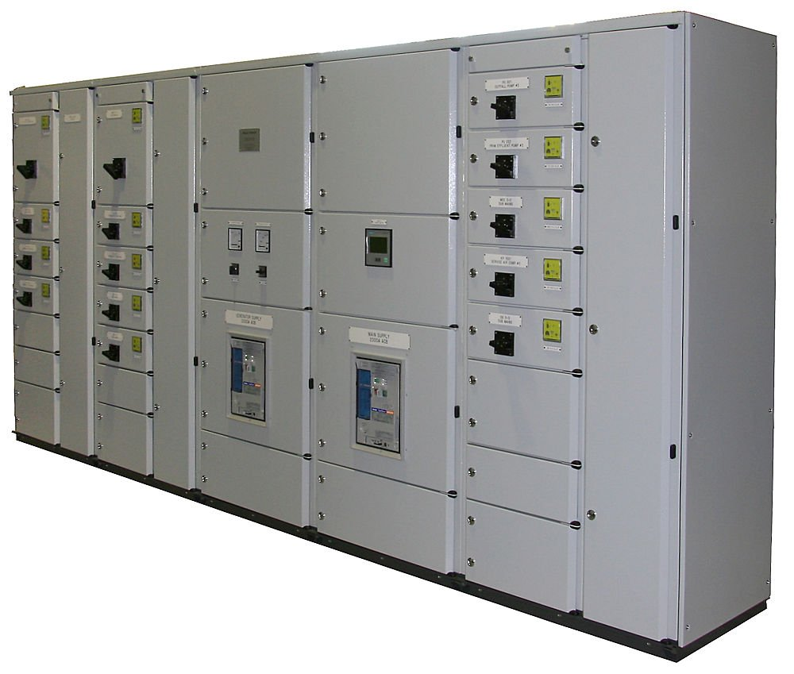
Black Swan - Existing Building

Slide 16
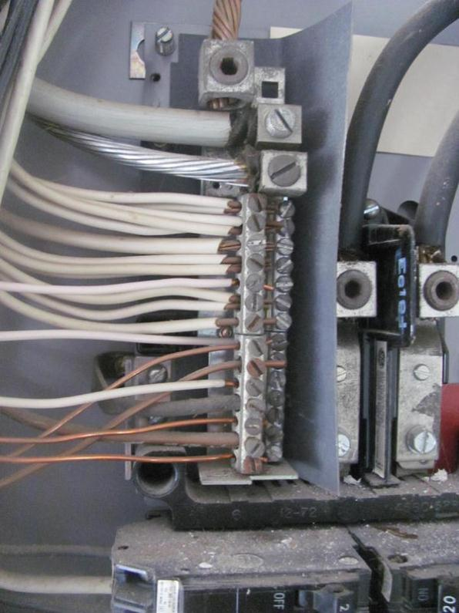
Black Swan - Existing Building
Distribution Panel

Slide 17
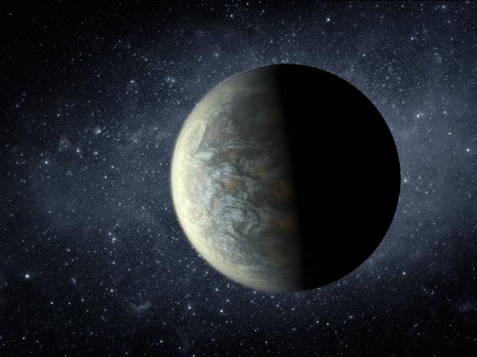
New Planet
Notes:
Incorporate Emerging Science into Design and Planning
Become early adaptors:
Examples: - NYC
- GRC
- Model for Future Scenarios
- Flood and Temperature

Slide 18
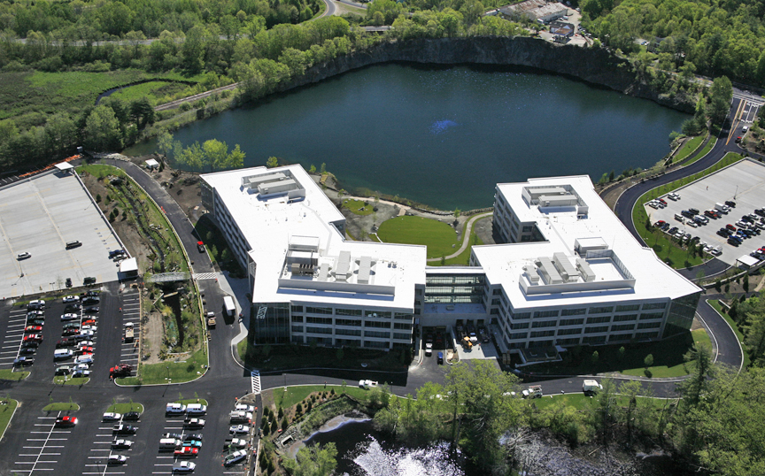
New Planet Design
Holistic Design

Slide 19
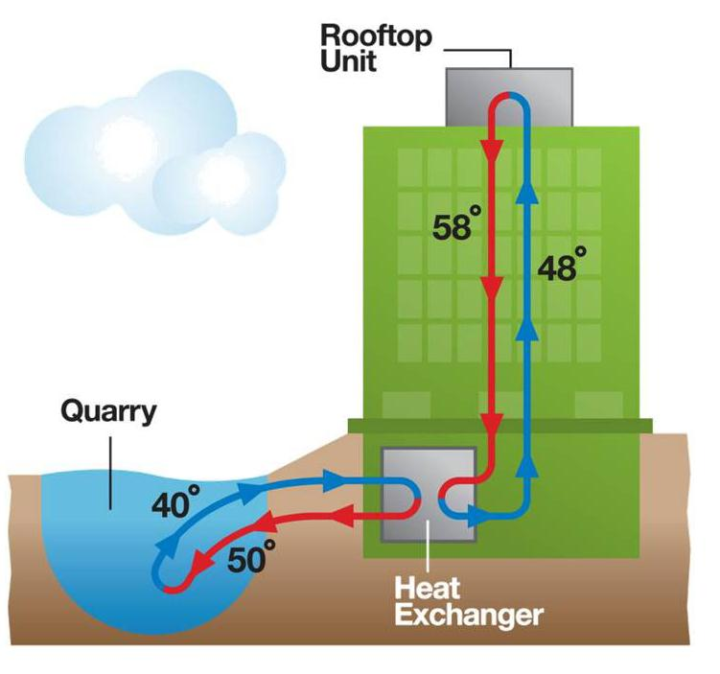
New Planet Design
Holistic Design

Slide 20
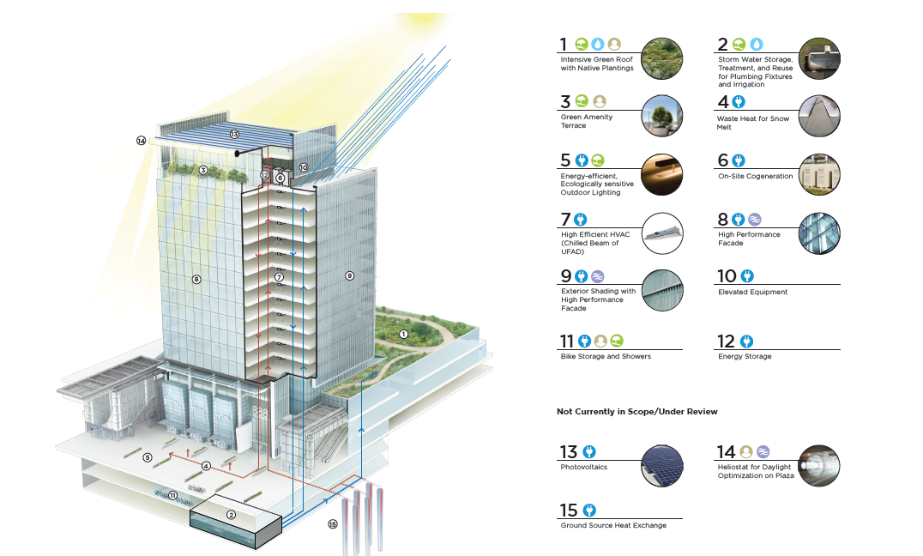
New Planet Design
Holistic Design

Slide 21
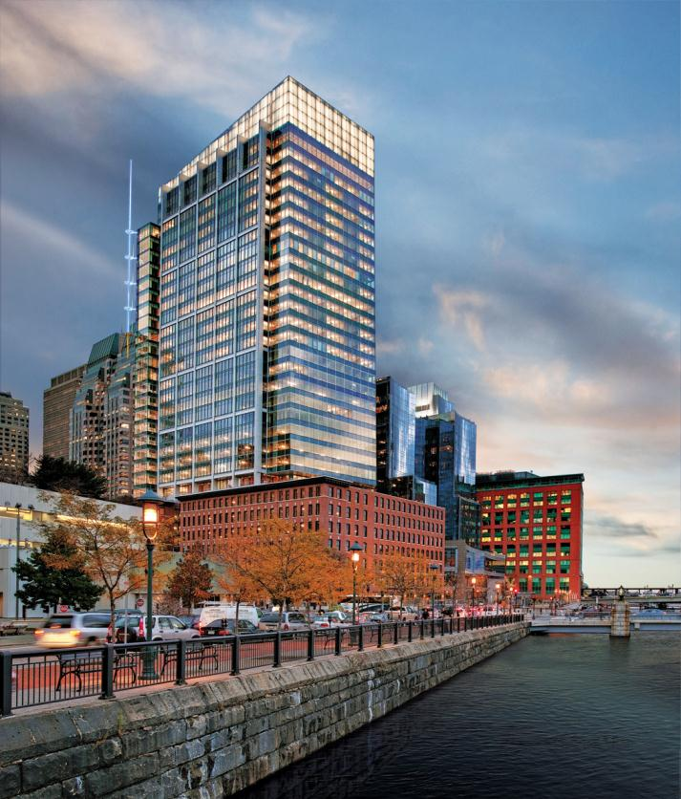

Resiliency Leadership

Slide 22

Resiliency Leadership

