Slide 1
Climate Change Impacts:
Why Increased Resilience Is Economically Essential
&
Why Insurance Has A Potentially Valuable Socio-Economic Role
Lindene Patton
14 November 2014

Slide 2
Disclaimer
The information in this publication was compiled from sources believed to be reliable for informational purposes only. All information herein should serve as a guideline which you can use at your risk. Any and all information contained herein is not intended to constitute legal advice and accordingly, you should consult with your own attorneys when developing actions, programs or policies. Neither the accuracy of this information nor any results are guaranteed.

Slide 3
Climate Change …
What is climate change and how is SLR relevant ?
What does it mean for the insurance industry ?
Why is public policy relevant ?
What does it mean for customers ?
What does it mean to you ?
Why Innovation in Decision Support Analysis is essential and what’s happening in some areas …

Slide 4
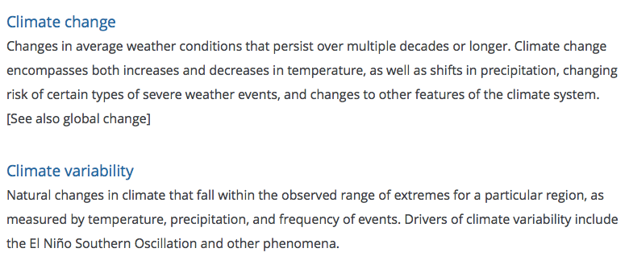
Climate Change v.
Climate Variability
source: US National Climate Assessment 2014
http://www.globalchange.gov/climate-change/whats-happening-why

Slide 5
What climate change means for the insurance industry …
Increased severity of specific types of events
Loss of stationarity (water cycle is changed; rainfall frequency, severity and location change)
Rate of loss increase is greater than asset value increase
Increased expectations / demands from customers
Temporal Dissonance between term of insurance instrument (usually 1 -3 years) and ‘problem’ or ‘symptoms’ it seeks to mitigate risk from (multi-decadenal)
Leads to rate making challenges with regulators and insureds

Slide 6
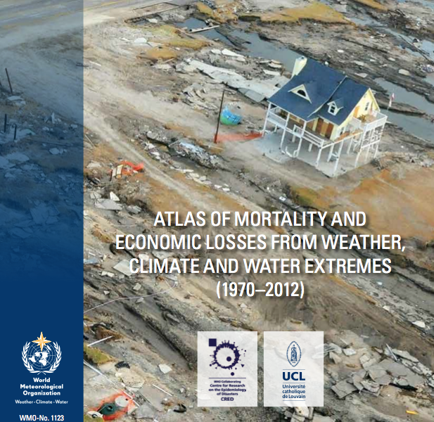

World Meteorological Organization (WMO) and the Centre for Research on the Epidemiology of Disasters (CRED)
Notes:
WMO has launched an initiative to develop guidelines, recommended practices and stan- dards for hazard definition and classification to support the geo-referencing of loss and damage data and risk analysis
191 Members to develop statistical hazard mapping as well as forecasting and forward-looking modelling tools and methodologies for meteorological, hydrological and climate-related hazards to support loss and damage data collection and analysis and probabilistic risk modelling

Slide 7

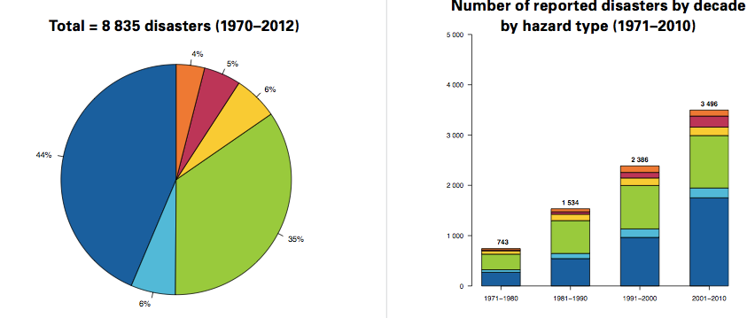
WMO World Atlas Results
Breakdown by Number, Type & Decade
Notes:
Scope of WMO Study
43 years (1970-2012)
N= 8835
1.9M lives lost
Damages $ 42.4 T USD
1% of events caused
69% of deaths
19% of economic losses
Storms & Floods caused
79% of number of disasters
54% of deaths
84% of economic losses
Droughts caused
35% of deaths

Slide 8
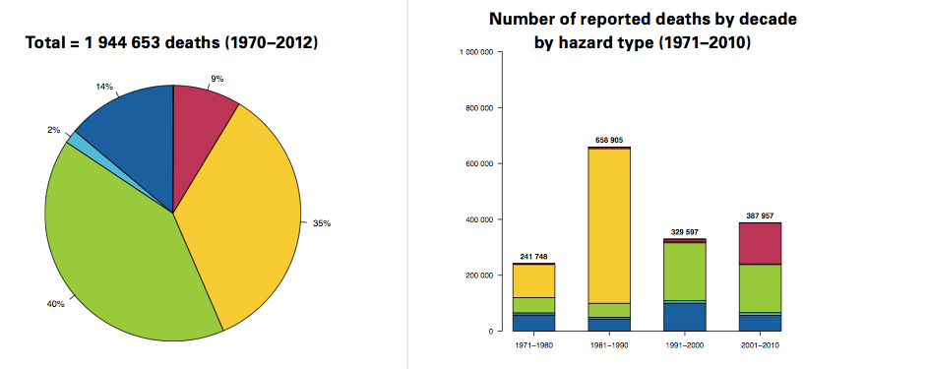
WMO World Atlas Results
Breakdown by Deaths & Decade
Notes:
Scope of WMO Study
43 years (1970-2012)
N= 8835
1.9M lives lost
Damages $ 42.4 T USD
1% of events caused
69% of deaths
19% of economic losses
Storms & Floods caused
79% of number of disasters
54% of deaths
84% of economic losses
Droughts caused
35% of deaths

Slide 9
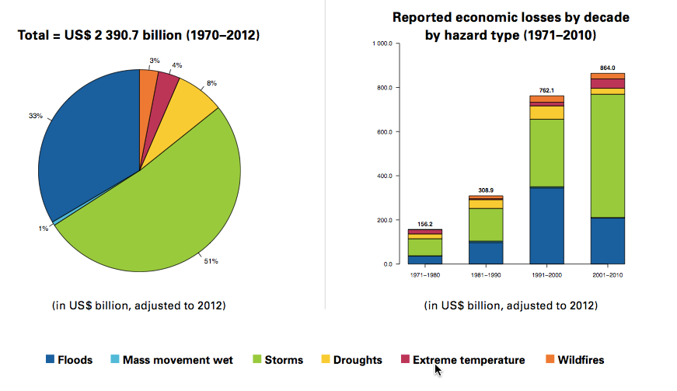
WMO World Atlas Results
Breakdown by Economic Damages and Decade
Notes:
Scope of WMO Study
43 years (1970-2012)
N= 8835
1.9M lives lost
Damages $ 42.4 T USD
1% of events caused
69% of deaths
19% of economic losses
Storms & Floods caused
79% of number of disasters
54% of deaths
84% of economic losses
Droughts caused
35% of deaths

Slide 10
Climate Change Impacts: Loss Ins
Worldwide Natural Disasters Losses 1980 – 2012
Billions USD
Derived from MR NatCatSERVICE data 2012

Slide 11
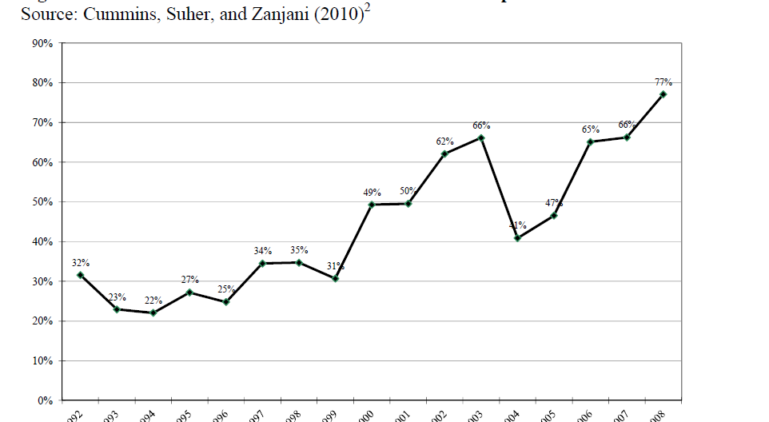
Climate Change Impacts: Trends in Federal Disaster Payment Ratios to Total Loss 1992 – 2008

Slide 12
Cummins 2010 / 2013: Unfunded Federal Disaster Response Costs
*Over 75 year horizon
2008 dollars
*Social Security: 4.7T
GAO
*Unfunded Federal Disaster Recovery Costs $1.1 T – 5.4T
Cummins (2010 / update 2013)
*Current US State Cat Funds
$3T USD underfunded according to
http://www.hawaiireporter.com/hurricane-sandy-pacific-tsunami-scare-expose-state-catastrophe-debts/123
Citing GAO-10-568R Natural Catastrophe Insurance Coverage GAO 2010
“Federal Financial Exposure to Natural Catastrophe Risk” J.David Cummins, Michael Suher, and George Zanjani (2010),
corrected.

Slide 13
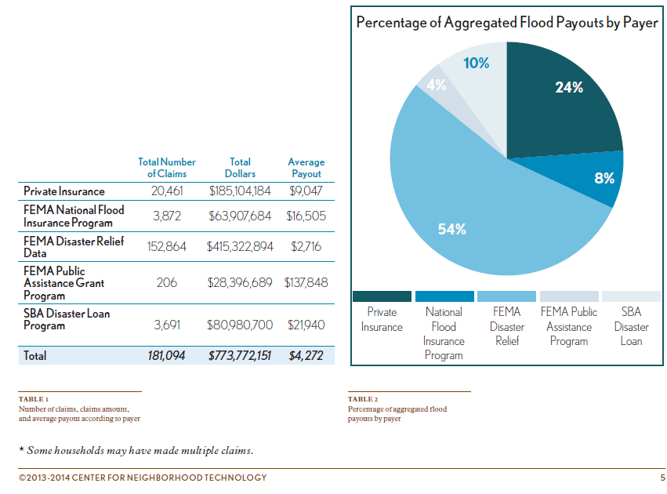
CNT : Urban Flooding Report for Cook County 14 May 2014
Documents chronic, repetitive
Flooding that is mostly funded by
disaster response – not insurance

Slide 14
The Challenge
Uncontrolled, accretive, off-budget disaster expense rising to level of unfunded social security liability to the US Federal Government and US Taxpayer
  Current annual average cost - $400 per household
  1.7-5.8T USD (Cummins et al)
Decreased insurance penetration relative to asset value
Government disaster risk management policies created when population was primarily rural and capable of significant ‘self-help’;
  Subsidize moving to the risk
  Underprice risk
Decreasing investment in infrastructure
Population location shift: primarily to urban / coastal with specialized labor – significant decrease in capacity to self-help
Public misunderstands purpose and extent of disaster response intent, obligations and fund capacity of available government assistance

Slide 15
What is being done now ?
More study than action
DOE measuring resilience metrics for specific utility classes
NIST resilience metrics
NIBS updating Multi-hazard mitigation Council report
Actuarial Climate Risk Index (CAS and SOA)(Updated Aug 2014 at NAIC)

Slide 16
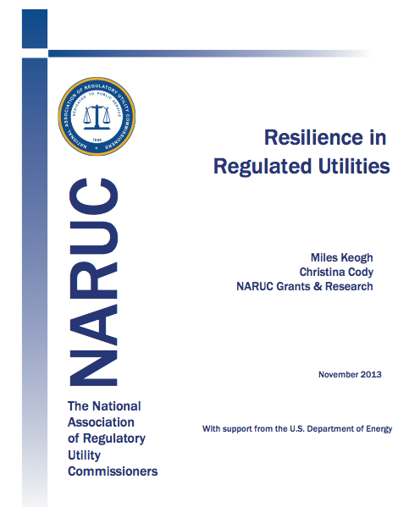
Resilience metrics

Slide 17
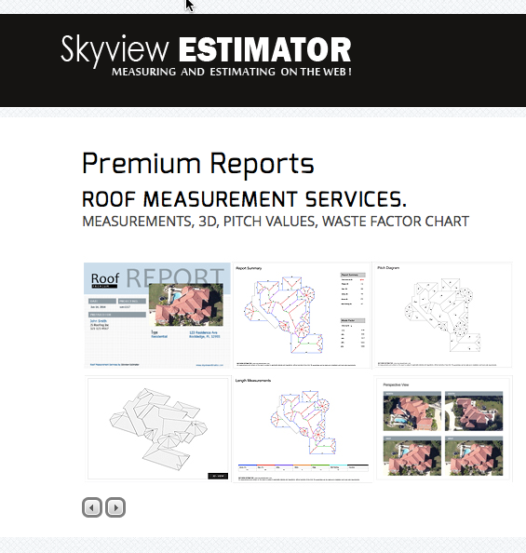

Consumer / Commercial Driven Applications
Now:
Current Image driven date
What’s coming:
Drone enabled imaging

Slide 18
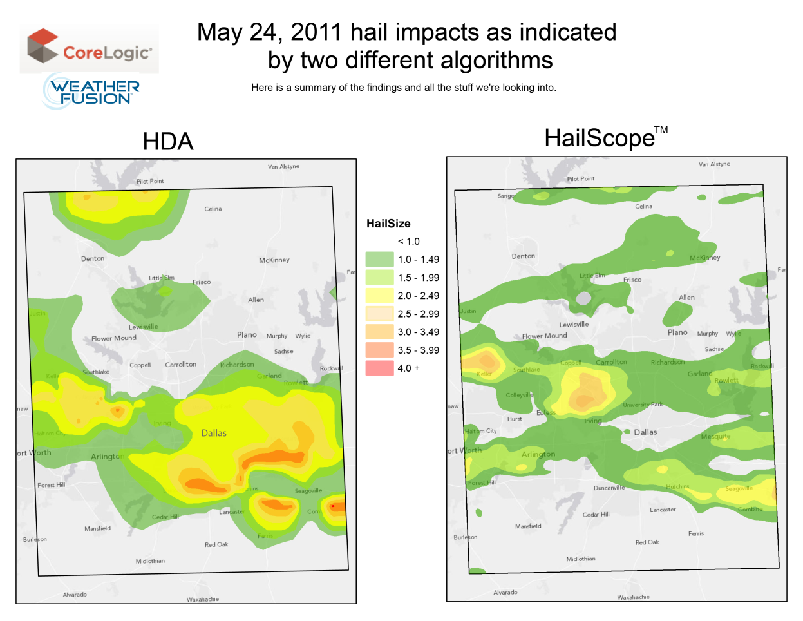
Potential Impact
Exaggerated hail impact areas
Realistic hail impact areas
Notes:
HDA-based hail data “Should not be relied upon for accurate determination
of severity or damage.” –Institute for Business and Home Safety (IBHS) Hail Study

Slide 19
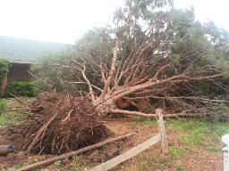
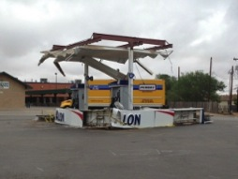
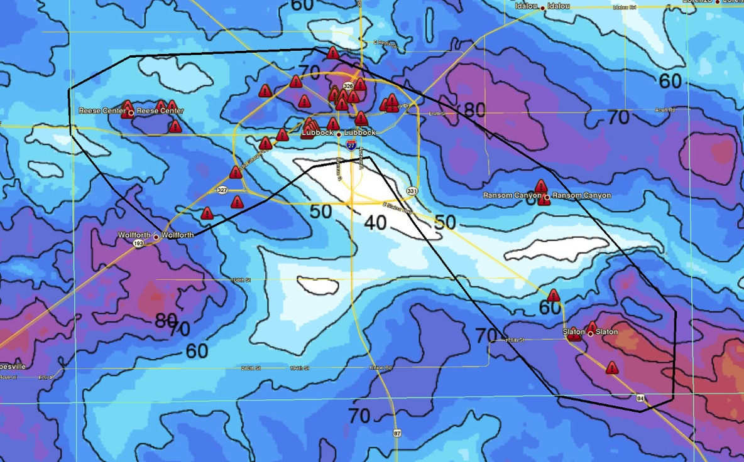
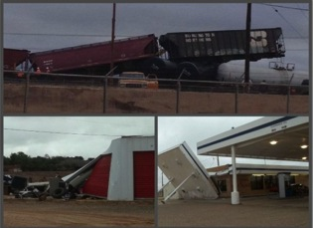
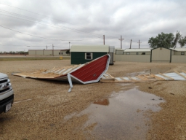
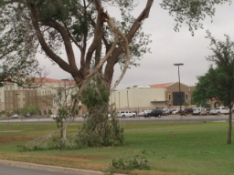
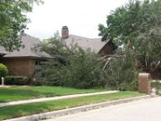
Wind: Sneak Peek
Lubbock, June 5, 2013
Wind Modeling
Lubbock, June 5, 2013

Slide 20

A Complete View From Point to Portfolio

