Slide 1
Boston University Sear Level Rise Conference, November 14, 2014
Public-Private Research Partnerships to Build Urban Resilience
Joan Fitzgerald
Resilient Cities Lab

Slide 2
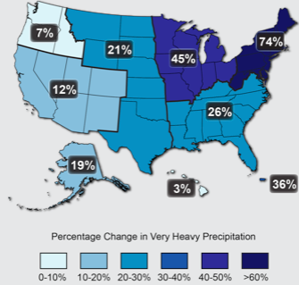
Source: Draft 2014 National Climate Assessment.

Slide 3
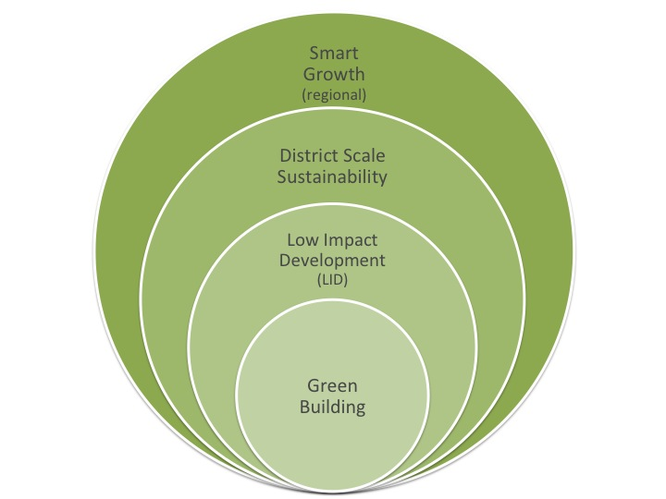

Slide 4
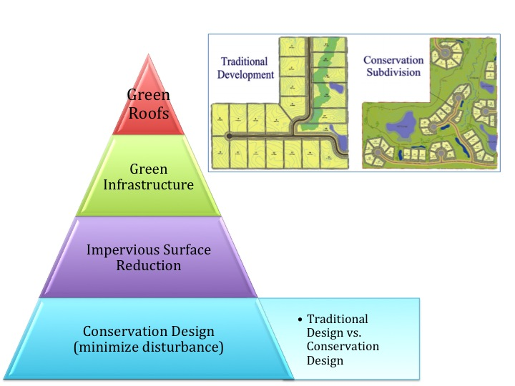

Slide 5
