Slide 1

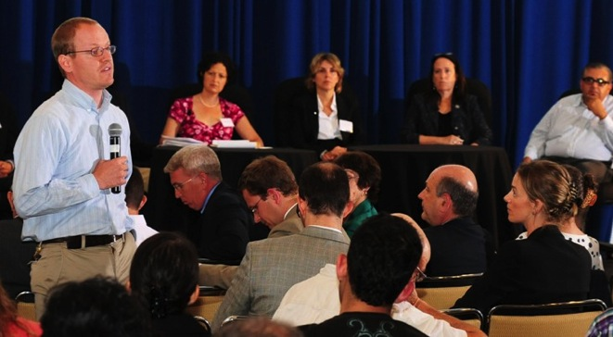

Center for Science and Democracy at the Union of Concerned Scientists
Andrew A Rosenberg, Director
Advance the role of science in public policy
Leverage UCS capabilities
Engage citizens, media and policy-makers
Connect to science in people’s well-being
Notes:
CSD Overview

Slide 2
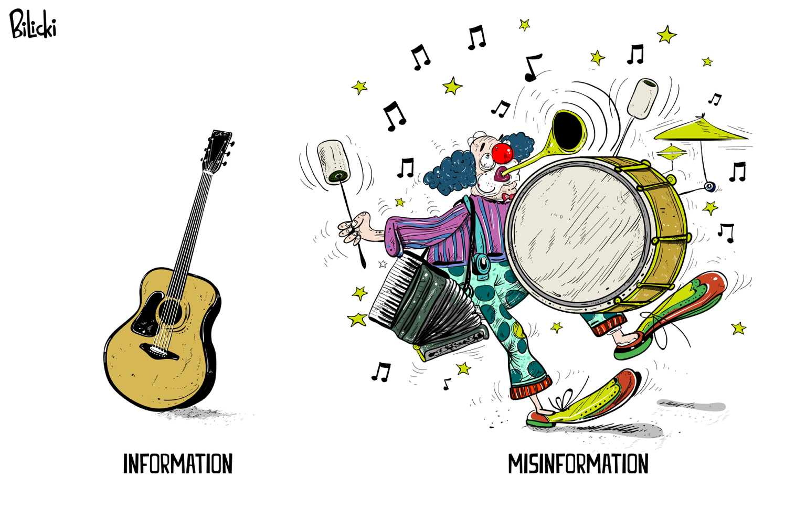

Slide 3

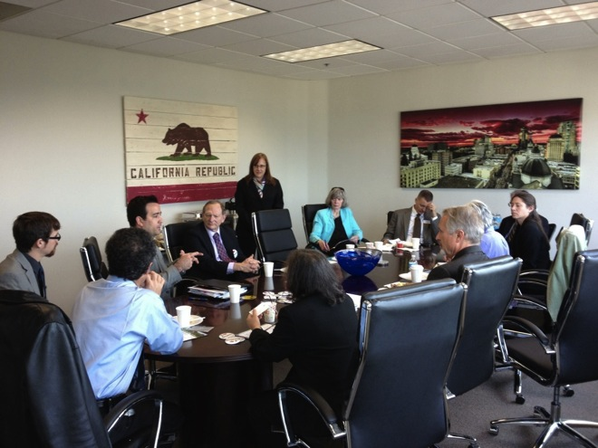
Strengthen the Voice for Science
The UCS Science Network
Cross Program
Skill-building workshops
Early Career Scientist events
Communications & advocacy resources
Engagement tools
Notes:
For the ECS events, mention the two networking happy hours at the American Association for the Advancement of Sciences and the Ecological Society of America annual meetings, which brought together more than 175 new scientists to learn about pursuing unconventional scientific careers related to public policy.
New resources include-- “how-to” videos, succinct practical guides, “tip of the week” info graphics, and ECS- tailored toolkit, for our members to help strengthen their voice for science.

Slide 4
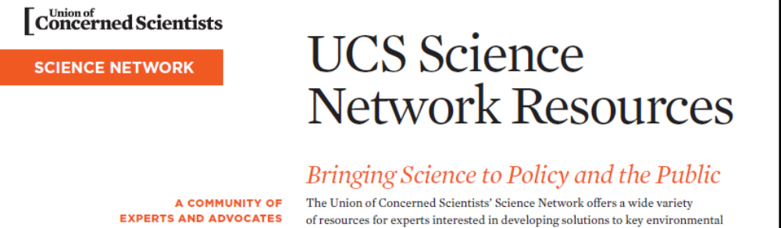
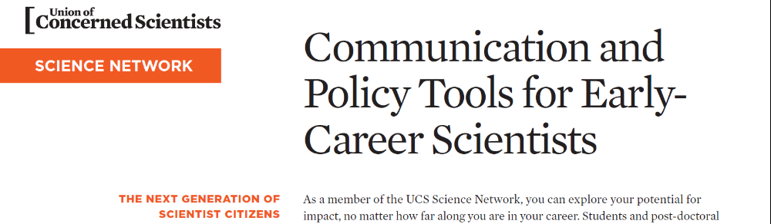

Slide 5
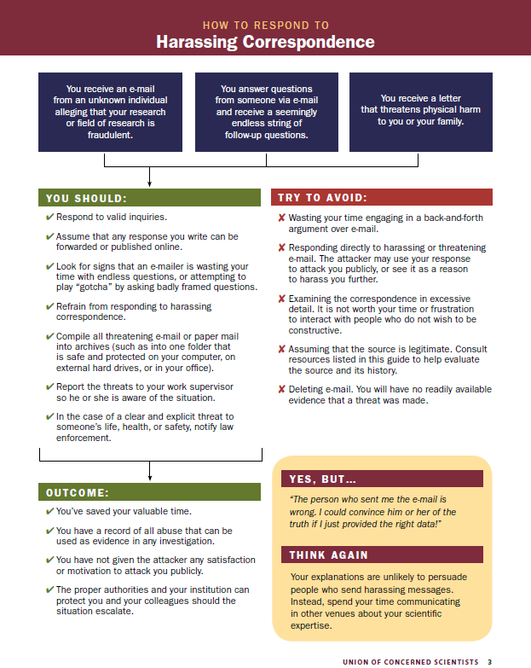
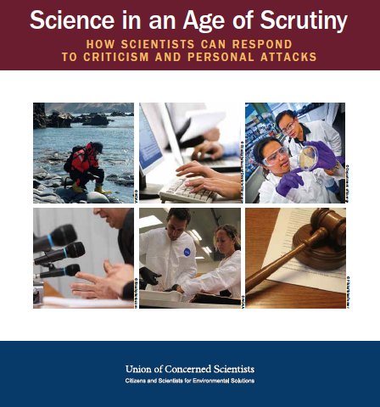
ucsusa.org/scientistsunderscrutiny
Notes:
Scientists today are under more scrutiny than ever. When their research ends up at the center of a contentious public policy debate, scientists receive many legitimate requests for more information, but they are also sometimes attacked by individuals who do not like the research results. These attacks can take multiple forms—emails, newspaper op-eds, blogs, open-records requests, even subpoenas—but the goals are
the same: to discredit the research by discrediting the researcher.
Fortunately, there are steps scientists can take to protect their reputations and the
integrity of their research while contributing their expertise to the critical issues of the
day. This guide will help scientists who find themselves in the spotlight make smart
decisions about how to respond.
------------------------ 1st page text below
Have you received hateful e-mail fromstrangers? Are public officials using
their office to cast doubt on your
research? Has your institution been
served with an open-records request for your e-mail?
Has a blogger publicly misrepresented your findings
or questioned your integrity?
As odd as it may seem, you deserve congratulations.
The attention you are receiving shows that your
research is now at the center of public policy debate.
Nevertheless, scientists often find such experiences
intimidating. This guide suggests some steps you can
take to deal with harassment and other attacks on the
integrity of your work. Based on the experiences of
other scientists, we know that the first 24 hours after
such attacks occur are critical, as this is often when
scientists make mistakes in attempting—or not
attempting—to respond.
It is vitally important that scientists respond to
valid critiques and questions about their work, from
both colleagues and the public. However, it is equally
important for scientists to differentiate between goodfaith
inquiries about their research and unfounded
criticisms designed to undermine public confidence
in either themselves or their field of research. And in
both cases, it is important for scientists to be honest,
communicate clearly, and demonstrate their trustworthiness
to the public.
Scientists who face harassment need to know
they are not alone. It is not uncommon for scientists
to face public criticism and attacks when their findings
threaten vested ideological and financial interests.
This has happened for decades. In the 1960s,
asbestos manufacturers hired public relations firms
to question research linking asbestos exposure to
cancer, specifically attacking the work of Dr. Irving
Selikoff, a pioneering asbestos researcher.1 In the
1970s, the lead industry targeted Dr. Herbert Needleman,
a physician whose research revealed the harmful
effects of lead exposure on children’s development.2
Climate scientists have become the most recent
high-profile public targets, as industry-funded groups
have attempted to discredit the research and reputation
of notable investigators. These include Dr. Benjamin
Santer, who drafted part of a report from the Intergovernmental
Panel on Climate Change,3 and Dr.
Michael Mann, whose research on modern versus
past climate4 has been attacked by members of
Congress and a state attorney general, as well as
industry-funded groups.
Some organizations and elected officials have also
used subpoenas and taken advantage of open-records
laws to demand data and private correspondence
from scientists at public universities and in government
agencies.5 Given ideological divides on many
science-based policy challenges, as well as the integral
role of science in the policy-making process, we can
expect such attacks to continue.
The Union of Concerned Scientists has created
this booklet to provide some basic guidance on dealing
with harassment as well as legitimate requests
for information. Nothing in this guide constitutes or
should replace legal advice. We advise you to consult
with your own counsel, or to contact organizations
that could provide you with legal assistance and
advice specific to your circumstances, such as Public
Employees for Environmental Responsibility or the
American Civil Liberties Union.

