Slide 1
Ashley D. Farmer
Research on Tap | Tackling Racial Inequities in Boston: What’s BU Learning?
Assistant Professor, Departments of History and African American Studies
College of Arts & Sciences
adfarmer@bu.edu

Slide 2
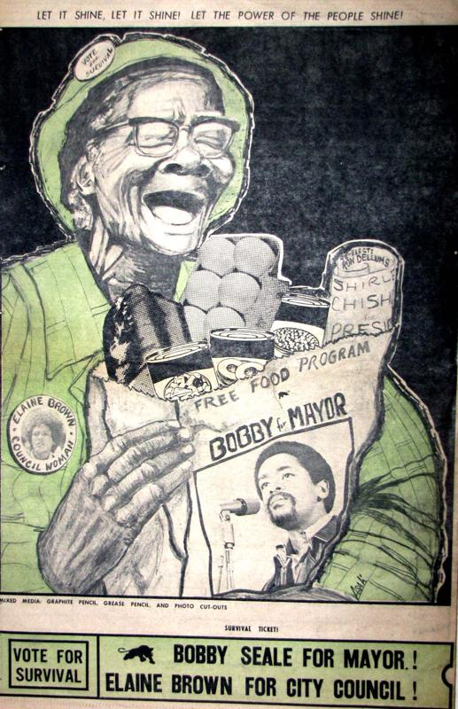
Understanding Racial Inequities in Boston in the Context of National Movements
Research:
Who: African American Women in the Black Power Movement
When: 1960s -1980.
Where: Nationwide
Why: I examine how African American women used political writings and images to reimagine their role in bringing about race, class, and gender equality
My Research:
1.Helps us understand how major issues in the civil rights and black power movements played out in Boston.
2: Helps us understand how we have fallen short of the dreams for racial and gender equality that past local activists imagined.

Slide 3
Research on Tap | Tackling Racial Inequities in Boston: What’s BU Learning?
Ideas: Advancing Racial Equity in the Region
Recreate some of the programs designed by the Black Panther Party
  Free Food Cooperative
  Free Health Clinic
  Legal Aid and Education Program
Create a “Civil Rights in Boston” Service Learning Course at BU
  Students would:
    Learn history of Civil Rights Movement in Boston
    Spend part of course working in a Boston-based civil rights group
    Play an active role in reshaping the racial landscape of the city

