Slide 1

Reducing Disparities & Promoting Well-Being in Boston:
The Role of the BU Community

Slide 2
Peggy Maisel
Associate Dean for Experiential Education
Clinical Professor of Law
School of Law

Slide 3
B.U. Law Clinics
Civil Litigation Program
  Housing, Employment, Family & Disability Clinic
  Employment Rights Clinic
Criminal Law Clinical Program
  Includes defender and prosecutor options
Immigrants’ Rights Clinic
Wrongful Convictions Clinic
International Human Rights Clinic
Human Trafficking Clinic
Entrepreneurship & IP Law Clinic
Technology & Cyberlaw Clinic
Environmental Law Practicum

Slide 4
IMPACT of the LAW CLINICS and EXTERNSHIPS
BU Law students graduate with knowledge and skills to represent clients in need of legal services both as public interest attorneys, public defenders, prosecutors or other government attorneys, or as pro bono attorneys while working in law firms or other jobs.
BU Law students and their faculty supervisors commit thousands of hours each year to serving indigent clients who otherwise would not be represented by an attorney. The students act as attorneys for these clients. They also educate the community on their rights and take on policy projects such as helping pass the first Anti-Trafficking Law in Massachusetts.
We also send students to other areas over spring break who work on Human Rights issues. In the first year as part of the Property Course we have all students doing a week in the Housing Court.

Slide 5
Why at BU?
Law students come to BU because they can learn via our clinics and externships and serve the community. We offer clinics in many types of law as needs for expertise have changed.
The Civil Litigation Clinic (housing, employment, family, disability law) and the Criminal Law Clinic (adults, juveniles, wrongful convictions) have been running at BU for almost 55 years and were the first law clinics in the country serving basic needs in the community with free legal representation and access to justice.
Newer clinics in Immigrant Rights, Human Trafficking, and International Human Rights as needs for legal services expand.
Environmental Law Practicum, Entrepreneurship and IP Clinic and Technology and Cyber Law clinics are our newest offerings. The Entrepreneurship and IP Clinic works closely with the BU Buzz Lab to serve student entrepreneurs.

Slide 6
Trudy Zimmerman
Assistant Dean for Field Education
Director, Dual Degree Program in Social Work & Education
School of Social Work

Slide 7

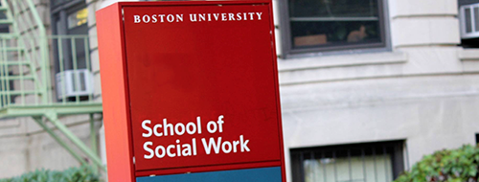
Three program platforms:
  Charles River full and part time
  3 off-campus part-time Friday-Sat
  Online part-time
Total 650-700 students
Clinical and Macro Practice

Slide 8

Numbers tell part of the story…
2016-2017
  Charles River campus students in the field: 192
  Hours of service: 72,000
  Off-campus students in the field: 63
  Hours of service: 25,225
  Online program students in the field: 184
  Hours of service: 89,190
  Total hours of service in 2016-2017: 186,415

Slide 9
Where are SSW students placed?
Wherever social workers practice…
    Clinical: mental health, addiction services, housing, schools, family service, hospitals/health centers, older adults, child welfare, community centers
    Macro: advocacy organizations, government agencies – local, state, federal, planning and prevention programs

Slide 10
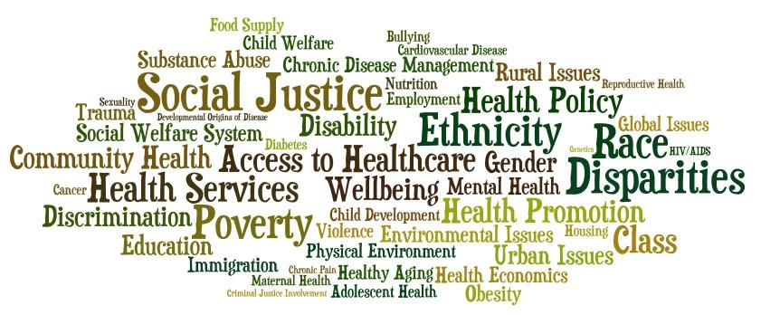
And what are they doing?
Clinical: individual counseling, case management, groups, family work, advocacy, information and referral
Macro: program planning, community organizing, grant-writing, management, legislative advocacy, policy development, program assessment
Two examples

Slide 11
Joanna Brown
Program Manager
Public Health Practice
School of Public Health

Slide 12

Activist Lab at BU School of Public Health
EDUCATE.
INNOVATE.
ADVOCATE.
activistlab.bu.edu

Slide 13

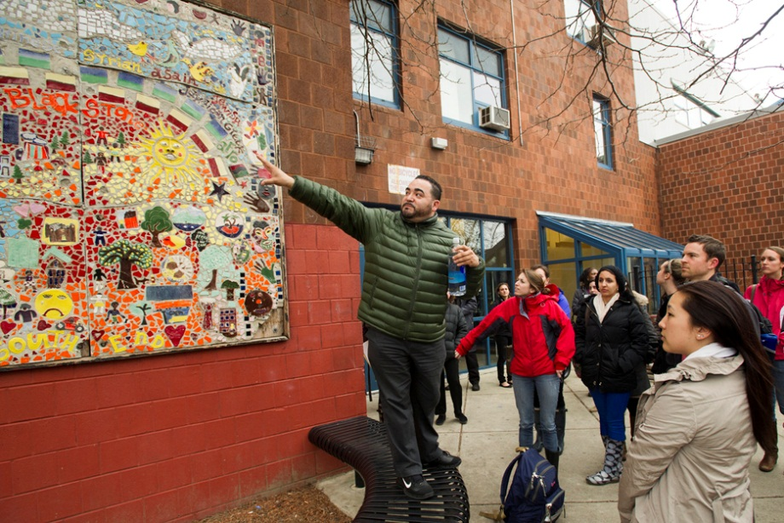
Community Engagement
BU FitWell Gym at the Blackstone Community Center
BU Spring Break Challenge students at Blackstone

Slide 14
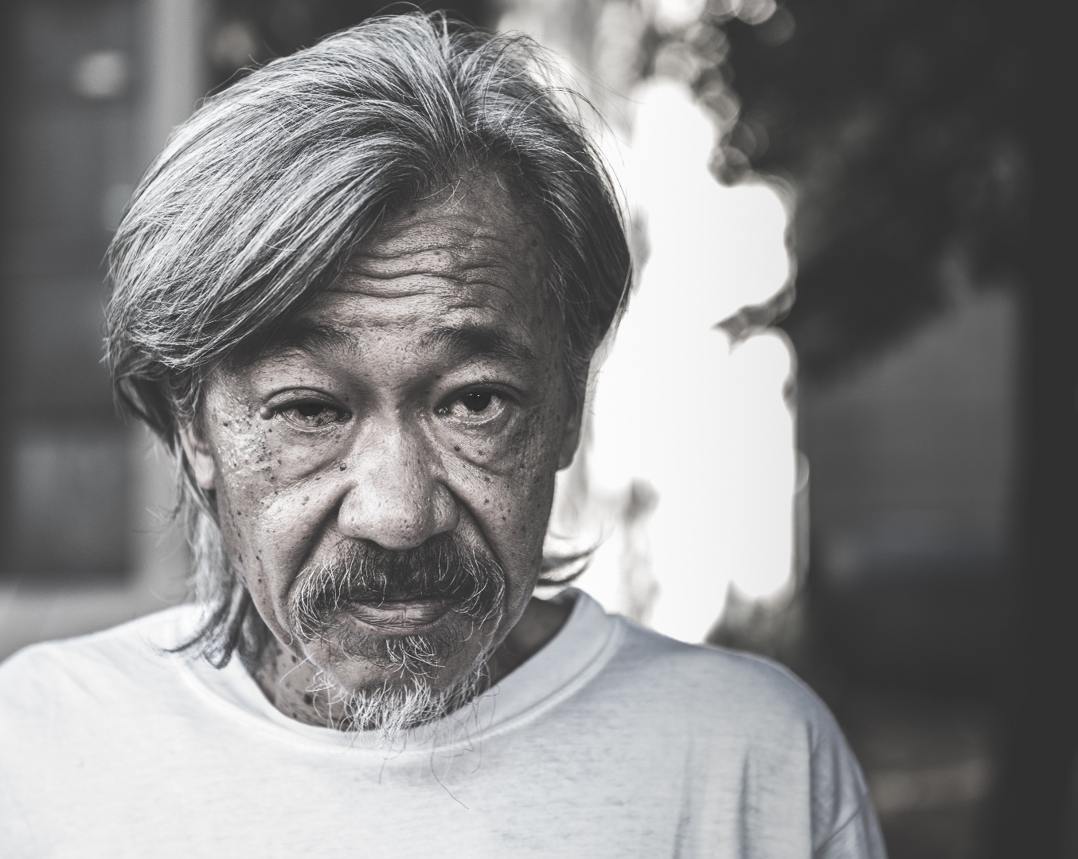
Community Engagement
Faces on Albany Street

Slide 15
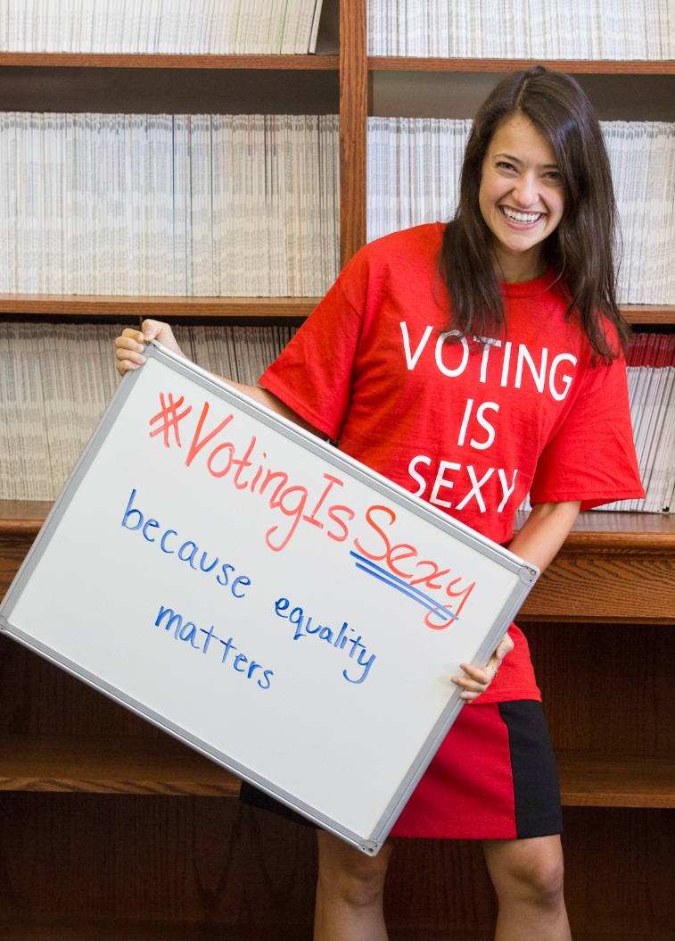
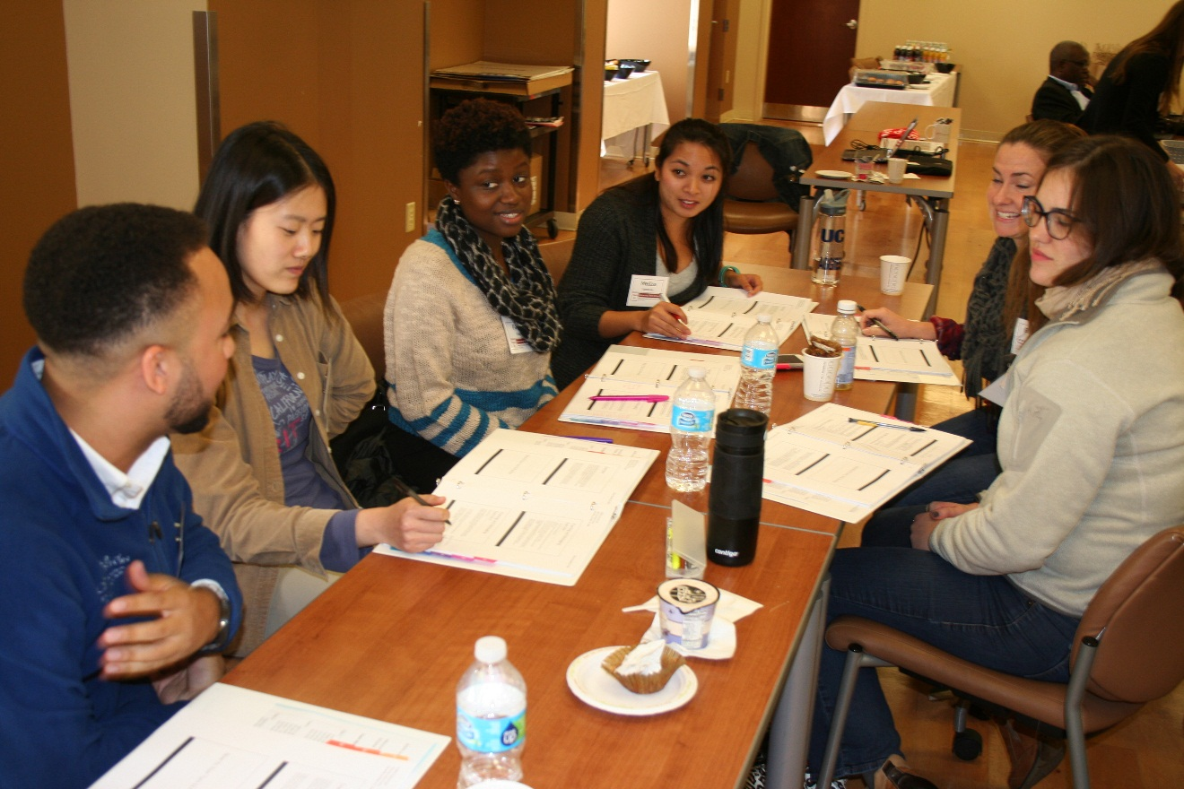
Culture of Activism
Fall 2016 Advocacy Bootcamp

Slide 16
Kathy Lituri
Clinical Instructor, Department of Health Policy & Health Services Research
Oral Health Promotion Director
Henry M. Goldman School of Dental Medicine

Slide 17

BU Henry M. Goldman
School of Dental Medicine
Global and Population Health
“Actively support students, faculty and staff in their efforts to improve the health of the world’s populations, and facilitate interdisciplinary health research, teaching, and practice across all departments and programs at GSDM and the University, with a special emphasis on global health and inter-professional care.”

Slide 18
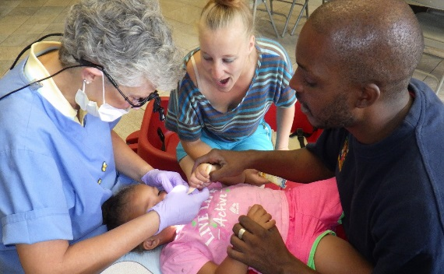
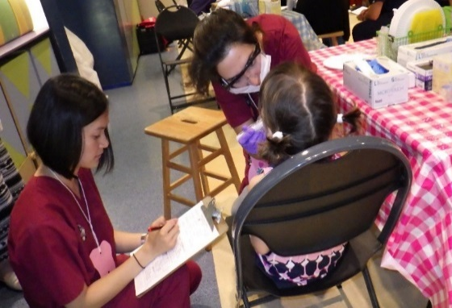
  Community Engagement Mission
  To improve the oral health and enhance the quality of life of our global community.
  To enhance the educational experience of our students.
  Populations we target:
  Homeless
  Financially disadvantaged
  Uninsured/underinsured children and adults
  Seniors
  Individuals living with HIV

Slide 19
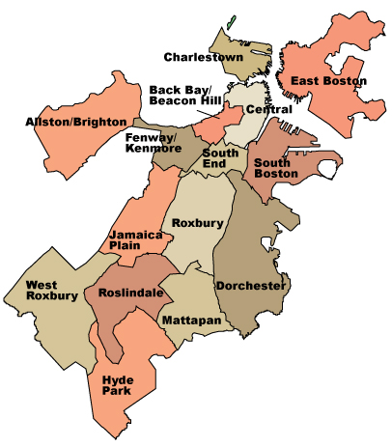
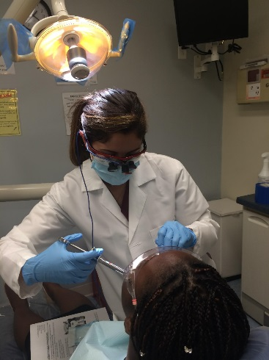
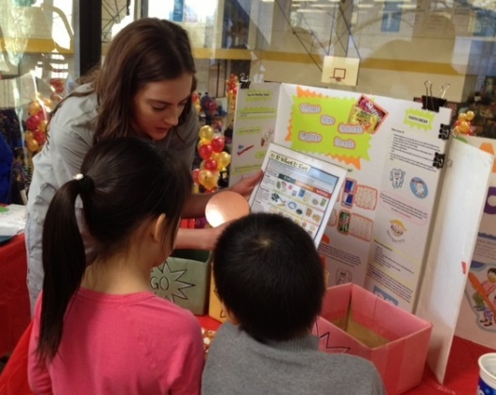
Boston: 2015-2016
Community-based Education
  80,000 visits in community health centers, hospital dental clinics and a federal medical center
School-based Programs
  30 Boston Public Schools
    3,374 children educated
    873 preventive dental visits
    363 molars sealed / 132 children
Community Outreach
  117 oral health promotion and non-oral health initiatives
  69% of students participate in outreach activities
Notes:
10 week externship
Community health project

Slide 20
Zachary Hobbs
Director
Boston University Community Service Center

Slide 21
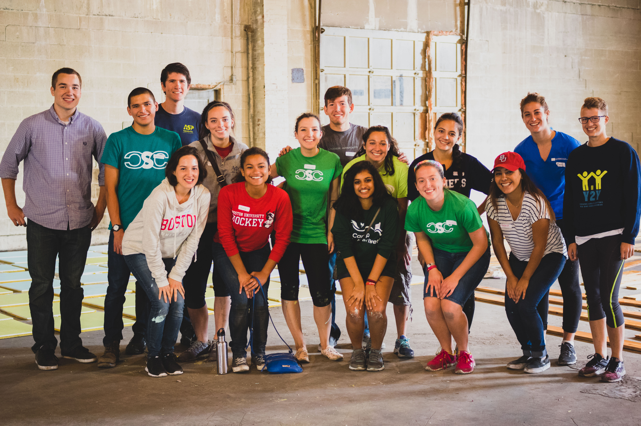

www.bu.edu/csc
GSU, 4th Floor

Slide 23
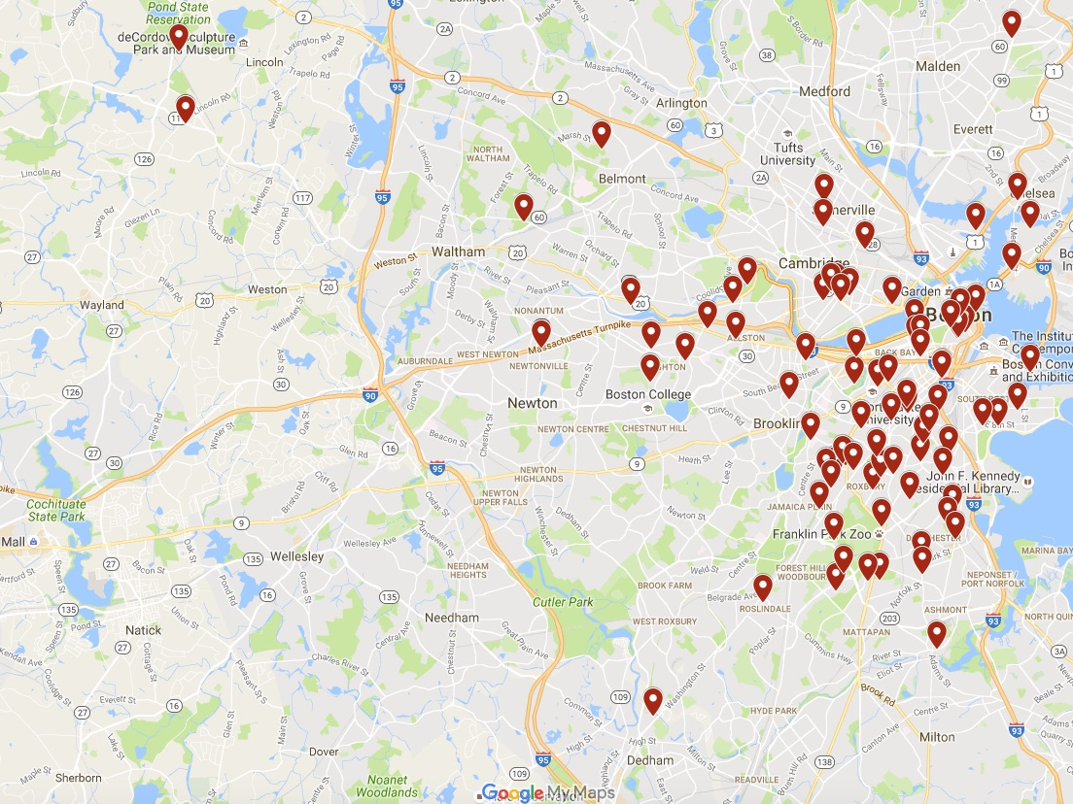
Welcoming Space
Service
Education
Reflection
Initiated by Students
In solidarity with our partners

Slide 24
Engagement
Partnership
Strategy

Slide 25
Michael Dennehy
Director
College Access & Completion
School of Education

Slide 26
SED College Access and Completion
(formerly Boston Public Schools Collaborative Office)
Programs Overview
General College Access
Upward Bound (1989)
BUILD (1997)
  SED and Student Employment
Menino-Boston Scholars (1974)
STEM College Access
Upward Bound Math Science (2007)
The Calculus Project (2015)
College Access with Teacher Prep-focus
Educators Rising (2014)
AACTE Holmes Scholars (2015)

Slide 27
2015-16 Numbers Served and BU Commitments
Program | 2015-16 Number BPS Students Served | Federal Funds | BU Funds | Notes
Upward Bound | 100 | $393,563 | $90,118 | BU funds direct & indirect
Upward Bound Math Science | 18 | $66,832 | $9,064 | UB MS also serves Chelsea students
Menino Scholars | 91 |  | $4,350,669 | Scholarship & Programming
BUILD | 742 | $190,883 | $163,193

Slide 28
Additional BU Commitments to Boston related to College Access
College Advising Corps (2015)
  Recent college graduates who are Americorps member and BU employees
  Goal of CAC is to increase college attendance rates among less advantaged students
  In every BPS high school
BPS Community Scholars (2009)
  Any BPS student attending BU is awarded full financial need, no loans
BU Undergraduate Admissions Programming for BPS Students
  BPS Summer Experience
    Each August - Rising Juniors
  BPS Overnight
    Each October - Current Seniors
  Free BU TOEFL
  Application fee waived for any BPS student

Slide 29
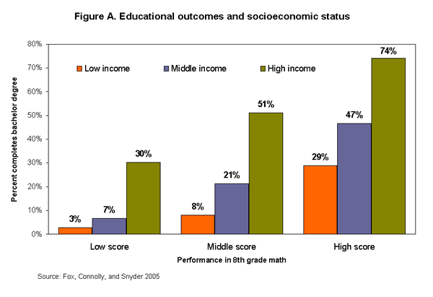
Why are these initiatives important?

Slide 30
Danielle Rousseau
Faculty Coordinator, Boston University Prison Education Program
Assistant Professor of Criminal Justice
Metropolitan College

Slide 31
BU PRISON EDUCATION PROGRAM
HISTORY
1972 Founded by Elizabeth Barker
Mid 1990s BU demonstrates ongoing commitment to program
Current Programs in two facilities MCI Norfolk and MCI Framingham
Ongoing Collaborations, program development, and research

Slide 32
PROGRAMMING
Music program
Physics
Philosophy
Ecology
Psychology
Botany
English Composition
Intro to Business Law
Sociology of Poverty
Principles of Sociology
Moral Psychology
Sociology of Minority Groups
Introduction to Ethics
American History
Women in Shakespeare
Modern Drama
Presidency
Urban Sociology
Macroeconomics
Entrepreneurial Management
Elementary Statistics
Intermediate Composition
Computer Science
Irish and English Poetry
Contemporary American Fiction
Politics and Philosophy

Slide 33
OUR STUDENTS

Slide 34
Lauren Sneider
Program Manager
Criminal Justice Diversion Program
Boston Emergency Services Team
Boston Medical Center

Slide 35
Nature of the problem…
People with mental illness and substance use disorders are overrepresented in the criminal justice system.
These individuals have frequently fallen through the “safety net” of families, hospitals, and community based treatment providers.
  Every year, approximately 800,000 people with severe mental illness are incarcerated in US jails.
  16% of incarcerated individuals have a serious mental illness compared to 5% in the general population

Slide 36
In Support of Criminal Justice Diversion…
The need for targeted services to safely manage community crises and divert people from the criminal and juvenile justice system and toward community based treatment is seen as a national priority.
Jail Diversion programs alleviate jail over-crowding, reduce the costs of treatment during incarceration, shrink court dockets and decrease unnecessary prosecution.
There are several stages to a criminal case—arraignment, bail, hearings before a judge, a trial, probation and incarceration. At any one of these stages a person’s mental illness may affect how a case proceeds, or whether a case can proceed at all. Early diversion can redirect time and resources to treatment instead of toward punitive sanctions.

Slide 37
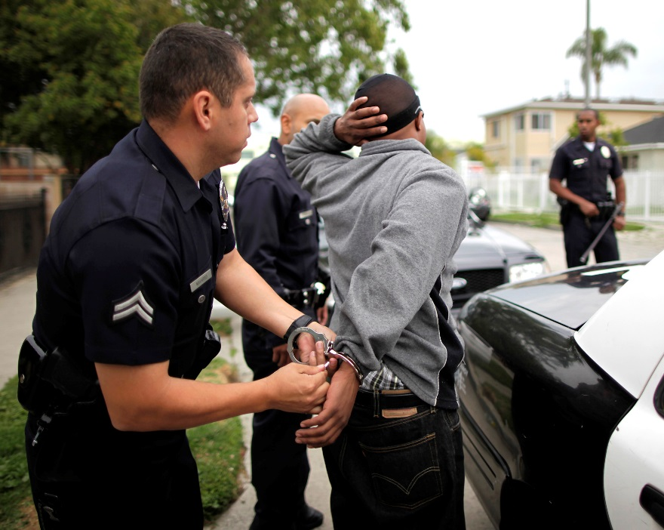
Police and Mental Health
7-10% of all police calls involve an “EDP” or Emotionally Disturbed Person.
Individuals who cycle in and out of the mental health, substance use and criminal justice systems and often receive fragmented treatment are at risk of re-arrest, often for non-violent offenses.
Holding cell safety upon arrest- Police hold liability for any injury so many unnecessary ambulance rides to ED’s occur.
Q5 list and holding cell evaluations by Emergency Service Providers.
DMH Designated Forensic Psychologist.
Police officers are able to exercise discretion, but historically have had few resources other than arrest to intervene.

Slide 38

Philosophical Basis for Mental Health Court
Therapeutic jurisprudence
The study of how the law acts as a therapeutic agent.
This perspective regards the law as a social force that produces behaviors and consequences.
Therapeutic jurisprudence wants us to be aware of this and wants us to see whether the law can be made or applied in a more therapeutic way so long as other values, such as justice and due process, can be fully respected.
Reduce the contact of the mentally ill defendant with the criminal justice system by creating a bridge

Slide 39
How Does Mental Health Court Differ?
Referrals come from defense attorneys, probation officers, judges, ADAs, community providers.
Client must meet criteria for “serious mental illness” and may additionally have a co-occurring substance use disorder.
Clinical assessment of each client referred is shared in open court and the judge makes final decision if a client will be accepted to the session.
Participation is voluntary.
Fees are often waived.
Treatment/Service plan is developed and revised as treatment needs change.
Access to Mental Health Court Clinician for treatment coordination & support.
Adherence to treatment plan is reviewed during court appearances before the judge even after disposition.
Client, Judge, Mental Health Court Clinician, Specialized Probation Officer and Specialized Assistant District Attorney comprise treatment team. Releases of information for outside providers is required.
Time in Mental Health Court is determined by client’s probationary period.
Upon successful completion of supervision period and service plan adherence client is presented with certificate of completion.

Slide 40
Thank you!
Email us your ideas: ioc@bu.edu
Follow us: @BUonCities
75 Bay State Road
Boston, MA 02215
(617) 358-8080 www.bu.edu/ioc

