Slide 1
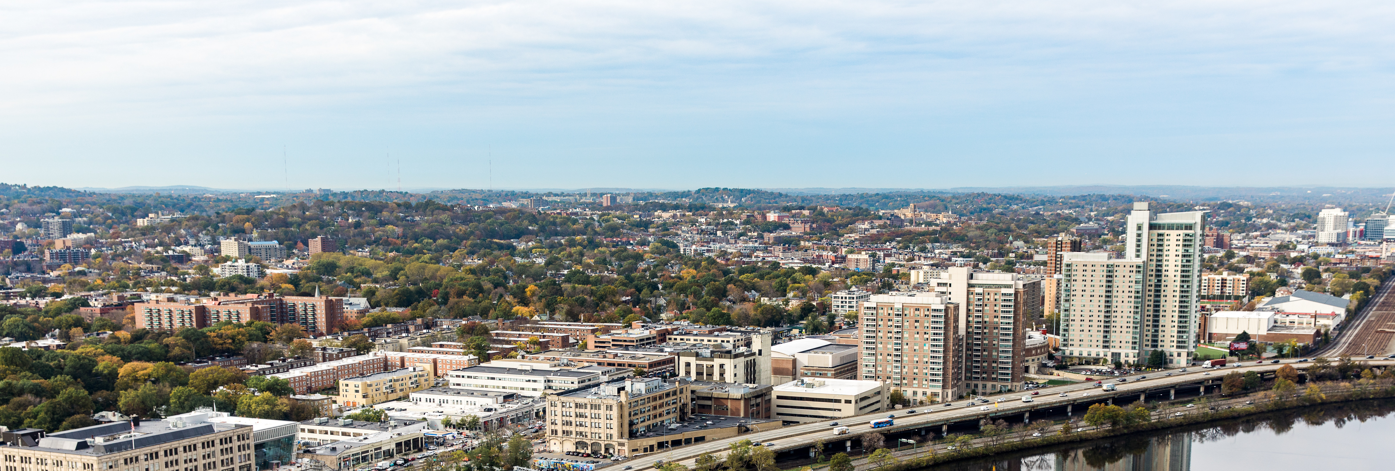
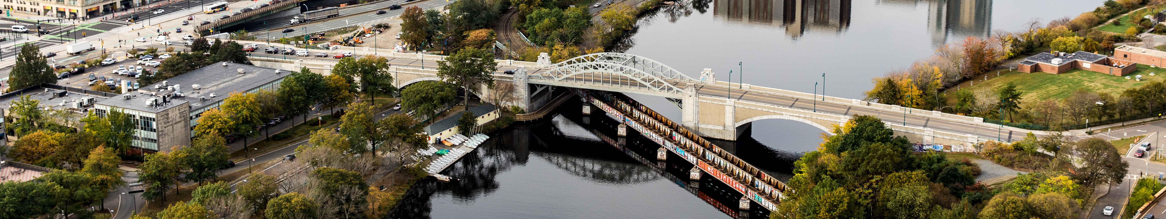
METROBRIDGE
Boston University Initiative on Cities
Memo Writing: Guidelines for Format & Content

Slide 2

METROBRIDGE
Boston University Initiative on Cities
What We’ll Cover
Purpose of a memo
Advice for before you start writing
Suggested memo content
General “do’s” and “don’ts”
Examples and guides for memo writing
Click Image for for Audio

Slide 3


METROBRIDGE
Boston University Initiative on Cities
Purpose of a Memo
Provides new information to decision makers and policy makers
Presents detailed or complicated information clearly and concisely
Suggests recommendations or action items
Click Image for Audio 1
Click Image for Audio 2

Slide 4

METROBRIDGE
Boston University Initiative on Cities
Before You Start Writing
Know your audience
Decide which information is most relevant to your reader
Consider the key takeaways or action items you want to convey
Click Image for Audio

Slide 5
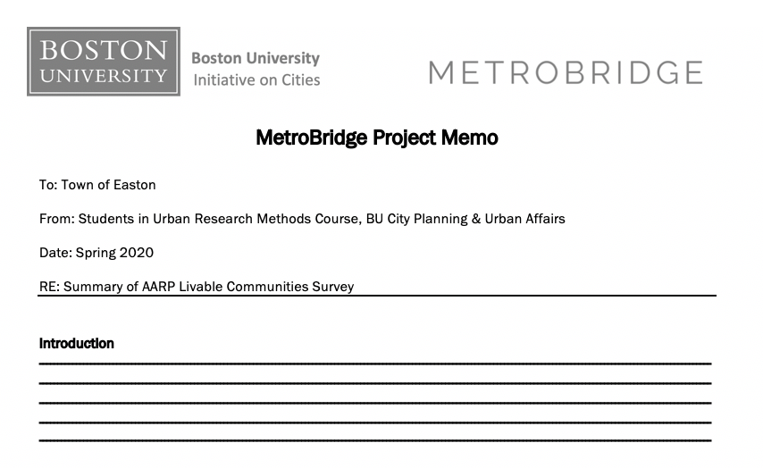

METROBRIDGE
Boston University Initiative on Cities
Suggested Memo Content: Header and Intro
LINK TO METROBRIDGE MEMO TEMPLATE
HEADER
  Separate lines for:
    Recipient, sender, subject, date
INTRODUCTION
  Purpose of the memo
  List important information that will follow
  Length: 3-5 sentences
Click Image for Audio

Slide 6
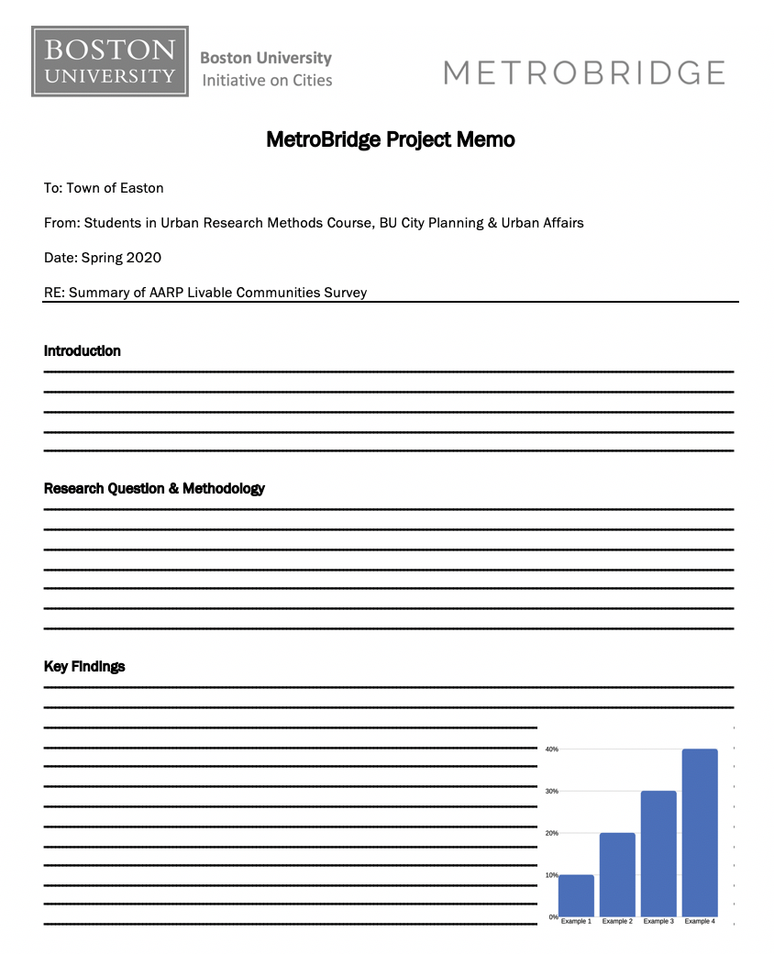
METROBRIDGE
Boston University Initiative on Cities
Suggested Memo Content: Body
RESEARCH QUESTION & METHODOLOGY
  Purpose of the project/survey
  Research activities undertaken
  Length: 5-7 sentences
KEY FINDINGS
  Highlights from data analysis
  Graphics (if applicable)
  Length: 10-15 sentences (this should be the largest memo section)
Click Image for Audio #1
Click Image for Audio #2

Slide 7
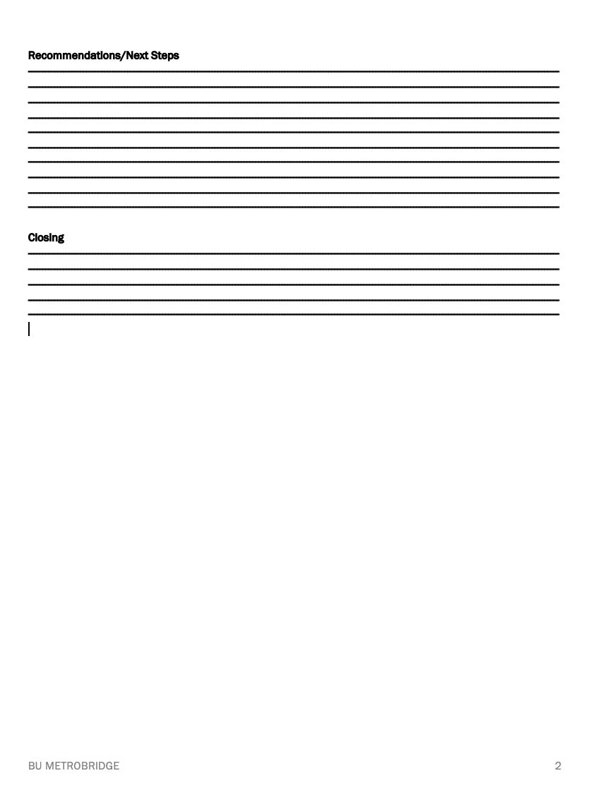
METROBRIDGE
Boston University Initiative on Cities
Suggested Memo Content: Rec’s + Closing
RECOMMENDATIONS/NEXT STEPS
  Specific action items
  List of key players involved
  Length: 7-10 sentences
CLOSING
  Briefly reiterate key findings and recommendations
  Share where to find further information or ask follow-up questions
  Length: 5-7 sentences
Click Image for Audio

Slide 8


METROBRIDGE
Boston University Initiative on Cities
Do’s and Don’ts
Click Image for Audio
Write a longer version first and then narrow down the content for the memo
Include graphs or infographics when appropriate
Ask someone who isn’t familiar with the topic to read it for clarity
Don’t include in-text citations or references
Try not to exceed 5 pages (the shorter the better)
Don’t use overly long sentences or paragraphs, keep things direct and to the point

Slide 9
METROBRIDGE
Boston University Initiative on Cities
Memo Examples and Guides
MetroBridge Memo Examples:
  Surveying the Needs of Senior Residents in Easton, MA
  Analysis of Regulating Short-Term Home Share Rentals in Watertown, MA
  Researching How Local Governments Use Social Media as a Community Engagement Tool for Everett, MA
Online Guides to Memo Writing:
  Woodrow Wilson School, Princeton University: Policy Memo Writing Tips
  Broad Institute, MIT: Policy Memo Guidance
  University of Birmingham: How to Write an Effective Briefing Note
  Writing Studio, Duke University: Policy Memo Guidance
Links to General Memo Examples:
  Center for Education Reform: Charter School Survey and Focus Group Results
  City of Mountlake Terrace: Community Satisfaction Survey Summary
Click Image for Audio

Slide 10
METROBRIDGE
Boston University Initiative on Cities
Questions?
Contact:
Emily Robbins
MetroBridge Program Manager
erobbins@bu.edu
@BUonCities | #BUMetroBridge
www.bu.edu/ioc.metrobridge
Click Image for Audio

