Slide 1
2017 Chadwick Fellowship: Helping New York City Fire Department to Improve its Response Time to Medical Emergencies
Canan G. Corlu, PhD
Assistant Professor
Administrative Sciences Department

Slide 2

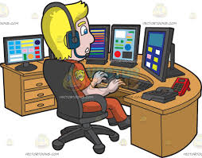
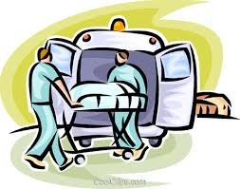
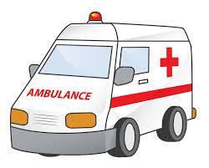
Background: 911 Call
Call arrives into the system and severity of call is estimated
Dispatcher checks the status of the system to determine which vehicle to send to the scene
Vehicle arrives the scene and provides the service
The vehicle returns to a predetermined location to wait for another call
2

Slide 3
Background: 911 Call
The most critical step:
Inefficiencies in the
whole system
Lead to loss of human life
Call arrives into the system and severity of call is estimated
Dispatcher checks the status of the system to determine which vehicle to send to the scene
Vehicle arrives the scene and provides the service
The vehicle returns to a predetermined location to wait for another call
3

Slide 4
Computerized Triage System
Traditionally, the severity of an incoming call is judged by a 911 agent.
FDNY is working on automating this process and currently working on a computerized triage method.
  Developed by medical doctors
  Fully dynamic and automatically guides the 911 agent to diagnose the call.
Two types of ambulances: ALS and BLS
  ALS: for more critical patients and resources are limited.
4

Slide 5
Computerized Triage System: Does it Work?
How does the traditional way of judging severity of a call compare to the computerized triage method in terms of the usage of resources in the system?
Two main changes have been identified:
  It becomes harder for the caller to secure an ALS ambulance
  Agent spends more time with the caller on the phone.
5

Slide 6
My Research
Investigate the impact of the changes in the whole system:
  What is the impact of the change in ALS requirements on response times for critical calls?
  What is the impact of longer talk times on call center staffing and percentage of unanswered calls?
My approach: Develop a computer simulation model of the system
6

