Slide 1
Chadwick Fellowship Update:
Enhancing Data Analysis Skills
Kristin McAuliffe
Director of Retention & Information Management
Boston University Metropolitan College
October 2017

Slide 2
Attended the Storytelling with Data Workshop at BU’s College of Communication, June 2017
Obtained Digital Badge in Data Storytelling, connected with faculty director of data journalism program to consult on future workshops
Enhanced data gathering and reporting capabilities using tools from the workshop (R, Tabula, etc.)
Developing presentation for future conference opportunities

Slide 3
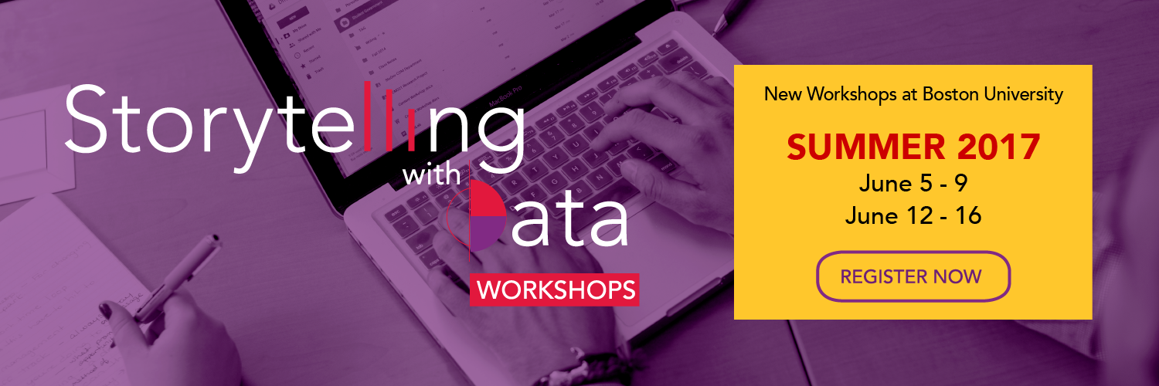
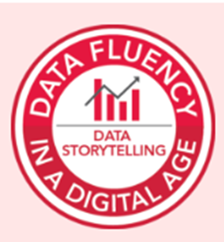
How Forbes defined it in 2015:
“Data storytelling is the process of translating data analyses into layman's terms in order to influence a business decision or action. With the rise of digital business and data-driven decision making, data storytelling has become a much-talked-about skill often associated with the data science and analytics community.”

Slide 4
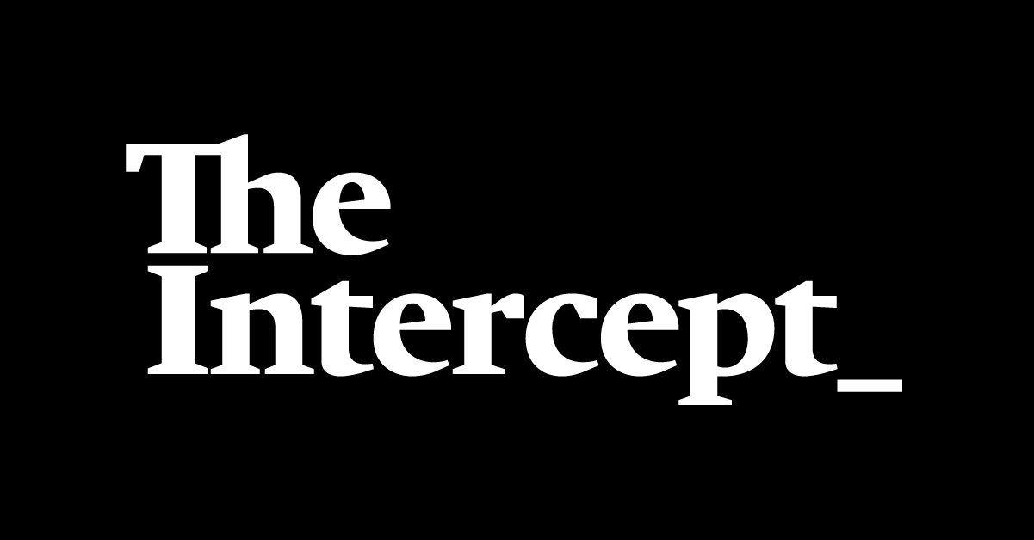
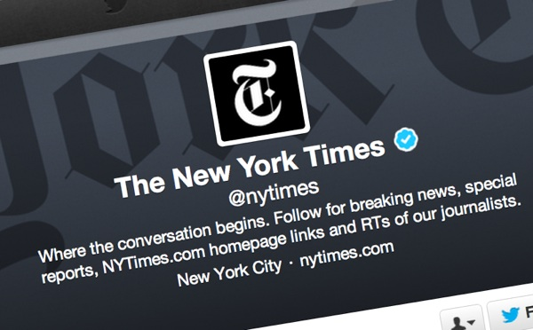


New ways to GET data
Mining from library of research links
Mining Social Media
Extract from PDFs
Clean “messy” data

Slide 5
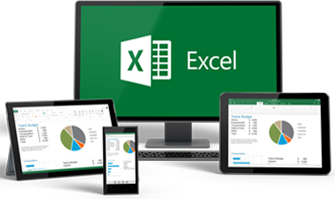
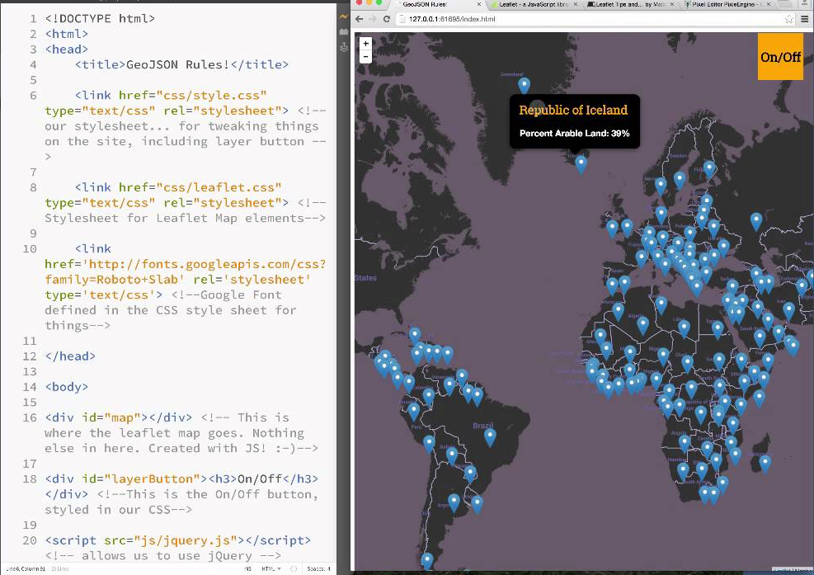
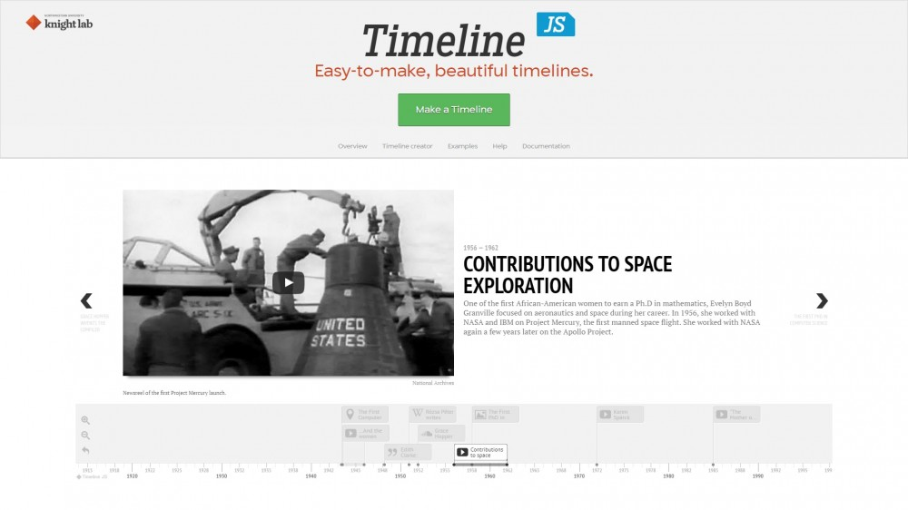

Tools for sharing data

Slide 6
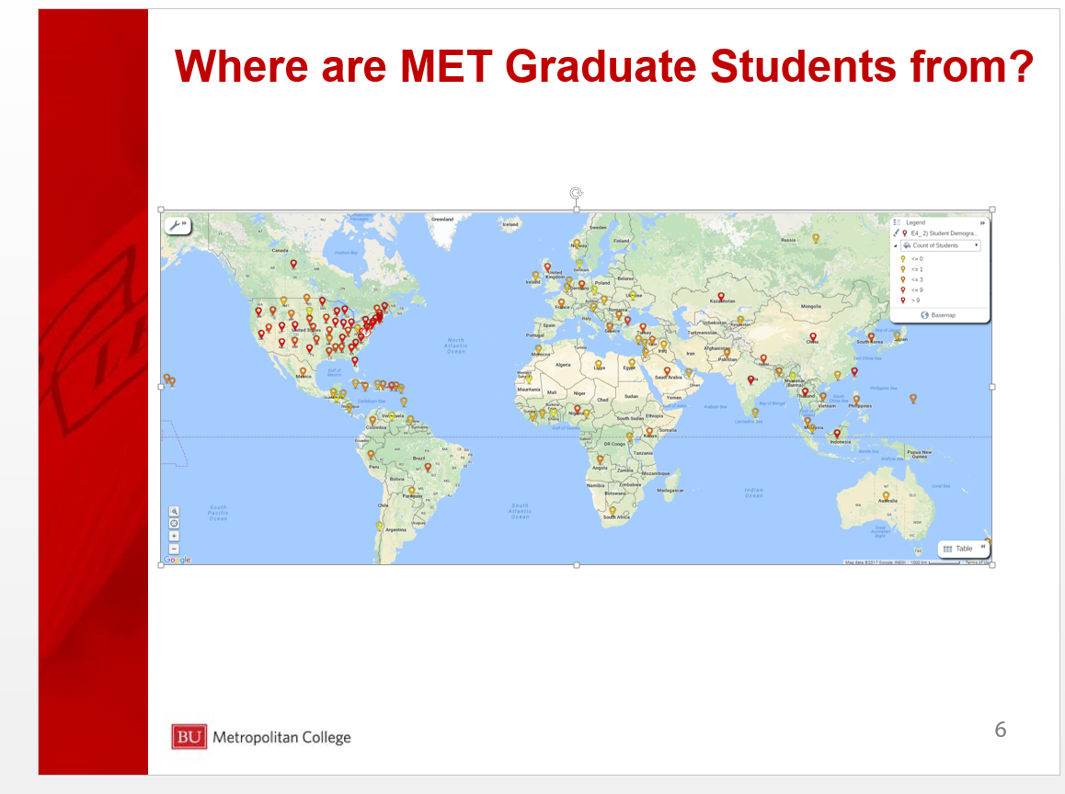
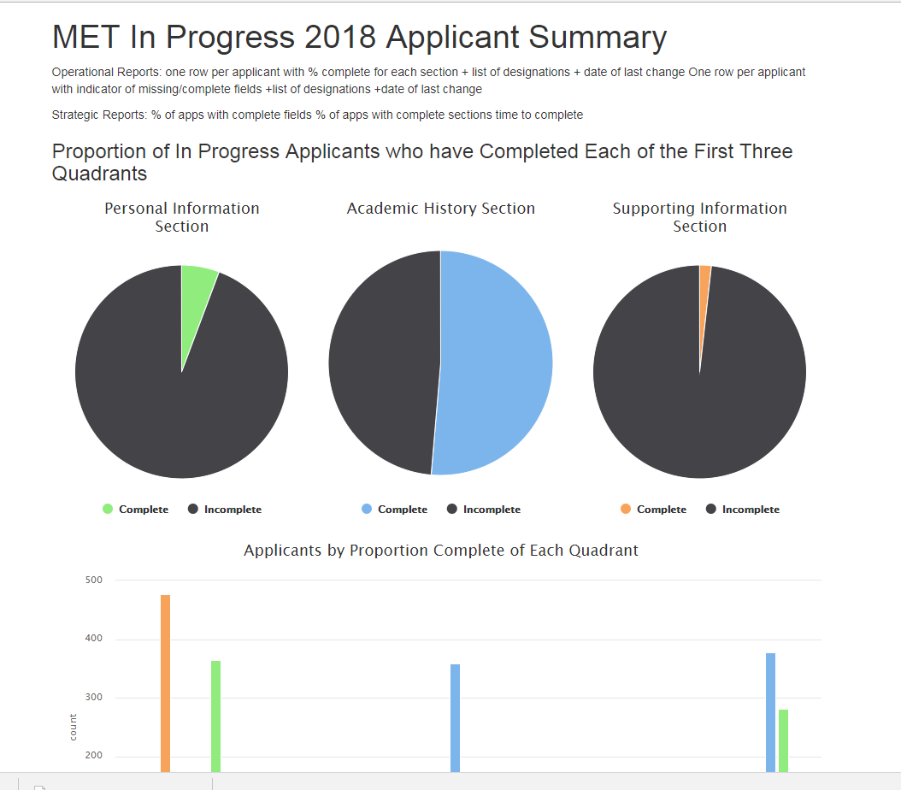
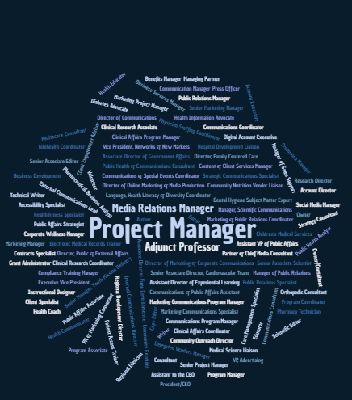
What’s Next?
Easier ways to collect information from social media on outcomes
Health Communication Graduates’ Job Titles
Better visualization of information for Open House Presentations
Utilizing new reporting tools to find information we need about applications

