Slide 1

Mindfulness and Resilience: Examination of a trauma informed integrative mindfulness program as implemented in Haiti
Danielle Rousseau , PhD LMHC
Boston University

Slide 2



Women and trauma- Haiti
Earthquake January 12, 2010
230,000 killed
300,000 injured
2 million homeless
Sexual and other forms of gender-based violence widespread before earthquake
Earthquake shattered few protections that existed
Temporary settlement camps increased risk of violence against women and children
Perpetrators often members of youth gangs
Constant threat of sexual violence
Few resources for managing traumatic stress
Aftershocks: Women Speak Out Against Sexual Violence in Haiti’s Camps. Amnesty International, 2011.

Slide 3
TIMBo Program
TIMBo = Trauma Informed Mind Body Program
Structured 16 session curriculum
Gender responsive, trauma informed
Addressees the ways in which mind body practices allow for long term traumatic recovery
The current work presents a case study exploring the translation, adaptation and implementation of the TIMBo Program in Port-au-Prince, Haiti

Slide 4
timbO OBJECTIVES
1. The first and most concrete objective of this program is to give women simple, effective and accessible tools to utilize as active coping strategies for self-regulation. These tools can be used anywhere, anytime and take just minutes to utilize.
2. The second objective is to help women gain awareness of their bodies and their body sensations. Emotional traumatic memory becomes lodged in the body and is triggered in an endless feedback loop that becomes chronic and debilitating in many.
3. The third and long-term objective is to help women renegotiate their self-belief through awareness of their inner experience, and begin the process of transformation.

Slide 5
Formative Implementation Study Findings
Gained insight into the intricacies of translating the TIMBo program for the Haitian population.
Overall, the training and programming were well received by Haitian participants.
Based on qualitative data, it appears that the mind-body practices had a demonstrable impact on the Haitian community leaders who participated in the facilitation training.
Findings suggest receptiveness of participants to the practice of yoga as well as willingness to share yoga with others.
Further evidence suggests that participation in programming may ameliorate the impact of traumatic stress and encourage alternative strategies for emotion regulation.

Slide 6
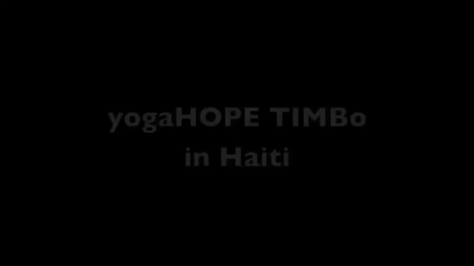
TIMBO Haiti

