Slide 1



Notes:
Intro slide image of glass:
Through the looking glass…..darkly

Slide 2
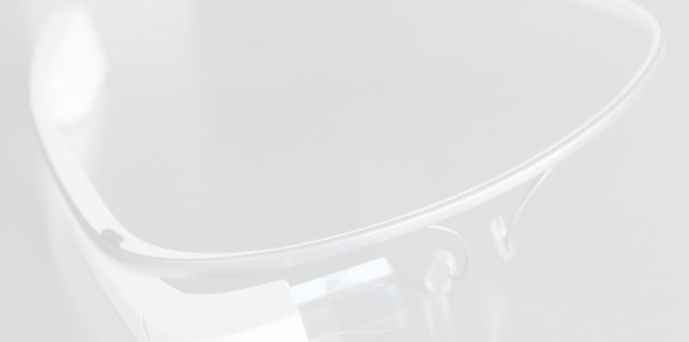
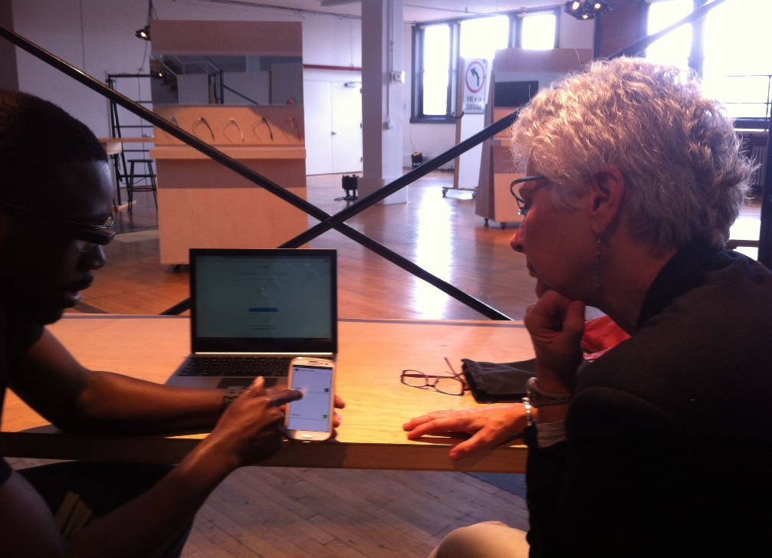
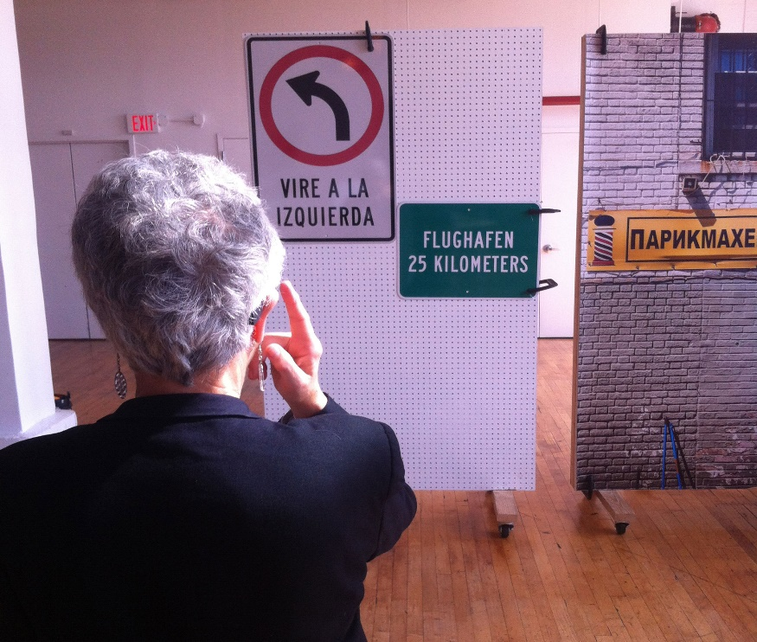
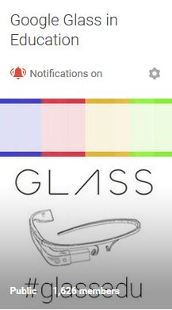
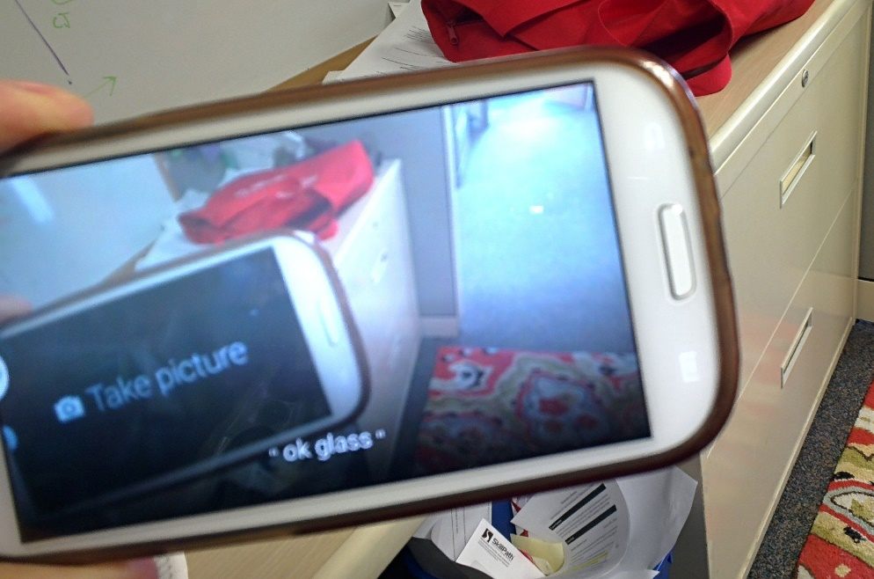

Google Glass for BU Distance Education?

Slide 3
Through the Google Glass Findings
Too cumbersome/does not scale
$$$$$$$
Google Glass, no
Smart glass technology, yes?
Chadwick Fellowship 2015
Elena Garofoli, Senior Instructional Designer
Office of Distance Education

