Slide 1
Building a food studies center at Met college
Megan Elias and Potter Palmer

Slide 2
Brief History of Food Studies at Met
1988 First Programs in Food and Wine Courses offered
1991 First Gastronomy Courses offered – 2 programs under common leadership
2012 Gastronomy Program added to Department of Applied Social Sciences at Met, Programs in Food and Wine remained separate
2017 proposal initiated to rejoin programs in the BU Center for Food Studies

Slide 3
Why form a center?
Pool resources and planning of two dynamic programs focused on food
Foreground the strength of food studies at BU: integration of hands-on and academic approaches to food.
Create a center for scholarship and programming

Slide 4
Existing Models for Food Studies Centers
University of Toronto, Scarborough: The Culinaria Research Centre is a multidisciplinary initiative that blends research excellence with community engagement and student research experience.
Chatham University, Pittsburgh PA: The Center for Regional Agriculture, Food, and Transformation (CRAFT) works to transform the future of food and agriculture in Western Pennsylvania and beyond.

Slide 5
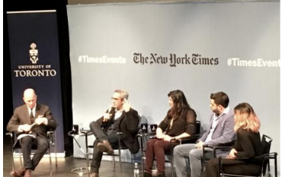
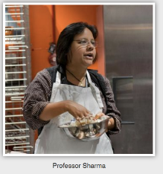
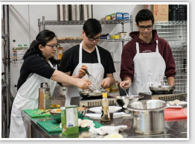
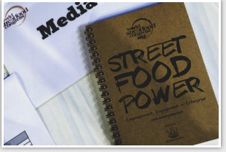
Events at the Culinaria Center
https://www.utsc.utoronto.ca/culinaria/past-events
A Toronto Tasting with the New York Times
Recipes for Historians
World Street Food Congress

Slide 6
Visiting the Culinaria Centre
Interview directors about mission and administration of Centre
Interview faculty about integrating curriculum and Centre events
Interview students about Centre as resource
Write report on findings and what can be applied to development of Center for Food Studies at BU.

Slide 7
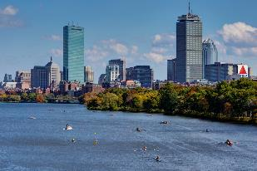

Food Center Connections

Slide 8

Spring 2019

