Slide 1

The Faculty & Staff Assistance Office
BU’s Employee Assistance Program
Offers confidential counseling, consultation and referrals for work-related or personal concerns
  With experienced, licensed behavioral health providers
  At no cost for Boston University faculty, staff and their immediate family members
www.bu.edu/fsao 617-353-5381

Slide 2
Common Concerns
Stress/anxiety
Transitions
Depression
Relationships
Family issues
  Parenting
  Eldercare
Substance use/addiction
Loss/grief
Concern about colleague
Harassment
Abuse/trauma
Finding a therapist
Well-being/self-care
www.bu.edu/fsao 617-353-5381

Slide 3
Counseling/Consultation Session
  Available via zoom, telephone or in person on the Charles River and Medical Campuses
  Assessment, support, problem solving
  Action plan may include:
    Short-term counseling at FSAO
    Referrals for assistance and treatment
  Interpreter services available
www.bu.edu/fsao 617-353-5381

Slide 4
Referrals
  To campus and community resources
  To local behavioral health providers with consideration of health insurance coverage, therapist’s style and areas of expertise, and employee’s therapist identity preferences
www.bu.edu/fsao 617-353-5381

Slide 5

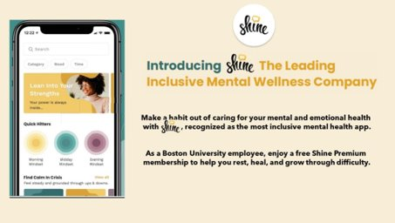
Learn more on the FSAO website
Digital Tools to
Support Well-Being
Free for BU employees
  Shine App
  Inclusive tools & resources to cultivate resilience and prioritize self-care
Headspace App
Meditation and mindfulness instruction and practice
Also available in Portuguese, Spanish, French and German
www.bu.edu/fsao 617-353-5381

Slide 6


Anonymous Mental Health
Self-Assessments
Disponibles en español
Learn to Live
Online CBT-based resource for mental health with optional coaching
Learn more on the FSAO website
www.bu.edu/fsao 617-353-5381
Notes:
Self-assessments and L2L, available in Spanish
L2L – CBT modules, coaching, live and recorded webinars

Slide 7
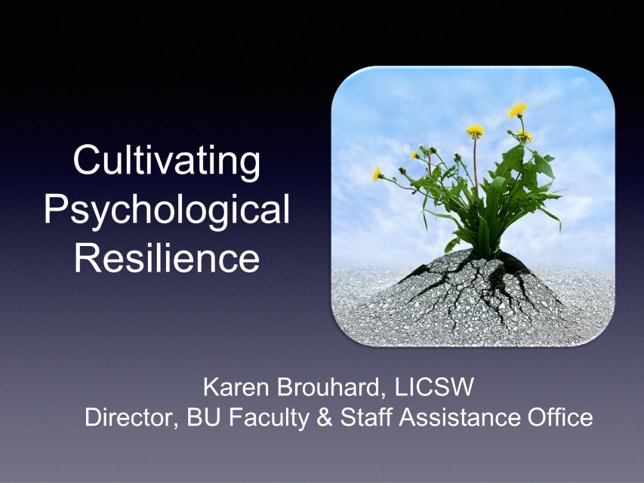


Additional Resources
Archive of FSAO presentations including:
Skills for Coping with Change and Uncertainty
Strategies for Sleep
CBT Skills for the Workplace
Resource pages:
Self-Care Tips
BIPOC Mental Health
LGBTQIA Mental Health
Twitter Feed @BUFSAO
www.bu.edu/fsao 617-353-5381

Slide 8



Charles River Campus
888 Commonwealth Ave
Suite 309
Medical Campus
Solomon Carter Fuller
85 E. Newton Street
M-818
Contact Us:
fsao@bu.edu (617) 353-5381
www.bu.edu/fsao @BUFSAO
Appointments available in person, via HIPAA compliant Zoom platform or by phone.

