Slide 1
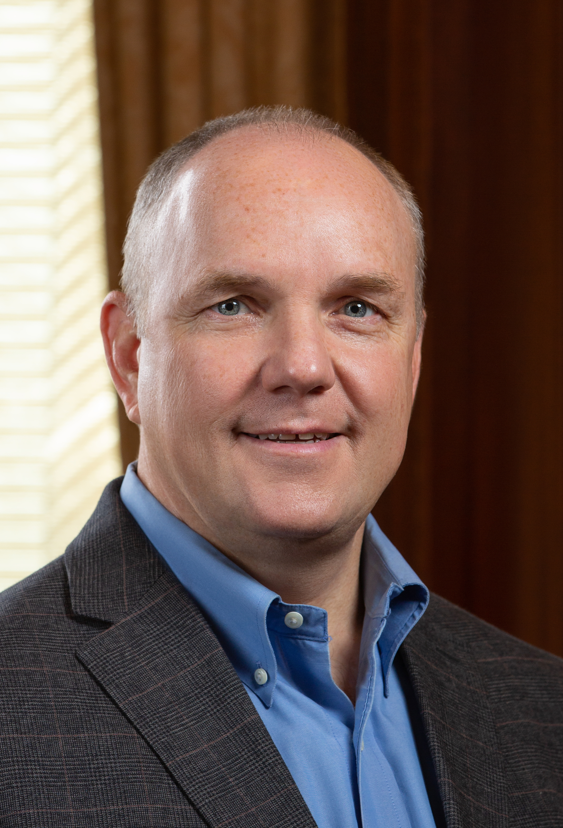
Technology Development | bu.edu/otd
We help bring your ideas and discoveries to market.
Primary Services:
Intellectual Property Protection (e.g., patents)
Licensing Agreements and Royalty Collection/Distribution
Support Agreements (outgoing MTAs, CDAs)
Educational Programs on Commercialization and Start-up Company Formation
Ignition Award Program
Supporting Services:
IP Terms in Sponsored Research Agreements
Lecture in Classes/Lab Groups on Intellectual Property
Stewards of the Intellectual Property Policies
General support on all IP related matters
Michael J. Pratt, MBA
Managing Director,
Technology Development
mpratt@bu.edu
617-353-4569

Slide 2
How to Get Started
Faculty service is our focus.
Personal Consultation:
Contact the OTD representative that best matches your research (see list below)
Other Contact Options:
Web Form (bu.edu/otd)
Technology Disclosure Form (bu.edu/otd)
Function | Name | e-mail | Phone
Managing Director | Michael Prat, MBA | mpratt@bu.edu | (617)-353-4569
Life Sciences (MED, Chem, Bio) | Tom McMurry, Ph.D. | tmcmurry@bu.edu | (617) 358-4550
Life Sciences (MED, Chem, Bio) | Nevena Dimova, Ph.D. | ndimova@bu.edu | (617) 358-6911
Medical Technologies (ENG, BME) | Frances Forrester, Ph.D. | fmf@bu.edu | 617-358-6911
Physical Sciences (ENG, Physics, Comp. Sci, Software) | Misty Farrell, MSME | mfpenn@bu.edu | (617) 358-3795
Faculty Entrepreneurship | Rana Gupta, MBA, MS | rkgupta@bu.edu | (617) 353-0606

Slide 3
Organization Chart
Michael Pratt, MBA
Managing Director
Ken Zwicker, Ph.D., J.D.
Executive Director IPL
Cindy Cabral
Director Finance
Frances Forrester, Ph.D.
BD Med Tech
Thomas McMurry Ph.D.
BD Life Sciences
Nevena Dimova Ph.D.
BD Life Sciences
Misty Farrell, MSEM
BD Physical Sciences
Rana Gupta MBA, MS
Director, Faculty Entrepreneurship
Elizabeth Carlson, J.D.
Licensing Director
John Turi, J.D.
Licensing Director
Janine Anderson
Director, IPL
Joseph Lee
IPL Specialist
Austin Spencer
Financial Admin

Slide 4


Connect with us
 | otd@bu.edu
 | Michael Pratt: mpratt@bu.edu
 | bu.edu/otd

