Slide 1
Supporting faculty mentors, postdocs and PhD students
Sarah Chobot Hokanson, PhD
Assistant Vice President and Assistant Provost
Research Development and PhD & Postdoctoral Affairs

Slide 2
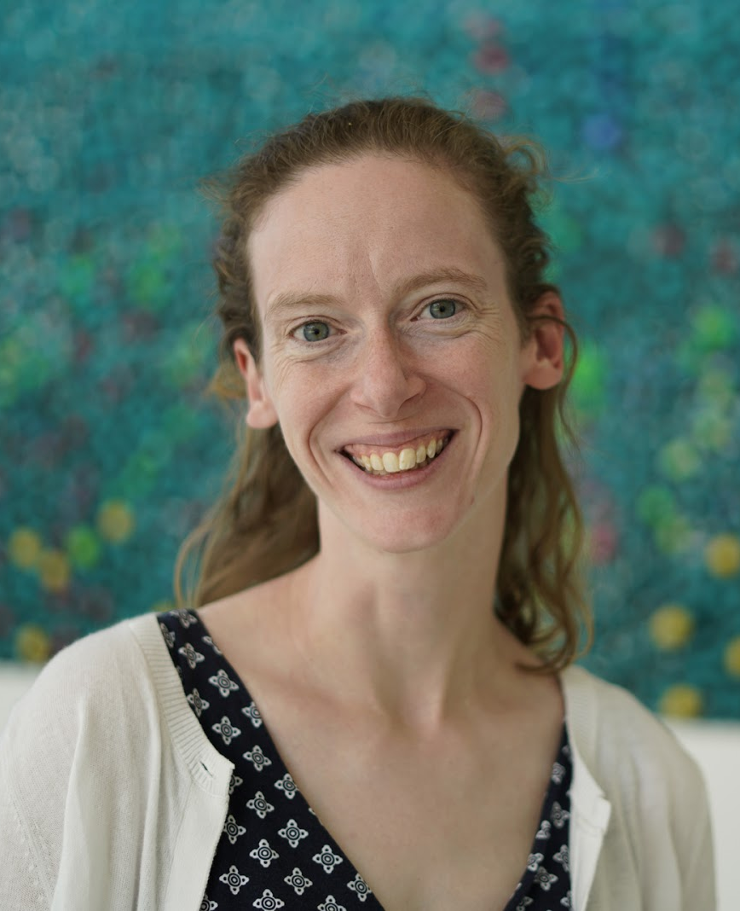
Research Development and PhD & Postdoctoral Affairs bu.edu/postdocs; bu.edu/grad; bu.edu/research support
We provide services and resources for postdocs, doctoral students, faculty mentors and departments.
Research development: Support our faculty to be competitive for research awards and scholarly recognition
Professional development: Skill building and fulfilling core competencies at each stage from PhD student to postdoc to faculty mentor
Student and postdoctoral affairs: Create policies, guidelines, and initiatives that support equitable and competitive training environments
Data: Support data-driven decision making, postdoctoral tracking, and research metrics
Grant-funded programs: Build national reputation and create impact at scale
Sarah Hokanson, PhD
Assistant Vice President and Assistant Provost
sch1@bu.edu
617-358-2111

Slide 3
Research Development
Supporting faculty research, scholarship, and mentorship

Slide 4
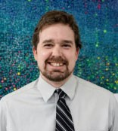
Research Development bu.edu/researchsupport
We support faculty research and scholarship:
Finding funding: help you find the funding opportunities relevant to your expertise; oversee limited submission process
Tools and templates: create a data pipeline to support large-scale grants; develop template language for proposal materials and letters of support; checklists for grant submissions
Consultations: develop proposal ideas and execute funded work
Professional development: grant writing workshops, research mentor training, project and people management
Fostering collaborations: find partners externally and internally to support your research ideas
Joe Farmer
Data Analyst and Program Manager
jpfarmer@bu.edu

Slide 5
Postdoctoral Affairs
Supporting the postdoc training experience at BU and advancing postdocs towards their next career steps

Slide 6
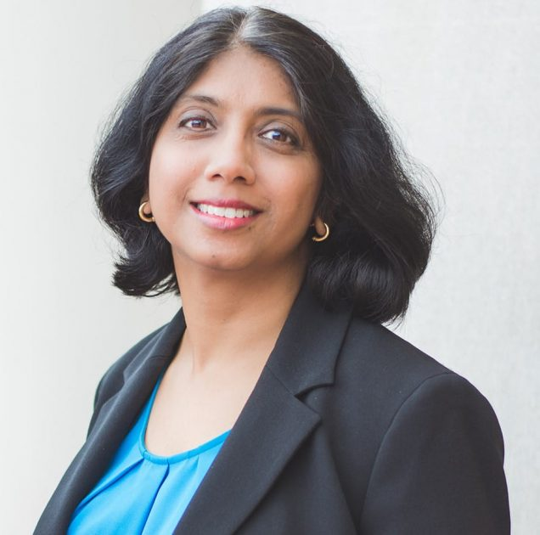
Postdoctoral Affairs bu.edu/postdocs
We support all aspects of the postdoctoral experience at BU
Professional Development: Build skills for postdocs through in-person workshops and online courses (Postdoc Academy)
Community: Partner with our postdoc association to help postdocs connect to colleagues across our campuses
Advising: Work with postdocs during postdoc orientation and through one-on-one appointments
Data: Manage information about our postdocs, collect research data
Grant-funded programs: Build national reputation and create impact at scale
Policy: Support equitable and competitive training environments
Pallavi Eswara
Director
eswara@bu.edu

Slide 7
PhD Student Affairs
Supporting the PhD student experience

Slide 8
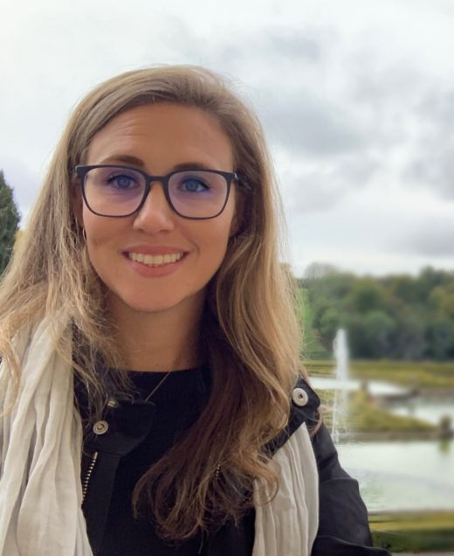
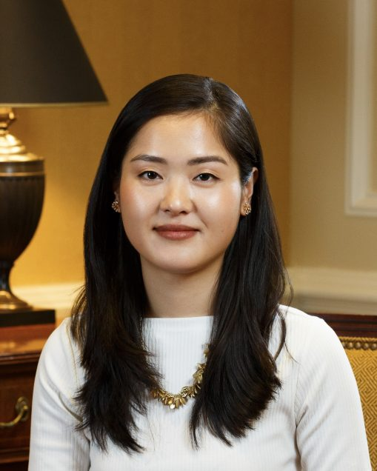
PhD Student Affairs bu.edu/grad
We support the PhD experience at BU
Professional Development: Build skills for PhD students through in-person workshops and micro-credentialling (PhD Progression)
Community: Partner with student organizations and our advisory board to connect students across our schools/colleges
Advising: Work with students during monthly office hours
Data: Collect program evaluation data
Fellowships: Fund diverse leaders on campus and advance their scholarship
Policy: Support equitable and competitive training environments
Sasha Goldman, PhD
Assistant Director
sbgold@bu.edu
Emma Zheng
Assistant Director
yzheng93@bu.edu

Slide 9


Learn more and connect with us
 | postdocs@bu.edu; gradpd@bu.edu; rcr@bu.edu
 | Sarah Hokanson: sch1@bu.edu
 | bu.edu/pdpa bu.edu/researchsupport bu.edu/grad bu.edu/vitaminphd postdocacademy.org inclusivestemteaching.org

