Slide 1

Boston University
New Faculty Orientation 2023

Slide 2
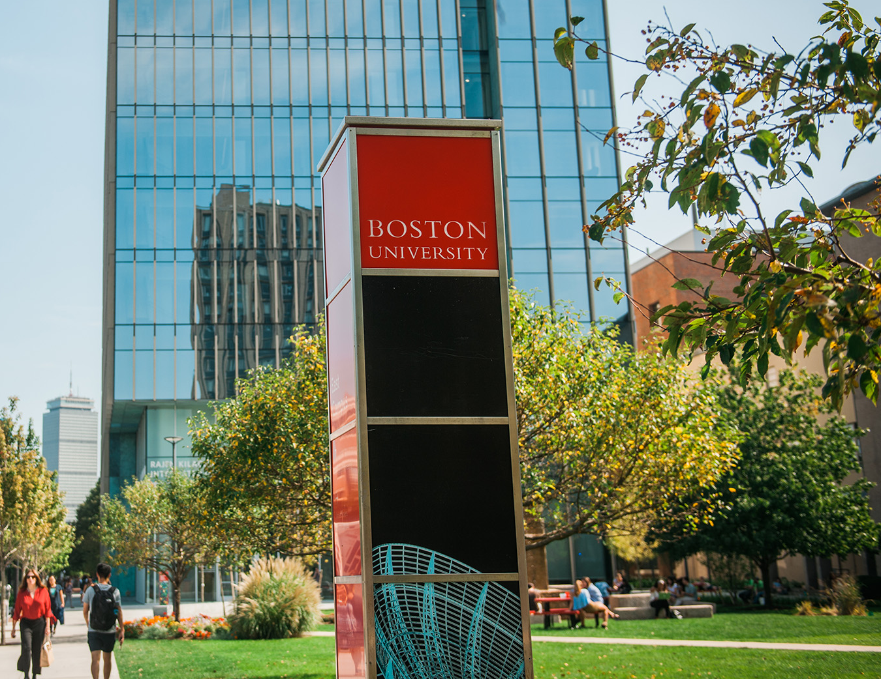
BU’s 2030 Strategic Plan
Announced in 2020, BU’s 2030 Strategic Plan identifies five priorities that will guide BU over a 10-year period:
A Vibrant Academic Experience
Research That Matters
Diversity, Equity, and Inclusion
Community, Big Yet Small
Global Engagement
bu.edu/plan2020

Slide 3
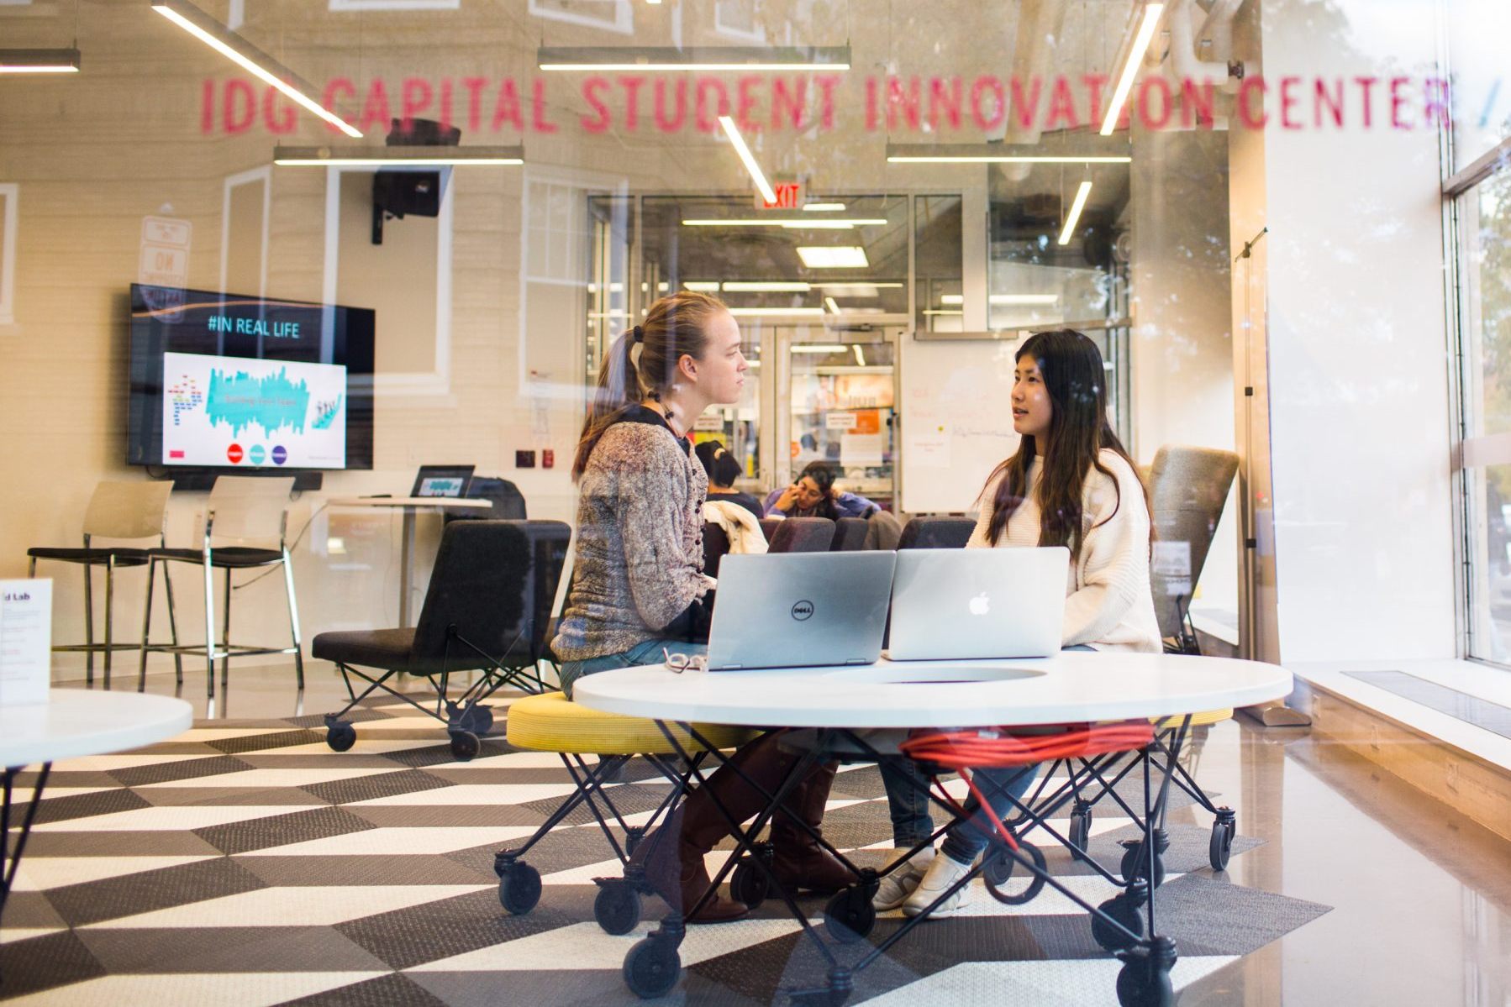
Vibrant Academic Experience
BU Hub
The BU Hub, our University-wide general education program, offers interdisciplinary and experiential opportunities for students to engage with topics of global significance. The Hub is a signature component of our undergraduate education, combining professional programs with a grounding in liberal arts and experiential learning.

Slide 4
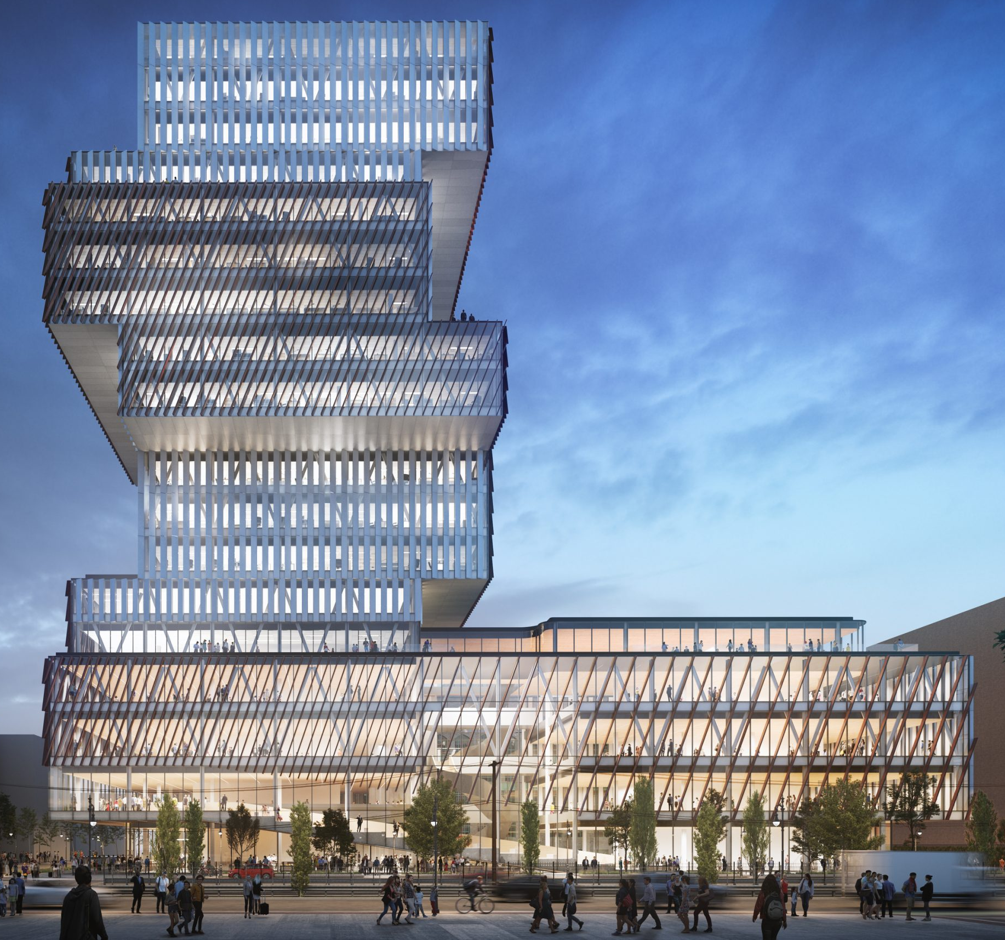
Vibrant Academic Experience
The Faculty of Computing & Data Sciences
CDS is a novel University-wide academic unit comprising scholars of computing and data sciences who will distinguish BU for its curricular and research excellence. Students can engage with CDS faculty throughout their BU experience in diverse ways, from developing fundamental computing and data science skills to taking part in interdisciplinary experiences to earning a certificate, minor, or dual degree in areas of national demand.

Slide 5

Research That Matters
Center for Antiracist Research
Founded and directed by Ibram X. Kendi, a leading scholar and author on antiracism, the center brings together researchers and practitioners with diverse specialties to figure out new and practical ways to understand, explain, and solve seemingly intractable problems of racial inequity and injustice.
Ibram X. Kendi, founding director of BU’s Center for Antiracist Research

Slide 6
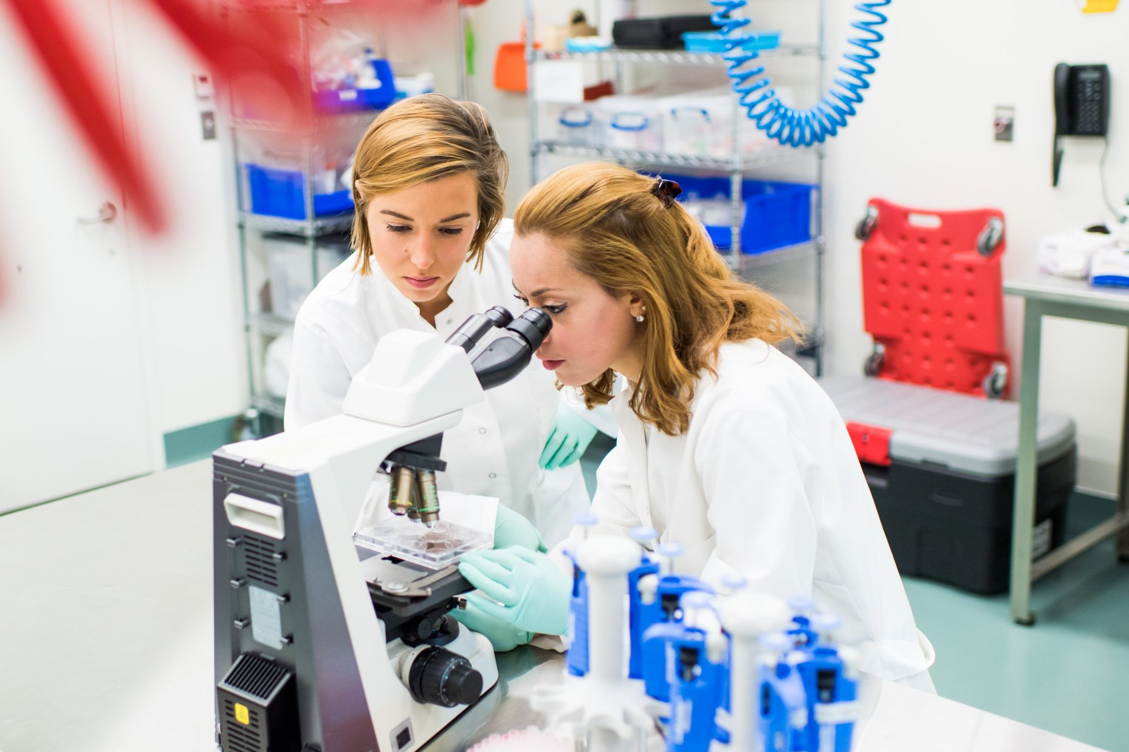
Research That Matters
NEIDL’s Open Collaboration
BU hosts the National Emerging Infectious Diseases Laboratories (NEIDL), a leading academic research center on world-threatening emerging infectious diseases.
BU is committed to realizing NEIDL’s potential through the fully developed infrastructure, diverse research thrusts, and open collaboration models necessary to make the laboratory a highly sought-after partner in this competitive and impactful field.

Slide 7
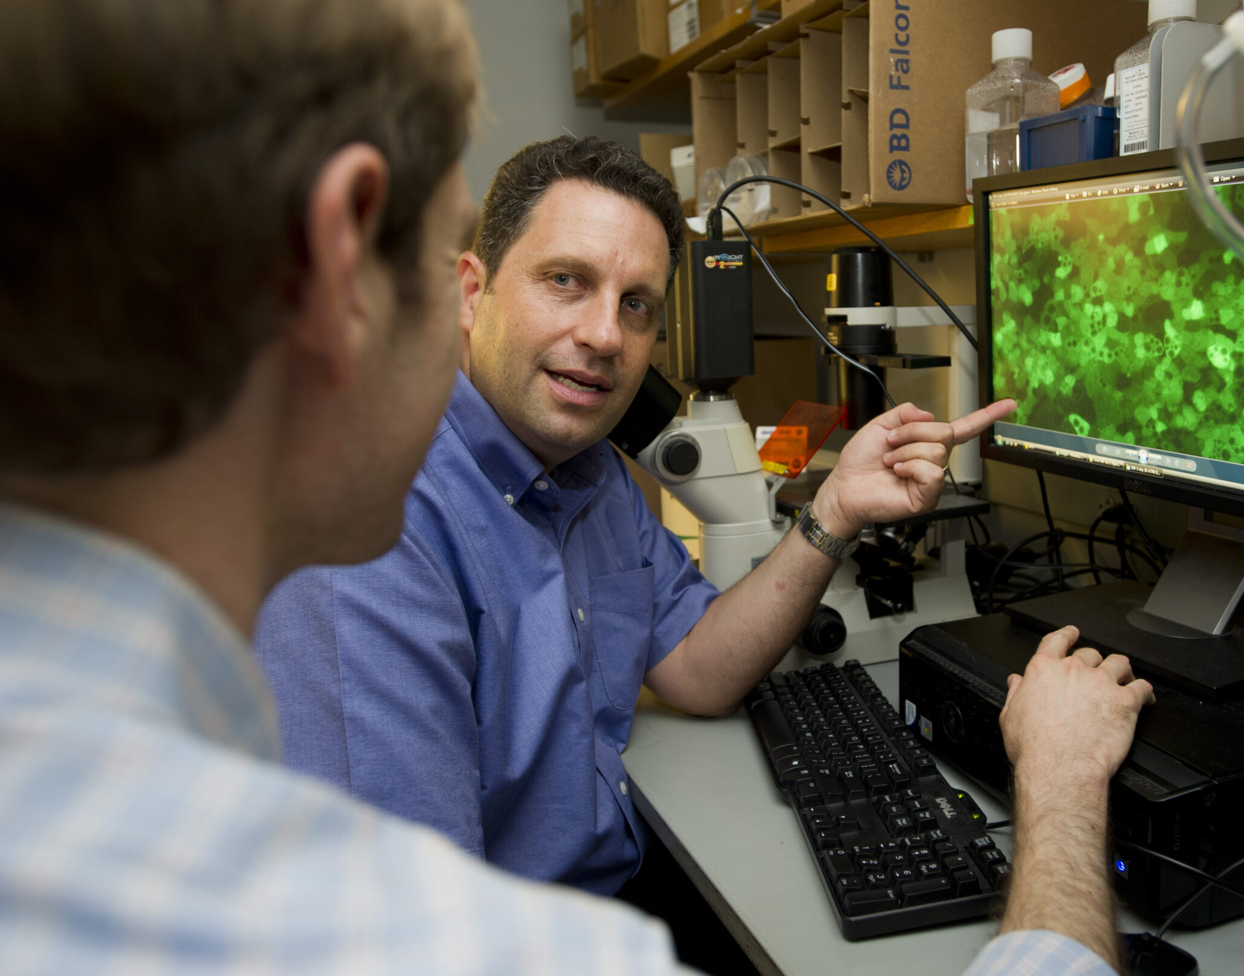
Research That Matters
Cross-Campus Joint Hiring and Partnerships
Through targeted joint hires, BU is creating a faculty whose teaching and research bridge the Medical and Charles River Campuses. This facilitates collaboration between campuses, provides a vibrant academic experience to all students by expanding opportunity, and draws the BU community closer together as a whole.

Slide 8
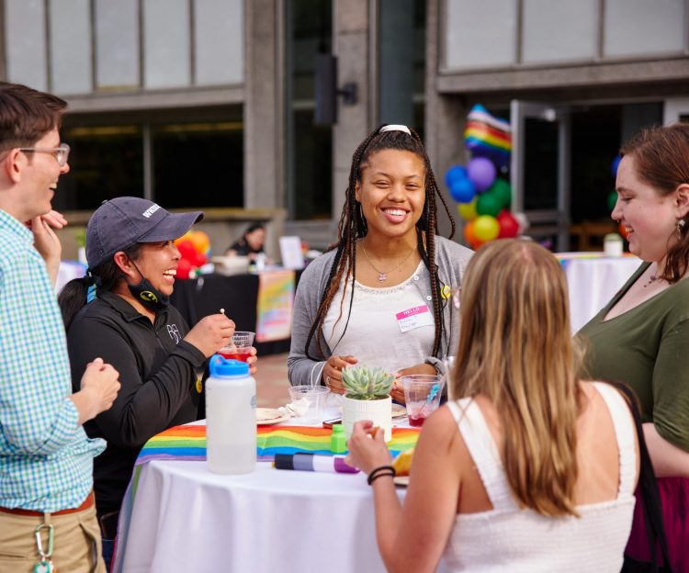
Diversity, Equity, and Inclusion
LGBTQIA+ Center for Faculty and Staff
The LGBTQIA+ Center for Faculty & Staff engages the BU community to foster a sense of belonging and connectedness for LGBTQIA+ faculty and staff; increase the visibility of LGBTQIA+ resources, research, and scholarship; celebrate the contributions of the diverse LGBTQIA+ community at BU; and improve recruitment and retention of LGBTQIA+ faculty and staff in the development of an inclusive and equitable workplace.

Slide 9
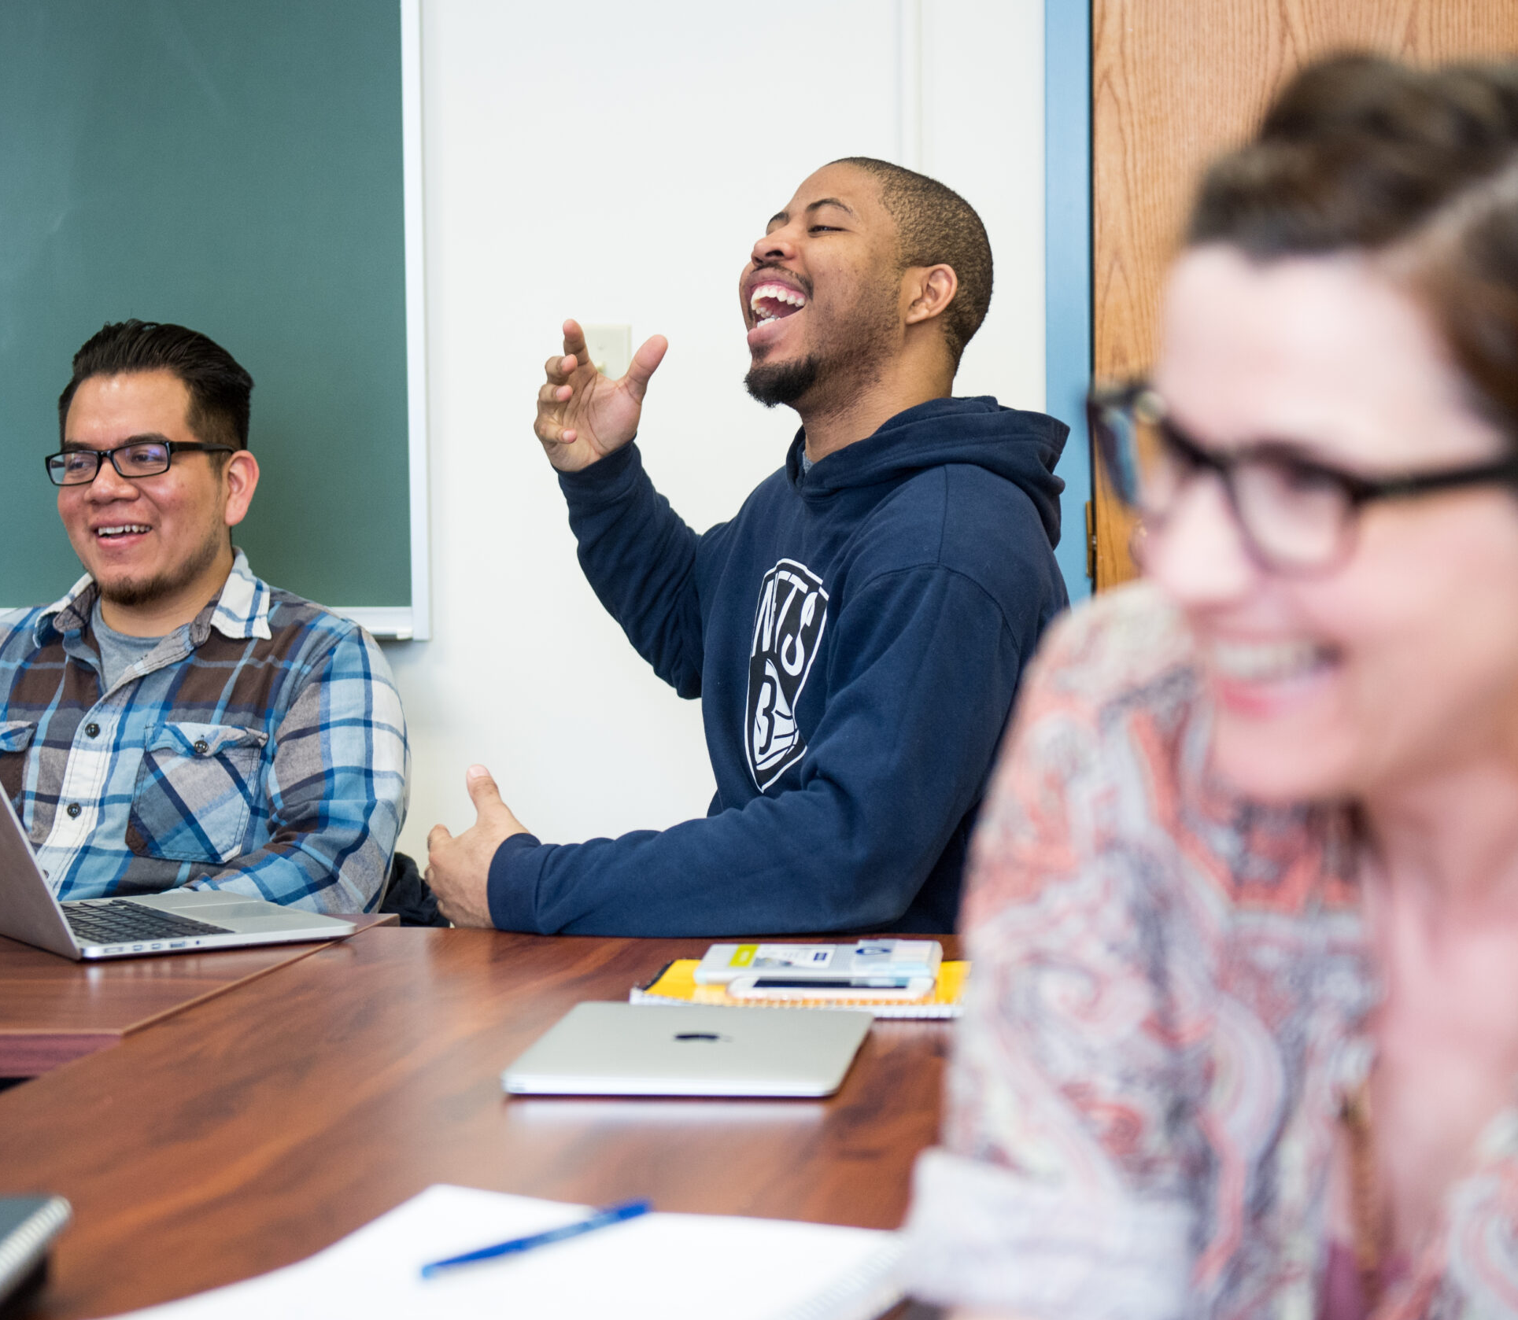
Diversity, Equity, and Inclusion affordableBU
In fall 2020, Boston University acted on a commitment to meet 100% of demonstrated financial need for all domestic, first-time, first-year undergraduates by expanding aid packages—work-study programs, scholarships, grants, and student loans.
What’s more, affordableBU guarantees that need-based scholarships won’t decrease during a student’s four-year college career, and will even grow to match incremental increases in tuition.

Slide 10
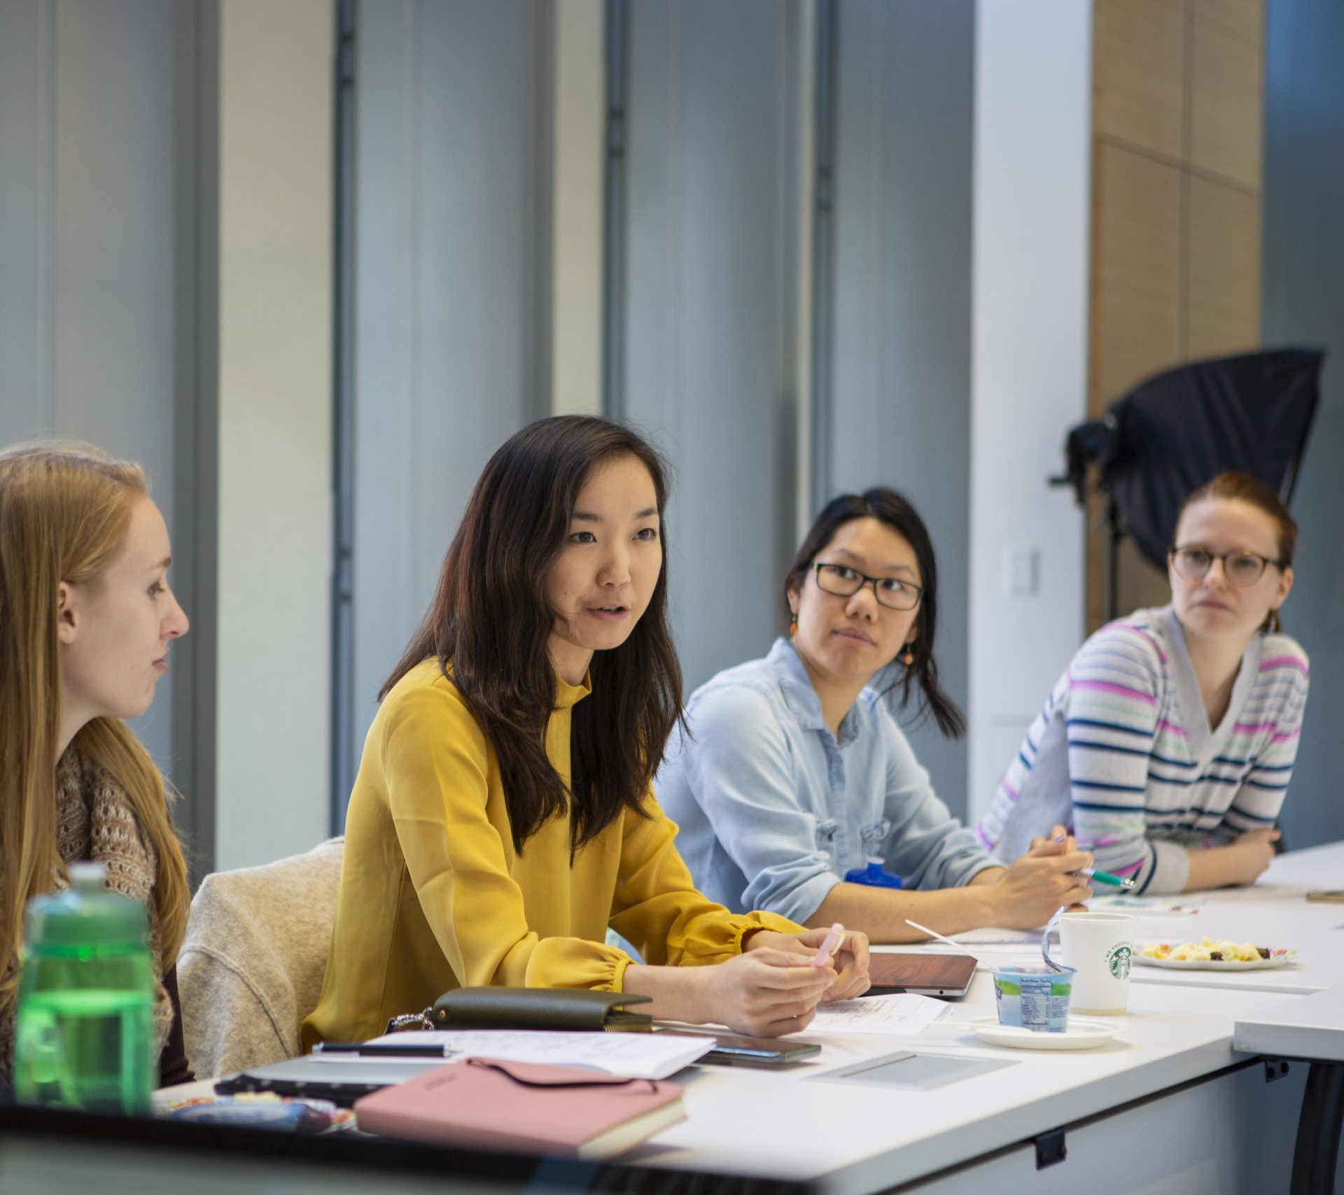
Diversity, Equity, and Inclusion
Inclusive Pedagogy
At BU, we provide students from all backgrounds the most effective learning tools available. That’s why we’re augmenting our teaching techniques to account for the diverse strengths and perspectives of our students, so they can excel.

Slide 11
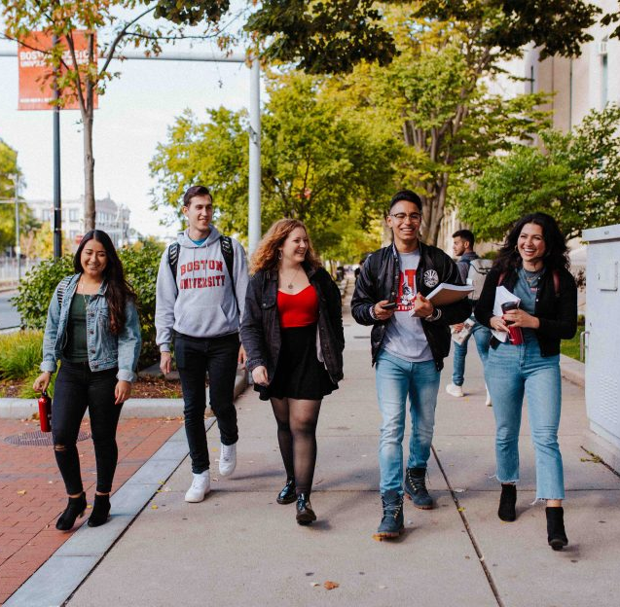
Community, Big Yet Small
The Newbury Center
The Newbury Center supports first-generation college students, acclimating them to life on campus before they arrive, building networks with families and support providers to help them here at BU, and connecting them with guidance and mentors as they prepare to launch careers.

Slide 12
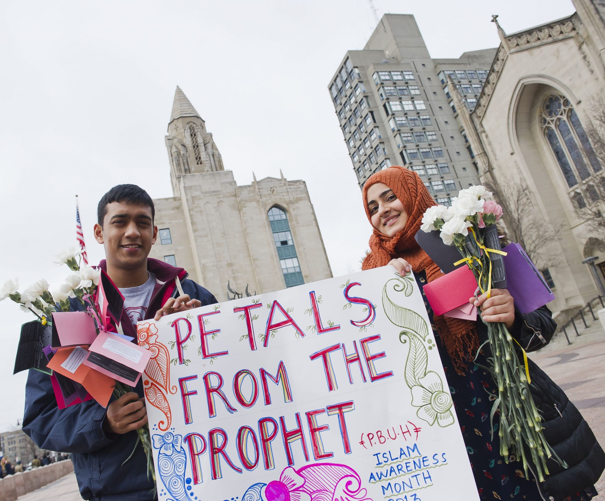
Community, Big Yet Small
Intersectional Identity Initiative
At Boston University we value the whole individual—the nuances, the facets, the layered perspectives that give each community member their sense of self.
We are developing plans for an Intersectional Identity Initiative, which would provide services on campus, in support of students as they face challenges—personal, academic, or social—arising from aspects of their identity.

Slide 13
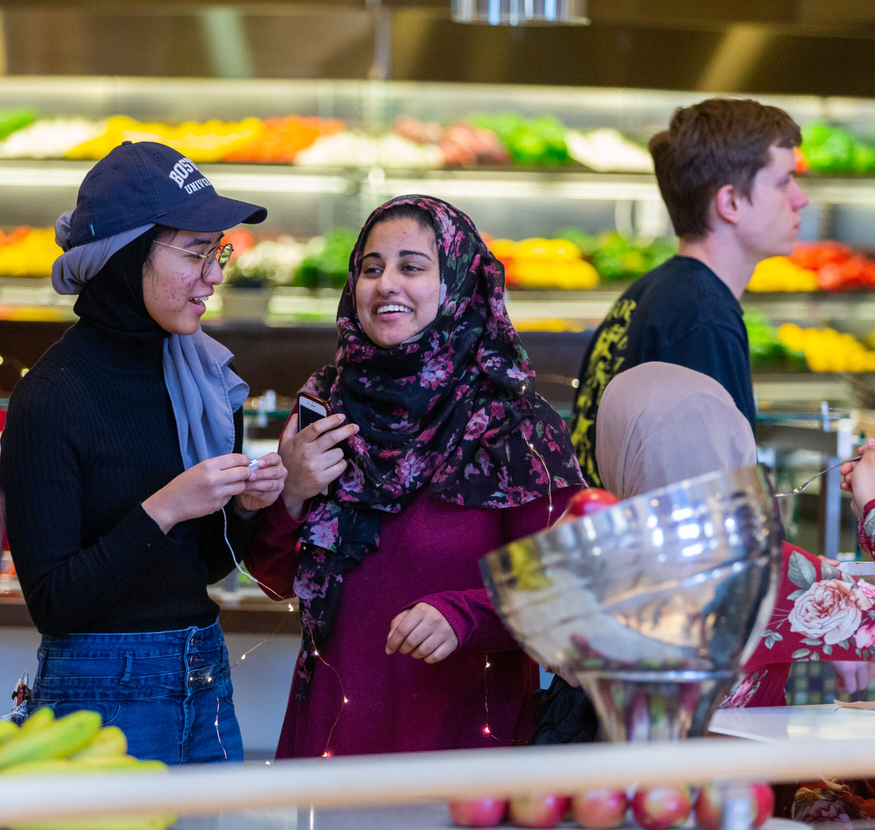
Global Engagement
Build on Our Strengths
BU is already a leader in global engagement, with a deserved reputation as a world-class research university that welcomes gifted students from every corner of the earth. Our Boston campuses are home to a diverse population, with about one-third of students joining us from outside the United States.

Slide 14
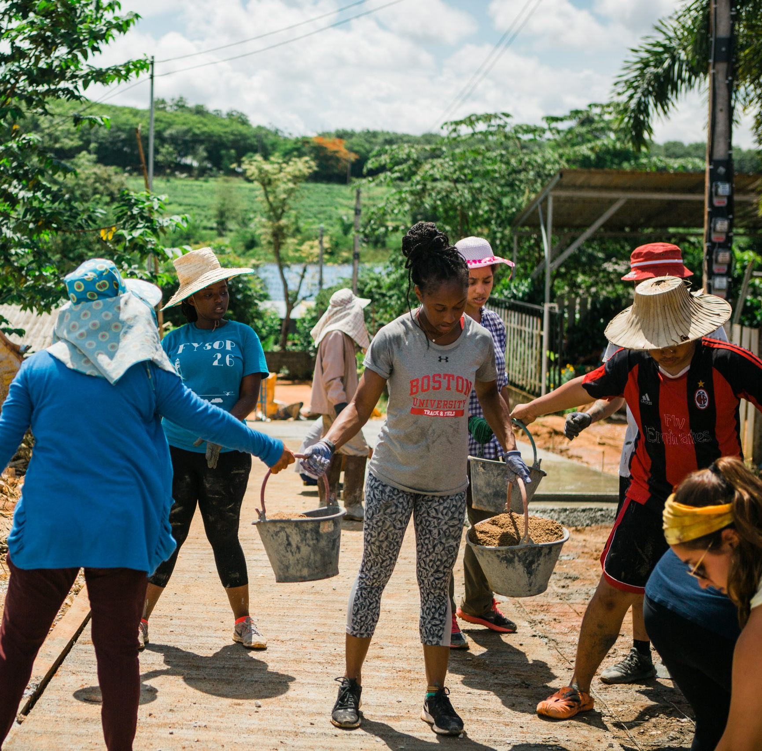
Global Engagement
Multipurpose Global Hubs
We are exploring the development of a small number of multipurpose “hubs”—global locations where we can co-locate services and engagement opportunities for students, faculty, alumni, and prospective students. A hub could host a range of activities—study abroad classes, meetings between research faculty and local partners, alumni networking events, and prospective student information sessions

Slide 15

Resources for Faculty
Office of the Ombuds
The BU Office of the Ombuds is a confidential, independent, and impartial office where any member of the BU Community may seek assistance addressing concerns related to life,
work, or study at BU.
That assistance may be as simple as locating the right resource at BU. More often, however, ombuds assist with highly sensitive individual conflicts and complex systemic issues for which there are no ready-made solutions.
bu.edu/ombuds/

Slide 16
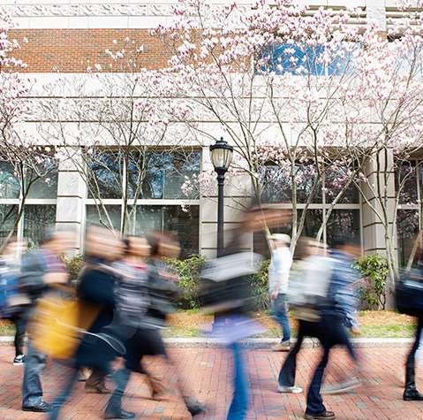
Resources for Faculty
Faculty & Staff Assistance Office
The Faculty and Staff Assistance Office (FSAO) is a resource where you and your immediate family members can find help. Our licensed behavioral health providers offer free and confidential consultation, short-term counseling, and referrals to community resources for a wide range of personal and work-related challenges. We also offer resources and programs to promote personal resilience and well-being.
bu.edu/fsao

Slide 17
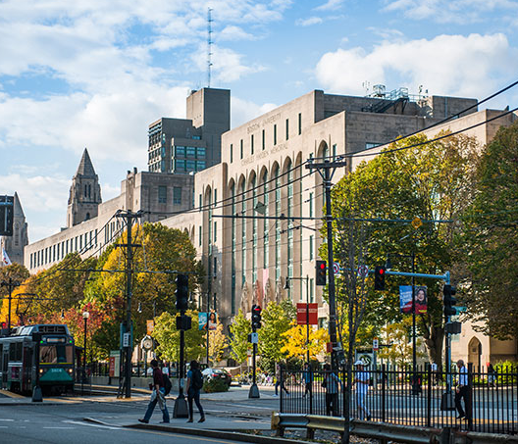
Resources for Faculty
Faculty Handbook
The Faculty Handbook is a collection of policies that apply specifically to faculty members, related to their unique role(s) in the University.
bu.edu/handbook

Slide 18
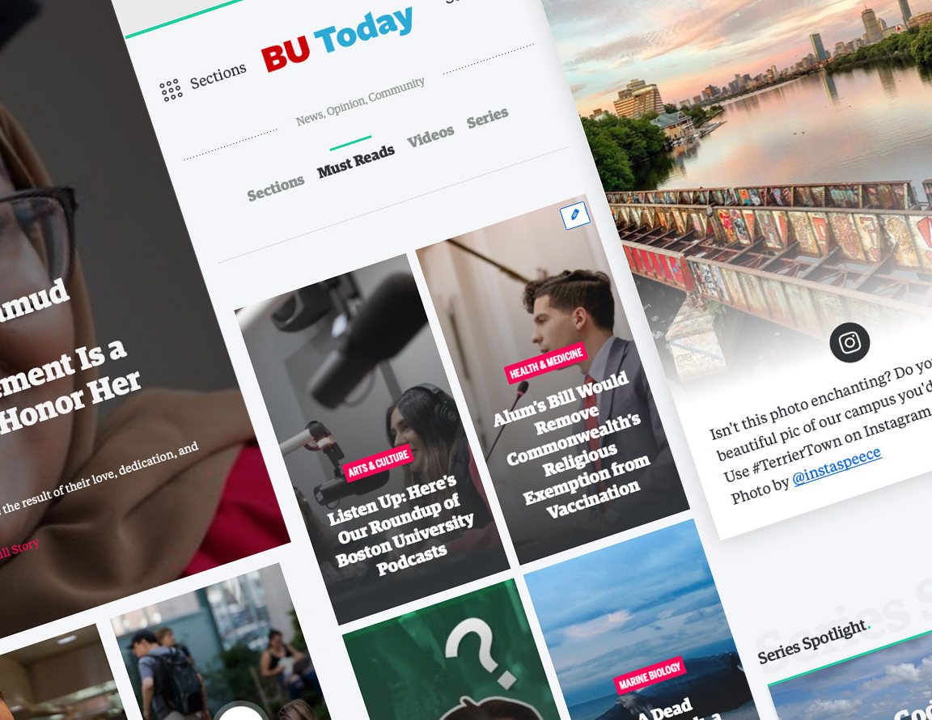
Resources for Faculty
BU Today
BU Today is Boston University’s award-winning daily website, featuring breaking news and research stories, plus coverage of students, faculty, staff, alumni, campus events and programs.
bu.edu/today

Slide 19
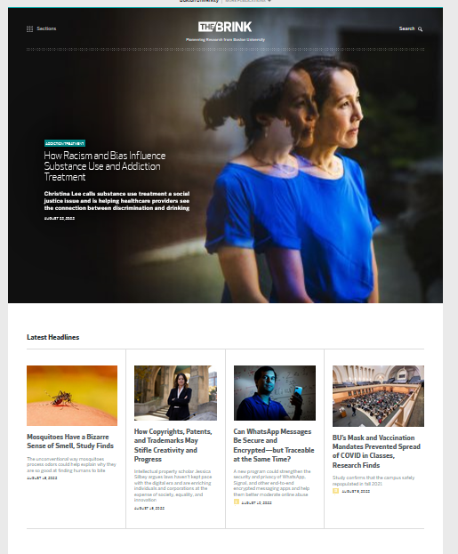
Resources for Faculty
The Brink
From astrophysics to climate change, data science, and infectious diseases, The Brink delivers the latest research news from Boston University.
bu.edu/brink

Slide 20
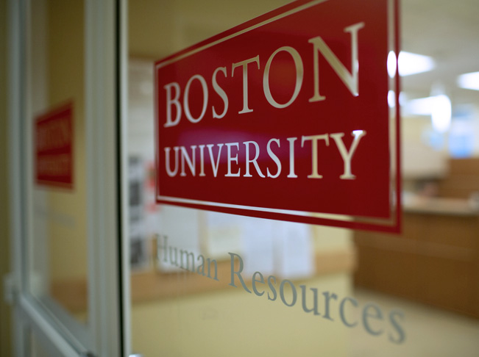
Resources for Faculty
Human Resources
Visit the BU Human Resources website for more information on employee benefits, perks, and other policies.
bu.edu/hr

Slide 21
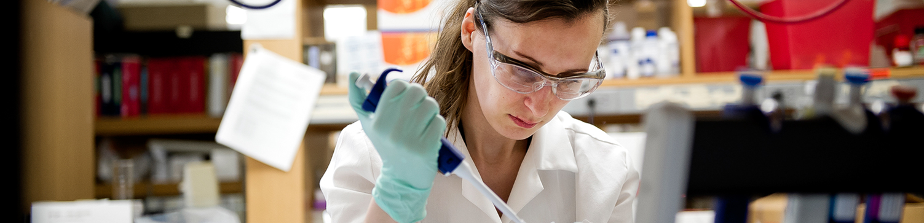
Resources for Faculty
Research Support
When we say Boston University is a major research institution, we mean really major. Coordinating it is a huge job. If you want to know who does what, who runs what, or have any other questions, our research administration is the place to start.
bu.edu/research/support

Slide 22

Resources for Faculty
Learn More Research Grants
The Learn More Research Grants support BU faculty members’ high-impact research on social issues related to the annual Learn More Series theme. Through these grants, BU D&I will support the critical work of scholars dedicated to contributing to a more just society through their research.
bu.edu/diversity

Slide 23
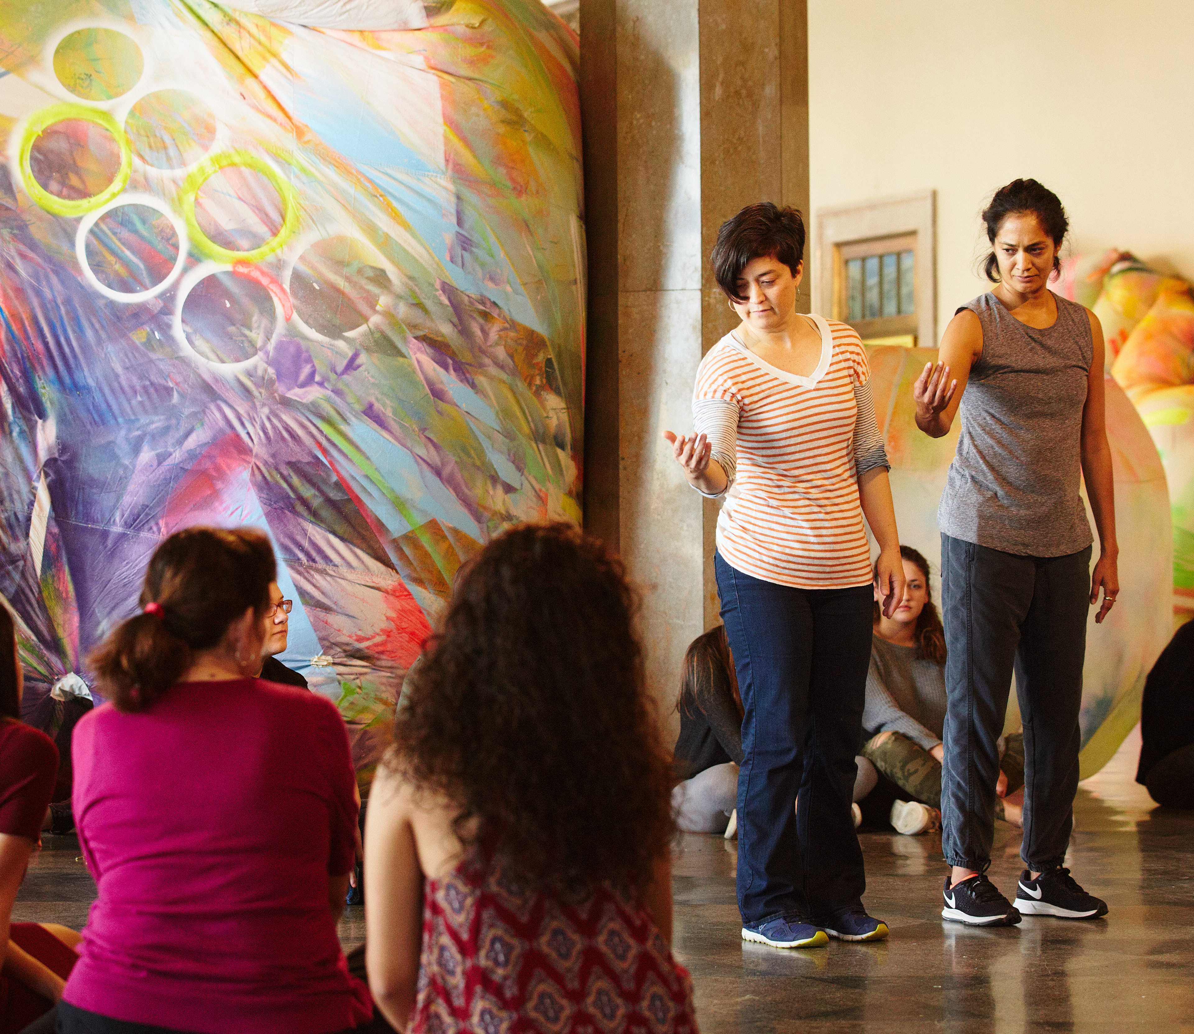
Resources for Faculty
BU Arts Initiative
The Boston University Arts Initiative ensures that the arts are fundamental to the student experience by developing and supporting university-wide programs to advance the role of the arts at BU through building community; supporting interdisciplinary arts teaching, learning, and research; and highlighting diverse artists and modes of artistry.
bu.edu/arts

Slide 24
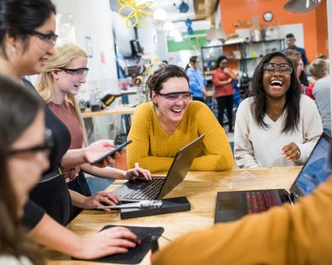
Resources for Faculty
Center for Teaching & Learning
The Center for Teaching & Learning (CTL) partners with faculty, staff, and students to cultivate teaching that is inclusive, centered on student learning, and guided by research and practice. We offer individualized consultations, workshops, seminars, and institutes designed to promote critical reflection and experimentation in teaching
bu.edu/ctl

Slide 25
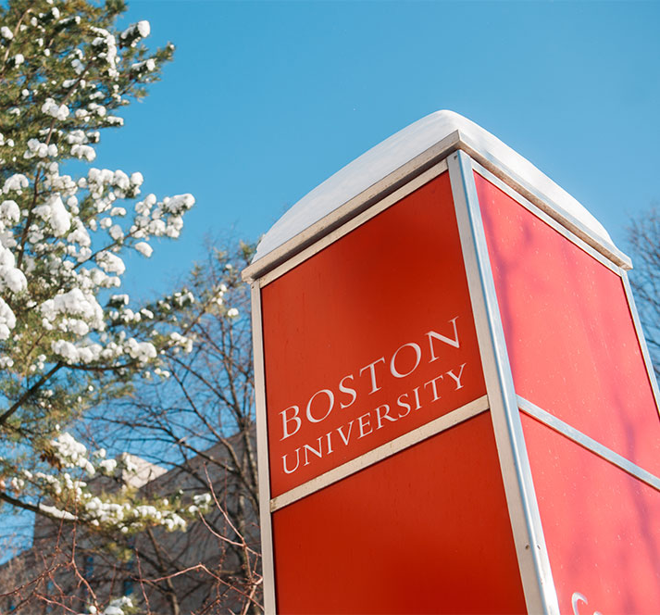
Resources for Faculty
Employee Wellness
Employee Wellness is an initiative to provide faculty and staff with resources, both on campus and off, to assist you in enhancing your overall wellness.
We want to make it easy for you to stay on point and keep thriving – with workshops, programs, tips, information, and help right here on campus. You might even have some fun too!
bu.edu/wellness

Slide 26
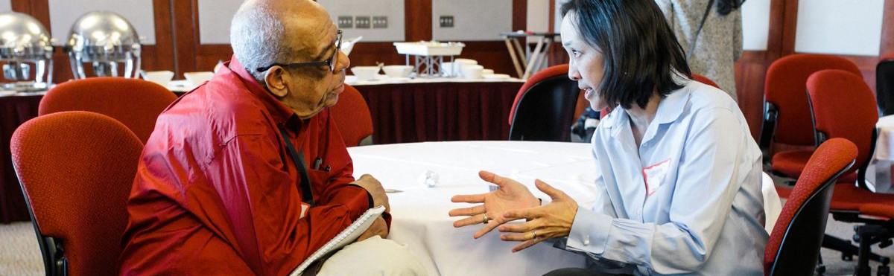
Resources for Faculty
Faculty & Staff Community Networks
Join our Faculty & Staff Community Networks (FSCNs):
Allies & Advocates Faculty & Staff Community Network
Faculty & Staff of Color Community Network
LGBTQIA+ Faculty & Staff Community Network
Staff and Faculty Extend BU Disability Support (SAFEBUDS)
bu.edu/diversity

Slide 27
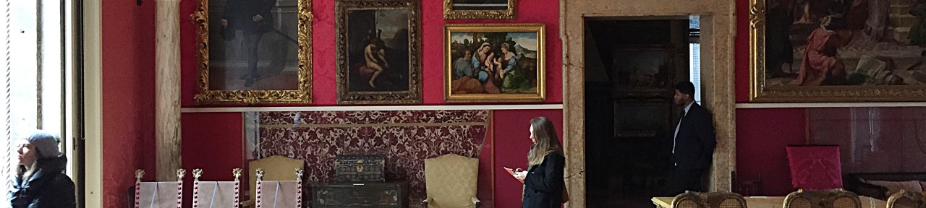
Resources for Faculty
Art Museum Passes
BU faculty and staff can obtain free or discounted passes to the following Boston-area art museums:
Museum of Fine Arts
Harvard Art Museums
Isabella Stewart Gardner Museum
Institute of Contemporary Art (ICA)
bu.edu/arts

Slide 28
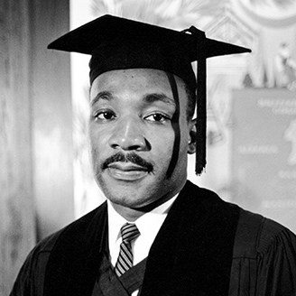
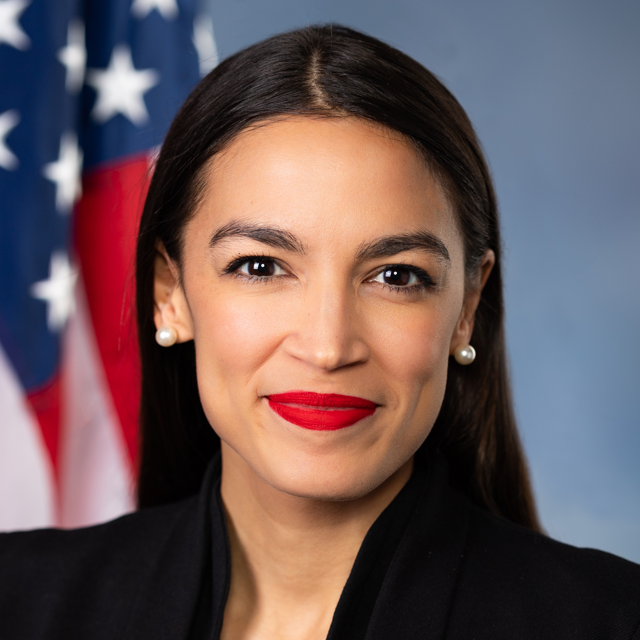
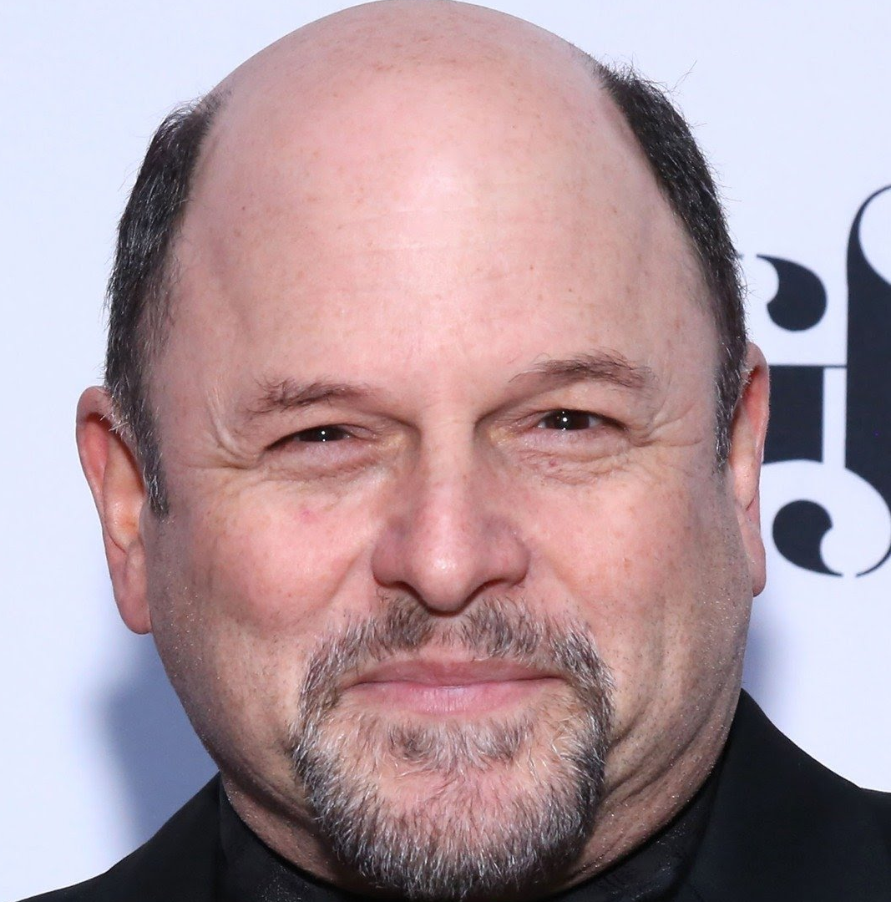
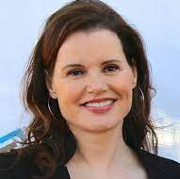
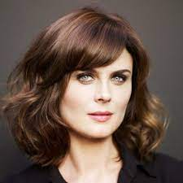
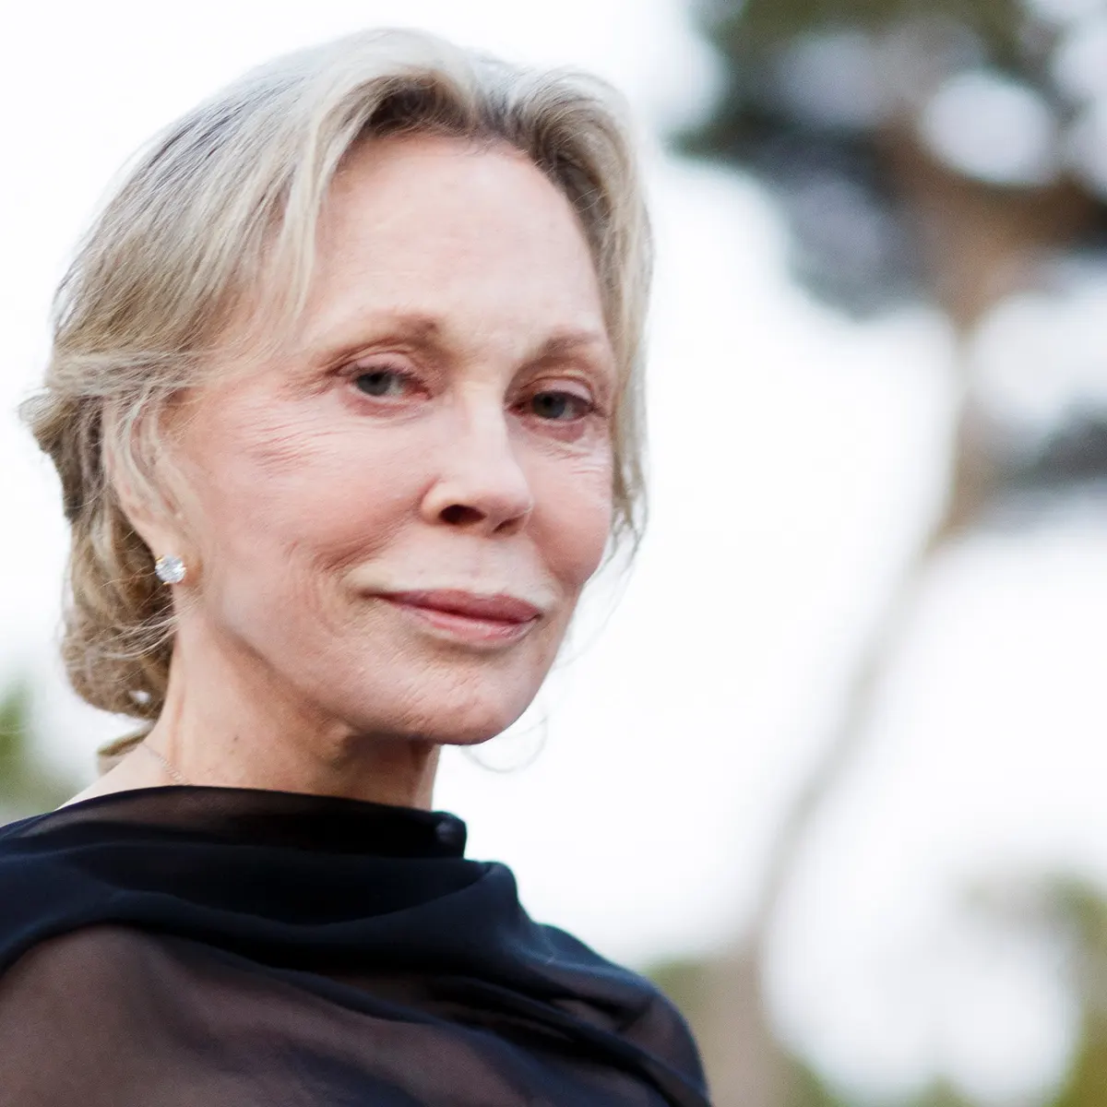
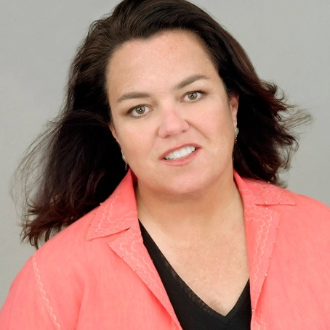
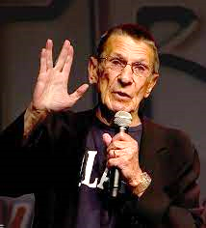
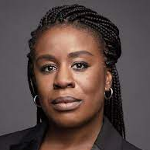
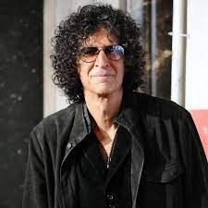
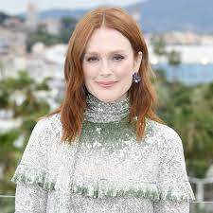
Did You Know?
Famous Alumni
Famous alumni of Boston University include:
Martin Luther King Jr.
Alexandria Ocasio-Cortez
Jason Alexander
Geena Davis
Emily Deschanel
Faye Dunaway
Rosie O’Donnell
Uzo Aduba
Julianne Moore
Howard Stern
Leonard Nimoy

Slide 29
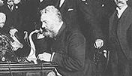
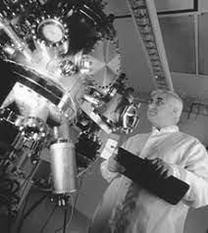
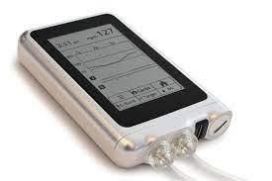
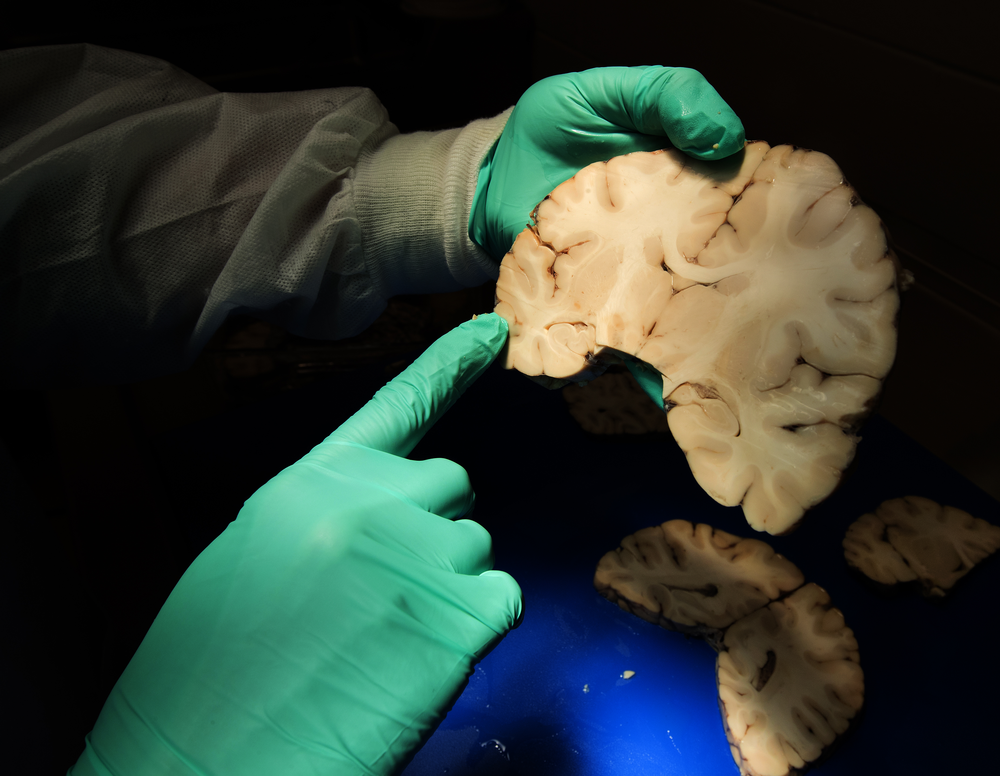
Did You Know?
BU Research Innovations
Alexander Graham Bell’s invention of the telephone
Process for synthesizing gallium nitride, a semiconductor that is now widely used in blue light-emitting diodes (LEDs)
Bionic pancreas technologies for autonomous regulation of blood sugar levels in people with diabetes
Study on Chronic Traumatic Encephalopathy (CTE) among football players

Slide 30
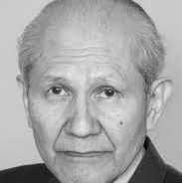
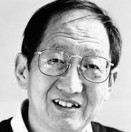
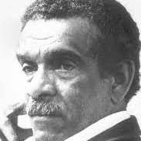
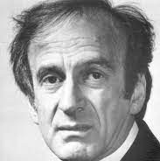
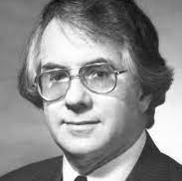
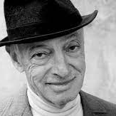
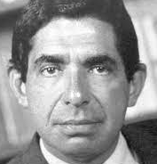
Did You Know?
BU Nobel Laureates
Faculty:
Osamu Shimomura
  2008, Nobel Prize in Chemistry
Daniel Tsui
  1998, Nobel Prize in Physics
Derek Walcott
  1992, Nobel Prize in Literature
Elie Wiesel
  1986, Nobel Peace Prize
Sheldon Glashow
  1979, Nobel Prize in Physics
Saul Bellow
  1976, Nobel Prize in Literature
Alumni:
Oscar Arias Sánchez
  1987, Nobel Peace Prize
Martin Luther King, Jr.
  1964, Nobel Peace Prize

Slide 31
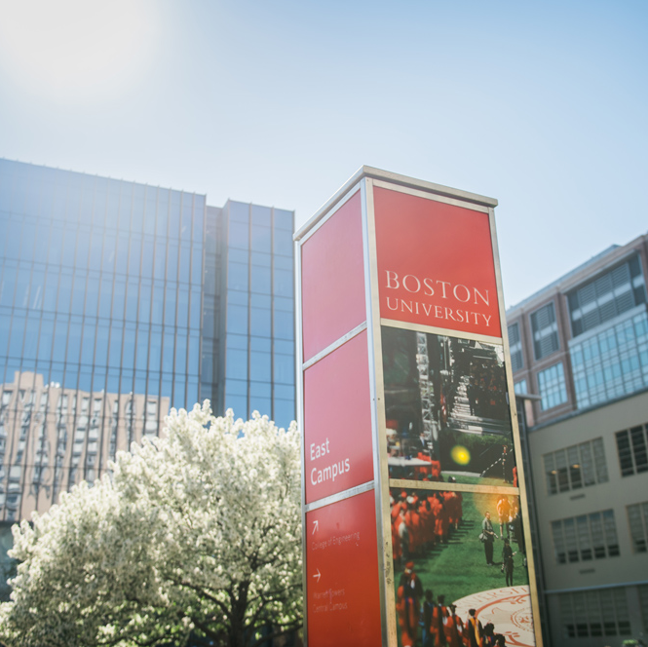
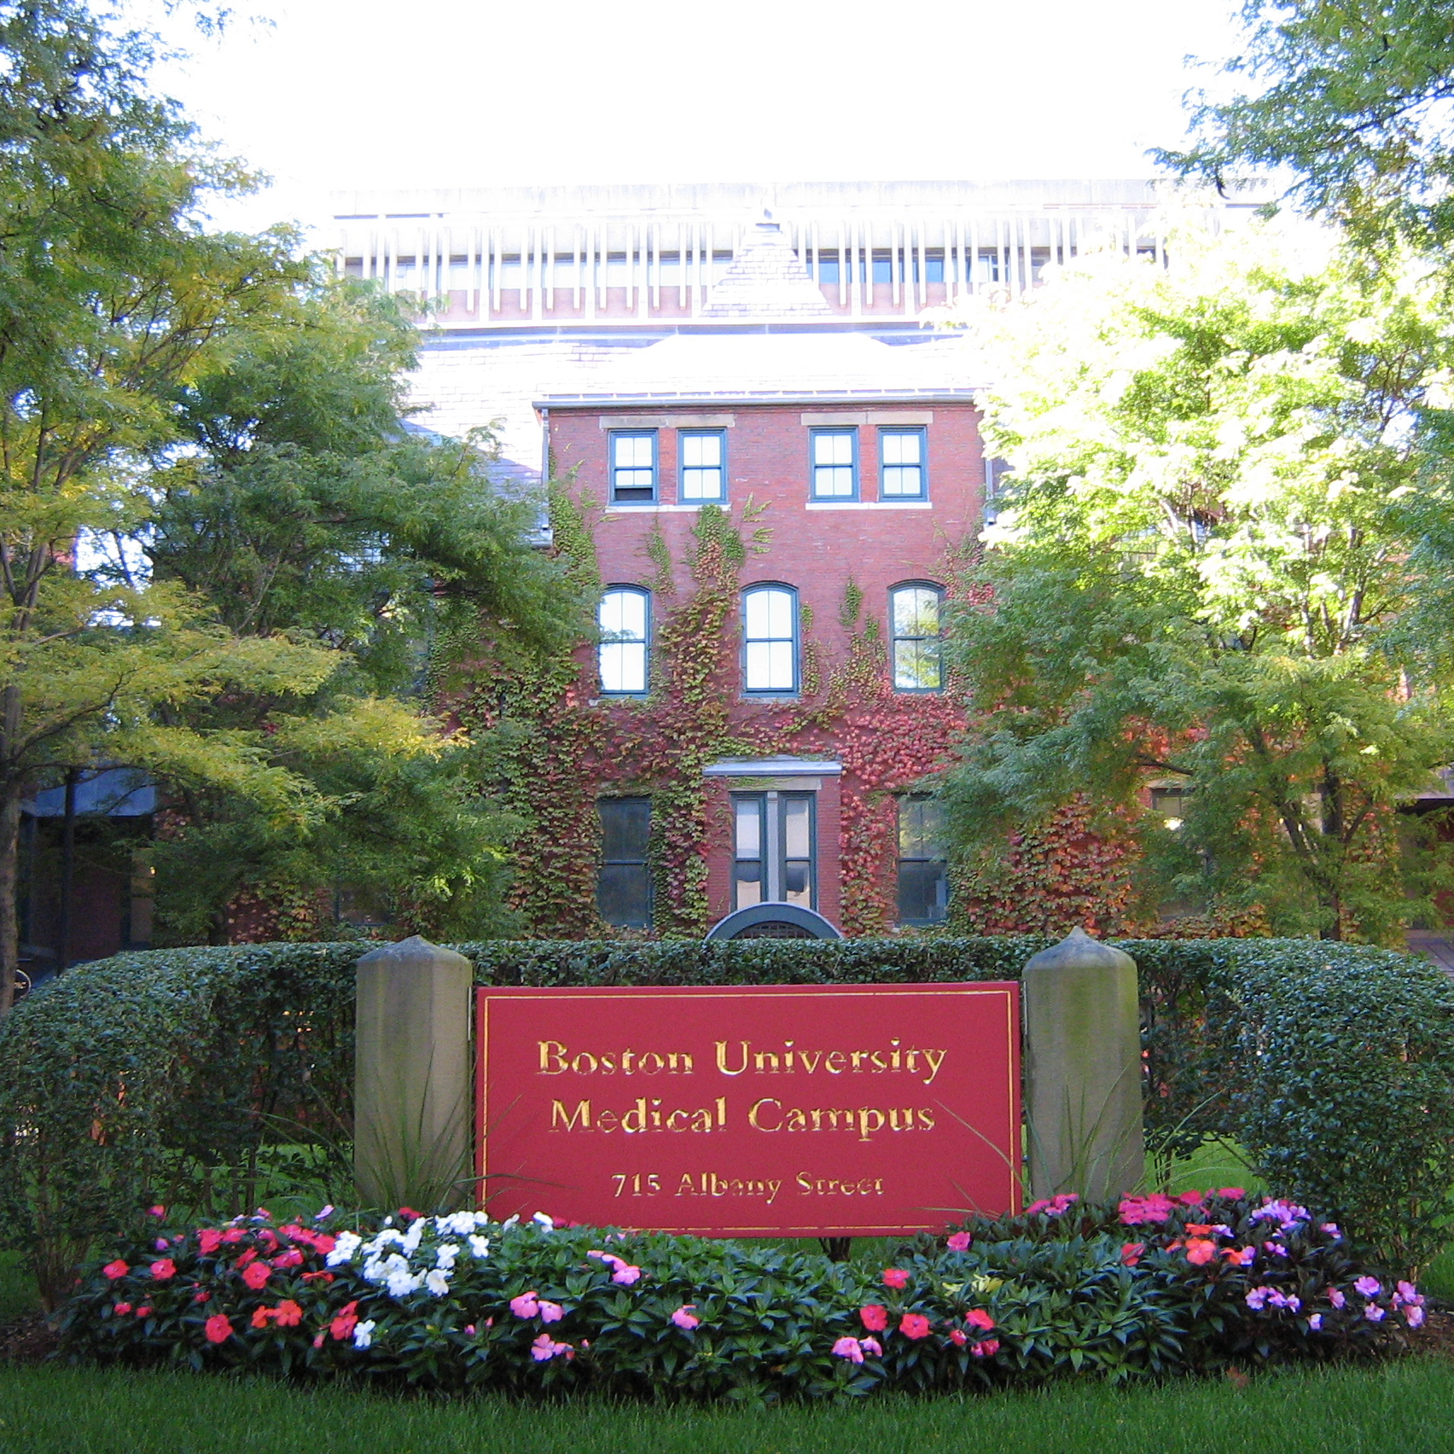
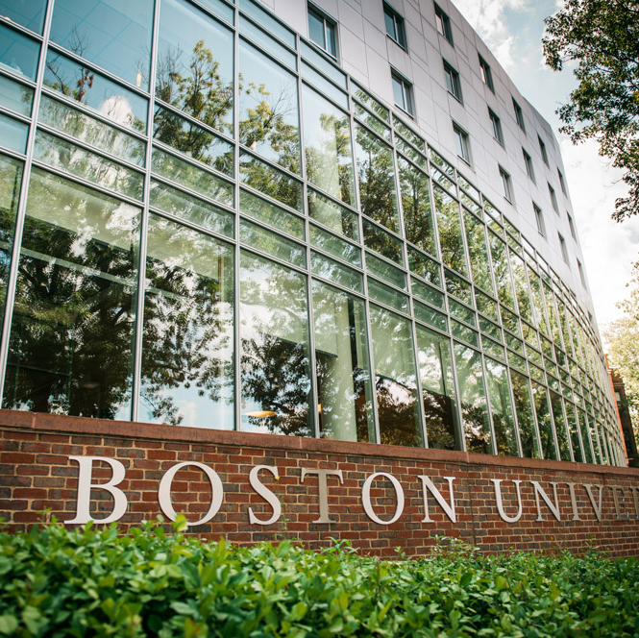
Did You Know?
Boston University Has Three Campuses
Charles River Campus
(CRC)
Medical Campus
Fenway Campus

Slide 32
Did You Know?
Academic Units at BU
Arvind & Chandan Nandlal Kilachand Honors College
Chobanian & Avedisian School of Medicine
College of Arts & Sciences
College of Communication
College of Engineering
College of Fine Arts
College of General Studies
College of Heath & Rehabilitation Sciences: Sargent College
Faculty of Computing & Data Sciences
Henry M. Goldman School of Dental Medicine
Metropolitan College
Pardee School of Global Studies
Questrom School of Business
School of Hospitality Administration
School of Law
School of Public Health
School of Social Work
School of Theology
Wheelock College of Education & Human Development

Slide 33
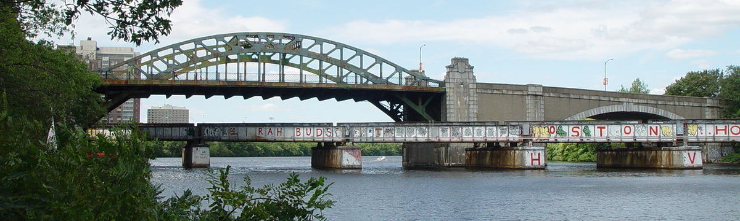
Did You Know?
Boston University Bridge
The Boston University bridge is one of three bridges in the world where a plane can fly over a car driving over a train traveling over a boat.

Slide 34
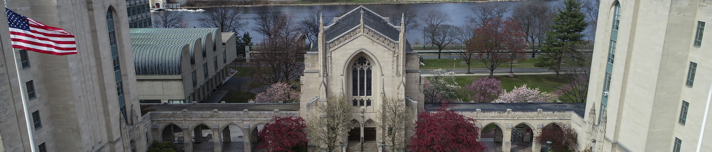
Did You Know?
BU’s Origins
Boston University traces its roots to the establishment of the Newbury Biblical Institute in Newbury, Vermont in 1839, and was chartered with the name "Boston University" by the Massachusetts Legislature in 1869.

Slide 35

BU New Faculty
Who are you?
150+ new full-time Charles River Campus faculty
130+ new full-time Medical Campus faculty
Unmodified professorial faculty, clinical faculty, of the practice faculty, research faculty, visiting faculty, lecturers, and instructors

Slide 36
BU Faculty
~1750 full-time Charles River Campus faculty
~1450 full-time Medical Campus faculty
Unmodified professorial faculty, clinical faculty, of the practice faculty, research faculty, visiting faculty, lecturers, and instructors

