Slide 1
Lead Contamination
Eliandro Tavares | Rick Reibstein
Notes:
My directed study was focused on lead contamination in our state

Slide 2
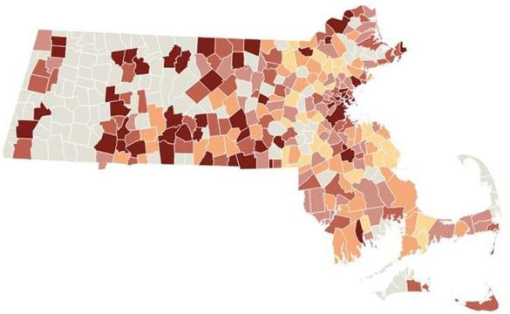
Goals
Identify problems with lead contamination
Solutions we want to see
Meet with the experts
Draft a list of goals for an effective lead abatement bill
Notes:
I began looking into lead contamination last semester, where I found out how much of a widespread problem it is. Nearly half of all public school water outlets tested for lead contamination came back with a concentration higher than the legal limit of 15 ppb. As a response to this, the state has acted to fund removal and replacement of these pipes, however it may not be enough.
This does not account for the fact that testing was voluntary, and does not take into consideration private homes, apartments or other buildings that may have the same or even greater problem.

Slide 3
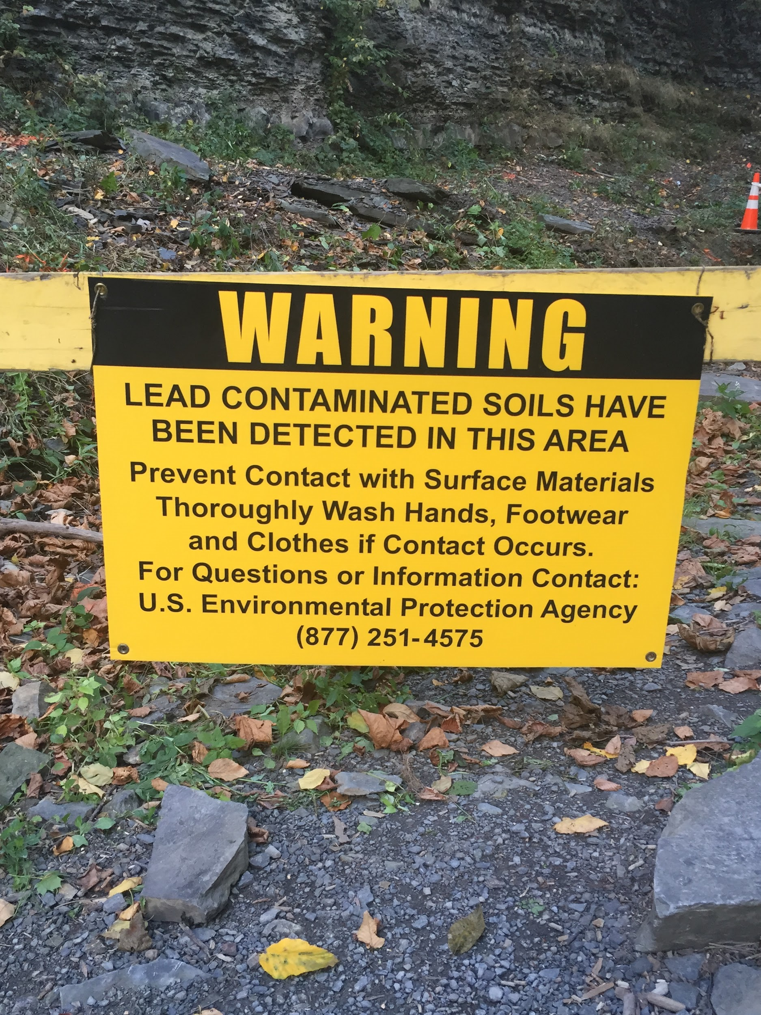
What needs to happen
Comprehensive list of goals for lead legislation
Expands testing and care to all, not just children in public schools
Expands awareness efforts to ensure that all citizens know what is legal/illegal with regards to lead contamination on buildings
Notes:
We created a comprehensive list of goals (handout) with the intention of giving this list to legislators so that they could add to it and make it feasible.
Headlining that list, we believe that lead testing needs to be expanded to all buildings, apartments and homes within the state. We also believe there needs to be a larger emphasis on awareness of the facts and existing laws surrounding lead contamination so that people can seek the necessary care if they suspect something is wrong

Slide 4
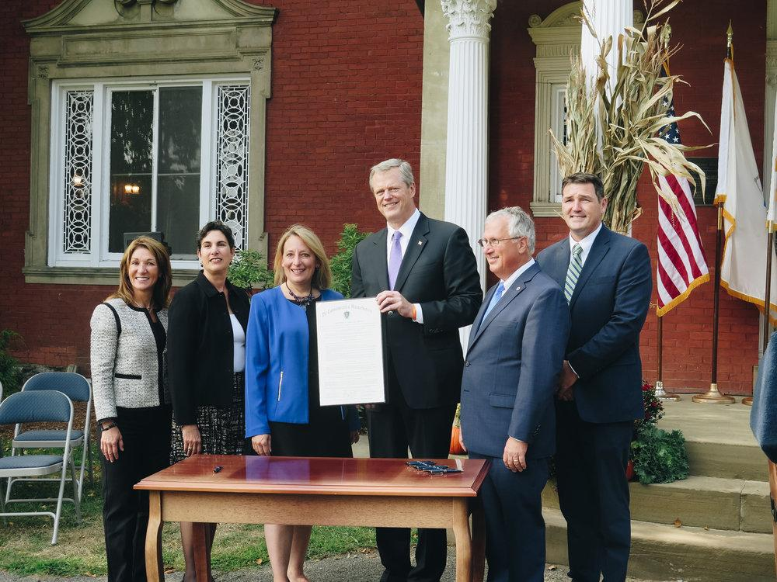
Who is working on this issue
Senators and representatives
  Senator Chang-Diaz
  Senator Eldridge
  Julian Cyr
  Jeffrey Sanchez
  Marc Pacheco
  Lori Ehrlich
Lead laws do not reach far enough to be completely effective
Notes:
We sent emails to several senators and representatives who have experience with lead legislation, but only established a meeting with one: Cal brown (Lori ehrlich’s staff director) who gave us a lot of insight about the road blocks to a solution and who we should talk to
We also looked at the primary bills that have passed in regards to lead abatement, and we found that many of them only make small revisions to existing laws (aka do not do much to prevent the issue)

Slide 5

Fair Housing and Civil Rights Conference
Came as presenters and held a discussion with people who work with lead laws
Gave ideas about what needs to be improved
Suggested different avenues other than changing legislation
Notes:
We brought up these talking points and our goals to the fair housing and civil rights conference, where we hosted a discussion about what is being done with lead contamination and potential solutions that they might have
Many of the participants worked with lead legislation and suggested that the solution was not to propose new legislation, but instead enforce existing laws that are being ignored, particularly by landlords

Slide 6
Where to go from here
Meet with legislators
More comprehensive data on lead contamination
Find ways to ensure existing lead legislation and laws are enforced
Lead awareness convention
Notes:
Result: Much more needs to be done to make sure lead is completely taken out from our buildings and water
For the future: we need more comprehensive data on lead contamination for all buildings and pipelines so that we know the true scale of the issue
We need to find ways to better enforce lead abatement so that cutting corners is properly punished
And a lead awareness convention (proposed by Deborah brown) would help us spread the facts about lead to everyone, and not just lead specialists

