Slide 1
Electric Vehicle Stations Placement
Walker Black, Bolaji Olagbegi

Slide 2
Research Findings- NYSERDA Deployment Program
Installation costs ranged from $777-$32,400
In most cases, revenue generated by stations do not offset networking fees
EVs are only actively charging for about half the time they’re plugged in
Urban based EV charging stations occupied more often than suburban ones
Plug- in times vary based on location:
Shortest times were retail locations (1.3 hrs) and leisure destinations (3.7 hrs)
Median times were universities/ medical centers (4.8 hrs)
Longest times were workplaces (7.3 hrs) and parking garages (9.5 hrs)
*Plug- in durations do not indicate amount of events
Notes:
Not offset costs-- a majority of stations are public and free. Publics usually have more events but privates are longer and dispense the highest amount of energy/event. Really look into places that benefit from greater visits and align w core values like Macy’s and Frito-Lays.
Actively charging..- some mention of systems that introduce a culture of unplugging someone else’s and can plan for more spaces around a single station in the event an ICE or noncharging is parked. Placards/notes---damage equipment---apps---costs assoc w lots of time

Slide 3
Research Findings
Ohio Case Study:
A limited number of well placed charging stations can provide substantially similar coverage to a larger network
Optimal placement remains constant as network expands
Retail locations are the optimal sites for DC Fast chargers - Infrastructure in place and average connection is shortest
Wu, F., Sioshansi, R., 2017. A stochastic-flow capturing model to optimize the location of fast-charging stations with uncertain electric vehicle flows. Transportation Research Part D: Transport and the Environment. 53 (May), 354-376

Slide 4
Associated Costs
Proximity of station to electrical panel
Whether a new electrical service panel must be added
Ground surface excavation required for underground conduit
Location within a state
Experience of installer
Balance between power generation and consumption, increased load tension
Notes:
Ground..- hard surfaces like pavement and concrete expensive to cut through, must leave aesthetically pleasing, mindful of trees w extensive root network
Location.. Diff fees and regulation assoc, realty more costly in city vs suburb, in underground and remote installs cellular service important!!
Experience..familiar with best placement and common problems, most efficient installation
Balance.. w/o will increase costs (fees, harmonic controller) and decrease electric grid efficiency

Slide 5
Key Considerations
Charging demand
Traffic convenience vs expanding network
Emphasis on flow rather than destination
Impact on transmission and distribution network strength
Real time balance between power generation and consumption
Education
Advertisement
Sign consistency
Advanced planning
Regulation and permitting
Communication with property owners and city planners
Underground conduit and wiring inspections
Utilize economic models to help predict conditions (e.g. ISM, Bayesian, FMICMAC)
Analyze traffic patterns and heat map of traffic flow
Notes:
Charging demand- enough use so not a total waste of resources, but value in isolated locations bc expands network
Lane situation and consider future development of property
Look into traffic flow
Transmission network- increases costs, decreases grid efficiency
Advertisement- most successful stations are proactive. Press releases lots of info outreach. Consistency in signs(~40% no signs=confusion). I’ve never seen one in Boston.

Slide 6
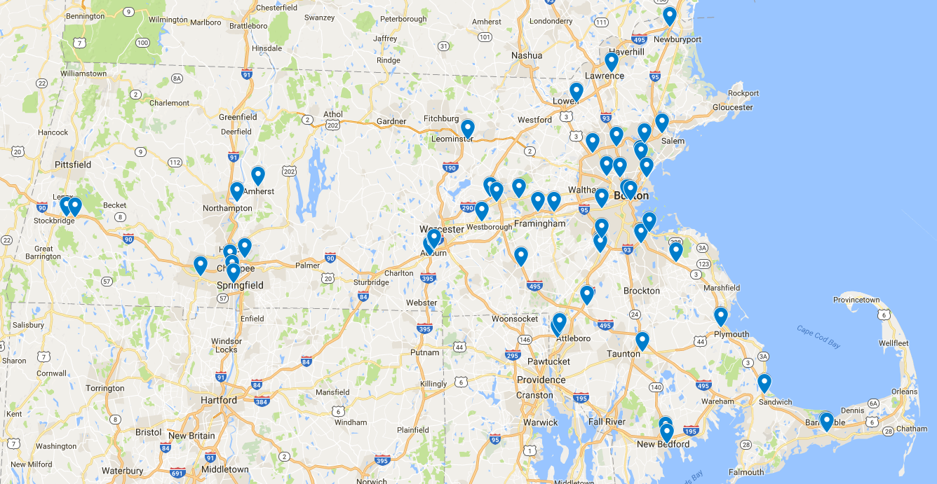
All DC Fast Charging Stations in MA

Slide 7
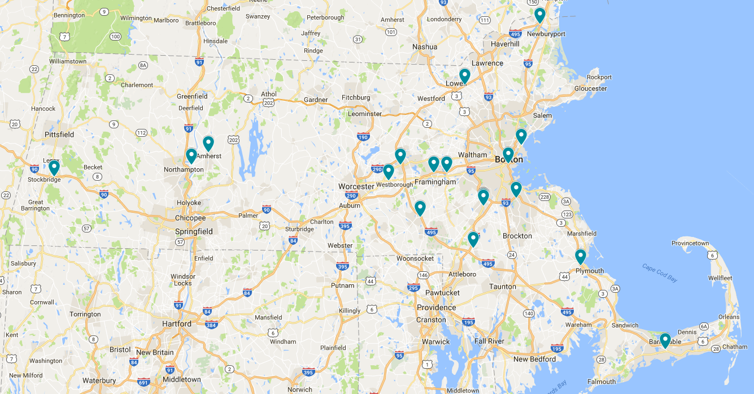
Public 24/7 DC Fast Charging Stations in MA

Slide 8
Filling in MA DC Fast Network
Key Observations:
Main benefit of DC Fast systems is en-route charging
Target cities and regions without public 24/7 charging stations
Large portions of major thoroughfares lack 24/7 access to travelers
Large Cities Without Access to 24 Hour Public Stations:
New Bedford, MA
  Population: 95,072
  Distance to DC Fast: 47 mi
Springfield, MA
  Population 153,060
  Distance to DC Fast: 21 mi
Fitchburg/Gardner/Leominster, MA
  Population: 101,305
  Distance to DC Fast: 25 mi

Slide 9
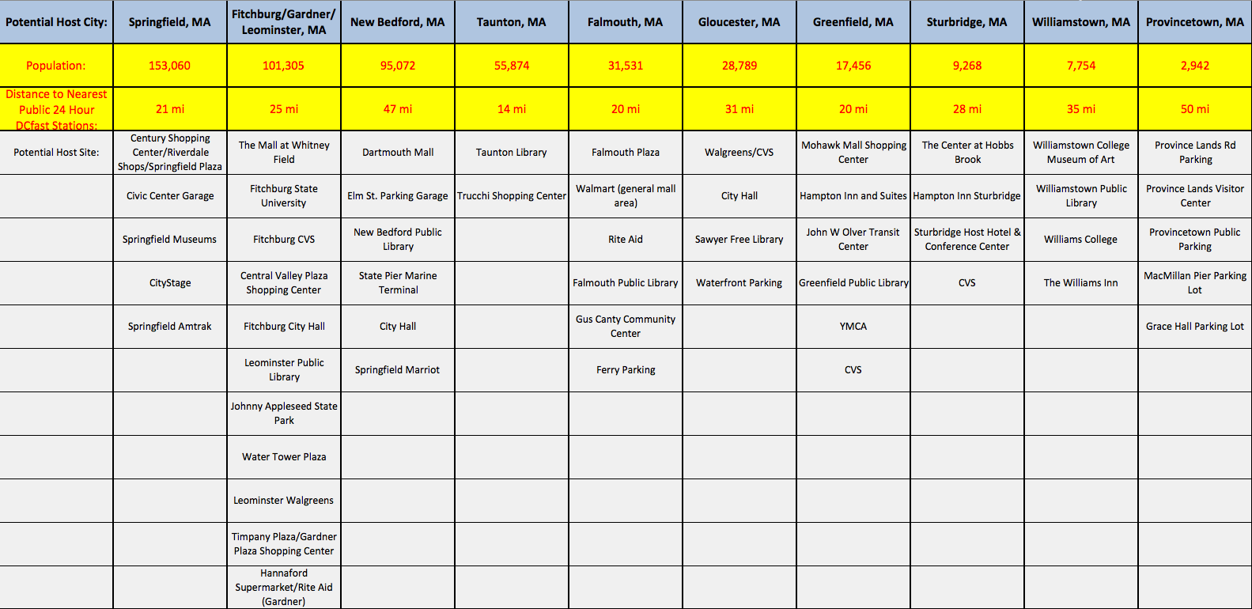

Slide 10
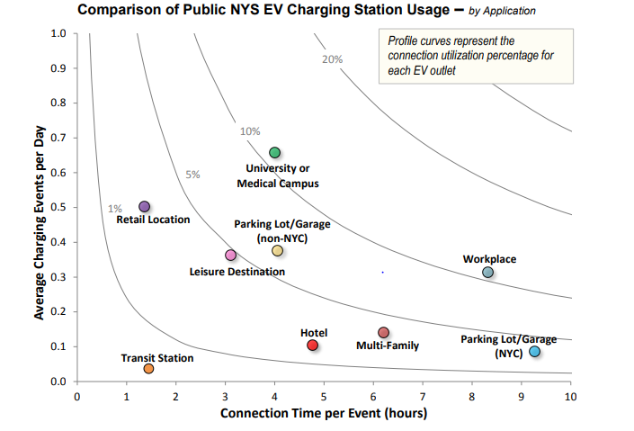
Optimal Placement
Notes:
Not to presume ut what learned from existing

Slide 11
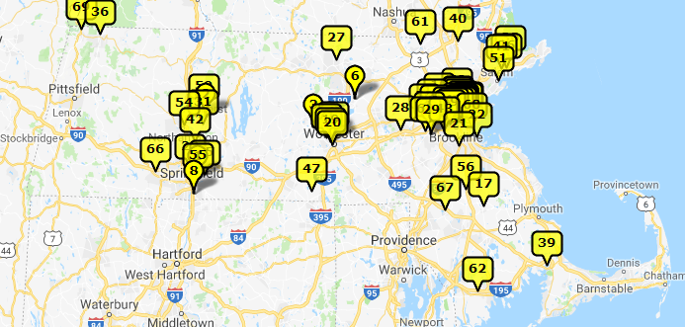
Optimal Placement
Universities
Harvard, MIT, Boston University, Tufts, Williams College (69), Salem State College (51), Mount Holyoke College (54), College of the Holy Cross (20), Massachusetts Maritime Academy (39), etc.
Notes:
First couple also include their medical centers
Universities- cant see it but right above 69, Green Mt. and Finger Lakes. Not necessarily restricting to these particular schools, but strategically placed so that near popular tour sites and workplaces and model provide a way to travel across state.
Workplaces- best way to expand consumer knowledge and demand bc routinely exposes them and convenient.

Slide 12
Optimal Placement
Shopping centers (Retail+Parking garages)
Prudential Center
Colony Place
Natick Mall
Holyoke Mall
Burlington Mall
Atrium Mall
Emerald Square Mall
Dartmouth Mall
Workplaces/ Businesses
Shaw’s and Star Markets
Baskin- Robbins HQ
Fidelity Investments
Hanover Insurance Group
Peter Pan Bus Lines
Distribution facilities
Notes:
Briefly going back to the chart in slide 7 showing retail and parking garages as high event stations, combining the two adds to the connection time. Once again a sample group, but one that spreads EV stations around state
Dist.. many hq in MA like Reebok, Converse, Smith & Wesson, Yankee Candle

Slide 13
Resources
https://www.nyserda.ny.gov/Researchers-and-Policymakers/Electric-Vehicles/Resources/Electric-Vehicle-Charging-Station-Data
http://www.communitywalk.com/massachusetts_colleges_universities_map
https://www.nyserda.ny.gov/Researchers-and-Policymakers/Electric-Vehicles/Resources/Best-Practice-Guides-for-Charging-Stations
http://ieeexplore.ieee.org/document/7368203/
https://www.nyserda.ny.gov/-/media/Files/Programs/ChargeNY/EVSE-Cluster-Analysis.pdf
https://www.ranker.com/list/companies-headquartered-in-massachusetts/the-working-man
https://dl.acm.org/citation.cfm?id=2832621
http://www.mdpi.com/2071-1050/9/4/484/pdf

